Slide 1

The SBML Java™ library

Slide 2
Concept of JSBML
Compromise:
High compatibility to libSBML
Java-like library
Main developers
Nicolas Rodriguez and Andreas Dräger
Both available during the meeting any time to answer JSBML-related questions

Slide 3

How to get started?

Slide 4
Obtaining JSBML
https://sourceforge.net/projects/jsbml/files/jsbml/0.8-b2/
Download the file jsbml-0.8-b2-with-dependencies.jar.
Once you have added it to the Java CLASSPATH, you can start working with JSBML.

Slide 5
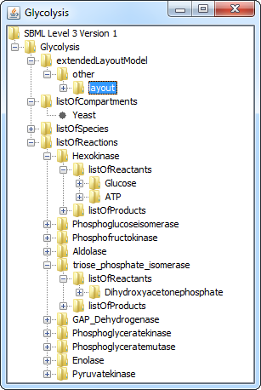
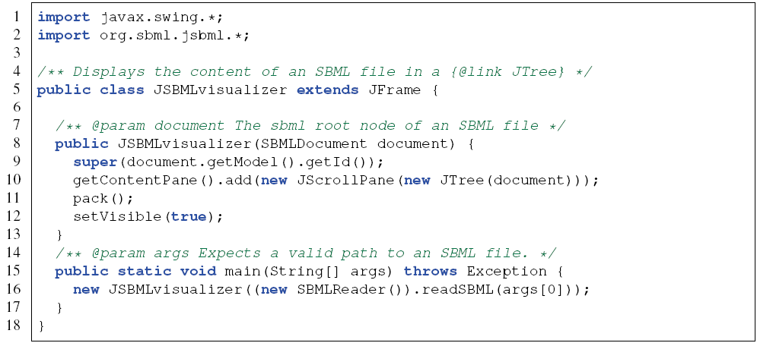
Visualizing the content of an SBML file

Slide 6
Data types

Slide 7
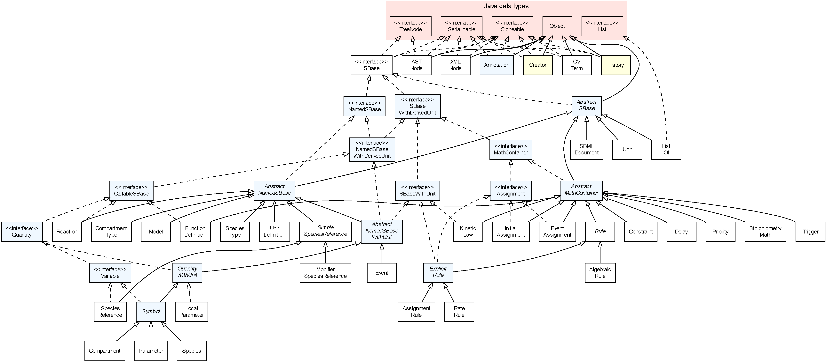
Type hierarchy
Recursively designed interface SBase
Also part of the SBML tree
Limitations:
Duplicate implementation of recursive methods
No way to listen to changes in elements not derived from SBase

Slide 8
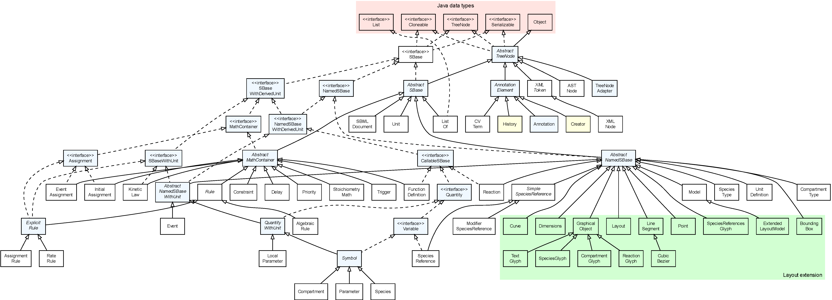
Unified type hierarchy

Slide 9
New top level super class AbstractTreeNode
Recursive methods
Adding, removing, and informing change listeners
clone()
hashCode()
equals(Object o)

Slide 10
Listening to changes
SBaseChangedListener in package org.sbml.jsbml
public void sbaseAdded(SBase sb) {
System.out.println("[ADD] " + sb);
}
public void sbaseRemoved(SBase sb) {
System.out.println("[RMV] " + sb);
}
public void stateChanged(SBaseChangedEvent ev) {
System.out.println("[CHG] " + ev);
}

Slide 11
Improved listener: TreeNodeChangeListener
Package org.sbml.jsbml.util, extending java.beans.PropertyChangeListener
public void nodeAdded(TreeNode node) {
System.out.println("[ADD] " + node);
}
public void nodeRemoved(TreeNode node) {
System.out.println("[RMV] " + node);
}
public void propertyChange(PropertyChangeEvent evt) {
System.out.println("[CHG] " + evt);
}
Specialised event implementation:
TreeNodeChangeEvent

Slide 12
New features and bug fixes

Slide 13
New features – an overview
TreeNodeAdapter as a wrapper for child elements that cannot extend AbstractTreeNode
SBMLreader: static methods
Maven script by Igor Rodchenkov
initDefaults(int level, int version)
Check for duplicate metaIds
Automatic, recursive level/version update in case of adding elements with undefined L/V specification to a top element

Slide 14
Most important bug fixes
General improvements:
Closing streams after reading/writing SBML files
Support for NaN values in formulas and ASTNodes
Improved Level 1 support:
Parsing of Rules with a type attribute (e.g., rate)
Denominator attribute in SpeciesReference was never read
No MathML in KineticLaw
Exception during conversion between LocalParameter and Parameter (no constant attribute)
Improved Level 3 support:
getDerivedUnitsInstance() in Species

Slide 15
Modules

Slide 16
Download of modules
LibSBML input/output:
svn co "https://jsbml.svn.sourceforge.net/svnroot/jsbml/modules/libSBMLio/"
libSBMLio
CellDesigner bridge:
svn co "https://jsbml.svn.sourceforge.net/svnroot/jsbml/modules/cellDesigner"
cellDesigner
LibSBML compatibility module for switching between libSBML and JSBML still under development

Slide 17
How to contribute
Creating a patch:
Checkout the sources from sourceforge
svn co “https://jsbml.svn.sourceforge.net/svnroot/jsbml/trunk jsbml“ JSBML
Do your modifications, then create a patch file:
svn diff > jsbml-patch.txt
Attach it to a tracker item or send it through the development list.
Bug tracker: http://sourceforge.net/tracker/?group_id=279608&atid=1186776
Mailing lists:
jsbml-development@caltech.edu: public list with discussion about the development of JSBML and support for users.
jsbml-team@caltech.edu: private list for the JSBML team were anybody can send mails for support or bugs reports.

Slide 18
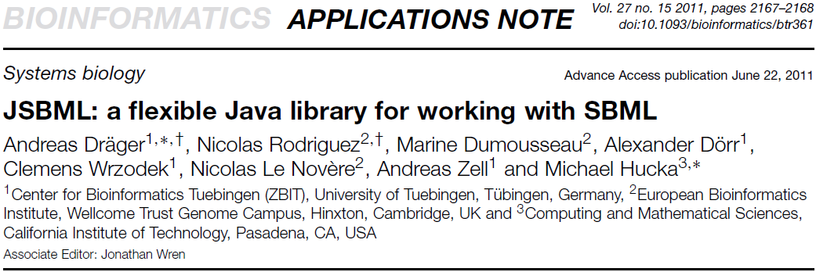
Thanks for your attention! http://sbml.org/Software/JSBML

