Slide 1

The SBML Java™ library

Slide 2
Concept of JSBML
Compromise:
High compatibility to libSBML
Java-like library
Main developers
Nicolas Rodriguez and Andreas Dräger
Both available during the meeting any time to answer JSBML-related questions

Slide 3

How to get started?

Slide 4
Obtaining JSBML
https://sourceforge.net/projects/jsbml/files/jsbml
Download the file jsbml-X.Y-with-dependencies.jar.
Once you have added it to the Java CLASSPATH, you can start working with JSBML.

Slide 5
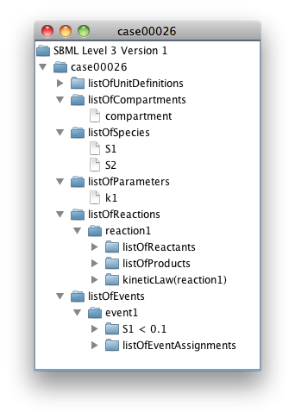
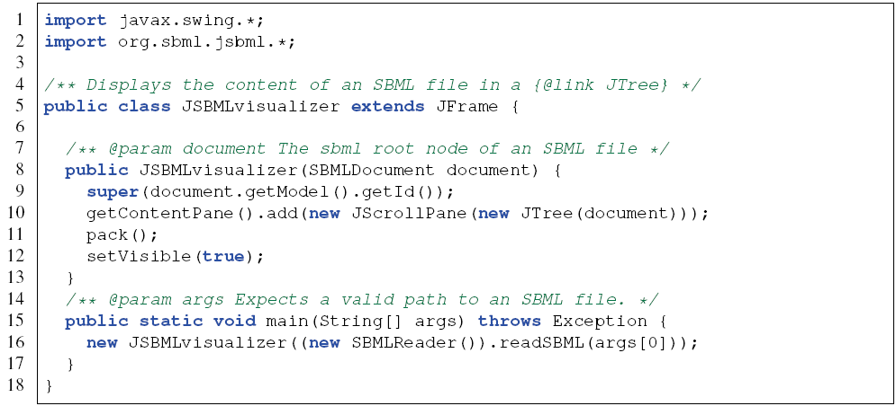
Visualizing the content of an SBML file
Notes:
TODO : Try to do an example with a qual model ?

Slide 6
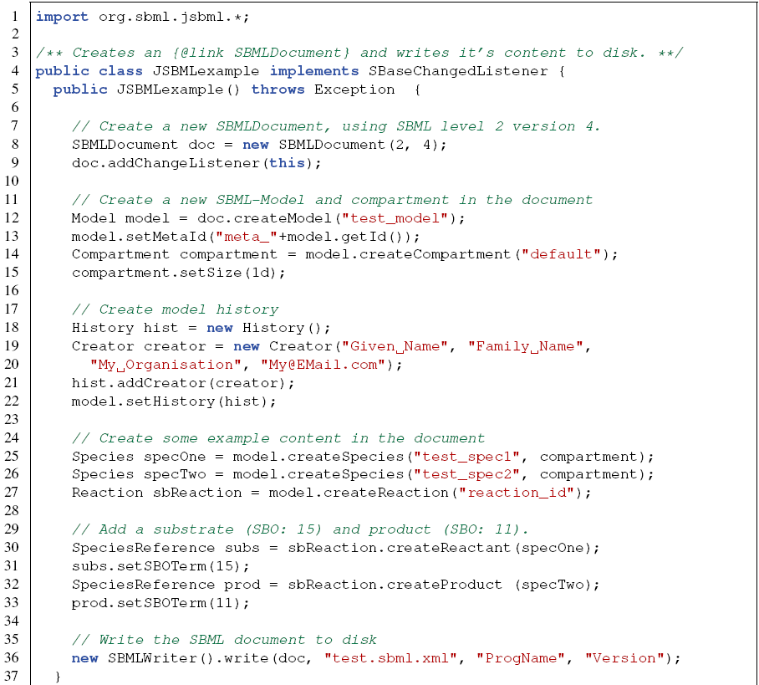
Creating a new model

Slide 7
How to compile jsbml-qual
Creating a patch:
Checkout the sources from sourceforge
svn co https://jsbml.svn.sourceforge.net/svnroot/jsbml/trunk jsbml
cd jsbml/core
ant jar
cd ../extension/qual
ant jar
now, includes the jar file from core/build, core/lib, extension/qual/build
Generating a big jar, including jsbml-qual:
cp extension/qual/build/*.jar core/lib
cd core
ant bigjar
now, you have a jsbml-X.Y-with-dependencies.jar that contains jsbml-qual as well
All of this will be automatised and we will provides the pre-compile jar files in the future

Slide 8
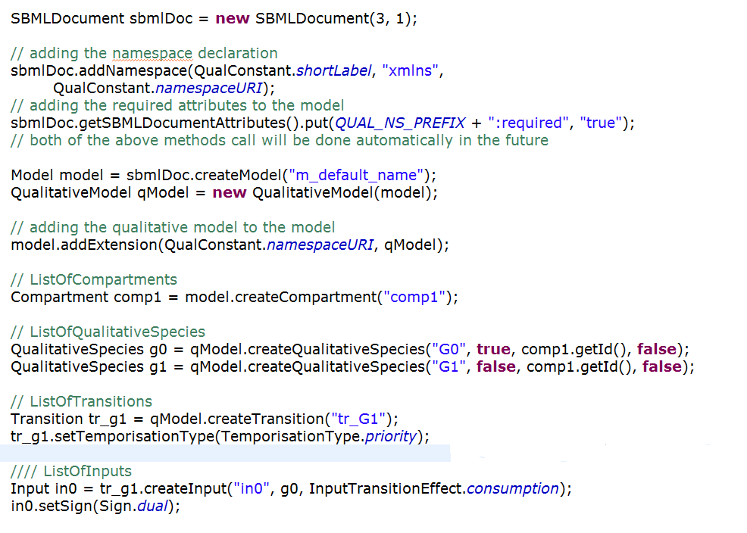
Using qual

Slide 9
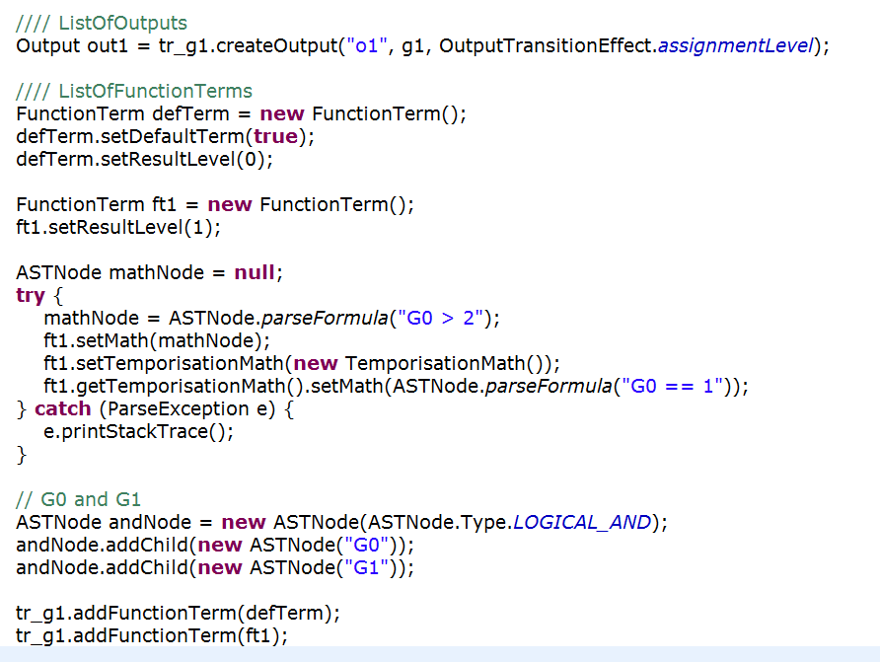

Slide 10
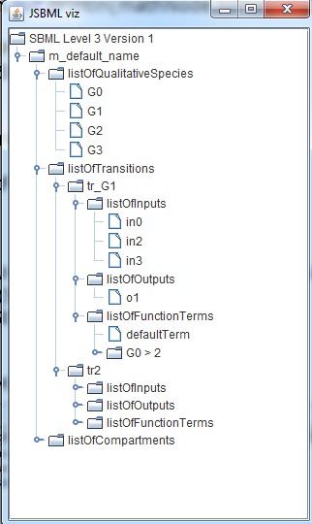

Slide 11
Some more details

Slide 12
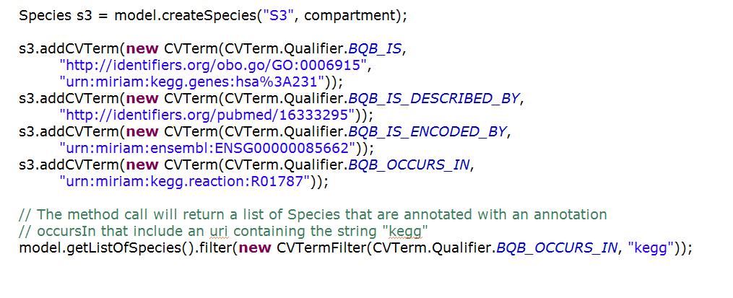
Using annotation

Slide 13
How to contribute
Creating a patch:
Checkout the sources from sourceforge
svn co “https://jsbml.svn.sourceforge.net/svnroot/jsbml/trunk jsbml“ JSBML
Do your modifications, then create a patch file:
svn diff > jsbml-patch.txt
Attach it to a tracker item or send it through the development list.
Bug tracker: http://sourceforge.net/tracker/?group_id=279608&atid=1186776
Pivotal : https://www.pivotaltracker.com/projects/499447
Mailing lists:
jsbml-development@caltech.edu: public list with discussion about the development of JSBML and support for users.
jsbml-team@caltech.edu: private list for the JSBML team were anybody can send mails for support or bugs reports.

Slide 14

Thanks http://sbml.org/Software/JSBML

Slide 16
XML parsing ?
/jsbml-trunk/resources/org/sbml/jsbml/resources/cfg/PackageParserNamespaces.xml
/jsbml-trunk/resources/org/sbml/jsbml/resources/cfg/SBMLCoreElements.xml
Then each SBase has a readAttributes and writeAttributes methods that take care of reading and writing the attributes of the element.
The parsing is done in:
org.sbml.jsbml.xml.stax: main entry point of the parsing, using Stax.
org.sbml.jsbml.xml.parsers: parser independent of the underlying XML parsing library used.

Slide 17
Data types

Slide 18
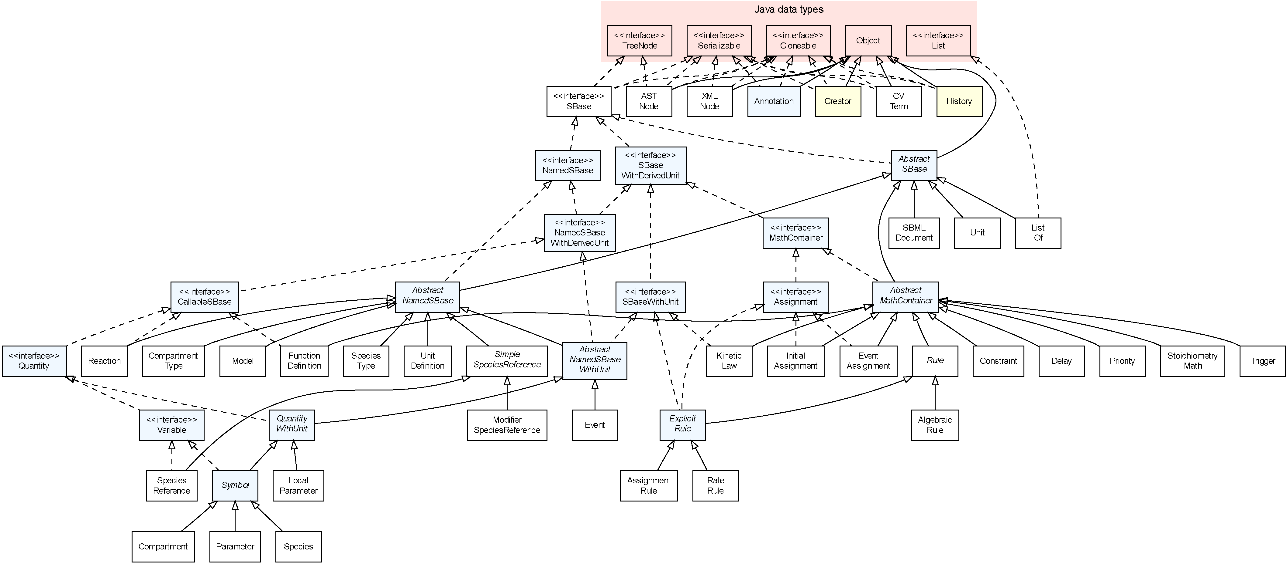
Type hierarchy

Slide 19
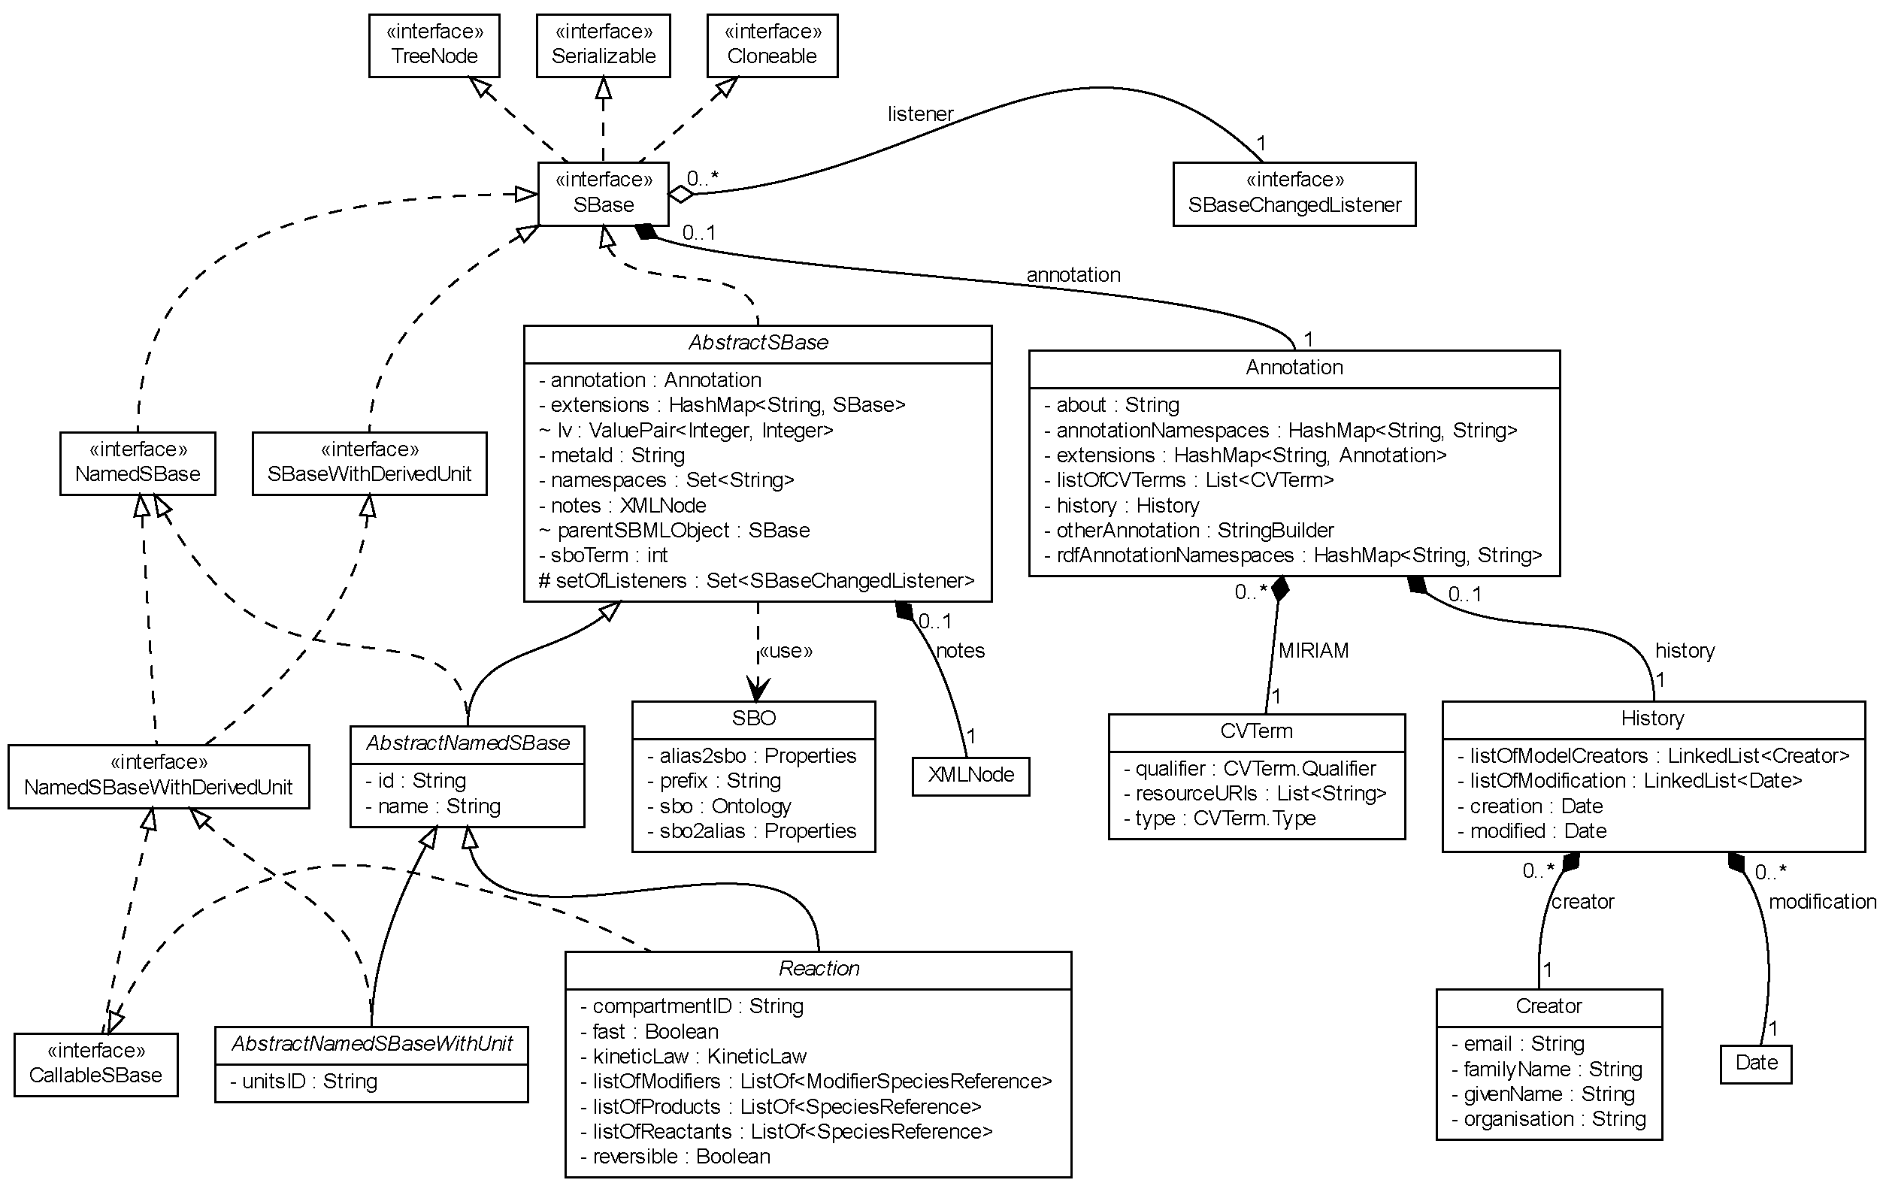
Closer look at the interface SBase

Slide 20
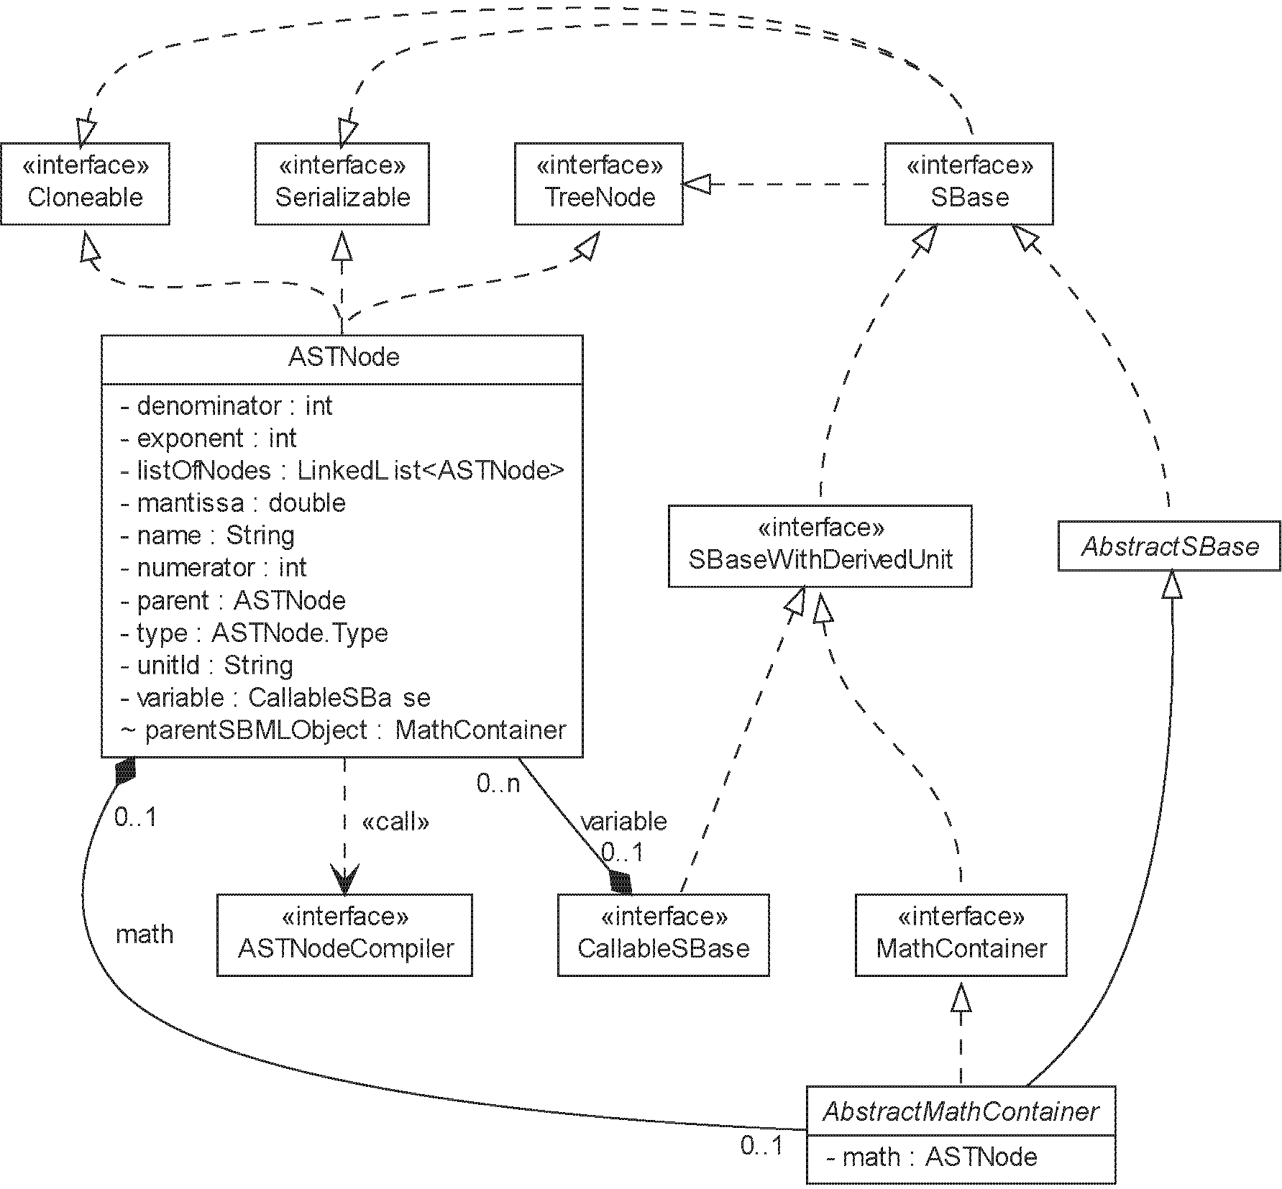
Representation of mathematical equations as ASTNode

Slide 21
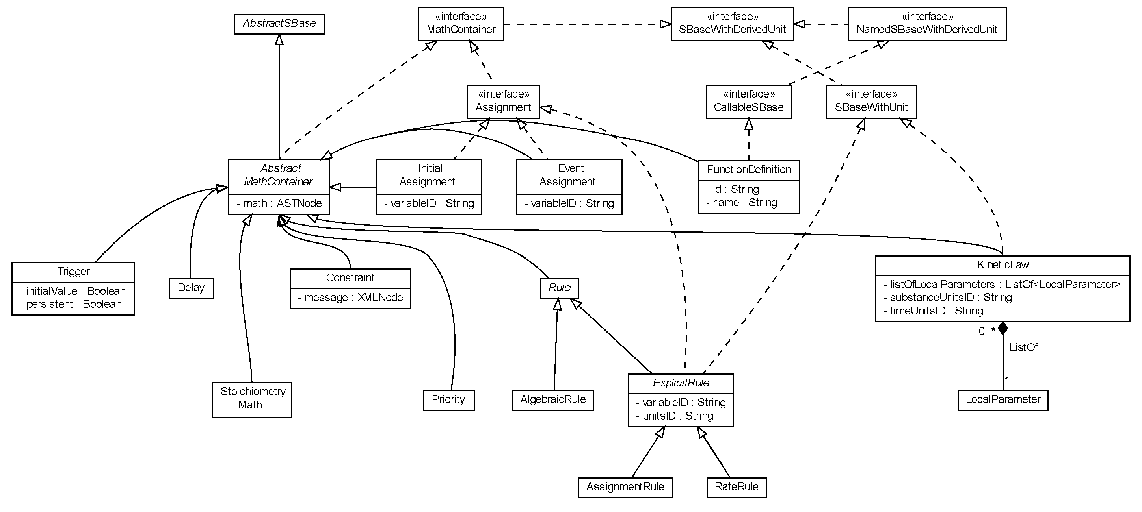
Closer look at the interface MathContainer

Slide 22
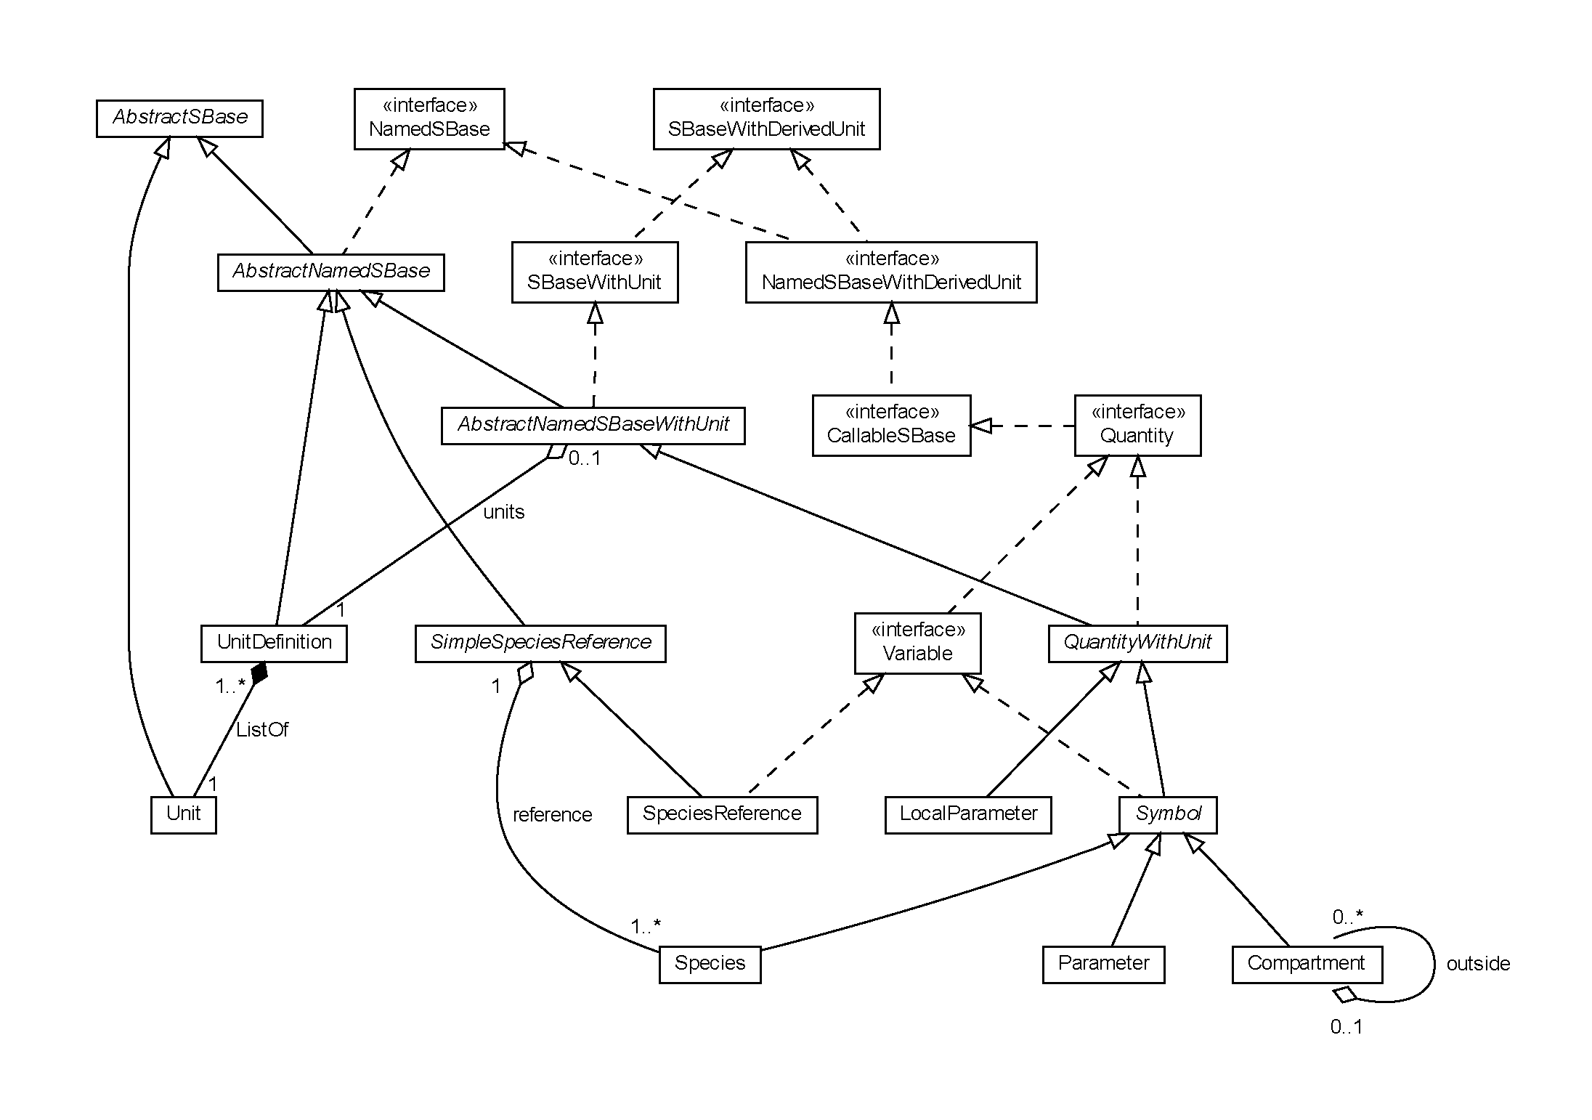
The relationship between instances of the interface Variable

Slide 23
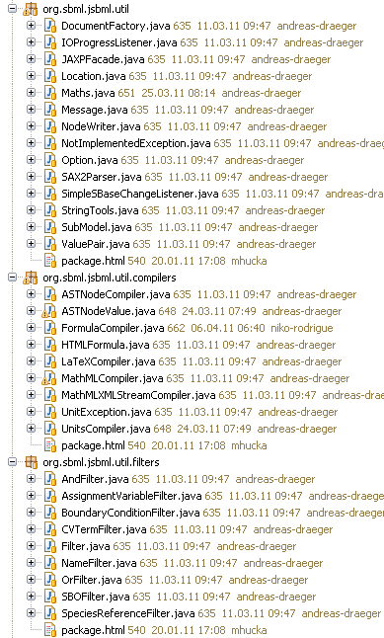
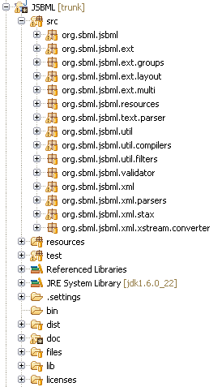
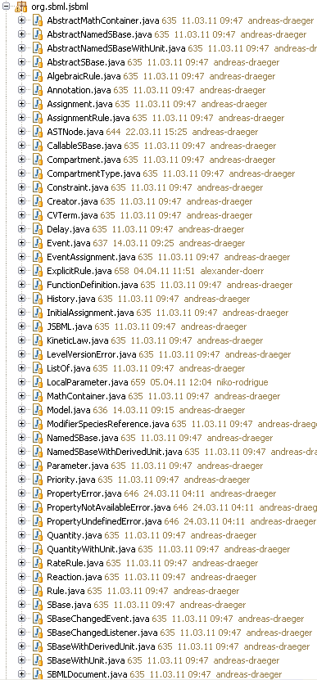
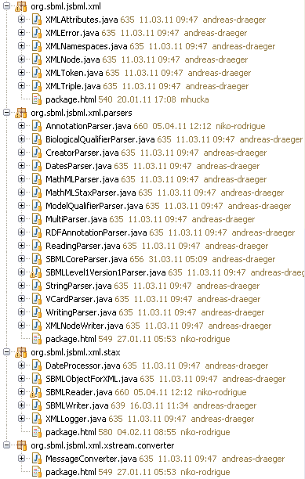
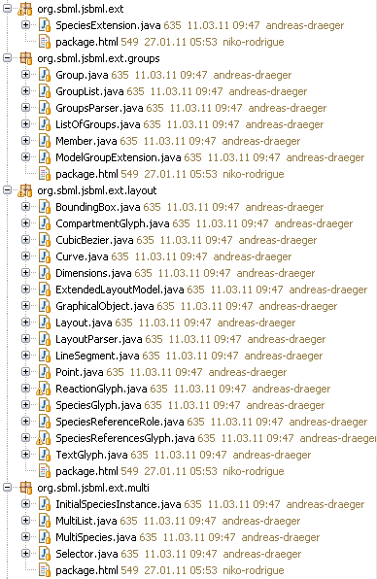
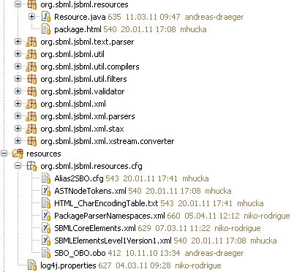
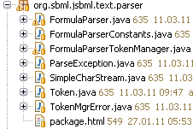

Package structure

Slide 24
Modules

Slide 25
Download of modules
LibSBML input/output:
svn co "https://jsbml.svn.sourceforge.net/svnroot/jsbml/modules/libSBMLio/"
libSBMLio
CellDesigner bridge:
svn co "https://jsbml.svn.sourceforge.net/svnroot/jsbml/modules/cellDesigner"
cellDesigner
LibSBML compatibility module for switching between libSBML and JSBML still under development

Slide 26
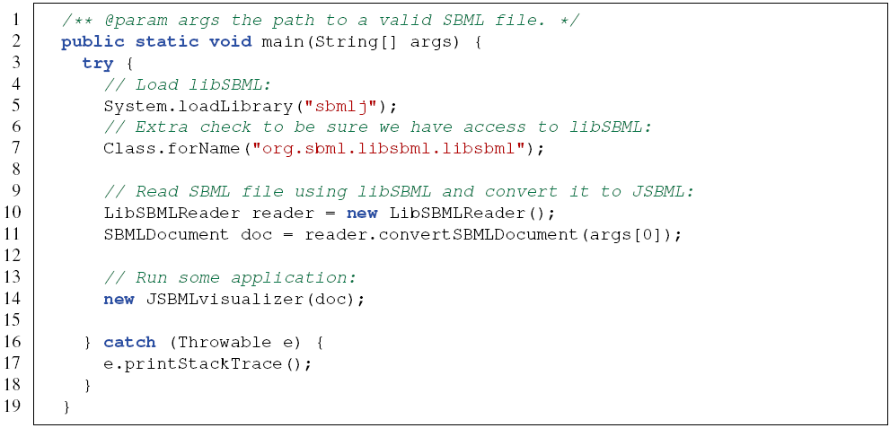
LibSBML module

Slide 27

CellDesigner module
Declares
Invokes
PluginAction
CellDesignerPlugin
Loads on start
Calls
CellDesigner
Turning an existing application into a plugin for CellDesigner
Only implementation of two abstract classes required

Slide 28
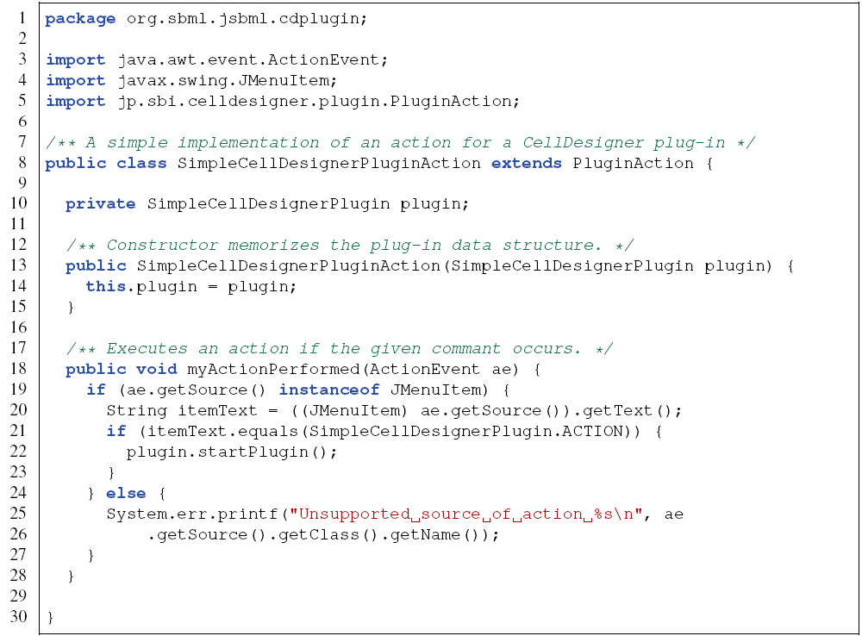
CellDesigner module: Example for a PluginAction

Slide 29
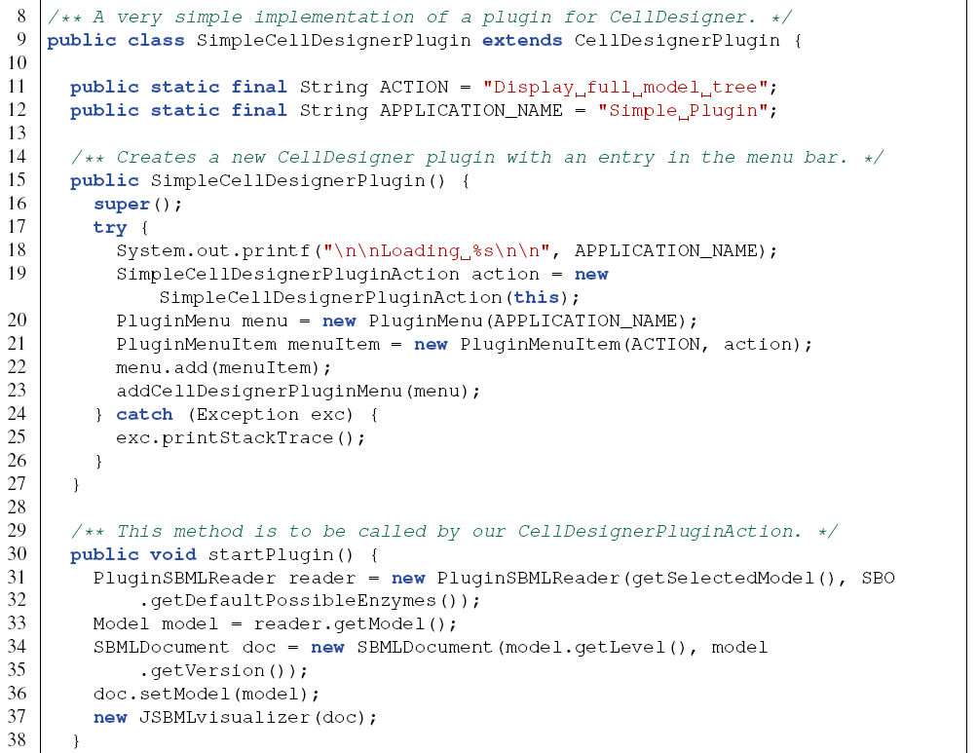
CellDesigner module: Example for a CellDesignerPlugin

