Slide 1

The SBML Java™ library

Slide 2
Concept of JSBML
Compromise
High compatibility to libSBML
Java-like library
Main developers
Nicolas Rodriguez, Alex Thomas, and Andreas Dräger
Mailing lists:
private: jsbml-team@caltech.edu
public: jsbml-development@googlegroups.com

Slide 3

How to get started?

Slide 4
Obtaining JSBML
Every stable and experimental release is available for download at http://sourceforge.net/projects/jsbml/files/jsbml/
Download the file jsbml-X.Y-with-dependencies.jar
Once you have added it to the Java CLASSPATH, you can start working with JSBML.

Slide 5
How to compile JSBML-qual
Creating a JAR file with the latest code from the repository:
Checkout the sources from sourceforge
svn co svn://svn.code.sf.net/p/jsbml/code/trunk JSBML
cd JSBML/core
ant jar
cd ../extensions/qual
ant jar
now, include the jar file from core/build, core/lib, extension/qual/build
Generating a big jar, including JSBML-qual:
cd ../..
cp -v extensions/qual/build/*.jar core/lib/
cd core
ant bigjar
now, you have a jsbml-X.Y-with-dependencies.jar that contains JSBML-qual as well
Since JSBML 1.0β1 a precompiled version of JSBML-qual is already available for download at http://sourceforge.net/projects/jsbml/files/jsbml/

Slide 6
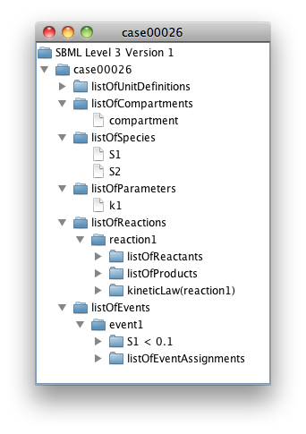
Visualizing the content of an SBML file
import java.io.File;
import javax.swing.*;
import org.sbml.jsbml.*;
/**
* Displays the content of an SBML file in a {@link JTree}
*/
public class JSBMLvisualizer extends JFrame {
/**
* @param document The SBML root node of an SBML file
*/
public JSBMLvisualizer(SBMLDocument document) {
super(document.getModel().getId());
getContentPane().add(new JScrollPane(new JTree(document)));
pack();
setVisible(true);
}
/**
* Main routine. Note: this does not perform any error checking,
* but should. It is an illustration only.
* @param args Expects a valid path to an SBML file.
*/
public static void main(String[] args) throws Exception {
UIManager.setLookAndFeel(UIManager.getSystemLookAndFeelClassName());
new JSBMLvisualizer(SBMLReader.read(new File(args[0])));
}
}
Example output when reading an SBML file with the code on the left from the SBML Test Suite with JSBML (on Mac OS X)
Notes:
TODO : Try to do an example with a qual model ?

Slide 7
How does XML parsing work?
Mapping between SBML elements and Java classes: /jsbml-trunk/resources/org/sbml/jsbml/resources/cfg/SBMLCoreElements.xml
Then each SBase has a readAttributes and writeAttributes methods that take care of reading and writing the attributes of the element.
The parsing is done in:
org.sbml.jsbml.xml.stax: main entry point of the parsing, using Stax.
org.sbml.jsbml.xml.parsers: parser independent of the underlying XML parsing library used.
For extension packages a similar parsing/writing mechanism is used

Slide 8
Creating a new SBML model from scratch
public JSBMLexample() throws Exception {
// Create a new SBMLDocument object, using SBML Level 3 Version 1.
SBMLDocument doc = new SBMLDocument(3, 1);
doc.addTreeNodeChangeListener(this);
// Create a new SBML model, and add a compartment to it.
Model model = doc.createModel("test_model");
Compartment compartment = model.createCompartment("default");
compartment.setSize(1d);
// Create a model history object and add author information to it.
History hist = model.getHistory(); // Will create the History, if it does not exist
Creator creator = new Creator("Given Name", "Family Name", "Organization", "My@EMail.com");
hist.addCreator(creator);
// Create some sample content in the SBML model.
Species specOne = model.createSpecies("test_spec1", compartment);
Species specTwo = model.createSpecies("test_spec2", compartment);
Reaction sbReaction = model.createReaction("reaction_id");
// Add a substrate (SBO:0000015) and product (SBO:0000011) to the reaction.
SpeciesReference subs = sbReaction.createReactant(specOne);
subs.setSBOTerm(15);
SpeciesReference prod = sbReaction.createProduct(specTwo);
prod.setSBOTerm(11);
// For brevity, WE DO NOT PERFORM ERROR CHECKING, but you should,
// using the method doc.checkConsistency() and then checking the error log.
// Write the SBML document to a file.
SBMLWriter.write(doc, "test.xml", "JSBMLexample", "1.0");
}

Slide 9
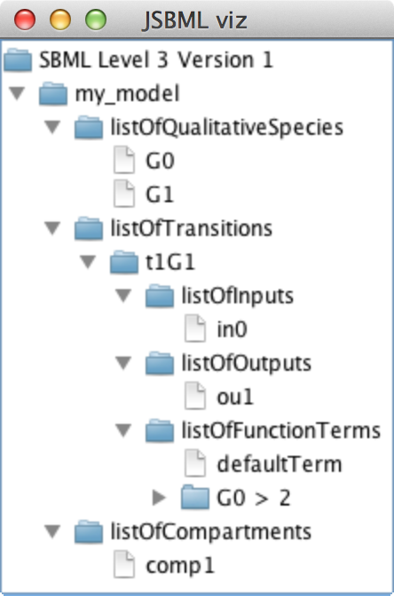
How to create a simple qual model in JSBML?
int level = 3, version = 1;
SBMLDocument doc = new SBMLDocument(level, version);
Model model = doc.createModel("my_model");
// Creating the qualitative model extension and adding it to the document
QualModelPlugin qualPlugin = new QualModelPlugin(model);
model.addExtension(QualConstants.getNamespaceURI(level, version), qualPlugin);
// ListOfCompartments
Compartment comp1 = model.createCompartment("comp1");
comp1.setConstant(true);
// ListOfQualitativeSpecies
QualitativeSpecies g0 = qualPlugin.createQualitativeSpecies("G0", comp1, false);
QualitativeSpecies g1 = qualPlugin.createQualitativeSpecies("G1", comp1, false);
// ListOfTransitions
Transition t1G1 = qualPlugin.createTransition("t1G1");
// ListOfInputs
t1G1.createInput("in0", g0, InputTransitionEffect.consumption);
// ListOfOutputs
t1G1.createOutput("ou1", g1, OutputTransitionEffect.assignmentLevel);
// ListOfFunctionTerms
FunctionTerm defTerm = new FunctionTerm(level, version);
defTerm.setDefaultTerm(true);
defTerm.setResultLevel(0);
FunctionTerm ft1 = new FunctionTerm(level, version);
ft1.setResultLevel(1);
try {
ft1.setMath(ASTNode.parseFormula("G0 > 2"));
} catch (ParseException exc) {
exc.printStackTrace();
}
// G0 and G1
ASTNode andNode = new ASTNode(ASTNode.Type.LOGICAL_AND);
andNode.addChild(new ASTNode(g0.getId()));
andNode.addChild(new ASTNode(g1.getId()));
t1G1.addFunctionTerm(defTerm);
t1G1.addFunctionTerm(ft1);

Slide 10
The resulting Qual model
<?xml version='1.0' encoding='UTF-8' standalone='no'?>
<sbml xmlns="http://www.sbml.org/sbml/level3/version1/core" qual:required="true" level="3" xmlns:qual="http://www.sbml.org/sbml/level3/version1/qual/version1" version="1">
<model id="my_model">
<qual:listOfQualitativeSpecies xmlns:qual="http://www.sbml.org/sbml/level3/version1/qual/version1">
<qual:qualitativeSpecies qual:constant="false" qual:compartment="comp1" qual:id="G0"/>
<qual:qualitativeSpecies qual:constant="false" qual:compartment="comp1" qual:id="G1"/>
</qual:listOfQualitativeSpecies>
<qual:listOfTransitions xmlns:qual="http://www.sbml.org/sbml/level3/version1/qual/version1">
<qual:transition qual:id="t1G1">
<qual:listOfInputs>
<qual:input qual:transitionEffect="consumption" qual:qualitativeSpecies="G0" qual:id="in0"/>
</qual:listOfInputs>
<qual:listOfOutputs>
<qual:output qual:transitionEffect="assignmentLevel" qual:qualitativeSpecies="G1" qual:id="ou1"/>
</qual:listOfOutputs>
<qual:listOfFunctionTerms>
<qual:defaultTerm qual:resultLevel="0">
</qual:defaultTerm>
<qual:functionTerm qual:resultLevel="1">
<math xmlns="http://www.w3.org/1998/Math/MathML">
<apply>
<gt/>
<ci> G0 </ci>
<cn type="integer"> 2 </cn>
</apply>
</math>
</qual:functionTerm>
</qual:listOfFunctionTerms>
</qual:transition>
</qual:listOfTransitions>
<listOfCompartments>
<compartment id="comp1" constant="true"/>
</listOfCompartments>
</model>
</sbml>

Slide 11
Recent Changes in JSBML with relevance for qual
File /core/resources/org/sbml/jsbml/resources/cfg/PackageParserNamespaces.xml has been deleted
SBMLReader and SBMLWriter now based on Java annotations ⇾ when using Eclipse and directly operating on the trunk, configuration needs to be updated as described here: https://code.google.com/p/spi/wiki/EclipseSettings
libSBML now also supports qual and the SBML online validator validates qual models
Naming conventions of qual objects: QualitativeModel is now deprecated (at the moment in the trunk, but at latest with the next release of 1.0 also in the stable version)
Please use QualModelPlugin instead. Reason: Compatibility to libSBML’s naming conventions
Improved support for MAVEN: All pom.xml files have been updated

Slide 12
Modules

Slide 13
Download of modules
LibSBML input/output:
svn co svn://svn.code.sf.net/p/jsbml/code/trunk/modules/libSBMLio libSBMLio
CellDesigner bridge:
svn co svn://svn.code.sf.net/p/jsbml/code/trunk/modules/celldesigner celldesigner
Further modules: Android, compare, libSBMLcompat
LibSBML compatibility module for switching between libSBML and JSBML still under development

Slide 14
LibSBML module
public static void main(String[] args) {
try {
// Load LibSBML:
System.loadLibrary("sbmlj");
// Extra check to be sure we have access to libSBML:
Class.forName("org.sbml.libsbml.libsbml");
// Read SBML file using LibSBML and convert it to JSBML:
SBMLInputConverter<org.sbml.libsbml.Model> reader = new LibSBMLReader();
SBMLDocument doc = reader.convertSBMLDocument(args[0]);
//SBMLDocument doc = new SBMLDocument(2,4);
org.sbml.libsbml.SBMLDocument libDoc = reader.getOriginalModel().getSBMLDocument();
//org.sbml.libsbml.SBMLDocument libDoc = new org.sbml.libsbml.SBMLDocument(2,4);
doc.addTreeNodeChangeListener(new LibSBMLChangeListener(libDoc));
// Run some application:
new JSBMLVisualizer(doc);
} catch (Throwable exc) {
exc.printStackTrace();
}
}

Slide 15

CellDesigner module
Turning an existing application into a plugin for CellDesigner
Only implementation of two abstract classes required
Declares
Invokes
PluginAction
CellDesignerPlugin
Loads on start
Calls
CellDesigner

Slide 16
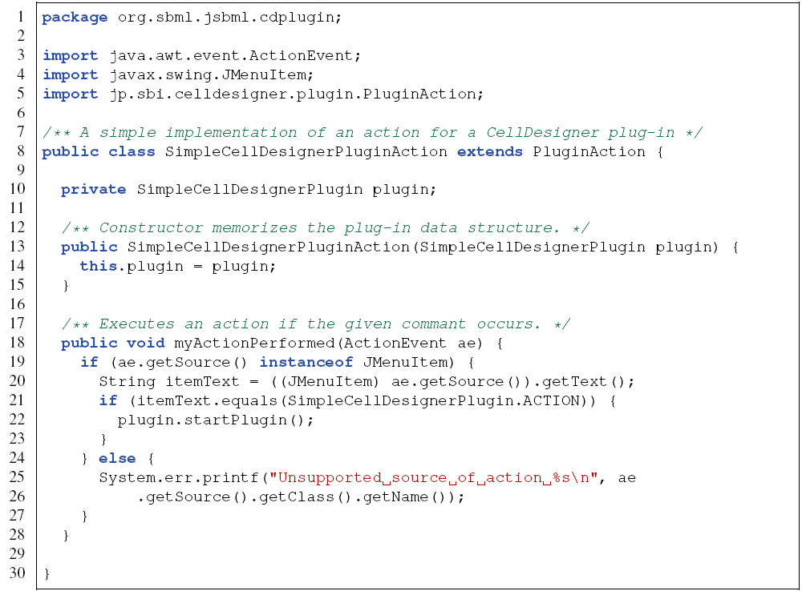
CellDesigner module: Example for a PluginAction

Slide 17
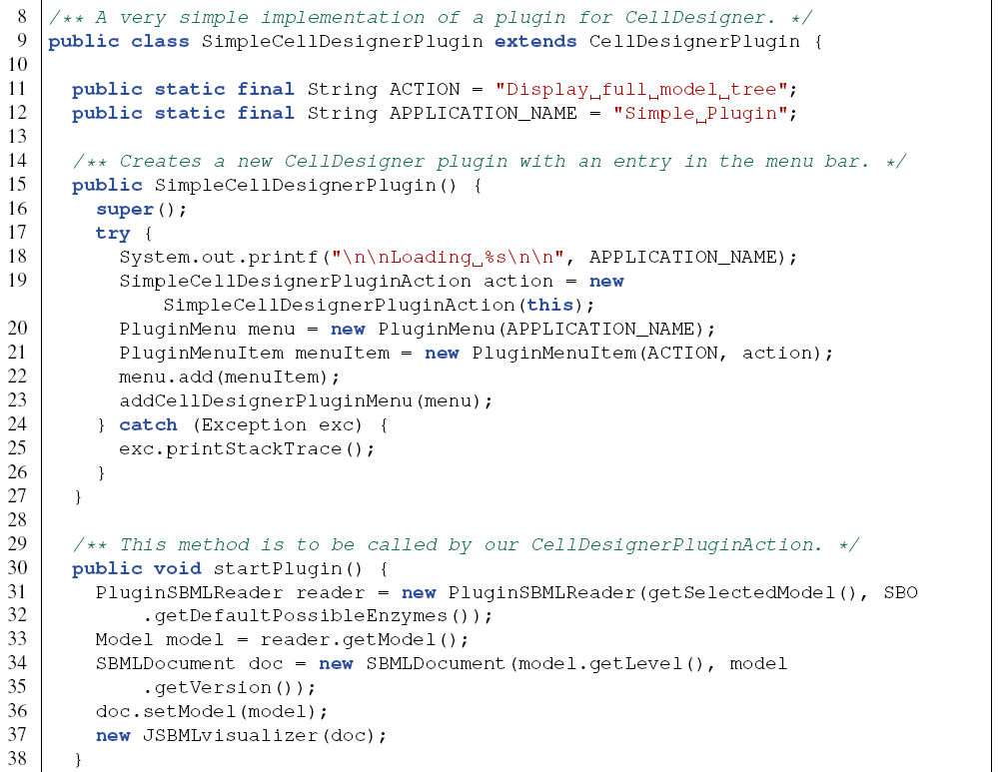
CellDesigner module: Example for a CellDesignerPlugin

Slide 18
Some more details

Slide 19
Using annotation
Species species = model.createSpecies("species", comp1);
species.addCVTerm(new CVTerm(CVTerm.Qualifier.BQB_IS,
"http://identifiers.org/go/GO:0006915",
"http://identifiers.org/kegg.genes/hsa:321"));
species.addCVTerm(new CVTerm(CVTerm.Qualifier.BQB_IS_DESCRIBED_BY,
"http://identifiers.org/pubmed/16333295"));
species.addCVTerm(new CVTerm(CVTerm.Qualifier.BQB_IS_ENCODED_BY,
"http://identifiers.org/ensembl/ENSG00000085662"));
species.addCVTerm(new CVTerm(CVTerm.Qualifier.BQB_OCCURS_IN,
"http://identifiers.org/kegg.reaction/R01787"));
/* This method call will return a List of Species that are annotated with the Qualifier
* 'occursIn' and a resource attached to this qualifier that contains the String 'kegg'.
*/
model.getListOfSpecies().filter(new CVTermFilter(CVTerm.Qualifier.BQB_OCCURS_IN, ".*kegg.*"));

Slide 20
How to contribute
Creating a patch:
Checkout the sources from sourceforge
svn co svn://svn.code.sf.net/p/jsbml/code/trunk JSBML
Do your modifications, then create a patch file:
svn diff > jsbml-patch.txt
Attach it to a tracker item or send it through the development list.
Bug tracker: http://sourceforge.net/p/jsbml/bugs/
Pivotal : https://www.pivotaltracker.com/projects/499447
Mailing lists:
jsbml-development@caltech.edu: public list with discussion about the development of JSBML and support for users.
jsbml-team@caltech.edu: private list for the JSBML team were anybody can send mails for support or bugs reports.

Slide 21

Thanks http://sbml.org/Software/JSBML

Slide 23
Data types

Slide 24
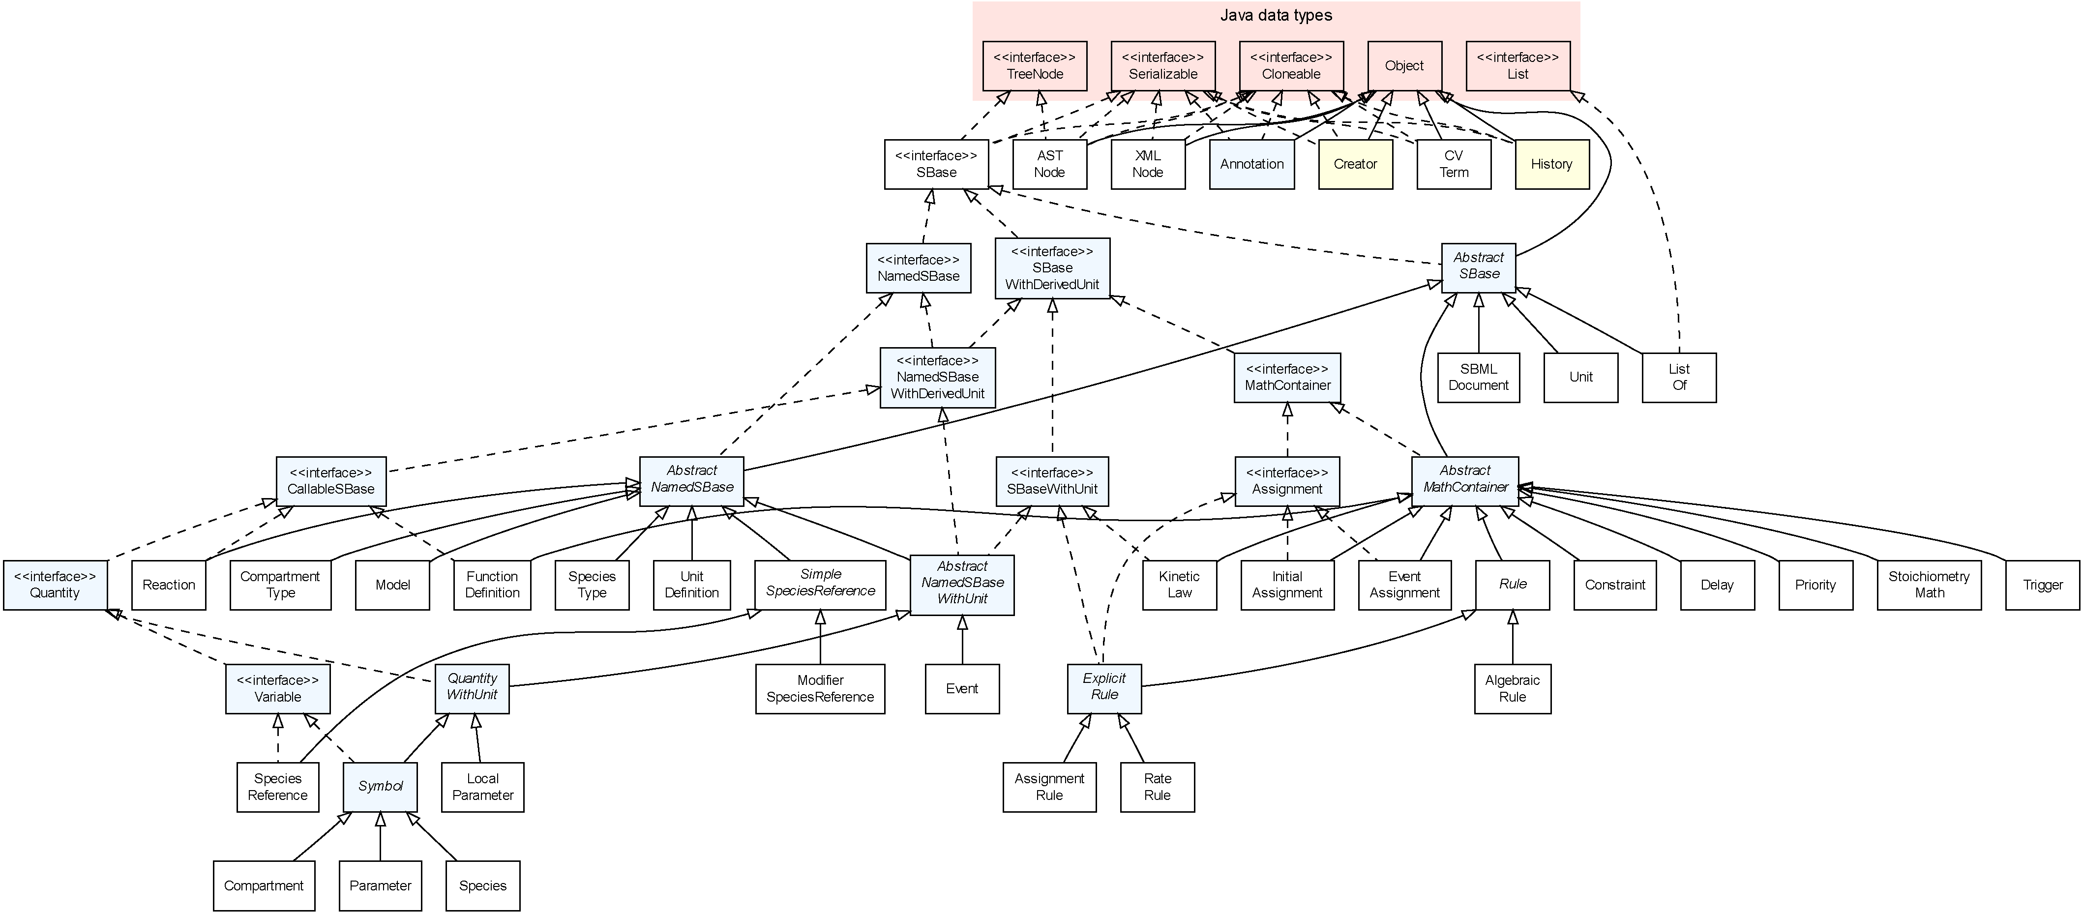
Type hierarchy

Slide 25
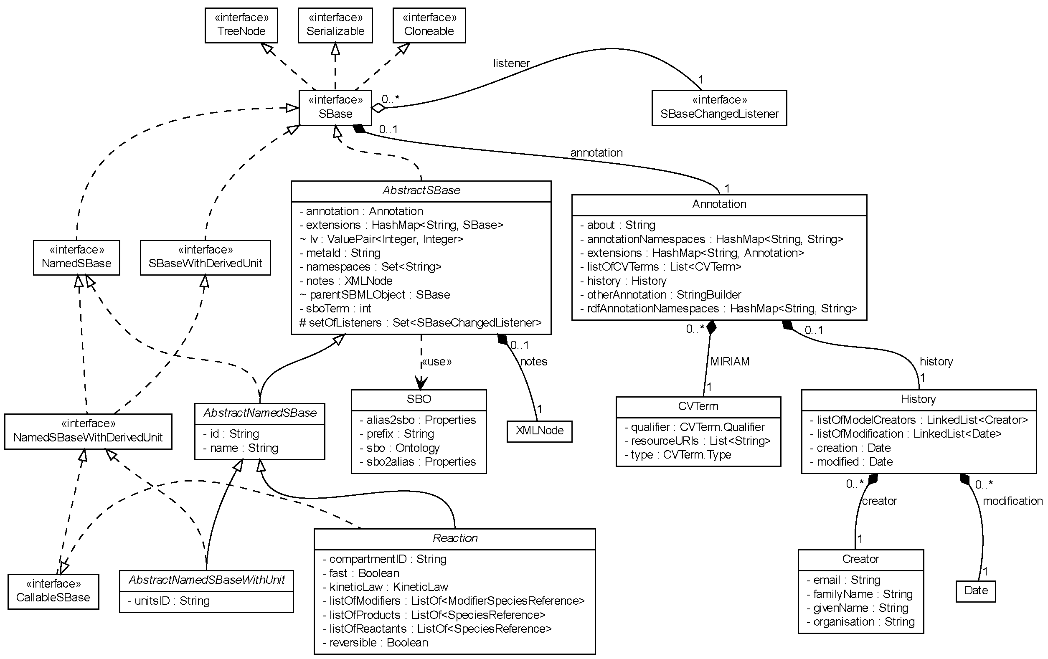
Closer look at the interface SBase

Slide 26
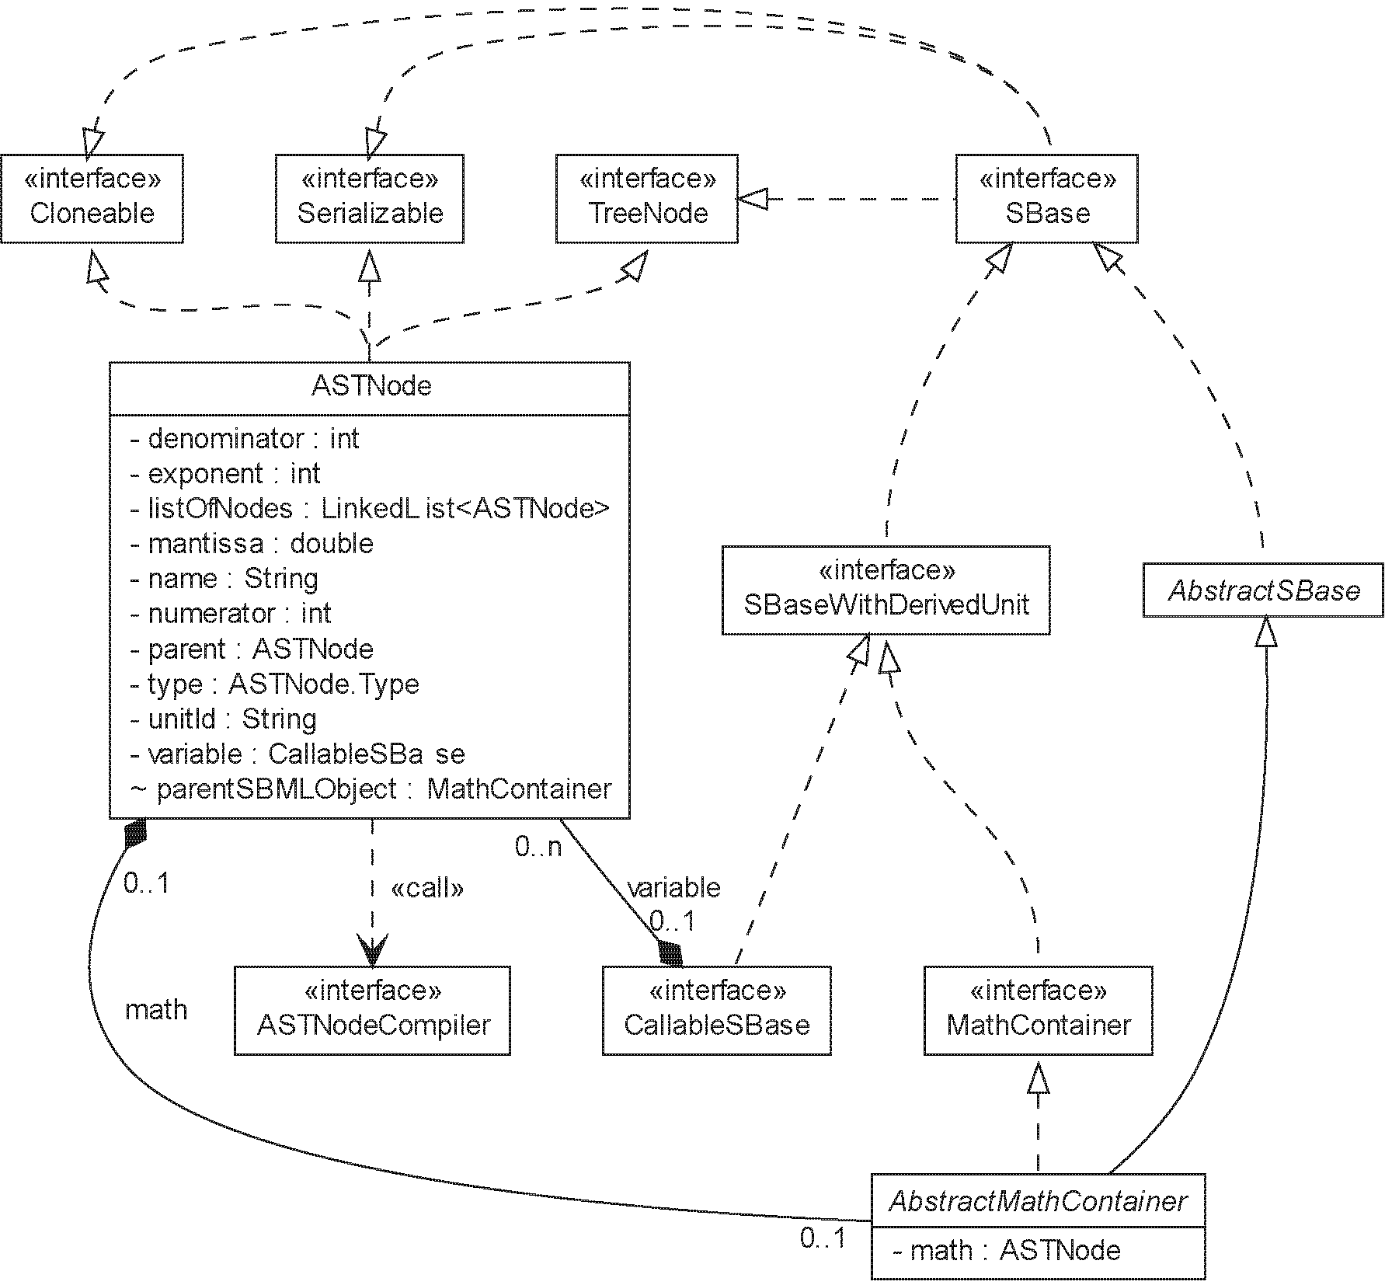
Representation of mathematical equations as ASTNode

Slide 27
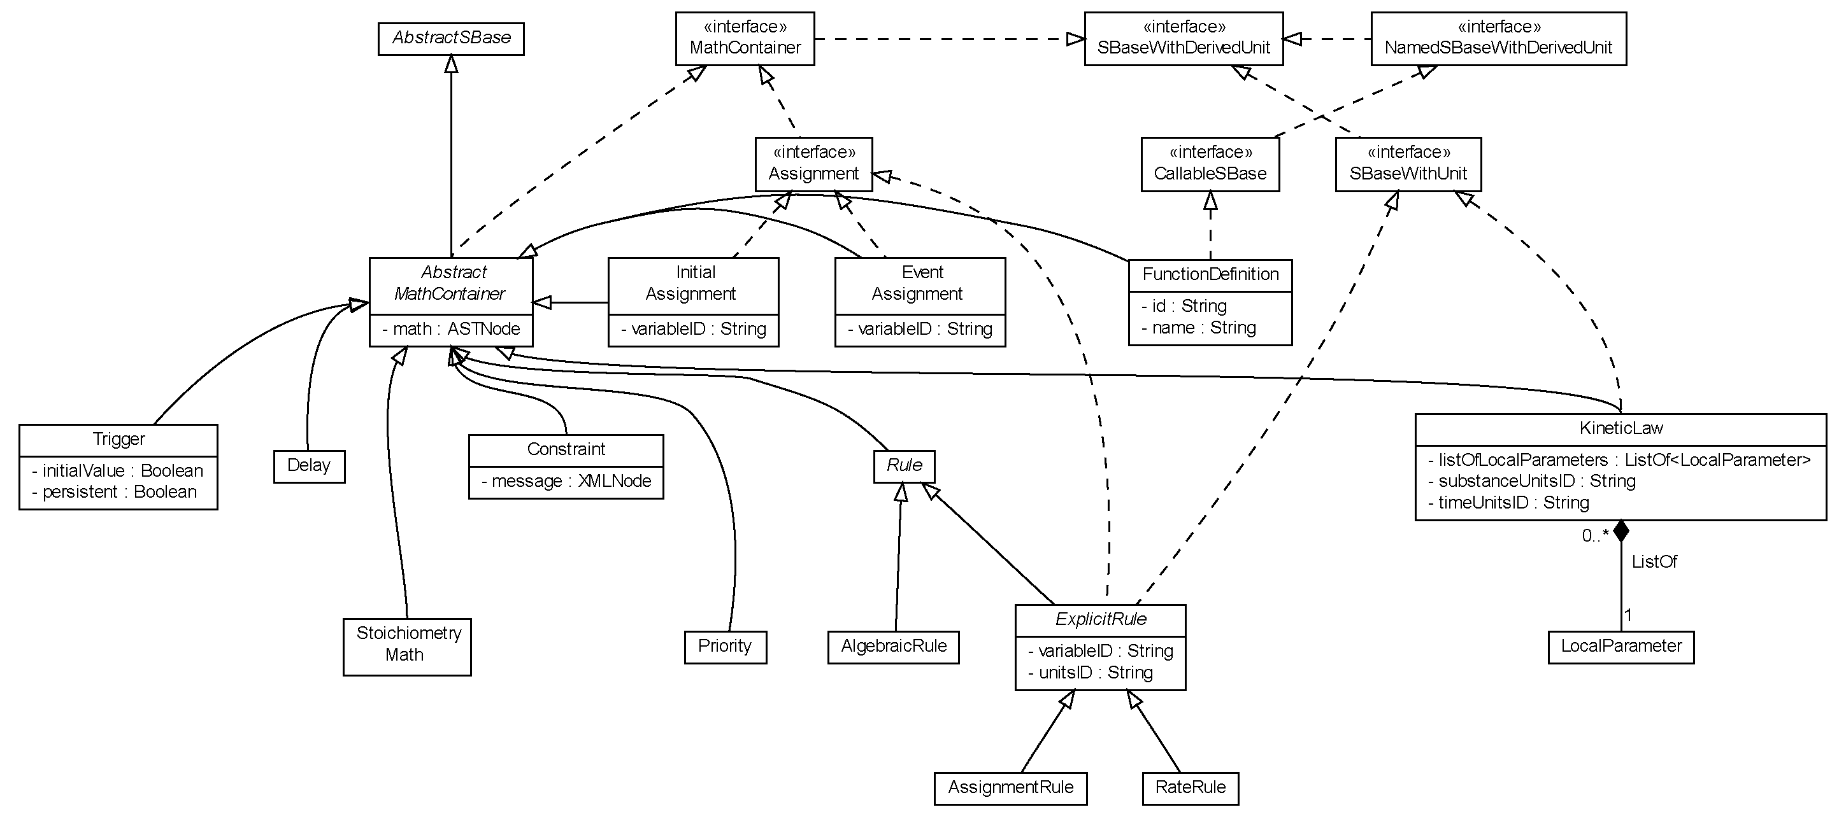
Closer look at the interface MathContainer

Slide 28
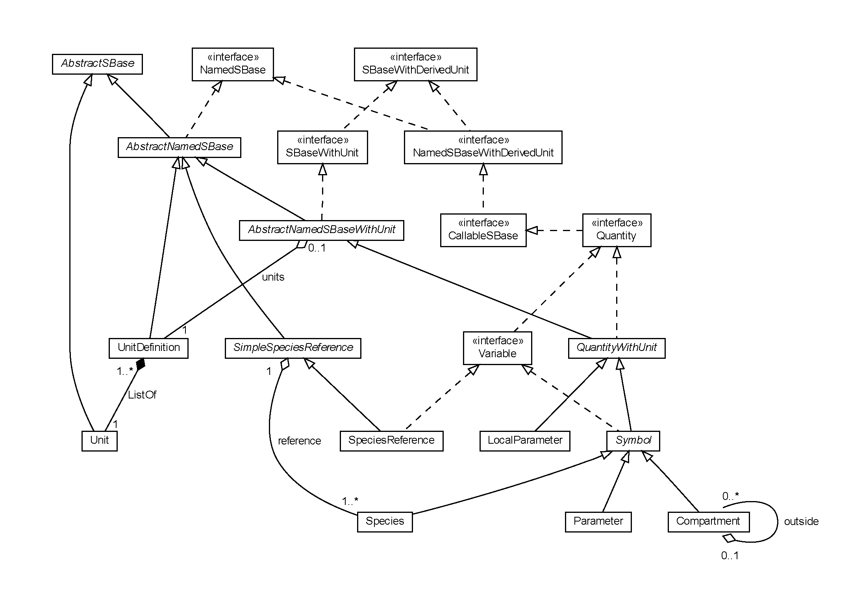
The relationship between instances of the interface Variable

Slide 29
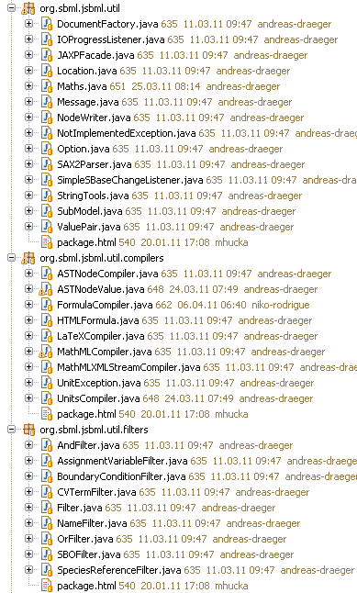
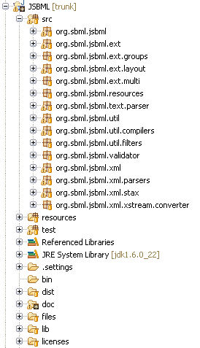
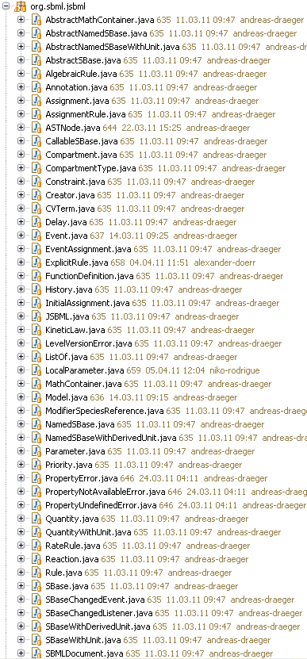
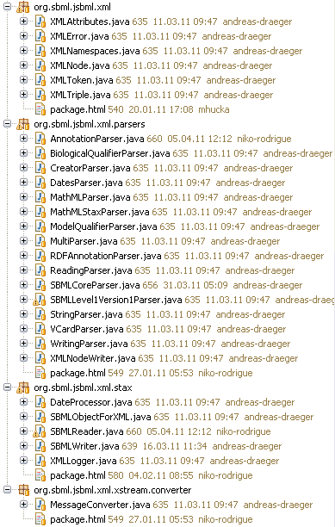
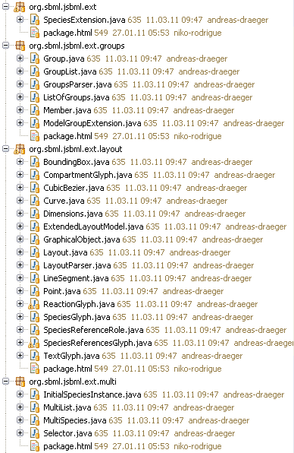
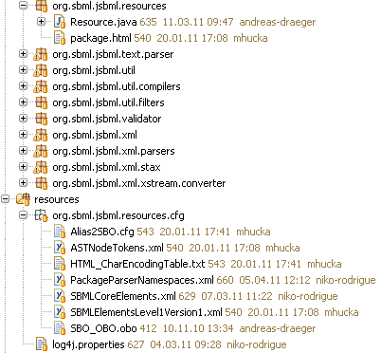
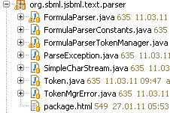

Package structure

