Slide 1
Claims Frequency Modelling
Anton Augustine Abraham

Slide 2
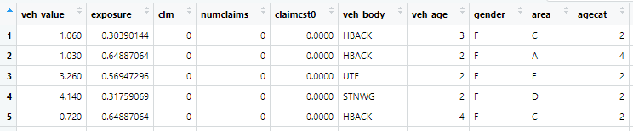
Dataset
Motor Policy Data - package “insuranceData”
Poisson Regression Modelling

Slide 3
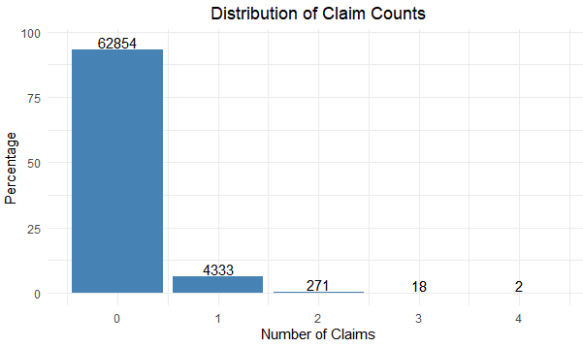
Data Pre Processing
368 duplicate records are removed.
93% - No claims.

Slide 4
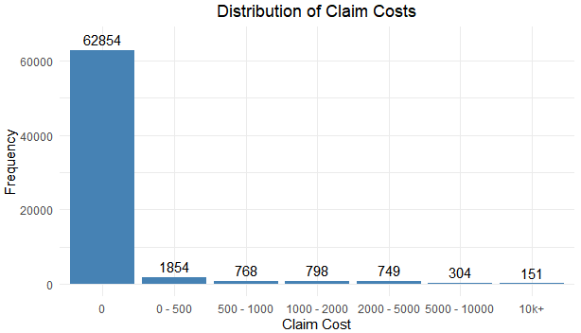
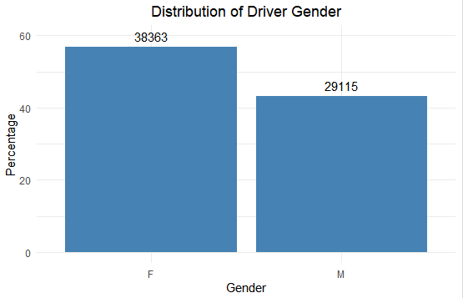
Data - Features

Slide 5
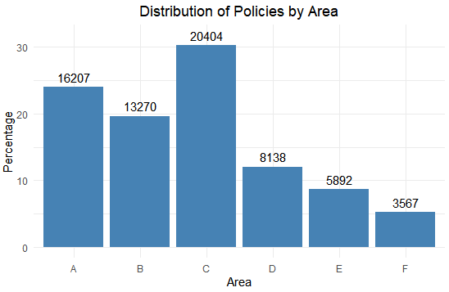
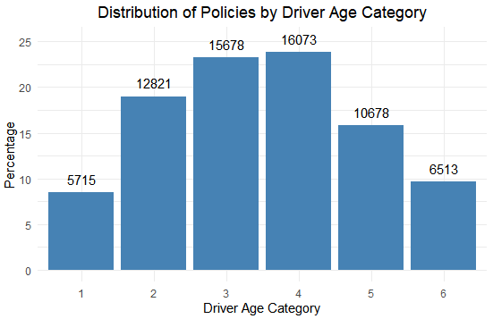
Data - Features

Slide 6
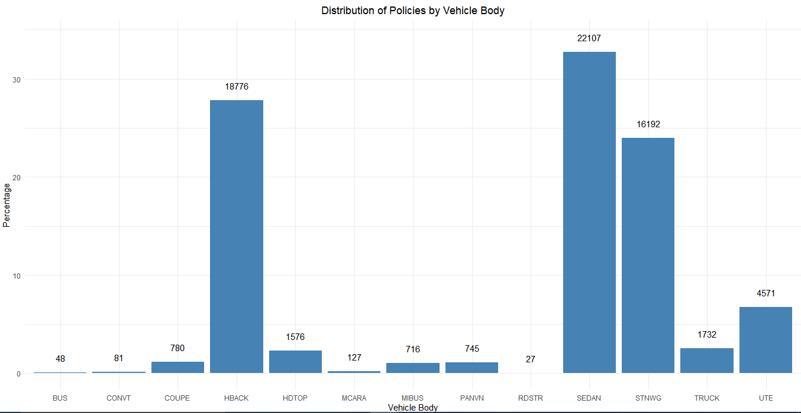
Data - Features

Slide 7
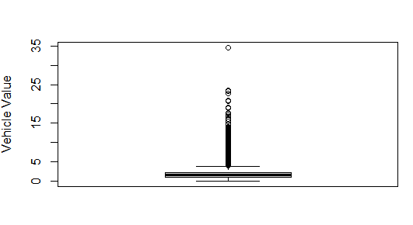
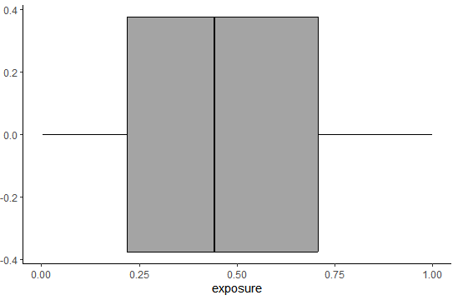
Data - Features

Slide 8
Hyper parameter Tuning
Hyper Parameter | Values
Eta (learning rate) | (0.01, 0.2)
Column sample by tree | (0.4, 0.9)
Max depth | (3, 10)
Subsample | (0.4, 0.9)
Number of Rounds | 5000
Early Stopping Rounds | 25
Objective Function | count:poisson
Booster Parameter | gbtree
Evaluation Metric | poisson-nloglik

Slide 9
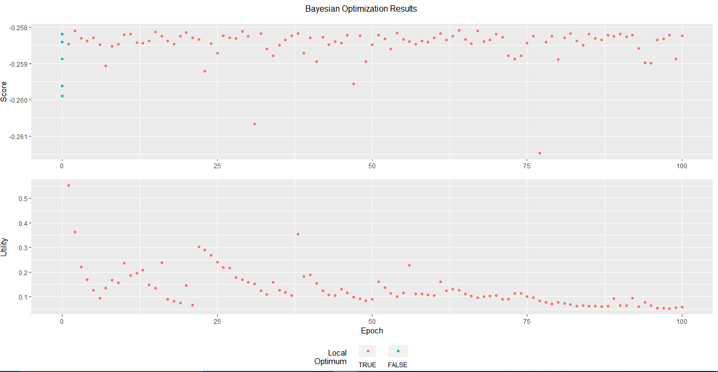

Slide 10
Final Model Parameters
Hyper Parameter | Value
Eta (learning rate) | 0.01
Column sample by tree | 0.6091719
Max depth | 3
Subsample | 0.4
Number of Rounds | 1059
Objective Function | count:poisson
Booster Parameter | gbtree
Evaluation Metric | poisson-nloglik

Slide 11
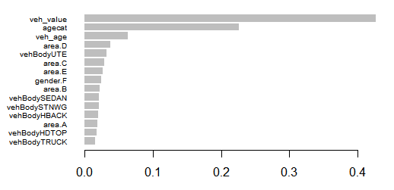
Plot - Factor Importance

Slide 12
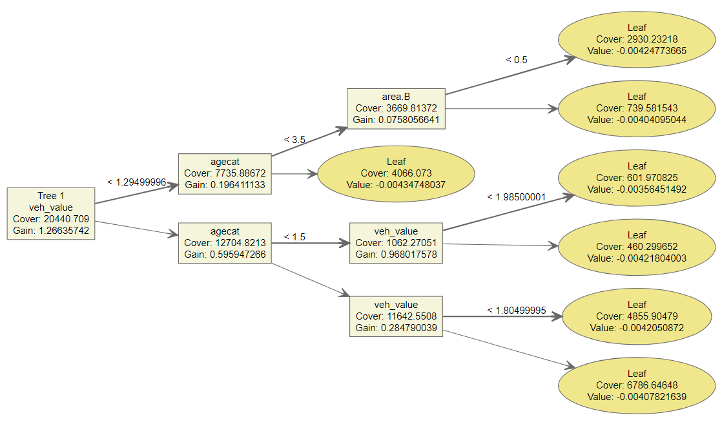
First Regression Tree

Slide 13
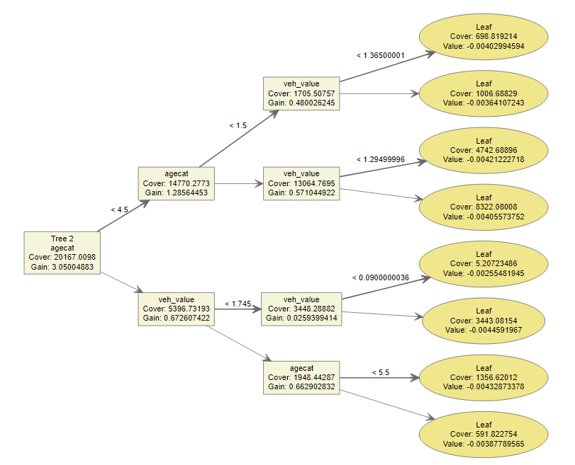
Second Regression Tree

Slide 14
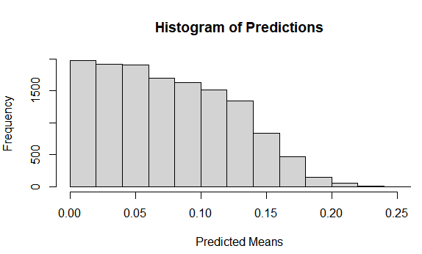
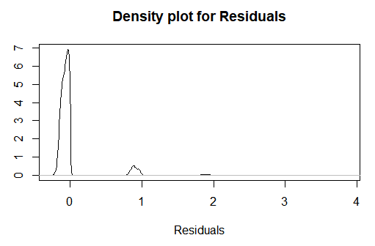
Predictions & Residuals

Slide 15
Evaluation – Test Data
Evaluation Metric | Value on Test Data
Mean Squared Error | 0.07388945
Mean Absolute Error | 0.1334131
RMSE | 0.2718261
Mean Squared Log Error | 0.03314206

Slide 16
ANY QUESTIONS?

