Slide 1

Reinforcement Learning: Snake

Slide 2
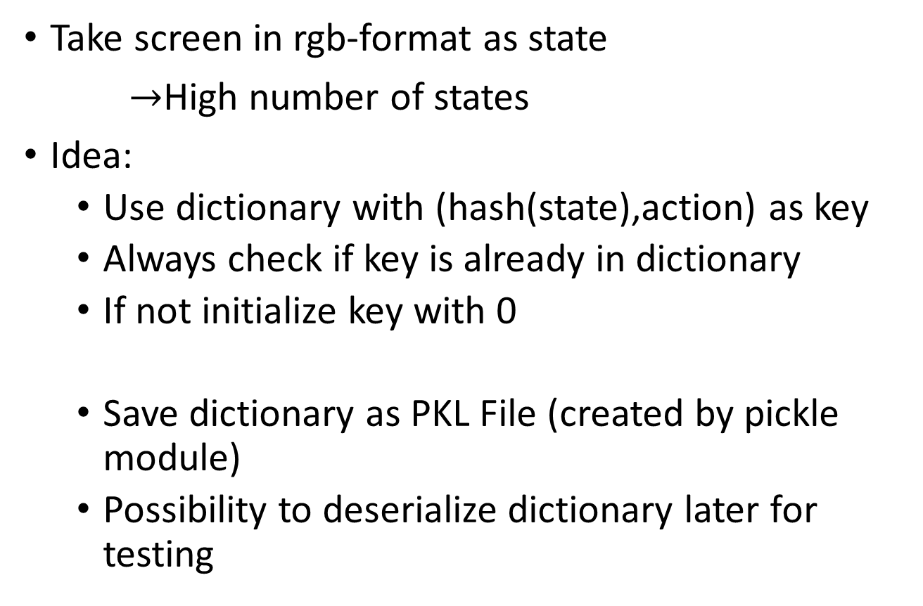
Q-Learning
Take screen in rgb-format as state
$→$High number of states
Idea:
Use dictionary with (hash(state),action) as key
Always check if key is already in dictionary
If not initialize key with 0
Save dictionary as PKL File (created by pickle module)
Possibility to deserialize dictionary later for testing

Slide 3
Analysis
#Frames | Time | Memory of process | Q-Dic in PKL format
100 | 1.96 sec | 49,34 MB | 13 kB
1000 | 16 sec | 49,57 MB | 128 kB
10000 | 2 min 10 sec | 57,87 MB | 1.274 kB
100000 | ~ 50 min | 112,76 MB | 12.373 kB
Measured on own Laptop (i7-6500U CPU 2.5 GHz , 12 GB RAM)

Slide 4
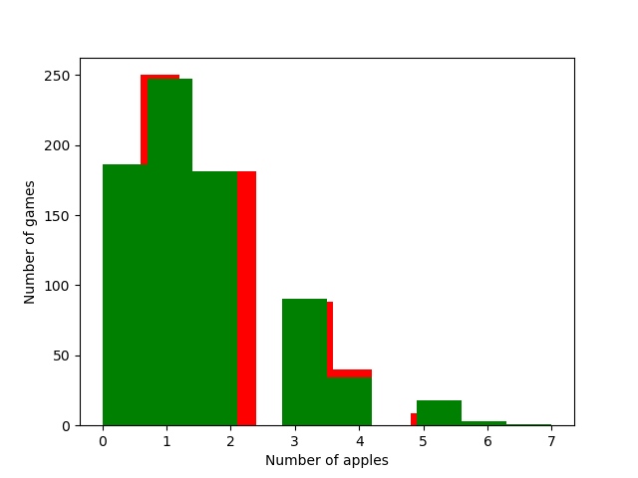
Compare learning with random decision
Red = Random
Green = Q-learning

Slide 5
Implementation…

