Slide 1
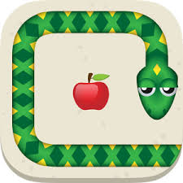
Reinforcement Learning: Snake

Slide 2
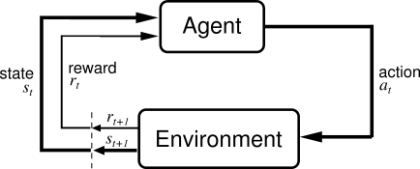
Reinforcement Learning
Idea: learning by interacting with environment
Learning algorithm gets rewards for chosen actions
Learning by doing
Need of appropriate environment: pygame learning environment

Slide 3
Introduction to our problem: Snake
Rules of the game:
Init: little snake on the match field
Match field is limited with borders
Apple at random location
Snake grows if it eats the apple
Snake dies if it eats itself or the border
Goal: Snake should grow as long as possible

Slide 4
Different approaches
Q-learning
Deep Q-learning

Slide 5
Q-learning
Snake | Agent
Decision of direction | Action
Apple / Dying | Positive / negative reward
Game field with size and position of snake and apple | Environment

Slide 6
Improvements
Reward function
Parameters (gamma, learning rate, probability of random)
Smaller environment (reducing number of states)
Goal changing (only surviving)

