Slide 1
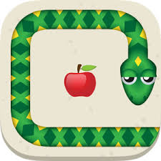
Reinforcement Learning: Snake

Slide 2
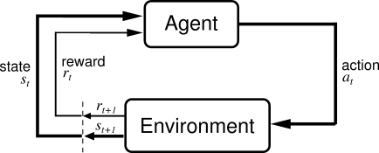
Reinforcement Learning
Idea: learning by interacting with environment
Learning algorithm gets rewards for chosen actions
Learning by doing
Need of appropriate environment: pygame learning environment

Slide 3
Introduction to our problem: Snake
Rules of the game:
Init: little snake on the match field
Match field is limited with borders
Apple at random location
Snake grows if it eats the apple
Snake dies if it eats itself or the border
Goal: Snake should grow as long as possible

Slide 4
Different approaches
Q-learning
Deep Q-learning

Slide 5
Q-learning
Snake | Agent
Decision of direction | Action
Apple / Dying | Positive / negative reward
Game field with size and position of snake and apple | Environment

Slide 6
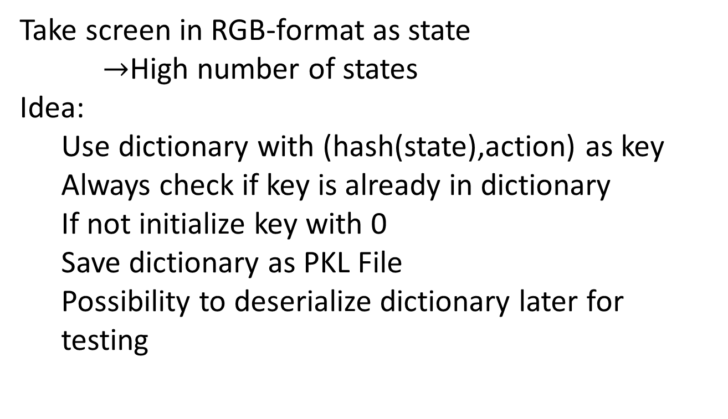
Q-learning implementation
Take screen in RGB-format as state
$→$High number of states
Idea:
Use dictionary with (hash(state),action) as key
Always check if key is already in dictionary
If not initialize key with 0
Save dictionary as PKL File
Possibility to deserialize dictionary later for testing

Slide 7
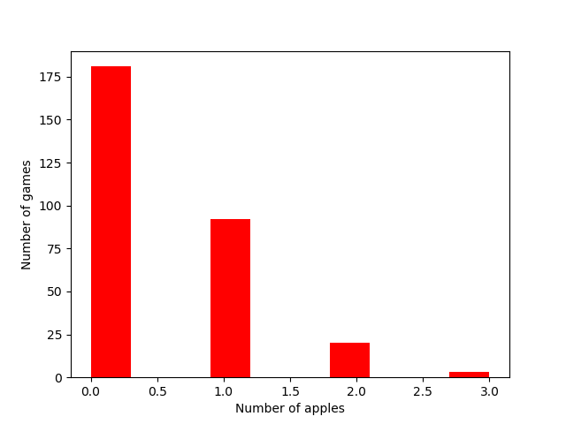
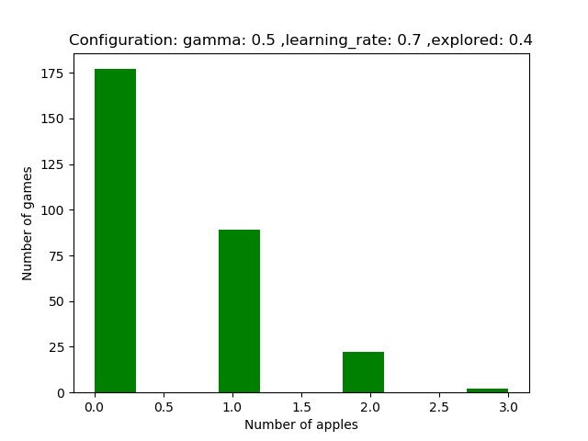
Q-learning first results
Random player
Our player
Number of Frames: 10000 (for training and testing)

Slide 8
Improvements
Change reward function
Smaller environment (reducing number of states)
Change hashkey
Set apple always to the same position
Test different parameters (gamma, learning rate, probability of random) with Mogon

Slide 9
Improvements
1000 varations of the parameters tested
Number of Frames: 4000000 training
Number of Frames: 100000 testing
Time: 24 min on Mogon
22 Configurations with at least one game with 6 and 7 apples

Slide 10
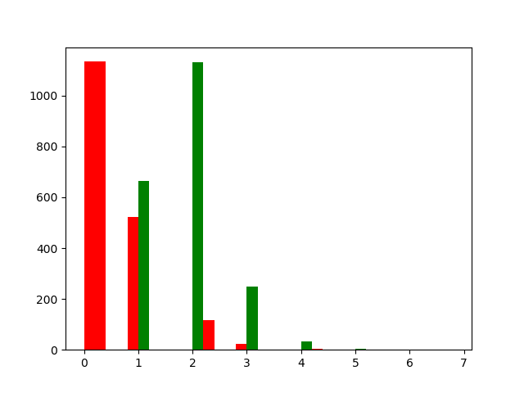
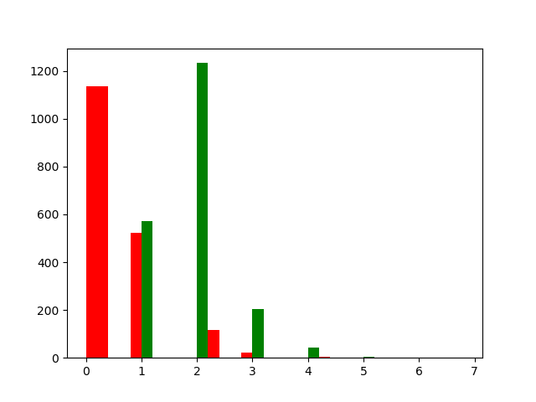
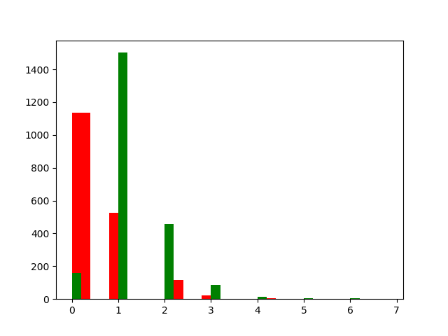
Q-learning final Results
0.1, 0.9 , 0.0
0.8, 0.9, 0.0
Gamma, learning rate, explore rate
Red = Random Player
Green = Our Player
0.6, 0.5, 0.9

Slide 11

Q-learning final Results
Gamma, learning rate, explore rate (0.6, 0.8, 0.0)
Red = Random Player 0.465 apples per game
Green = Our Player 1.89 apples per game

Slide 12
Deep Q-Learning - Network
Using Convolutional Neural Network (CNN):
Convolution layer / Filtering
Pooling / Subsampling
Normalization
Fully connected layer
Using TensorFlow (TF) library
Detailed documentation
Create layers
Possibility of composite layers

Slide 13
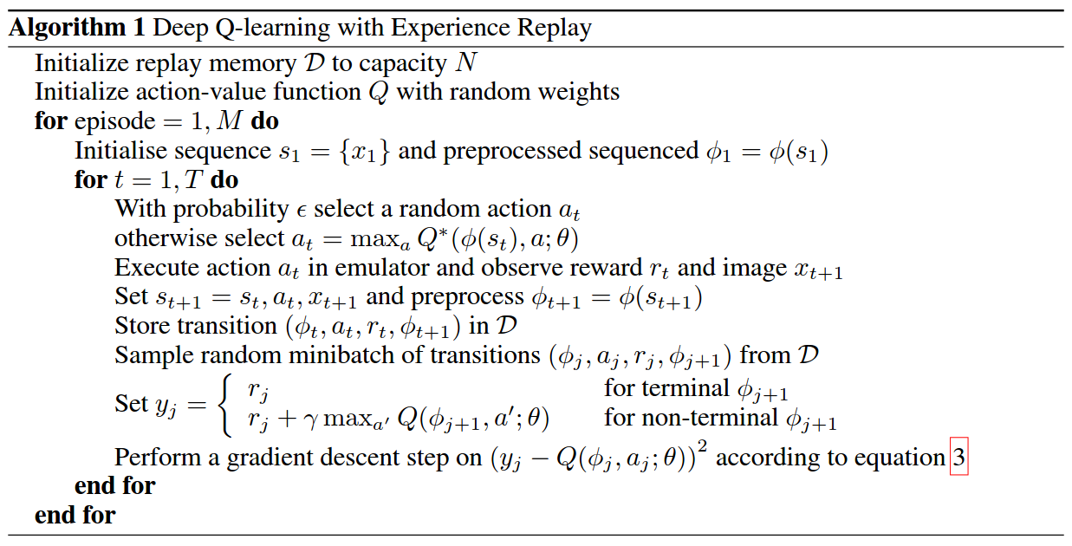
Deep Q-Learning – Algorithm
Algorithm from „Playing Atari with Deep Reinforcement Learning“:

Slide 14
Deep Q-Learning - Implementation
Agent training method:
S
Init. PyGame Learning Environm.
Init. Neural Network and start TF Session
Init. Phi function
Start learning
Restart Game
Choose random action
Update state based values
Make movement
Choose best action
Calculate reward
Update replay memory
Gradient descent
Update state based values

Slide 15
Deep Q-Learning – First results
Last week testing for a short time
-> no good results
This week testing for longer time
-> still no good results
Improvements
-> Debuged the code
-> Change # actions
-> Change input data for training
-> Normalized Screen values
-> Some changes throw exceptions

