Slide 1
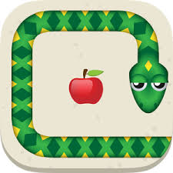
Reinforcement Learning: Snake

Slide 2
Q-Learning
Improve reward function:
def getSmartReward(self, current_state, next_state, reward): if reward == -5: # game over return -5 elif reward == 1: # Snake found apple return 3 else: if self.foodIsNearer(current_state, next_state): # snake goes to apple return 0.5 return 0 # snake goes away from apple def foodIsNearer(self, state1, state2): if (abs(state1["snake_head_x"] - state1["food_x"])
+ abs(state1["snake_head_y"] - state1["food_y"]) > abs(state2["snake_head_x"] - state2["food_x"]) + abs(state2["snake_head_y"] - state2["food_y"])): return True else: return False

Slide 3
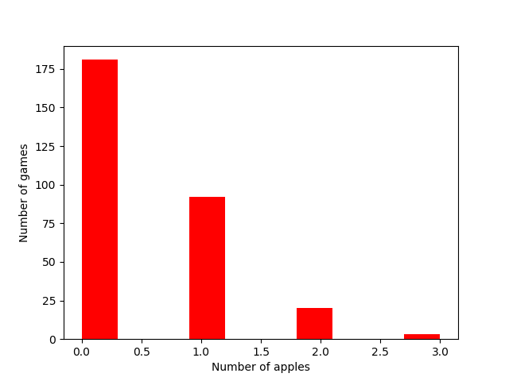
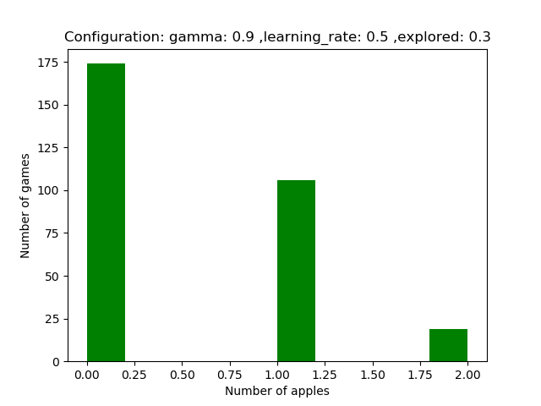
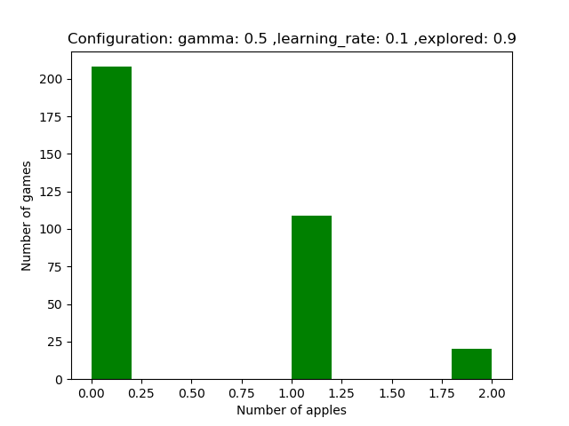
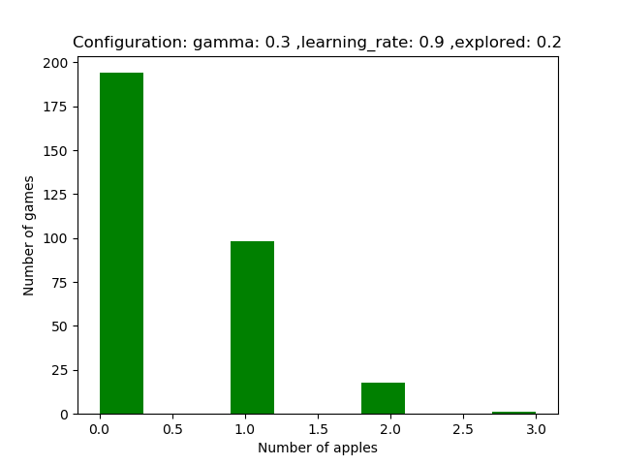
Different configurations

Slide 4
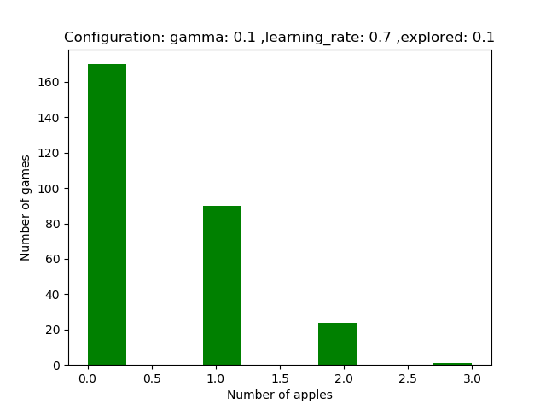

Different configurations
Number of Frames: 100000
(for traning and testing)

Slide 5
Learn for longer time
Configuration:
gamma = 0.5 learner = 0.7 explored = 0.4
Learn for 100000 Frames
Show histogram
Save dictionary in PKL file
Reload PKL-file and learn for the next 100000 Frames

Slide 6
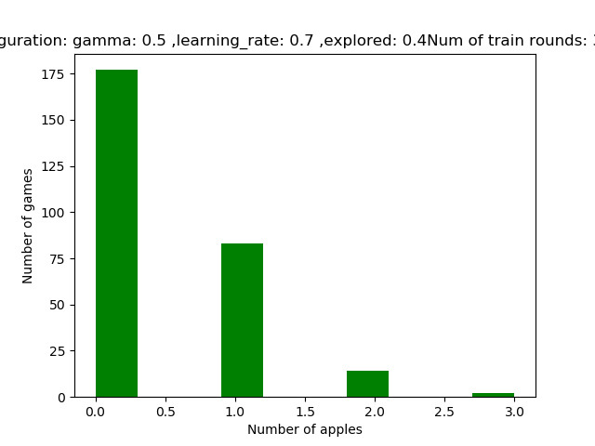
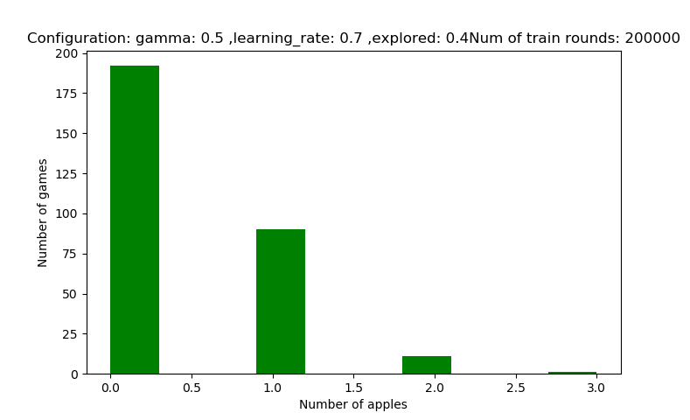
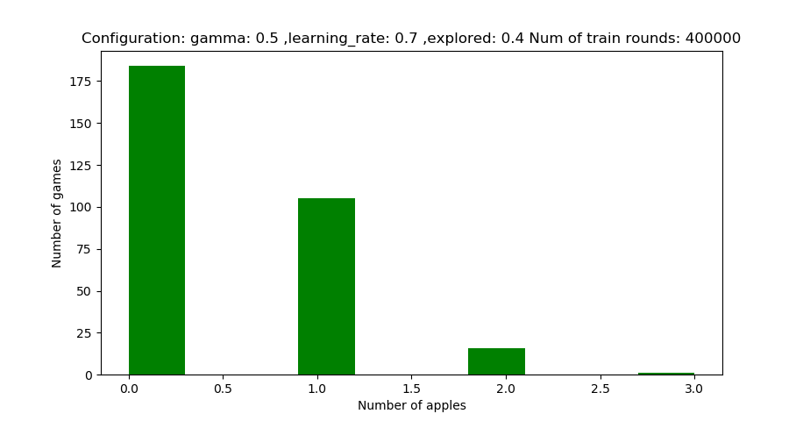
Learn for longer time
100000

Slide 7
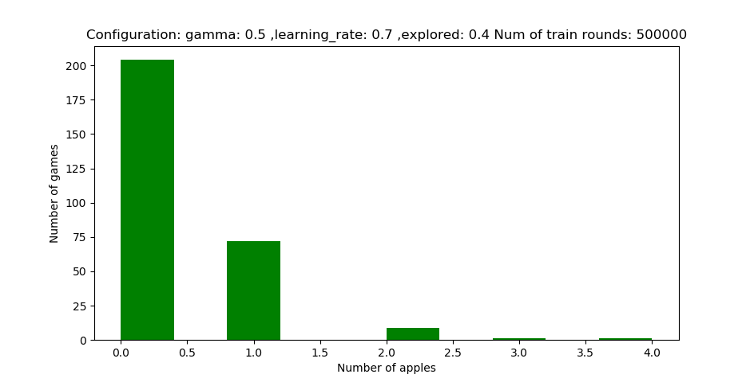
Learn for longer time

Slide 8
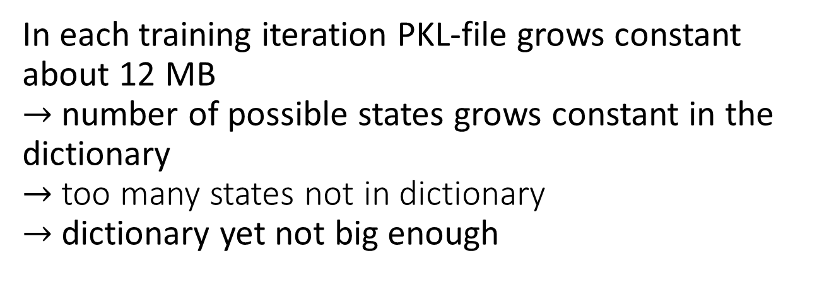
Observation
In each training iteration PKL-file grows constant about 12 MB
$→$number of possible states grows constant in the dictionary
$→$ too many states not in dictionary
$→$ dictionary yet not big enough

Slide 9
Improvement ideas
Reduce number of states
Smaller playground for the snake
Using different base for the dictionary (not screen hash value)
Make a different prime goal. Not eating the food but instead survive.

