Slide 1

Reinforcement Learning: Snake

Slide 2
Deep Q Learning
Changed input data (only black and white)
Network has better output (does not always take the same action)
Training and testing now based on a given time
Training:
1/3 of time just random actions
1/3 of time random actions + network
1/3 of time just network

Slide 3
First observation
Train network for 1h (gamma=0.5,explore=0.5)
Interesting result:
snake get stuck in a movement pattern (just survives do not catch an apple)
try to avoid this behavior
change reward function with new values

Slide 4
First observation
Old reward function
Snake gets apple=1
Dies=0
Moves to apple=0.7
Moves away from apple=0.2
New reward function:
Snake gets apple=1
Dies=0
Moves to apple=0.2
Moves away from apple=0.1
No significant changing in the behavior
Focus on size of snake and apple

Slide 5
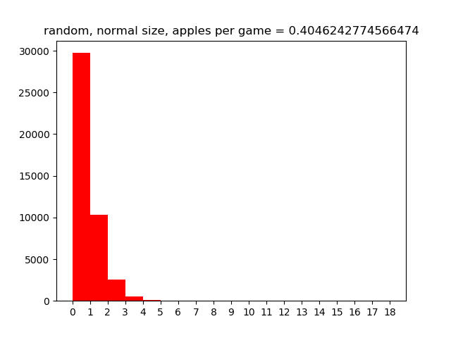
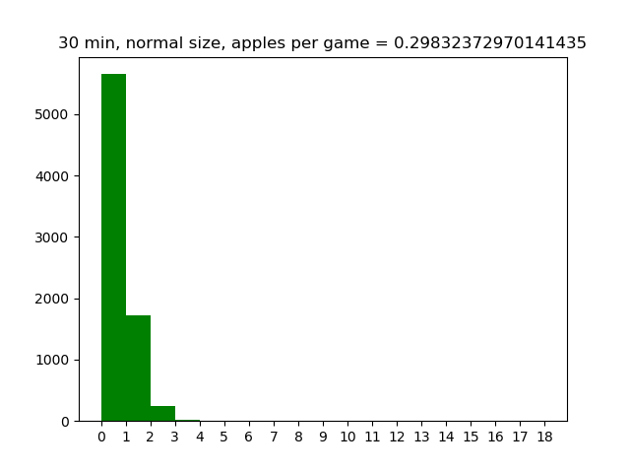
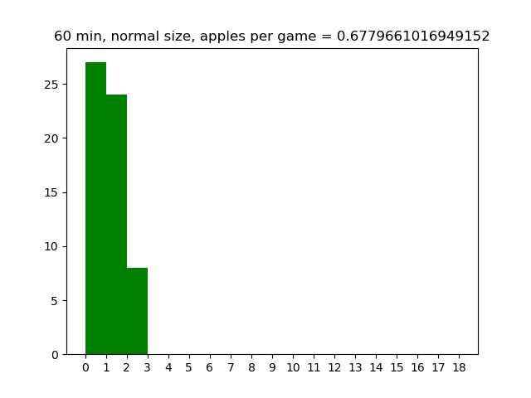
5 min testing
Red ≙ random player
Green ≙ deep-q player
X-Axis ≙ cached apples
Y-Axis ≙ number of games

Slide 6
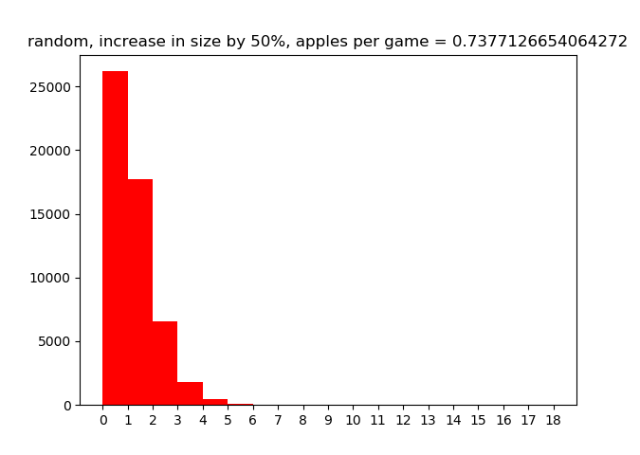
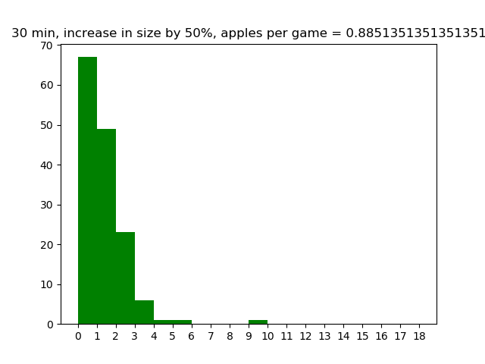
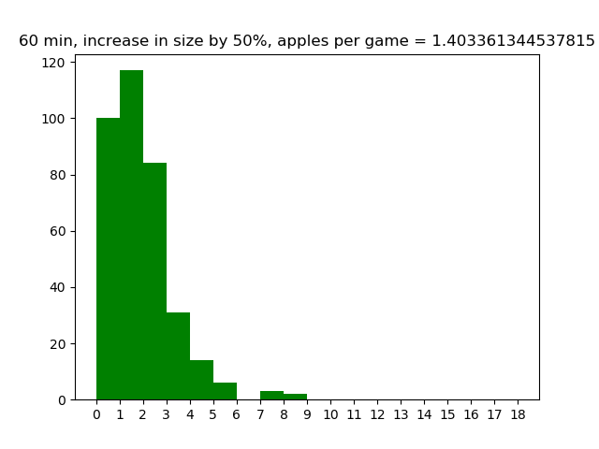

Slide 7
