Slide 1
cs5460/6460 Lecture 05: Linking and Loading
Anton Burtsev
January, 2024

Slide 2
What is inside a program?
What parts do we need to run code?

Slide 3
Parts needed to run a program
Code itself
By convention it's called text
Stack
To call functions
Space for variables

Slide 4
What types of variables do you know?
Global variables
Initialized → data section
Uninitalized → BSS
Local variables
Stack
Dynamic variables
Heap

Slide 5
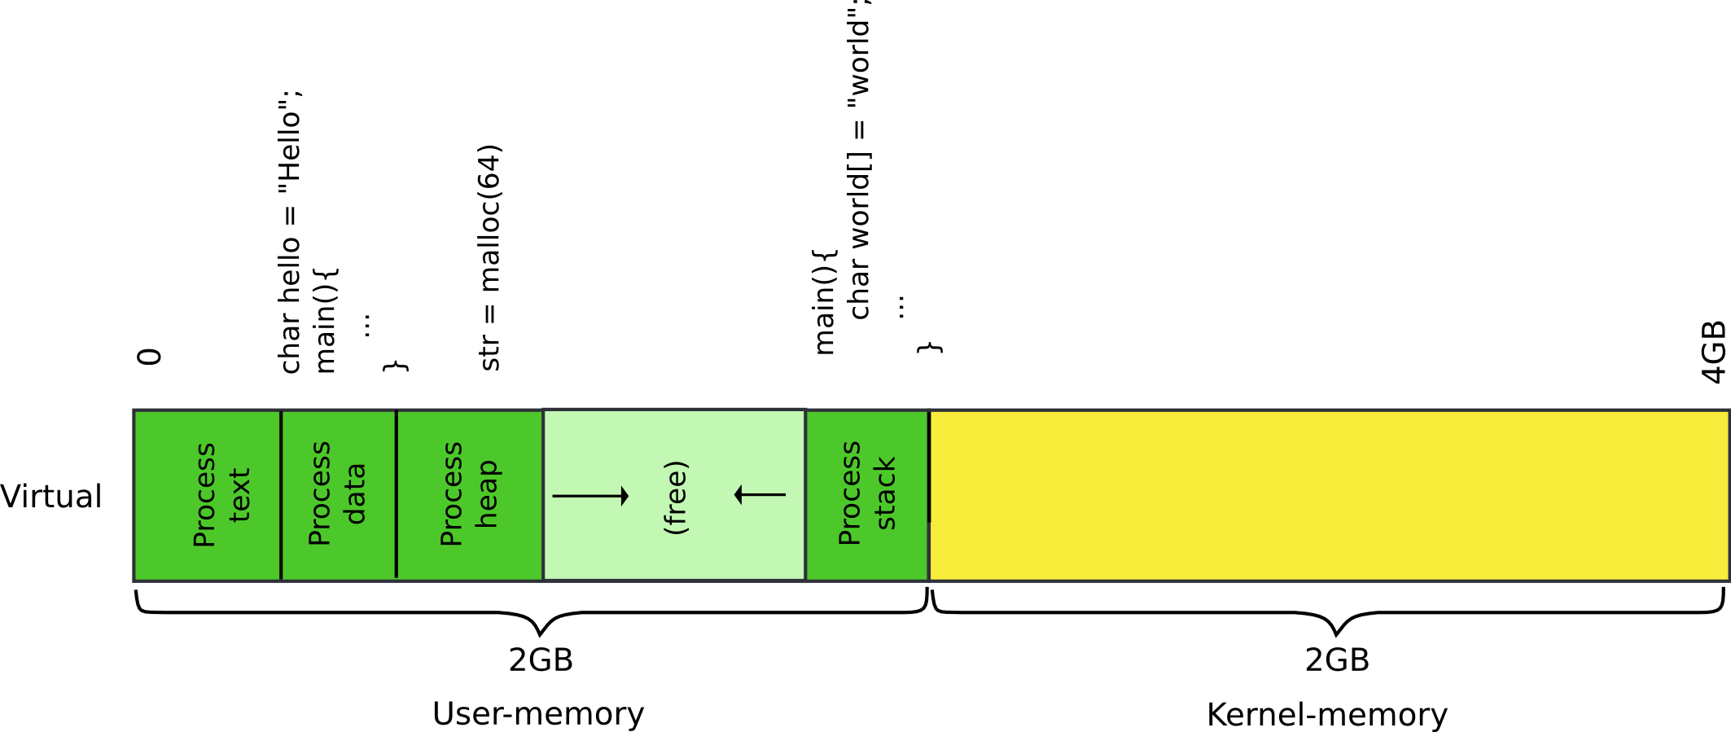
Memory layout of a process

Slide 6
Where do these areas come from?

Slide 7
Memory layout of a process
OS kernel
Compiler and linker

Slide 8
Example program
Compute 5 + 6
#include <stdio.h>
int main(int ac, char **av)
{
int a = 5, b = 6;
return a + b;
}
We build it like
I'm on 64 bit system, but want 32bit code, hence -m32
-fno-pic – disables position independent code
gcc -m32 -fno-pic hello-int.c

Slide 9
objdump -sd a.out
GCC syntax, i.e. mov %esp, %ebp // EBP = ESP
a.out: file format elf32-i386
Contents of section .text:
80483e0 d0c9e979 ffffff90 e973ffff ff5589e5 ...y.....s...U..
80483f0 83ec10c7 45f80500 0000c745 fc060000 ....E......E....
8048400 008b45fc 8b55f801 d0c9c366 90669090 ..E..U.....f.f..
8048410 555731ff 5653e805 ffffff81 c3e51b00 UW1.VS..........
8048420 0083ec1c 8b6c2430 8db30cff ffffe861 .....l$0.......a
8048430 feffff8d 8308ffff ff29c6c1 fe0285f6 .........)......
Contents of section .rodata:
8048498 03000000 01000200 ........
Contents of section .data:
804a014 00000000 00000000 ........
Disassembly of section .text:
…
080483ed <main>:
80483ed: 55 push %ebp
80483ee: 89 e5 mov %esp,%ebp
80483f0: 83 ec 10 sub $0x10,%esp
80483f3: c7 45 f8 05 00 00 00 movl $0x5,-0x8(%ebp)
80483fa: c7 45 fc 06 00 00 00 movl $0x6,-0x4(%ebp)
8048401: 8b 45 fc mov -0x4(%ebp),%eax
8048404: 8b 55 f8 mov -0x8(%ebp),%edx
8048407: 01 d0 add %edx,%eax
8048409: c9 leave
804840a: c3 ret
804840b: 66 90 xchg %ax,%ax
804840d: 66 90 xchg %ax,%ax
804840f: 90 nop

Slide 10
objdump -sd a.out
a.out: file format elf32-i386
Contents of section .text:
80483e0 d0c9e979 ffffff90 e973ffff ff5589e5 ...y.....s...U..
80483f0 83ec10c7 45f80500 0000c745 fc060000 ....E......E....
8048400 008b45fc 8b55f801 d0c9c366 90669090 ..E..U.....f.f..
8048410 555731ff 5653e805 ffffff81 c3e51b00 UW1.VS..........
8048420 0083ec1c 8b6c2430 8db30cff ffffe861 .....l$0.......a
8048430 feffff8d 8308ffff ff29c6c1 fe0285f6 .........)......
Contents of section .rodata:
8048498 03000000 01000200 ........
Contents of section .data:
804a014 00000000 00000000 ........
Disassembly of section .text:
…
080483ed <main>:
80483ed: 55 push %ebp # Maintain the stack frame
80483ee: 89 e5 mov %esp,%ebp
80483f0: 83 ec 10 sub $0x10,%esp
80483f3: c7 45 f8 05 00 00 00 movl $0x5,-0x8(%ebp)
80483fa: c7 45 fc 06 00 00 00 movl $0x6,-0x4(%ebp)
8048401: 8b 45 fc mov -0x4(%ebp),%eax
8048404: 8b 55 f8 mov -0x8(%ebp),%edx
8048407: 01 d0 add %edx,%eax
8048409: c9 leave
804840a: c3 ret
804840b: 66 90 xchg %ax,%ax
804840d: 66 90 xchg %ax,%ax
804840f: 90 nop

Slide 11
objdump -sd a.out
a.out: file format elf32-i386
Contents of section .text:
80483e0 d0c9e979 ffffff90 e973ffff ff5589e5 ...y.....s...U..
80483f0 83ec10c7 45f80500 0000c745 fc060000 ....E......E....
8048400 008b45fc 8b55f801 d0c9c366 90669090 ..E..U.....f.f..
8048410 555731ff 5653e805 ffffff81 c3e51b00 UW1.VS..........
8048420 0083ec1c 8b6c2430 8db30cff ffffe861 .....l$0.......a
8048430 feffff8d 8308ffff ff29c6c1 fe0285f6 .........)......
Contents of section .rodata:
8048498 03000000 01000200 ........
Contents of section .data:
804a014 00000000 00000000 ........
Disassembly of section .text:
…
080483ed <main>:
80483ed: 55 push %ebp
80483ee: 89 e5 mov %esp,%ebp
80483f0: 83 ec 10 sub $0x10,%esp # Allocate space for a and b
80483f3: c7 45 f8 05 00 00 00 movl $0x5,-0x8(%ebp)
80483fa: c7 45 fc 06 00 00 00 movl $0x6,-0x4(%ebp)
8048401: 8b 45 fc mov -0x4(%ebp),%eax
8048404: 8b 55 f8 mov -0x8(%ebp),%edx
8048407: 01 d0 add %edx,%eax
8048409: c9 leave
804840a: c3 ret
804840b: 66 90 xchg %ax,%ax
804840d: 66 90 xchg %ax,%ax
804840f: 90 nop

Slide 12
objdump -sd a.out
a.out: file format elf32-i386
Contents of section .text:
80483e0 d0c9e979 ffffff90 e973ffff ff5589e5 ...y.....s...U..
80483f0 83ec10c7 45f80500 0000c745 fc060000 ....E......E....
8048400 008b45fc 8b55f801 d0c9c366 90669090 ..E..U.....f.f..
8048410 555731ff 5653e805 ffffff81 c3e51b00 UW1.VS..........
8048420 0083ec1c 8b6c2430 8db30cff ffffe861 .....l$0.......a
8048430 feffff8d 8308ffff ff29c6c1 fe0285f6 .........)......
Contents of section .rodata:
8048498 03000000 01000200 ........
Contents of section .data:
804a014 00000000 00000000 ........
Disassembly of section .text:
…
080483ed <main>:
80483ed: 55 push %ebp
80483ee: 89 e5 mov %esp,%ebp
80483f0: 83 ec 10 sub $0x10,%esp # Allocate space for a and b
80483f3: c7 45 f8 05 00 00 00 movl $0x5,-0x8(%ebp)
80483fa: c7 45 fc 06 00 00 00 movl $0x6,-0x4(%ebp)
8048401: 8b 45 fc mov -0x4(%ebp),%eax
8048404: 8b 55 f8 mov -0x8(%ebp),%edx
8048407: 01 d0 add %edx,%eax
8048409: c9 leave
804840a: c3 ret
804840b: 66 90 xchg %ax,%ax
804840d: 66 90 xchg %ax,%ax
804840f: 90 nop

Slide 13
objdump -sd a.out
a.out: file format elf32-i386
Contents of section .text:
80483e0 d0c9e979 ffffff90 e973ffff ff5589e5 ...y.....s...U..
80483f0 83ec10c7 45f80500 0000c745 fc060000 ....E......E....
8048400 008b45fc 8b55f801 d0c9c366 90669090 ..E..U.....f.f..
8048410 555731ff 5653e805 ffffff81 c3e51b00 UW1.VS..........
8048420 0083ec1c 8b6c2430 8db30cff ffffe861 .....l$0.......a
8048430 feffff8d 8308ffff ff29c6c1 fe0285f6 .........)......
Contents of section .rodata:
8048498 03000000 01000200 ........
Contents of section .data:
804a014 00000000 00000000 ........
Disassembly of section .text:
…
080483ed <main>:
80483ed: 55 push %ebp
80483ee: 89 e5 mov %esp,%ebp
80483f0: 83 ec 10 sub $0x10,%esp
80483f3: c7 45 f8 05 00 00 00 movl $0x5,-0x8(%ebp) # Initialize a = 5
80483fa: c7 45 fc 06 00 00 00 movl $0x6,-0x4(%ebp) # Initialize b = 6
8048401: 8b 45 fc mov -0x4(%ebp),%eax
8048404: 8b 55 f8 mov -0x8(%ebp),%edx
8048407: 01 d0 add %edx,%eax
8048409: c9 leave
804840a: c3 ret
804840b: 66 90 xchg %ax,%ax
804840d: 66 90 xchg %ax,%ax
804840f: 90 nop

Slide 14
objdump -sd a.out
a.out: file format elf32-i386
Contents of section .text:
80483e0 d0c9e979 ffffff90 e973ffff ff5589e5 ...y.....s...U..
80483f0 83ec10c7 45f80500 0000c745 fc060000 ....E......E....
8048400 008b45fc 8b55f801 d0c9c366 90669090 ..E..U.....f.f..
8048410 555731ff 5653e805 ffffff81 c3e51b00 UW1.VS..........
8048420 0083ec1c 8b6c2430 8db30cff ffffe861 .....l$0.......a
8048430 feffff8d 8308ffff ff29c6c1 fe0285f6 .........)......
Contents of section .rodata:
8048498 03000000 01000200 ........
Contents of section .data:
804a014 00000000 00000000 ........
Disassembly of section .text:
…
080483ed <main>:
80483ed: 55 push %ebp
80483ee: 89 e5 mov %esp,%ebp
80483f0: 83 ec 10 sub $0x10,%esp
80483f3: c7 45 f8 05 00 00 00 movl $0x5,-0x8(%ebp) # Initialize a = 5
80483fa: c7 45 fc 06 00 00 00 movl $0x6,-0x4(%ebp) # Initialize b = 6
8048401: 8b 45 fc mov -0x4(%ebp),%eax
8048404: 8b 55 f8 mov -0x8(%ebp),%edx
8048407: 01 d0 add %edx,%eax
8048409: c9 leave
804840a: c3 ret
804840b: 66 90 xchg %ax,%ax
804840d: 66 90 xchg %ax,%ax
804840f: 90 nop

Slide 15
objdump -sd a.out
a.out: file format elf32-i386
Contents of section .text:
80483e0 d0c9e979 ffffff90 e973ffff ff5589e5 ...y.....s...U..
80483f0 83ec10c7 45f80500 0000c745 fc060000 ....E......E....
8048400 008b45fc 8b55f801 d0c9c366 90669090 ..E..U.....f.f..
8048410 555731ff 5653e805 ffffff81 c3e51b00 UW1.VS..........
8048420 0083ec1c 8b6c2430 8db30cff ffffe861 .....l$0.......a
8048430 feffff8d 8308ffff ff29c6c1 fe0285f6 .........)......
Contents of section .rodata:
8048498 03000000 01000200 ........
Contents of section .data:
804a014 00000000 00000000 ........
Disassembly of section .text:
…
080483ed <main>:
80483ed: 55 push %ebp
80483ee: 89 e5 mov %esp,%ebp
80483f0: 83 ec 10 sub $0x10,%esp
80483f3: c7 45 f8 05 00 00 00 movl $0x5,-0x8(%ebp) # Initialize a = 5
80483fa: c7 45 fc 06 00 00 00 movl $0x6,-0x4(%ebp) # Initialize b = 6
8048401: 8b 45 fc mov -0x4(%ebp),%eax
8048404: 8b 55 f8 mov -0x8(%ebp),%edx
8048407: 01 d0 add %edx,%eax
8048409: c9 leave
804840a: c3 ret
804840b: 66 90 xchg %ax,%ax
804840d: 66 90 xchg %ax,%ax
804840f: 90 nop

Slide 16
objdump -sd a.out
a.out: file format elf32-i386
Contents of section .text:
80483e0 d0c9e979 ffffff90 e973ffff ff5589e5 ...y.....s...U..
80483f0 83ec10c7 45f80500 0000c745 fc060000 ....E......E....
8048400 008b45fc 8b55f801 d0c9c366 90669090 ..E..U.....f.f..
8048410 555731ff 5653e805 ffffff81 c3e51b00 UW1.VS..........
8048420 0083ec1c 8b6c2430 8db30cff ffffe861 .....l$0.......a
8048430 feffff8d 8308ffff ff29c6c1 fe0285f6 .........)......
Contents of section .rodata:
8048498 03000000 01000200 ........
Contents of section .data:
804a014 00000000 00000000 ........
Disassembly of section .text:
…
080483ed <main>:
80483ed: 55 push %ebp
80483ee: 89 e5 mov %esp,%ebp
80483f0: 83 ec 10 sub $0x10,%esp
80483f3: c7 45 f8 05 00 00 00 movl $0x5,-0x8(%ebp)
80483fa: c7 45 fc 06 00 00 00 movl $0x6,-0x4(%ebp)
8048401: 8b 45 fc mov -0x4(%ebp),%eax # Move b into %eax
8048404: 8b 55 f8 mov -0x8(%ebp),%edx # Move a into %edx
8048407: 01 d0 add %edx,%eax
8048409: c9 leave
804840a: c3 ret
804840b: 66 90 xchg %ax,%ax
804840d: 66 90 xchg %ax,%ax
804840f: 90 nop

Slide 17
objdump -sd a.out
a.out: file format elf32-i386
Contents of section .text:
80483e0 d0c9e979 ffffff90 e973ffff ff5589e5 ...y.....s...U..
80483f0 83ec10c7 45f80500 0000c745 fc060000 ....E......E....
8048400 008b45fc 8b55f801 d0c9c366 90669090 ..E..U.....f.f..
8048410 555731ff 5653e805 ffffff81 c3e51b00 UW1.VS..........
8048420 0083ec1c 8b6c2430 8db30cff ffffe861 .....l$0.......a
8048430 feffff8d 8308ffff ff29c6c1 fe0285f6 .........)......
Contents of section .rodata:
8048498 03000000 01000200 ........
Contents of section .data:
804a014 00000000 00000000 ........
Disassembly of section .text:
…
080483ed <main>:
80483ed: 55 push %ebp
80483ee: 89 e5 mov %esp,%ebp
80483f0: 83 ec 10 sub $0x10,%esp
80483f3: c7 45 f8 05 00 00 00 movl $0x5,-0x8(%ebp)
80483fa: c7 45 fc 06 00 00 00 movl $0x6,-0x4(%ebp)
8048401: 8b 45 fc mov -0x4(%ebp),%eax
8048404: 8b 55 f8 mov -0x8(%ebp),%edx
8048407: 01 d0 add %edx,%eax # a + b
8048409: c9 leave
804840a: c3 ret
804840b: 66 90 xchg %ax,%ax
804840d: 66 90 xchg %ax,%ax
804840f: 90 nop

Slide 18
objdump -sd a.out
a.out: file format elf32-i386
Contents of section .text:
80483e0 d0c9e979 ffffff90 e973ffff ff5589e5 ...y.....s...U..
80483f0 83ec10c7 45f80500 0000c745 fc060000 ....E......E....
8048400 008b45fc 8b55f801 d0c9c366 90669090 ..E..U.....f.f..
8048410 555731ff 5653e805 ffffff81 c3e51b00 UW1.VS..........
8048420 0083ec1c 8b6c2430 8db30cff ffffe861 .....l$0.......a
8048430 feffff8d 8308ffff ff29c6c1 fe0285f6 .........)......
Contents of section .rodata:
8048498 03000000 01000200 ........
Contents of section .data:
804a014 00000000 00000000 ........
Disassembly of section .text:
…
080483ed <main>:
80483ed: 55 push %ebp
80483ee: 89 e5 mov %esp,%ebp
80483f0: 83 ec 10 sub $0x10,%esp
80483f3: c7 45 f8 05 00 00 00 movl $0x5,-0x8(%ebp)
80483fa: c7 45 fc 06 00 00 00 movl $0x6,-0x4(%ebp)
8048401: 8b 45 fc mov -0x4(%ebp),%eax
8048404: 8b 55 f8 mov -0x8(%ebp),%edx
8048407: 01 d0 add %edx,%eax
8048409: c9 leave # Pop the frame ESP = EBP
804840a: c3 ret # return
804840b: 66 90 xchg %ax,%ax
804840d: 66 90 xchg %ax,%ax
804840f: 90 nop

Slide 19
objdump -sd a.out
a.out: file format elf32-i386
Contents of section .text:
80483e0 d0c9e979 ffffff90 e973ffff ff5589e5 ...y.....s...U..
80483f0 83ec10c7 45f80500 0000c745 fc060000 ....E......E....
8048400 008b45fc 8b55f801 d0c9c366 90669090 ..E..U.....f.f..
8048410 555731ff 5653e805 ffffff81 c3e51b00 UW1.VS..........
8048420 0083ec1c 8b6c2430 8db30cff ffffe861 .....l$0.......a
8048430 feffff8d 8308ffff ff29c6c1 fe0285f6 .........)......
Contents of section .rodata:
8048498 03000000 01000200 ........
Contents of section .data:
804a014 00000000 00000000 ........
Disassembly of section .text:
…
080483ed <main>:
80483ed: 55 push %ebp
80483ee: 89 e5 mov %esp,%ebp
80483f0: 83 ec 10 sub $0x10,%esp
80483f3: c7 45 f8 05 00 00 00 movl $0x5,-0x8(%ebp)
80483fa: c7 45 fc 06 00 00 00 movl $0x6,-0x4(%ebp)
8048401: 8b 45 fc mov -0x4(%ebp),%eax
8048404: 8b 55 f8 mov -0x8(%ebp),%edx
8048407: 01 d0 add %edx,%eax
8048409: c9 leave
804840a: c3 ret
804840b: 66 90 xchg %ax,%ax
804840d: 66 90 xchg %ax,%ax
804840f: 90 nop
What’s this?
Poll

Slide 20
objdump -sd a.out
a.out: file format elf32-i386
Contents of section .text:
80483e0 d0c9e979 ffffff90 e973ffff ff5589e5 ...y.....s...U..
80483f0 83ec10c7 45f80500 0000c745 fc060000 ....E......E....
8048400 008b45fc 8b55f801 d0c9c366 90669090 ..E..U.....f.f..
8048410 555731ff 5653e805 ffffff81 c3e51b00 UW1.VS..........
8048420 0083ec1c 8b6c2430 8db30cff ffffe861 .....l$0.......a
8048430 feffff8d 8308ffff ff29c6c1 fe0285f6 .........)......
Contents of section .rodata:
8048498 03000000 01000200 ........
Contents of section .data:
804a014 00000000 00000000 ........
Disassembly of section .text:
…
080483ed <main>:
80483ed: 55 push %ebp
80483ee: 89 e5 mov %esp,%ebp
80483f0: 83 ec 10 sub $0x10,%esp
80483f3: c7 45 f8 05 00 00 00 movl $0x5,-0x8(%ebp)
80483fa: c7 45 fc 06 00 00 00 movl $0x6,-0x4(%ebp)
8048401: 8b 45 fc mov -0x4(%ebp),%eax
8048404: 8b 55 f8 mov -0x8(%ebp),%edx
8048407: 01 d0 add %edx,%eax
8048409: c9 leave
804840a: c3 ret
804840b: 66 90 xchg %ax,%ax # Code alignment
804840d: 66 90 xchg %ax,%ax # 2 byte no op
804840f: 90 nop # 1 byte no op

Slide 21
“Optimizing subroutines in assembly language” by Agner Fog: https://www.agner.org/optimize/optimizing_assembly.pdf
11.5 Alignment of code
Most microprocessors fetch code in aligned 16-byte or 32-byte blocks. If an important subroutine entry or jump label happens to be near the end of a 16-byte block then the microprocessor will only get a few useful bytes of code when fetching that block of code. It may have to fetch the next 16 bytes too before it can decode the first instructions after the label. This can be avoided by aligning important subroutine entries and loop entries by 16.
...
Aligning a subroutine entry is as simple as putting as many NOP 's as needed before the subroutine entry to make the address divisible by 8, 16, 32 or 64, as desired.

Slide 22
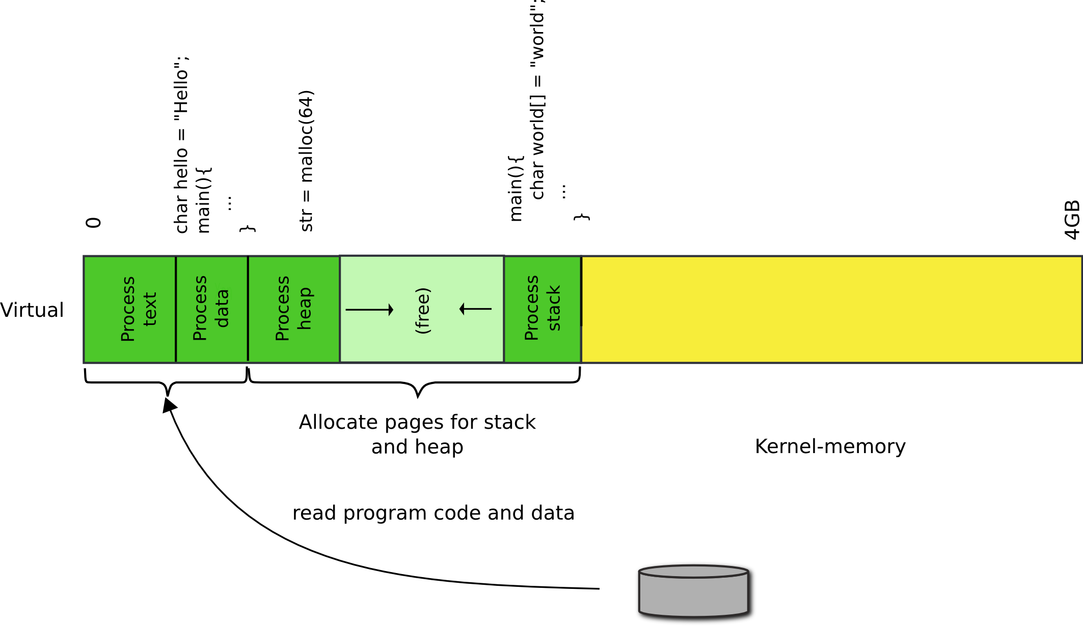
Load program in memory

Slide 23
We build programs from multiple files
_{Part of the xv6 Makefile}
bootblock: bootasm.S bootmain.c
$(CC) $(CFLAGS) -fno-pic -O -nostdinc -I. -c bootmain.c
$(CC) $(CFLAGS) -fno-pic -nostdinc -I. -c bootasm.S
$(LD) $(LDFLAGS) -N -e start -Ttext 0x7C00 -o bootblock.o bootasm.o bootmain.o
$(OBJDUMP) -S bootblock.o > bootblock.asm
$(OBJCOPY) -S -O binary -j .text bootblock.o bootblock
./sign.pl bootblock

Slide 24
Linking and Loading

Slide 25
Linking and loading
Linking
Combining multiple code modules into a single executable
E.g., use standard libraries in your own code
Loading
Process of getting an executable running on the machine

Slide 26
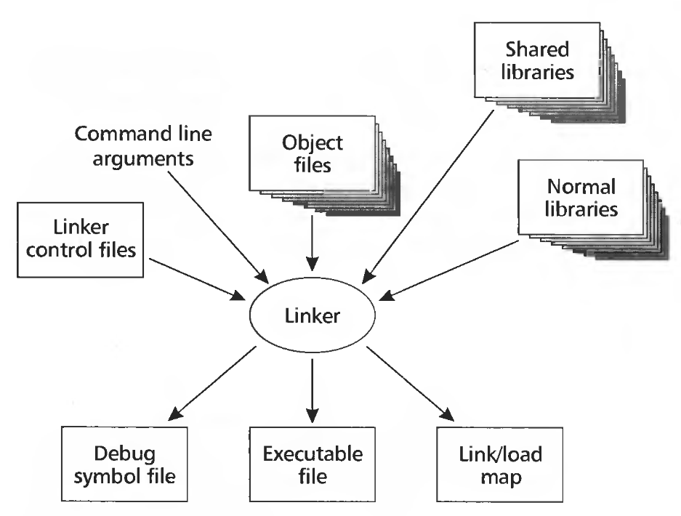

Slide 27
Input: object files (code modules)
Each object file contains
A set of segments
Code
Data
A symbol table
Imported & exported symbols
Output: executable file, library, etc.

Slide 28
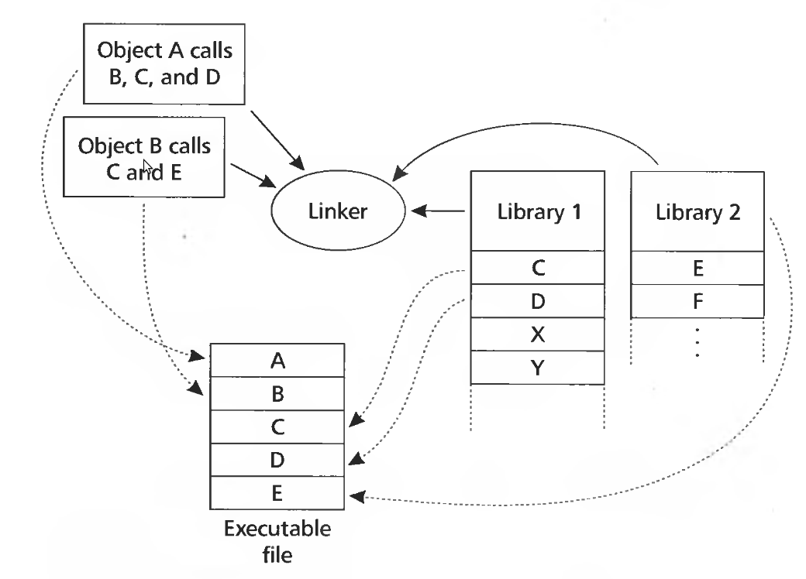

Slide 29
Why linking?

Slide 30
Why linking?
Modularity
Program can be written as a collection of modules
We can build libraries of common functions
Efficiency
Code compilation
Change one source file, recompile it, and re-link the executable
Space efficiency
Share common code across executable files
On disk and in memory

Slide 31
Two path process
Path 1: scan input files
Identify boundaries of each segment
Collect all defined and undefined symbol information
Determine sizes and locations of each segment
Path 2
Adjust memory addresses in code and data to reflect relocated segment addresses

Slide 32
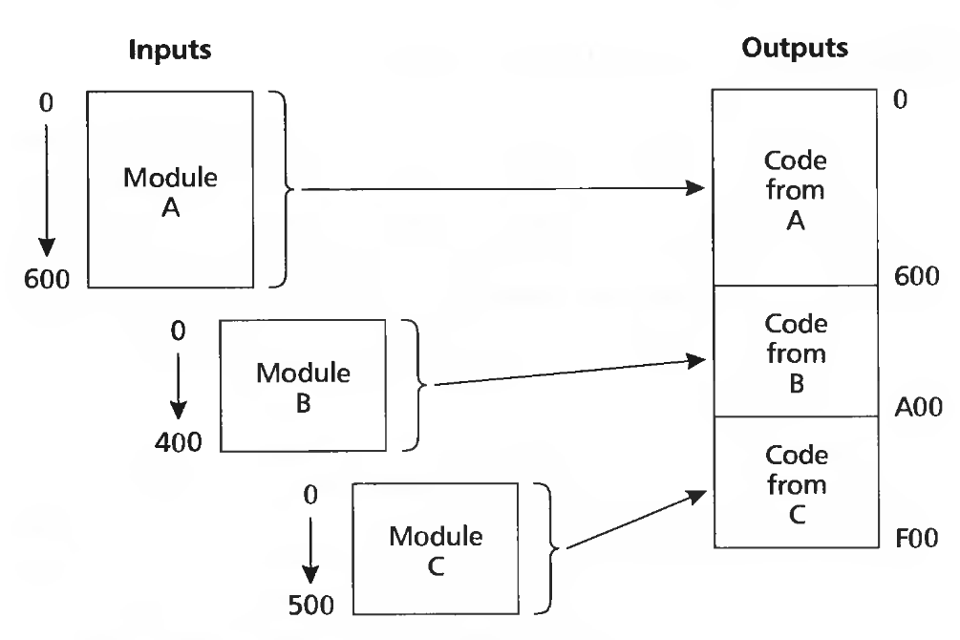
Multiple object files

Slide 33
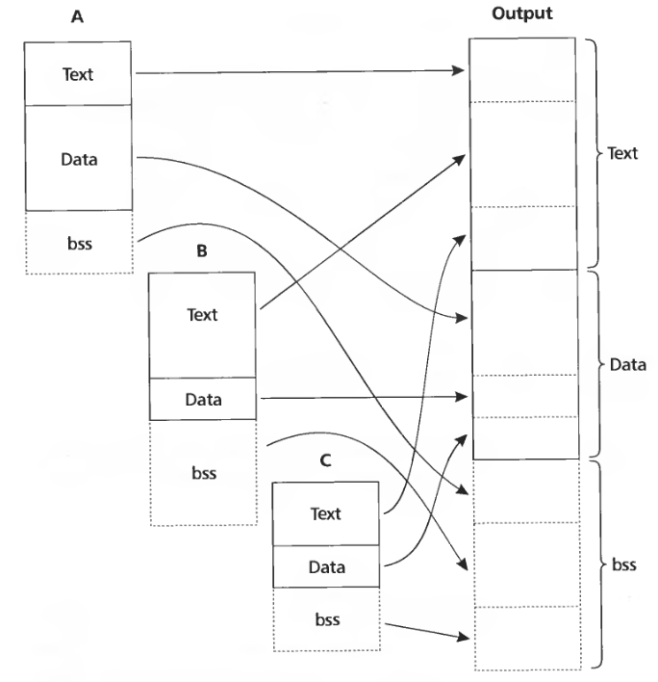
Merging segments

Slide 34
What needs to be done to merge (or move) code in memory?

Slide 35
Relocation

Slide 36
Example
Save a into b, e.g., b = a
mov a, %eax
mov %eax, b
Generated code
a is defined in the same file at 0x1234, b is imported
Each instruction is 1 byte opcode + 4 bytes address
A1 34 12 00 00 mov a, %eax
A3 00 00 00 00 mov %eax, b

Slide 37
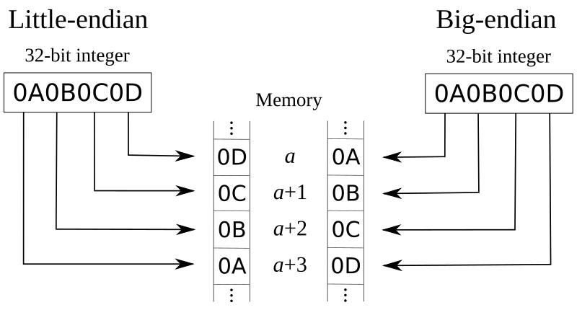
Example
Save a into b, e.g., b = a
mov a, %eax
mov %eax, b
Generated code
a is defined in the same file at 0x1234, b is imported
Each instruction is 1 byte opcode + 4 bytes address
A1 34 12 00 00 mov a, %eax
A3 00 00 00 00 mov %eax, b
One-byte opcode

Slide 38
Example
Save a into b, e.g., b = a
mov a, %eax
mov %eax, b
Generated code
a is defined in the same file at 0x1234, b is imported
Each instruction is 1 byte opcode + 4 bytes address
A1 34 12 00 00 mov a, %eax
A3 00 00 00 00 mov %eax, b
Four-byte address

Slide 39
Example
Save a into b, e.g., b = a
mov a, %eax
mov %eax, b
Generated code:
a is defined in the same file at 0x1234, b is imported
Each instruction is 1 byte opcode + 4 bytes address
A1 34 12 00 00 mov a, %eax
A3 00 00 00 00 mov %eax, b
b is imported, we don’t know the address

Slide 40
Example
Save a into b, e.g., b = a
mov a, %eax
mov %eax, b
Generated code
a is defined in the same file at 0x1234, b is imported
Each instruction is 1 byte opcode + 4 bytes address
A1 34 12 00 00 mov a, %eax
A3 00 00 00 00 mov %eax, b
Assume that a is relocated by 0x10000 bytes, and b is found at 0x9a12
A1 34 12 01 00 mov a,%eax
A3 12 9A 00 00 mov %eax,b

Slide 41
Example
Save a into b, e.g., b = a
mov a, %eax
mov %eax, b
Generated code
a is defined in the same file at 0x1234, b is imported
Each instruction is 1 byte opcode + 4 bytes address
A1 34 12 00 00 mov a, %eax
A3 00 00 00 00 mov %eax, b
Assume that a is relocated by 0x10000 bytes, and b is found at 0x9a12
A1 34 12 01 00 mov a,%eax
A3 12 9A 00 00 mov %eax,b

Slide 42
More realistic example
Source file m.c
extern void a(char *);
int main(int ac, char **av)
{
static char string[] = "Hello, world!\n";
a(string);
}
Source file a.c
#include <unistd.h>
#include <string.h>
void a(char *s)
{
write(1, s, strlen(s));
}

Slide 43
More realistic example
Source file m.c
extern void a(char *);
int main(int ac, char **av)
{
static char string[] = "Hello, world!\n";
a(string);
}
Source file a.c
#include <unistd.h>
#include <string.h>
void a(char *s)
{
write(1, s, strlen(s));
}

Slide 44
More realistic example
Source file m.c
extern void a(char *);
int main(int ac, char **av)
{
static char string[] = "Hello, world!\n";
a(string);
}
Source file a.c
#include <unistd.h>
#include <string.h>
void a(char *s)
{
write(1, s, strlen(s));
}

Slide 45
More realistic example
Sections:
Idx Name Size VMA LMA File off Algn
0 .text 00000010 00000000 00000000 00000020 2**3
1 .data 00000010 00000010 00000010 00000030 2**3
Disassembly of section .text:
00000000 <_main>:
0: 55 pushl %ebp
1: 89 e5 movl %esp,%ebp
3: 68 10 00 00 00 pushl $0x10
4: 32 .data
8: e8 f3 ff ff ff call 0
9: DISP32 _a
d: c9 leave
e: c3 ret
...

Slide 46
More realistic example
Two sections:
Text (0x10 – 16 bytes)
Data (16 bytes)
Sections:
Idx Name Size VMA LMA File off Algn
0 .text 00000010 00000000 00000000 00000020 2**3
1 .data 00000010 00000010 00000010 00000030 2**3
Disassembly of section .text:
00000000 <_main>:
0: 55 pushl %ebp
1: 89 e5 movl %esp,%ebp
3: 68 10 00 00 00 pushl $0x10
4: 32 .data
8: e8 f3 ff ff ff call 0
9: DISP32 _a
d: c9 leave
e: c3 ret
...

Slide 47
More realistic example
Two sections:
Text starts at 0x0
Data is at 0x10
Sections:
Idx Name Size VMA LMA File off Algn
0 .text 00000010 00000000 00000000 00000020 2**3
1 .data 00000010 00000010 00000010 00000030 2**3
Disassembly of section .text:
00000000 <_main>:
0: 55 pushl %ebp
1: 89 e5 movl %esp,%ebp
3: 68 10 00 00 00 pushl $0x10
4: 32 .data
8: e8 f3 ff ff ff call 0
9: DISP32 _a
d: c9 leave
e: c3 ret
...

Slide 48
More realistic example
Text (code) is disassembled starting from 0x0
Sections:
Idx Name Size VMA LMA File off Algn
0 .text 00000010 00000000 00000000 00000020 2**3
1 .data 00000010 00000010 00000010 00000030 2**3
Disassembly of section .text:
00000000 <_main>:
0: 55 pushl %ebp
1: 89 e5 movl %esp,%ebp
3: 68 10 00 00 00 pushl $0x10
4: 32 .data
8: e8 f3 ff ff ff call 0
9: DISP32 _a
d: c9 leave
e: c3 ret
...

Slide 49
More realistic example
Sections:
Idx Name Size VMA LMA File off Algn
0 .text 00000010 00000000 00000000 00000020 2**3
1 .data 00000010 00000010 00000010 00000030 2**3
Disassembly of section .text:
00000000 <_main>:
0: 55 pushl %ebp
1: 89 e5 movl %esp,%ebp
3: 68 10 00 00 00 pushl $0x10 # push string on the stack
4: 32 .data
8: e8 f3 ff ff ff call 0
9: DISP32 _a
d: c9 leave
e: c3 ret
...
First relocation entry
Marks pushl 0x10
0x10 is beginning of the data section
This is where “Hello world\n” string is stored

Slide 50
More realistic example
Source file m.c
extern void a(char *);
int main(int ac, char **av)
{
static char string[] = "Hello, world!\n";
a(string);
}
Source file a.c
#include <unistd.h>
#include <string.h>
void a(char *s)
{
write(1, s, strlen(s));
}

Slide 51
More realistic example
Sections:
Idx Name Size VMA LMA File off Algn
0 .text 00000010 00000000 00000000 00000020 2**3
1 .data 00000010 00000010 00000010 00000030 2**3
Disassembly of section .text:
00000000 <_main>:
0: 55 pushl %ebp
1: 89 e5 movl %esp,%ebp
3: 68 10 00 00 00 pushl $0x10
4: 32 .data
8: e8 f3 ff ff ff call 0
9: DISP32 _a
d: c9 leave
e: c3 ret
...
Second relocation entry
Marks call 0x0
a() is external so we don’t know the address

Slide 52
More realistic example
Sections:
Idx Name Size VMA LMA File off Algn
0 .text 00000010 00000000 00000000 00000020 2**3
1 .data 00000010 00000010 00000010 00000030 2**3
Disassembly of section .text:
00000000 <_main>:
0: 55 pushl %ebp
1: 89 e5 movl %esp,%ebp
3: 68 10 00 00 00 pushl $0x10
4: 32 .data
8: e8 f3 ff ff ff call 0
9: DISP32 _a
d: c9 leave
e: c3 ret
...
But why it’s 0xf3ff_ffff ?

Slide 53
More realistic example
Sections:
Idx Name Size VMA LMA File off Algn
0 .text 00000010 00000000 00000000 00000020 2**3
1 .data 00000010 00000010 00000010 00000030 2**3
Disassembly of section .text:
00000000 <_main>:
0: 55 pushl %ebp
1: 89 e5 movl %esp,%ebp
3: 68 10 00 00 00 pushl $0x10
4: 32 .data
8: e8 f3 ff ff ff call 0
9: DISP32 _a
d: c9 leave
e: c3 ret
...
But why it’s 0xf3ff_ffff ?
0x ff ff ff f3 is -13 (-0xd)
-a = ~a + 1

Slide 54
More realistic example
Source file m.c
extern void a(char *);
int main(int ac, char **av)
{
static char string[] = "Hello, world!\n";
a(string);
}
Source file a.c
#include <unistd.h>
#include <string.h>
void a(char *s)
{
write(1, s, strlen(s));
}

Slide 55
More realistic example
Sections:
Idx Name Size VMA LMA File off Algn
0 .text 0000001c 00000000 00000000 00000020 2**2
CONTENTS, ALLOC, LOAD, RELOC, CODE
1 .data 00000000 0000001c 0000001c 0000003c 2**2
CONTENTS, ALLOC, LOAD, DATA
Disassembly of section .text:
00000000 <_a>:
0: 55 pushl %ebp
1: 89 e5 movl %esp,%ebp
3: 53 pushl %ebx
4: 8b 5d 08 movl 0x8(%ebp),%ebx
7: 53 pushl %ebx
8: e8 f3 ff ff ff call 0
9: DISP32 _strlen
d: 50 pushl %eax
e: 53 pushl %ebx
f: 6a 01 pushl $0x1
11: e8 ea ff ff ff call 0
12: DISP32 _write
16: 8d 65 fc leal -4(%ebp),%esp
19: 5b popl %ebx
1a: c9 leave
1b: c3 ret
Two sections:
Text (28 bytes)
Data (0 bytes)

Slide 56
More realistic example
Source file m.c
extern void a(char *);
int main(int ac, char **av)
{
static char string[] = "Hello, world!\n";
a(string);
}
Source file a.c
#include <unistd.h>
#include <string.h>
void a(char *s)
{
write(1, s, strlen(s));
}

Slide 57
Poll: what needs to be relocated?
Source file m.c
extern void a(char *);
int main(int ac, char **av)
{
static char string[] = "Hello, world!\n";
a(string);
}
Source file a.c
#include <unistd.h>
#include <string.h>
void a(char *s)
{
write(1, s, strlen(s));
}

Slide 58
More realistic example
Source file m.c
extern void a(char *);
int main(int ac, char **av)
{
static char string[] = "Hello, world!\n";
a(string);
}
Source file a.c
#include <unistd.h>
#include <string.h>
void a(char *s)
{
write(1, s, strlen(s));
}

Slide 59
More realistic example
Sections:
Idx Name Size VMA LMA File off Algn
0 .text 0000001c 00000000 00000000 00000020 2**2
CONTENTS, ALLOC, LOAD, RELOC, CODE
1 .data 00000000 0000001c 0000001c 0000003c 2**2
CONTENTS, ALLOC, LOAD, DATA
Disassembly of section .text:
00000000 <_a>:
0: 55 pushl %ebp
1: 89 e5 movl %esp,%ebp
3: 53 pushl %ebx
4: 8b 5d 08 movl 0x8(%ebp),%ebx
7: 53 pushl %ebx
8: e8 f3 ff ff ff call 0
9: DISP32 _strlen
d: 50 pushl %eax
e: 53 pushl %ebx
f: 6a 01 pushl $0x1
11: e8 ea ff ff ff call 0
12: DISP32 _write
16: 8d 65 fc leal -4(%ebp),%esp
19: 5b popl %ebx
1a: c9 leave
1b: c3 ret
Two relocation entries:
strlen()
write()

Slide 60
Now we understand how to produce an executable
Combine corresponding segments from each object file
Combined text segment
Combined data segment
(Optional) pad each segment to 4KB to match the page size

Slide 61
Multiple object files

Slide 62
Merging segments

Slide 63
Linked executable
Sections:
Idx Name Size VMA LMA File off Algn
0 .text 00000fe0 00001020 00001020 00000020 2**3
1 .data 00001000 00002000 00002000 00001000 2**3
2 .bss 00000000 00003000 00003000 00000000 2**3
Disassembly of section .text:
00001020 <start-c>:
...
1092: e8 0d 00 00 00 call 10a4 <_main>
...
000010a4 <_main>:
10a7: 68 24 20 00 00 pushl $0x2024
10ac: e8 03 00 00 00 call 10b4 <_a>
...
000010b4 <_a>:
10bc: e8 37 00 00 00 call 10f8 <_strlen>
...
10c3: 6a 01 pushl $0x1
10c5: e8 a2 00 00 00 call 116c <_write>
...
000010f8 <_strlen>:
...
0000116c <_write>:
...
Some init code executes before main()

Slide 64
Linked executable
Sections:
Idx Name Size VMA LMA File off Algn
0 .text 00000fe0 00001020 00001020 00000020 2**3
1 .data 00001000 00002000 00002000 00001000 2**3
2 .bss 00000000 00003000 00003000 00000000 2**3
Disassembly of section .text:
00001020 <start-c>:
...
1092: e8 0d 00 00 00 call 10a4 <_main>
...
000010a4 <_main>:
10a7: 68 24 20 00 00 pushl $0x2024
10ac: e8 03 00 00 00 call 10b4 <_a>
...
000010b4 <_a>:
10bc: e8 37 00 00 00 call 10f8 <_strlen>
...
10c3: 6a 01 pushl $0x1
10c5: e8 a2 00 00 00 call 116c <_write>
...
000010f8 <_strlen>:
...
0000116c <_write>:
...
string is in the .data section which starts at 0x2000

Slide 65
Linked executable
Sections:
Idx Name Size VMA LMA File off Algn
0 .text 00000fe0 00001020 00001020 00000020 2**3
1 .data 00001000 00002000 00002000 00001000 2**3
2 .bss 00000000 00003000 00003000 00000000 2**3
Disassembly of section .text:
00001020 <start-c>:
...
1092: e8 0d 00 00 00 call 10a4 <_main>
...
000010a4 <_main>:
10a7: 68 24 20 00 00 pushl $0x2024
10ac: e8 03 00 00 00 call 10b4 <_a>
...
000010b4 <_a>:
10bc: e8 37 00 00 00 call 10f8 <_strlen>
...
10c3: 6a 01 pushl $0x1
10c5: e8 a2 00 00 00 call 116c <_write>
...
000010f8 <_strlen>:
...
0000116c <_write>:
...
Call a()

Slide 66
Linked executable
Sections:
Idx Name Size VMA LMA File off Algn
0 .text 00000fe0 00001020 00001020 00000020 2**3
1 .data 00001000 00002000 00002000 00001000 2**3
2 .bss 00000000 00003000 00003000 00000000 2**3
Disassembly of section .text:
00001020 <start-c>:
...
1092: e8 0d 00 00 00 call 10a4 <_main>
...
000010a4 <_main>:
10a7: 68 24 20 00 00 pushl $0x2024
10ac: e8 03 00 00 00 call 10b4 <_a>
...
000010b4 <_a>:
10bc: e8 37 00 00 00 call 10f8 <_strlen>
...
10c3: 6a 01 pushl $0x1
10c5: e8 a2 00 00 00 call 116c <_write>
...
000010f8 <_strlen>:
...
0000116c <_write>:
...
Relative to EIP (+3)

Slide 67
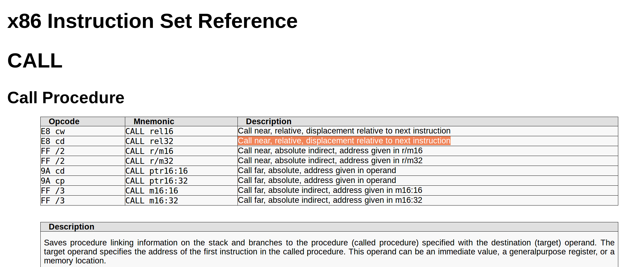
x86 Call instruction

Slide 68
Linked executable
Sections:
Idx Name Size VMA LMA File off Algn
0 .text 00000fe0 00001020 00001020 00000020 2**3
1 .data 00001000 00002000 00002000 00001000 2**3
2 .bss 00000000 00003000 00003000 00000000 2**3
Disassembly of section .text:
00001020 <start-c>:
...
1092: e8 0d 00 00 00 call 10a4 <_main>
...
000010a4 <_main>:
10a7: 68 24 20 00 00 pushl $0x2024
10ac: e8 03 00 00 00 call 10b4 <_a>
...
000010b4 <_a>:
10bc: e8 37 00 00 00 call 10f8 <_strlen>
...
10c3: 6a 01 pushl $0x1
10c5: e8 a2 00 00 00 call 116c <_write>
...
000010f8 <_strlen>:
...
0000116c <_write>:
...
Relative calls to strlen() and write()

Slide 69
Object files (.o)

Slide 70
Object files
Conceptually: five kinds of information
Header: code size, name of the source file, creation date
Object code: binary instruction and data generated by the compiler
Relocation information: list of places in the object code that need to be patched
Symbols: global symbols defined by this module
Symbols to be imported from other modules
Debugging information: source file and file number information, local symbols, data structure description

Slide 71
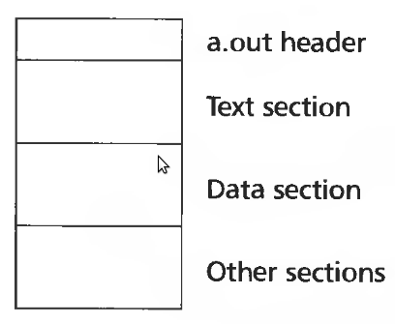
Example: UNIX A.OUT
Small header
Text section
Executable code
Data section
Initial values for static data

Slide 72
A.OUT header
int a_magic; // magic number
int a_text; // text segment size
int a_data; // initialized data size
int a_bss; // uninitialized data size
int a_syms; // symbol table size
int a_entry; // entry point
int a_trsize; // text relocation size
int a_drsize; // data relocation size

Slide 73
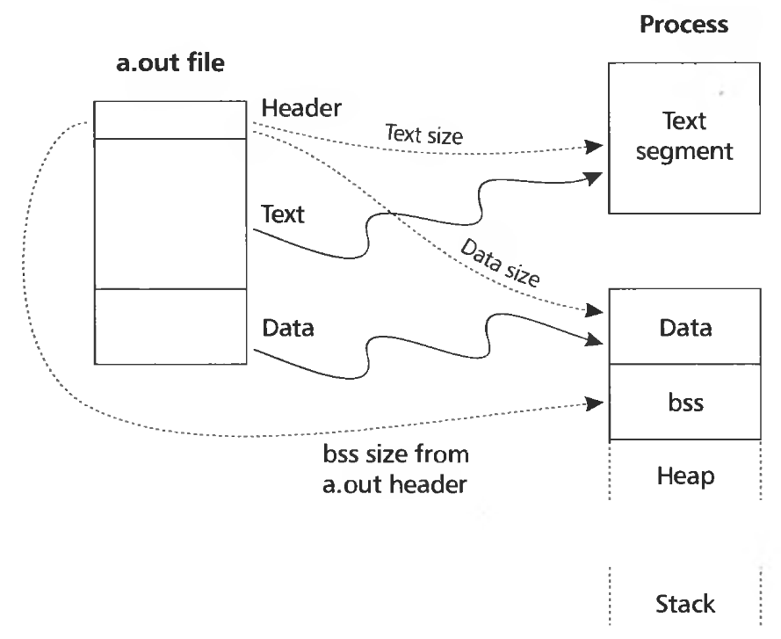
A.OUT loading

Slide 74
A.OUT loading
Read the header to get segment sizes
Check if there is a shareable code segment for this file
If not, create one,
Map into the address space,
Read segment from a file into the address space
Create a private data segment
Large enough for data and BSS
Read data segment, zero out the BSS segment
Create and map stack segment
Place arguments from the command line on the stack
Jump to the entry point

Slide 75
Executable and Linkable Format
(ELF)

Slide 76
Types of object files
Relocatable object files (.o)
Static libraries (.a)
Shared libraries (.so)
Executable files
We looked at A.OUT, but Unix has a general format capable to hold all of these files
ELF

Slide 77
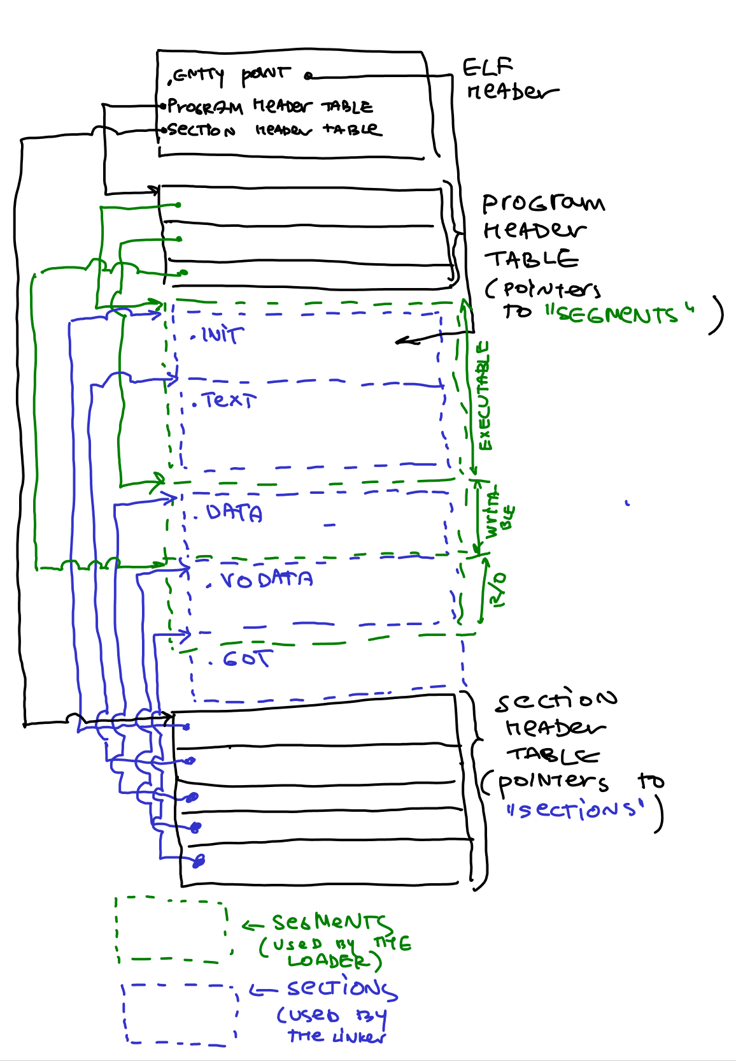
ELF
Header
Magic number
Entry point
Pointers to two tables
Program header table
Section header table

Slide 78
ELF header
gcc -c -fno-pic -static -fno-builtin -ggdb -m32 -fno-omit-frame-pointer hello-elf.c
ld -m elf_i386 -N -e main -Ttext 0 -o a.out hello-elf.o
readelf -a a.out
ELF Header:
Magic: 7f 45 4c 46 01 01 01 00 00 00 00 00 00 00 00 00
Class: ELF32
Data: 2's complement, little endian
Version: 1 (current)
OS/ABI: UNIX - System V
ABI Version: 0
Type: EXEC (Executable file)
Machine: Intel 80386
Version: 0x1
Entry point address: 0x0
Start of program headers: 52 (bytes into file)
Start of section headers: 2980 (bytes into file)
Flags: 0x0
Size of this header: 52 (bytes)
Size of program headers: 32 (bytes)
Number of program headers: 2
Size of section headers: 40 (bytes)
Number of section headers: 15
Section header string table index: 14

Slide 79
Program header table
Used by the loader
Take all “segments” marked as LOAD and load them into memory

Slide 80
Program header table
gcc -c -fno-pic -static -fno-builtin -ggdb -m32 -fno-omit-frame-pointer hello-elf.c
ld -m elf_i386 -N -e main -Ttext 0 -o a.out hello-elf.o
readelf -a a.out
Program Headers:
Type Offset VirtAddr PhysAddr FileSiz MemSiz Flg Align
LOAD 0x000074 0x00000000 0x00000000 0x00068 0x0006c RWE 0x4
GNU_STACK 0x000000 0x00000000 0x00000000 0x00000 0x00000 RW 0x10
Section to Segment mapping:
Segment Sections...
00 .text .rodata .eh_frame .data .bss
01

Slide 81
Section header table
Used by the linker
Merging (linking) code and data sections together
.text
Code of the program
.data
Initialized global variables
.rodata
Initialized R/O global variables
.bss
Better Save Space
Uninitialized global variables

Slide 82
Section header table
readelf -a a.out
Section Headers:
[Nr] Name Type Addr Off Size ES Flg Lk Inf Al
[ 0] NULL 00000000 000000 000000 00 0 0 0
[ 1] .text PROGBITS 00000000 000074 000028 00 WAX 0 0 1
[ 2] .rodata PROGBITS 00000028 00009c 000004 00 A 0 0 4
[ 3] .eh_frame PROGBITS 0000002c 0000a0 000038 00 A 0 0 4
[ 4] .data PROGBITS 00000064 0000d8 000004 00 WA 0 0 4
[ 5] .bss NOBITS 00000068 0000dc 000004 00 WA 0 0 4
[ 6] .comment PROGBITS 00000000 0000dc 000029 01 MS 0 0 1
[ 7] .debug_aranges PROGBITS 00000000 000105 000020 00 0 0 1
[ 8] .debug_info PROGBITS 00000000 000125 000389 00 0 0 1
[ 9] .debug_abbrev PROGBITS 00000000 0004ae 000113 00 0 0 1
[10] .debug_line PROGBITS 00000000 0005c1 0000c2 00 0 0 1
[11] .debug_str PROGBITS 00000000 000683 00032c 01 MS 0 0 1
[12] .symtab SYMTAB 00000000 0009b0 000140 10 13 13 4
[13] .strtab STRTAB 00000000 000af0 00002c 00 0 0 1
[14] .shstrtab STRTAB 00000000 000b1c 000087 00 0 0 1
Key to Flags:
W (write), A (alloc), X (execute), M (merge), S (strings), I (info),
L (link order), O (extra OS processing required), G (group), T (TLS),
C (compressed), x (unknown), o (OS specific), E (exclude),
p (processor specific)

Slide 83
Loading ELF

Slide 84
Static libraries
(.a)

Slide 85
Libraries
Conceptually a library is
Collection of object files
UNIX uses an archive format
Remember the ar tool
Can support collections of any objects
Rarely used for anything instead of libraries

Slide 86
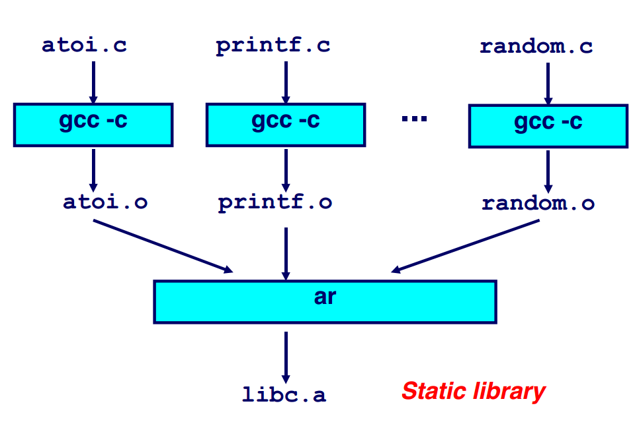
Creating a static library

Slide 87
Example
Create a library
ar rcs libclass.a class1.o class2.o class3.o
Linking (linker can read ar files)
C compiler calls linker
gcc main.c libclass.a
or (if libclass.a is placed in standard library path, like /usr/local/lib)
gcc main.c -lclass
or (during linking)
ld ... main.o -lclass ...
is the same as:
gcc main.c class1.o class2.o class3.o

Slide 88
Searching libraries
First linker path needs resolve symbol names into function locations
To improve the search library formats add an index
Map names to member positions

Slide 89
Shared libraries
(.so or .dll on Windows)

Slide 90
Motivation
1000 programs in a typical UNIX system
1000 copies of printf
How big is printf() actually?

Slide 91
Motivation
Disk space
2504 programs in /usr/bin on my Linux laptop
ls /usr/bin | wc -l
printf() is a large function
Handles conversion of multiple types to strings
5-10K
This means 10-25MB of disk can be wasted just on printf()
Runtime memory costs are
5-10K times the number of running programs
250 programs running on my Linux laptop
ps -aux | wc -l
1MB-2.5MB – huge number for most systems 15-20 years ago

Slide 92
Motivation for shared libraries

Slide 93
Example: size of a statically vs dynamically linked program
On Ubuntu 16.04 (gcc 5.4.0, libc 2.23)
Statically linked trivial example
gcc -m32 -static hello-int.c -o test
725KB
Dyncamically linked trivial example
gcc -m32 hello-int.c -o test
7KB

Slide 94
Shared libraries
Motivation
Share code of a library across all processes
E.g. libc is linked by all processes in the system
Code section should remain identical
To be shared read-only
What if library is loaded at different addresses?
Remember it needs to be relocated

Slide 95
Position independent code
(Parts adapted from Eli Bendersky)
https://eli.thegreenplace.net/2011/11/03/position-independent-code-pic-in-shared-libraries/

Slide 96
Position independent code (PIC)
Main idea:
Generate code in such a way that it can work no matter where it is located in the address space
Share code across all address spaces

Slide 97
What needs to be changed?
Can stay untouched
Local jumps and calls are relative
Stack data is relative to the stack
Needs to be modified
Global variables
Imported functions

Slide 98
Example
Reference to a data section
Code and data sections can be
moved around
000010a4 <_main>:
10a4: 55 pushl %ebp
10a5: 89 e5 movl %esp,%ebp
10a7: 68 10 00 00 00 pushl $0x10
10a8: 32 .data
10ac: e8 03 00 00 00 call 10b4 <_a>
...
000010b4 <_a>:
10bc: e8 37 00 00 00 call 10f8 <_strlen>
...
10c3: 6a 01 pushl $0x1
10c5: e8 a2 00 00 00 call 116c <_write>
...

Slide 99
Example
Local function invocations
use relative addresses
No need to relocate
000010a4 <_main>:
10a4: 55 pushl %ebp
10a5: 89 e5 movl %esp,%ebp
10a7: 68 10 00 00 00 pushl $0x10
10a8: 32 .data
10ac: e8 03 00 00 00 call 10b4 <_a>
...
000010b4 <_a>:
10bc: e8 37 00 00 00 call 10f8 <_strlen>
...
10c3: 6a 01 pushl $0x1
10c5: e8 a2 00 00 00 call 116c <_write>
...

Slide 100
Position independent code
How would you build it?

Slide 101
Position independent code
How would you build it?
Main idea:
Add additional layer of indirection for all references to
Global data
Imported functions

Slide 102
Position independent code
Main insight
Code sections are followed by data sections
The distance between code and data remains constant even if code is relocated
Linker knows the distance

Slide 103
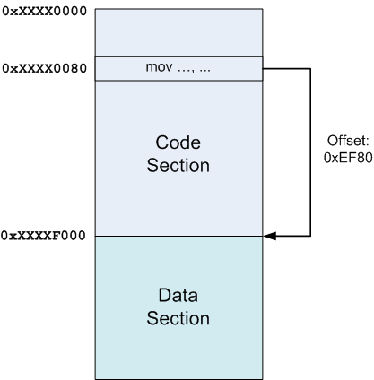
Insight 1: Constant offset between text and data sections

Slide 104
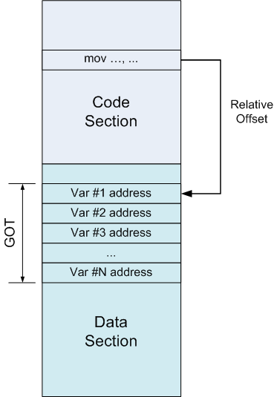
Global offset table (GOT)
Insight #2:
Instead of referring to a variable by its absolute address
Which would require a relocation
Refer through GOT

Slide 105
Global offset table (GOT)
GOT
Table of addresses
Each entry contains absolute address of a variable
GOT is patched by the linker at relocation time

Slide 106
How to find position of the code in memory at run time?

Slide 107
How to find position of the code in memory at run time?
Is there an x86 instruction that does this?
i.e., give me my current code address
x86 32bit architecture requires absolute addresses for mov instructions
No relative addresses allowed
There is no instruction to learn the value of EIP
Instruction pointer

Slide 108
How to find position of the code in memory at run time?
Simple trick
call L2
L2: popl %ebx
Call next instruction
Saves EIP on the stack
EIP holds current position of the code
Use popl to fetch EIP into a register

Slide 109
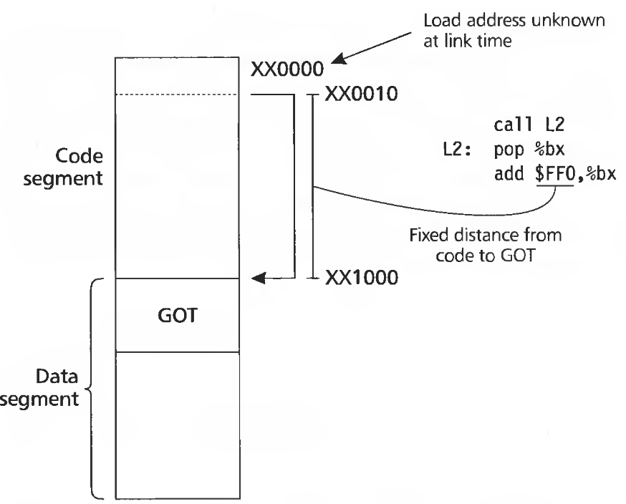

Slide 110
Examples of position independent code

Slide 111
PIC example
int myglob = 42;
int ml_func(int a, int b)
{
return myglob + a + b;
}
0000043c <ml_func>:
43c: 55 push ebp
43d: 89 e5 mov ebp,esp
43f: e8 16 00 00 00 call 45a <__i686.get_pc_thunk.cx>
444: 81 c1 b0 1b 00 00 add ecx,0x1bb0
44a: 8b 81 f0 ff ff ff mov eax,DWORD PTR [ecx-0x10]
450: 8b 00 mov eax,DWORD PTR [eax]
452: 03 45 08 add eax,DWORD PTR [ebp+0x8]
455: 03 45 0c add eax,DWORD PTR [ebp+0xc]
458: 5d pop ebp
459: c3 ret
0000045a <__i686.get_pc_thunk.cx>:
45a: 8b 0c 24 mov ecx,DWORD PTR [esp]
45d: c3 ret

Slide 112
PIC example
int myglob = 42;
int ml_func(int a, int b)
{
return myglob + a + b;
}
0000043c <ml_func>:
43c: 55 push ebp
43d: 89 e5 mov ebp,esp
43f: e8 16 00 00 00 call 45a <__i686.get_pc_thunk.cx>
444: 81 c1 b0 1b 00 00 add ecx,0x1bb0
44a: 8b 81 f0 ff ff ff mov eax,DWORD PTR [ecx-0x10]
450: 8b 00 mov eax,DWORD PTR [eax]
452: 03 45 08 add eax,DWORD PTR [ebp+0x8]
455: 03 45 0c add eax,DWORD PTR [ebp+0xc]
458: 5d pop ebp
459: c3 ret
0000045a <__i686.get_pc_thunk.cx>:
45a: 8b 0c 24 mov ecx,DWORD PTR [esp]
45d: c3 ret
Access a global variable myglob

Slide 113
PIC example
int myglob = 42;
int ml_func(int a, int b)
{
return myglob + a + b;
}
0000043c <ml_func>:
43c: 55 push ebp
43d: 89 e5 mov ebp,esp
43f: e8 16 00 00 00 call 45a <__i686.get_pc_thunk.cx>
444: 81 c1 b0 1b 00 00 add ecx,0x1bb0
44a: 8b 81 f0 ff ff ff mov eax,DWORD PTR [ecx-0x10]
450: 8b 00 mov eax,DWORD PTR [eax]
452: 03 45 08 add eax,DWORD PTR [ebp+0x8]
455: 03 45 0c add eax,DWORD PTR [ebp+0xc]
458: 5d pop ebp
459: c3 ret
0000045a <__i686.get_pc_thunk.cx>:
45a: 8b 0c 24 mov ecx,DWORD PTR [esp]
45d: c3 ret
Save EIP into ECX

Slide 114
PIC example
int myglob = 42;
int ml_func(int a, int b)
{
return myglob + a + b;
}
0000043c <ml_func>:
43c: 55 push ebp
43d: 89 e5 mov ebp,esp
43f: e8 16 00 00 00 call 45a <__i686.get_pc_thunk.cx>
444: 81 c1 b0 1b 00 00 add ecx,0x1bb0
44a: 8b 81 f0 ff ff ff mov eax,DWORD PTR [ecx-0x10]
450: 8b 00 mov eax,DWORD PTR [eax]
452: 03 45 08 add eax,DWORD PTR [ebp+0x8]
455: 03 45 0c add eax,DWORD PTR [ebp+0xc]
458: 5d pop ebp
459: c3 ret
0000045a <__i686.get_pc_thunk.cx>:
45a: 8b 0c 24 mov ecx,DWORD PTR [esp]
45d: c3 ret
Add offset to GOT
0x1bb0

Slide 115
PIC example
int myglob = 42;
int ml_func(int a, int b)
{
return myglob + a + b;
}
0000043c <ml_func>:
43c: 55 push ebp
43d: 89 e5 mov ebp,esp
43f: e8 16 00 00 00 call 45a <__i686.get_pc_thunk.cx>
444: 81 c1 b0 1b 00 00 add ecx,0x1bb0
44a: 8b 81 f0 ff ff ff mov eax,DWORD PTR [ecx-0x10]
450: 8b 00 mov eax,DWORD PTR [eax]
452: 03 45 08 add eax,DWORD PTR [ebp+0x8]
455: 03 45 0c add eax,DWORD PTR [ebp+0xc]
458: 5d pop ebp
459: c3 ret
0000045a <__i686.get_pc_thunk.cx>:
45a: 8b 0c 24 mov ecx,DWORD PTR [esp]
45d: c3 ret
Access address of a specific GOT entry (address of myglob)
Save it in EAX

Slide 116
PIC example
int myglob = 42;
int ml_func(int a, int b)
{
return myglob + a + b;
}
0000043c <ml_func>:
43c: 55 push ebp
43d: 89 e5 mov ebp,esp
43f: e8 16 00 00 00 call 45a <__i686.get_pc_thunk.cx>
444: 81 c1 b0 1b 00 00 add ecx,0x1bb0
44a: 8b 81 f0 ff ff ff mov eax,DWORD PTR [ecx-0x10]
450: 8b 00 mov eax,DWORD PTR [eax]
452: 03 45 08 add eax,DWORD PTR [ebp+0x8]
455: 03 45 0c add eax,DWORD PTR [ebp+0xc]
458: 5d pop ebp
459: c3 ret
0000045a <__i686.get_pc_thunk.cx>:
45a: 8b 0c 24 mov ecx,DWORD PTR [esp]
45d: c3 ret
Load the value of the variable at the address pointed by EAX
i.e., load myglob into EAX

Slide 117
What about function calls?

Slide 118
What about function calls?
Same approach can work
But this is not how it is done

Slide 119
Late binding
When a shared library refers to some function, the real address of that function is not known until load time
Resolving this address is called binding

Slide 120
Lazy procedure binding
In large libraries many routines are never called
Libc has over 600
The number of functions is much larger than the number of global variables
It's ok to bind all routines when the program is statically linked
Binding is done offline, no runtime costst
But with dynamic linking run-time overhead is too high
Lazy approach, i.e., linking only when used, works better

Slide 121
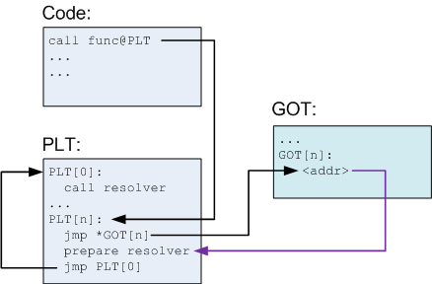
Procedure linkage table (PLT)

Slide 122
Procedure linkage table (PLT)
PLT is part of the executable text section
A set of entries
A special first entry
One for each external function
Each PLT entry
Is a short chunk of executable code
Has a corresponding entry in the GOT
Contains an actual offset to the function
Only after it is resolved by the dynamic loader

Slide 123
Each PLT entry but the first consists of these parts:
A jump to a location which is specified in a corresponding GOT entry
Preparation of arguments for a "resolver" routine
Call to the resolver routine, which resides in the first entry of the PLT

Slide 124
Before function is resolved
Nth GOT entry points to after the jump

Slide 125
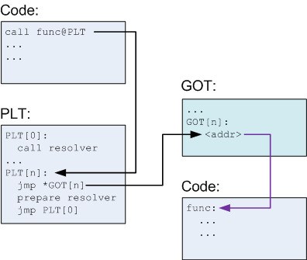
PLT after the function is resolved
Nth GOT entry points to the actual function

Slide 126
PIC example (functions)
int ml_util_func(int a)
{
return a + 1;
}
int ml_func(int a, int b)
{
int c = b + ml_util_func(a);
myglob += c;
return b + myglob;
}
00000477 <ml_func>:
477: 55 push ebp
478: 89 e5 mov ebp,esp
47a: 53 push ebx
47b: 83 ec 24 sub esp,0x24
47e: e8 e4 ff ff ff call 467 <__i686.get_pc_thunk.bx>
483: 81 c3 71 1b 00 00 add ebx,0x1b71
489: 8b 45 08 mov eax,DWORD PTR [ebp+0x8]
48c: 89 04 24 mov DWORD PTR [esp],eax
48f: e8 0c ff ff ff call 3a0 <ml_util_func@plt>
...
000003a0 <ml_util_func@plt>:
3a0: ff a3 14 00 00 00 jmp DWORD PTR [ebx+0x14]
3a6: 68 10 00 00 00 push 0x10
3ab: e9 c0 ff ff ff jmp 370 <_init+0x30>

Slide 127
PIC example (functions)
int ml_util_func(int a)
{
return a + 1;
}
int ml_func(int a, int b)
{
int c = b + ml_util_func(a);
myglob += c;
return b + myglob;
}
00000477 <ml_func>:
477: 55 push ebp
478: 89 e5 mov ebp,esp
47a: 53 push ebx
47b: 83 ec 24 sub esp,0x24
47e: e8 e4 ff ff ff call 467 <__i686.get_pc_thunk.bx>
483: 81 c3 71 1b 00 00 add ebx,0x1b71
489: 8b 45 08 mov eax,DWORD PTR [ebp+0x8]
48c: 89 04 24 mov DWORD PTR [esp],eax
48f: e8 0c ff ff ff call 3a0 <ml_util_func@plt>
...
000003a0 <ml_util_func@plt>:
3a0: ff a3 14 00 00 00 jmp DWORD PTR [ebx+0x14]
3a6: 68 10 00 00 00 push 0x10
3ab: e9 c0 ff ff ff jmp 370 <_init+0x30>
Resolve the address of GOT
First learn EIP
Saved in EBX
Then add offset to EBX

Slide 128
PIC example (functions)
int ml_util_func(int a)
{
return a + 1;
}
int ml_func(int a, int b)
{
int c = b + ml_util_func(a);
myglob += c;
return b + myglob;
}
00000477 <ml_func>:
477: 55 push ebp
478: 89 e5 mov ebp,esp
47a: 53 push ebx
47b: 83 ec 24 sub esp,0x24
47e: e8 e4 ff ff ff call 467 <__i686.get_pc_thunk.bx>
483: 81 c3 71 1b 00 00 add ebx,0x1b71
489: 8b 45 08 mov eax,DWORD PTR [ebp+0x8]
48c: 89 04 24 mov DWORD PTR [esp],eax
48f: e8 0c ff ff ff call 3a0 <ml_util_func@plt>
...
000003a0 <ml_util_func@plt>:
3a0: ff a3 14 00 00 00 jmp DWORD PTR [ebx+0x14]
3a6: 68 10 00 00 00 push 0x10
3ab: e9 c0 ff ff ff jmp 370 <_init+0x30>
Push the argument a on the stack

Slide 129
PIC example (functions)
int ml_util_func(int a)
{
return a + 1;
}
int ml_func(int a, int b)
{
int c = b + ml_util_func(a);
myglob += c;
return b + myglob;
}
00000477 <ml_func>:
477: 55 push ebp
478: 89 e5 mov ebp,esp
47a: 53 push ebx
47b: 83 ec 24 sub esp,0x24
47e: e8 e4 ff ff ff call 467 <__i686.get_pc_thunk.bx>
483: 81 c3 71 1b 00 00 add ebx,0x1b71
489: 8b 45 08 mov eax,DWORD PTR [ebp+0x8]
48c: 89 04 24 mov DWORD PTR [esp],eax
48f: e8 0c ff ff ff call 3a0 <ml_util_func@plt>
...
000003a0 <ml_util_func@plt>:
3a0: ff a3 14 00 00 00 jmp DWORD PTR [ebx+0x14]
3a6: 68 10 00 00 00 push 0x10
3ab: e9 c0 ff ff ff jmp 370 <_init+0x30>
Call the PLT entry for the ml_util_func()

Slide 130
PIC example (functions)
int ml_util_func(int a)
{
return a + 1;
}
int ml_func(int a, int b)
{
int c = b + ml_util_func(a);
myglob += c;
return b + myglob;
}
00000477 <ml_func>:
477: 55 push ebp
478: 89 e5 mov ebp,esp
47a: 53 push ebx
47b: 83 ec 24 sub esp,0x24
47e: e8 e4 ff ff ff call 467 <__i686.get_pc_thunk.bx>
483: 81 c3 71 1b 00 00 add ebx,0x1b71
489: 8b 45 08 mov eax,DWORD PTR [ebp+0x8]
48c: 89 04 24 mov DWORD PTR [esp],eax
48f: e8 0c ff ff ff call 3a0 <ml_util_func@plt>
...
000003a0 <ml_util_func@plt>:
3a0: ff a3 14 00 00 00 jmp DWORD PTR [ebx+0x14]
3a6: 68 10 00 00 00 push 0x10
3ab: e9 c0 ff ff ff jmp 370 <_init+0x30>
Jump to an address specified in GOT
[ebx+0x14] contains address 0x3a6
i.e., effectively we jump to the next instruction via GOT

Slide 131
PIC example (functions)
int ml_util_func(int a)
{
return a + 1;
}
int ml_func(int a, int b)
{
int c = b + ml_util_func(a);
myglob += c;
return b + myglob;
}
00000477 <ml_func>:
477: 55 push ebp
478: 89 e5 mov ebp,esp
47a: 53 push ebx
47b: 83 ec 24 sub esp,0x24
47e: e8 e4 ff ff ff call 467 <__i686.get_pc_thunk.bx>
483: 81 c3 71 1b 00 00 add ebx,0x1b71
489: 8b 45 08 mov eax,DWORD PTR [ebp+0x8]
48c: 89 04 24 mov DWORD PTR [esp],eax
48f: e8 0c ff ff ff call 3a0 <ml_util_func@plt>
...
000003a0 <ml_util_func@plt>:
3a0: ff a3 14 00 00 00 jmp DWORD PTR [ebx+0x14]
3a6: 68 10 00 00 00 push 0x10
3ab: e9 c0 ff ff ff jmp 370 <_init+0x30>
Prepare arguments for the resolver

Slide 132
PIC example (functions)
int ml_util_func(int a)
{
return a + 1;
}
int ml_func(int a, int b)
{
int c = b + ml_util_func(a);
myglob += c;
return b + myglob;
}
00000477 <ml_func>:
477: 55 push ebp
478: 89 e5 mov ebp,esp
47a: 53 push ebx
47b: 83 ec 24 sub esp,0x24
47e: e8 e4 ff ff ff call 467 <__i686.get_pc_thunk.bx>
483: 81 c3 71 1b 00 00 add ebx,0x1b71
489: 8b 45 08 mov eax,DWORD PTR [ebp+0x8]
48c: 89 04 24 mov DWORD PTR [esp],eax
48f: e8 0c ff ff ff call 3a0 <ml_util_func@plt>
...
000003a0 <ml_util_func@plt>:
3a0: ff a3 14 00 00 00 jmp DWORD PTR [ebx+0x14]
3a6: 68 10 00 00 00 push 0x10
3ab: e9 c0 ff ff ff jmp 370 <_init+0x30>
Call resolver

Slide 133
PIC example (functions)
int ml_util_func(int a)
{
return a + 1;
}
int ml_func(int a, int b)
{
int c = b + ml_util_func(a);
myglob += c;
return b + myglob;
}
00000477 <ml_func>:
477: 55 push ebp
478: 89 e5 mov ebp,esp
47a: 53 push ebx
47b: 83 ec 24 sub esp,0x24
47e: e8 e4 ff ff ff call 467 <__i686.get_pc_thunk.bx>
483: 81 c3 71 1b 00 00 add ebx,0x1b71
489: 8b 45 08 mov eax,DWORD PTR [ebp+0x8]
48c: 89 04 24 mov DWORD PTR [esp],eax
48f: e8 0c ff ff ff call 3a0 <ml_util_func@plt>
...
000003a0 <ml_util_func@plt>:
3a0: ff a3 14 00 00 00 jmp DWORD PTR [ebx+0x14]
3a6: 68 10 00 00 00 push 0x10
3ab: e9 c0 ff ff ff jmp 370 <_init+0x30>
After the address of ml_util_func() is resolved
i.e., on the next invocation
This jump goes to the function entry

Slide 134
What did we gain?
Processes can share code
Each have private GOT
Why is it better?
GOT is in the data section, private to each process anyway
We saved memory
We saved some linking time too
GOT is patched per variable, not per variable reference
There are many references to the same variable in the code
It takes some time to relocate
We saved this time

Slide 135
PIC: Advantages and disadvantages
Any ideas?

Slide 136
PIC: Advantages and disadvantages
Bad
Code gets slower
One register is wasted to keep GOT pointer
x86 has 7 registers (plus maybe EBP is used to maintain the fraim, so maybe 6)
Loosing one of them is bad
One more memory dereference
GOT can be large (lots of global variables)
Extra memory dereferences can have a high cost due to cache misses
One more call to find GOT
Good
Share memory of common libraries
Address space randomization

Slide 137
Loading and starting programs

Slide 138
Starting statically linked programs

Slide 139
Remember we call execv()
Kernel reads the program from disk
Kernel can handle multiple executable formats
It tries all of them one by one until it succeeds
E.g. it can execute scripts by noticing that the program starts with
#!
We’ll concentrate on ELF

Slide 140
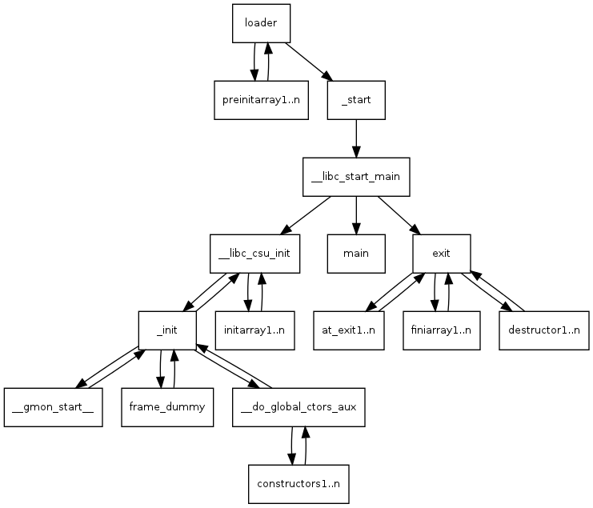
A bit of work before main()

Slide 141
To see the backtrace before main()
Execute this command in GDB
(gdb) set backtrace past-main on
Example for our homework
Breakpoint 1, main () at main.c:26
26 s = sum(100);
Missing separate debuginfos, use: debuginfo-install glibc-2.17-292.el7.i686
(gdb) set backtrace past-main on
(gdb) bt
#0 main () at main.c:26
#1 0xf7dfb2a3 in __libc_start_main () from /lib/libc.so.6
#2 0x08048331 in _start ()
(gdb)

Slide 142
Alternatively set a breakpoint on __start
Use readelf
readelf -a hello
Example for our homework
ELF Header:
Magic: 7f 45 4c 46 01 01 01 00 00 00 00 00 00 00 00 00
Class: ELF32
Data: 2's complement, little endian
Version: 1 (current)
OS/ABI: UNIX - System V
ABI Version: 0
Type: EXEC (Executable file)
Machine: Intel 80386
Version: 0x1
Entry point address: 0x8048310
Start of program headers: 52 (bytes into file)
Start of section headers: 6880 (bytes into file)
Flags: 0x0
Size of this header: 52 (bytes)
Size of program headers: 32 (bytes)
Number of program headers: 9
Size of section headers: 40 (bytes)
Number of section headers: 36
Section header string table index: 35

Slide 143
Initializers and finalizers
C++ needs a segment for invoking constructors for static variables
List of pointers to startup routines
Startup code in every module is put into an anonymous startup routine
Put into a segment called .init
Problem
Order matters
Ideally you should track dependencies
This is not done
Simple hack
System libraries go first (.init), then user (.ctor)

Slide 144
Example of a constructor
#include <stdio.h>
void __attribute__ ((constructor)) a_constructor() {
printf("%s\n", __FUNCTION__);
}
int
main()
{
printf("%s\n",__FUNCTION__);
}
Run it
$ ./hello
a_constructor
main
$

Slide 145
Starting main()

Slide 146
Starting dynamically linked programs

Slide 147
Loading a dynamically linked ELF program
Map ELF sections into memory
Note the interpreter section
Usually ld.so
Map ld.so into memory
Start ld.so instead of the program
Linker (ld.so) intializes itself
Finds the names of shared libraries required by the program
DT_NEEDED entries

Slide 148
Starting dynamically linked programs

Slide 149
Runtime linker: ld-linux.so
The kernel checks if PT_INTERP is present in the ELF header
Reads the filename of the interpreter
Reads the interpreter and loads it in program’s memory
It’s an ELF executable itself
Sets to start the program at the entry point of the interpreter
execv() completes starting interpreter

Slide 150
Finding libraries in the file system
DT_RPATH symbol
Can be linked into a file by a normal linker at link time
LD_LIBRARY_PATH
Library cache file
/etc/ld.so.conf
This is the most normal way to resolve library paths
Default library path
/usr/lib

Slide 151
Loading more libraries
When the library is found it is loaded into memory
Linker adds its symbol table to the linked list of symbol tables
Recursively searches if the library depends on other libraries
Loads them if needed

Slide 152
Shared library initialization
Remember PIC needs relocation in the data segment and GOT
ld.so linker performs this relocation

Slide 153
Conclusion
You understand linking and loading
Relocation
Assign load address to each object file
Patch the code
Symbol resolution
Resolve symbols imported from other object files

Slide 154
Resources
How statically linked programs run on Linux by Eli Bendersky
https://eli.thegreenplace.net/2012/08/13/how-statically-linked-programs-run-on-linux
Linux x86 Program Start Up or - How the heck do we get to main()? by Patrick Horgan
http://dbp-consulting.com/tutorials/debugging/linuxProgramStartup.html
https://lwn.net/Articles/630727/
https://lwn.net/Articles/631631/

Slide 155
Thank you!

Slide 156
Weak vs strong symbols
Virtually every program uses printf
Printf can convert floating-point numbers to strings
Printf uses fcvt()
Does this mean that every program needs to link against floating-point libraries?
Weak symbols allow symbols to be undefined
If program uses floating numbers, it links against the floating-point libraries
fcvt() is defined an everything is fine
If program doesn't use floating-point libraries
fcvt() remains NULL but is never called

Slide 157
nm a.out
0804a01c B __bss_start
0804a01c b completed.6591
0804a014 D __data_start
0804a014 W data_start
….
0804a01c D _edata
0804a020 B _end
08048484 T _fini
...
08048294 T _init
...
080483ed T main
…
080482f0 T _start
...

