Slide 1
cs5460/6460: Operating Systems Lecture: Synchronization
Anton Burtsev
April, 2024

Slide 2
Starting other CPUs

Slide 3
Started from main()
1317 main(void)
1318 {
...
1336 startothers(); // start other processors
1337 kinit2(P2V(4*1024*1024), P2V(PHYSTOP));
1338 userinit(); // first user process
1339 mpmain();
1340 }

Slide 4
Starting other CPUs
Copy start code in a good location
0x7000 (remember same as the one used by boot loader)
Pass start parameters on the stack
Allocate a new stack for each CPU
Send a magic inter-processor interrupt (IPI) with the entry point (mpenter())

Slide 5
Start other CPUs
1374 startothers(void)
1375 {
1384 code = P2V(0x7000);
1385 memmove(code, _binary_entryother_start,
(uint)_binary_entryother_size);
1386
1387 for(c = cpus; c < cpus+ncpu; c++){
1388 if(c == cpus+cpunum()) // We’ve started already.
1389 continue;
...
1394 stack = kalloc();
1395 *(void**)(code−4) = stack + KSTACKSIZE;
1396 *(void**)(code−8) = mpenter;
1397 *(int**)(code−12) = (void *) V2P(entrypgdir);
1398
1399 lapicstartap(c−>apicid, V2P(code));

Slide 6
Start other CPUs
1374 startothers(void)
1375 {
1384 code = P2V(0x7000);
1385 memmove(code, _binary_entryother_start,
(uint)_binary_entryother_size);
1386
1387 for(c = cpus; c < cpus+ncpu; c++){
1388 if(c == cpus+cpunum()) // We’ve started already.
1389 continue;
...
1394 stack = kalloc();
1395 *(void**)(code−4) = stack + KSTACKSIZE;
1396 *(void**)(code−8) = mpenter;
1397 *(int**)(code−12) = (void *) V2P(entrypgdir);
1398
1399 lapicstartap(c−>apicid, V2P(code));
Allocate a new kernel stack for each CPU
What will be running on this stack?
https://pollev.com/aburtsev

Slide 7
Start other CPUs
1374 startothers(void)
1375 {
1384 code = P2V(0x7000);
1385 memmove(code, _binary_entryother_start,
(uint)_binary_entryother_size);
1386
1387 for(c = cpus; c < cpus+ncpu; c++){
1388 if(c == cpus+cpunum()) // We’ve started already.
1389 continue;
...
1394 stack = kalloc();
1395 *(void**)(code−4) = stack + KSTACKSIZE;
1396 *(void**)(code−8) = mpenter;
1397 *(int**)(code−12) = (void *) V2P(entrypgdir);
1398
1399 lapicstartap(c−>apicid, V2P(code));
Allocate a new kernel stack for each CPU
What will be running on this stack?
Scheduler

Slide 8
Start other CPUs
1374 startothers(void)
1375 {
1384 code = P2V(0x7000);
1385 memmove(code, _binary_entryother_start,
(uint)_binary_entryother_size);
1386
1387 for(c = cpus; c < cpus+ncpu; c++){
1388 if(c == cpus+cpunum()) // We’ve started already.
1389 continue;
...
1394 stack = kalloc();
1395 *(void**)(code−4) = stack + KSTACKSIZE;
1396 *(void**)(code−8) = mpenter;
1397 *(int**)(code−12) = (void *) V2P(entrypgdir);
1398
1399 lapicstartap(c−>apicid, V2P(code));
What is done here?

Slide 9
Start other CPUs
1374 startothers(void)
1375 {
1384 code = P2V(0x7000);
1385 memmove(code, _binary_entryother_start,
(uint)_binary_entryother_size);
1386
1387 for(c = cpus; c < cpus+ncpu; c++){
1388 if(c == cpus+cpunum()) // We’ve started already.
1389 continue;
...
1394 stack = kalloc();
1395 *(void**)(code−4) = stack + KSTACKSIZE;
1396 *(void**)(code−8) = mpenter;
1397 *(int**)(code−12) = (void *) V2P(entrypgdir);
1398
1399 lapicstartap(c−>apicid, V2P(code));
What is done here?
Kernel stack
Address of mpenter()
Physical address of entrypgdir

Slide 10
Start other CPUs
1374 startothers(void)
1375 {
1384 code = P2V(0x7000);
1385 memmove(code, _binary_entryother_start,
(uint)_binary_entryother_size);
1386
1387 for(c = cpus; c < cpus+ncpu; c++){
1388 if(c == cpus+cpunum()) // We’ve started already.
1389 continue;
...
1394 stack = kalloc();
1395 *(void**)(code−4) = stack + KSTACKSIZE;
1396 *(void**)(code−8) = mpenter;
1397 *(int**)(code−12) = (void *) V2P(entrypgdir);
1398
1399 lapicstartap(c−>apicid, V2P(code));
Send “magic” interrupt
Wake up other CPUs

Slide 11
entryother.S
1123 .code16
1124 .globl start
1125 start:
1126 cli
1127
1128 xorw %ax,%ax
1129 movw %ax,%ds
1130 movw %ax,%es
1131 movw %ax,%ss
1132
Disable interrupts
Init segments with 0

Slide 12
entryother.S
1133 lgdt gdtdesc
1134 movl %cr0, %eax
1135 orl $CR0_PE, %eax
1136 movl %eax, %cr0
1150 ljmpl $(SEG_KCODE<<3), $(start32)
1151
1152 .code32
1153 start32:
1154 movw $(SEG_KDATA<<3), %ax
1155 movw %ax, %ds
1156 movw %ax, %es
1157 movw %ax, %ss
1158 movw $0, %ax
1159 movw %ax, %fs
1160 movw %ax, %gs
Load GDT
Switch to 32bit mode
Long jump to start32
Load segments

Slide 13
entryother.S
1162 # Turn on page size extension for 4Mbyte pages
1163 movl %cr4, %eax
1164 orl $(CR4_PSE), %eax
1165 movl %eax, %cr4
1166 # Use enterpgdir as our initial page table
1167 movl (start−12), %eax
1168 movl %eax, %cr3
1169 # Turn on paging.
1170 movl %cr0, %eax
1171 orl $(CR0_PE|CR0_PG|CR0_WP), %eax
1172 movl %eax, %cr0
1173
1174 # Switch to the stack allocated by startothers()
1175 movl (start−4), %esp
1176 # Call mpenter()
1177 call *(start−8)

Slide 14
entryother.S
1162 # Turn on page size extension for 4Mbyte pages
1163 movl %cr4, %eax
1164 orl $(CR4_PSE), %eax
1165 movl %eax, %cr4
1166 # Use enterpgdir as our initial page table
1167 movl (start−12), %eax
1168 movl %eax, %cr3
1169 # Turn on paging.
1170 movl %cr0, %eax
1171 orl $(CR0_PE|CR0_PG|CR0_WP), %eax
1172 movl %eax, %cr0
1173
1174 # Switch to the stack allocated by startothers()
1175 movl (start−4), %esp
1176 # Call mpenter()
1177 call *(start−8)

Slide 15
entryother.S
1162 # Turn on page size extension for 4Mbyte pages
1163 movl %cr4, %eax
1164 orl $(CR4_PSE), %eax
1165 movl %eax, %cr4
1166 # Use enterpgdir as our initial page table
1167 movl (start−12), %eax
1168 movl %eax, %cr3
1169 # Turn on paging.
1170 movl %cr0, %eax
1171 orl $(CR0_PE|CR0_PG|CR0_WP), %eax
1172 movl %eax, %cr0
1173
1174 # Switch to the stack allocated by startothers()
1175 movl (start−4), %esp
1176 # Call mpenter()
1177 call *(start−8)

Slide 16
entryother.S
1162 # Turn on page size extension for 4Mbyte pages
1163 movl %cr4, %eax
1164 orl $(CR4_PSE), %eax
1165 movl %eax, %cr4
1166 # Use enterpgdir as our initial page table
1167 movl (start−12), %eax
1168 movl %eax, %cr3
1169 # Turn on paging.
1170 movl %cr0, %eax
1171 orl $(CR0_PE|CR0_PG|CR0_WP), %eax
1172 movl %eax, %cr0
1173
1174 # Switch to the stack allocated by startothers()
1175 movl (start−4), %esp
1176 # Call mpenter()
1177 call *(start−8)

Slide 17
1251 static void
1252 mpenter(void)
1253 {
1254 switchkvm();
1255 seginit();
1256 lapicinit();
1257 mpmain();
1258 }

Slide 18
Init segments
1251 static void
1252 mpenter(void)
1253 {
1254 switchkvm();
1255 seginit();
1256 lapicinit();
1257 mpmain();
1258 }

Slide 19
Init segments
seginit(void)
{
struct cpu *c;
// Map "logical" addresses to virtual addresses using identity map.
// Cannot share a CODE descriptor for both kernel and user
// because it would have to have DPL_USR, but the CPU forbids
// an interrupt from CPL=0 to DPL=3.
c = &cpus[cpuid()];
c->gdt[SEG_KCODE] = SEG(STA_X|STA_R, 0, 0xffffffff, 0);
c->gdt[SEG_KDATA] = SEG(STA_W, 0, 0xffffffff, 0);
c->gdt[SEG_UCODE] = SEG(STA_X|STA_R, 0, 0xffffffff, DPL_USER);
c->gdt[SEG_UDATA] = SEG(STA_W, 0, 0xffffffff, DPL_USER);
lgdt(c->gdt, sizeof(c->gdt));
}

Slide 20
Per-CPU variables
Variables private to each CPU

Slide 21
Per-CPU variables
Variables private to each CPU
Current running process
Kernel stack for interrupts
Hence, TSS that stores that stack
struct cpu cpus[NCPU];

Slide 22
// Per-CPU state
struct cpu {
uchar apicid; // Local APIC ID
struct context *scheduler; // swtch() here to enter scheduler
struct taskstate ts; // Used by x86 to find stack for interrupt
struct segdesc gdt[NSEGS]; // x86 global descriptor table
volatile uint started; // Has the CPU started?
int ncli; // Depth of pushcli nesting.
int intena; // Were interrupts enabled before pushcli?
struct proc *proc; // The process running on this cpu or null
};
extern struct cpu cpus[NCPU];

Slide 23
cpuid()
// Must be called with interrupts disabled
int cpuid() {
return mycpu()-cpus;
}
struct cpu* mycpu(void)
{
int apicid, i;
if(readeflags()&FL_IF)
panic("mycpu called with interrupts enabled\n");
apicid = lapicid();
// APIC IDs are not guaranteed to be contiguous. Maybe we should have
// a reverse map, or reserve a register to store &cpus[i].
for (i = 0; i < ncpu; ++i) {
if (cpus[i].apicid == apicid)
return &cpus[i];
}
panic("unknown apicid\n");
}

Slide 24
mpmain()
1250 // Common CPU setup code.
1251 static void
1252 mpmain(void)
1253 {
1254 cprintf("cpu%d: starting %d\n", cpuid(), cpuid());
1255 idtinit(); // load idt register
1256 xchg(&(mycpu()−>started), 1); // tell startothers() we’re up
1257 scheduler(); // start running processes
1258 }

Slide 25
How do CPUs access memory?

Slide 26
Intel Memory Hierarchy

Slide 27
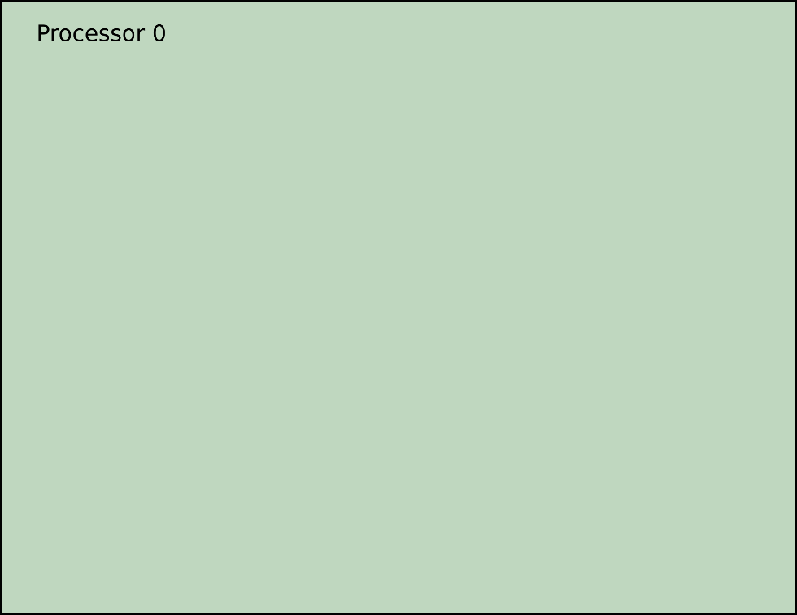
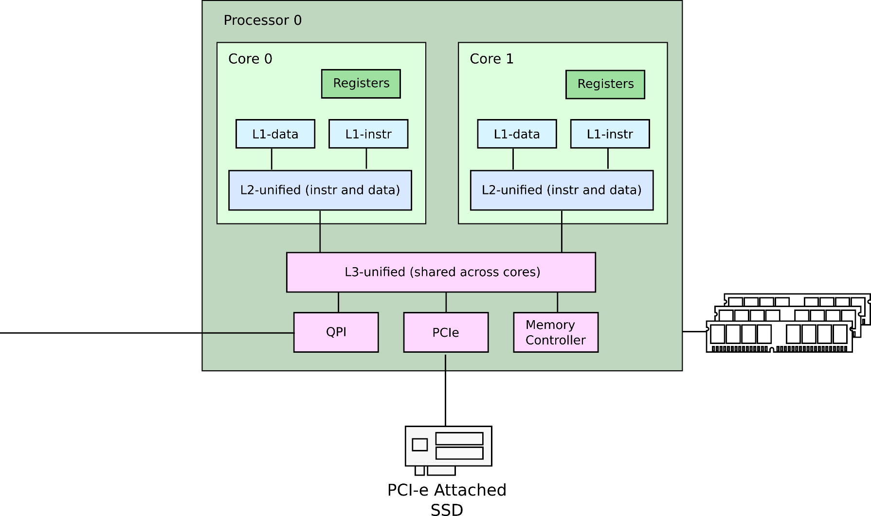
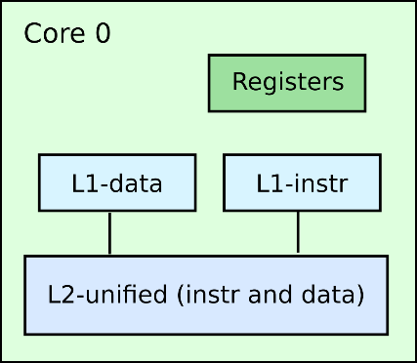
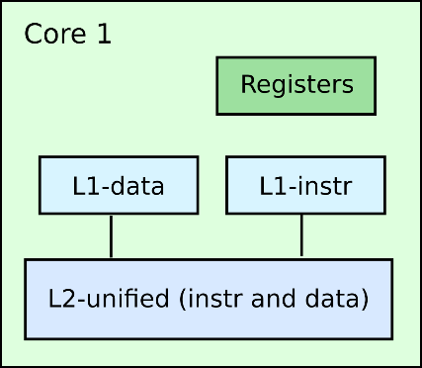
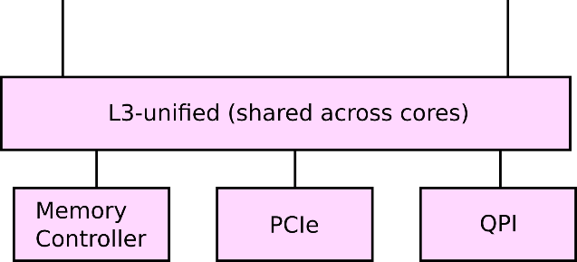
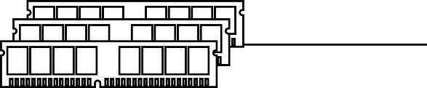
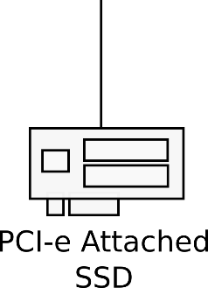
Processors, cores, memory and PCIe

Slide 28

Caches (load)

Slide 29
Cache-coherence (store)

Slide 30
Cache-coherence (load of modified)

Slide 31


Latencies: load from local L1

Slide 32


Latencies: load from local L2

Slide 33


Latencies: load from local L3

Slide 34

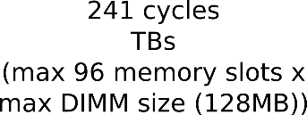
Latencies: load from local memory

Slide 35

Latencies: load from same die core’s L2

Slide 36

Latencies: load from same die core’s L1

Slide 37

Latencies: load from remote L3

Slide 38
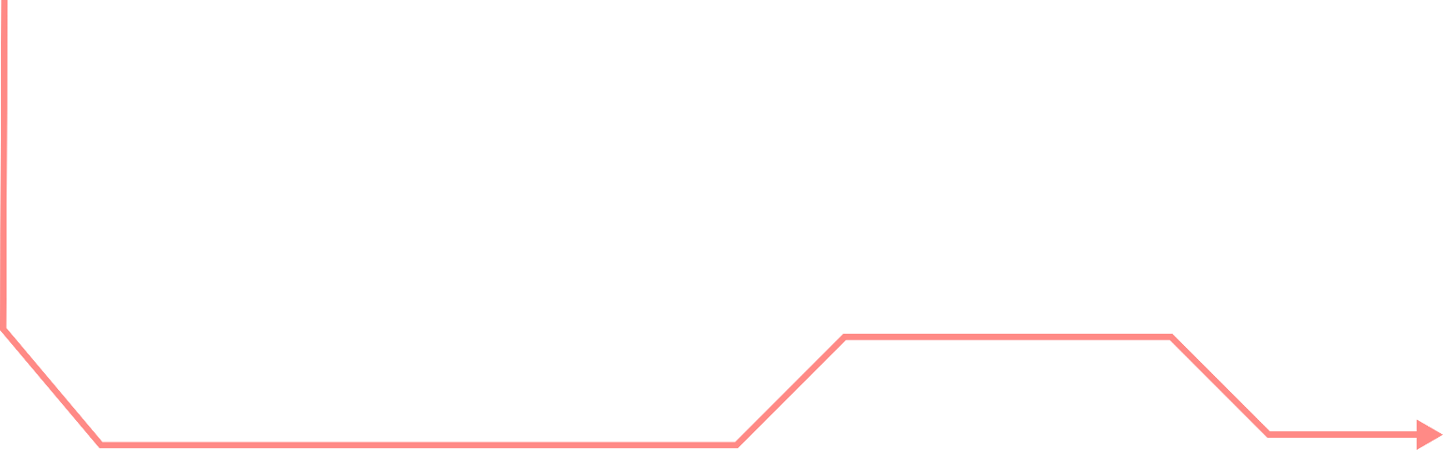


Latencies: load from remote memory

Slide 39

Latencies: load from remote L2

Slide 40

Latencies: load from remote L2

Slide 41
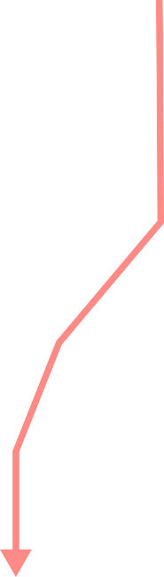
Latencies: PCIe round-trip

Slide 42
Device I/O
Essentially just sending data to and from external devices
Modern devices communicate over PCIe
Well there are other popular buses, e.g., USB, SATA (disks), etc.
Conceptually they are similar
Devices can
Read memory
Send interrupts to the CPU

Slide 43
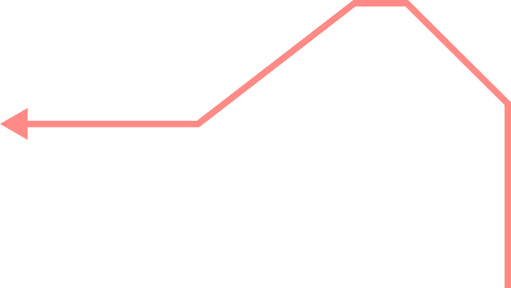
Direct memory access

Slide 44

Interrupts
int 0x…

Slide 45
Device I/O
Write incoming data in memory, e.g.,
Network packets
Disk requests, etc.
Then raise an interrupt to notify the CPU
CPU starts executing interrupt handler
Then reads incoming packets form memory
int 0x…

Slide 46

Device I/O (polling mode)
Alternatively the CPU has to check for incoming data in memory periodically
Or poll
Rationale
Interrupts are expensive

Slide 47
References
Cache Coherence Protocol and Memory Performance of the Intel Haswell-EP Architecture. http://ieeexplore.ieee.org/abstract/document/7349629
Intel SGX Explained https://eprint.iacr.org/2016/086.pdf
DC Express: Shortest Latency Protocol for Reading Phase Change Memory over PCI Express https://www.usenix.org/system/files/conference/fast14/fast14-paper_vucinic.pdf

Slide 48
Detour: Cache-coherence and memory hierarchy

Slide 49
Synchronization

Slide 50
Race conditions
Example:
Disk driver maintains a list of outstanding requests
Each process can add requests to the list

Slide 51
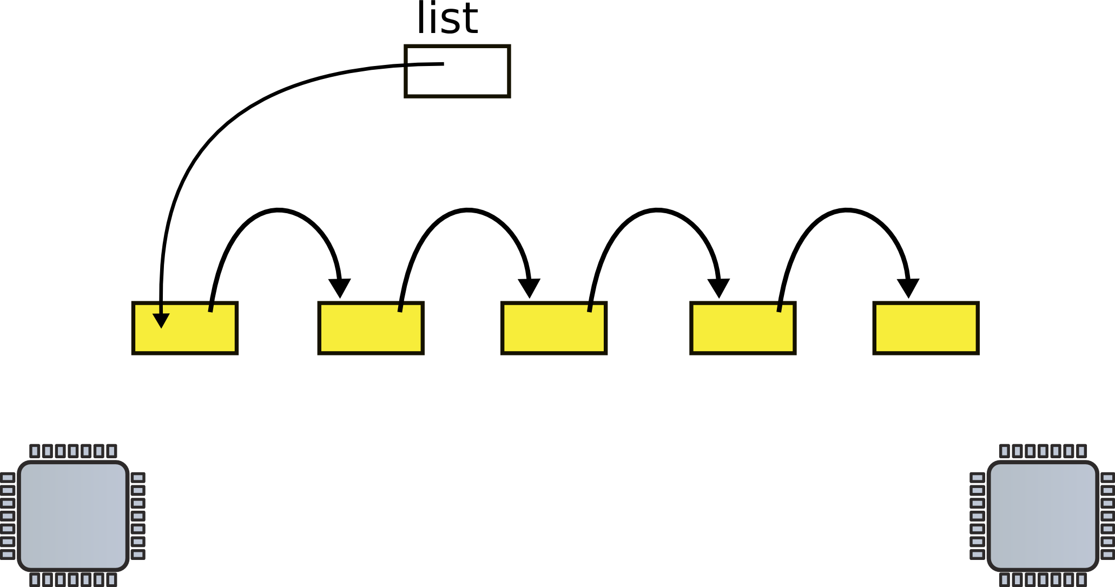
List implementation (no locks)
1 struct list {
2 int data;
3 struct list *next;
4 };
...
6 struct list *list = 0;
...
9 insert(int data)
10 {
11 struct list *l;
12
13 l = malloc(sizeof *l);
14 l->data = data;
15 l->next = list;
16 list = l;
17 }
List
One data element
Pointer to the next element

Slide 52
List implementation (no locks)
1 struct list {
2 int data;
3 struct list *next;
4 };
...
6 struct list *list = 0;
...
9 insert(int data)
10 {
11 struct list *l;
12
13 l = malloc(sizeof *l);
14 l->data = data;
15 l->next = list;
16 list = l;
17 }
Global head

Slide 53
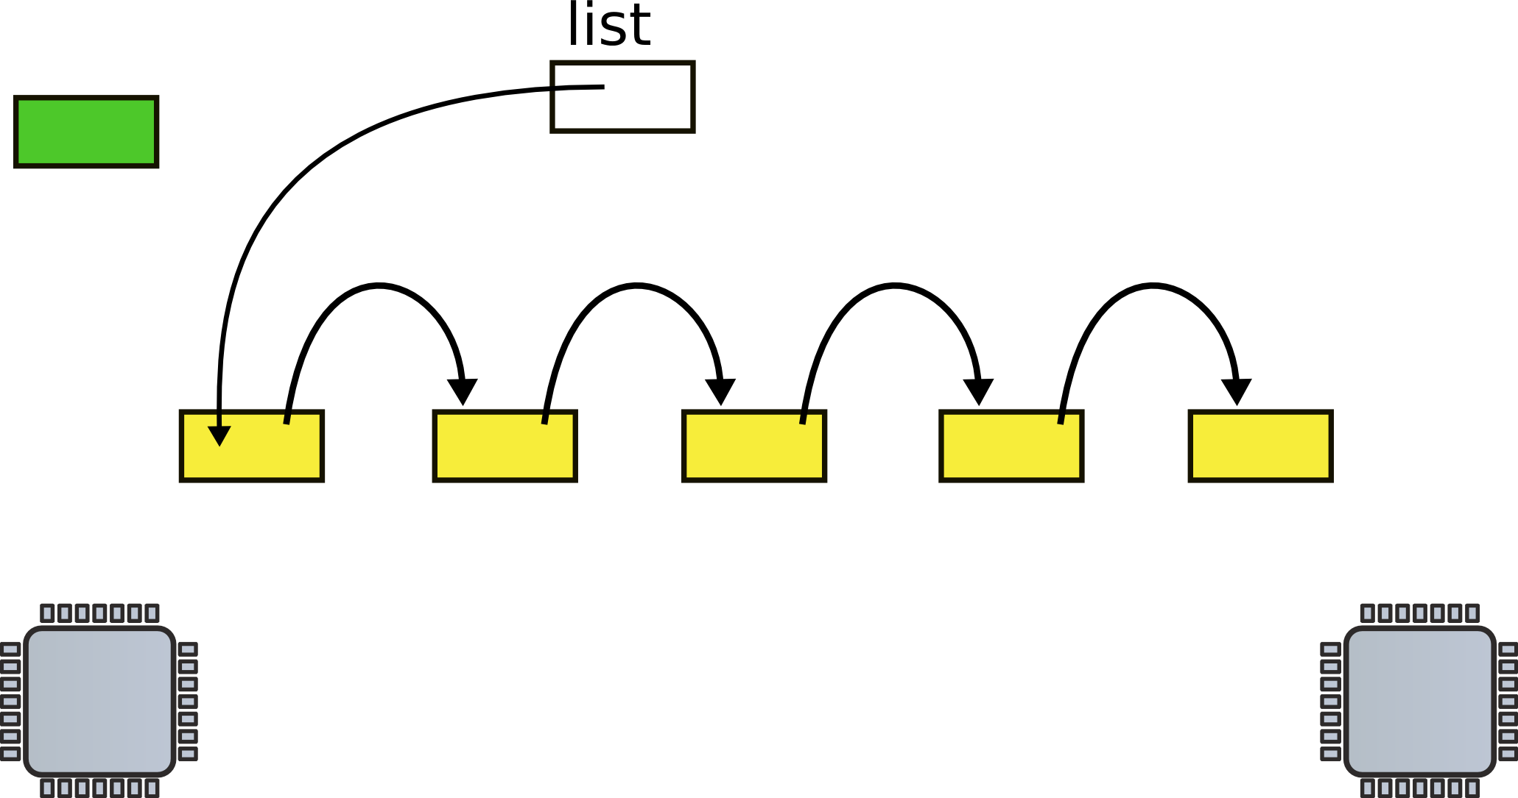
List implementation (no locks)
1 struct list {
2 int data;
3 struct list *next;
4 };
...
6 struct list *list = 0;
...
9 insert(int data)
10 {
11 struct list *l;
12
13 l = malloc(sizeof *l);
14 l->data = data;
15 l->next = list;
16 list = l;
17 }
Insertion
Allocate new list element

Slide 54
List implementation (no locks)
1 struct list {
2 int data;
3 struct list *next;
4 };
...
6 struct list *list = 0;
...
9 insert(int data)
10 {
11 struct list *l;
12
13 l = malloc(sizeof *l);
14 l->data = data;
15 l->next = list;
16 list = l;
17 }
Insertion
Allocate new list element
Save data into that element

Slide 55
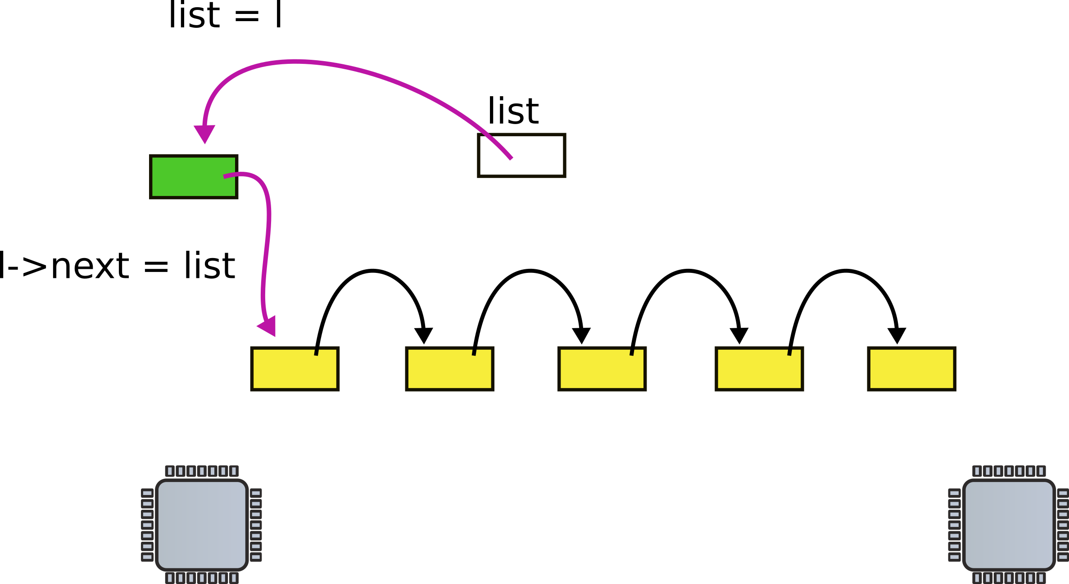
List implementation (no locks)
1 struct list {
2 int data;
3 struct list *next;
4 };
...
6 struct list *list = 0;
...
9 insert(int data)
10 {
11 struct list *l;
12
13 l = malloc(sizeof *l);
14 l->data = data;
15 l->next = list;
16 list = l;
17 }
Insertion
Allocate new list element
Save data into that element
Insert into the list

Slide 56
Now what happens when two CPUs access the same list

Slide 57
Request queue (e.g. pending disk requests)
Linked list, list is pointer to the first element

Slide 58
CPU1 allocates new request

Slide 59
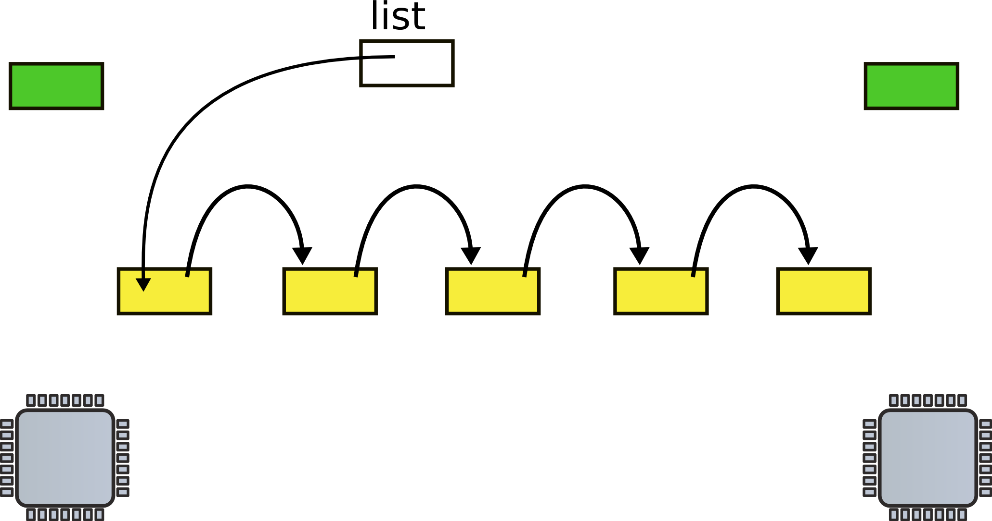
CPU2 allocates new request

Slide 60
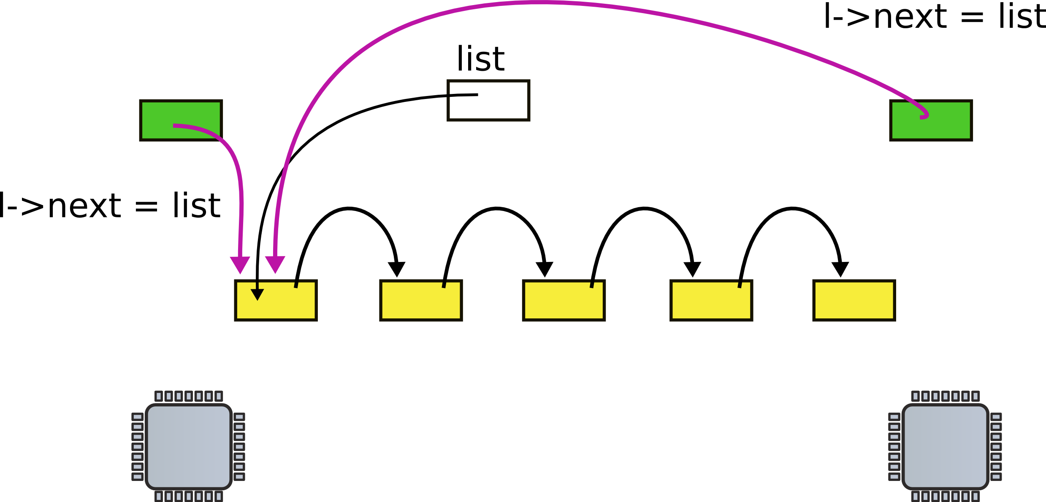
CPUs 1 and 2 update next pointer

Slide 61
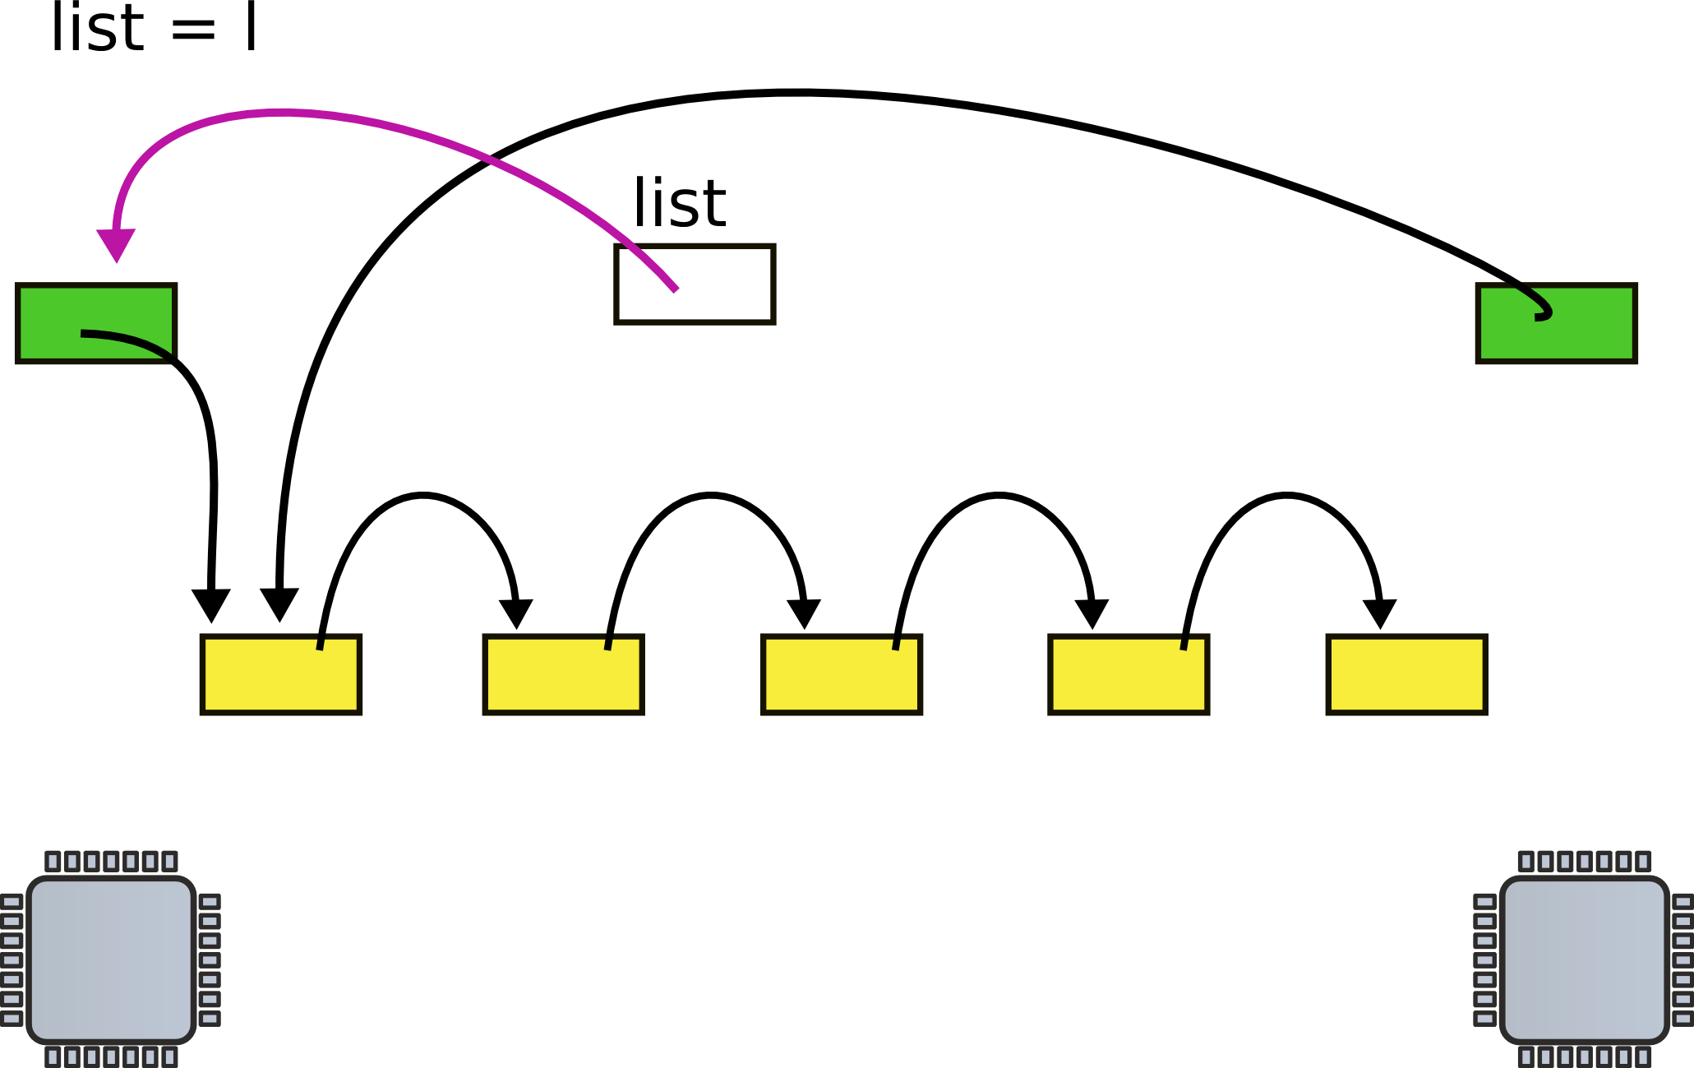
CPU1 updates head pointer

Slide 62
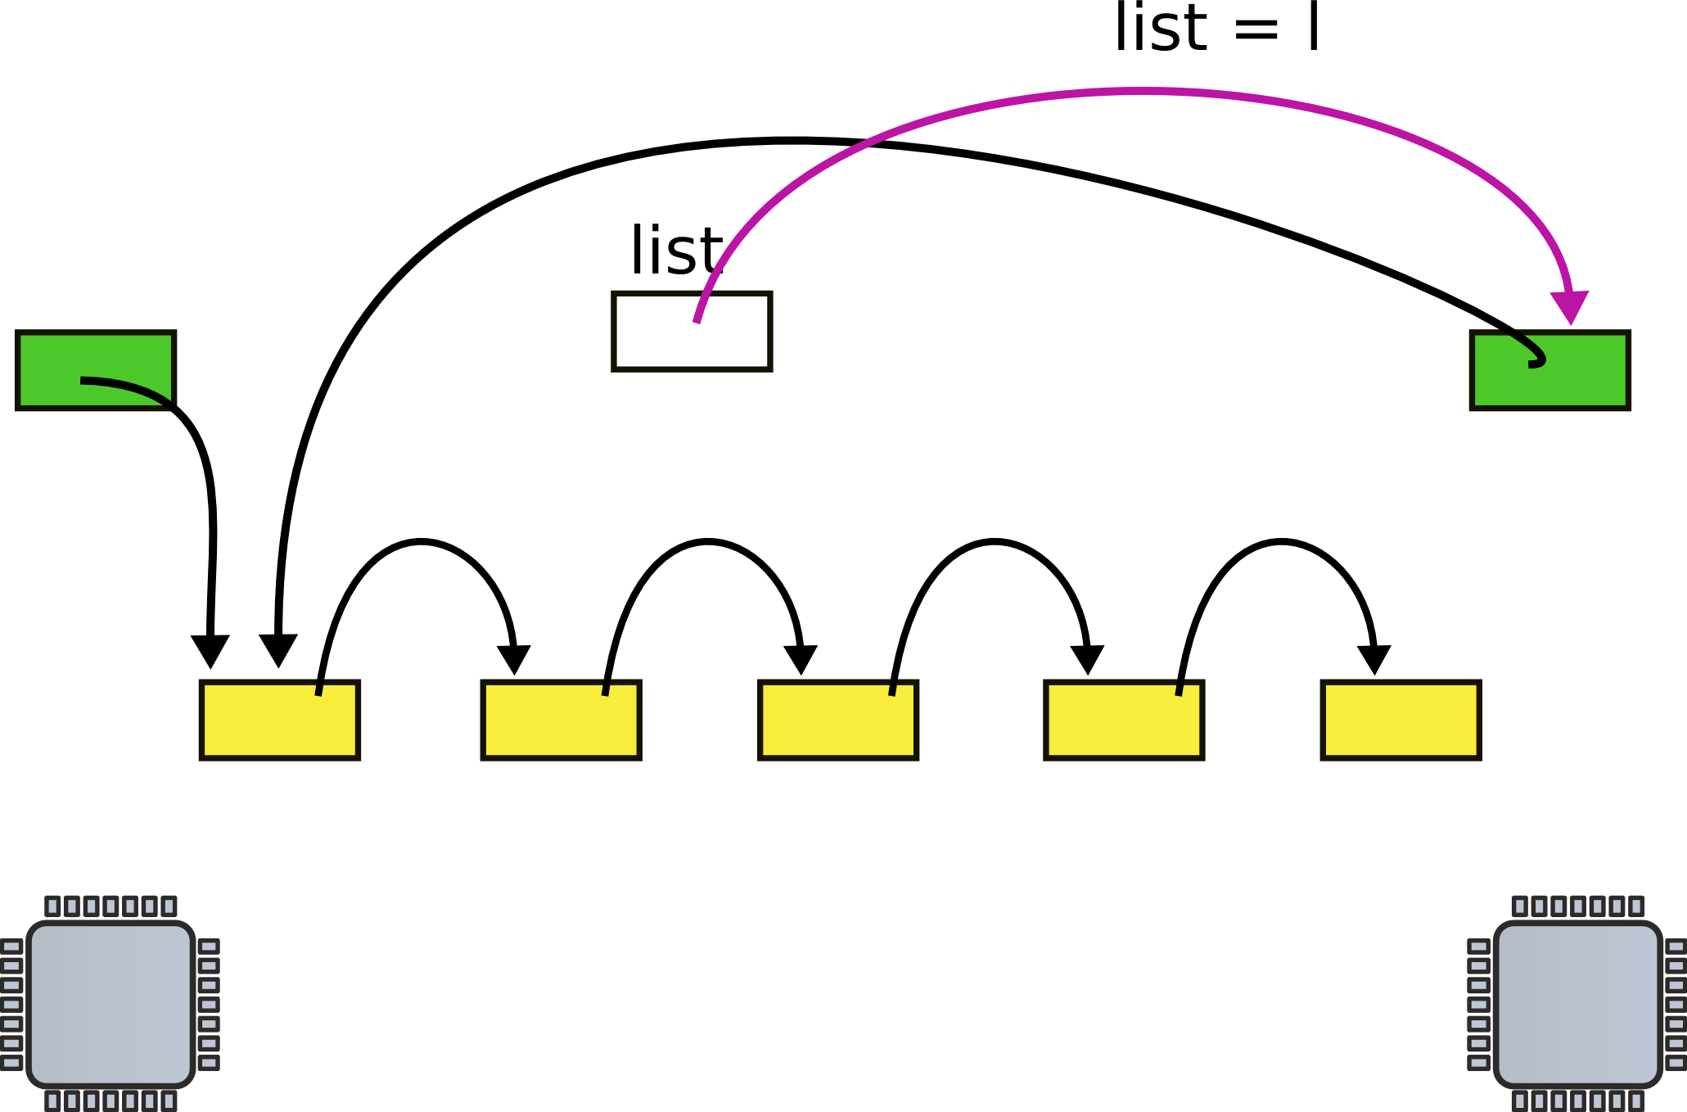
CPU2 updates head pointer

Slide 63
CPU2 updates head pointer
Is everything ok? Poll: PollEv.com/aburtsev

Slide 64
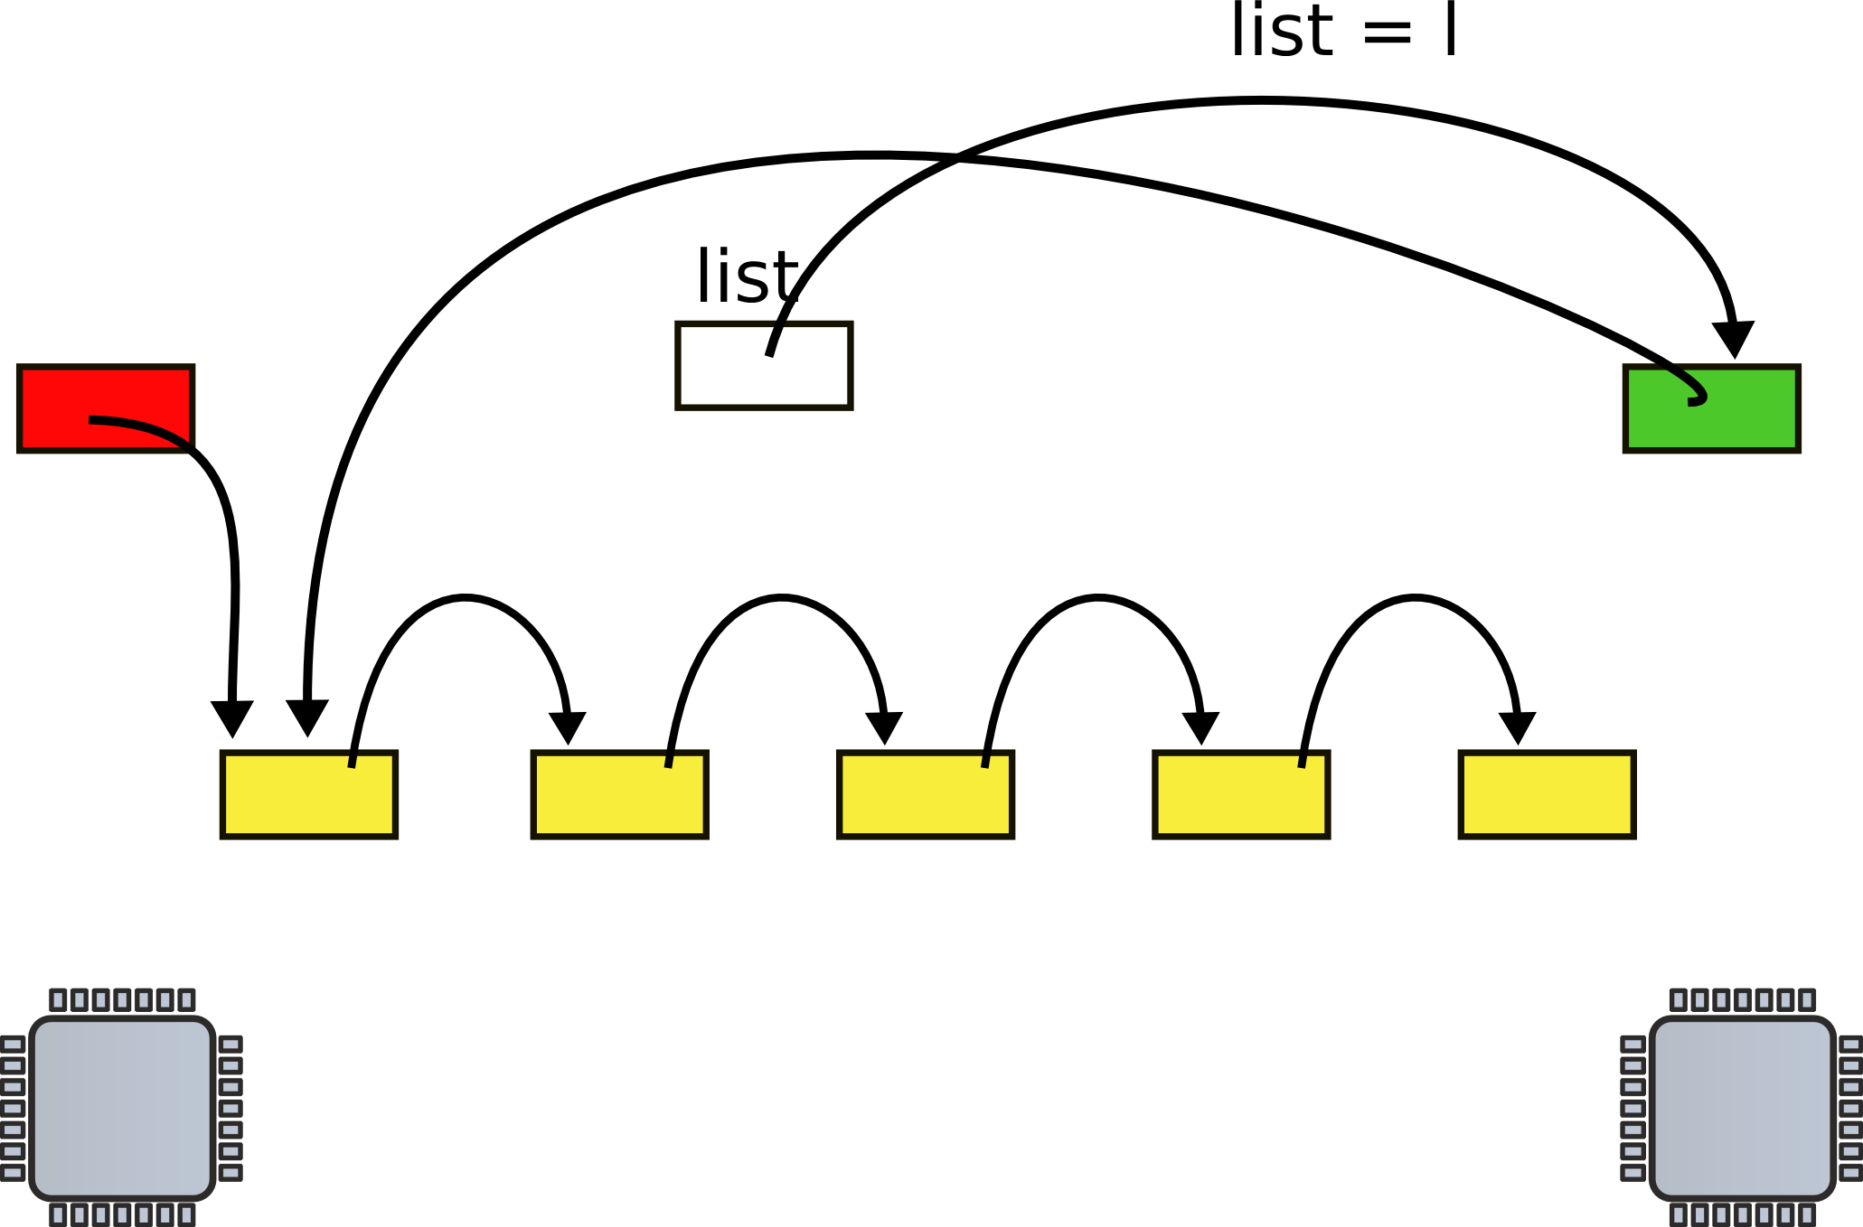
State after the race (red element is lost)

Slide 65
Mutual exclusion
Only one CPU can update list at a time

Slide 66
List implementation with locks
1 struct list {
2 int data;
3 struct list *next;
4 };
6 struct list *list = 0;
struct lock listlock;
9 insert(int data)
10 {
11 struct list *l;
13 l = malloc(sizeof *l);
acquire(&listlock);
14 l->data = data;
15 l->next = list;
16 list = l;
release(&listlock);
17 }
Critical section

Slide 67
How can we implement acquire()?

Slide 68
Spinlock
21 void
22 acquire(struct spinlock *lk)
23 {
24 for(;;) {
25 if(!lk->locked) {
26 lk->locked = 1;
27 break;
28 }
29 }
30 }
Spin until lock is 0
Set it to 1

Slide 69
Still incorrect
21 void
22 acquire(struct spinlock *lk)
23 {
24 for(;;) {
25 if(!lk->locked) {
26 lk->locked = 1;
27 break;
28 }
29 }
30 }
Two CPUs can reach line #25 at the same time
See not locked, and
Acquire the lock
Lines #25 and #26 need to be atomic

Slide 70
Compare and swap: xchg
Swap a word in memory with a new value
Return old value

Slide 71
Correct implementation
1573 void
1574 acquire(struct spinlock *lk)
1575 {
...
1580 // The xchg is atomic.
1581 while(xchg(&lk−>locked, 1) != 0)
1582 ;
...
1592 }

Slide 72
xchg instruction
0568 static inline uint
0569 xchg(volatile uint *addr, uint newval)
0570 {
0571 uint result;
0572
0573 // The + in "+m" denotes a read−modify−write
operand.
0574 asm volatile("lock; xchgl %0, %1" :
0575 "+m" (*addr), "=a" (result) :
0576 "1" (newval) :
0577 "cc");
0578 return result;
0579 }

Slide 73
Correct implementation
1573 void
1574 acquire(struct spinlock *lk)
1575 {
...
1580 // The xchg is atomic.
1581 while(xchg(&lk−>locked, 1) != 0)
1582 ;
1584 // Tell the C compiler and the processor to not move loads or stores
1585 // past this point, to ensure that the critical section’s memory
1586 // references happen after the lock is acquired.
1587 __sync_synchronize();
...
1592 }

Slide 74
Deadlocks

Slide 75
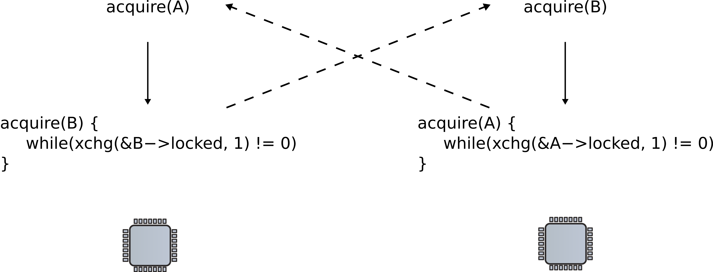
Deadlocks

Slide 76
Lock ordering
Locks need to be acquired in the same order

Slide 77
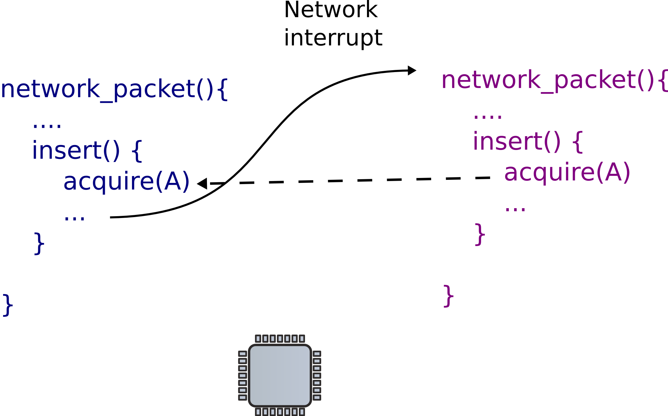
Locks and interrupts

Slide 78
Locks and interrupts
Never hold a lock with interrupts enabled

Slide 79
Disabling interrupts
1573 void
1574 acquire(struct spinlock *lk)
1575 {
1576 pushcli(); // disable interrupts to avoid deadlock.
1577 if(holding(lk))
1578 panic("acquire");
1580 // The xchg is atomic.
1581 while(xchg(&lk−>locked, 1) != 0)
1582 ;
...
1587 __sync_synchronize();
...
1592 }

Slide 80
Simple disable/enable is not enough
If two locks are acquired
Interrupts should be re-enabled only after the second lock is released
Pushcli() uses a counter

Slide 81
Pushcli()/popcli()
1655 pushcli(void)
1656 {
1657 int eflags;
1658
1659 eflags = readeflags();
1660 cli();
1661 if(cpu−>ncli == 0)
1662 cpu−>intena = eflags & FL_IF;
1663 cpu−>ncli += 1;
1664 }

Slide 82
Pushcli()/popcli()
1667 popcli(void)
1668 {
1669 if(readeflags()&FL_IF)
1670 panic("popcli − interruptible");
1671 if(−−cpu−>ncli < 0)
1672 panic("popcli");
1673 if(cpu−>ncli == 0 && cpu−>intena)
1674 sti();
1675 }

Slide 83
Locks and interprocess communication

Slide 84
Send/receive queue
100 struct q {
101 void *ptr;
102 };
103
104 void*
105 send(struct q *q, void *p)
106 {
107 while(q->ptr != 0)
108 ;
109 q->ptr = p;
110 }
112 void*
113 recv(struct q *q)
114 {
115 void *p;
116
117 while((p = q->ptr) == 0)
118 ;
119 q->ptr = 0;
120 return p;
121 }
Sends one pointer between two CPUs

Slide 85
Send/receive queue
100 struct q {
101 void *ptr;
102 };
103
104 void*
105 send(struct q *q, void *p)
106 {
107 while(q->ptr != 0)
108 ;
109 q->ptr = p;
110 }
112 void*
113 recv(struct q *q)
114 {
115 void *p;
116
117 while((p = q->ptr) == 0)
118 ;
119 q->ptr = 0;
120 return p;
121 }

Slide 86
Send/receive queue
100 struct q {
101 void *ptr;
102 };
103
104 void*
105 send(struct q *q, void *p)
106 {
107 while(q->ptr != 0)
108 ;
109 q->ptr = p;
110 }
112 void*
113 recv(struct q *q)
114 {
115 void *p;
116
117 while((p = q->ptr) == 0)
118 ;
119 q->ptr = 0;
120 return p;
121 }

Slide 87
Send/receive queue
100 struct q {
101 void *ptr;
102 };
103
104 void*
105 send(struct q *q, void *p)
106 {
107 while(q->ptr != 0)
108 ;
109 q->ptr = p;
110 }
112 void*
113 recv(struct q *q)
114 {
115 void *p;
116
117 while((p = q->ptr) == 0)
118 ;
119 q->ptr = 0;
120 return p;
121 }
Poll: https://pollev.com/aburtsev

Slide 88
Send/receive queue
100 struct q {
101 void *ptr;
102 };
103
104 void*
105 send(struct q *q, void *p)
106 {
107 while(q->ptr != 0)
108 ;
109 q->ptr = p;
110 }
112 void*
113 recv(struct q *q)
114 {
115 void *p;
116
117 while((p = q->ptr) == 0)
118 ;
119 q->ptr = 0;
120 return p;
121 }
Works well, but expensive if communication is rare
Receiver wastes CPU cycles

Slide 89
Sleep and wakeup
sleep(channel)
Put calling process to sleep
Release CPU for other work
wakeup(channel)
Wakes all processes sleeping on a channel if any
i.e., causes sleep() calls to return

Slide 90
Send/receive queue
201 void*
202 send(struct q *q, void *p)
203 {
204 while(q->ptr != 0)
205 ;
206 q->ptr = p;
207 wakeup(q); /*wake recv*/
208 }
210 void*
211 recv(struct q *q)
212 {
213 void *p;
214
215 while((p = q->ptr) == 0)
216 sleep(q);
217 q->ptr = 0;
218 return p;
219 }

Slide 91
Send/receive queue
201 void*
202 send(struct q *q, void *p)
203 {
204 while(q->ptr != 0)
205 ;
206 q->ptr = p;
207 wakeup(q); /*wake recv*/
208 }
210 void*
211 recv(struct q *q)
212 {
213 void *p;
214
215 while((p = q->ptr) == 0)
216 sleep(q);
217 q->ptr = 0;
218 return p;
219 }
recv() gives up the CPU to other processes
But there is a problem...

Slide 92
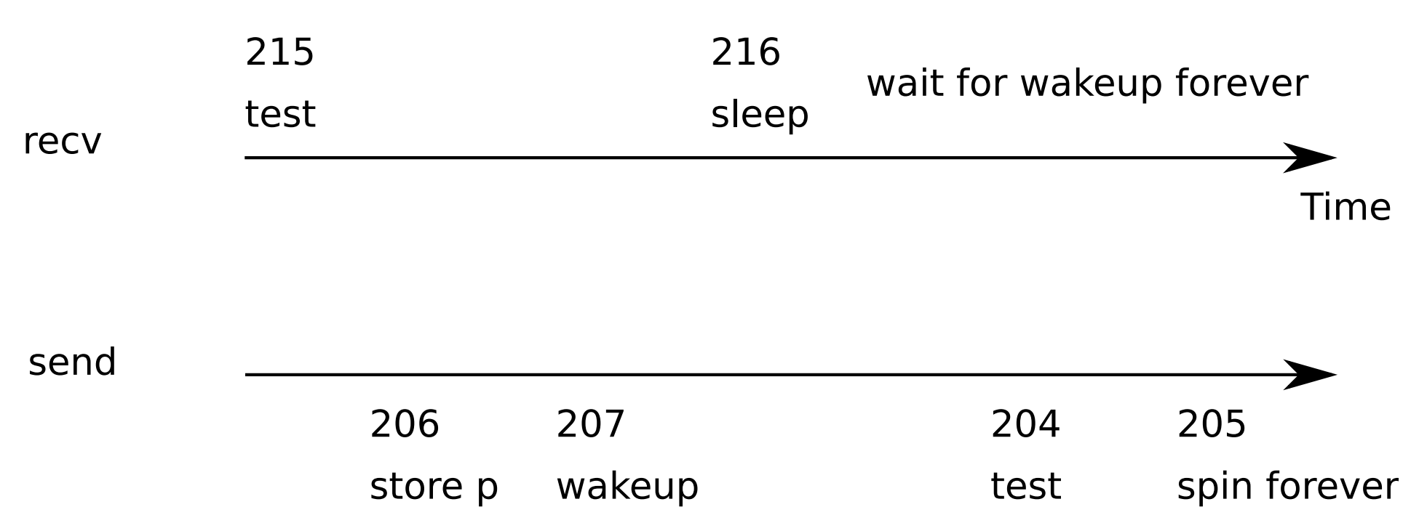
Lost wakeup problem

Slide 93
Lock the queue
300 struct q {
301 struct spinlock lock;
302 void *ptr;
303 };
304
305 void*
306 send(struct q *q, void *p)
307 {
308 acquire(&q->lock);
309 while(q->ptr != 0)
310 ;
311 q->ptr = p;
312 wakeup(q);
313 release(&q->lock);
314 }
316 void*
317 recv(struct q *q)
318 {
319 void *p;
320
321 acquire(&q->lock);
322 while((p = q->ptr) == 0)
323 sleep(q);
324 q->ptr = 0;
325 release(&q->lock);
326 return p;
327 }

Slide 94
Doesn't work either: deadlocks
Holds a lock while sleeping

Slide 95
Pass lock inside sleep()
300 struct q {
301 struct spinlock lock;
302 void *ptr;
303 };
304
305 void*
306 send(struct q *q, void *p)
307 {
308 acquire(&q->lock);
309 while(q->ptr != 0)
310 ;
311 q->ptr = p;
312 wakeup(q);
313 release(&q->lock);
314 }
316 void*
317 recv(struct q *q)
318 {
319 void *p;
320
321 acquire(&q->lock);
322 while((p = q->ptr) == 0)
323 sleep(q, &q->lock);
324 q->ptr = 0;
325 release(&q->lock);
326 return p;
327 }

Slide 96
sleep()
2809 sleep(void *chan, struct spinlock *lk)
2810 {
...
2823 if(lk != &ptable.lock){
2824 acquire(&ptable.lock);
2825 release(lk);
2826 }
2827
2828 // Go to sleep.
2829 proc−>chan = chan;
2830 proc−>state = SLEEPING;
2831 sched();
...
2836 // Reacquire original lock.
2837 if(lk != &ptable.lock){
2838 release(&ptable.lock);
2839 acquire(lk);
2840 }
2841 }
Two steps:
Acquire ptable.lock
All process operations are protected with ptable.lock

Slide 97
sleep()
2809 sleep(void *chan, struct spinlock *lk)
2810 {
...
2823 if(lk != &ptable.lock){
2824 acquire(&ptable.lock);
2825 release(lk);
2826 }
2827
2828 // Go to sleep.
2829 proc−>chan = chan;
2830 proc−>state = SLEEPING;
2831 sched();
...
2836 // Reacquire original lock.
2837 if(lk != &ptable.lock){
2838 release(&ptable.lock);
2839 acquire(lk);
2840 }
2841 }
Two steps:
Acquire ptable.lock
All process operations are protected with ptable.lock
Release lk lock
Why is it safe?

Slide 98
sleep()
2809 sleep(void *chan, struct spinlock *lk)
2810 {
...
2823 if(lk != &ptable.lock){
2824 acquire(&ptable.lock);
2825 release(lk);
2826 }
2827
2828 // Go to sleep.
2829 proc−>chan = chan;
2830 proc−>state = SLEEPING;
2831 sched();
...
2836 // Reacquire original lock.
2837 if(lk != &ptable.lock){
2838 release(&ptable.lock);
2839 acquire(lk);
2840 }
2841 }
Acquire ptable.lock
All process operations are protected with ptable.lock
Release lk
Why is it safe?
Even if new wakeup starts at this point, it cannot proceed
Sleep() holds ptable.lock

Slide 99
wakeup()
2853 wakeup1(void *chan)
2854 {
2855 struct proc *p;
2856
2857 for(p = ptable.proc; p < &ptable.proc[NPROC]; p++)
2858 if(p−>state == SLEEPING && p−>chan == chan)
2859 p−>state = RUNNABLE;
2860 }
..
2864 wakeup(void *chan)
2865 {
2866 acquire(&ptable.lock);
2867 wakeup1(chan);
2868 release(&ptable.lock);
2869 }

Slide 100
Thank you!

Slide 101
Pipes

Slide 102
Pipe
6459 #define PIPESIZE 512
6460
6461 struct pipe {
6462 struct spinlock lock;
6463 char data[PIPESIZE];
6464 uint nread; // number of bytes read
6465 uint nwrite; // number of bytes written
6466 int readopen; // read fd is still open
6467 int writeopen; // write fd is still open
6468 };

Slide 103
Pipe
6459 #define PIPESIZE 512
6460
6461 struct pipe {
6462 struct spinlock lock;
6463 char data[PIPESIZE];
6464 uint nread; // number of bytes read
6465 uint nwrite; // number of bytes written
6466 int readopen; // read fd is still open
6467 int writeopen; // write fd is still open
6468 };

Slide 104
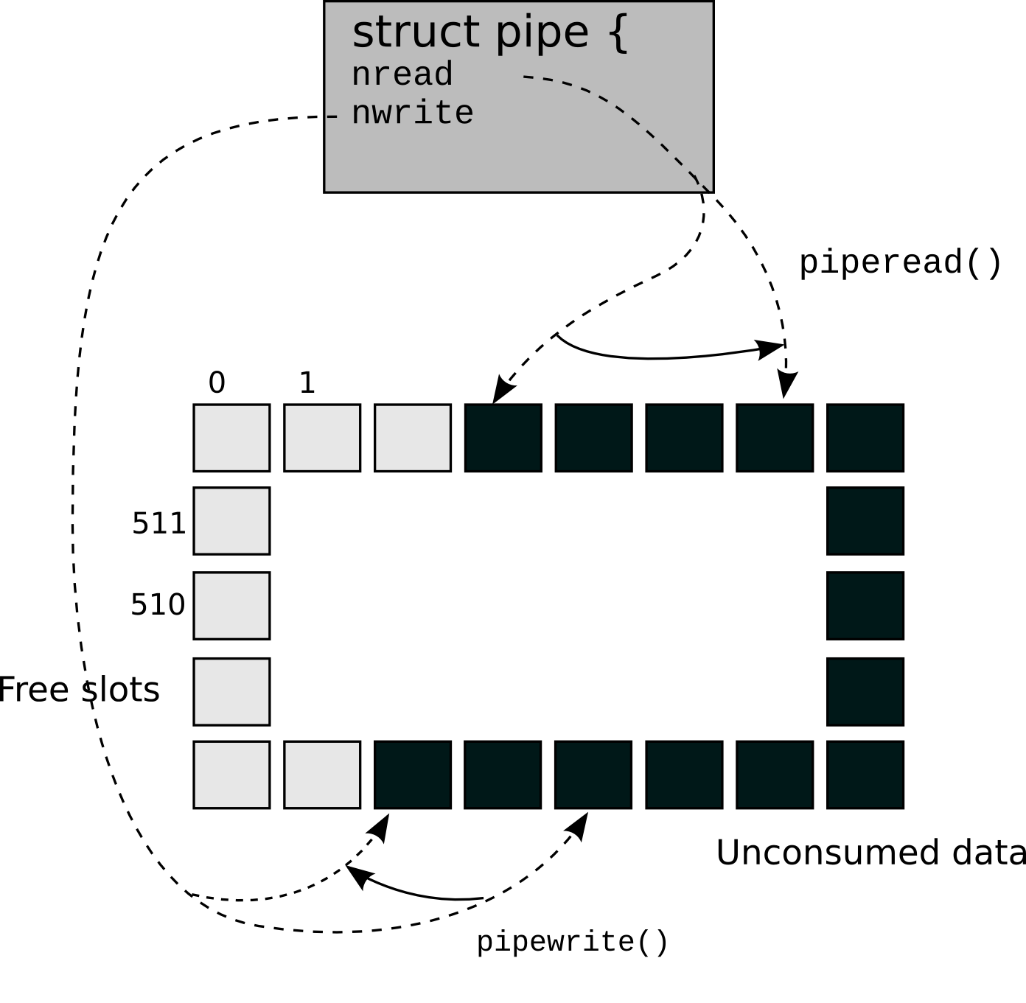
Pipe buffer
Buffer full
p−>nwrite == p−>nread + PIPESIZE
Buffer empty
p−>nwrite == p−>nread

Slide 105
Pipe buffer
Buffer full
p−>nwrite == p−>nread + PIPESIZE
Buffer empty
p−>nwrite == p−>nread

Slide 106
Pipe buffer
Buffer full
p−>nwrite == p−>nread + PIPESIZE
Buffer empty
p−>nwrite == p−>nread

Slide 107
Pipe buffer
Buffer full
p−>nwrite == p−>nread + PIPESIZE
Buffer empty
p−>nwrite == p−>nread

Slide 108
piperead()
6551 piperead(struct pipe *p, char *addr, int n)
6552 {
6553 int i;
6554
6555 acquire(&p−>lock);
6556 while(p−>nread == p−>nwrite && p−>writeopen){
6557 if(proc−>killed){
6558 release(&p−>lock);
6559 return −1;
6560 }
6561 sleep(&p−>nread, &p−>lock);
6562 }
6563 for(i = 0; i < n; i++){
6564 if(p−>nread == p−>nwrite)
6565 break;
6566 addr[i] = p−>data[p−>nread++ % PIPESIZE];
6567 }
6568 wakeup(&p−>nwrite);
6569 release(&p−>lock);
6570 return i;
6571 }
Acquire pipe lock
All pipe operations are are protected with the lock

Slide 109
piperead()
6551 piperead(struct pipe *p, char *addr, int n)
6552 {
6553 int i;
6554
6555 acquire(&p−>lock);
6556 while(p−>nread == p−>nwrite && p−>writeopen){
6557 if(proc−>killed){
6558 release(&p−>lock);
6559 return −1;
6560 }
6561 sleep(&p−>nread, &p−>lock);
6562 }
6563 for(i = 0; i < n; i++){
6564 if(p−>nread == p−>nwrite)
6565 break;
6566 addr[i] = p−>data[p−>nread++ % PIPESIZE];
6567 }
6568 wakeup(&p−>nwrite);
6569 release(&p−>lock);
6570 return i;
6571 }
If the buffer is empty && the write end is still open
Go to sleep

Slide 110
piperead()
6551 piperead(struct pipe *p, char *addr, int n)
6552 {
6553 int i;
6554
6555 acquire(&p−>lock);
6556 while(p−>nread == p−>nwrite && p−>writeopen){
6557 if(proc−>killed){
6558 release(&p−>lock);
6559 return −1;
6560 }
6561 sleep(&p−>nread, &p−>lock);
6562 }
6563 for(i = 0; i < n; i++){
6564 if(p−>nread == p−>nwrite)
6565 break;
6566 addr[i] = p−>data[p−>nread++ % PIPESIZE];
6567 }
6568 wakeup(&p−>nwrite);
6569 release(&p−>lock);
6570 return i;
6571 }
After reading some data from the buffer
Wakeup the writer

Slide 111
pipewrite()
6530 pipewrite(struct pipe *p, char *addr, int n)
6531 {
6532 int i;
6533
6534 acquire(&p−>lock);
6535 for(i = 0; i < n; i++){
6536 while(p−>nwrite == p−>nread + PIPESIZE){
6537 if(p−>readopen == 0 || proc−>killed){
6538 release(&p−>lock);
6539 return −1;
6540 }
6541 wakeup(&p−>nread);
6542 sleep(&p−>nwrite, &p−>lock);
6543 }
6544 p−>data[p−>nwrite++ % PIPESIZE] = addr[i];
6545 }
6546 wakeup(&p−>nread);
6547 release(&p−>lock);
6548 return n;
6549 }
If the buffer is full
Wakeup reader
Go to sleep

Slide 112
pipewrite()
6530 pipewrite(struct pipe *p, char *addr, int n)
6531 {
6532 int i;
6533
6534 acquire(&p−>lock);
6535 for(i = 0; i < n; i++){
6536 while(p−>nwrite == p−>nread + PIPESIZE){
6537 if(p−>readopen == 0 || proc−>killed){
6538 release(&p−>lock);
6539 return −1;
6540 }
6541 wakeup(&p−>nread);
6542 sleep(&p−>nwrite, &p−>lock);
6543 }
6544 p−>data[p−>nwrite++ % PIPESIZE] = addr[i];
6545 }
6546 wakeup(&p−>nread);
6547 release(&p−>lock);
6548 return n;
6549 }
If the buffer is full
Wakeup reader
Go to sleep
However if the read end is closed
Return an error
(-1)

Slide 113
pipewrite()
6530 pipewrite(struct pipe *p, char *addr, int n)
6531 {
6532 int i;
6533
6534 acquire(&p−>lock);
6535 for(i = 0; i < n; i++){
6536 while(p−>nwrite == p−>nread + PIPESIZE){
6537 if(p−>readopen == 0 || proc−>killed){
6538 release(&p−>lock);
6539 return −1;
6540 }
6541 wakeup(&p−>nread);
6542 sleep(&p−>nwrite, &p−>lock);
6543 }
6544 p−>data[p−>nwrite++ % PIPESIZE] = addr[i];
6545 }
6546 wakeup(&p−>nread);
6547 release(&p−>lock);
6548 return n;
6549 }
Otherwise keep writing bytes into the pipe
When done
Wakeup reader

