Slide 1
3810: Computer Organization
Lecture 3: Basic MIPS Architecture
Anton Burtsev
October, 2022

Slide 2
Basic MIPS Architecture
Now that we understand clocks and storage of states,
we’ll design a simple CPU that executes:
  basic math (add, sub, and, or, slt)
  memory access (lw and sw)
  branch and jump instructions (beq and j)

Slide 3
Implementation Overview
We need memory
  to store instructions
  to store data
  for now, let’s make them separate units
We need registers, ALU, and a whole lot of control logic
CPU operations common to all instructions:
  use the program counter (PC) to pull instruction out
  of instruction memory
  read register values

Slide 4
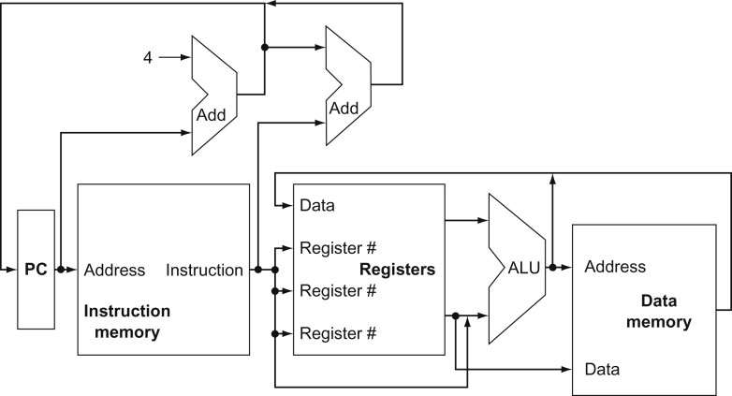
View from 30,000 Feet
Note: we haven’t bothered
showing multiplexors
What is the role of the Add units?
Explain the inputs to the data memory unit
Explain the inputs to the ALU
Explain the inputs to the register unit
Source: H&P textbook

Slide 5
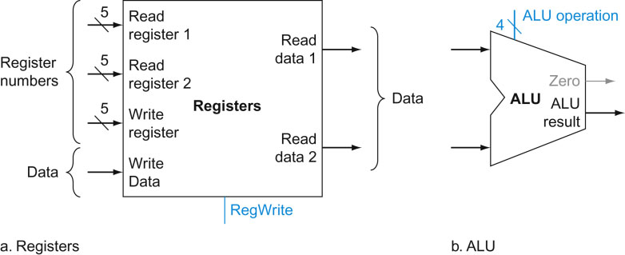
Implementing R-type Instructions
Instructions of the form add $r1, $r2, $r3
Explain the role of each signal
Source: H&P textbook

Slide 6
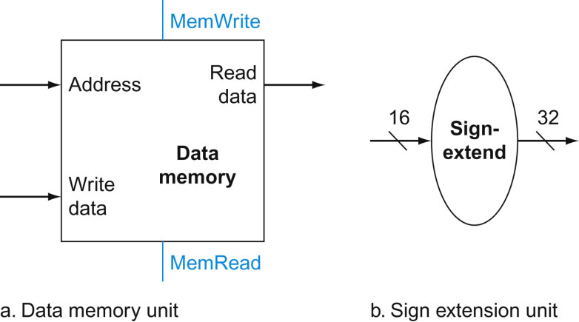
Implementing Loads/Stores
Instructions of the form lw $r1, 8($r2) and sw $r1, 8($r2)
Explain the role of each signal
Where does this input come from?
Source: H&P textbook

Slide 7
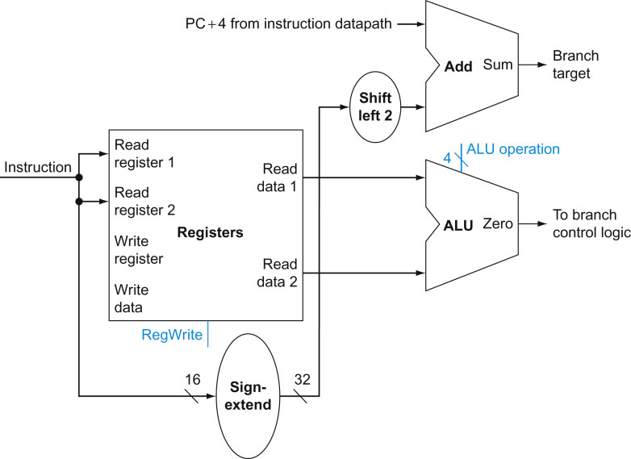
Implementing J-type Instructions
Instructions of the form beq $r1, $r2, offset
Source: H&P textbook

Slide 8
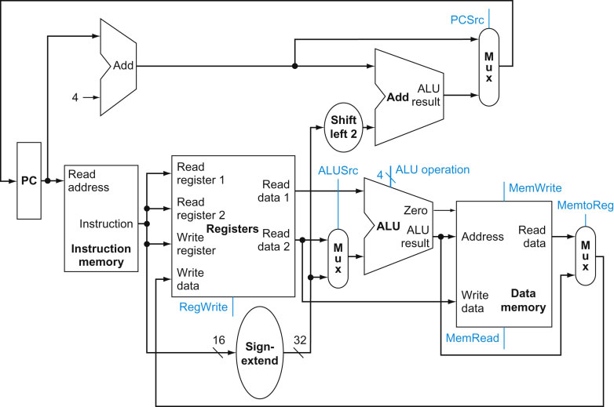
View from 10,000 Feet
Source: H&P textbook

Slide 9
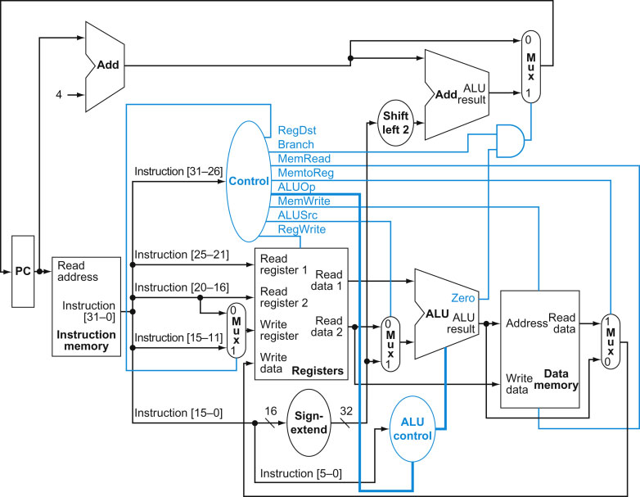
View from 5,000 Feet
Source: H&P textbook

Slide 10
Thank you!

Slide 11
Clocking Methodology
Source: H&P textbook
Which of the above units need a clock?
What is being saved (latched) on the rising edge of the clock?
Keep in mind that the latched value remains there for an entire cycle

