Slide 1
CS/ECE 3810: Computer Organization
Lecture 3: Understanding Performance
Anton Burtsev
August, 2022

Slide 2
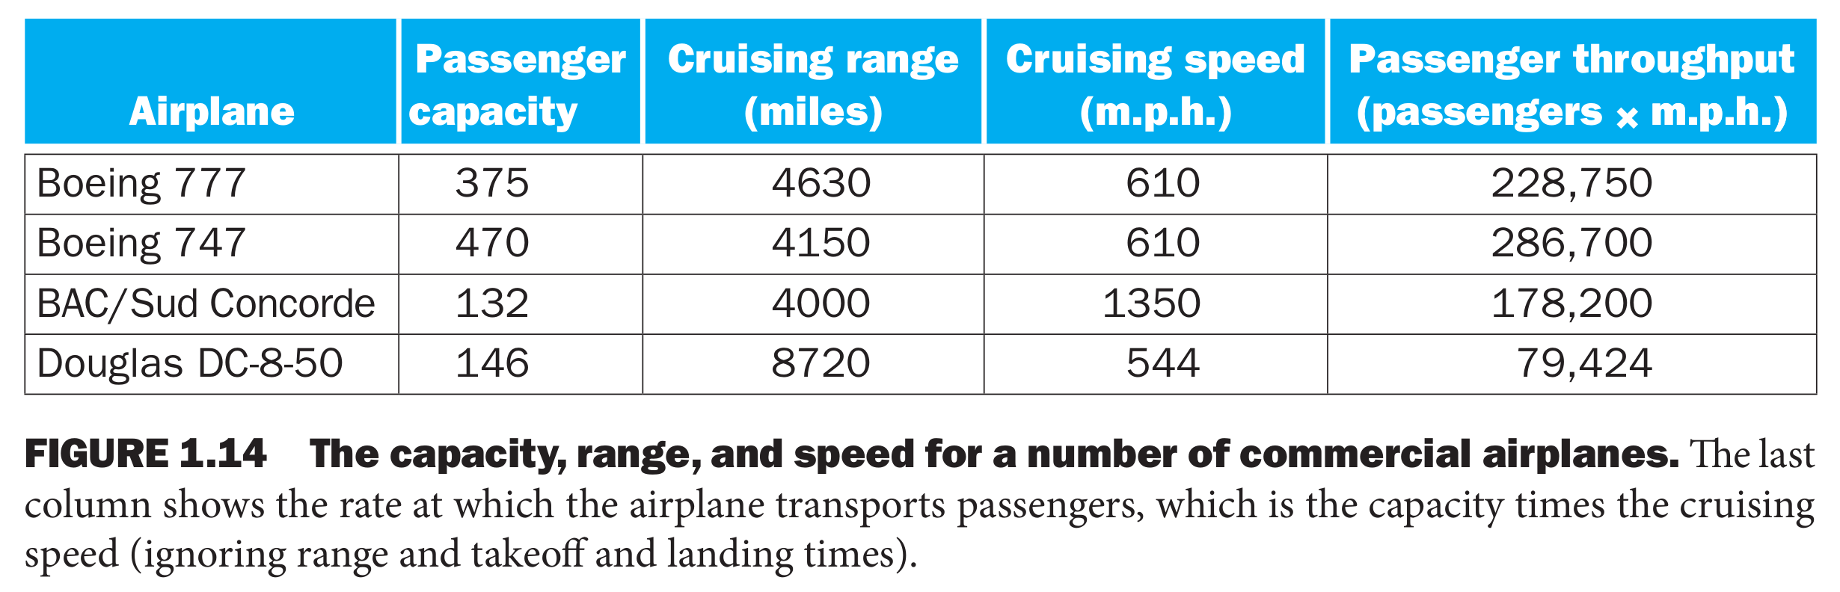
Defining performance

Slide 3
Performance metrics
Possible measures:
  response time – time elapsed between start and end
of a program
  throughput – amount of work done in a fixed time
The two measures are usually linked
  A faster processor will improve both
  More processors will likely only improve throughput
  Some policies will improve throughput and worsen
response time (or vice versa)
What influences performance?

Slide 4
Example
Do the following changes to a computer system increase throughput, decrease response time, or both?
  Replacing the processor in a computer with a faster version
  Adding additional processors to a system that uses multiple processors for separate tasks—for example, searching the web

Slide 5
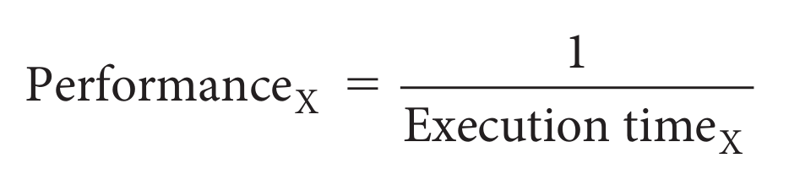
Execution Time
Consider a system X executing a fixed workload W
Execution time = response time = wall clock time
- Note that this includes time to execute the workload
as well as time spent by the operating system
co-ordinating various events
The UNIX “time” command breaks up the wall clock time
as user and system time

Slide 6
Speedup and Improvement
Example:
  System X executes a program in 10 seconds, system Y
executes the same program in 15 seconds
System X is 1.5 times faster than system Y
The speedup of system X over system Y is 1.5 (the ratio)
= perf X / perf Y = exectime Y / exectime X
The performance improvement of X over Y is
1.5 -1 = 0.5 = 50% = (perf X – perf Y) / perf Y = speedup - 1

Slide 7
Factors influencing performance

Slide 8
A Primer on Clocks and Cycles

Slide 9
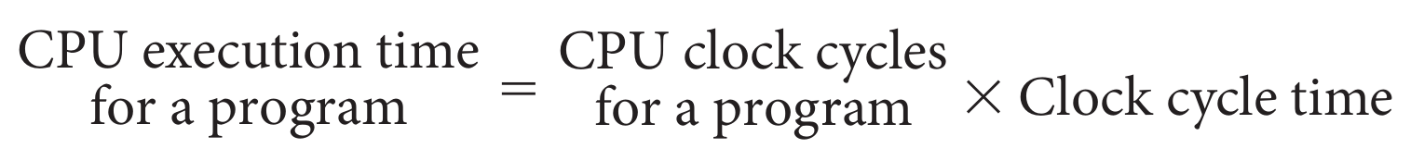
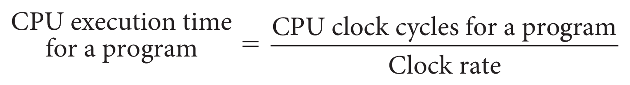
Performance Equation
or alternatively
If a processor has a frequency of 2 GHz, the clock ticks
2 billion times in a second as we’ll soon see, with each
clock tick, one or more/less instructions may complete

Slide 10
Performance Equation
or alternatively
If a processor has a frequency of 2 GHz, the clock ticks
2 billion times in a second – as we’ll soon see, with each
clock tick, one or more/less instructions may complete
If a program runs for 10 seconds on a 2 GHz processor,
how many clock cycles did it run for?

Slide 11
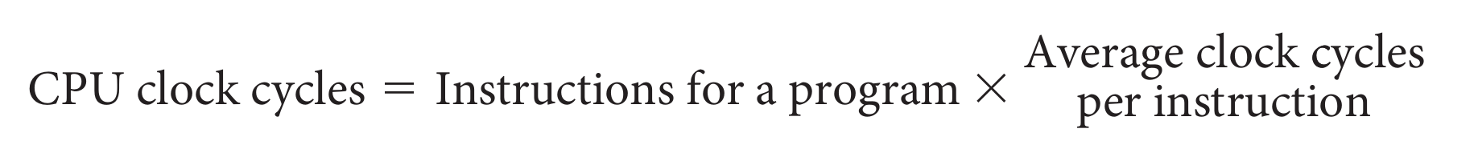
Performance Equation (continued)
We call average clock cycles per instruction = CPI
If we substitute CPU clock cycles in
We get:
If a 2 GHz processor graduates an instruction every third cycle, how many instructions are there in a program that runs for 10 seconds?

Slide 12
Classic performance equation
Three factors that influence performance
  Instruction count
  CPI
  Clock cycle time
If a 2 GHz processor graduates an instruction every third cycle, how many instructions are there in a program that runs for 10 seconds?

Slide 13
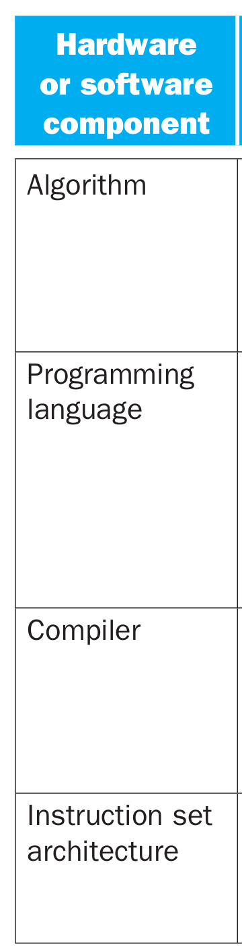
Factors Influencing Performance

Slide 14
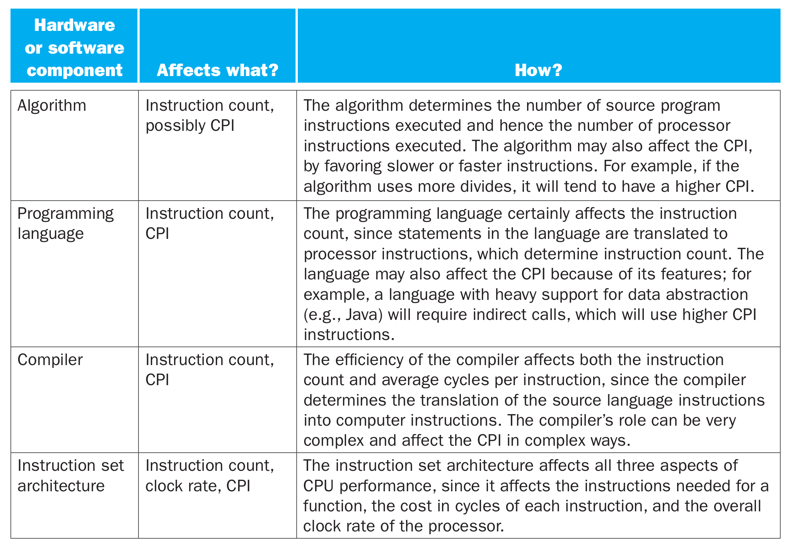
Factors Influencing Performance

Slide 15
Benchmark Suites
Each vendor announces a SPEC rating for their system
  a measure of execution time for a fixed collection of
programs
  is a function of a specific CPU, memory system, IO
system, operating system, compiler
  enables easy comparison of different systems
The key is coming up with a collection of relevant programs

Slide 16
Comparing performance

Slide 17
SPEC CPU
SPEC: System Performance Evaluation Corporation, an industry
consortium that creates a collection of relevant programs
SPEC 2006 includes 12 integer and 17 floating-point applications
The SPEC rating specifies how much faster a system is, compared
to a baseline machine – a system with SPEC rating 600 is 1.5
times faster than a system with SPEC rating 400
Note that this rating incorporates the behavior of all 29
programs – this may not necessarily predict performance for
your favorite program!
Latest version: SPEC 2017

Slide 18
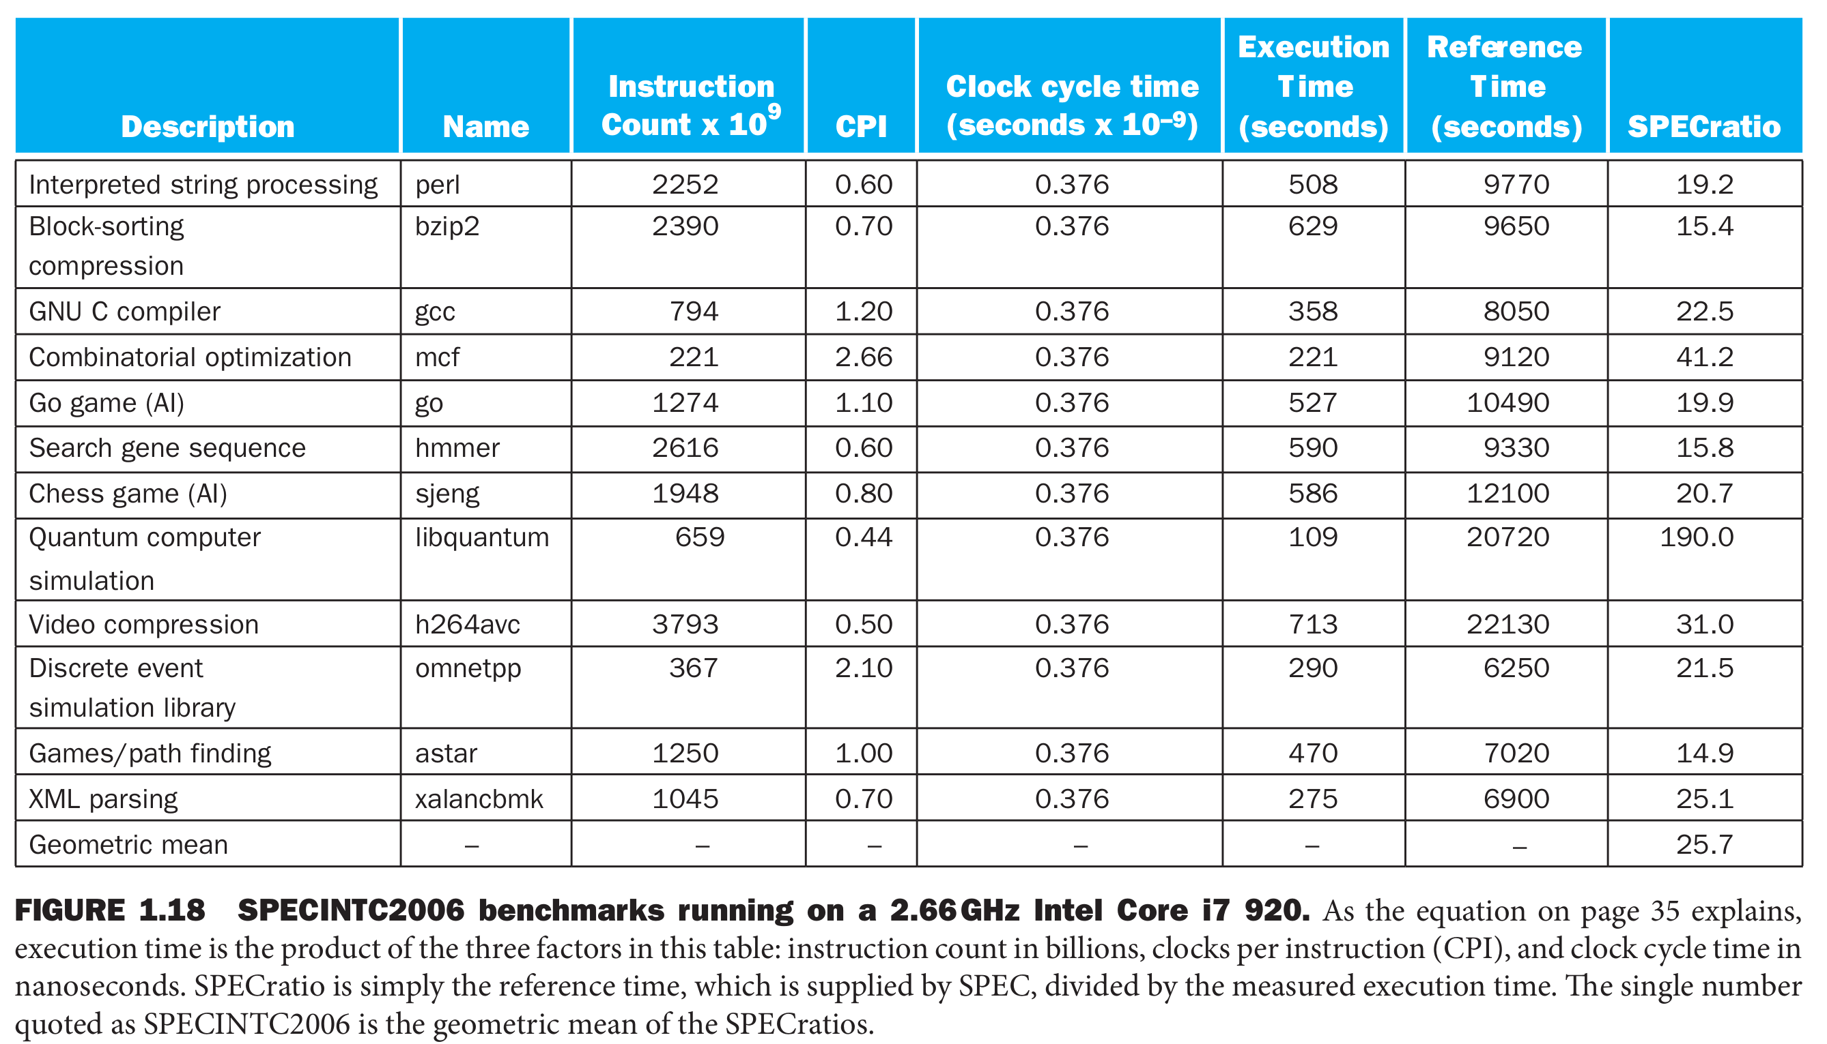

Slide 19
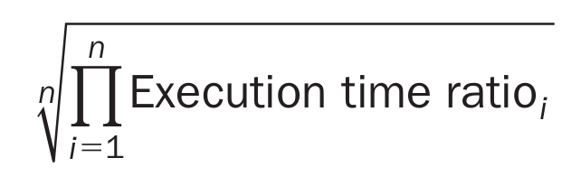
Deriving a Single Performance Number
How is the performance of 29 different apps compressed
into a single performance number?
SPEC uses geometric mean (GM) – the execution time
of each program is multiplied and the N^{th} root is derived
Another popular metric is arithmetic mean (AM) – the
average of each program’s execution time
Weighted arithmetic mean – the execution times of some
programs are weighted to balance priorities

Slide 20
Amdahl’s Law
Architecture design is very bottleneck-driven – make the
common case fast, do not waste resources on a component
that has little impact on overall performance/power
Amdahl’s Law: performance improvements through an
enhancement is limited by the fraction of time the
enhancement comes into play
Example: a web server spends 40% of time in the CPU
and 60% of time doing I/O – a new processor that is ten
times faster results in a 36% reduction in execution time
(speedup of 1.56) – Amdahl’s Law states that maximum
execution time reduction is 40% (max speedup of 1.66)

Slide 21
Recap
Knowledge of hardware improves software quality:
compilers, OS, threaded programs, memory management
Important trends: growing transistors, move to multi-core
and accelerators, slowing rate of performance improvement,
power/thermal constraints, long memory/disk latencies
Reasoning about performance: clock speeds, CPI,
benchmark suites, performance and power equations
Next: assembly instructions

Slide 22
The power wall

Slide 23
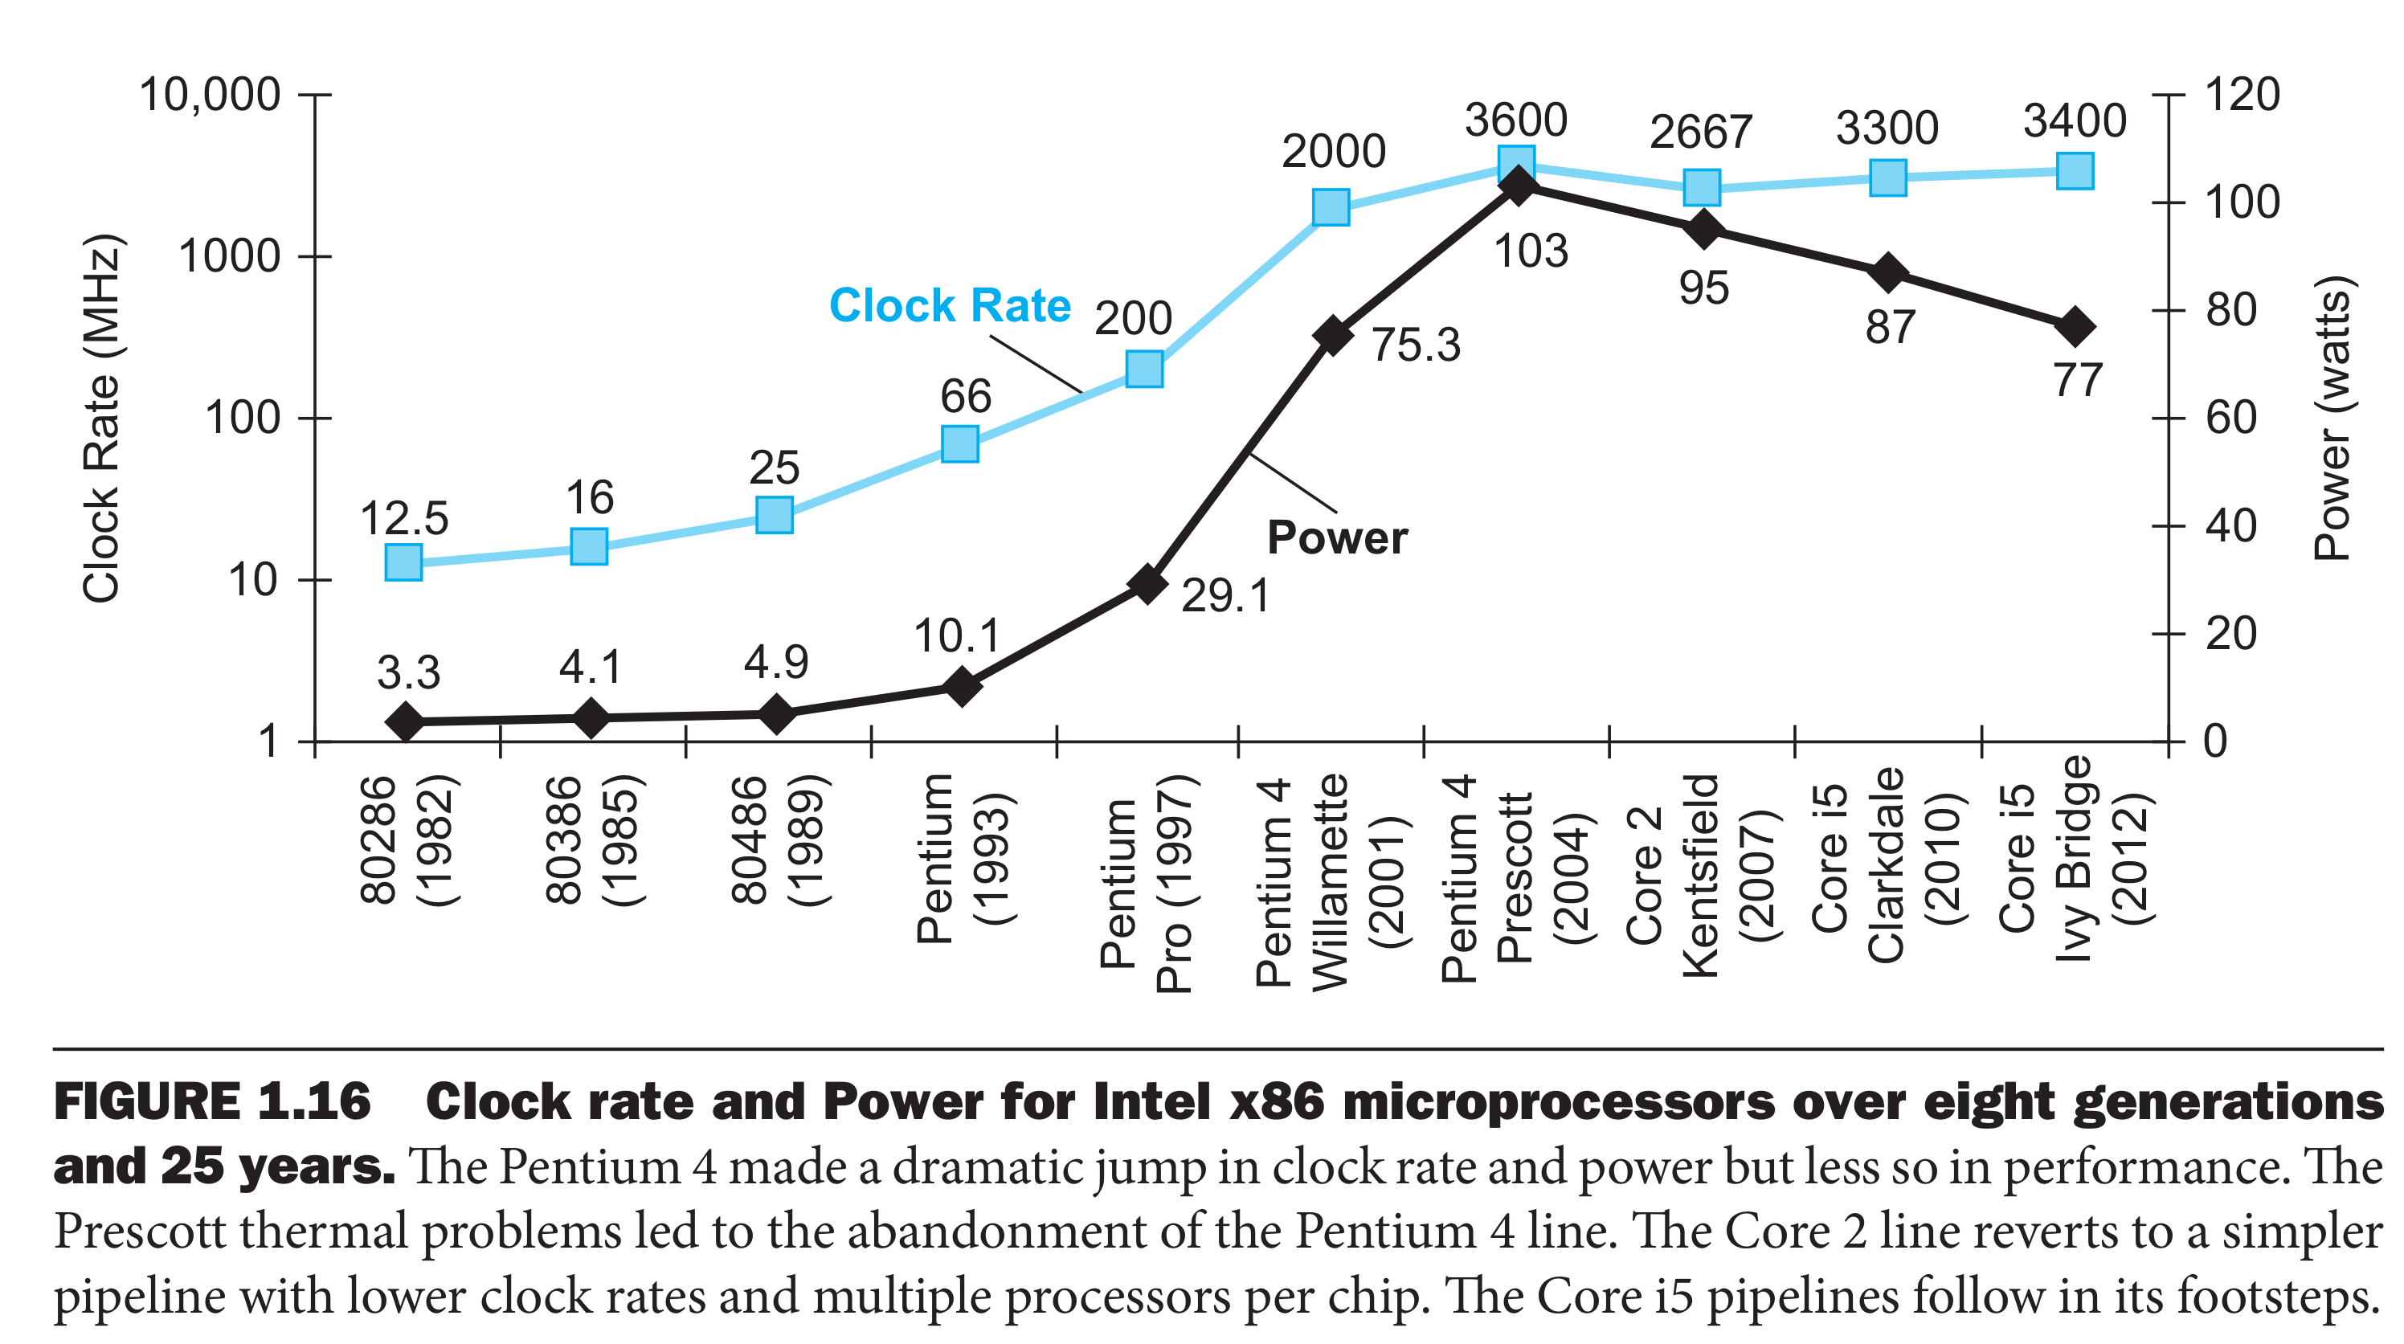

Slide 24
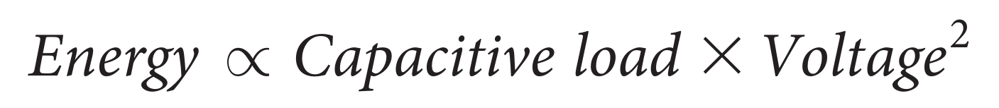
Power and energy
Total energy = dynamic energy + leakage
Dynamic energy:
Power required per transistor is just the product of energy of a transition and the frequency of transitions:
Frequency switched is a function of clock rate
Capacitive load per transistor is a function
  number of transistors connected to an output (called the fanout)
  technology, which determines the capacitance of both wires and transistors

Slide 25
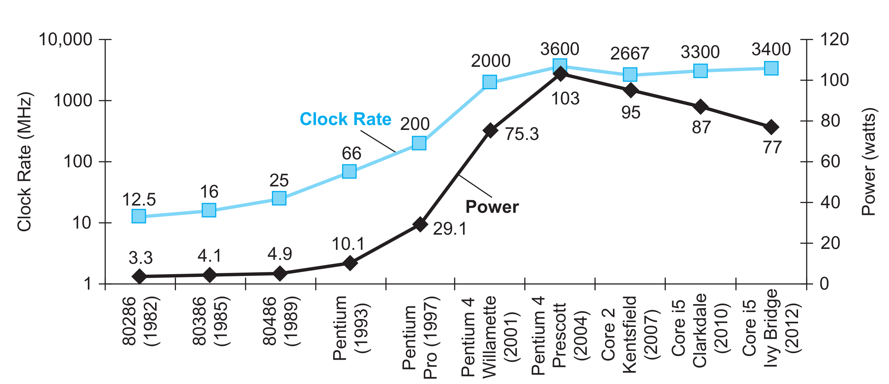
In 20 years voltage was reduced from 5V to 1V
  15% per generation
Clock rates increased 1000 times
Power increased 30x

Slide 26
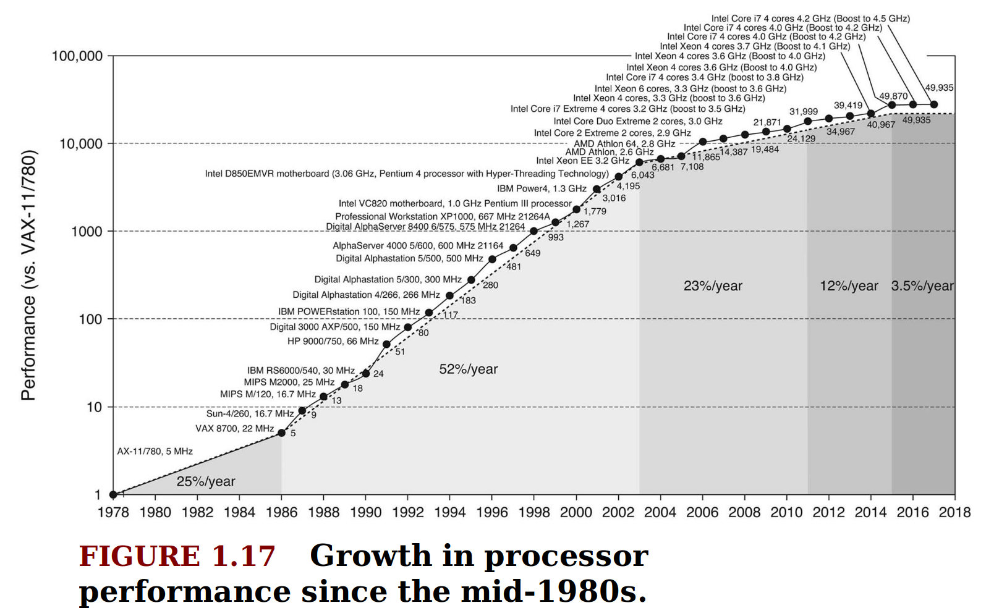

Slide 27
Thank you!

