Slide 1
CS/ECE 3810: Computer Organization
Lecture 4: MIPS instruction set
Anton Burtsev
August, 2022

Slide 2
Instruction Set
Understanding the language of the hardware is key to understanding
the hardware/software interface
A program (in say, C) is compiled into an executable that is composed
of machine instructions – this executable must also run on future
machines – for example, each Intel processor reads in the same x86
instructions, but each processor handles instructions differently
Java programs are converted into portable bytecode that is converted
into machine instructions during execution (just-in-time compilation)
What are important design principles when defining the instruction
set architecture (ISA)?

Slide 3
Instruction Set
Important design principles when defining the
instruction set architecture (ISA):
  keep the hardware simple – the chip must only
implement basic primitives and run fast
  keep the instructions regular – simplifies the
decoding/scheduling of instructions
We will later discuss RISC vs CISC

Slide 4
A Basic MIPS Instruction
C code: a = b + c ;
Assembly code: (human-friendly machine instructions)
add a, b, c # a is the sum of b and c

Slide 5
A Basic MIPS Instruction
C code: a = b + c ;
Assembly code: (human-friendly machine instructions)
add a, b, c # a is the sum of b and c
Machine code: (hardware-friendly machine instructions)
00000010001100100100000000100000
Translate the following C code into assembly code:
a = b + c + d + e;

Slide 6
Example
C code a = b + c + d + e;
translates into the following assembly code:

Slide 7
Example
C code a = b + c + d + e;
translates into the following assembly code:
add a, b, c add a, b, c
add a, a, d or add f, d, e
add a, a, e add a, a, f
Instructions are simple: fixed number of operands (unlike C)
A single line of C code is converted into multiple lines of
assembly code
Some sequences are better than others… the second
sequence needs one more (temporary) variable f

Slide 8
Subtract Example
C code f = (g + h) – (i + j);
Assembly code translation with only add and sub instructions:

Slide 9
Subtract Example
C code f = (g + h) – (i + j);
translates into the following assembly code:
add t0, g, h add f, g, h
add t1, i, j or sub f, f, i
sub f, t0, t1 sub f, f, j

Slide 10
Operands
In C, each “variable” is a location in memory
In hardware, each memory access is expensive – if
variable a is accessed repeatedly, it helps to bring the
variable into an on-chip scratchpad and operate on the
scratchpad (registers)
To simplify the instructions, we require that each
instruction (add, sub) only operate on registers
Note: the number of operands (variables) in a C program is
very large; the number of operands in assembly is fixed…
there can be only so many scratchpad registers

Slide 11
Registers
The MIPS ISA has 32 registers (x86 has 8 registers) –
Why not more? Why not less?
Each register is 32 bits wide (modern 64-bit architectures
have 64-bit wide registers)
A 32-bit entity (4 bytes) is referred to as a word
To make the code more readable, registers are
partitioned as $s0-$s7 (C/Java variables), $t0-$t9
(temporary variables)…

Slide 12
Binary Stuff
8 bits = 1 Byte, also written as 8b = 1B
1 word = 32 bits = 4B
1KB = 1024 B = 2¹⁰ B
1MB = 1024 x 1024 B = 2²⁰ B
1GB = 1024 x 1024 x 1024 B = 2³⁰ B
A 32-bit memory address refers to a number between
0 and 2³² – 1, i.e., it identifies a byte in a 4GB memory

Slide 13
Memory Operands
Values must be fetched from memory before (add and sub)
instructions can operate on them
Load word
lw $t0, memory-address
Store word
sw $t0, memory-address
How is memory-address determined?
Memory
Register
Memory
Register

Slide 14
Memory Address
The compiler organizes data in memory… it knows the
location of every variable (saved in a table)… it can fill
in the appropriate mem-address for load-store instructions
int a, b, c, d[10]
…
Memory
Base address

Slide 15
Memory Organization
$gp points to area in memory that saves global variables
Stack
Dynamic data (heap)
Static data (globals)
$gp
Text (instructions)

Slide 16
Memory Instruction Format
The format of a load instruction:
destination register
source address
lw $t0, 8($t3)
any register
a constant that is added to the register in parentheses

Slide 17
Memory Instruction Format
The format of a store instruction:
source register
destination address
sw $t0, 8($t3)
any register
a constant that is added to the register in parentheses

Slide 18
Example
int a, b, c, d[10];
addi $gp, $zero, 1000 # assume that data is stored at
# base address 1000; placed in $gp;
# $zero is a register that always
# equals zero
lw $s1, 0($gp) # brings value of a into register $s1
lw $s2, 4($gp) # brings value of b into register $s2
lw $s3, 8($gp) # brings value of c into register $s3
lw $s4, 12($gp) # brings value of d[0] into register $s4
lw $s5, 16($gp) # brings value of d[1] into register $s5

Slide 19
Example
Convert to assembly:
Remember: int a, b, c, d[10];
C code: d[3] = d[2] + a;

Slide 20
Example
Convert to assembly:
Remember: int a, b, c, d[10];
C code: d[3] = d[2] + a;
Assembly (same assumptions as previous example):
lw $s0, 0($gp) # a is brought into $s0
lw $s1, 20($gp) # d[2] is brought into $s1
add $s2, $s0, $s1 # the sum is in $s2
sw $s2, 24($gp) # $s2 is stored into d[3]
Assembly version of the code continues to expand!

Slide 21
Memory Organization
The space allocated on stack by a procedure is termed the activation
record (includes saved values and data local to the procedure) – frame
pointer points to the start of the record and stack pointer points to the
end – variable addresses are specified relative to $fp as $sp may
change during the execution of the procedure
$gp points to area in memory that saves global variables
Dynamically allocated storage (with malloc()) is placed on the heap
Stack
Dynamic data (heap)
Static data (globals)
Text (instructions)

Slide 22
Binary Representation
The binary number
01011000 00010101 00101110 11100111
represents the quantity
0 x 2³¹ + 1 x 2³⁰ + 0 x 2²⁹ + … + 1 x 2⁰
A 32-bit word can represent 2³² numbers between
0 and 2³²-1
… this is known as the unsigned representation as
we’re assuming that numbers are always positive
Most significant bit
Least significant bit

Slide 23
Negative Numbers
32 bits can only represent 2³² numbers – if we wish to also represent
negative numbers, we can represent 2³¹ positive numbers (incl zero)
and 2³¹ negative numbers
0000 0000 0000 0000 0000 0000 0000 0000_{two} = 0_{ten}
0000 0000 0000 0000 0000 0000 0000 0001_{two} = 1_{ten}
…
0111 1111 1111 1111 1111 1111 1111 1111_{two} = 2³¹-1
1000 0000 0000 0000 0000 0000 0000 0000_{two} = -2³¹
1000 0000 0000 0000 0000 0000 0000 0001_{two} = -(2³¹ – 1)
1000 0000 0000 0000 0000 0000 0000 0010_{two} = -(2³¹ – 2)
…
1111 1111 1111 1111 1111 1111 1111 1110_{two} = -2
1111 1111 1111 1111 1111 1111 1111 1111_{two} = -1

Slide 24
2’s Complement
0000 0000 0000 0000 0000 0000 0000 0000_{two} = 0_{ten}
0000 0000 0000 0000 0000 0000 0000 0001_{two} = 1_{ten}
…
0111 1111 1111 1111 1111 1111 1111 1111_{two} = 2³¹-1
1000 0000 0000 0000 0000 0000 0000 0000_{two} = -2³¹
1000 0000 0000 0000 0000 0000 0000 0001_{two} = -(2³¹ – 1)
1000 0000 0000 0000 0000 0000 0000 0010_{two} = -(2³¹ – 2)
…
1111 1111 1111 1111 1111 1111 1111 1110_{two} = -2
1111 1111 1111 1111 1111 1111 1111 1111_{two} = -1
Why is this representation favorable?
Consider the sum of 1 and -2 …. we get -1
Consider the sum of 2 and -1 …. we get +1
This format can directly undergo addition without any conversions!
Each number represents the quantity
x₃₁ -2³¹ + x₃₀ 2³⁰ + x₂₉ 2²⁹ + … + x₁ 2¹ + x₀ 2⁰

Slide 25
2’s Complement
0000 0000 0000 0000 0000 0000 0000 0000_{two} = 0_{ten}
0000 0000 0000 0000 0000 0000 0000 0001_{two} = 1_{ten}
…
0111 1111 1111 1111 1111 1111 1111 1111_{two} = 2³¹-1
1000 0000 0000 0000 0000 0000 0000 0000_{two} = -2³¹
1000 0000 0000 0000 0000 0000 0000 0001_{two} = -(2³¹ – 1)
1000 0000 0000 0000 0000 0000 0000 0010_{two} = -(2³¹ – 2)
…
1111 1111 1111 1111 1111 1111 1111 1110_{two} = -2
1111 1111 1111 1111 1111 1111 1111 1111_{two} = -1
Note that the sum of a number x and its inverted representation x’ always
equals a string of 1s (-1).
x + x’ = -1
x’ + 1 = -x … hence, can compute the negative of a number by
-x = x’ + 1 inverting all bits and adding 1
Similarly, the sum of x and –x gives us all zeroes, with a carry of 1
In reality, x + (-x) = 2^{n} … hence the name 2’s complement

Slide 26
Example
Compute the 32-bit 2’s complement representations
for the following decimal numbers:
5, -5, -6

Slide 27
Example
Compute the 32-bit 2’s complement representations
for the following decimal numbers:
5, -5, -6
5: 0000 0000 0000 0000 0000 0000 0000 0101
-5: 1111 1111 1111 1111 1111 1111 1111 1011
-6: 1111 1111 1111 1111 1111 1111 1111 1010
Given -5, verify that negating and adding 1 yields the
number 5

Slide 28
Recap – Numeric Representations
Decimal 35₁₀ = 3 x 10¹ + 5 x 10⁰
Binary 00100011₂ = 1 x 2⁵ + 1 x 2¹ + 1 x 2⁰
Hexadecimal (compact representation)
0x 23 or 23_{hex} = 2 x 16¹ + 3 x 16⁰
0-15 (decimal) → 0-9, a-f (hex)
Dec Binary Hex
0 0000 00
1 0001 01
2 0010 02
3 0011 03
Dec Binary Hex
4 0100 04
5 0101 05
6 0110 06
7 0111 07
Dec Binary Hex
8 1000 08
9 1001 09
10 1010 0a
11 1011 0b
Dec Binary Hex
12 1100 0c
13 1101 0d
14 1110 0e
15 1111 0f

Slide 29
Constant or Immediate Operands
We often use constants in operations
Example: add 4 to register $s3
lw $t0, AddrConstant4($s1)# $t0 = constant 4
add $s3,$s3,$t0 # $s3 = $s3 + $t0 ($t0 == 4)
A more elegant way
addi $s3,$s3,4 # $s3 = $s3 + 4

Slide 30
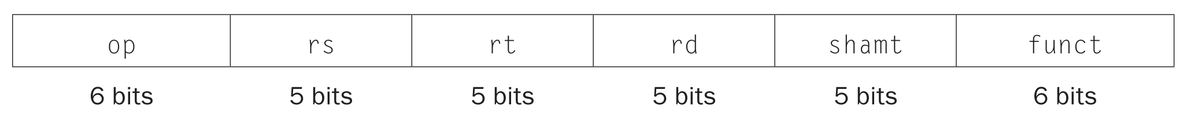
Instruction format (R-type)
Instructions are 32bit words in memory
op: Basic operation of the instruction, traditionally called the opcode
rs: The first register source operand
rt: The second register source operand
rd: The register destination operand. It gets the result of the operation
shamt: Shift amount
funct: Function/function code, selects the specific variant of the operation in the op field

Slide 31
Instruction format (R-type)
Instructions are 32bit words in memory
This works ok well for instructions like
  add $s0, $s1, $s3
But what about
  lw $t0, 32($s0)
  addi $t0, $t1, 4 # t0 = t1 + 4

Slide 32
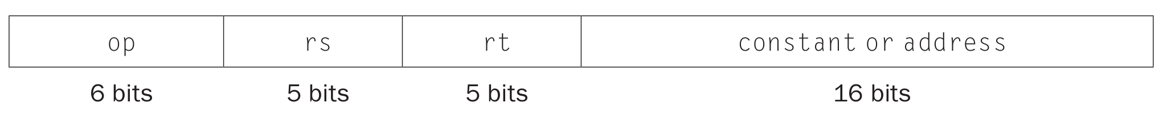
Instruction format (I-type)
Instructions are 32bit words in memory
op: Basic operation of the instruction, traditionally called the opcode
rs: The first register source operand
rt: New meaning – destination register

Slide 33
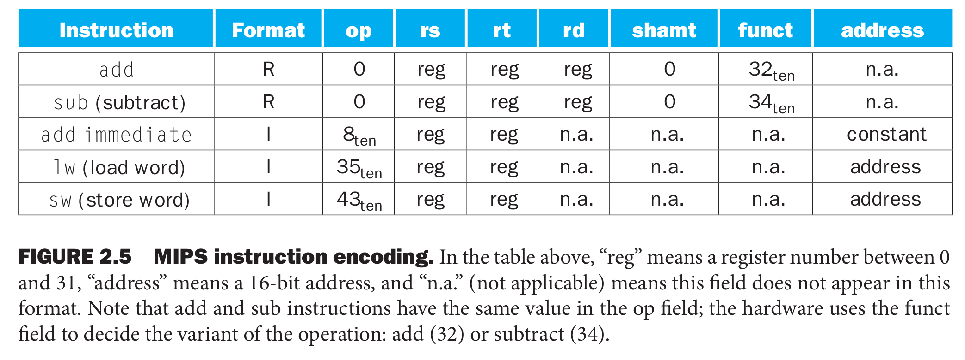
Examples

Slide 34
Register numbers
$s0 - $s7 map on hardware registers 16 – 23
  E.g., $s0 is 16, $s1 is 17
$t0 - $t7 map on hardware registers 8 – 15
  E.g., $t0 is 8, $t1 is 17

Slide 35
Example
A[300] = h + A[300]
Gets compiled to

Slide 36
Example
A[300] = h + A[300]
Gets compiled to
lw $t0,1200($t1) # Temporary reg $t0 gets A[300]
add $t0,$s2,$t0 # Temporary reg $t0 gets h + A[300]
sw $t0,1200($t1) # Stores h+A[300] back into A[300]

Slide 37
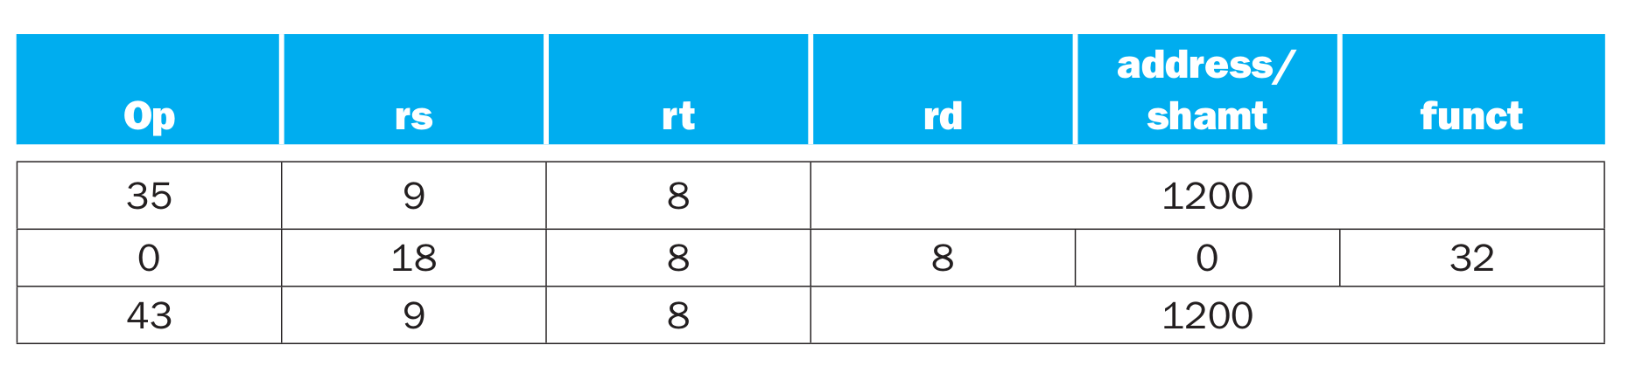
Example
A[300] = h + A[300]
Gets compiled to
lw $t0,1200($t1) # Temporary reg $t0 gets A[300]
add $t0,$s2,$t0 # Temporary reg $t0 gets h + A[300]
sw $t0,1200($t1) # Stores h+A[300] back into A[300]

Slide 38
Instruction encoding

Slide 39
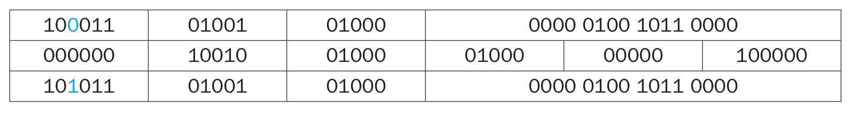
Example
Decimal
Binary

Slide 40
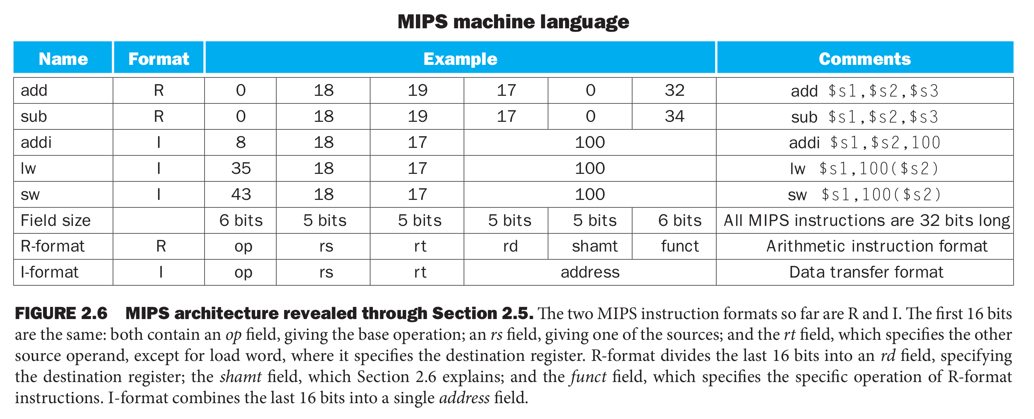

Slide 41
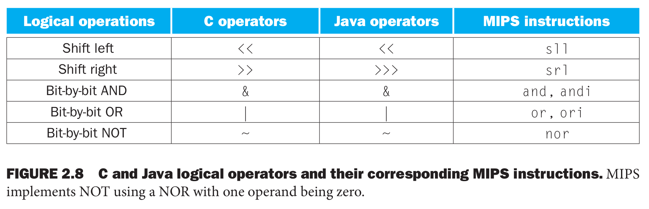
Logical operations

Slide 42
Shift
Shift left by 4
Before
  0000 0000 0000 0000 0000 0000 0000 1001 = 9
After
  0000 0000 0000 0000 0000 0000 1001 0000 = 144

Slide 43
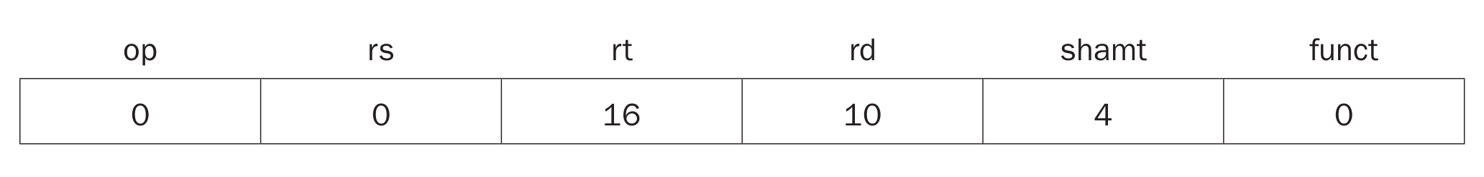
Encoding shift
Example
  sll $t2,$s0,4 # reg $t2 = reg $s0 << 4 bits
Shift amount

Slide 44
Control instructions

Slide 45
Branch instructions
Branch when equal
  beq register1, register2, L1
  Go to L1 if register1 equals register2
Branch when not equal
  bne register1, register2, L1
  Go to L1 if register1 does not equal register2
Unconditional jump
  j L1
  Jump to L1

Slide 46
If then .. else …
if (i == j) f = g + h; else f = g – h;
Assume that f,g, h, i, and j are in $s0, $s1, etc.

Slide 47
If then .. else …
if (i == j) f = g + h; else f = g – h;
Assume that f,g, h, i, and j are in $s0, $s1, etc.
bne $s3,$s4,Else # go to Else if i ≠ j
add $s0,$s1,$s2 # f = g + h (skipped if i ≠ j)
j Exit # unconditional jump to Exit
Else:
sub $s0,$s1,$s2 # f = g – h (skipped if i = j)
Exit:

Slide 48
Loops
while (save[i] == k)
i += 1;
Assume that i and k are in $s3 and $s5

Slide 49
Loops
while (save[i] == k)
i += 1;
Assume that i and k are in $s3 and $s5
Loop: sll $t1,$s3,2
add $t1,$t1,$s6 # $t1 = address of save[i]
lw $t0,0($t1) # Temp reg $t0 = save[i]
bne $t0,$s5, Exit # go to Exit if save[i] ≠ k
addi $s3,$s3,1 # i = i + 1
j Loop # go to Loop
Exit:

Slide 50
Comparisons
Set on less than
  slt $t0, $s3, $s4 # $t0 = 1 if $s3 < $s4
Or with a constrant
  slti $t0,$s2,10 # $t0 = 1 if $s2 < 10
Now you can use slt, slti, beq, and bne along with $zero (register that is always 0)

Slide 51
Branch instructions
Branch when equal
  beq register1, register2, L1
  Go to L1 if register1 equals register2
Branch when not equal
  bne register1, register2, L1
  Go to L1 if register1 does not equal register2
Unconditional jump
  j L1
  Jump to L1

Slide 52
Branch instructions
Branch when equal
  beq register1, register2, L1
  Go to L1 if register1 equals register2
Branch when not equal
  bne register1, register2, L1
  Go to L1 if register1 does not equal register2
Unconditional jump
  j L1
  Jump to L1

Slide 53
Signed / Unsigned
The hardware recognizes two formats:
unsigned (corresponding to the C declaration unsigned int)
-- all numbers are positive, a 1 in the most significant bit
just means it is a really large number
signed (C declaration is signed int or just int)
-- numbers can be +/- , a 1 in the MSB means the number
is negative
This distinction enables us to represent twice as many
numbers when we’re sure that we don’t need negatives

Slide 54
MIPS Instructions
Consider a comparison instruction:
slt $t0, $t1, $zero
and $t1 contains the 32-bit number 1111 01…01
What gets stored in $t0?

Slide 55
MIPS Instructions
Consider a comparison instruction:
slt $t0, $t1, $zero
and $t1 contains the 32-bit number 1111 01…01
What gets stored in $t0?
The result depends on whether $t1 is a signed or unsigned
number – the compiler/programmer must track this and
accordingly use either slt or sltu
slt $t0, $t1, $zero stores 1 in $t0
sltu $t0, $t1, $zero stores 0 in $t0

Slide 56
Sign Extension
Occasionally, 16-bit signed numbers must be converted
into 32-bit signed numbers – for example, when doing an
add with an immediate operand
The conversion is simple: take the most significant bit and
use it to fill up the additional bits on the left – known as
sign extension
So 2₁₀ goes from 0000 0000 0000 0010 to
0000 0000 0000 0000 0000 0000 0000 0010
and -2₁₀ goes from 1111 1111 1111 1110 to
1111 1111 1111 1111 1111 1111 1111 1110

Slide 57
Registers
The 32 MIPS registers are partitioned as follows:
  Register 0 : $zero always stores the constant 0
  Regs 2-3 : $v0, $v1 return values of a procedure
  Regs 4-7 : $a0-$a3 input arguments to a procedure
  Regs 8-15 : $t0-$t7 temporaries
  Regs 16-23: $s0-$s7 variables
  Regs 24-25: $t8-$t9 more temporaries
  Reg 28 : $gp global pointer
  Reg 29 : $sp stack pointer
  Reg 30 : $fp frame pointer
  Reg 31 : $ra return address

