Slide 1
3810: Computer Organization
Lecture 7: Basics of Digital Design
Anton Burtsev
October, 2022

Slide 2
Digital Design Basics
Two voltage levels – high and low (1 and 0, true and false)
Hence, the use of binary arithmetic/logic in all computers
A transistor is a 3-terminal device that acts as a switch
V
V
0
V
V
Conducting
0
Non-conducting
0
0

Slide 3
Logic Blocks
A logic block has a number of binary inputs and produces
a number of binary outputs – the simplest logic block is
composed of a few transistors
A logic block is termed combinational if the output is only
a function of the inputs
A logic block is termed sequential if the block has some
internal memory (state) that also influences the output
A basic logic block is termed a gate (AND, OR, NOT, etc.)
We will only deal with combinational circuits today

Slide 4
Truth Table
A truth table defines the outputs of a logic block for each
set of inputs
Consider a block with 3 inputs A, B, C and an output E
that is true only if exactly 2 inputs are true
A B C E

Slide 5
Truth Table
A truth table defines the outputs of a logic block for each
set of inputs
Consider a block with 3 inputs A, B, C and an output E
that is true only if exactly 2 inputs are true
A B C E
0 0 0 0
0 0 1 0
0 1 0 0
0 1 1 1
1 0 0 0
1 0 1 1
1 1 0 1
1 1 1 0
Can be compressed by only
representing cases that
have an output of 1

Slide 6
Boolean Algebra
Equations involving two values and three primary operators:
  OR : symbol + , X = A + B ➔ X is true if at least one of
  A or B is true
  AND : symbol . , X = A . B ➔ X is true if both A and B
  are true
  NOT : symbol , X = A ➔ X is the inverted value of A

Slide 7
Boolean Algebra Rules
Identity law : A + 0 = A ; A . 1 = A
Zero and One laws : A + 1 = 1 ; A . 0 = 0
Inverse laws : A . A = 0 ; A + A = 1
Commutative laws : A + B = B + A ; A . B = B . A
Associative laws : A + (B + C) = (A + B) + C
A . (B . C) = (A . B) . C
Distributive laws : A . (B + C) = (A . B) + (A . C)
A + (B . C) = (A + B) . (A + C)

Slide 8
DeMorgan’s Laws
A + B = A . B
A . B = A + B
Confirm that these are indeed true

Slide 9
Logic for common arithmetic operations
Simple ALU

Slide 10


Pictorial Representations
AND OR NOT
Source: H&P textbook
What logic function is this?
Source: H&P textbook

Slide 11
Boolean Equation
Consider the logic block that has an output E that is true
only if exactly two of the three inputs A, B, C are true
Multiple correct equations:
Two must be true, but all three cannot be true:
E = ((A . B) + (B . C) + (A . C)) . (A . B . C)
Identify the three cases where it is true:
E = (A . B . C) + (A . C . B) + (C . B . A)

Slide 12
Sum of Products
Can represent any logic block with the AND, OR, NOT operators
  Draw the truth table
  For each true output, represent the corresponding inputs
  as a product
  The final equation is a sum of these products
A B C E
0 0 0 0
0 0 1 0
0 1 0 0
0 1 1 1
1 0 0 0
1 0 1 1
1 1 0 1
1 1 1 0
(A . B . C) + (A . C . B) + (C . B . A)
Can also use “product of sums”
Any equation can be implemented
with an array of ANDs, followed by
an array of ORs

Slide 13
NAND and NOR
NAND : NOT of AND : A nand B = A . B
NOR : NOT of OR : A nor B = A + B
NAND and NOR are universal gates, i.e., they can be
used to construct any complex logical function

Slide 14
Common Logic Blocks – Decoder
Takes in N inputs and activates one of 2^{N} outputs
I₀ I₁ I₂ O₀ O₁ O₂ O₃ O₄ O₅ O₆ O₇
0 0 0 1 0 0 0 0 0 0 0
0 0 1 0 1 0 0 0 0 0 0
0 1 0 0 0 1 0 0 0 0 0
0 1 1 0 0 0 1 0 0 0 0
1 0 0 0 0 0 0 1 0 0 0
1 0 1 0 0 0 0 0 1 0 0
1 1 0 0 0 0 0 0 0 1 0
1 1 1 0 0 0 0 0 0 0 1
3-to-8
Decoder
I₀₋₂
O₀₋₇

Slide 15
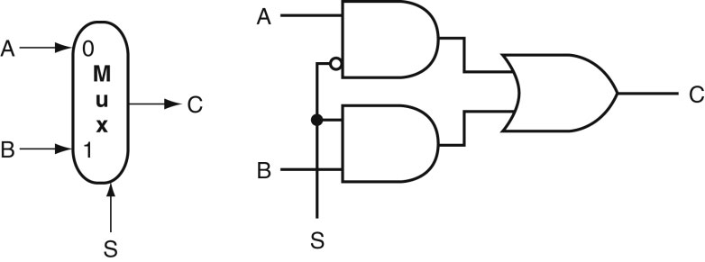
Common Logic Blocks – Multiplexor
Multiplexor or selector: one of N inputs is reflected on the
output depending on the value of the log₂N selector bits
2-input mux
Source: H&P textbook

Slide 16
Adder Algorithm
1 0 0 1
0 1 0 1
Sum 1 1 1 0
Carry 0 0 0 1
Truth Table for the above operations:
A B Cin Sum Cout
0 0 0
0 0 1
0 1 0
0 1 1
1 0 0
1 0 1
1 1 0
1 1 1

Slide 17
Adder Algorithm
1 0 0 1
0 1 0 1
Sum 1 1 1 0
Carry 0 0 0 1
Equations:
Sum = Cin . A . B +
B . Cin . A +
A . Cin . B +
A . B . Cin
Cout = A . B . Cin +
A . B . Cin +
A . Cin . B +
B . Cin . A
= A . B +
A . Cin +
B . Cin
Truth Table for the above operations:
A B Cin Sum Cout
0 0 0 0 0
0 0 1 1 0
0 1 0 1 0
0 1 1 0 1
1 0 0 1 0
1 0 1 0 1
1 1 0 0 1
1 1 1 1 1

Slide 18
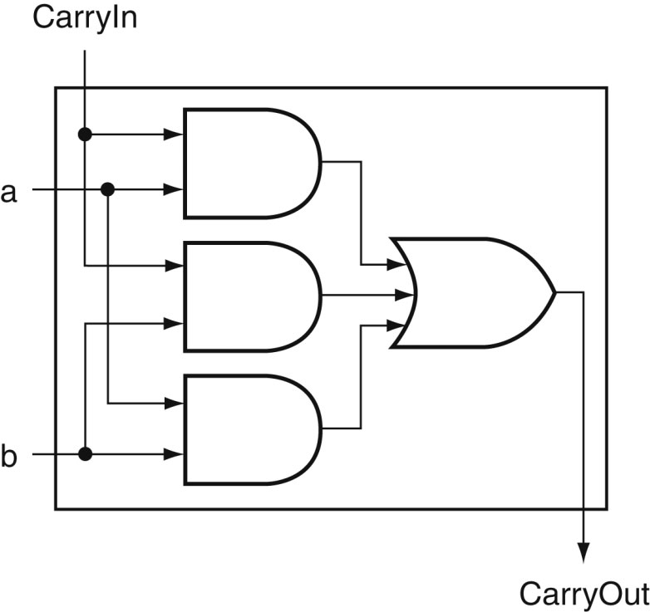
Carry Out Logic
Equations:
Sum = Cin . A . B +
B . Cin . A +
A . Cin . B +
A . B . Cin
Cout = A . B . Cin +
A . B . Cin +
A . Cin . B +
B . Cin . A
= A . B +
A . Cin +
B . Cin
Source: H&P textbook

Slide 19
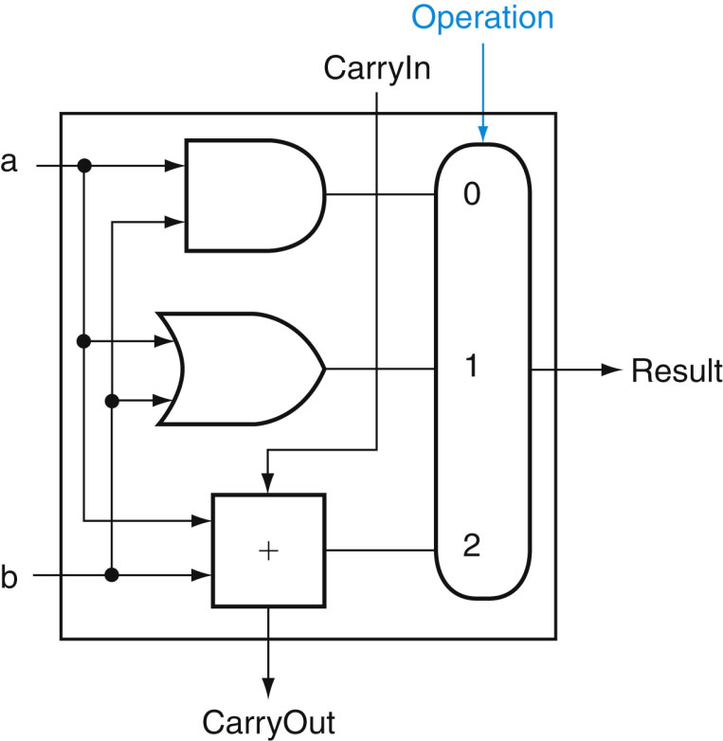
1-Bit ALU with Add, Or, And
Multiplexor selects between Add, Or, And operations
Source: H&P textbook

Slide 20
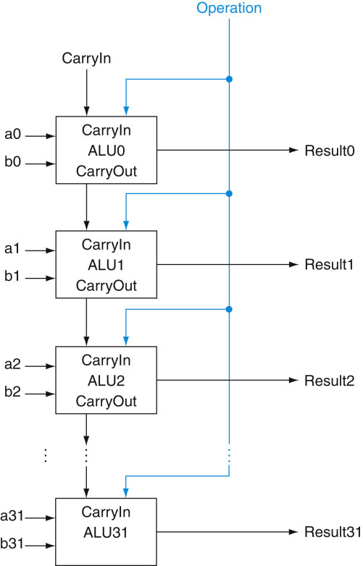
32-bit Ripple Carry Adder
1-bit ALUs are connected
“in series” with the
carry-out of 1 box
going into the carry-in
of the next box
Source: H&P textbook

Slide 21
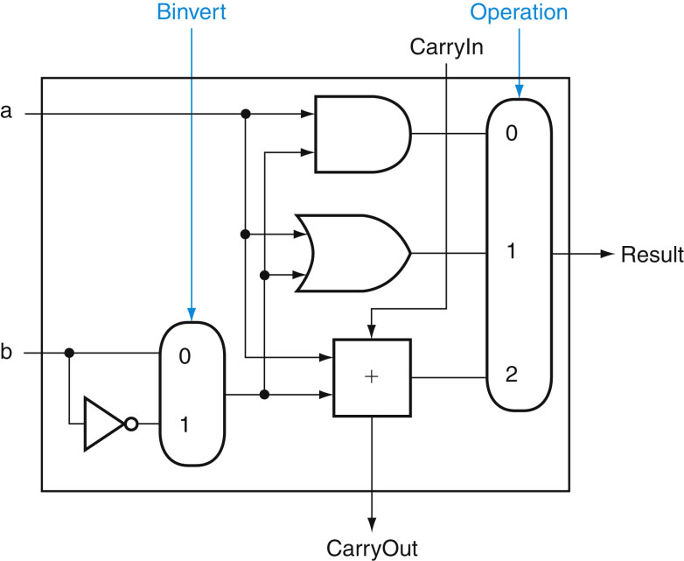
Incorporating Subtraction
Must invert bits of B and add a 1
  Include an inverter
  CarryIn for the first bit is 1
  The CarryIn signal (for the
  first bit) can be the same
  as the Binvert signal
Source: H&P textbook

Slide 22
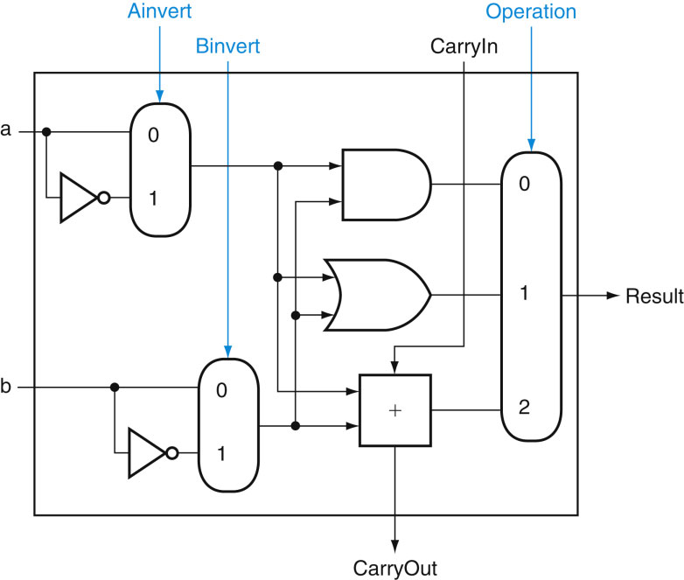
Incorporating NOR and NAND
Source: H&P textbook

Slide 23
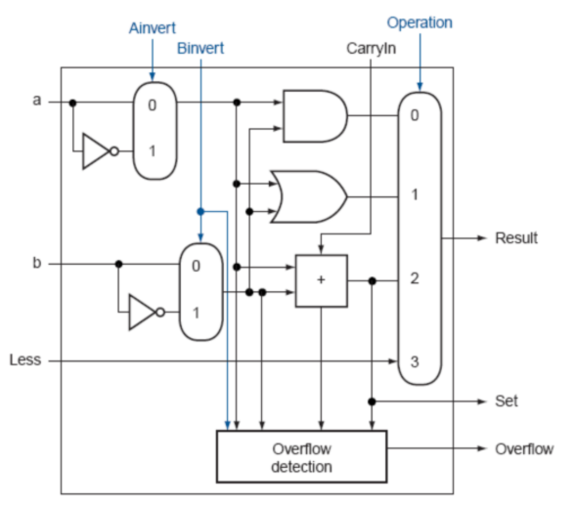
Incorporating slt (set bit when less than)
Perform a – b and check
the sign
New signal (Less) that
is zero for ALU boxes
1-31
The 31st box has a unit
to detect overflow and
sign – the sign bit
serves as the Less
signal for the 0th box
Source: H&P textbook

Slide 24
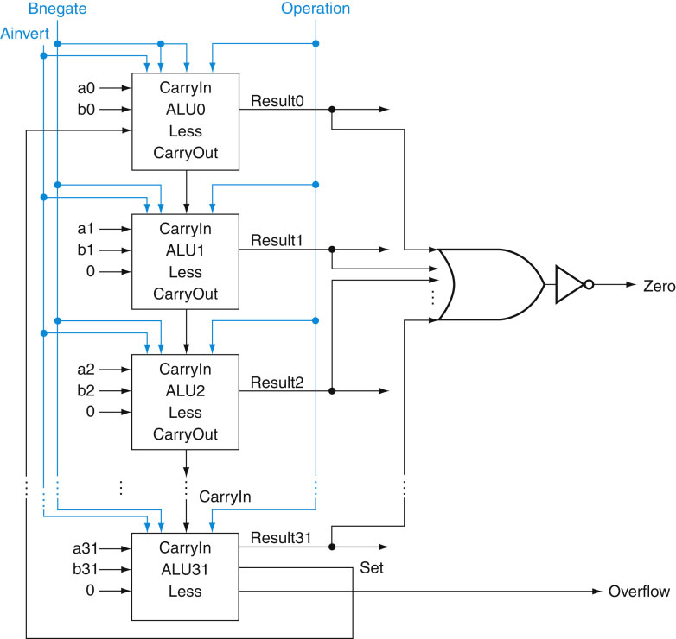
Incorporating slt (set bit when less than)
Perform a – b and check
the sign
New signal (Less) that
is zero for ALU boxes
1-31
The 31st box has a unit
to detect overflow and
sign – the sign bit
serves as the Less
signal for the 0th box
Source: H&P textbook

Slide 25
Incorporating jeq (jump when equal)
Perform a – b and
confirm that the
result is all zero’s
Source: H&P textbook

Slide 26
Control Lines
What are the values
of the control lines
and what operations
do they correspond to?
Source: H&P textbook

Slide 27
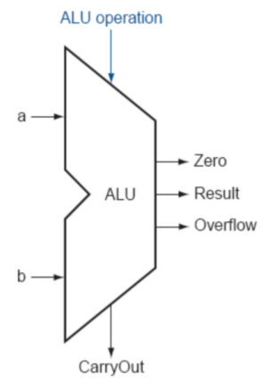
Control Lines
What are the values
of the control lines
and what operations
do they correspond to?
Ai Bn Op
AND 0 0 00
OR 0 0 01
Add 0 0 10
Sub 0 1 10
SLT 0 1 11
NOR 1 1 00
Source: H&P textbook

Slide 28
Speed of Ripple Carry
The carry propagates thru every 1-bit box: each 1-bit box sequentially
implements AND and OR – total delay is the time to go through 64 gates!
We’ve already seen that any logic equation can be expressed as the
sum of products – so it should be possible to compute the result by
going through only 2 gates!
Caveat: need many parallel gates and each gate may have a very
large number of inputs – it is difficult to efficiently build such large
gates, so we’ll find a compromise:
  moderate number of gates
  moderate number of inputs to each gate
  moderate number of sequential gates traversed

Slide 29
Clocks
A microprocessor is composed of many different circuits that are operating simultaneously – if each circuit X takes ininputs at time TI_{X}, takes time TE_{X} to execute the logic, and produces outputs at time TO_{X}, imagine the complications in co-ordinating the tasks of every circuit
A major school of thought (used in most processors built today): all circuits on the chip share a clock signal (a square wave) that tells every circuit when to accept inputs, how much time they have to execute the logic, and when they must produce outputs

Slide 30
Clock Terminology
Rising clock edge
Cycle time
Falling clock edge
4 GHz = clock speed = 1 = 1 .
cycle time 250 ps

Slide 31
Sequential Circuits
Until now, circuits were combinational – when inputs change, the outputs change after a while (time = logic delay thru circuit)
Combinational
Circuit
Combinational
Circuit
Inputs
Outputs
We want the clock to act like a start and stop signal – a “latch” is a storage device that separates these circuits – it ensures that the inputs to the circuit do not change during a clock cycle
Clock
Clock
Combinational
Circuit
Outputs
Combinational
Circuit
Inputs
Latch
Latch

Slide 32
Sequential Circuits
Sequential circuit: consists
of combinational circuit and
a storage element
At the start of the clock
cycle, the rising edge
causes the “state” storage
to store some input values
This state will not change for an entire cycle (until next rising edge)
The combinational circuit has some time to accept the value
of “state” and “inputs” and produce “outputs”
Some of the outputs (for example, the value of next “state”) may feed
back (but through the latch so they’re only seen in the next cycle)
Inputs
State
Clock
Inputs
Outputs
Combinational Cct

Slide 33
Sequential circuits

Slide 34
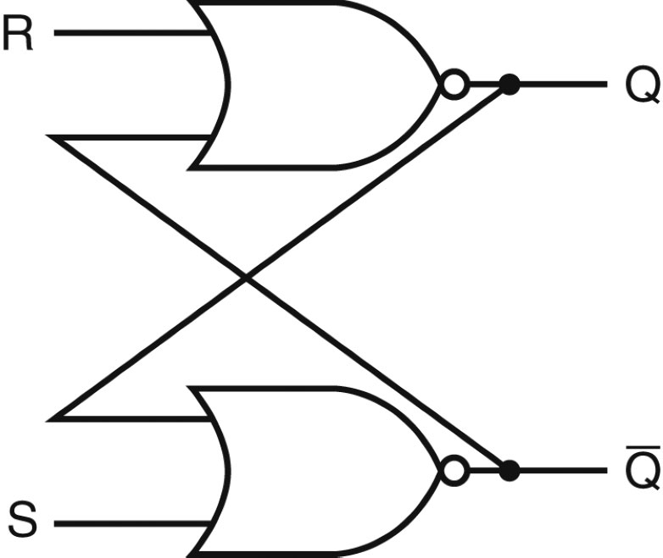
Designing a Latch
An S-R latch: set-reset latch
  When Set is high, a 1 is stored
  When Reset is high, a 0 is stored
  When both are low, the previous state is preserved (hence,
  known as a storage or memory element)
  Both are high – this set of inputs is not allowed
  Verify the above behavior!
Source: H&P textbook

Slide 35
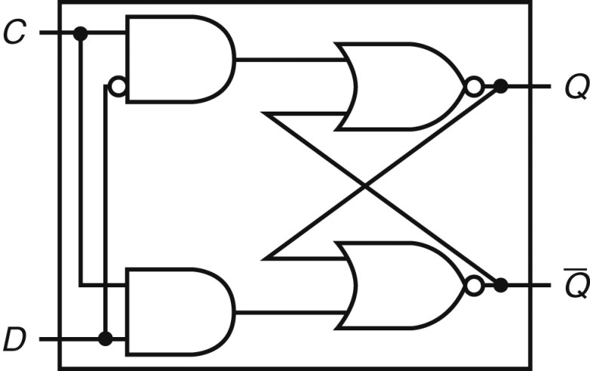
D Latch
Incorporates a clock
The value of the input D signal (data) is stored only when the clock
is high – the previous state is preserved when the clock is low
Source: H&P textbook

Slide 36
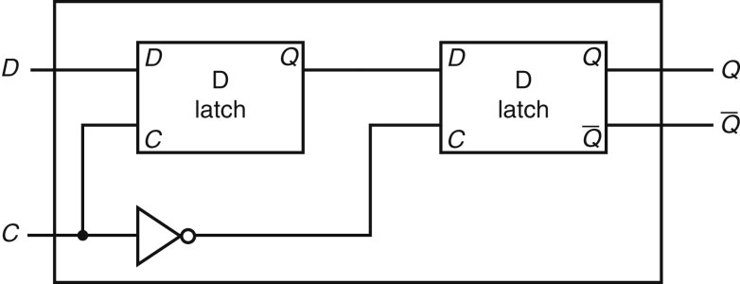
D Flip Flop
Terminology:
Latch: outputs can change any time the clock is high (asserted)
Flip flop: outputs can change only on a clock edge
Two D latches in series – ensures that a value is stored only on
the falling edge of the clock
Source: H&P textbook

Slide 37
Sequential Circuits
Until now, circuits were combinational – when inputs change, the outputs change after a while (time = logic delay thru circuit)
Combinational
Circuit
Combinational
Circuit
Inputs
Outputs
We want the clock to act like a start and stop signal – a “latch” is a storage device that separates these circuits – it ensures that the inputs to the circuit do not change during a clock cycle
Clock
Clock
Combinational
Circuit
Outputs
Combinational
Circuit
Inputs
Latch
Latch

Slide 38
Finite State Machines

Slide 39
Finite State Machine
A sequential circuit is described by a variation of a truth
table – a finite state diagram (hence, the circuit is also
called a finite state machine)
Note that state is updated only on a clock edge
Next-state
Function
Next
state
Clock
Current
State
Output
Function
Outputs
Inputs

Slide 40
State Diagrams
Each state is shown with a circle, labeled with the state
value – the contents of the circle are the outputs
An arc represents a transition to a different state, with the
inputs indicated on the label
D = 0
D = 1
This is a state diagram for ___?
D = 1
0
0
1
1
D = 0

Slide 41
3-Bit Counter
Consider a circuit that stores a number and increments the value on
every clock edge – on reaching the largest value, it starts again from 0
Draw the state diagram:
  How many states?
  How many inputs?

Slide 42
3-Bit Counter
Consider a circuit that stores a number and increments the value on
every clock edge – on reaching the largest value, it starts again from 0
Draw the state diagram:
  How many states?
  How many inputs?
000
001
010
011
100
101
110
111
000
001
010
011
100
101
110
111

