Slide 1
CS/EE 3810: Computer Organization
Lecture 9: Midterm Recap
Anton Burtsev
October, 2022

Slide 2
Simple program: String Copy
MIPS code:
strcpy:
addi $sp, $sp, -4 # adjust stack for 1 item
sw $s0, 0($sp) # save $s0
add $s0, $zero, $zero # i = 0
L1: add $t1, $s0, $a1 # addr of y[i] in $t1
lbu $t2, 0($t1) # $t2 = y[i]
add $t3, $s0, $a0 # addr of x[i] in $t3
sb $t2, 0($t3) # x[i] = y[i]
beq $t2, $zero, L2 # exit loop if y[i] == 0
addi $s0, $s0, 1 # i = i + 1
j L1 # next iteration of loop
L2: lw $s0, 0($sp) # restore saved $s0
addi $sp, $sp, 4 # pop 1 item from stack
jr $ra # and return
Notes:
The University of Adelaide, School of Computer Science
October 19, 2022
Chapter 2 — Instructions: Language of the Computer

Slide 3
Where is this program stored?
How does it get executed?

Slide 4
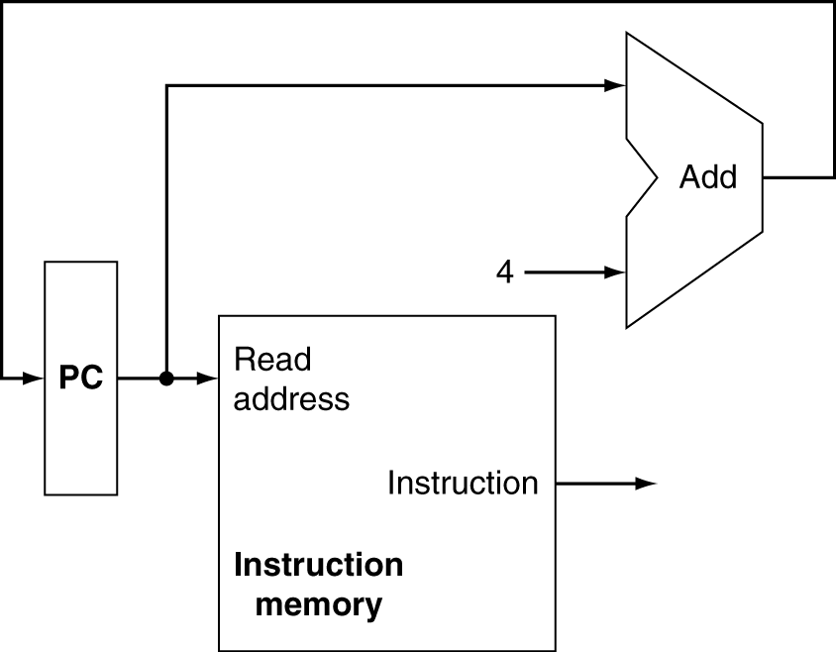
Instruction Fetch
Increment by 4 for next instruction
32-bit register
Chapter 4 — The Processor — <number>
Notes:
Morgan Kaufmann Publishers
19 October 2022
Chapter 4 — The Processor

Slide 5
Three types of instructions
R-Type
  Add, and, jr, nor, or, slt, sll, sub
I-Type
  addi, beq, bne, lw (and other loads), ori, slti, sw (and other stores)
J-Type
  j, jal

Slide 6
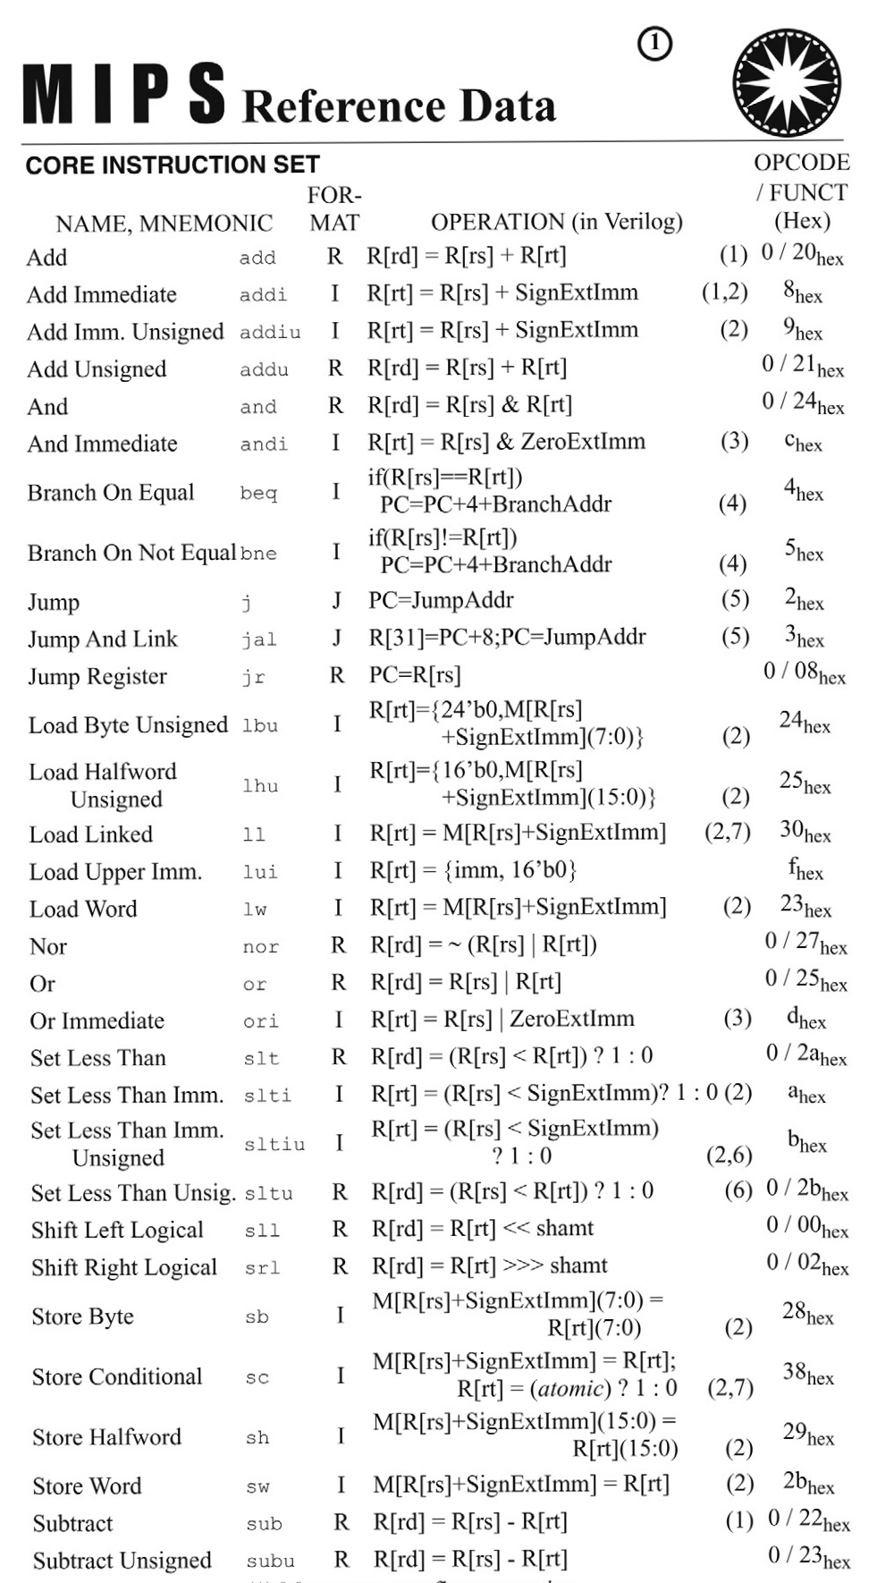
Fits on one page

Slide 7
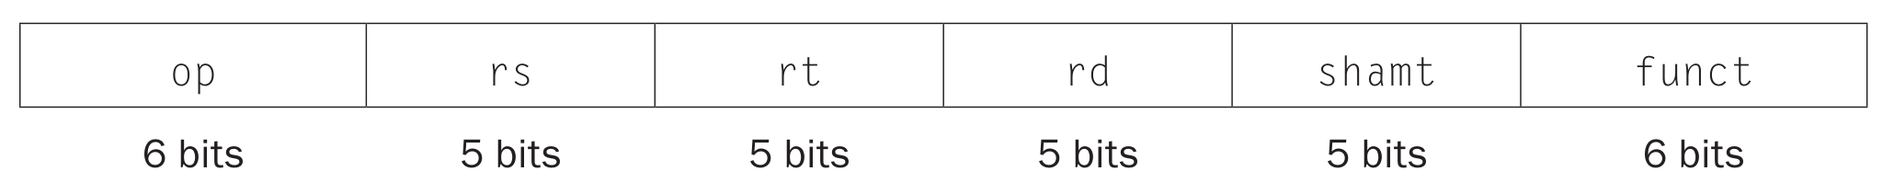
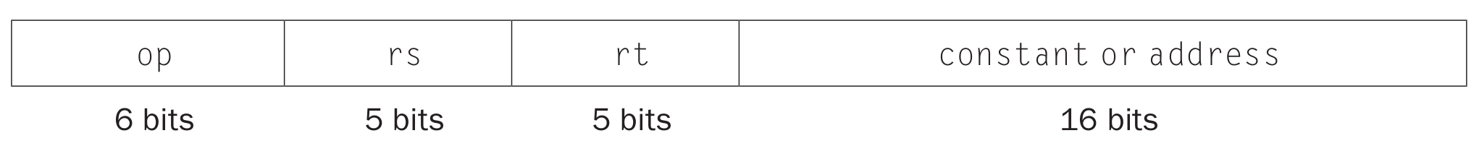
Three types of instructions
R-Type
I-Type
J-Type
op
rs
rt
constant or address
6 bits
5 bits
5 bits
16 bits

Slide 8
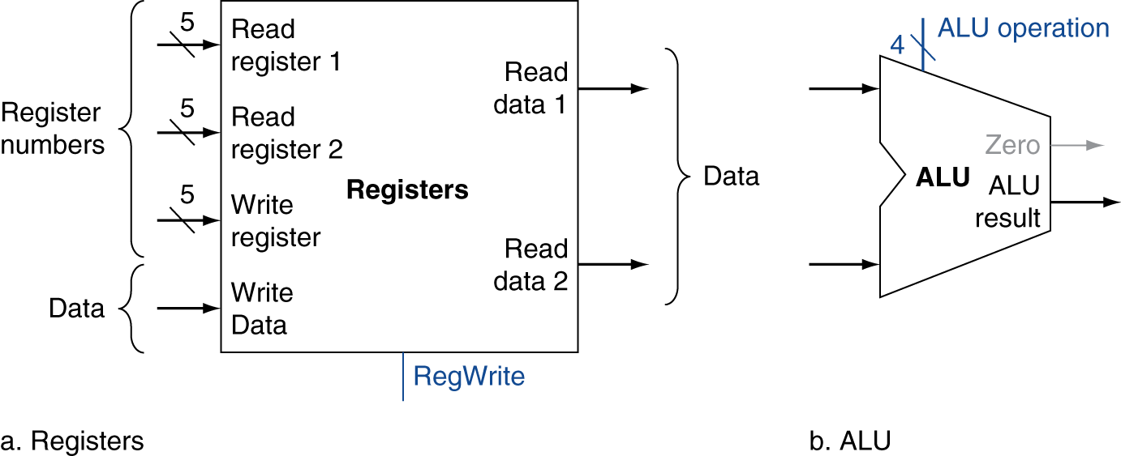
R-Format Instructions
Read two register operands
Perform arithmetic/logical operation
Write register result
Chapter 4 — The Processor — <number>
Notes:
Morgan Kaufmann Publishers
19 October 2022
Chapter 4 — The Processor

Slide 9
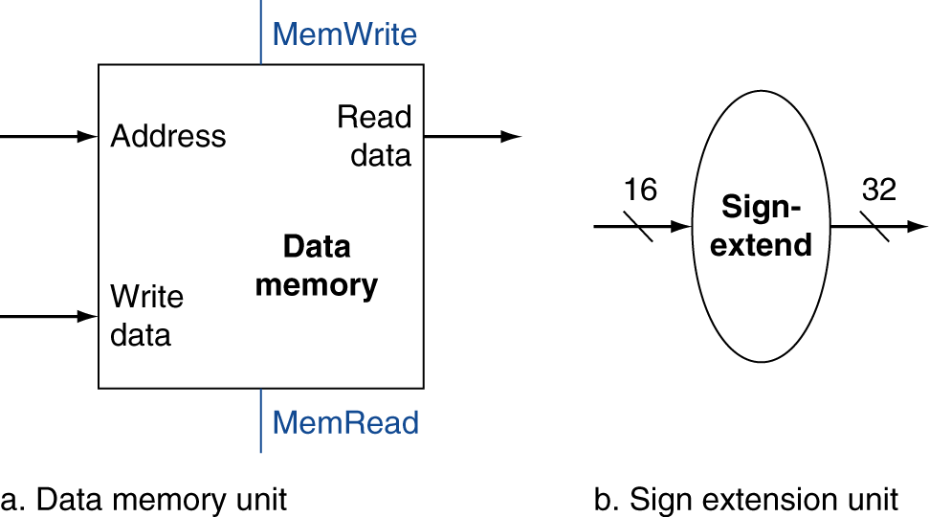
Load/Store Instructions
Read register operands
Calculate address using 16-bit offset
  Use ALU, but sign-extend offset
Load: Read memory and update register
Store: Write register value to memory
Chapter 4 — The Processor — <number>
Notes:
Morgan Kaufmann Publishers
19 October 2022
Chapter 4 — The Processor

Slide 10
Branch Instructions
Read register operands
Compare operands
  Use ALU, subtract and check Zero output
Calculate target address
  Sign-extend displacement
  Shift left 2 places (word displacement)
  Add to PC + 4
    Already calculated by instruction fetch
Chapter 4 — The Processor — <number>
Notes:
Morgan Kaufmann Publishers
19 October 2022
Chapter 4 — The Processor

Slide 11
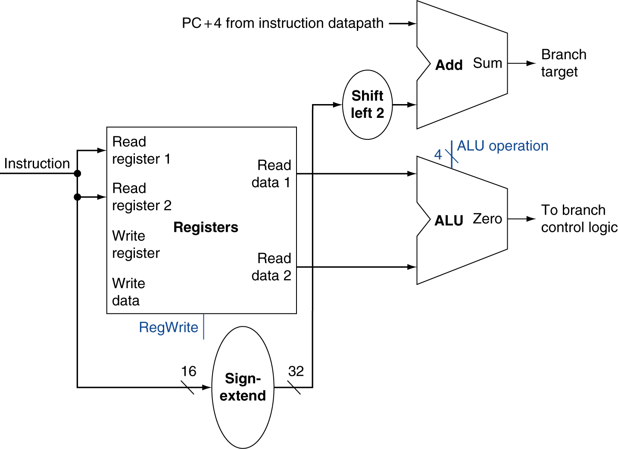
Branch Instructions
Just
re-routes wires
Sign-bit wire replicated
Chapter 4 — The Processor — <number>
Notes:
Morgan Kaufmann Publishers
19 October 2022
Chapter 4 — The Processor

Slide 12
Composing the Elements
First-cut data path does an instruction in one clock cycle
  Each datapath element can only do one function at a time
  Hence, we need separate instruction and data memories
Use multiplexers where alternate data sources are used for different instructions
Chapter 4 — The Processor — <number>
Notes:
Morgan Kaufmann Publishers
19 October 2022
Chapter 4 — The Processor

Slide 13
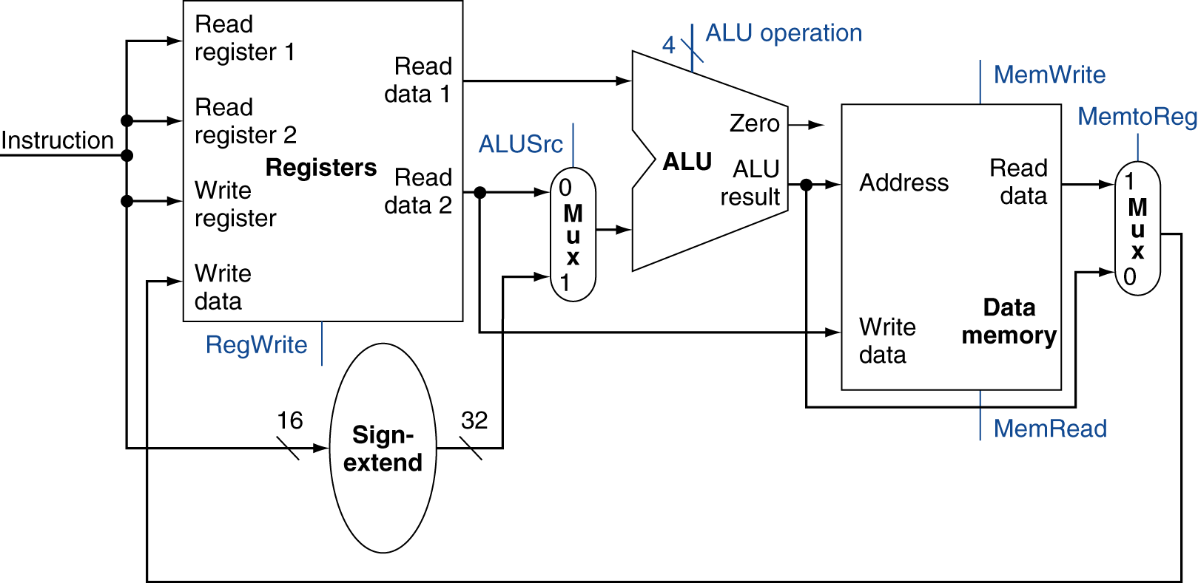
R-Type/Load/Store Datapath
Chapter 4 — The Processor — <number>
Notes:
Morgan Kaufmann Publishers
19 October 2022
Chapter 4 — The Processor

Slide 14
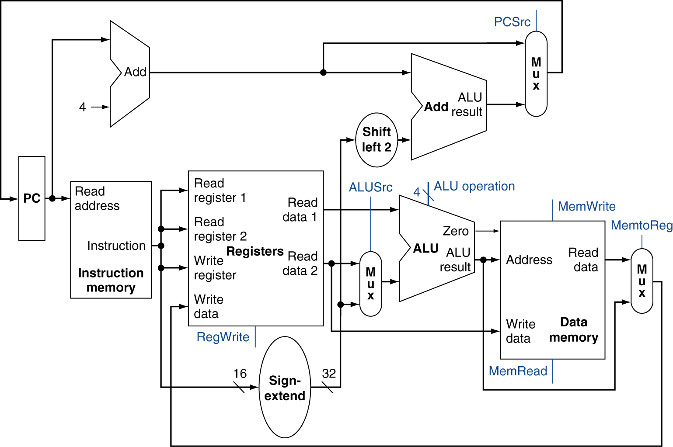
Full Datapath
Chapter 4 — The Processor — <number>
Notes:
Morgan Kaufmann Publishers
19 October 2022
Chapter 4 — The Processor

Slide 15
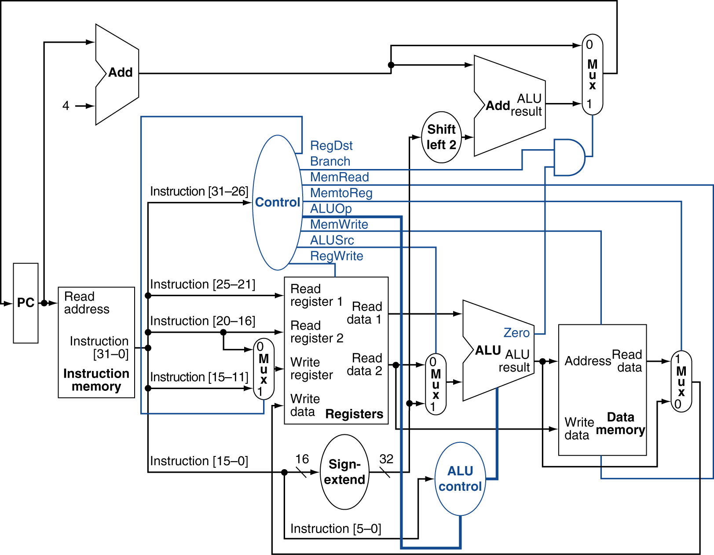
Datapath With Control
Chapter 4 — The Processor — <number>
Notes:
Morgan Kaufmann Publishers
19 October 2022
Chapter 4 — The Processor

Slide 16
ALU Control
ALU used for
  Load/Store: F = add
  Branch: F = subtract
  R-type: F depends on funct field
§4.4 A Simple Implementation Scheme
ALU control | Function
0000 | AND
0001 | OR
0010 | add
0110 | subtract
0111 | set-on-less-than
1100 | NOR
Chapter 4 — The Processor — <number>
Notes:
Morgan Kaufmann Publishers
19 October 2022
Chapter 4 — The Processor

Slide 17
ALU Control
Assume 2-bit ALUOp derived from opcode
  Combinational logic derives ALU control
opcode | ALUOp | Operation | funct | ALU function | ALU control
lw | 00 | load word | XXXXXX | add | 0010
sw | 00 | store word | XXXXXX | add | 0010
beq | 01 | branch equal | XXXXXX | subtract | 0110
R-type | 10 | add | 100000 | add | 0010
 |  | subtract | 100010 | subtract | 0110
 |  | AND | 100100 | AND | 0000
 |  | OR | 100101 | OR | 0001
 |  | set-on-less-than | 101010 | set-on-less-than | 0111
Chapter 4 — The Processor — <number>
Notes:
Morgan Kaufmann Publishers
19 October 2022
Chapter 4 — The Processor

Slide 18
The Main Control Unit
Control signals derived from instruction
R-type
0
rs
rt
rd
shamt
funct
31:26
25:21
20:16
15:11
10:6
5:0
Load/
Store
35 or 43
rs
rt
address
31:26
25:21
20:16
15:0
Branch
4
rs
rt
address
31:26
25:21
20:16
15:0
opcode
always read
read, except for load
write for R-type and load
sign-extend and add
Chapter 4 — The Processor — <number>
Notes:
Morgan Kaufmann Publishers
19 October 2022
Chapter 4 — The Processor

Slide 19
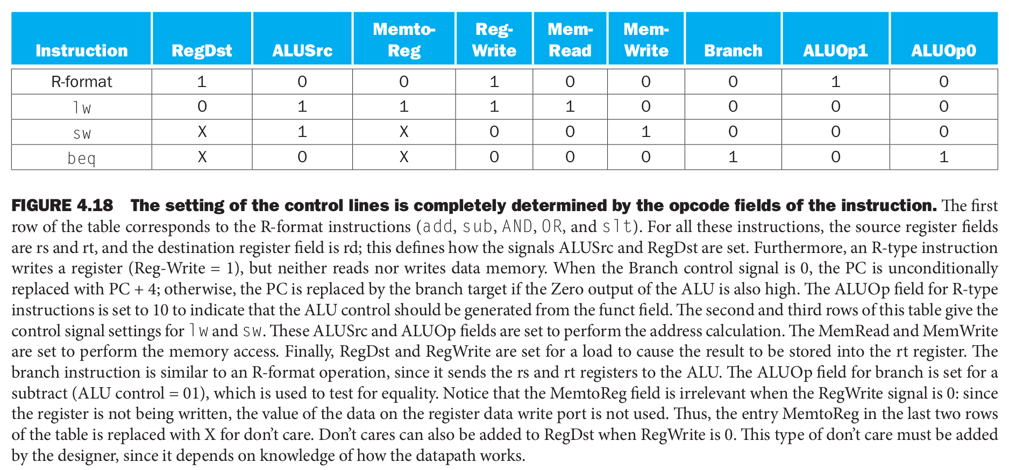
The Main Control Unit

Slide 20
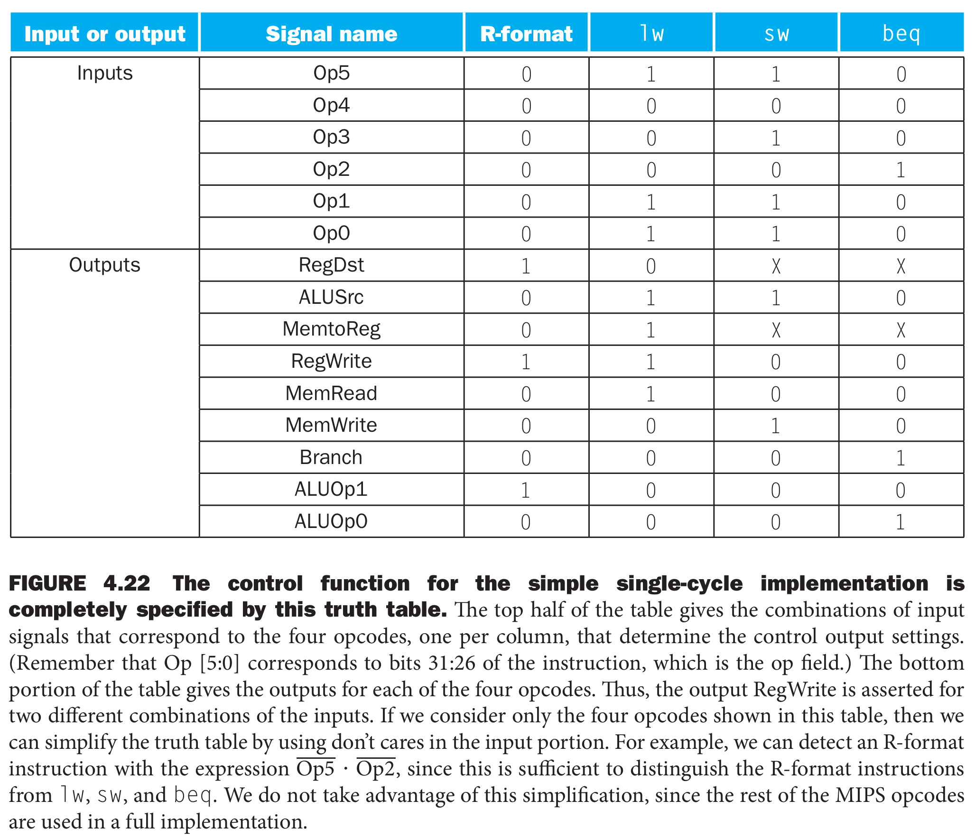

Slide 21
Datapath With Control
Chapter 4 — The Processor — <number>
Notes:
Morgan Kaufmann Publishers
19 October 2022
Chapter 4 — The Processor

Slide 22
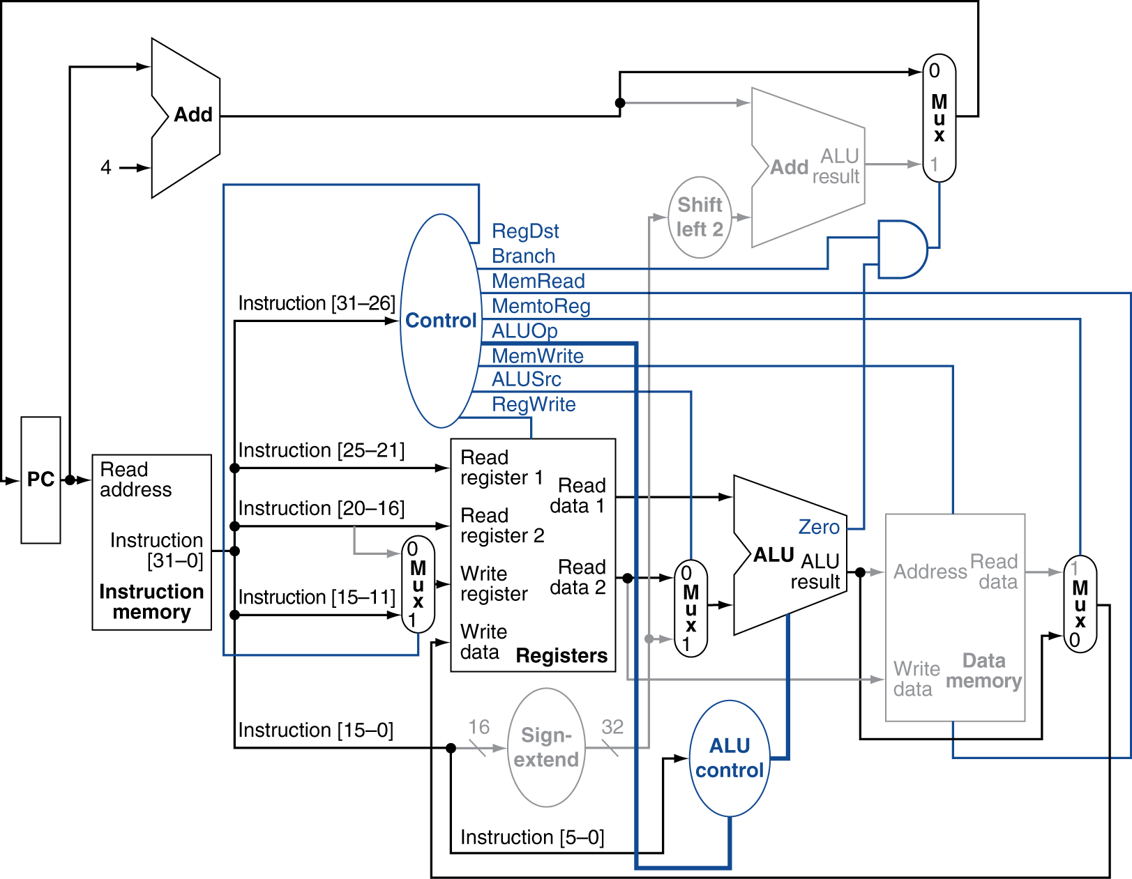
R-Type Instruction
Chapter 4 — The Processor — <number>
Notes:
Morgan Kaufmann Publishers
19 October 2022
Chapter 4 — The Processor

Slide 23
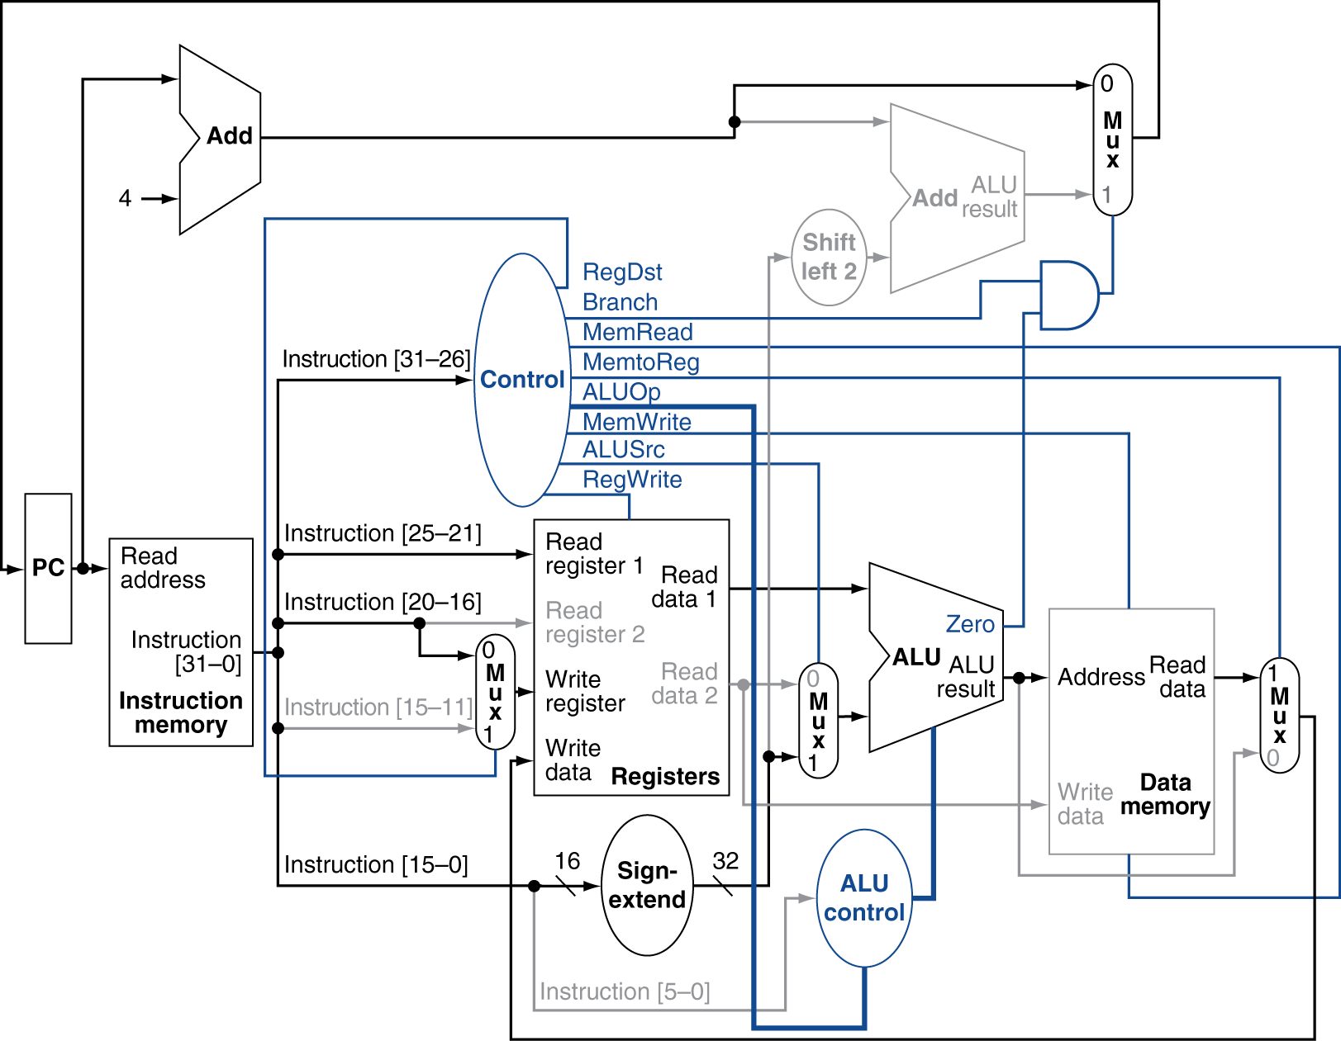
Load Instruction
Chapter 4 — The Processor — <number>
Notes:
Morgan Kaufmann Publishers
19 October 2022
Chapter 4 — The Processor

Slide 24
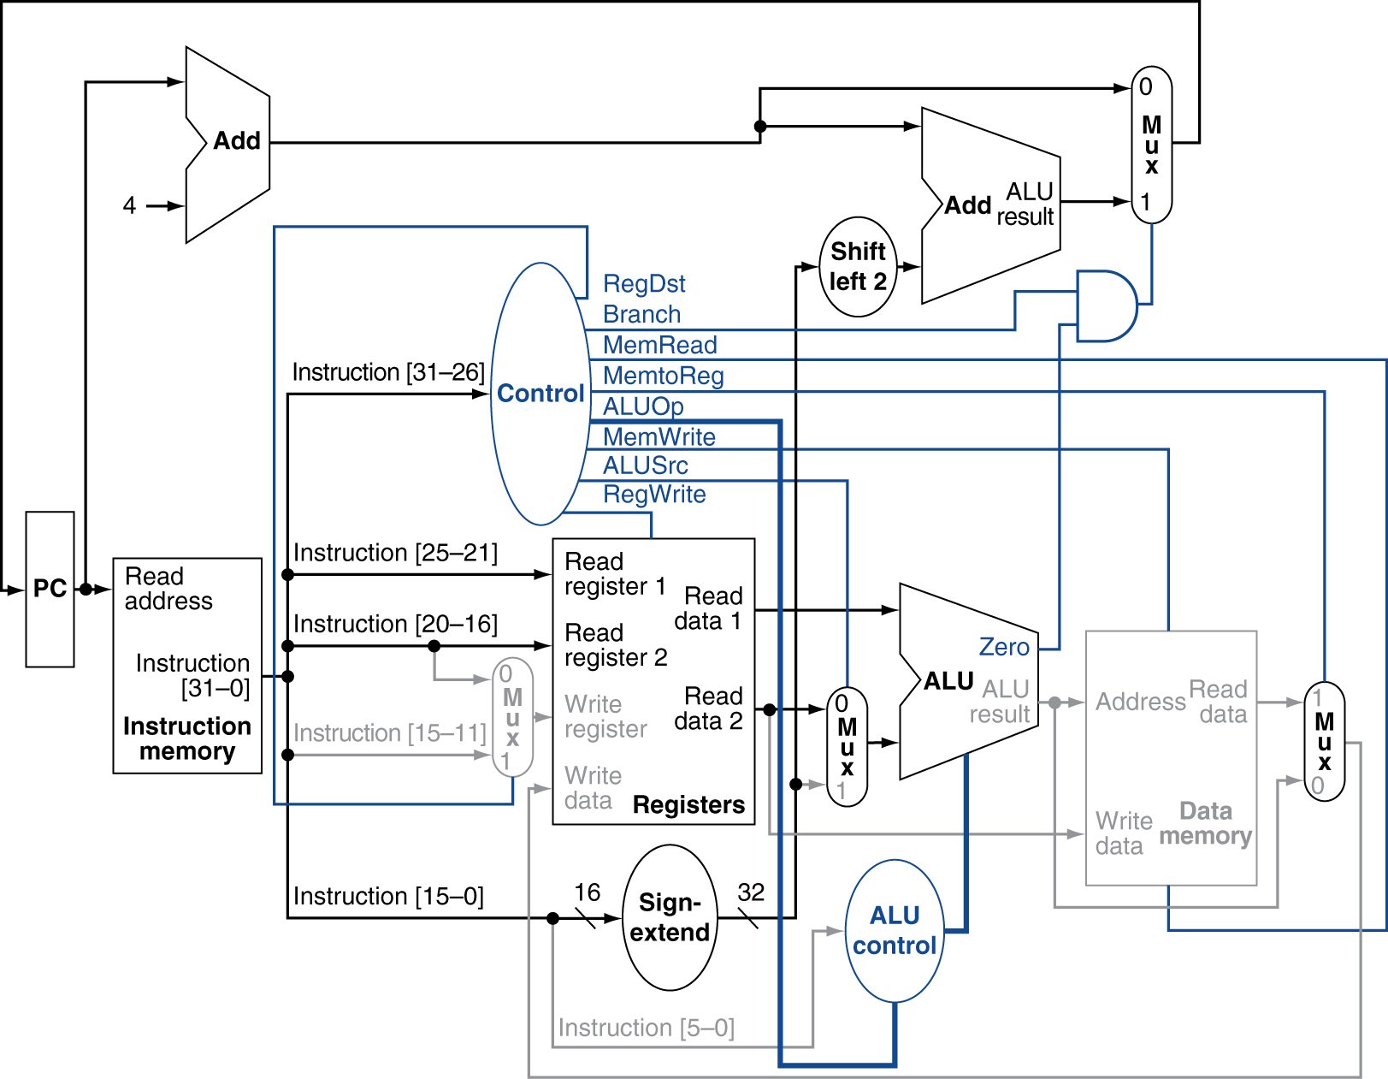
Branch-on-Equal Instruction
Chapter 4 — The Processor — <number>
Notes:
Morgan Kaufmann Publishers
19 October 2022
Chapter 4 — The Processor

Slide 25
Implementing Jumps
Jump
2
address
31:26
25:0
Jump uses word address
Update PC with concatenation of
  Top 4 bits of old PC
  26-bit jump address
  00
Need an extra control signal decoded from opcode
Chapter 4 — The Processor — <number>
Notes:
Morgan Kaufmann Publishers
19 October 2022
Chapter 4 — The Processor

Slide 26
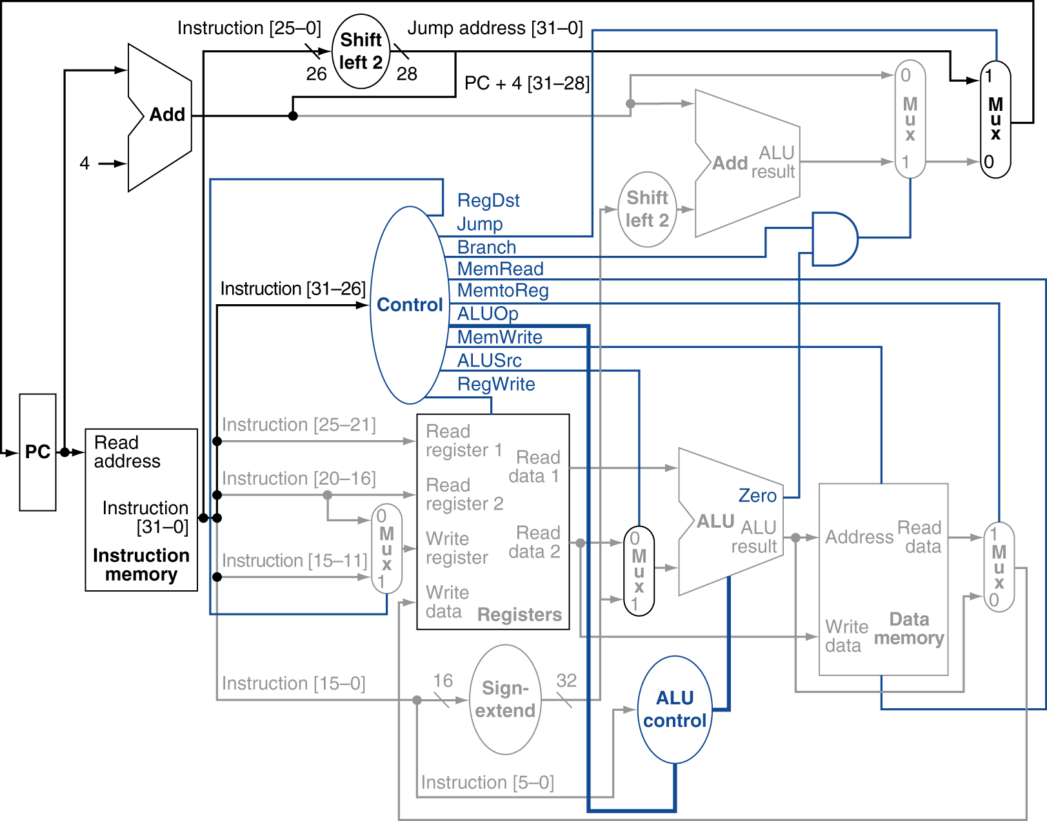
Datapath With Jumps Added
Chapter 4 — The Processor — <number>
Notes:
Morgan Kaufmann Publishers
19 October 2022
Chapter 4 — The Processor

Slide 27
How do we get from high-level languages to MIPS instructions?

Slide 28
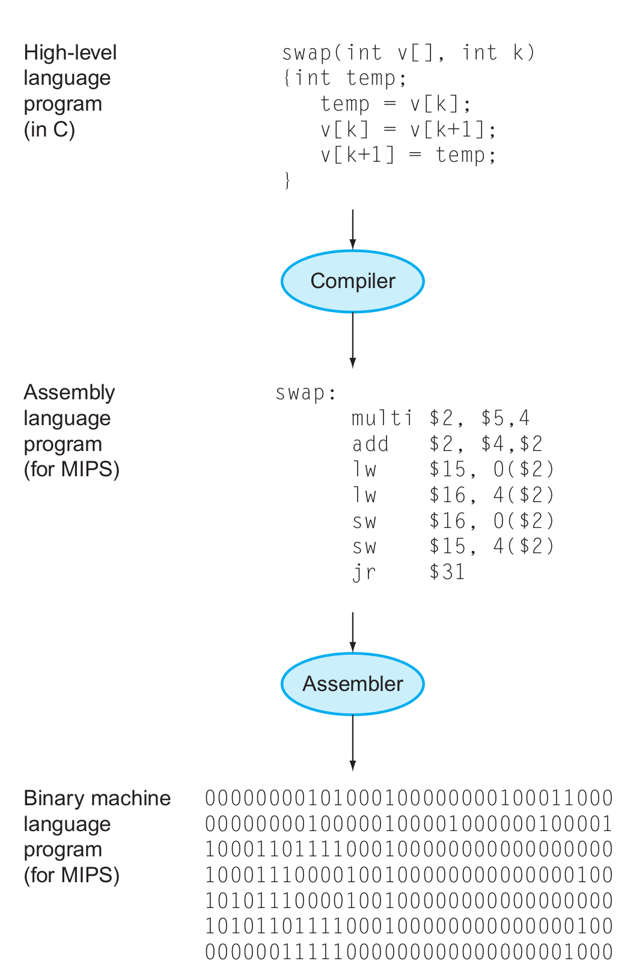
The HW/SW Interface
Application software
Systems software
(OS, compiler)
Hardware

Slide 29
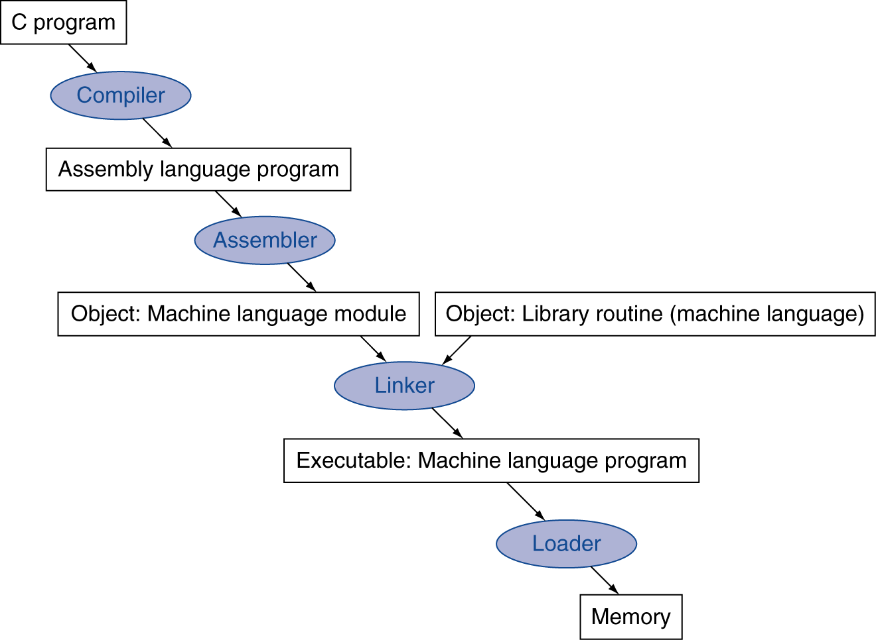
Translation and Startup
Many compilers produce object modules directly
§2.12 Translating and Starting a Program
Static linking
Chapter 2 — Instructions: Language of the Computer — <number>
Notes:
The University of Adelaide, School of Computer Science
October 19, 2022
Chapter 2 — Instructions: Language of the Computer

Slide 30
If then .. else …
if (i == j) f = g + h; else f = g – h;
Assume that f,g, h, i, and j are in $s0, $s1, etc.

Slide 31
If then .. else …
if (i == j) f = g + h; else f = g – h;
Assume that f,g, h, i, and j are in $s0, $s1, etc.
bne $s3,$s4,Else # go to Else if i ≠ j
add $s0,$s1,$s2 # f = g + h (skipped if i ≠ j)
j Exit # unconditional jump to Exit
Else:
sub $s0,$s1,$s2 # f = g – h (skipped if i = j)
Exit:

Slide 32
Loops
while (save[i] == k)
i += 1;
Assume that i and k are in $s3 and $s5

Slide 33
Loops
while (save[i] == k)
i += 1;
Assume that i and k are in $s3 and $s5
Loop: sll $t1,$s3,2
add $t1,$t1,$s6 # $t1 = address of save[i]
lw $t0,0($t1) # Temp reg $t0 = save[i]
bne $t0,$s5, Exit # go to Exit if save[i] ≠ k
addi $s3,$s3,1 # i = i + 1
j Loop # go to Loop
Exit:

Slide 34
Procedures

Slide 35
Calling functions
// some code...
foo();
// more code..
$ra contains information for how to return from a subroutine
  i.e., from foo()
Functions can be called from different places in the program
if (a == 0) {
foo();
…
} else {
foo();
…
}

Slide 36
Procedure Call Instructions
Procedure call: jump and link
jal ProcedureLabel
  Address of following instruction put in $ra
  Jumps to target address
Procedure return: jump register
jr $ra
  Copies $ra to program counter
  Can also be used for computed jumps
    e.g., for case/switch statements
Chapter 2 — Instructions: Language of the Computer — <number>
Notes:
The University of Adelaide, School of Computer Science
October 19, 2022
Chapter 2 — Instructions: Language of the Computer

Slide 37
Calling conventions
Goal: re-entrant programs
  How to pass arguments
    On the stack?
    In registers?
  How to return values
    On the stack?
    In registers?
  What registers have to be preserved
    All? Some subset?
Conventions differ from compiler, optimizations, etc.

Slide 38
Passing arguments
First 4 arguments in registers
  $a0 - $a3
Other arguments on the stack
Return values in registers
  $v0 - $v1

Slide 39
Preserving registers
$t0 – $t9: temporaries
  Can be overwritten by callee
$s0 – $s7: saved
  Must be saved/restored by callee

Slide 40
Leaf Procedure Example
C code:
int leaf_example (int g, h, i, j)
{ int f;
f = (g + h) - (i + j);
return f;
}
  Arguments g, …, j in $a0, …, $a3
  f in $s0 (hence, need to save $s0 on stack)
  Result in $v0
Chapter 2 — Instructions: Language of the Computer — <number>
Notes:
The University of Adelaide, School of Computer Science
October 19, 2022
Chapter 2 — Instructions: Language of the Computer

Slide 41
Leaf Procedure Example
MIPS code:
leaf_example:
addi $sp, $sp, -4
sw $s0, 0($sp)
add $t0, $a0, $a1
add $t1, $a2, $a3
sub $s0, $t0, $t1
add $v0, $s0, $zero
lw $s0, 0($sp)
addi $sp, $sp, 4
jr $ra
Save $s0 on stack
Procedure body
Result
Restore $s0
Return
Chapter 2 — Instructions: Language of the Computer — <number>
Notes:
The University of Adelaide, School of Computer Science
October 19, 2022
Chapter 2 — Instructions: Language of the Computer

Slide 42
Recursive invocations
foo(int a) {
if (a == 0)
return;
a--;
foo(a);
return;
}
foo(4);

Slide 43
Non-Leaf Procedures
Procedures that call other procedures
For nested call, caller needs to save on the stack:
  Its return address
  Any arguments and temporaries needed after the call
Restore from the stack after the call
Chapter 2 — Instructions: Language of the Computer — <number>
Notes:
The University of Adelaide, School of Computer Science
October 19, 2022
Chapter 2 — Instructions: Language of the Computer

Slide 44
Non-Leaf Procedure Example
C code:
int fact (int n)
{
if (n < 1) return f;
else return n * fact(n - 1);
}
  Argument n in $a0
  Result in $v0
Chapter 2 — Instructions: Language of the Computer — <number>
Notes:
The University of Adelaide, School of Computer Science
October 19, 2022
Chapter 2 — Instructions: Language of the Computer

Slide 45
Non-Leaf Procedure Example
MIPS code:
fact:
addi $sp, $sp, -8 # adjust stack for 2 items
sw $ra, 4($sp) # save return address
sw $a0, 0($sp) # save argument
slti $t0, $a0, 1 # test for n < 1
beq $t0, $zero, L1
addi $v0, $zero, 1 # if so, result is 1
addi $sp, $sp, 8 # pop 2 items from stack
jr $ra # and return
L1: addi $a0, $a0, -1 # else decrement n
jal fact # recursive call
lw $a0, 0($sp) # restore original n
lw $ra, 4($sp) # and return address
addi $sp, $sp, 8 # pop 2 items from stack
mul $v0, $a0, $v0 # multiply to get result
jr $ra # and return
Notes:
The University of Adelaide, School of Computer Science
October 19, 2022
Chapter 2 — Instructions: Language of the Computer

Slide 46
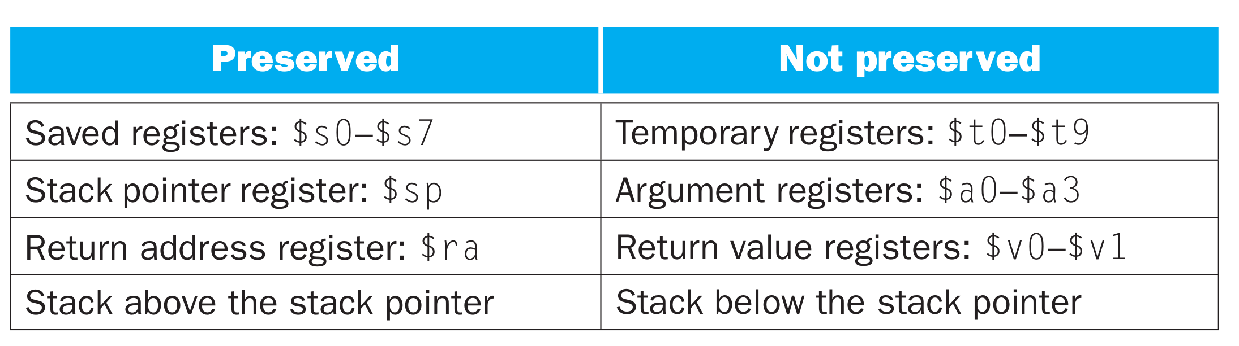
Calling convention (again)

Slide 47
Translation and Startup
Many compilers produce object modules directly
§2.12 Translating and Starting a Program
Static linking
Chapter 2 — Instructions: Language of the Computer — <number>
Notes:
The University of Adelaide, School of Computer Science
October 19, 2022
Chapter 2 — Instructions: Language of the Computer

Slide 48
Translation and Startup
Many compilers produce object modules directly
§2.12 Translating and Starting a Program
Static linking
Chapter 2 — Instructions: Language of the Computer — <number>
Notes:
The University of Adelaide, School of Computer Science
October 19, 2022
Chapter 2 — Instructions: Language of the Computer

Slide 49
Translation and Startup
Many compilers produce object modules directly
§2.12 Translating and Starting a Program
Static linking
Chapter 2 — Instructions: Language of the Computer — <number>
Notes:
The University of Adelaide, School of Computer Science
October 19, 2022
Chapter 2 — Instructions: Language of the Computer

Slide 50
Translation and Startup
Many compilers produce object modules directly
§2.12 Translating and Starting a Program
Static linking
Chapter 2 — Instructions: Language of the Computer — <number>
Notes:
The University of Adelaide, School of Computer Science
October 19, 2022
Chapter 2 — Instructions: Language of the Computer

Slide 51


Slide 52
Relocation
(What needs to be done to move the program in memory?)

Slide 53
What types of variables do you know?
Or where these variables are allocated in memory?

Slide 54
What types of variables do you know?
Global variables
  Initialized → data section
  Uninitalized → BSS
Dynamic variables
  Heap
Local variables
  Stack

Slide 55
Global variables
#include <stdio.h>
char hello[] = "Hello";
int main(int ac, char **av)
{
static char world[] = "world!";
printf("%s %s\n", hello, world);
return 0;
}

Slide 56
Global variables
#include <stdio.h>
char hello[] = "Hello";
int main(int ac, char **av)
{
static char world[] = "world!";
printf("%s %s\n", hello, world);
return 0;
}
Allocated in the data section
  It is split in initialized (non-zero), and non-initialized (zero)
  As well as read/write, and read only data section

Slide 57
Global variables

Slide 58
Dynamic variables (heap)
#include <stdio.h>
#include <string.h>
#include <stdlib.h>
char hello[] = "Hello";
int main(int ac, char **av)
{
char world[] = "world!";
char *str = malloc(64);
memcpy(str, "beautiful", 64);
printf("%s %s %s\n", hello, str, world);
return 0;
}

Slide 59
Dynamic variables (heap)
#include <stdio.h>
#include <string.h>
#include <stdlib.h>
char hello[] = "Hello";
int main(int ac, char **av)
{
char world[] = "world!";
char *str = malloc(64);
memcpy(str, "beautiful", 64);
printf("%s %s %s\n", hello, str, world);
return 0;
}
Allocated on the heap
  Special area of memory provided by the OS from where malloc() can allocate memory

Slide 60
Local variables
Local variables
#include <stdio.h>
char hello[] = "Hello";
int main(int ac, char **av)
{
//static char world[] = "world!";
char world[] = "world!";
printf("%s %s\n", hello, world);
return 0;
}

Slide 61
1 # "Hello World" in MIPS assembly
2 # From: http://labs.cs.upt.ro/labs/so2/html/resources/nachos-doc/mipsf.html
3
4 # All program code is placed after the
5 # .text assembler directive
6 .text
7
8 # Declare main as a global function
9 .globl main
10
11 # The label 'main' represents the starting point
12 main:
13 # Run the print_string syscall which has code 4
14 li $v0,4 # Code for syscall: print_string
15 la $a0, msg # Pointer to string (load the address of msg)
16 syscall
17 li $v0,10 # Code for syscall: exit
18 syscall
19
20 # All memory structures are placed after the
21 # .data assembler directive
22 .data
23
24 # The .asciiz assembler directive creates
25 # an ASCII string in memory terminated by
26 # the null character. Note that strings are
27 # surrounded by double-quotes
28 msg: .asciiz "Hello World!\n"

Slide 62
What needs to be relocated?
User Text Segment [00400000]..[00440000]
[00400000] 8fa40000 lw $4, 0($29) ; 183: lw $a0 0($sp) # argc
[00400004] 27a50004 addiu $5, $29, 4 ; 184: addiu $a1 $sp 4 # argv
[00400008] 24a60004 addiu $6, $5, 4 ; 185: addiu $a2 $a1 4 # envp
[0040000c] 00041080 sll $2, $4, 2 ; 186: sll $v0 $a0 2
[00400010] 00c23021 addu $6, $6, $2 ; 187: addu $a2 $a2 $v0
[00400014] 0c100009 jal 0x00400024 [main] ; 188: jal main
[00400018] 00000000 nop ; 189: nop
[0040001c] 3402000a ori $2, $0, 10 ; 191: li $v0 10
[00400020] 0000000c syscall ; 192: syscall # syscall 10 (exit)
[00400024] 34020004 ori $2, $0, 4 ; 14: li $v0,4 # Code for syscall:
; print_string
[00400028] 3c011001 lui $1, 4097 [msg] ; 15: la $a0, msg # Pointer to string ; (load the address of msg)
[0040002c] 34240000 ori $4, $1, 0 [msg]
[00400030] 0000000c syscall ; 16: syscall
[00400034] 3402000a ori $2, $0, 10 ; 17: li $v0,10 # Code for syscall: ; exit
[00400038] 0000000c syscall ; 18: syscall

Slide 63
What needs to be relocated?
User Text Segment [00400000]..[00440000]
[00400000] 8fa40000 lw $4, 0($29) ; 183: lw $a0 0($sp) # argc
[00400004] 27a50004 addiu $5, $29, 4 ; 184: addiu $a1 $sp 4 # argv
[00400008] 24a60004 addiu $6, $5, 4 ; 185: addiu $a2 $a1 4 # envp
[0040000c] 00041080 sll $2, $4, 2 ; 186: sll $v0 $a0 2
[00400010] 00c23021 addu $6, $6, $2 ; 187: addu $a2 $a2 $v0
[00400014] 0c100009 jal 0x00400024 [main] ; 188: jal main
[00400018] 00000000 nop ; 189: nop
[0040001c] 3402000a ori $2, $0, 10 ; 191: li $v0 10
[00400020] 0000000c syscall ; 192: syscall # syscall 10 (exit)
[00400024] 34020004 ori $2, $0, 4 ; 14: li $v0,4 # Code for syscall:
; print_string
[00400028] 3c011001 lui $1, 4097 [msg] ; 15: la $a0, msg # Pointer to string ; (load the address of msg)
[0040002c] 34240000 ori $4, $1, 0 [msg]
[00400030] 0000000c syscall ; 16: syscall
[00400034] 3402000a ori $2, $0, 10 ; 17: li $v0,10 # Code for syscall: ; exit
[00400038] 0000000c syscall ; 18: syscall

Slide 64
Translation and Startup
Many compilers produce object modules directly
§2.12 Translating and Starting a Program
Static linking
Chapter 2 — Instructions: Language of the Computer — <number>
Notes:
The University of Adelaide, School of Computer Science
October 19, 2022
Chapter 2 — Instructions: Language of the Computer

Slide 65

Memory layout of a process

Slide 66
Where do these areas come from?

Slide 67
Memory layout of a process
OS kernel
Compiler and linker

Slide 68

Load program in memory

Slide 69
Translation and Startup
Many compilers produce object modules directly
§2.12 Translating and Starting a Program
Static linking
Chapter 2 — Instructions: Language of the Computer — <number>
Notes:
The University of Adelaide, School of Computer Science
October 19, 2022
Chapter 2 — Instructions: Language of the Computer

Slide 70
Thank you!

