Slide 1
CS/EE 3810: Computer Organization
Lecture 16: Memory
Anton Burtsev
November, 2022

Slide 2
Off-Chip DRAM Main Memory
Main memory is stored in DRAM cells that have much
higher storage density
DRAM cells lose their state over time – must be refreshed
periodically, hence the name Dynamic
A number of DRAM chips are aggregated on a DIMM to
provide high capacity – a DIMM is a module that plugs
into a bus on the motherboard
DRAM access suffers from long access time and high
energy overhead

Slide 3
Memory Architecture
Processor
Bank
Row Buffer
Memory Controller
Address/Cmd
DIMM
Data
DIMM: a PCB with DRAM chips on the back and front
The memory system is itself organized into ranks and banks; each
bank can process a transaction in parallel
Each bank has a row buffer that retains the last row touched in a bank
(it’s like a cache in the memory system that exploits spatial locality)
(row buffer hits have a lower latency than a row buffer miss)

Slide 4
Intel Xeon Gold 6142 Processor
22M Cache, 2.60 GHz
https://ark.intel.com/content/www/us/en/ark/products/120487/intel-xeon-gold-6142-processor-22m-cache-2-60-ghz.html
6 memory channels, 2666MT/s
Theoretical memory throughput
  2666 MT/s * 8 (bytes per transaction) * 6 (num channels) = 127.9 GB/s (Theoretical peak memory bandwidth)

Slide 5
Intel Xeon Gold 6142 Processor
CPUs, however, communicate with DRAM in the unit of cache-lines (64 bytes).
  Therefore, to access even one byte of data the CPU will issue a cache-line read
A single memory channel is capable of performing 333.2 millions of cache-line reads or writes per second
  A six channel system achieves 1.9 billions of cache-line transactions
To keep the memory subsystem saturated, the socket should issue a cache-line transaction every 0.5 nanoseconds.
On a 16 core socket
  Each core submits a cache-line transaction every 8 ns
  Or 20 cycles on a 2.6GHz machine
  Or 40 cycles if logical threads are enabled.

Slide 6
Virtual Memory and Page Tables

Slide 7
Paging

Slide 8

Pages

Slide 9

Pages

Slide 10
Paging idea
Break up memory into 4096-byte chunks called pages
  Modern hardware supports 2MB, 4MB, and 1GB pages
Independently control mapping for each page of linear address space
Compare with segmentation (single base + limit)
  many more degrees of freedom

Slide 11
How can we build this translation mechanism?

Slide 12
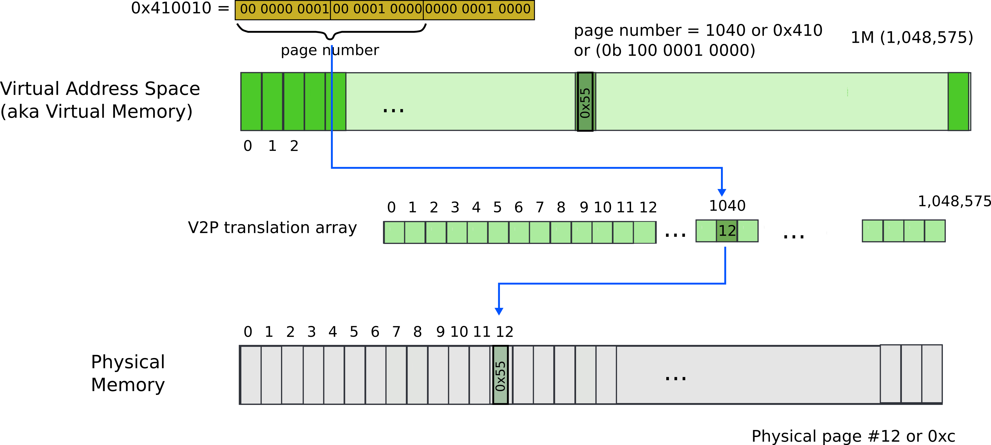
Paging: naive approach: translation array
Virtual address 0x410010

Slide 13
What is wrong?

Slide 14
What is wrong?
We need 4 bytes to relocate each page
  20 bits for physical page number
  12 bits of access flags
  Therefore, we need array of 4 bytes x 1M entries
    4MBs

Slide 15
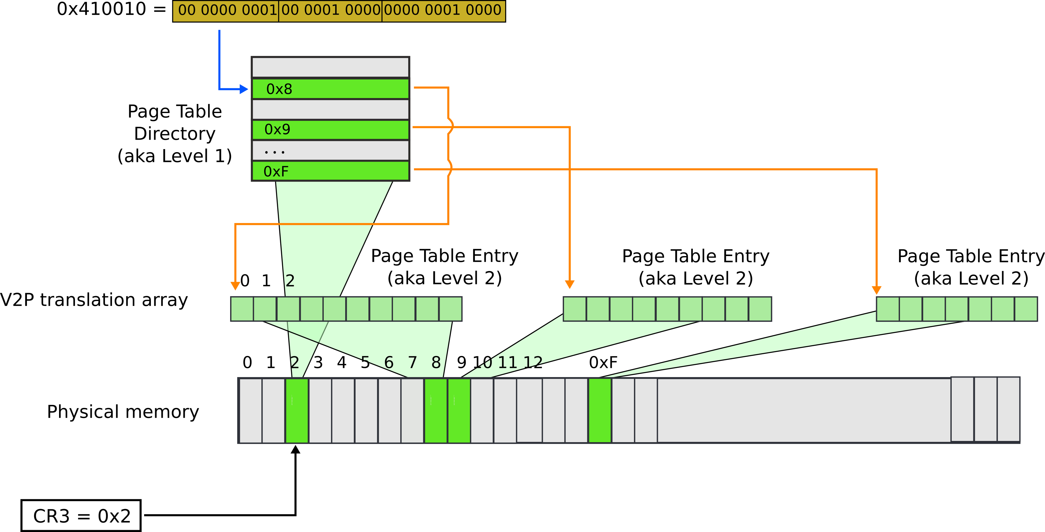
Paging: page table

Slide 16

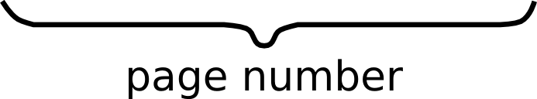





Slide 17



Slide 18





Slide 19

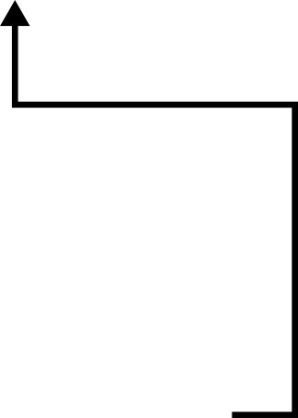


Slide 20



Slide 21
Result:
  EAX = 55

Slide 22

Page translation

Slide 23
Page translation

Slide 24
Page translation

Slide 25
Page translation

Slide 26
Benefit of page tables
… Compared to arrays?
Page tables represent sparse address space more efficiently
  An entire array has to be allocated upfront
  But if the address space uses a handful of pages
  Only page tables (Level 1 and 2 need to be allocated to describe translation)
On a dense address space this benefit goes away
  I'll assign a homework!

Slide 27

What about isolation?
Two programs, one memory?
Each process has its own page table
  OS switches between them

Slide 28

P1 and P2 can't access each other memory

Slide 29
TLB
Since the number of pages is very high, the page table
capacity is too large to fit on chip
A translation lookaside buffer (TLB) caches the virtual
to physical page number translation for recent accesses
A TLB miss requires us to access the page table, which
may not even be found in the cache – two expensive
memory look-ups to access one word of data!
A large page size can increase the coverage of the TLB
and reduce the capacity of the page table, but also
increases memory waste

Slide 30
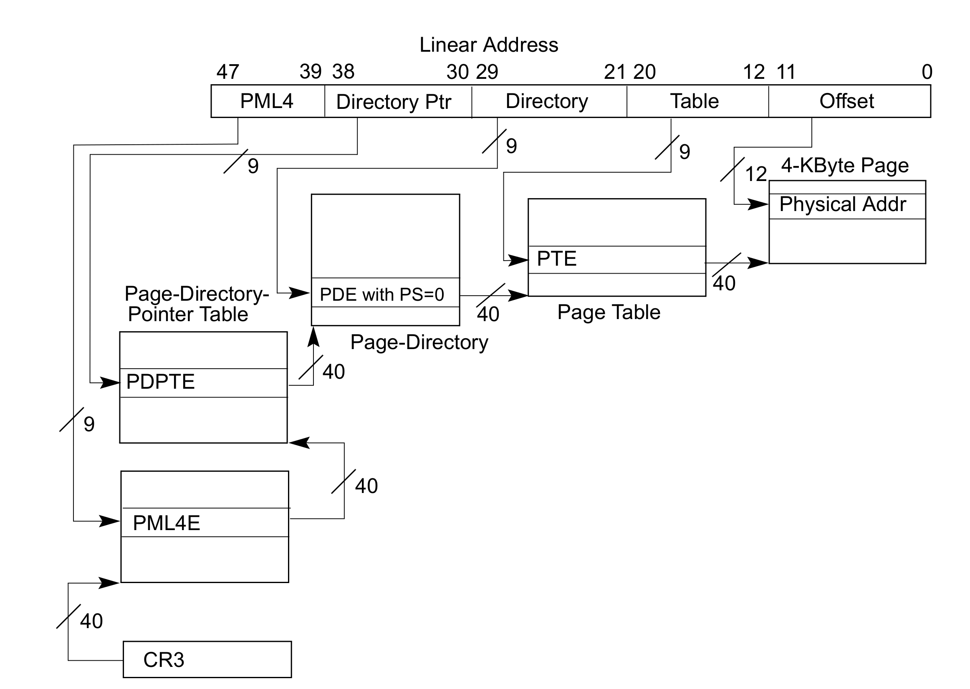
Page translation in 64bit mode
Virtual addresses are 48 bits
Physical addresses are 52 bits

Slide 32
Memory Hierarchy Properties
A virtual memory page can be placed anywhere in physical
memory (fully-associative)
Replacement is usually LRU (since the miss penalty is
huge, we can invest some effort to minimize misses)
A page table (indexed by virtual page number) is used for
translating virtual to physical page number
The memory-disk hierarchy can be either inclusive or
exclusive and the write policy is writeback

Slide 33
TLB and Cache
Is the cache indexed with virtual or physical address?
  To index with a physical address, we will have to first
  look up the TLB, then the cache → longer access time
  Multiple virtual addresses can map to the same
  physical address – can we ensure that these
  different virtual addresses will map to the same
  location in cache? Else, there will be two different
  copies of the same physical memory word
Does the tag array store virtual or physical addresses?
  Since multiple virtual addresses can map to the same
  physical address, a virtual tag comparison can flag a
  miss even if the correct physical memory word is present

Slide 34
TLB and Cache

Slide 35
Virtually Indexed Caches
24-bit virtual address, 4KB page size → 12 bits offset and
12 bits virtual page number
To handle the example below, the cache must be designed to use only 12
index bits – for example, make the 64KB cache 16-way
Page coloring can ensure that some bits of virtual and physical address match
abcdef
abbdef
Virtually indexed
cache
cdef
bdef
Page in physical
memory
Data cache that needs 16
index bits 64KB direct-mapped
or 128KB 2-way…

Slide 36
Thank you!

