Slide 1
CS/ECE 3810: Computer Organization
Lecture 5: Arithmetic for Computers
Anton Burtsev
September, 2022

Slide 2
Arithmetic for Computers
§3.1 Introduction
Operations on integers
  Addition and subtraction
  Multiplication and division
  Dealing with overflow
Floating-point real numbers
  Representation and operations
Chapter 3 — Arithmetic for Computers — <number>
Notes:
Morgan Kaufmann Publishers
26 September 2022
Chapter 3 — Arithmetic for Computers

Slide 3
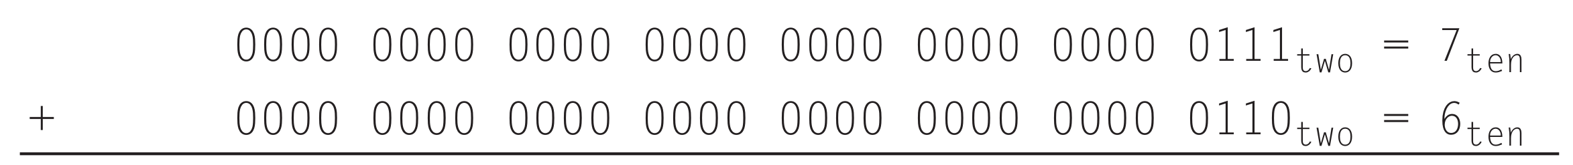
Integer addition
Example 7 + 6

Slide 4
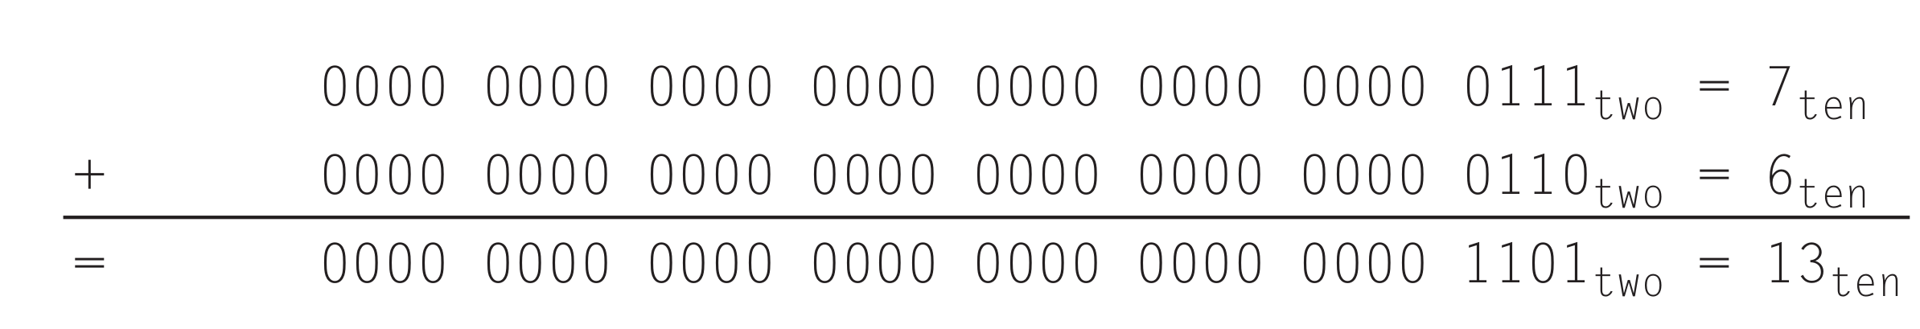
Integer addition
Example 7 + 6

Slide 5
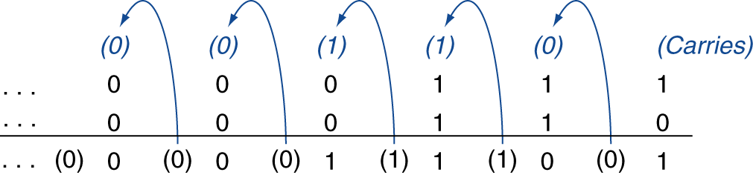
Integer Addition
Example: 7 + 6
§3.2 Addition and Subtraction
Chapter 3 — Arithmetic for Computers — <number>
Notes:
Morgan Kaufmann Publishers
26 September 2022
Chapter 3 — Arithmetic for Computers

Slide 6
Integer Addition
Example: 7 + 6
§3.2 Addition and Subtraction
Overflow if result out of range
  Adding + (positive) and – (negative) operands, no overflow
  Adding two + (positive) operands
    Overflow if result sign is 1
  Adding two –(negative) operands
    Overflow if result sign is 0
Chapter 3 — Arithmetic for Computers — <number>
Notes:
Morgan Kaufmann Publishers
26 September 2022
Chapter 3 — Arithmetic for Computers

Slide 7
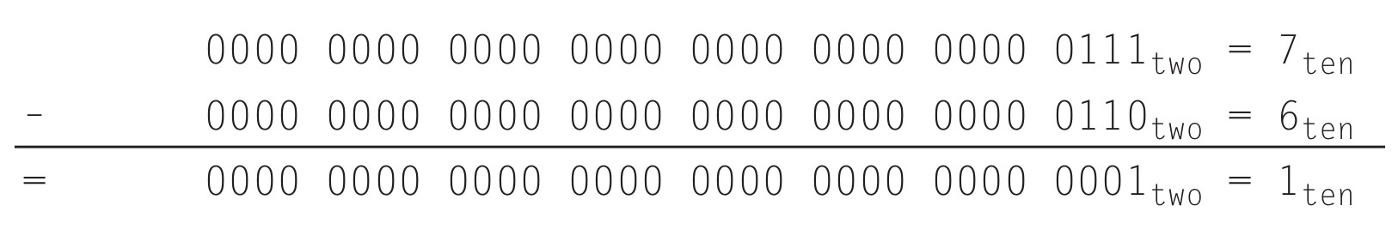
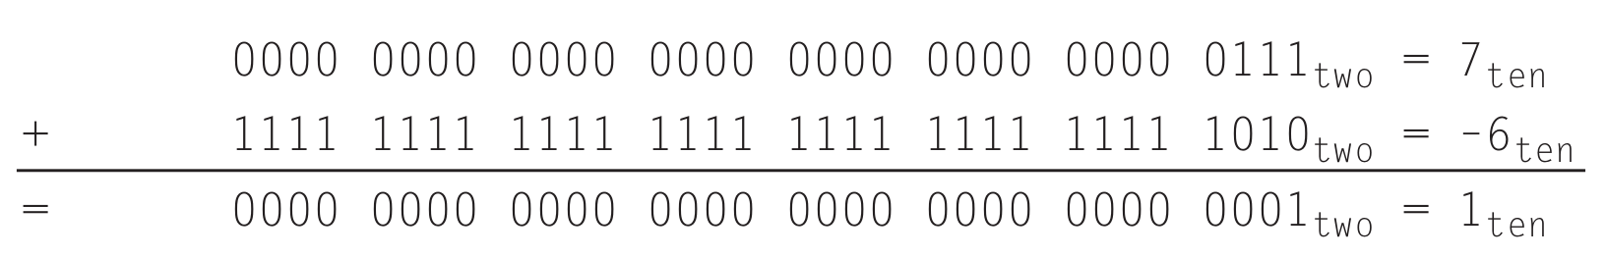
Integer subtraction
Example 7 – 6
  Directly:
  Or as adding (-6)

Slide 8
Integer Subtraction
Add negation of second operand
Example: 7 – 6 = 7 + (–6)
  +7: 0000 0000 … 0000 0111
  –6: 1111 1111 … 1111 1010
  +1: 0000 0000 … 0000 0001
Overflow if result out of range
  Subtracting two +(positive) or two –negative operands, no overflow
  Subtracting +(positive) from –(negative) operand
    Overflow if result sign is 0
  Subtracting –(negative) from +(positive) operand
    Overflow if result sign is 1
Chapter 3 — Arithmetic for Computers — <number>
Notes:
Morgan Kaufmann Publishers
26 September 2022
Chapter 3 — Arithmetic for Computers

Slide 9
Dealing with Overflow
Some languages (e.g., C) ignore overflow
  Use MIPS addu, addui, subu instructions
Other languages (e.g., Ada, Fortran) require raising an exception
  Use MIPS add, addi, sub instructions
  On overflow, invoke exception handler
    Save PC in exception program counter (EPC) register
    Jump to predefined handler address
    mfc0 (move from coprocessor reg) instruction can retrieve EPC value, to return after corrective action
Chapter 3 — Arithmetic for Computers — <number>
Notes:
Morgan Kaufmann Publishers
26 September 2022
Chapter 3 — Arithmetic for Computers

Slide 10
Multiplication

Slide 11
Multiplication
§3.3 Multiplication
Start with long-multiplication approach
multiplicand
1000
× 1001
1000
0000
0000
1000
1001000
multiplier
product
Length of product is the sum of operand lengths
Chapter 3 — Arithmetic for Computers — <number>
Notes:
Morgan Kaufmann Publishers
26 September 2022
Chapter 3 — Arithmetic for Computers

Slide 12
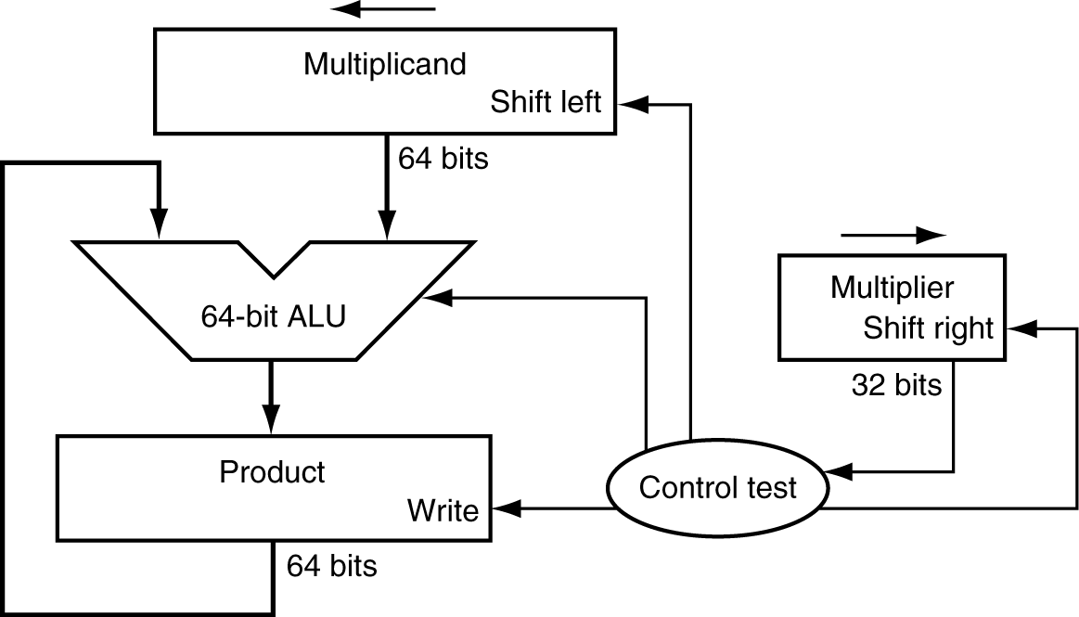
Multiplication
§3.3 Multiplication
Start with long-multiplication approach
multiplicand
1000
× 1001
1000
0000
0000
1000
1001000
multiplier
product
Length of product is the sum of operand lengths
Chapter 3 — Arithmetic for Computers — <number>
Notes:
Morgan Kaufmann Publishers
26 September 2022
Chapter 3 — Arithmetic for Computers

Slide 13
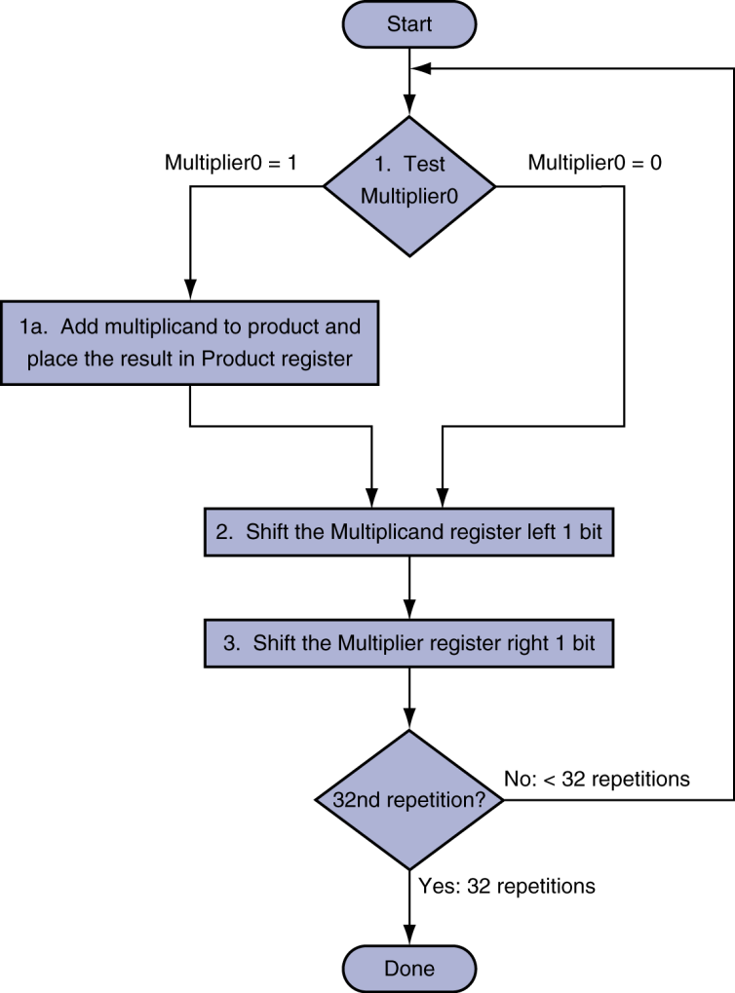
Multiplication Hardware
Initially 0
Chapter 3 — Arithmetic for Computers — <number>
Notes:
Morgan Kaufmann Publishers
26 September 2022
Chapter 3 — Arithmetic for Computers

Slide 14
Can we do it faster?
§3.3 Multiplication
Start with long-multiplication approach
multiplicand
1000
× 1001
1000
0000
0000
1000
1001000
multiplier
product
Length of product is the sum of operand lengths
Chapter 3 — Arithmetic for Computers — <number>
Notes:
Morgan Kaufmann Publishers
26 September 2022
Chapter 3 — Arithmetic for Computers

Slide 15
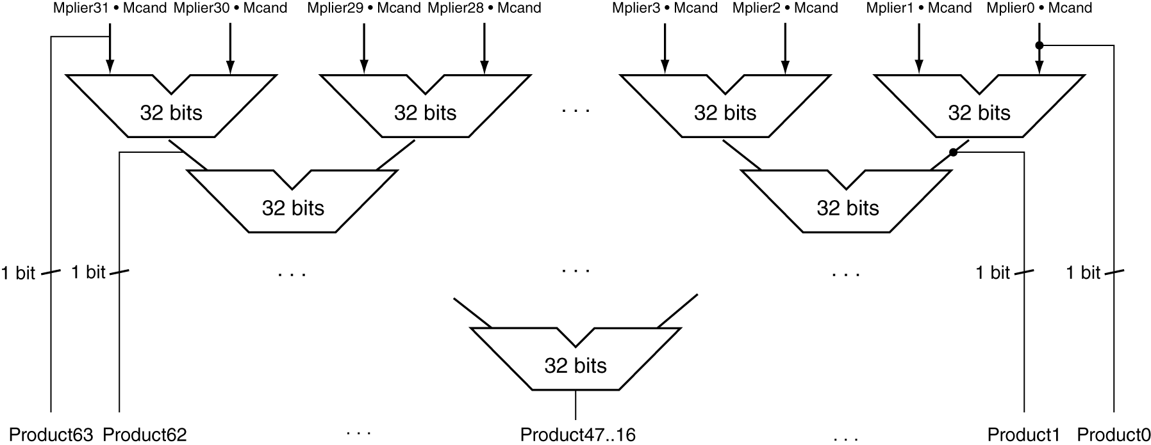
Faster Multiplier
Uses multiple adders
  Cost/performance tradeoff
Can be pipelined
  Several multiplication performed in parallel
Chapter 3 — Arithmetic for Computers — <number>
Notes:
Morgan Kaufmann Publishers
26 September 2022
Chapter 3 — Arithmetic for Computers

Slide 16
MIPS Multiplication
Two 32-bit registers for product
  HI: most-significant 32 bits
  LO: least-significant 32-bits
Instructions
  mult rs, rt / multu rs, rt
    64-bit product in HI/LO
  mfhi rd / mflo rd
    Move from HI/LO to rd
    Can test HI value to see if product overflows 32 bits
  mul rd, rs, rt
    Least-significant 32 bits of product –> rd
Chapter 3 — Arithmetic for Computers — <number>
Notes:
Morgan Kaufmann Publishers
26 September 2022
Chapter 3 — Arithmetic for Computers

Slide 17
Division

Slide 18
Division
1001_{ten} Quotient
Divisor 1000_{ten} | 1001010_{ten} Dividend
-1000
10
101
1010
-1000
10_{ten} Remainder
At every step,
  shift divisor right and compare it with current dividend
  if divisor is larger, shift 0 as the next bit of the quotient
  if divisor is smaller, subtract to get new dividend and shift 1
as the next bit of the quotient

Slide 19
Division
1001_{ten} Quotient
Divisor 1000_{ten} | 1001010_{ten} Dividend
0001001010 0001001010 0000001010 0000001010
100000000000 → 0001000000→ 0000100000→0000001000
Quo: 0 000001 0000010 000001001
At every step,
  shift divisor right and compare it with current dividend
  if divisor is larger, shift 0 as the next bit of the quotient
  if divisor is smaller, subtract to get new dividend and shift 1
as the next bit of the quotient

Slide 20
Divide Example
Divide 7_{ten} (0000 0111_{two}) by 2_{ten} (0010_{two})
Iter | Step | Quot | Divisor | Remainder
0 | Initial values
1
2
3
4
5

Slide 21
Divide Example
Divide 7_{ten} (0000 0111_{two}) by 2_{ten} (0010_{two})
Iter | Step | Quot | Divisor | Remainder
0 | Initial values | 0000 | 0010 0000 | 0000 0111
1 | Rem = Rem – Div Rem < 0 ➔ +Div, shift 0 into Q Shift Div right | 0000 0000 0000 | 0010 0000 0010 0000 0001 0000 | 1110 0111 0000 0111 0000 0111
2 | Same steps as 1 | 0000 0000 0000 | 0001 0000 0001 0000 0000 1000 | 1111 0111 0000 0111 0000 0111
3 | Same steps as 1 | 0000 | 0000 0100 | 0000 0111
4 | Rem = Rem – Div Rem >= 0 ➔ shift 1 into Q Shift Div right | 0000 0001 0001 | 0000 0100 0000 0100 0000 0010 | 0000 0011 0000 0011 0000 0011
5 | Same steps as 4 | 0011 | 0000 0001 | 0000 0001

Slide 22
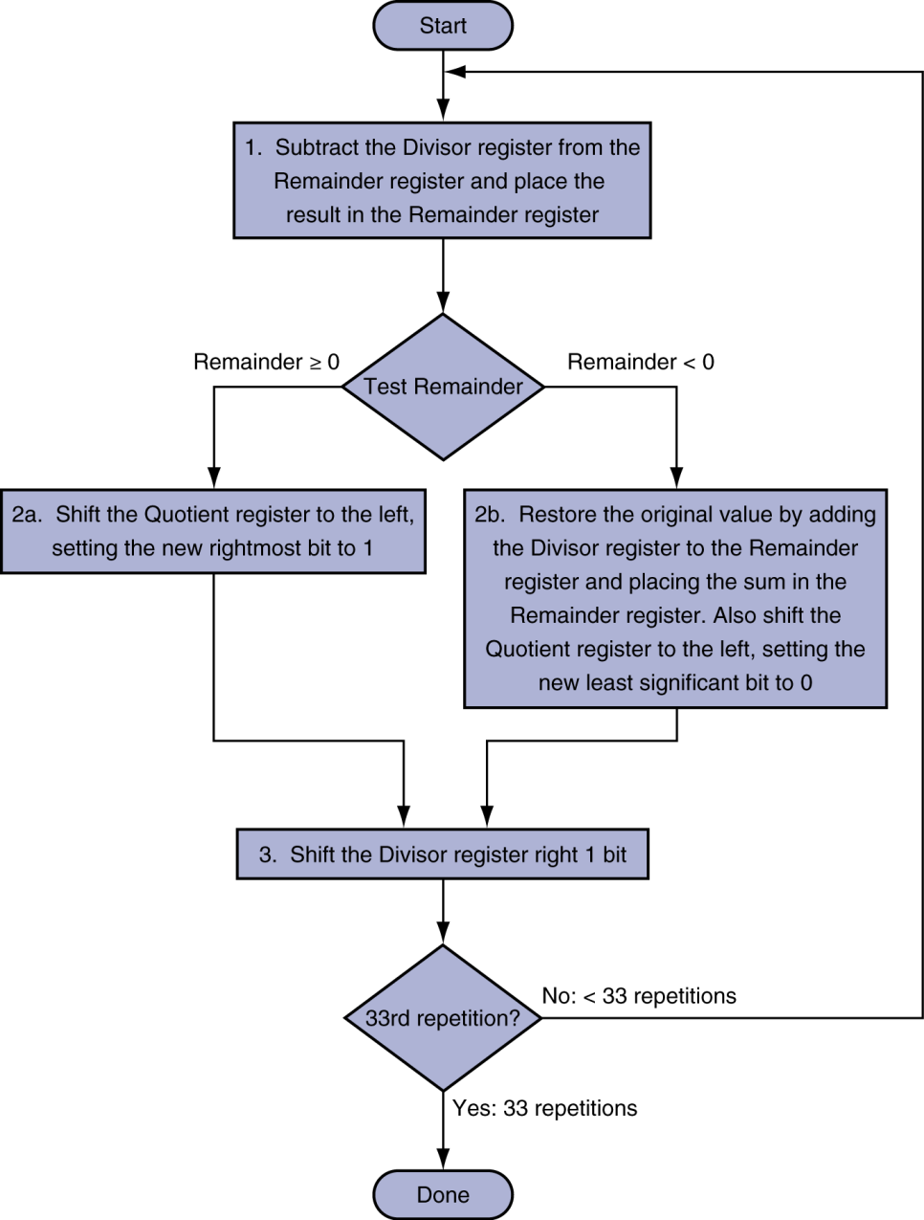
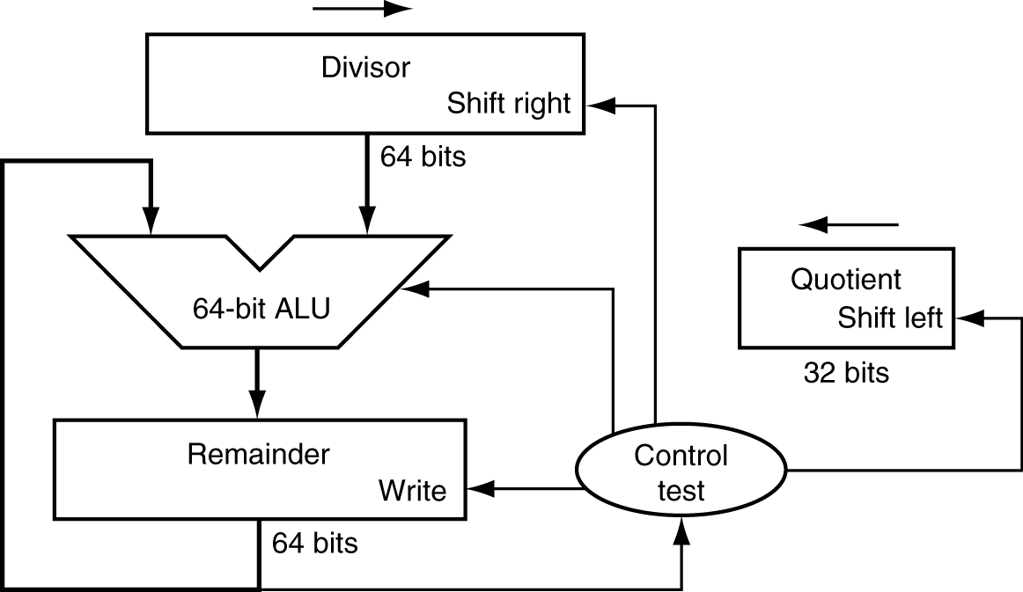
Division Hardware
Initially divisor in left half
Initially dividend
Chapter 3 — Arithmetic for Computers — <number>
Notes:
Morgan Kaufmann Publishers
26 September 2022
Chapter 3 — Arithmetic for Computers

Slide 23
MIPS Division
Use HI/LO registers for result
  HI: 32-bit remainder
  LO: 32-bit quotient
Instructions
  div rs, rt / divu rs, rt
  No overflow or divide-by-0 checking
    Software must perform checks if required
  Use mfhi, mflo to access result
Chapter 3 — Arithmetic for Computers — <number>
Notes:
Morgan Kaufmann Publishers
26 September 2022
Chapter 3 — Arithmetic for Computers

Slide 24
Thank you!

