Slide 1
CS/ECE 3810: Computer Systems
Architecture
Lecture 1: Introduction
Anton Burtsev
September, 2022

Slide 2
Class details
Undergraduate
  203 students
Instructor: Anton Burtsev

Slide 3
Who am I?
I build operating systems
  Since I was your age, i.e., since 2000
Bits of L4 microkernel, micro-ITRON, XenTT, LCDs, KSplit
  https://www.cs.utah.edu/~aburtsev/

Slide 4
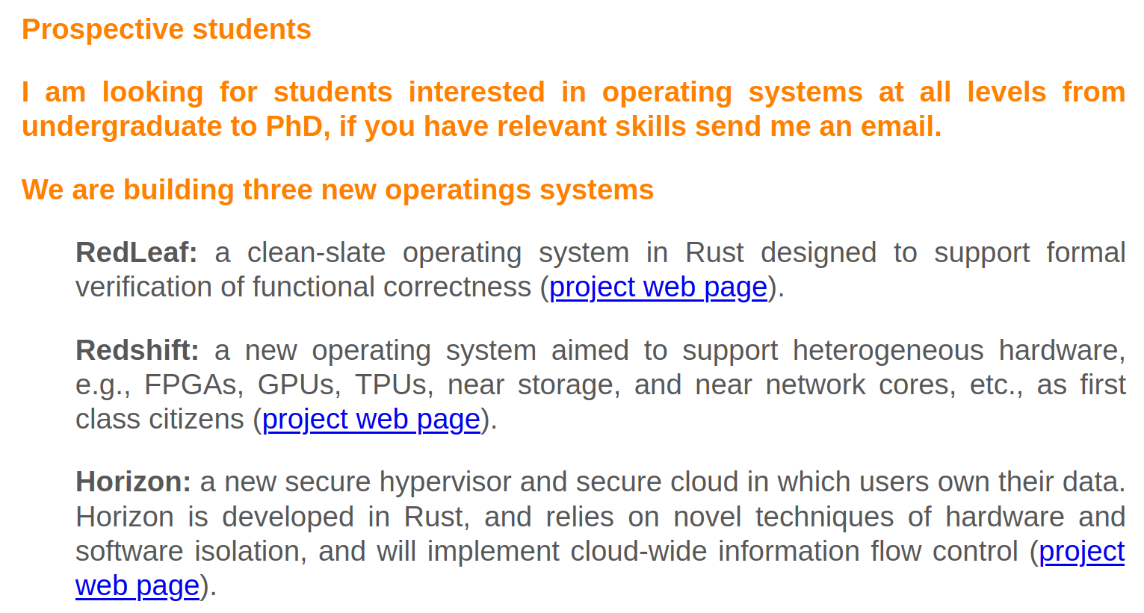

Slide 5
Class details
Undergraduate
  203 students
Instructor: Anton Burtsev
Meeting time: 11:50am-1:10pm (Mon/Wed)
4 TAs
  Send us a private message on Piazza
Web page
  https://www.cs.utah.edu/~aburtsev/3810

Slide 6
More details
8-10 small homework assignments
1-2 lab-like assignments
  Requires basics familiarity with UNIX
  Shell, C
Midterm
Final
Grades are curved
  Homework: 30%, midterm exam: 30%, final exam: 40% of your grade.
  You can drop two assignments
  Late submissions are 0

Slide 7
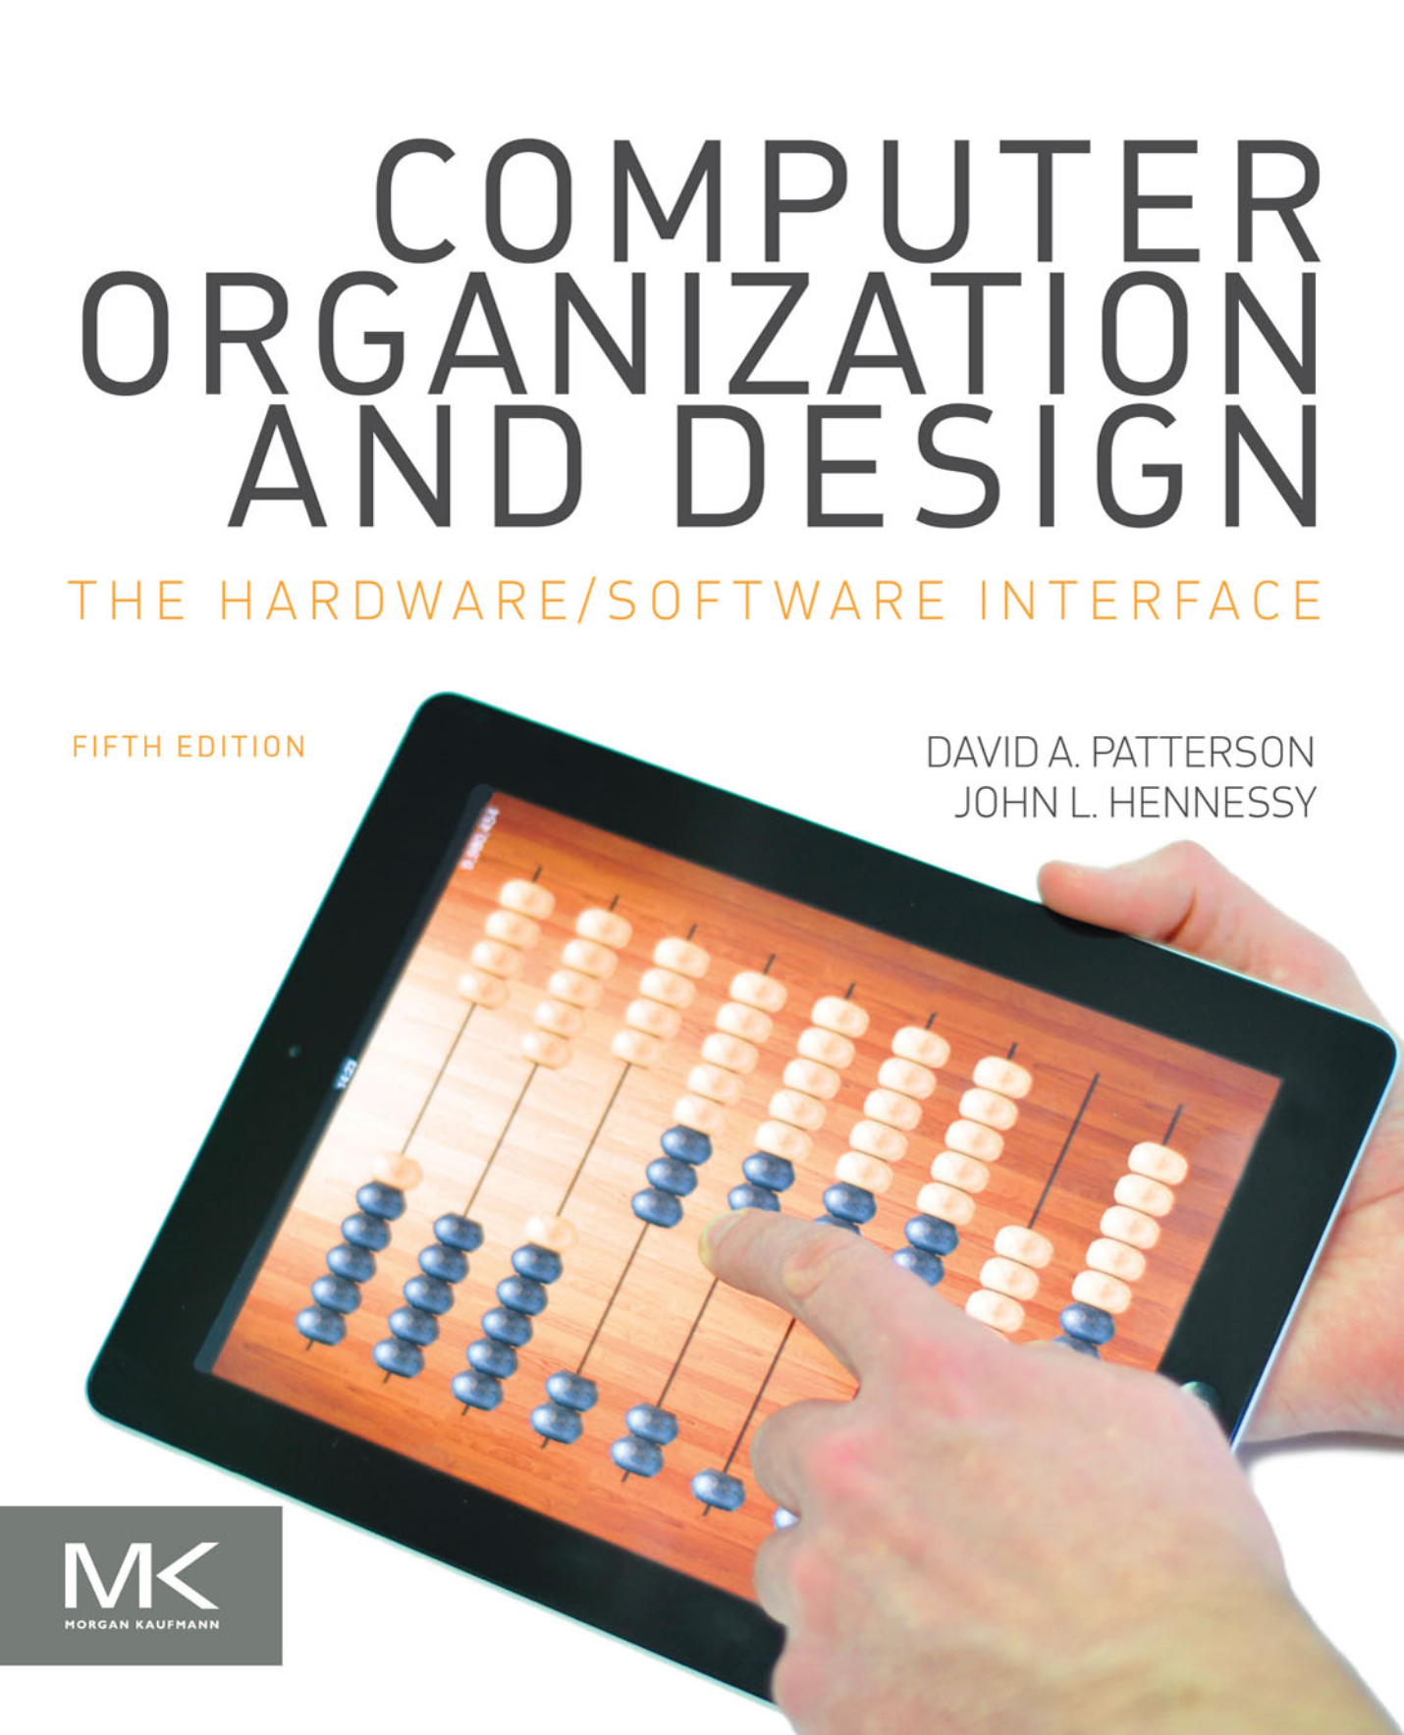
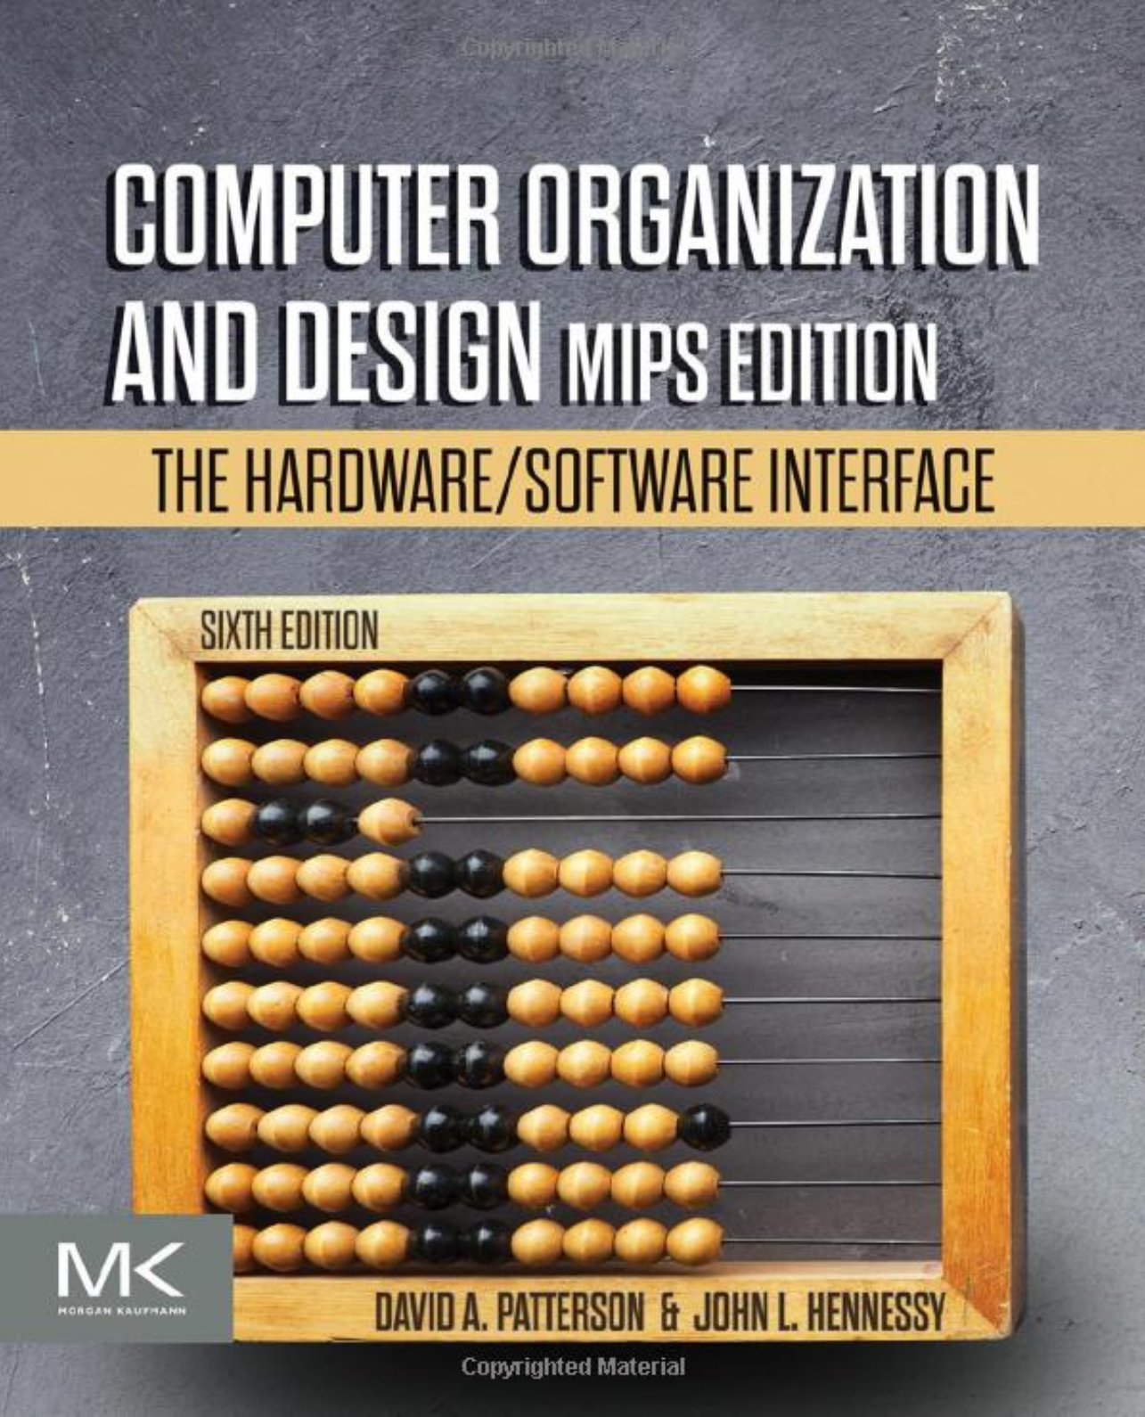
This course
Book: Hennessy and Patterson’s
  Computer Organization and Design
Topics
  Understanding performance/cost/power
  Assembly language
  Computer arithmetic
  Pipelining
  Using predictions
  Memory hierarchies
  Accelerators
  Reliability and Security

Slide 8
Course organization
Lectures
  High level concepts and abstractions
  Recorded (and hopefully live stream)
Reading
  Hennessy and Patterson
  Bits of additional notes
Homeworks
Exams
  Open notes (but might include open questions)

Slide 9
Questions?

Slide 10

Why this class?

Slide 11
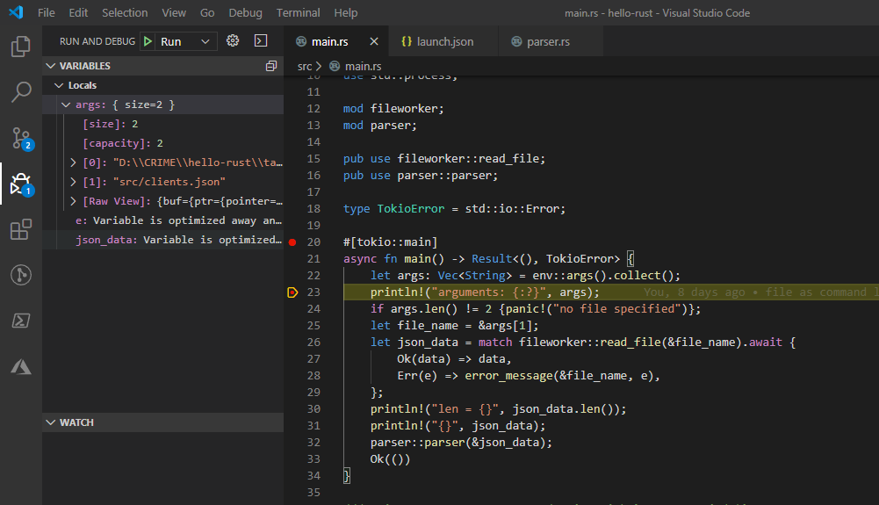

Slide 12
But can you do it fast?
… or secure

Slide 13
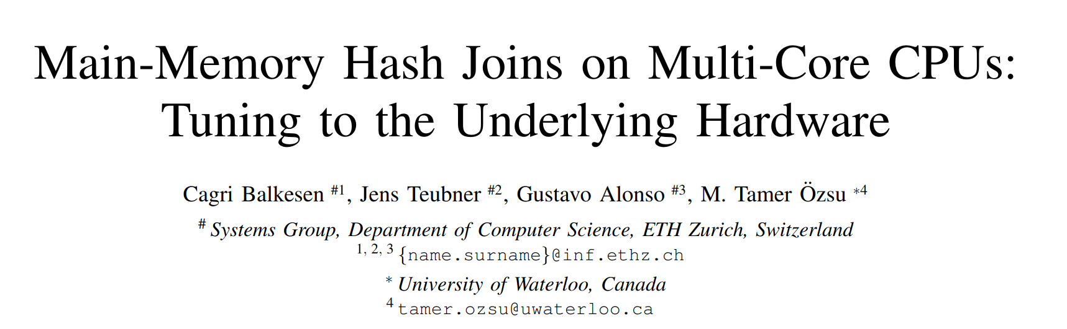
Example 1: Database Join
https://15721.courses.cs.cmu.edu/spring2016/papers/balkesen-icde2013.pdf

Slide 14
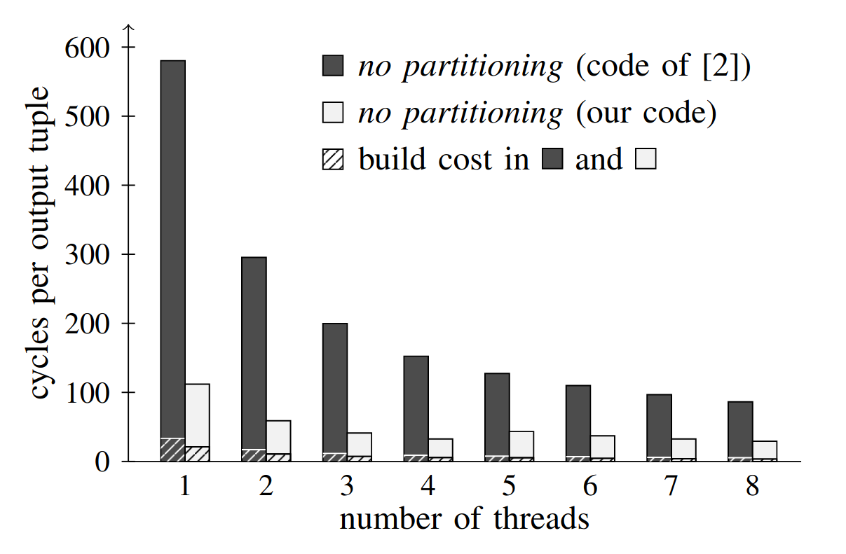
Example 1: Database Join

Slide 15
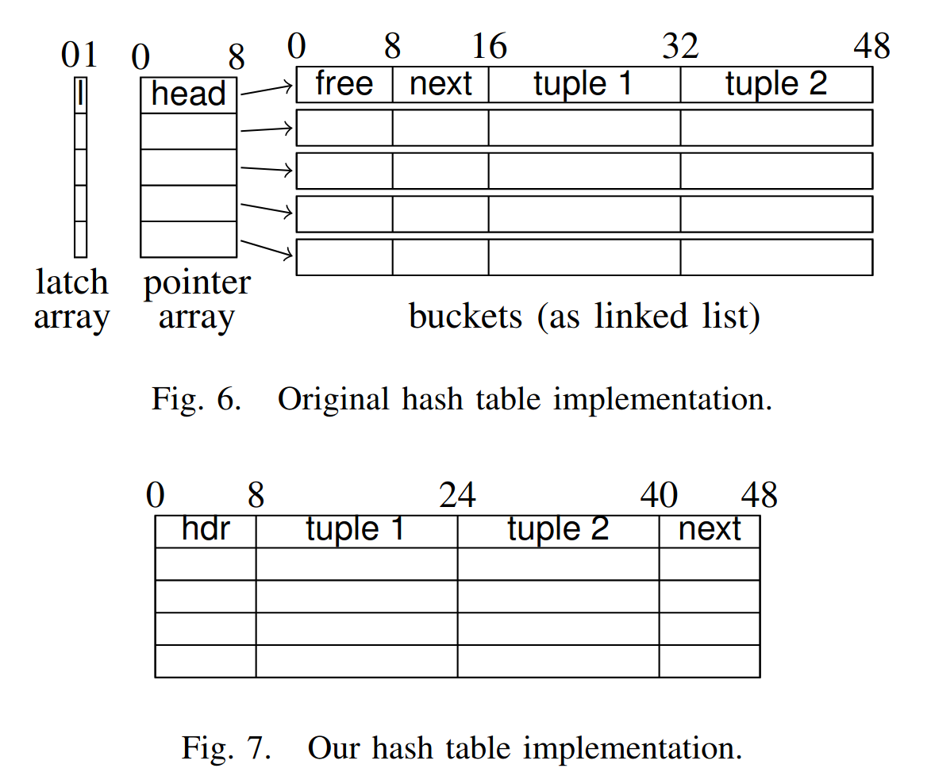
Example 1: Database Join

Slide 16
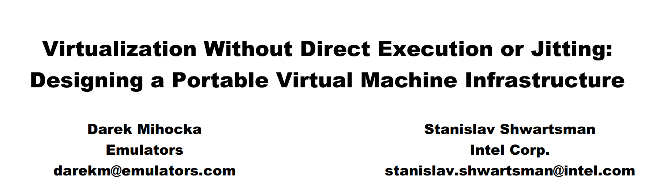
Example 2: Virtualization
https://bochs.sourceforge.io/Virtualization_Without_Hardware_Final.pdf

Slide 17
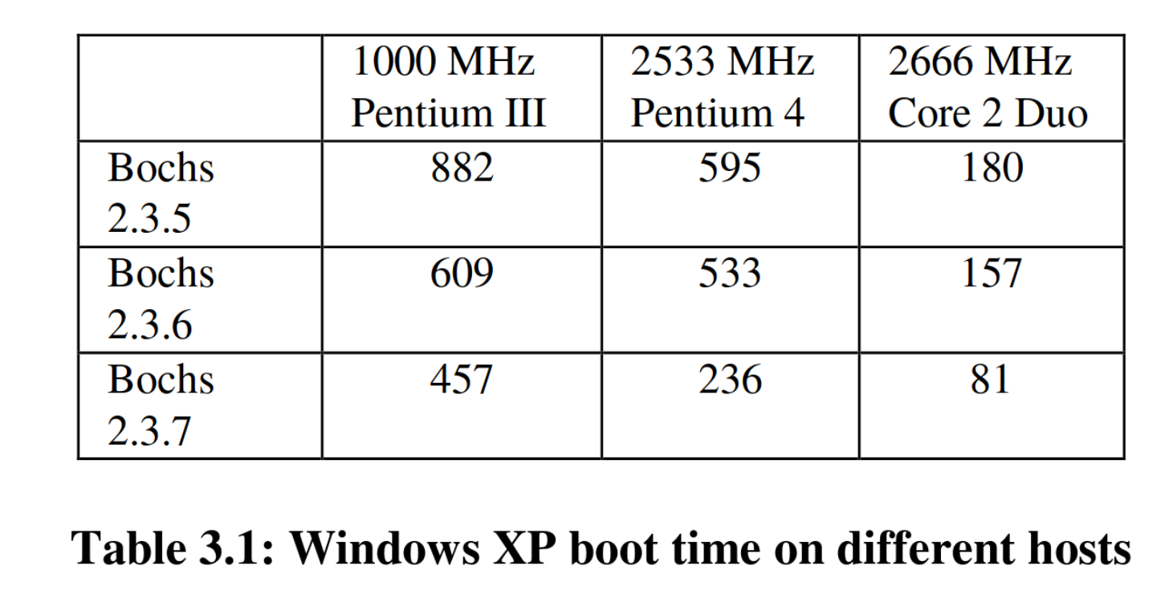
Example 2: Virtualization

Slide 18
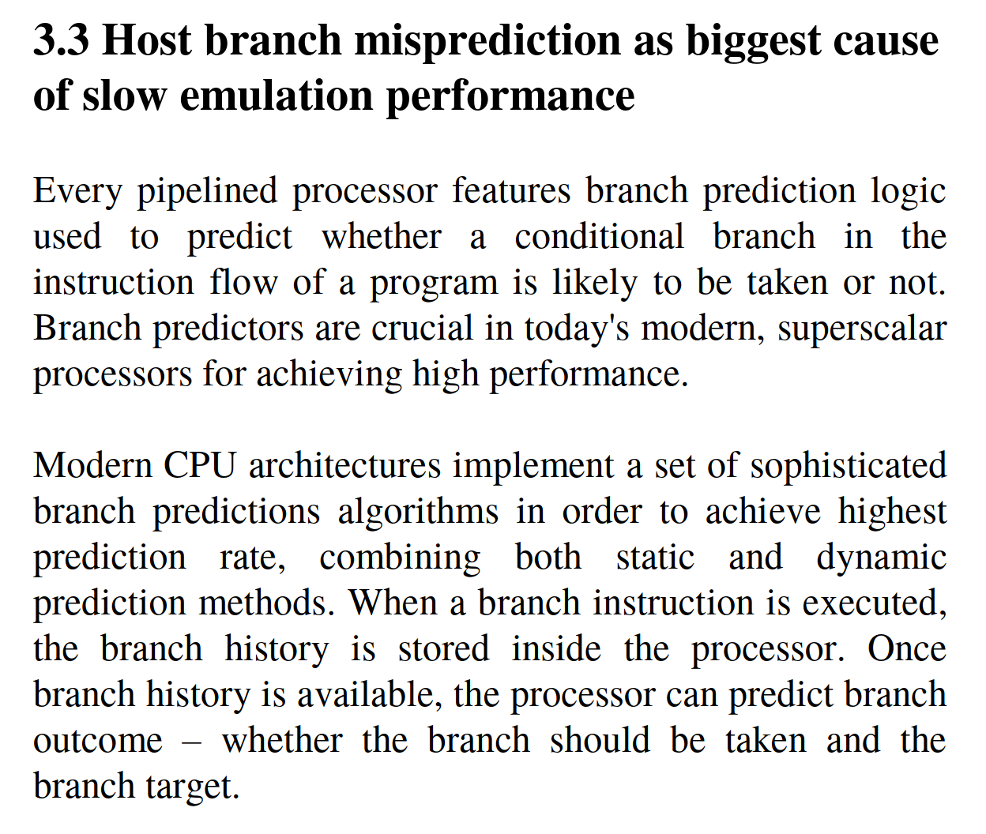
Example 2: Virtualization

Slide 19
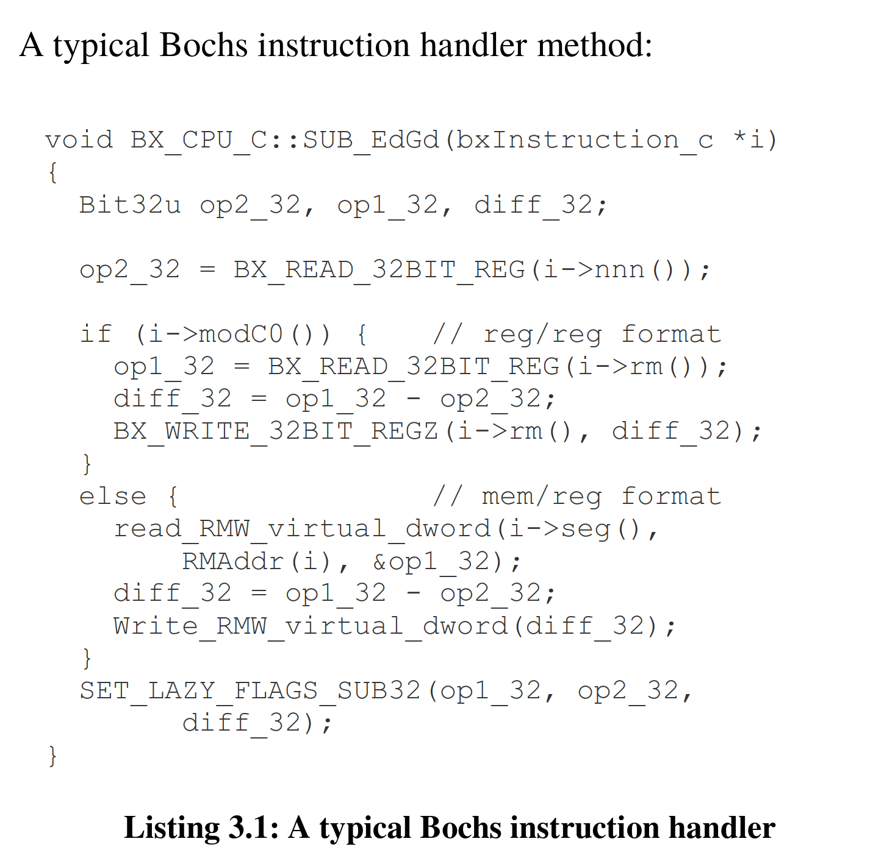

Slide 20
Why is it so hard?

Slide 21
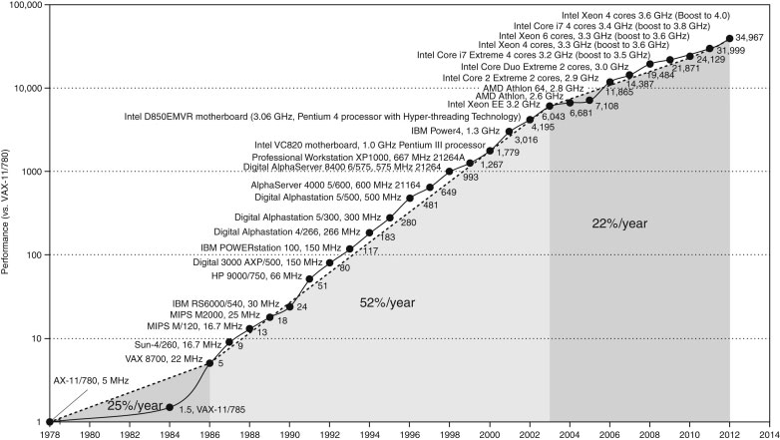
Microprocessor Performance
50% improvement every year!!
What contributes to this improvement?
Source: H&P Textbook

Slide 22
What’s inside a typical machine?

Slide 23
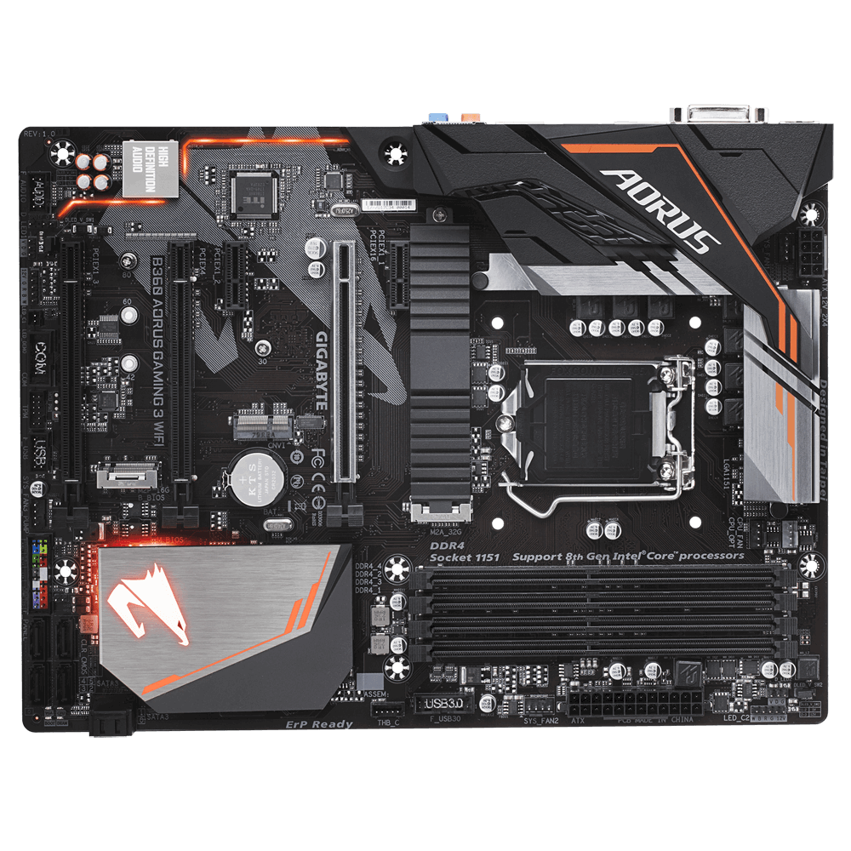
B360 AORUS Motherboard

Slide 24

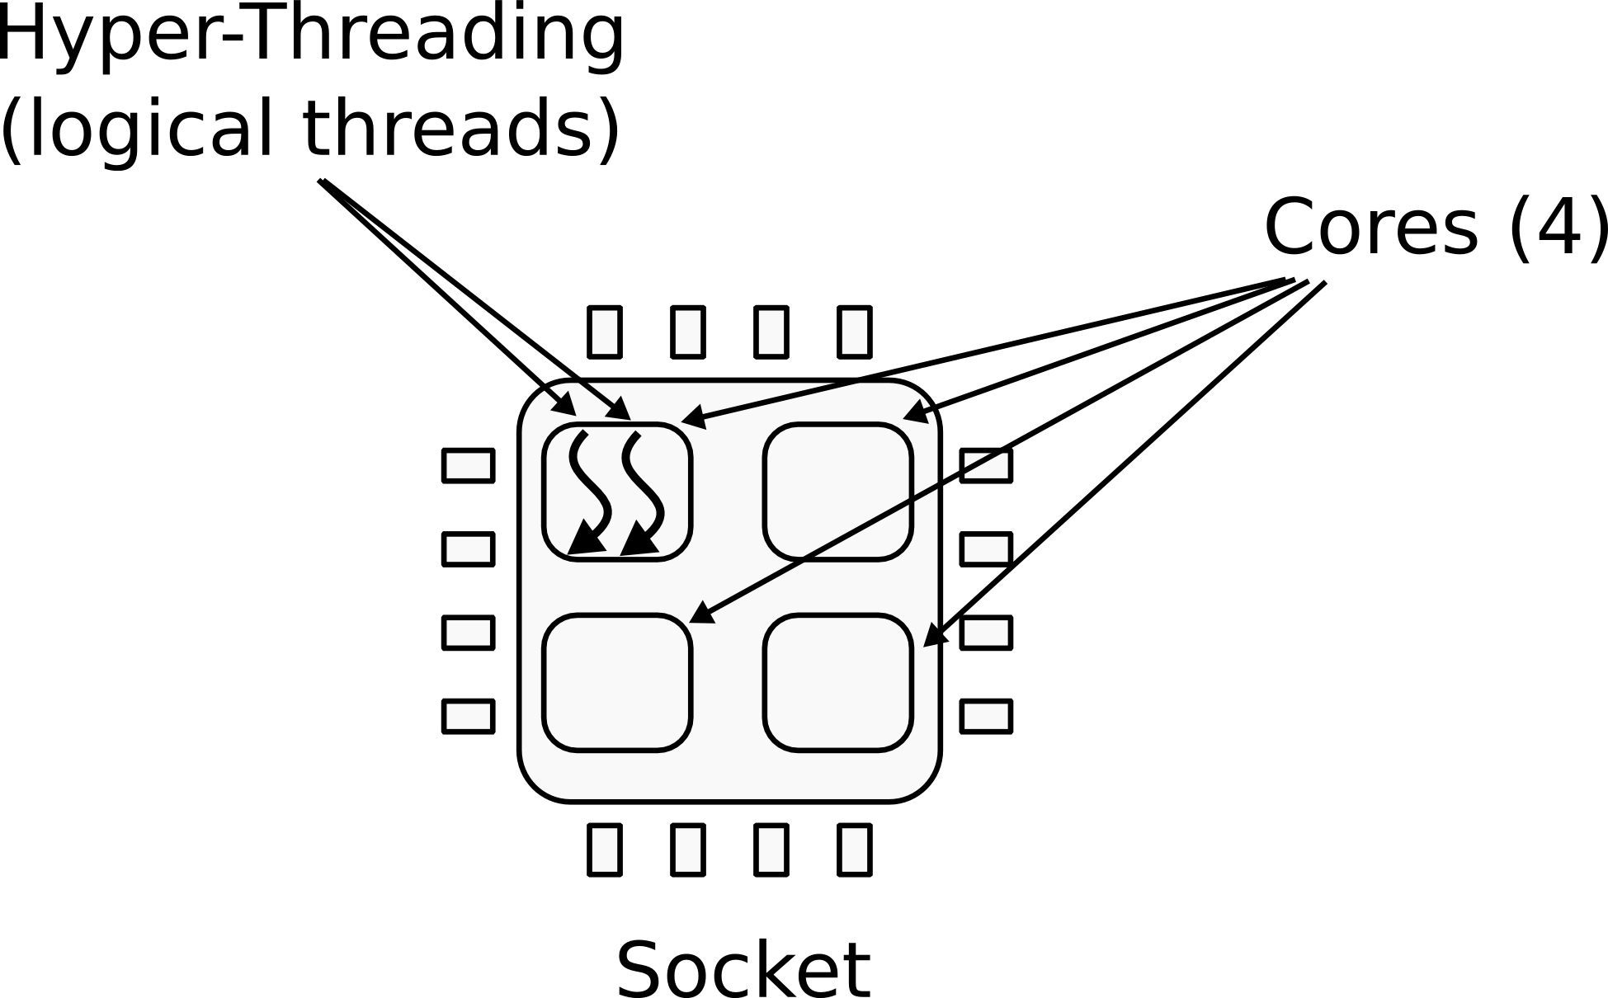
CPU
1 CPU socket
  4 cores
  2 logical threads each (hyperthreads)

Slide 25
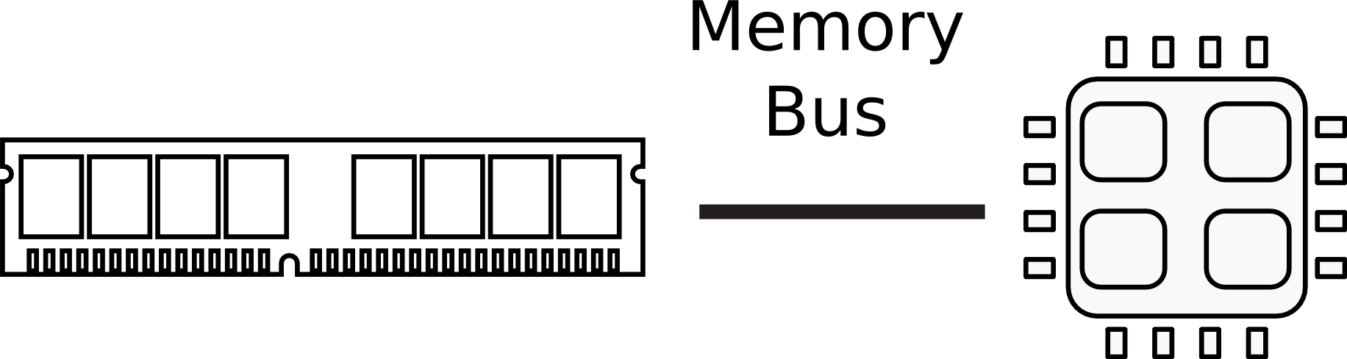

Memory

Slide 26

Memory abstraction

Slide 27
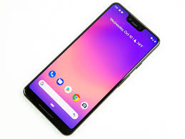

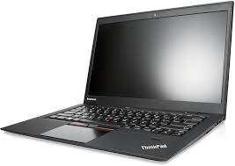
I/O Devices

Slide 28
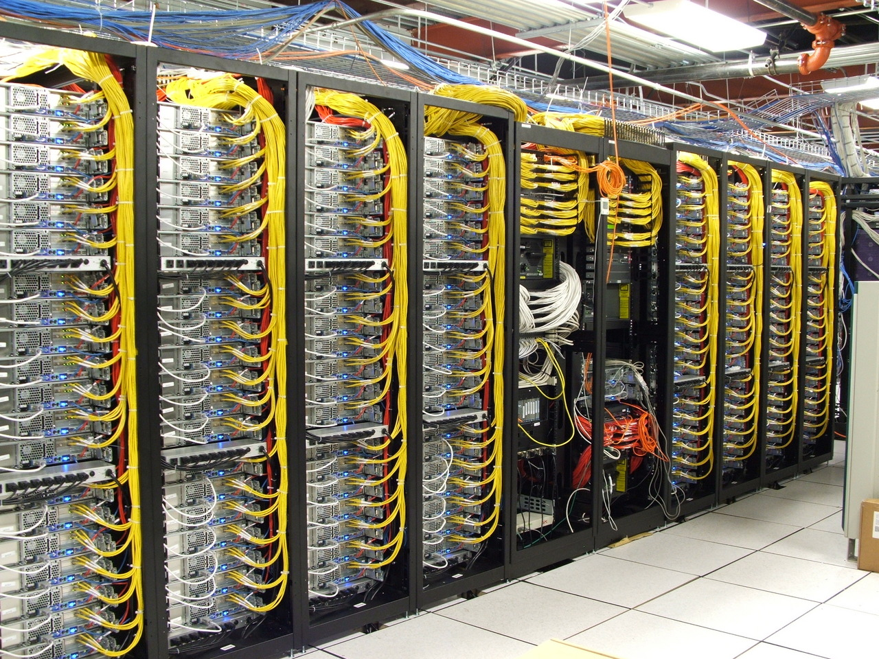
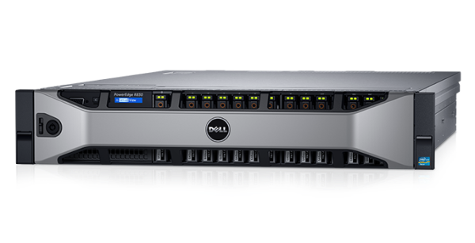
Dell R830 4-socket server
Dell Poweredge R830 System Server with 2 sockets on the main floor and 2 sockets on the expansion
http://www.dell.com/support/manuals/us/en/19/poweredge-r830/r830_om/supported-configurations-for-the-poweredge-r830-system?guid=guid-01303b2b-f884-4435-b4e2-57bec2ce225a&lang=en-us

Slide 29
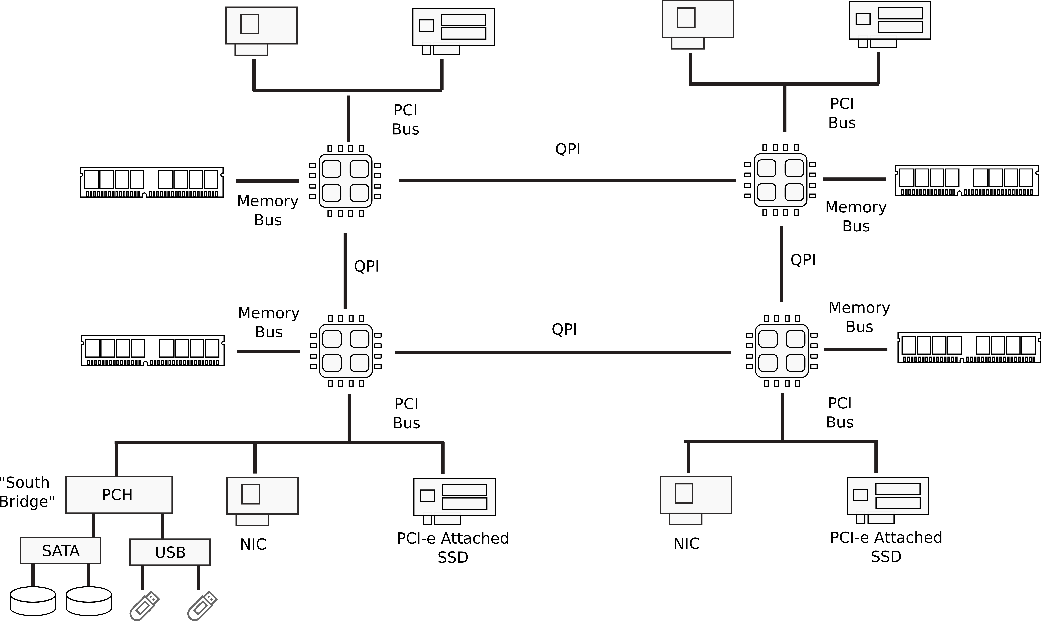
Multi-socket machines

Slide 30
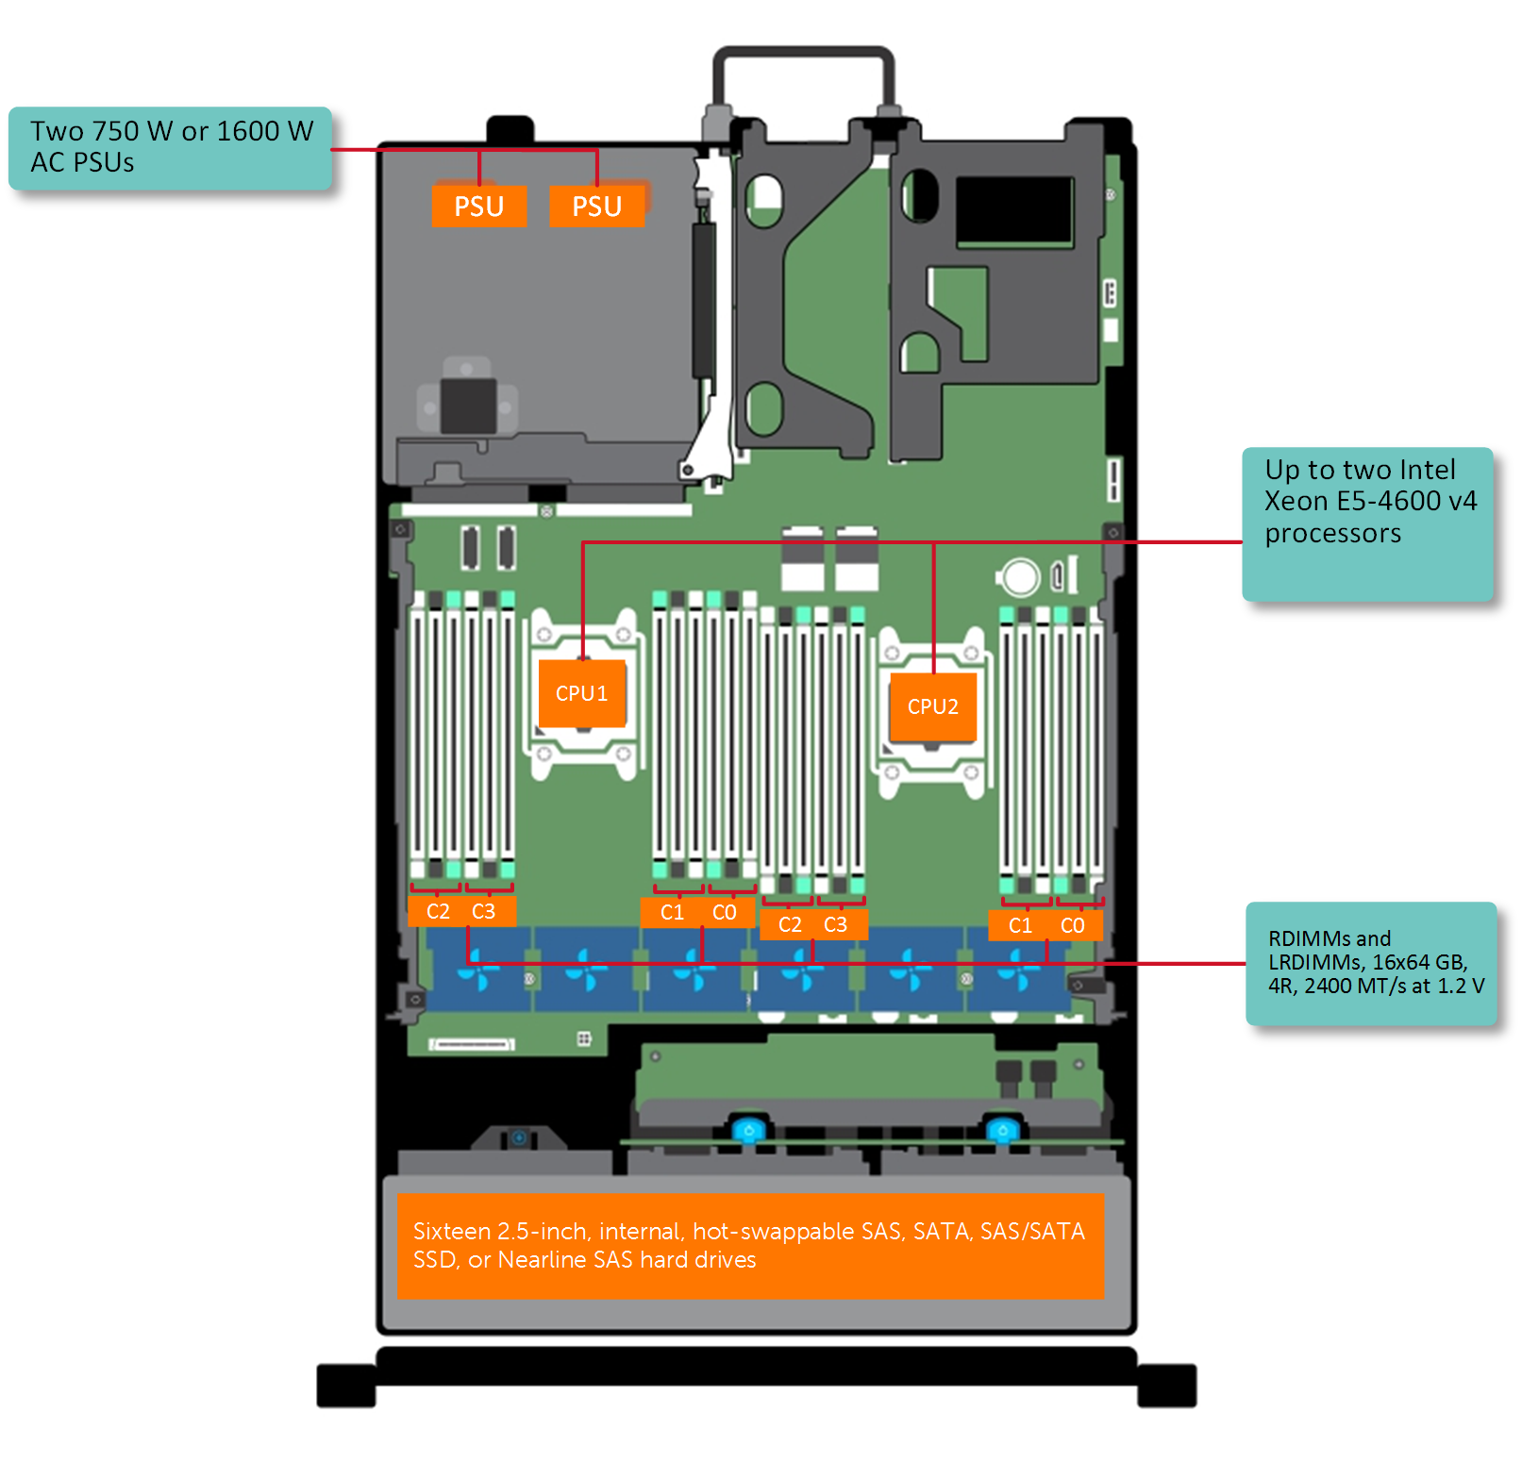
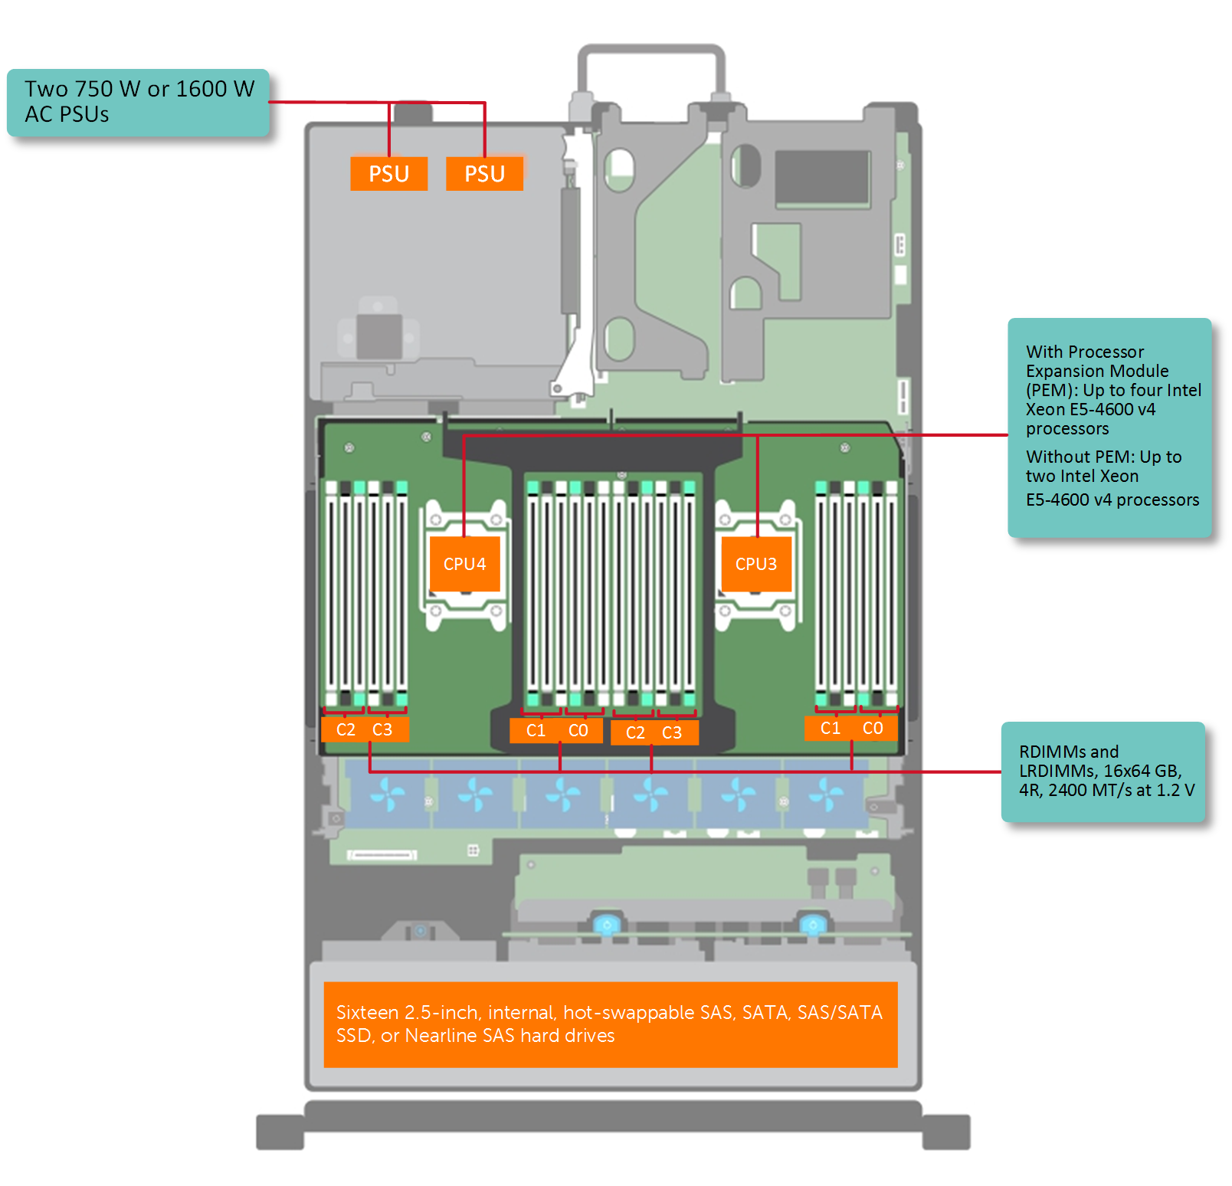
Dell R830 4-socket server
Dell Poweredge R830 System Server with 2 sockets on the main floor and 2 sockets on the expansion
http://www.dell.com/support/manuals/us/en/19/poweredge-r830/r830_om/supported-configurations-for-the-poweredge-r830-system?guid=guid-01303b2b-f884-4435-b4e2-57bec2ce225a&lang=en-us

Slide 31
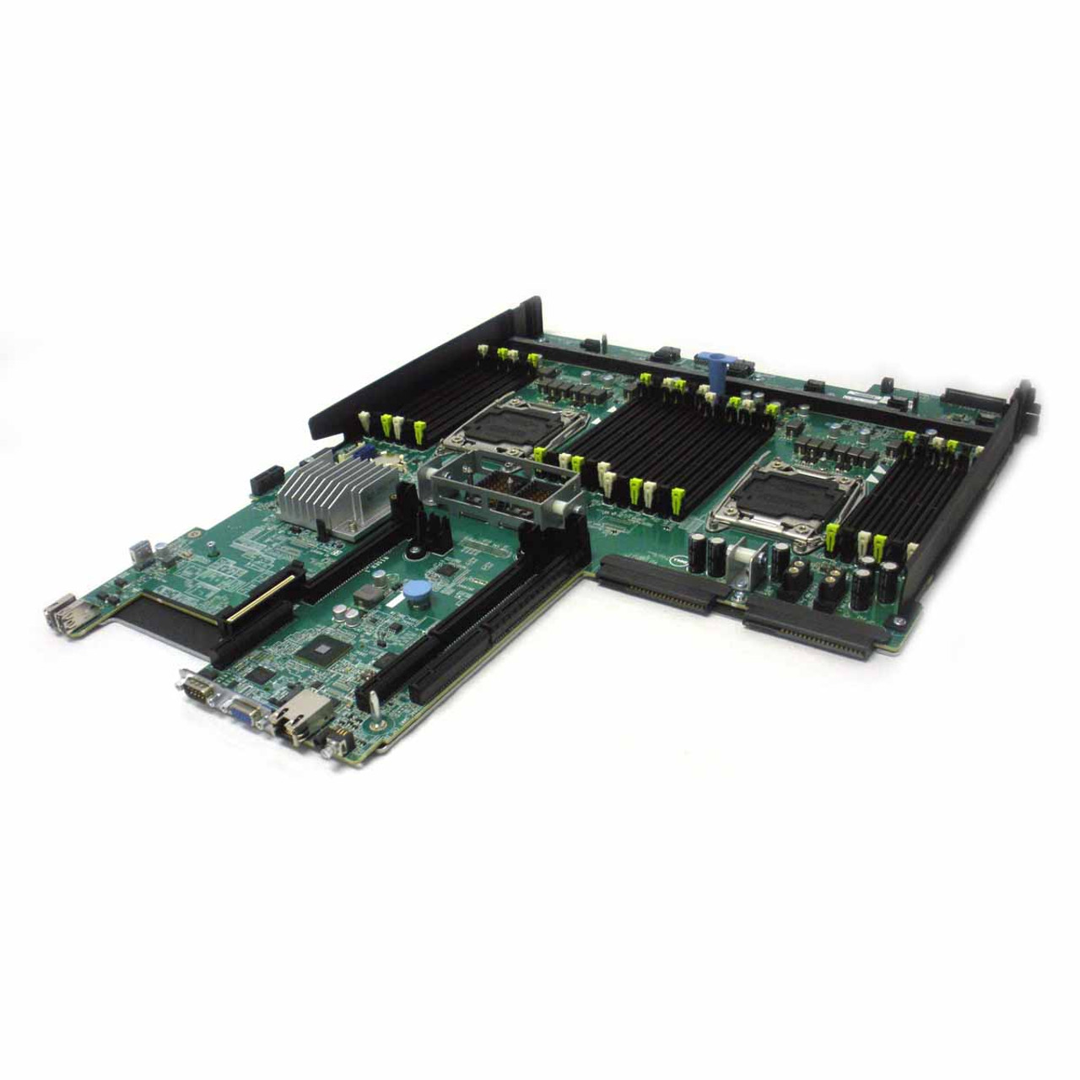
Dell R830 Motherboard

Slide 32
What does CPU do internally?

Slide 33

CPU execution loop
CPU repeatedly reads instructions from memory
Executes them
Example
ADD EDX, EAX
// EDX = EAX + EDX

Slide 34
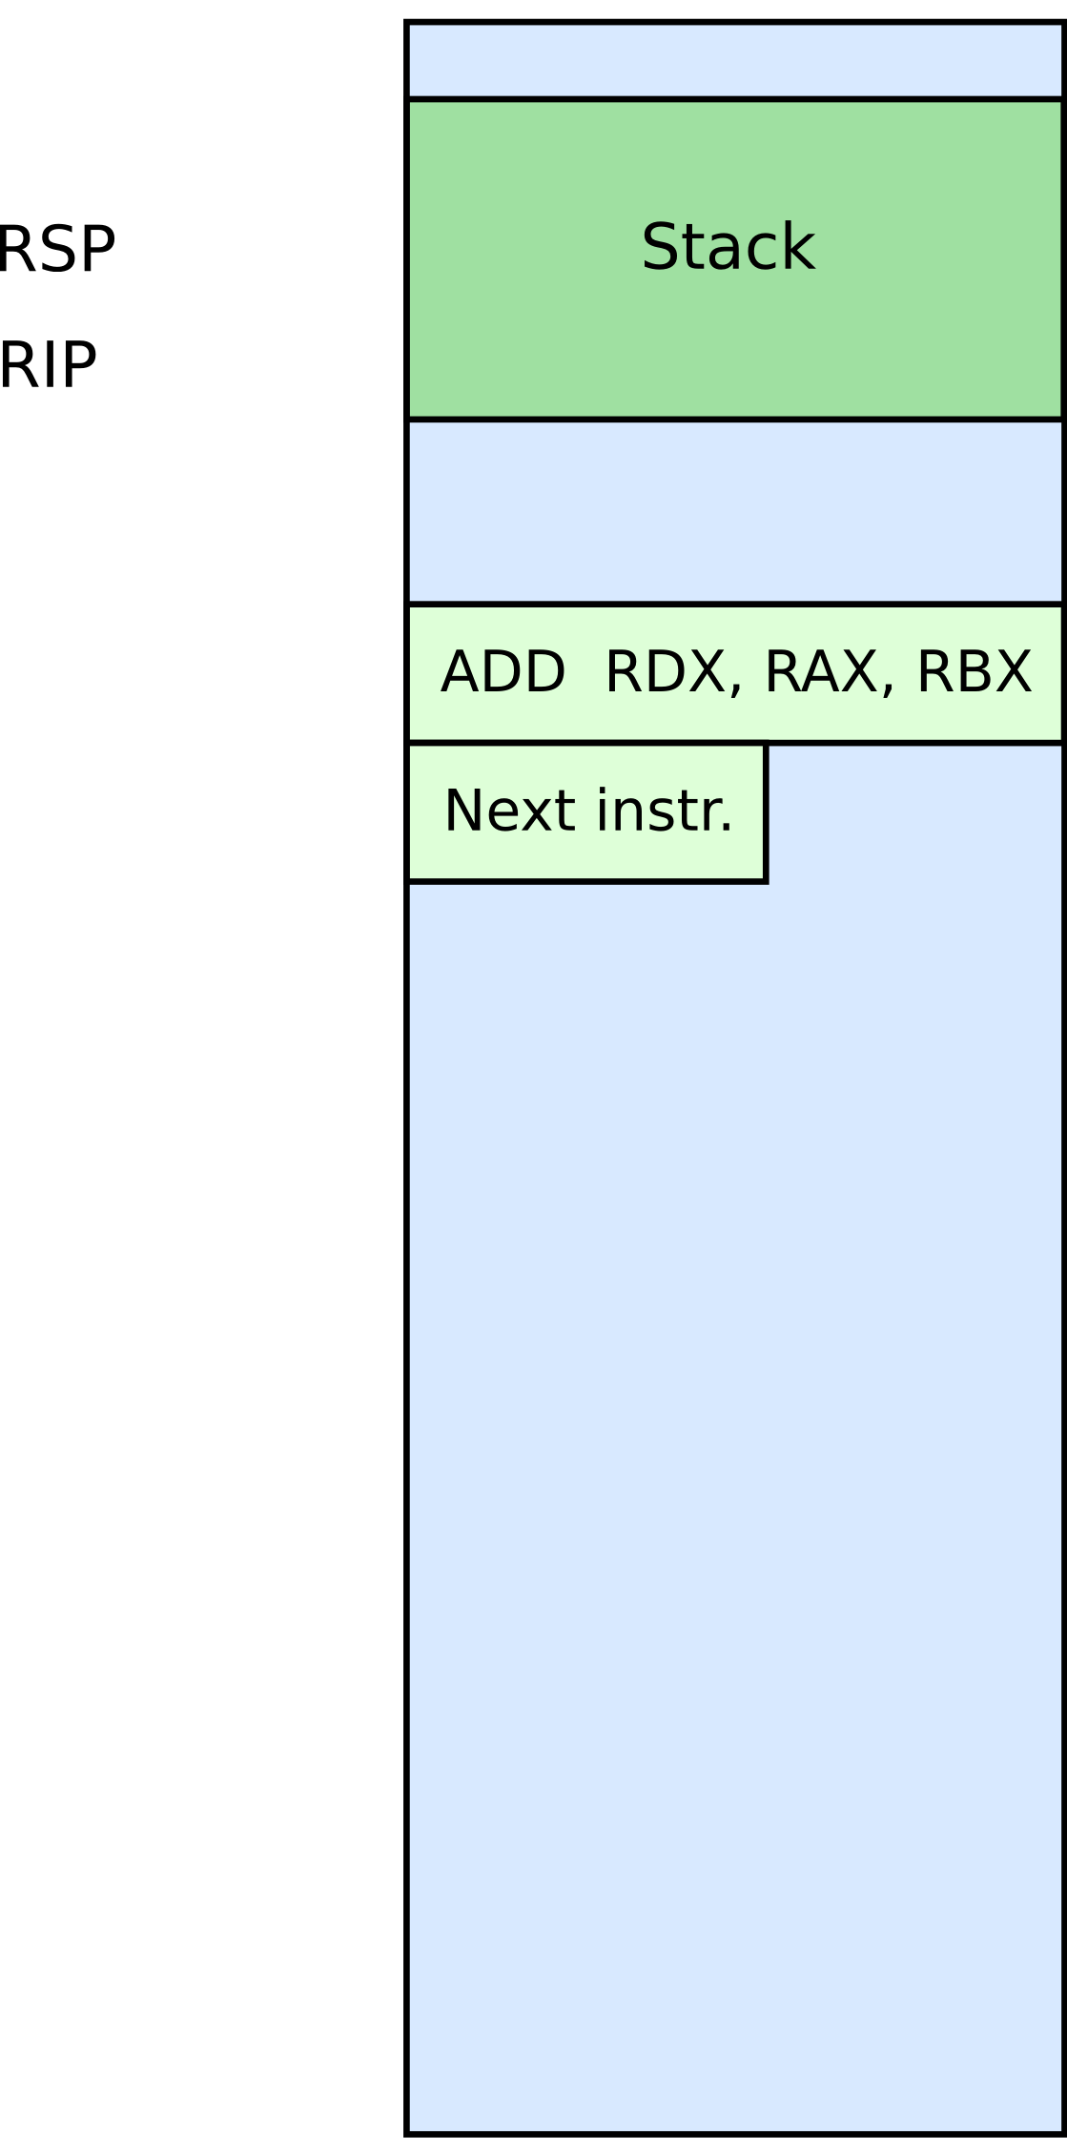



Slide 35
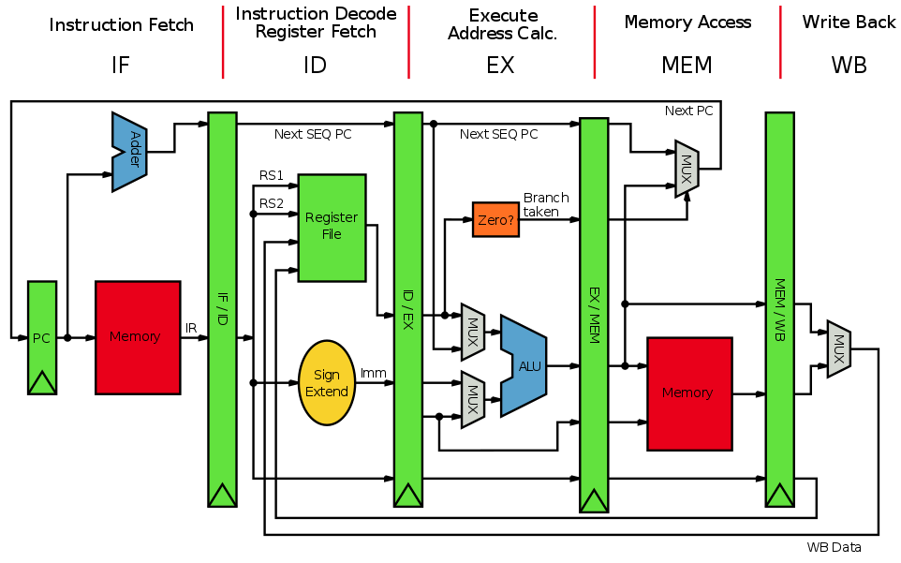
A simple 5-stage pipeline

Slide 36
Thank you!

