Slide 1
CS/ECE 3810: Computer Organization
Lecture 2: Introduction (Continued)
Anton Burtsev
August, 2022

Slide 2
Recap (xournal drawing)

Slide 3
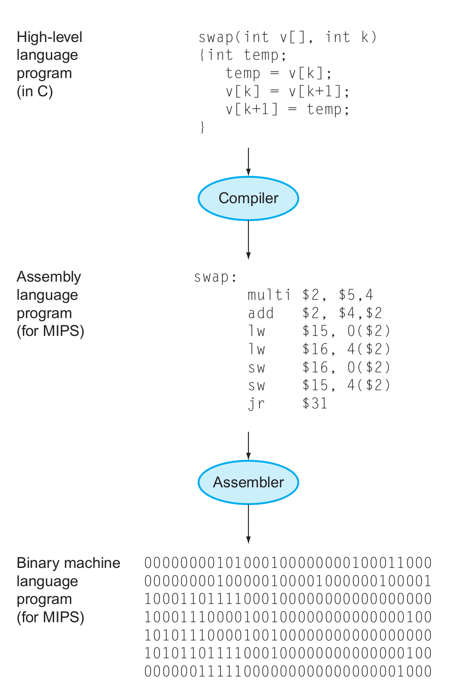
The HW/SW Interface
Application software
Systems software
(OS, compiler)
Hardware

Slide 4
Computer Components
Input/output devices
Secondary storage: non-volatile, slower, cheaper (HDD/SSD)
Primary storage: volatile, faster, costlier (RAM)
CPU/processor (datapath and control)

Slide 5
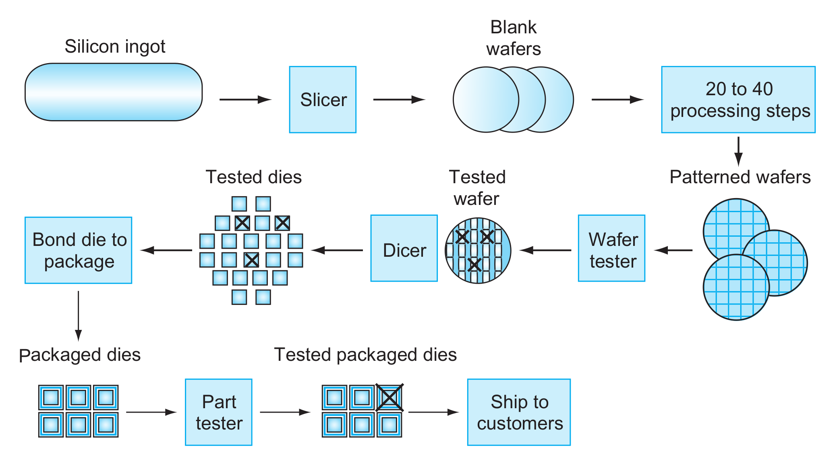
Chip manufacturing process

Slide 6
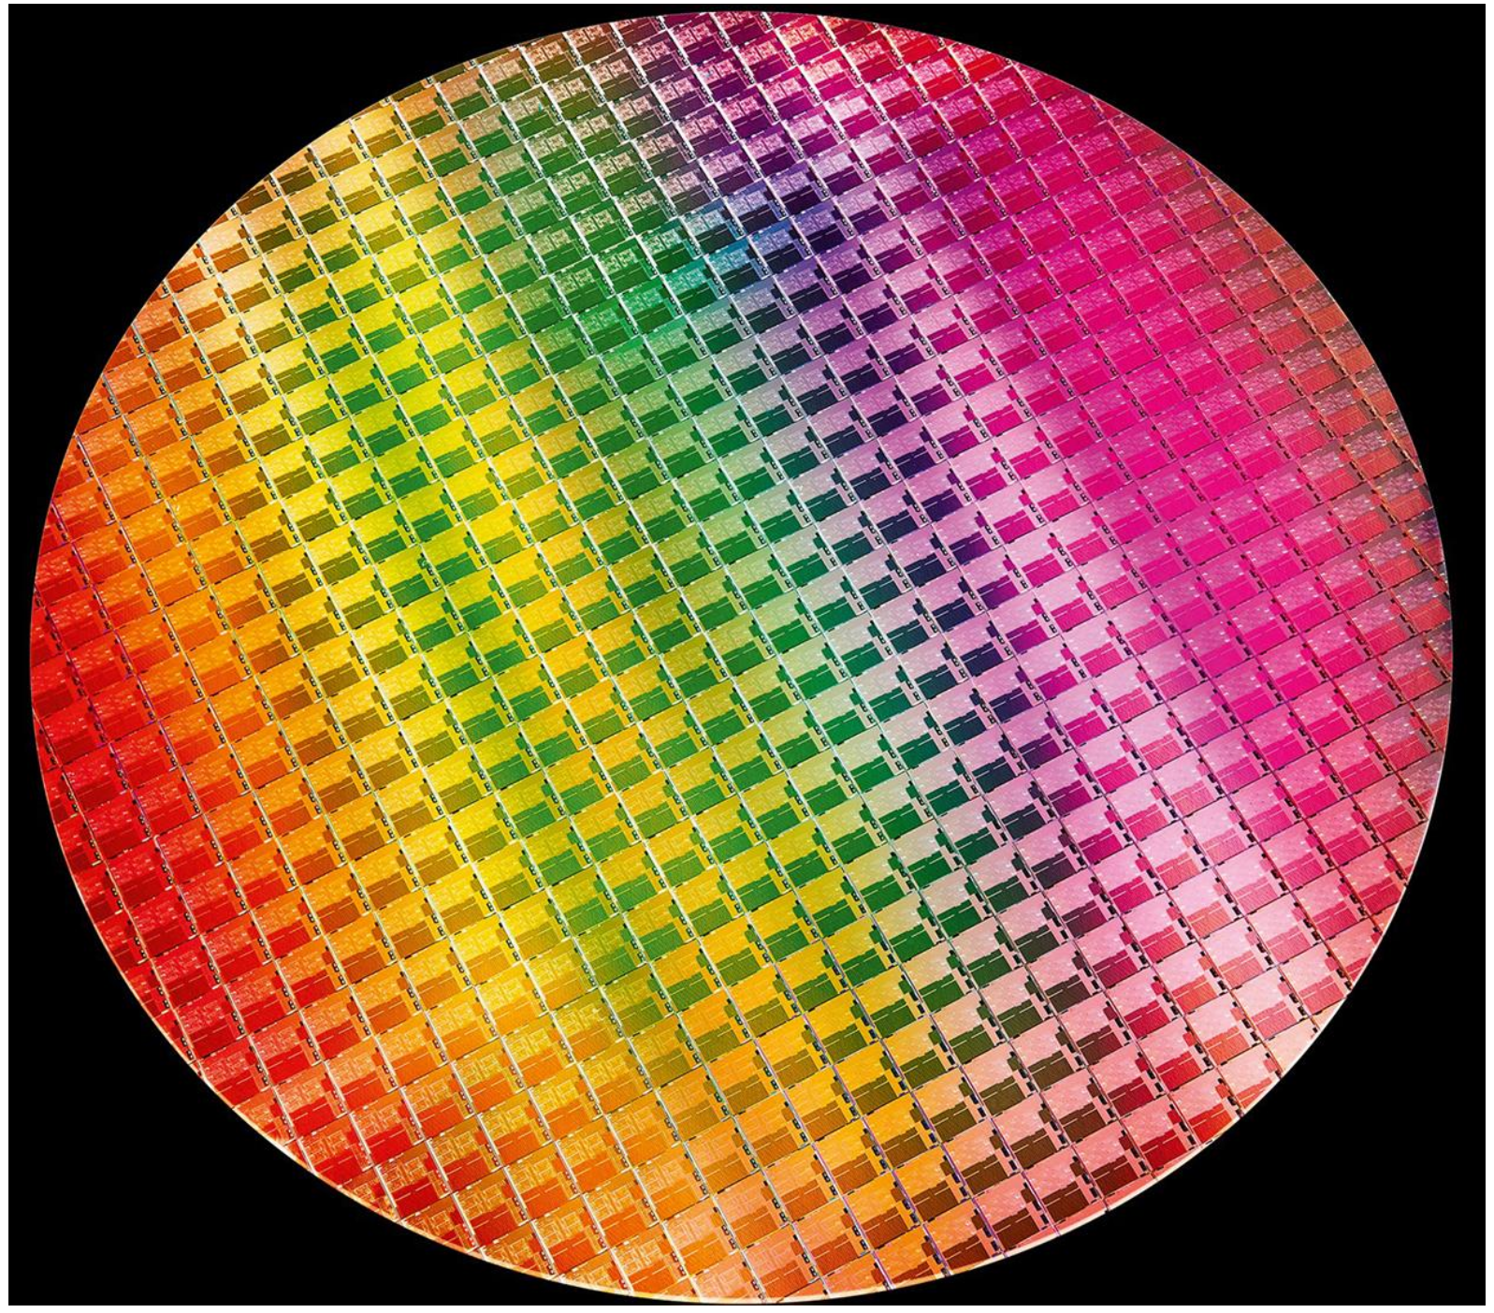
Wafers and Dies
Source: H&P Textbook

Slide 7
Manufacturing Process
Silicon wafers undergo many processing steps so that different
parts of the wafer behave as insulators, conductors, and
transistors (switches)
Multiple metal layers on the silicon enable connections
between transistors
The wafer is chopped into many dies – the size of the die
determines yield and cost

Slide 8
Processor Technology Trends
Shrinking of transistor sizes: 250nm (1997) →
130nm (2002) → 70nm (2008) → 35nm (2014) →
2019 transition to 10nm, now transitioning to 7nm
Transistor density increases by 35% per year and die size
increases by 10-20% per year… functionality improvements!
Transistor speed improves linearly with size (complex
equation involving voltages, resistances, capacitances)
Wire delays do not scale down at the same rate as
transistor delays

Slide 9
Memory and I/O Technology Trends
DRAM density increases by 40-60% per year, latency has
reduced by 33% in 10 years (the memory wall!), bandwidth
improves twice as fast as latency decreases
Disk density improves by 100% every year, latency
improvement similar to DRAM
Networks: significant bandwidth and latency improvement

Slide 10
Thank you!

