Slide 1
CS/ECE 3810: Computer Organization
Lecture 6: Floating Point
Anton Burtsev
September, 2022

Slide 2
Motivation...

Slide 3
Floating Point Standard
Defined by IEEE Std 754-1985
  Institute of Electrical and Electronics Engineers
Developed in response to divergence of representations
  Portability issues for scientific code
Now almost universally adopted
Two representations
  Single precision (32-bit)
  Double precision (64-bit)
Chapter 3 — Arithmetic for Computers — <number>
Notes:
Morgan Kaufmann Publishers
28 September 2022
Chapter 3 — Arithmetic for Computers

Slide 4
Floating Point
Normalized scientific notation: single non-zero digit to the
left of the decimal (binary) point – example: 3.5 x 10⁹
1.010001 x 2⁻⁵_{two} = (1 + 0 x 2⁻¹ + 1 x 2⁻² + … + 1 x 2⁻⁶) x 2⁻⁵_{ten}
A standard notation enables easy exchange of data between
machines and simplifies hardware algorithms – the
IEEE 754 standard defines how floating point numbers
are represented

Slide 5
Sign and Magnitude Representation
Sign Exponent Fraction
1 bit 8 bits 23 bits
S
E
F
More exponent bits ➔ wider range of numbers (not necessarily more
numbers – recall there are infinite real numbers)
More fraction bits ➔ higher precision
Register value = (-1)^{S} x F x 2E
Since we are only representing normalized numbers, we are
guaranteed that the number is of the form 1.xxxx..
Hence, in IEEE 754 standard, the 1 is implicit
Register value = (-1)^{S} x (1 + F) x 2E

Slide 6
Sign and Magnitude Representation
Sign Exponent Fraction
1 bit 8 bits 23 bits
S
E
F
Largest number that can be represented: 2.0 x 2¹²⁸ = 2.0 x 10³⁸
(not really – see upcoming details)
Smallest number that can be represented: 1.0 x 2⁻¹²⁷ = 2.0 x 10⁻³⁸
(not really – see upcoming details)
Overflow: when representing a number larger than the max;
Underflow: when representing a number smaller than the min
Double precision format: occupies two 32-bit registers:
Largest: Smallest:
Sign Exponent Fraction
1 bit 11 bits 52 bits
S
E
F

Slide 7
Details
The number “0” has a special code so that the implicit 1 does not
get added: the code is all 0s
(it may seem that this takes up the representation for 1.0, but
given how the exponent is represented, that’s not the case)
(see discussion of denorms in the textbook)
The largest exponent value (with zero fraction) represents +/- infinity
The largest exponent value (with non-zero fraction) represents
NaN (not a number) – for the result of 0/0 or (infinity minus infinity)
Note that these choices impact the smallest and largest numbers
that can be represented

Slide 8
Exponent Representation
To simplify sort, sign was placed as the first bit
For a similar reason, the representation of the exponent is also
modified: in order to use integer compares, it would be preferable to
have the smallest exponent as 00…0 and the largest exponent as 11…1
This is the biased notation, where a bias is subtracted from the
exponent field to yield the true exponent
IEEE 754 single-precision uses a bias of 127 (since the exponent
must have values between -127 and 128)…double precision uses
a bias of 1023
Final representation: (-1)^{S} x (1 + Fraction) x 2^{(Exponent – Bias)}

Slide 9
Value inf
Value NAN
Highest value ~2 x 2¹²⁷
2 special cases up top that use the
reserved exponent field of 255
0 255 00…0
0 255 xx….x
0 254 11….1
Value 1
0 127 00…0
Exponent field < 127, i.e., after
subtracting bias, they are negative
exponents, representing numbers < 1
Smallest Norm ~2 x 2⁻¹²⁶
Largest Denorm ~1 x 2⁻¹²⁶
Smallest Denorm ~2⁻¹⁴⁹
0 0..01 00…0
0 0..00 11…1
0 0..00 00…1
Special case with exponent field 0, used to
represent denorms, that help us gradually approach 0
Value 0
0 00..0 00…0
Same rules as above, but the sign bit is 1
Same magnitudes as above, but negative numbers

Slide 10
Denormal Numbers
Exponent = 000...0 ⇒ hidden bit is 0
Smaller than normal numbers
  allow for gradual underflow, with diminishing precision
Denormal with fraction = 000...0
Two representations of 0.0!
Chapter 3 — Arithmetic for Computers — <number>
Notes:
Morgan Kaufmann Publishers
28 September 2022
Chapter 3 — Arithmetic for Computers

Slide 11
Infinities and NaNs
Exponent = 111...1, Fraction = 000...0
  ±Infinity
  Can be used in subsequent calculations, avoiding need for overflow check
Exponent = 111...1, Fraction ≠ 000...0
  Not-a-Number (NaN)
  Indicates illegal or undefined result
    e.g., 0.0 / 0.0
  Can be used in subsequent calculations
Chapter 3 — Arithmetic for Computers — <number>
Notes:
Morgan Kaufmann Publishers
28 September 2022
Chapter 3 — Arithmetic for Computers

Slide 12
Floating-Point Example
Represent –0.75
  –0.75 = (–1)¹ × 1.1₂ × 2^{–1}
  S = 1
  Fraction = 1000…00₂
  Exponent = –1 + Bias
    Single: –1 + 127 = 126 = 01111110₂
    Double: –1 + 1023 = 1022 = 01111111110₂
Single: 1011111101000…00
Double: 1011111111101000…00
Chapter 3 — Arithmetic for Computers — <number>
Notes:
Morgan Kaufmann Publishers
28 September 2022
Chapter 3 — Arithmetic for Computers

Slide 13
Floating-Point Example
What number is represented by the single-precision float
11000000101000…00
  S = 1
  Fraction = 01000…00₂
  Fxponent = 10000001₂ = 129
x = (–1)¹ × (1 + 01₂) × 2^{(129 – 127)}
  = (–1) × 1.25 × 2²
  = –5.0
Chapter 3 — Arithmetic for Computers — <number>
Notes:
Morgan Kaufmann Publishers
28 September 2022
Chapter 3 — Arithmetic for Computers

Slide 14
Floating-Point Addition
Consider a 4-digit decimal example
  9.999 × 10¹ + 1.610 × 10^{–1}
1. Align decimal points
  Shift number with smaller exponent
  9.999 × 10¹ + 0.016 × 10¹
2. Add significands
  9.999 × 10¹ + 0.016 × 10¹ = 10.015 × 10¹
3. Normalize result & check for over/underflow
  1.0015 × 10²
4. Round and renormalize if necessary
  1.002 × 10²
Chapter 3 — Arithmetic for Computers — <number>
Notes:
Morgan Kaufmann Publishers
28 September 2022
Chapter 3 — Arithmetic for Computers

Slide 15
Floating-Point Addition
Now consider a 4-digit binary example
  1.000₂ × 2^{–1} + –1.110₂ × 2^{–2} (0.5 + –0.4375)
1. Align binary points
  Shift number with smaller exponent
  1.000₂ × 2^{–1} + –0.111₂ × 2^{–1}
2. Add significands
  1.000₂ × 2^{–1} + –0.111₂ × 2–1 = 0.001₂ × 2^{–1}
3. Normalize result & check for over/underflow
  1.000₂ × 2^{–4}, with no over/underflow
4. Round and renormalize if necessary
  1.000₂ × 2^{–4} (no change) = 0.0625
Chapter 3 — Arithmetic for Computers — <number>
Notes:
Morgan Kaufmann Publishers
28 September 2022
Chapter 3 — Arithmetic for Computers

Slide 16
FP Adder Hardware
Much more complex than integer adder
Doing it in one clock cycle would take too long
  Much longer than integer operations
  Slower clock would penalize all instructions
FP adder usually takes several cycles
  Can be pipelined
Chapter 3 — Arithmetic for Computers — <number>
Notes:
Morgan Kaufmann Publishers
28 September 2022
Chapter 3 — Arithmetic for Computers

Slide 17
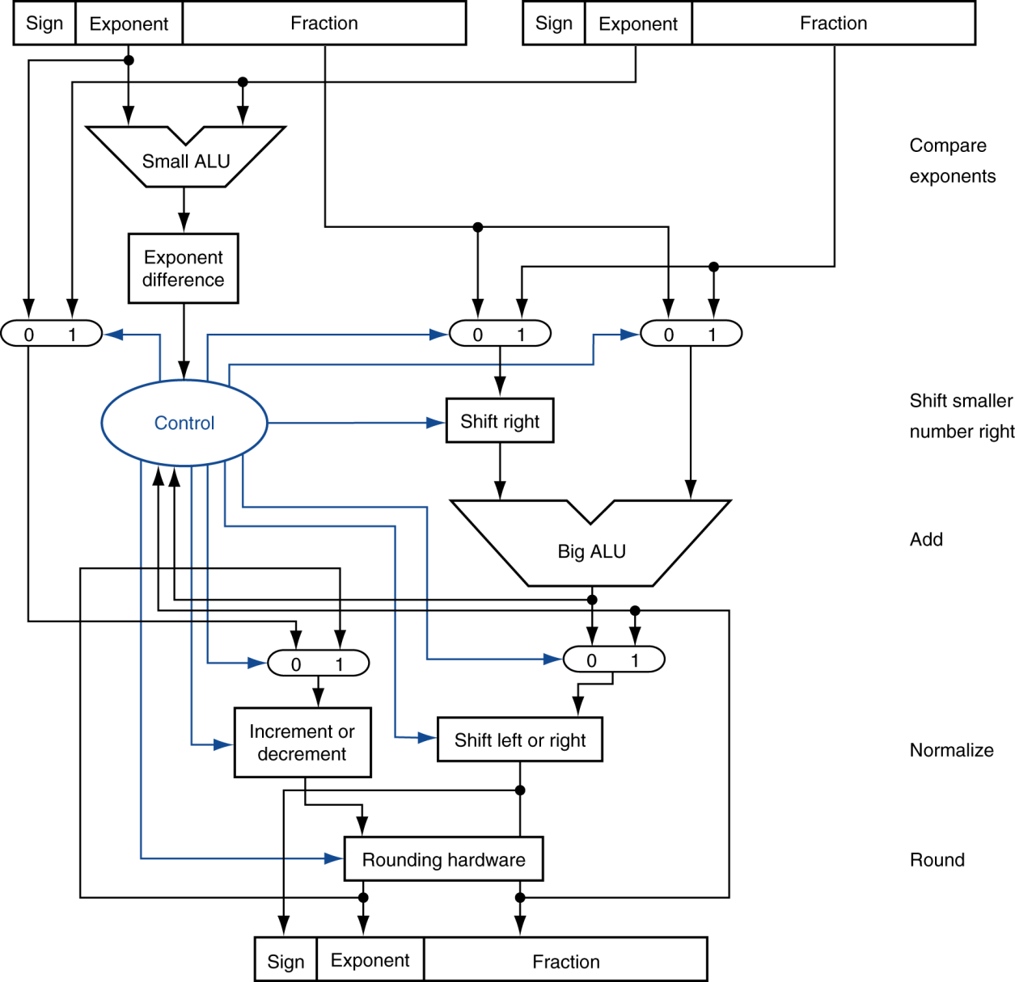
FP Adder Hardware
Step 1
Step 2
Step 3
Step 4
Chapter 3 — Arithmetic for Computers — <number>
Notes:
Morgan Kaufmann Publishers
28 September 2022
Chapter 3 — Arithmetic for Computers

Slide 18
Floating-Point Multiplication
Consider a 4-digit decimal example
  1.110 × 10¹⁰ × 9.200 × 10^{–5}
1. Add exponents
  For biased exponents, subtract bias from sum
  New exponent = 10 + –5 = 5
2. Multiply significands
  1.110 × 9.200 = 10.212 ⇒ 10.212 × 10⁵
3. Normalize result & check for over/underflow
  1.0212 × 10⁶
4. Round and renormalize if necessary
  1.021 × 10⁶
5. Determine sign of result from signs of operands
  +1.021 × 10⁶
Chapter 3 — Arithmetic for Computers — <number>
Notes:
Morgan Kaufmann Publishers
28 September 2022
Chapter 3 — Arithmetic for Computers

Slide 19
Floating-Point Multiplication
Now consider a 4-digit binary example
  1.000₂ × 2^{–1} × –1.110₂ × 2^{–2} (0.5 × –0.4375)
1. Add exponents
  Unbiased: –1 + –2 = –3
  Biased: (–1 + 127) + (–2 + 127) = –3 + 254 – 127 = –3 + 127
2. Multiply significands
  1.000₂ × 1.110₂ = 1.1102 ⇒ 1.110₂ × 2^{–3}
3. Normalize result & check for over/underflow
  1.110₂ × 2^{–3} (no change) with no over/underflow
4. Round and renormalize if necessary
  1.110₂ × 2^{–3} (no change)
5. Determine sign: +ve × –ve ⇒ –ve
  –1.110₂ × 2^{–3} = –0.21875
Chapter 3 — Arithmetic for Computers — <number>
Notes:
Morgan Kaufmann Publishers
28 September 2022
Chapter 3 — Arithmetic for Computers

Slide 20
FP Arithmetic Hardware
FP multiplier is of similar complexity to FP adder
  But uses a multiplier for significands instead of an adder
FP arithmetic hardware usually does
  Addition, subtraction, multiplication, division, reciprocal, square-root
  FP ↔ integer conversion
Operations usually takes several cycles
  Can be pipelined
Chapter 3 — Arithmetic for Computers — <number>
Notes:
Morgan Kaufmann Publishers
28 September 2022
Chapter 3 — Arithmetic for Computers

Slide 21
FP Instructions in MIPS
FP hardware is coprocessor 1
  Adjunct processor that extends the ISA
Separate FP registers
  32 single-precision: $f0, $f1, … $f31
  Paired for double-precision: $f0/$f1, $f2/$f3, …
    Release 2 of MIPs ISA supports 32 × 64-bit FP reg’s
FP instructions operate only on FP registers
  Programs generally don’t do integer ops on FP data, or vice versa
  More registers with minimal code-size impact
FP load and store instructions
  lwc1, ldc1, swc1, sdc1
    e.g., ldc1 $f8, 32($sp)
Chapter 3 — Arithmetic for Computers — <number>
Notes:
Morgan Kaufmann Publishers
28 September 2022
Chapter 3 — Arithmetic for Computers

Slide 22
FP Instructions in MIPS
Single-precision arithmetic
  add.s, sub.s, mul.s, div.s
    e.g., add.s $f0, $f1, $f6
Double-precision arithmetic
  add.d, sub.d, mul.d, div.d
    e.g., mul.d $f4, $f4, $f6
Single- and double-precision comparison
  c.xx.s, c.xx.d (xx is eq, lt, le, …)
  Sets or clears FP condition-code bit
    e.g. c.lt.s $f3, $f4
Branch on FP condition code true or false
  bc1t, bc1f
    e.g., bc1t TargetLabel
Chapter 3 — Arithmetic for Computers — <number>
Notes:
Morgan Kaufmann Publishers
28 September 2022
Chapter 3 — Arithmetic for Computers

Slide 23
x86 FP Architecture
Originally based on 8087 FP coprocessor
  8 × 80-bit extended-precision registers
  Used as a push-down stack
  Registers indexed from TOS: ST(0), ST(1), …
FP values are 32-bit or 64 in memory
  Converted on load/store of memory operand
  Integer operands can also be converted
  on load/store
Very difficult to generate and optimize code
  Result: poor FP performance
§3.7 Real Stuff: Streaming SIMD Extensions and AVX in x86
Chapter 3 — Arithmetic for Computers — <number>
Notes:
Morgan Kaufmann Publishers
28 September 2022
Chapter 3 — Arithmetic for Computers

Slide 24
FP Example: °F to °C
C code:
float f2c (float fahr) {
return ((5.0/9.0)*(fahr - 32.0));
}
  fahr in $f12, result in $f0, literals in global memory space
Compiled MIPS code:
f2c: lwc1 $f16, const5($gp)
lwc2 $f18, const9($gp)
div.s $f16, $f16, $f18
lwc1 $f18, const32($gp)
sub.s $f18, $f12, $f18
mul.s $f0, $f16, $f18
jr $ra
Chapter 3 — Arithmetic for Computers — <number>
Notes:
Morgan Kaufmann Publishers
28 September 2022
Chapter 3 — Arithmetic for Computers

Slide 25
Fixed Point
FP operations are much slower than integer ops
Fixed point arithmetic uses integers, but assumes that
every number is multiplied by the same factor
Example: with a factor of 1/1000, the fixed-point
representations for 1.46, 1.7198, and 5624 are
respectively 1460, 1720, and 5624000
More programming effort and possibly lower precision
for higher performance

Slide 26
Subword Parallelism
ALUs are typically designed to perform 64-bit or 128-bit
arithmetic
Some data types are much smaller, e.g., bytes for pixel
RGB values, half-words for audio samples
Partitioning the carry-chains within the ALU can convert
the 64-bit adder into 4 16-bit adders or 8 8-bit adders
A single load can fetch multiple values, and a single
add instruction can perform multiple parallel additions,
referred to as subword parallelism

Slide 27
Thank you!

Slide 28
FP Example: Array Multiplication
X = X + Y × Z
  All 32 × 32 matrices, 64-bit double-precision elements
C code:
void mm (double x[][],
double y[][], double z[][]) {
int i, j, k;
for (i = 0; i! = 32; i = i + 1)
for (j = 0; j! = 32; j = j + 1)
for (k = 0; k! = 32; k = k + 1)
x[i][j] = x[i][j]
+ y[i][k] * z[k][j];
}
  Addresses of x, y, z in $a0, $a1, $a2, and
  i, j, k in $s0, $s1, $s2
Chapter 3 — Arithmetic for Computers — <number>
Notes:
Morgan Kaufmann Publishers
28 September 2022
Chapter 3 — Arithmetic for Computers

Slide 29
FP Example: Array Multiplication
MIPS code:
li $t1, 32 # $t1 = 32 (row size/loop end)
li $s0, 0 # i = 0; initialize 1st for loop
L1: li $s1, 0 # j = 0; restart 2nd for loop
L2: li $s2, 0 # k = 0; restart 3rd for loop
sll $t2, $s0, 5 # $t2 = i * 32 (size of row of x)
addu $t2, $t2, $s1 # $t2 = i * size(row) + j
sll $t2, $t2, 3 # $t2 = byte offset of [i][j]
addu $t2, $a0, $t2 # $t2 = byte address of x[i][j]
l.d $f4, 0($t2) # $f4 = 8 bytes of x[i][j]
L3: sll $t0, $s2, 5 # $t0 = k * 32 (size of row of z)
addu $t0, $t0, $s1 # $t0 = k * size(row) + j
sll $t0, $t0, 3 # $t0 = byte offset of [k][j]
addu $t0, $a2, $t0 # $t0 = byte address of z[k][j]
l.d $f16, 0($t0) # $f16 = 8 bytes of z[k][j]
…
Chapter 3 — Arithmetic for Computers — <number>
Notes:
Morgan Kaufmann Publishers
28 September 2022
Chapter 3 — Arithmetic for Computers

Slide 30
FP Example: Array Multiplication
…
sll $t0, $s0, 5 # $t0 = i*32 (size of row of y)
addu $t0, $t0, $s2 # $t0 = i*size(row) + k
sll $t0, $t0, 3 # $t0 = byte offset of [i][k]
addu $t0, $a1, $t0 # $t0 = byte address of y[i][k]
l.d $f18, 0($t0) # $f18 = 8 bytes of y[i][k]
mul.d $f16, $f18, $f16 # $f16 = y[i][k] * z[k][j]
add.d $f4, $f4, $f16 # f4=x[i][j] + y[i][k]*z[k][j]
addiu $s2, $s2, 1 # $k k + 1
bne $s2, $t1, L3 # if (k != 32) go to L3
s.d $f4, 0($t2) # x[i][j] = $f4
addiu $s1, $s1, 1 # $j = j + 1
bne $s1, $t1, L2 # if (j != 32) go to L2
addiu $s0, $s0, 1 # $i = i + 1
bne $s0, $t1, L1 # if (i != 32) go to L1
Chapter 3 — Arithmetic for Computers — <number>
Notes:
Morgan Kaufmann Publishers
28 September 2022
Chapter 3 — Arithmetic for Computers

