Slide 1
CS/EE3810: Computer Organization
Lecture 17: Cache-Coherence and synchronization
Anton Burtsev
November, 2022

Slide 2
Memory organization

Slide 3
Memory Organization - I
Centralized shared-memory multiprocessor or
Symmetric shared-memory multiprocessor (SMP)
Multiple processors connected to a single centralized
memory – since all processors see the same memory
organization → uniform memory access (UMA)
Shared-memory because all processors can access the
entire memory address space
Can centralized memory emerge as a bandwidth
bottleneck? – not if you have large caches and employ
fewer than a dozen processors

Slide 4
Cache Coherence Protocols
Directory-based: A single location (directory) keeps track
of the sharing status of a block of memory
Snooping: Every cache block is accompanied by the sharing
status of that block – all cache controllers monitor the
shared bus so they can update the sharing status of the
block, if necessary
Write-invalidate: a processor gains exclusive access of
a block before writing by invalidating all other copies
Write-update: when a processor writes, it updates other
shared copies of that block

Slide 5
Multiprocs -- Memory Organization - I
Centralized shared-memory multiprocessor or
Symmetric shared-memory multiprocessor (SMP)
Multiple processors connected to a single centralized
memory – since all processors see the same memory
organization → uniform memory access (UMA)
Shared-memory because all processors can access the
entire memory address space
Can centralized memory emerge as a bandwidth
bottleneck? – not if you have large caches and employ
fewer than a dozen processors

Slide 6
Snooping-Based Protocols
Three states for a block: invalid, shared, modified
A write is placed on the bus and sharers invalidate themselves
The protocols are referred to as MSI, MESI, etc.
Processor
Processor
Processor
Processor
Caches
Caches
Caches
Caches
Main Memory
I/O System

Slide 7
Example
P1 reads X: not found in cache-1, request sent on bus, memory responds,
X is placed in cache-1 in shared state
P2 reads X: not found in cache-2, request sent on bus, everyone snoops
this request, cache-1does nothing because this is just a read request,
memory responds, X is placed in cache-2 in shared state
P1
P2
P1 writes X: cache-1 has data in shared
state (shared only provides read perms),
request sent on bus, cache-2 snoops and
then invalidates its copy of X, cache-1
moves its state to modified
P2 reads X: cache-2 has data in invalid
state, request sent on bus, cache-1 snoops
and realizes it has the only valid copy, so it
downgrades itself to shared state and
responds with data, X is placed in cache-2
in shared state, memory is also updated
Cache-1
Cache-2
Main Memory

Slide 8
Example
Request | Cache Hit/Miss | Request on the bus | Who responds | State in Cache 1 | State in Cache 2 | State in Cache 3 | State in Cache 4
 |  |  |  | Inv | Inv | Inv | Inv
P1: Rd X | Miss | Rd X | Memory | S | Inv | Inv | Inv
P2: Rd X | Miss | Rd X | Memory | S | S | Inv | Inv
P2: Wr X | Perms Miss | Upgrade X | No response. Other caches invalidate. | Inv | M | Inv | Inv
P3: Wr X | Write Miss | Wr X | P2 responds | Inv | Inv | M | Inv
P3: Rd X | Read Hit | - | - | Inv | Inv | M | Inv
P4: Rd X | Read Miss | Rd X | P3 responds. Mem wrtbk | Inv | Inv | S | S

Slide 9
Multiprocs -- Memory Organization - II
For higher scalability, memory is distributed among
processors → distributed memory multiprocessors
If one processor can directly address the memory local
to another processor, the address space is shared →
distributed shared-memory (DSM) multiprocessor
If memories are strictly local, we need messages to
communicate data → cluster of computers or multicomputers
Non-uniform memory architecture (NUMA) since local
memory has lower latency than remote memory

Slide 10
Distributed Memory Multiprocessors
Processor
& Caches
Processor
& Caches
Processor
& Caches
Processor
& Caches
Memory
I/O
Memory
I/O
Memory
I/O
Memory
I/O
Interconnection network

Slide 11
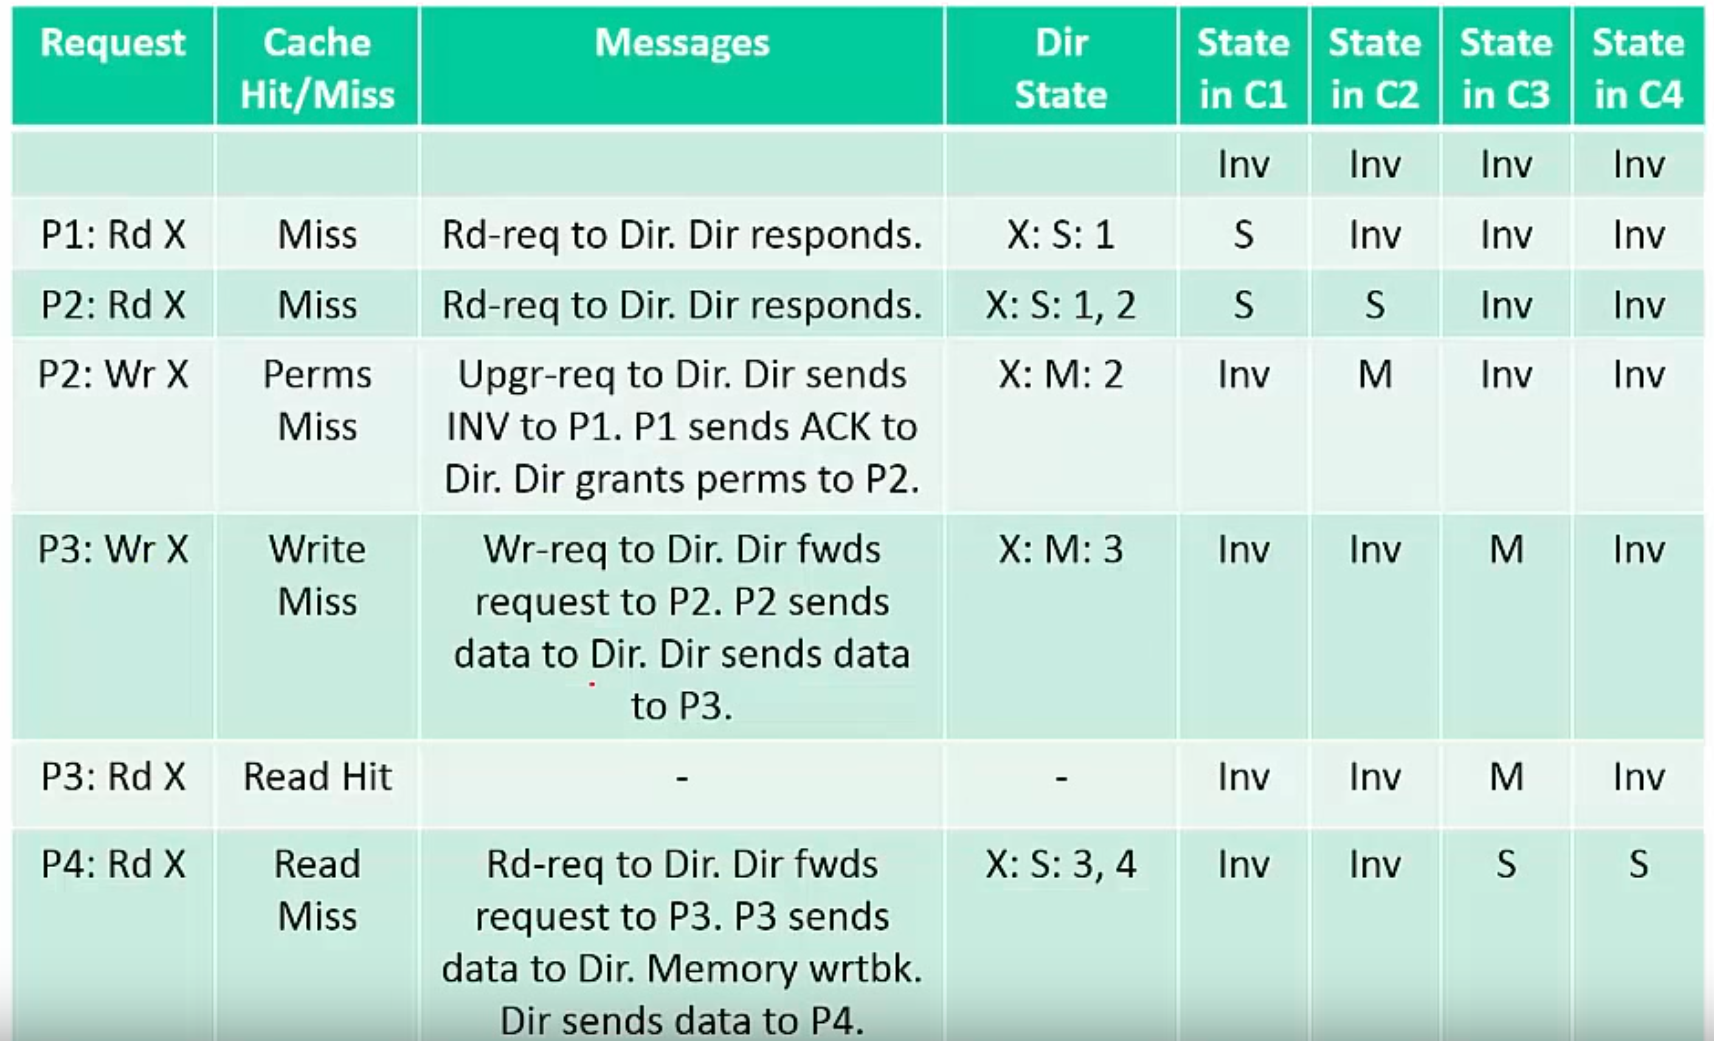
Directory-based protocol

Slide 12
Synchronization

Slide 13
Constructing Locks
Applications have phases (consisting of many instructions)
that must be executed atomically, without other parallel
processes modifying the data
A lock surrounding the data/code ensures that only one
program can be in a critical section at a time
The hardware must provide some basic primitives that
allow us to construct locks with different properties
Lock algorithms assume an underlying cache coherence
mechanism – when a process updates a lock, other
processes will eventually see the update

Slide 14
Race conditions
Example:
  Global list of, for example, requests
  Each thread can add requests to the list

Slide 15

List implementation (no locks)
1 struct list {
2 int data;
3 struct list *next;
4 };
...
6 struct list *list = 0;
...
9 insert(int data)
10 {
11 struct list *l;
12
13 l = malloc(sizeof *l);
14 l->data = data;
15 l->next = list;
16 list = l;
17 }
List
  One data element
  Pointer to the next element

Slide 16
List implementation (no locks)
1 struct list {
2 int data;
3 struct list *next;
4 };
...
6 struct list *list = 0;
...
9 insert(int data)
10 {
11 struct list *l;
12
13 l = malloc(sizeof *l);
14 l->data = data;
15 l->next = list;
16 list = l;
17 }
Global head

Slide 17

List implementation (no locks)
1 struct list {
2 int data;
3 struct list *next;
4 };
...
6 struct list *list = 0;
...
9 insert(int data)
10 {
11 struct list *l;
12
13 l = malloc(sizeof *l);
14 l->data = data;
15 l->next = list;
16 list = l;
17 }
Insertion
  Allocate new list element

Slide 18
List implementation (no locks)
1 struct list {
2 int data;
3 struct list *next;
4 };
...
6 struct list *list = 0;
...
9 insert(int data)
10 {
11 struct list *l;
12
13 l = malloc(sizeof *l);
14 l->data = data;
15 l->next = list;
16 list = l;
17 }
Insertion
  Allocate new list element
  Save data into that element

Slide 19

List implementation (no locks)
1 struct list {
2 int data;
3 struct list *next;
4 };
...
6 struct list *list = 0;
...
9 insert(int data)
10 {
11 struct list *l;
12
13 l = malloc(sizeof *l);
14 l->data = data;
15 l->next = list;
16 list = l;
17 }
Insertion
  Allocate new list element
  Save data into that element
  Insert into the list

Slide 20
Now what happens when two CPUs access the same list

Slide 21
Request queue (e.g. pending disk requests)
Linked list, list is pointer to the first element

Slide 22
CPU1 allocates new request

Slide 23

CPU2 allocates new request
b

Slide 24

CPUs 1 and 2 update next pointer

Slide 25

CPU1 updates head pointer

Slide 26

CPU2 updates head pointer

Slide 27

State after the race
(red element is lost)

Slide 28
Mutual exclusion
Only one CPU can update list at a time

Slide 29
List implementation with locks
1 struct list {
2 int data;
3 struct list *next;
4 };
6 struct list *list = 0;
struct lock listlock;
9 insert(int data)
10 {
11 struct list *l;
13 l = malloc(sizeof *l);
acquire(&listlock);
14 l->data = data;
15 l->next = list;
16 list = l;
release(&listlock);
17 }
Critical section

Slide 30
How can we implement acquire()?

Slide 31
Spinlock
21 void
22 acquire(struct spinlock *lk)
23 {
24 for(;;) {
25 if(!lk->locked) {
26 lk->locked = 1;
27 break;
28 }
29 }
30 }
Spin until lock is 0
Set it to 1

Slide 32
Still incorrect
21 void
22 acquire(struct spinlock *lk)
23 {
24 for(;;) {
25 if(!lk->locked) {
26 lk->locked = 1;
27 break;
28 }
29 }
30 }
Two CPUs can reach line #25 at the same time
  See not locked, and
  Acquire the lock
Lines #25 and #26 need to be atomic
  I.e. indivisible

Slide 33
Synchronization
The simplest hardware primitive that greatly facilitates
synchronization implementations (locks, barriers, etc.)
is an atomic read-modify-write
Atomic exchange: swap contents of register and memory
Special case of atomic exchange: test & set: transfer
memory location into register and write 1 into memory
acquire: t&s register, location
bnz register, acquire
CS
release: st location, #0

Slide 34
How does it work?
Processor
Processor
Processor
Processor
Caches
Caches
Caches
Caches
Main Memory
I/O System

Slide 35
How does it work for directory based protocol
Processor
& Caches
Processor
& Caches
Processor
& Caches
Processor
& Caches
Memory
I/O
Memory
I/O
Memory
I/O
Memory
I/O
Interconnection network

Slide 36
What is the main problem with locks?

Slide 37
What is the main problem with locks?
Scalability

Slide 38
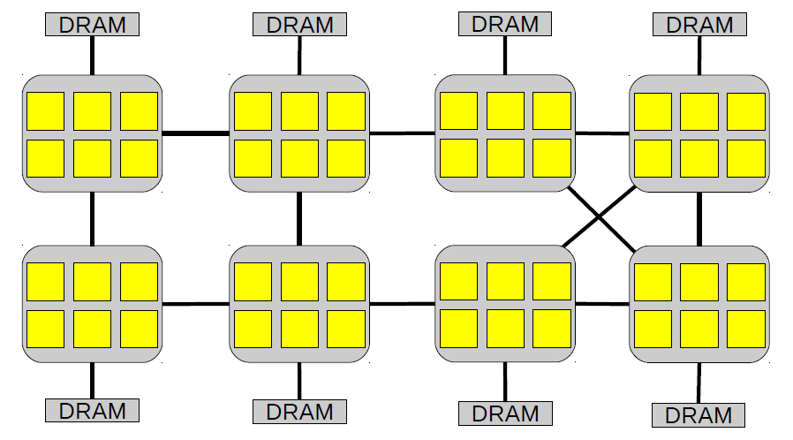
48-core AMD server

Slide 39
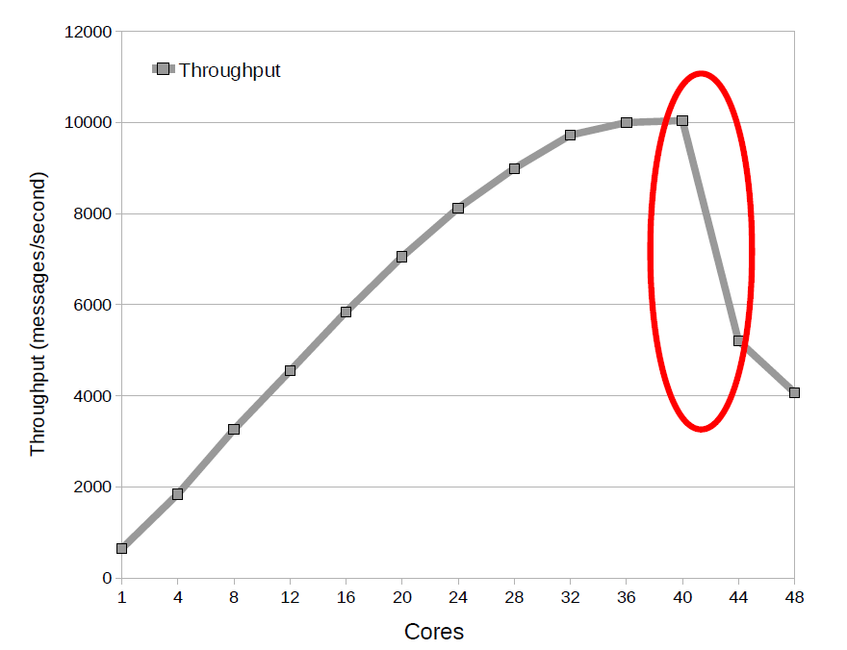
Exim collapse

Slide 40
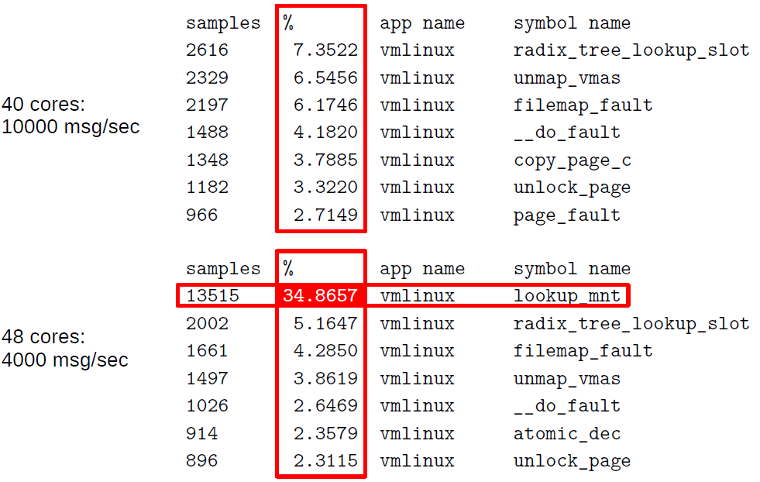
Oprofile results

Slide 41
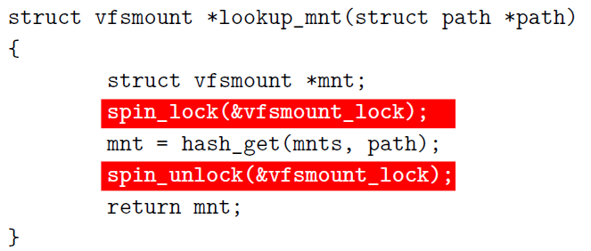
Exim collapse
sys_open eventually calls:

Slide 42
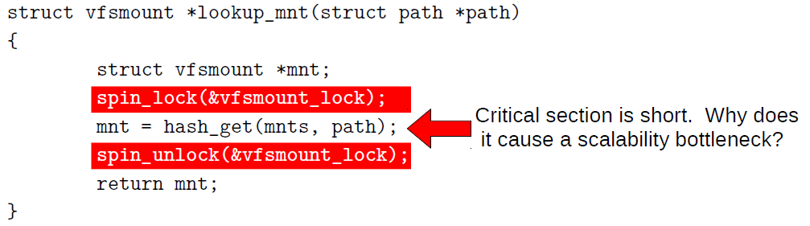
Exim collapse
sys_open eventually calls:
spin_lock and spin_unlock use many more cycles than the critical section

Slide 43
Ticket lock in Linux
struct spinlock_t {
int current_ticket ;
int next_ticket ;
}
void spin_lock ( spinlock_t *lock)
{
int t = atomic_fetch_and_inc (&lock -> next_ticket );
while (t != lock -> current_ticket )
; /* spin */
}
void spin_unlock ( spinlock_t *lock)
{
lock -> current_ticket ++;
}

Slide 44
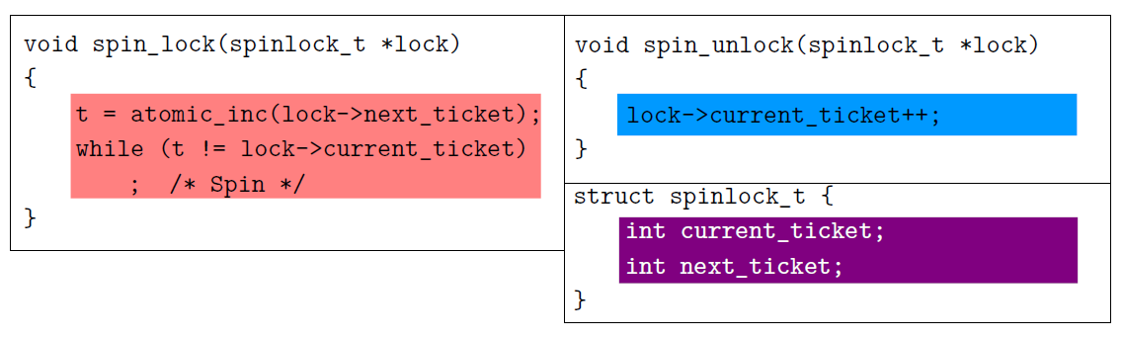
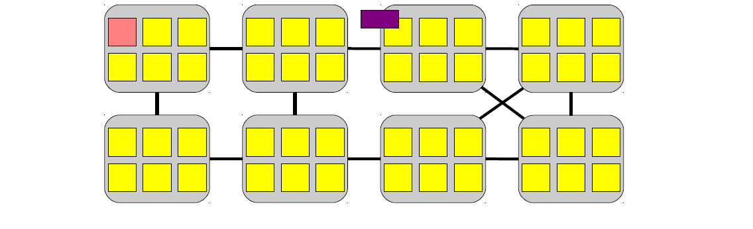
Spin lock implementation

Slide 45
Spin lock implementation
Allocate a ticket

Slide 46
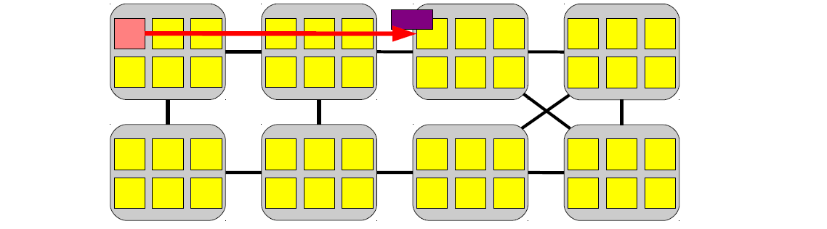
Spin lock implementation
Allocate a ticket

Slide 47
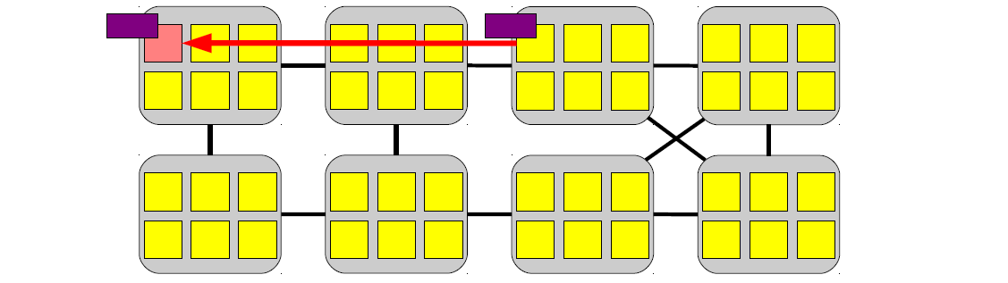
Spin lock implementation
Allocate a ticket

Slide 48
Spin lock implementation
Allocate a ticket
120-420 cycles

Slide 49
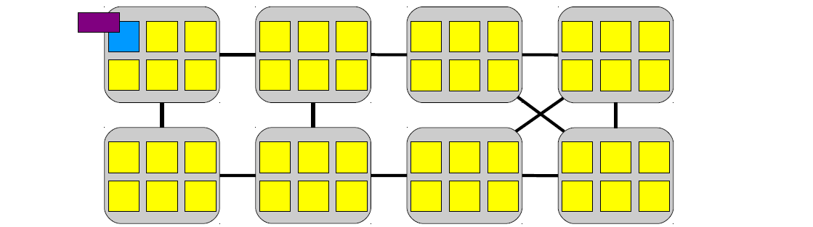
Spin lock implementation
Update the ticket value

Slide 50
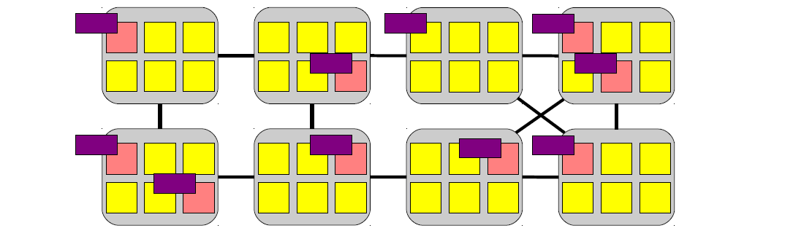
Spin lock implementation
Bunch of cores are
spinning

Slide 51
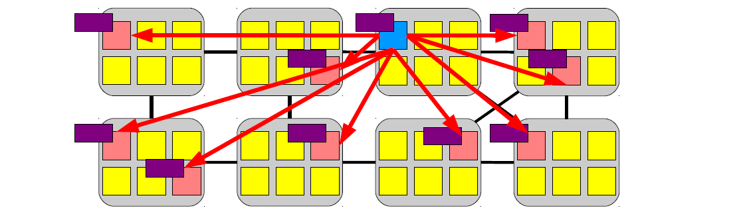
Spin lock implementation
Broadcast message
(invalidate the value)

Slide 52
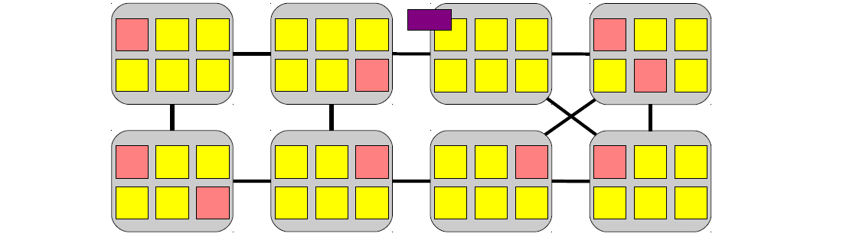
Spin lock implementation
Cores don't have the
value of current_ticket

Slide 53
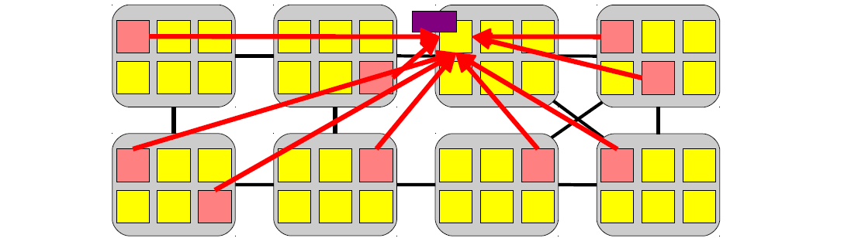
Spin lock implementation
Re-read the value

Slide 54
Spin lock implementation
(120-420) * N/2 cycles

Slide 55
In most architectures, the cache-coherence reads are serialized (either by a shared bus or at the cache line’s home or directory node)
Thus completing them all takes time proportional to the number of cores.
The core that is next in line for the lock can expect to receive its copy of the cache line midway through this process.
  N/2

Slide 56
Atomic synchronization primitives
do not scale well

Slide 57
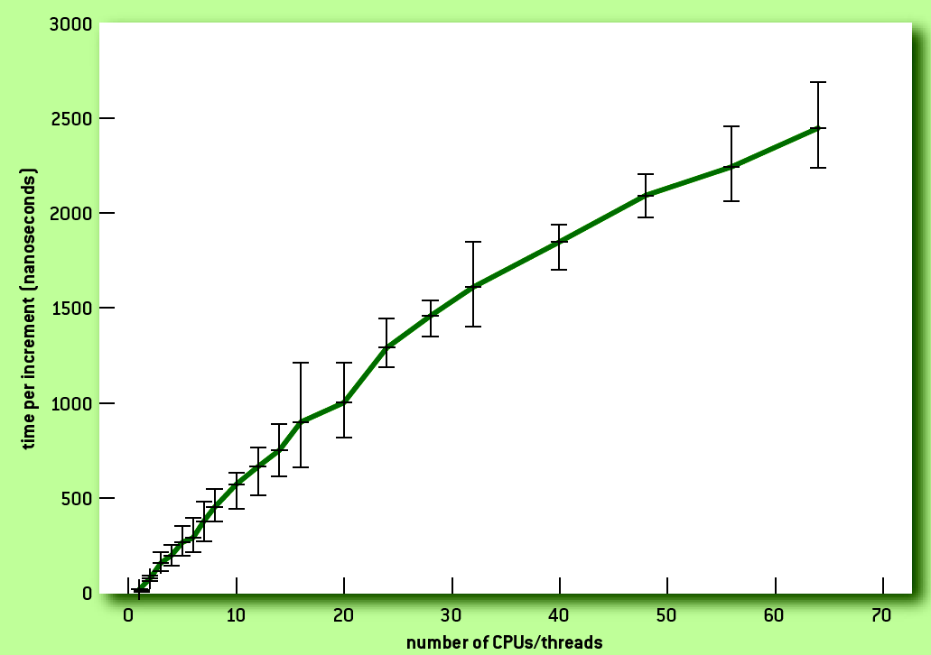
Atomic increment on 64 cores

Slide 58
Thank you!

