Slide 1
CS/EE3810: Computer Organization
Lecture 18: Hyperthreading, SIMD, GPUs
Anton Burtsev
November, 2022

Slide 2
Hyperthreading

Slide 3
The Alpha 21264 Out-of-Order Implementation
Reorder Buffer (ROB)
Branch prediction
and instr fetch
Instr 1
Instr 2
Instr 3
Instr 4
Instr 5
Instr 6
Instr 7
Committed
Reg Map
R1→P1
R2→P2
Register File
P1-P64
R1 ← R1+R2
R2 ← R1+R3
BEQZ R2
R3 ← R1+R2
R1 ← R3+R2
LD R4 ← 8[R3]
ST R4 → 8[R1]
Decode &
Rename
P33 ← P1+P2
P34 ← P33+P3
BEQZ P34
P35 ← P33+P34
P36 ← P35+P34
P37 ← 8[P35]
P37 → 8[P36]
ALU
ALU
ALU
Speculative
Reg Map
R1→P36
R2→P34
Results written to
regfile and tags
broadcast to IQ
Instr Fetch Queue
Issue Queue (IQ)
P37 ← [P35 + 8]
P37 → [P36 + 8]
ALU
D-Cache
LSQ

Slide 4
Thread-Level Parallelism
Motivation:
  a single thread leaves a processor under-utilized
  for most of the time
  by doubling processor area, single thread performance
  barely improves
Strategies for thread-level parallelism:
  multiple threads share the same large processor →
  reduces under-utilization, efficient resource allocation
  Simultaneous Multi-Threading (SMT)
  each thread executes on its own mini processor →
  simple design, low interference between threads
  Chip Multi-Processing (CMP) or multi-core

Slide 5
How are Resources Shared?
Each box represents an issue slot for a functional unit. Peak thruput is 4 IPC.
Thread 1
Thread 2
Thread 3
Cycles
Thread 4
Idle
Superscalar
Fine-Grained
Multithreading
Simultaneous
Multithreading
Superscalar processor has high under-utilization – not enough work every
cycle, especially when there is a cache miss
Fine-grained multithreading can only issue instructions from a single thread
in a cycle – can not find max work every cycle, but cache misses can be tolerated
Simultaneous multithreading can issue instructions from any thread every
cycle – has the highest probability of finding work for every issue slot

Slide 6
What Resources are Shared?
Multiple threads are simultaneously active (in other words,
a new thread can start without a context switch)
For correctness, each thread needs its own PC, IFQ,
logical regs (and its own mappings from logical to phys regs)
For performance, each thread could have its own ROB/LSQ
(so that a stall in one thread does not stall commit in other
threads), I-cache, branch predictor, D-cache, etc. (for low
interference), although note that more sharing → better
utilization of resources
Each additional thread costs a PC, IFQ, rename tables,
and ROB – cheap!

Slide 7
Pipeline Structure
Private/
Shared
Front-end
I-Cache
Bpred
Front
End
Front
End
Front
End
Front
End
Private
Front-end
Rename
ROB
Execution Engine
Regs
IQ
Shared
Exec Engine
DCache
FUs

Slide 8
Resource Sharing
Thread-1
R1 ← R1 + R2
R3 ← R1 + R4
R5 ← R1 + R3
P65← P1 + P2
P66 ← P65 + P4
P67 ← P65 + P66
Instr Fetch
Instr Rename
Instr Fetch
Instr Rename
Issue Queue
R2 ← R1 + R2
R5 ← R1 + R2
R3 ← R5 + R3
P76 ← P33 + P34
P77 ← P33 + P76
P78 ← P77 + P35
P65← P1 + P2
P66 ← P65 + P4
P67 ← P65 + P66
P76 ← P33 + P34
P77 ← P33 + P76
P78 ← P77 + P35
Thread-2
Register File
FU
FU
FU
FU

Slide 9
Performance Implications of SMT
Single thread performance is likely to go down (caches,
branch predictors, registers, etc. are shared) – this effect
can be mitigated by trying to prioritize one thread
With eight threads in a processor with many resources,
SMT yields throughput improvements of roughly 2-4

Slide 10
Single instruction multiple data (SIMD)

Slide 11
SIMD Processors
Single instruction, multiple data
Such processors offer energy efficiency because a single
instruction fetch can trigger many data operations
Such data parallelism may be useful for many
image/sound and numerical applications

Slide 12

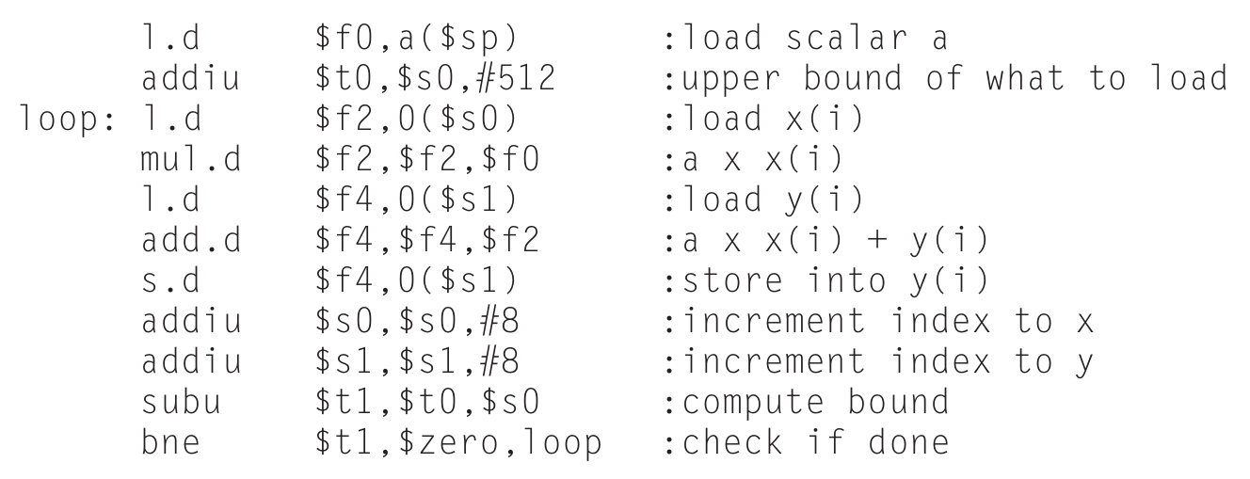
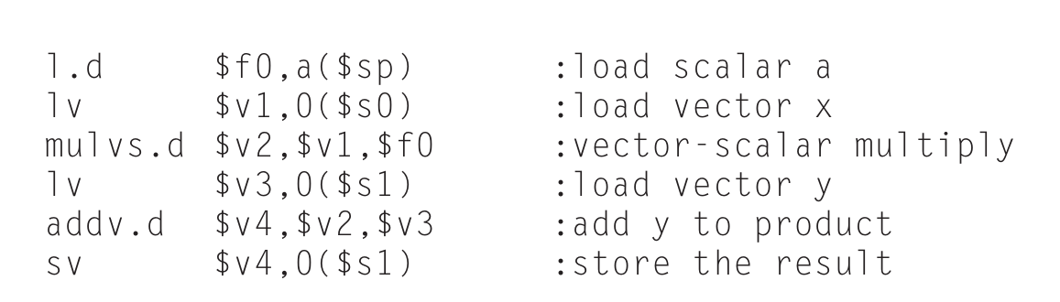
Example

Slide 13
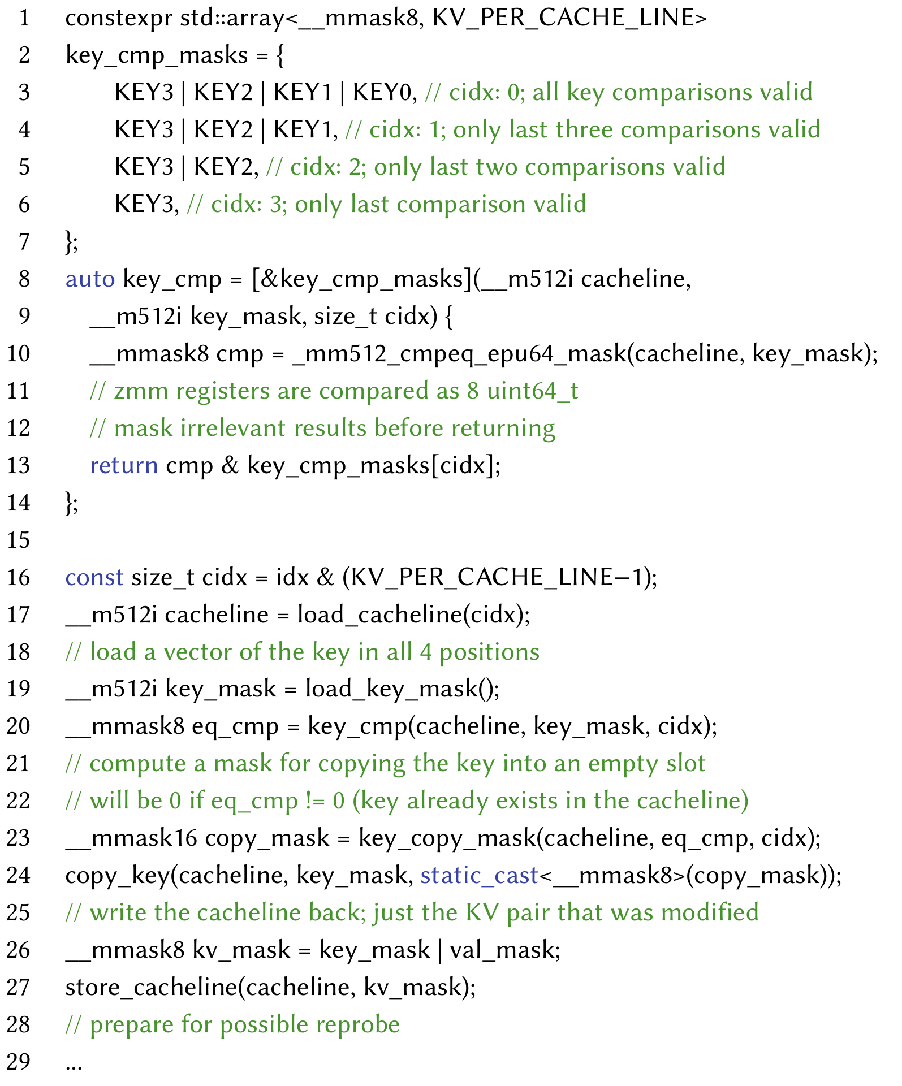
Example #2
Hash table
  Insertion

Slide 14
GPUs
Initially developed as graphics accelerators; now viewed
as one of the densest compute engines available
Many on-going efforts to run non-graphics workloads on
GPUs, i.e., use them as general-purpose GPUs or GPGPUs
C/C++ based programming platforms enable wider use
of GPGPUs – CUDA from NVidia and OpenCL from an
industry consortium
A heterogeneous system has a regular host CPU and a
GPU that handles (say) CUDA code (they can both be
on the same chip)

Slide 15
GPUs

Slide 16
The GPU Architecture
SIMT – single instruction, multiple thread; a GPU has
many SIMT cores
A large data-parallel operation is partitioned into many
thread blocks (one per SIMT core); a thread block is
partitioned into many warps (one warp running at a
time in the SIMT core); a warp is partitioned across many
in-order pipelines (each is called a SIMD lane)
A SIMT core can have multiple active warps at a time,
i.e., the SIMT core stores the registers for each warp;
warps can be context-switched at low cost; a warp
scheduler keeps track of runnable warps and schedules
a new warp if the currently running warp stalls

Slide 17
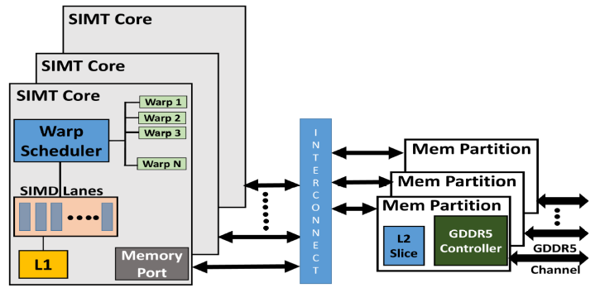
The GPU Architecture

Slide 18
Architecture Features
Simple in-order pipelines that rely on thread-level parallelism
to hide long latencies
Many registers (~1K) per in-order pipeline (lane) to support
many active warps
When a branch is encountered, some of the lanes proceed
along the “then” case depending on their data values;
later, the other lanes evaluate the “else” case; a branch
cuts the data-level parallelism by half (branch divergence)
When a load/store is encountered, the requests from all
lanes are coalesced into a few 128B cache line requests;
each request may return at a different time (mem divergence)

Slide 19
GPU Memory Hierarchy
Each SIMT core has a private L1 cache (shared by the
warps on that core)
A large L2 is shared by all SIMT cores; each L2 bank
services a subset of all addresses
Each L2 partition is connected to its own memory
controller and memory channel
The GDDR5 memory system runs at higher frequencies,
and uses chips with more banks, wide IO, and better
power delivery networks
A portion of GDDR5 memory is private to the GPU and the
rest is accessible to the host CPU (the GPU performs copies)

Slide 20
Thank you!

