Slide 1
3810: Computer Organization
Lecture 10: Memory
Anton Burtsev
October, 2022

Slide 2
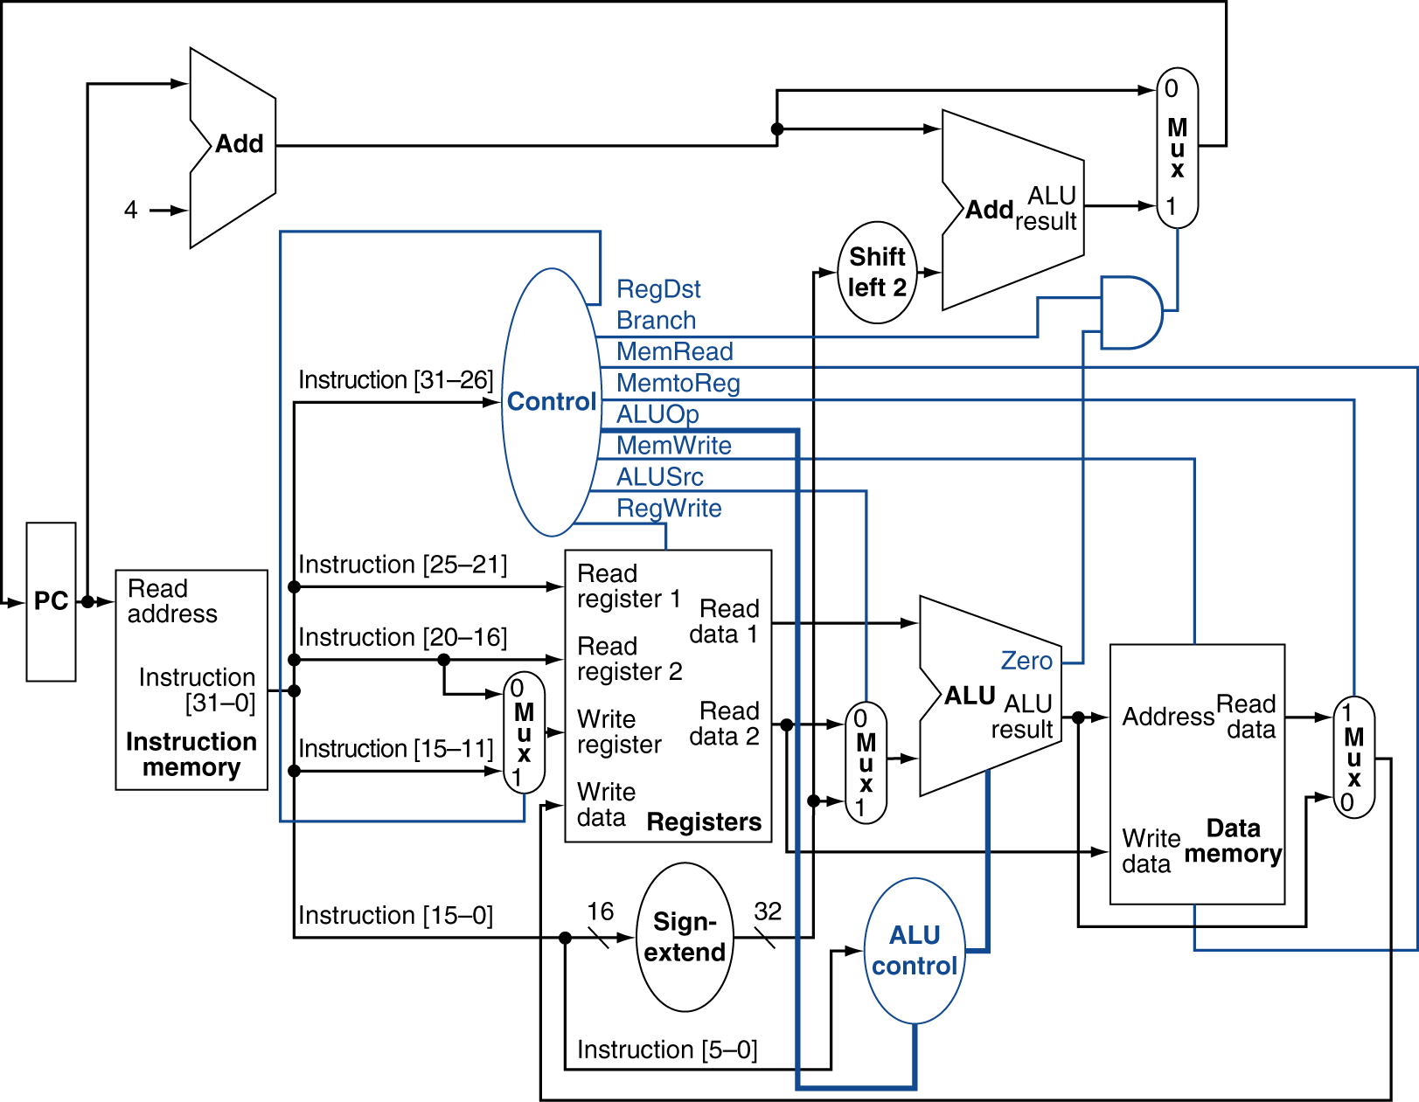
MIPS Datapath
Chapter 4 — The Processor — <number>
Notes:
Morgan Kaufmann Publishers
26 October 2022
Chapter 4 — The Processor

Slide 3
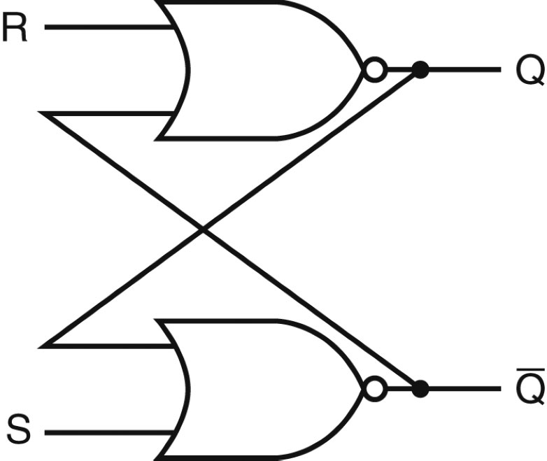
Designing a Latch
An S-R latch: set-reset latch
  When Set is high, a 1 is stored
  When Reset is high, a 0 is stored
  When both are low, the previous state is preserved (hence,
  known as a storage or memory element)
  Both are high – this set of inputs is not allowed
  Verify the above behavior!
Source: H&P textbook

Slide 4
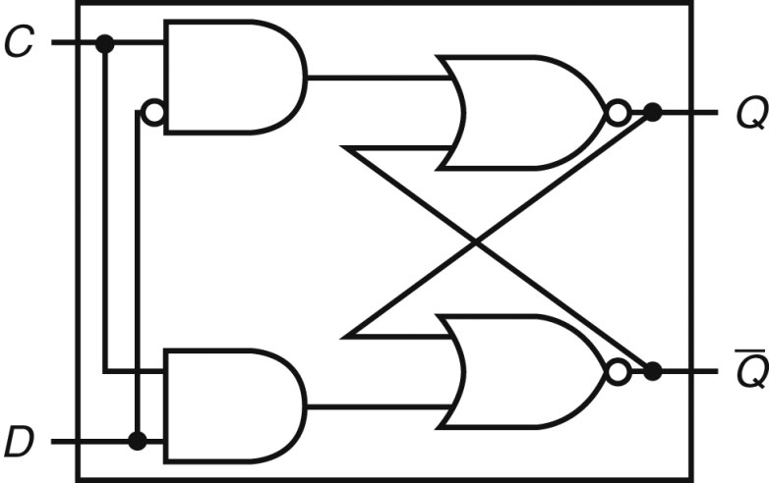
D Latch
Incorporates a clock
The value of the input D signal (data) is stored only when the clock
is high – the previous state is preserved when the clock is low
Source: H&P textbook

Slide 5
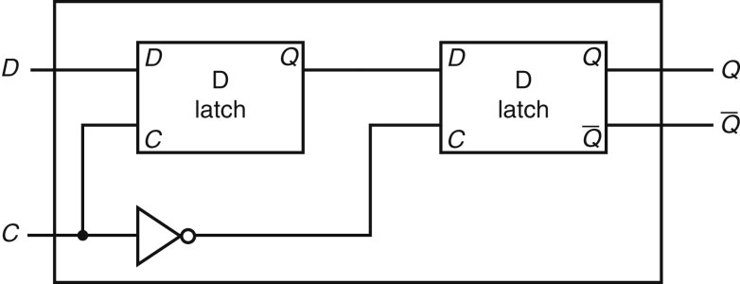
D Flip Flop
Terminology:
Latch: outputs can change any time the clock is high (asserted)
Flip flop: outputs can change only on a clock edge
Two D latches in series – ensures that a value is stored only on
the falling edge of the clock
Source: H&P textbook

Slide 6
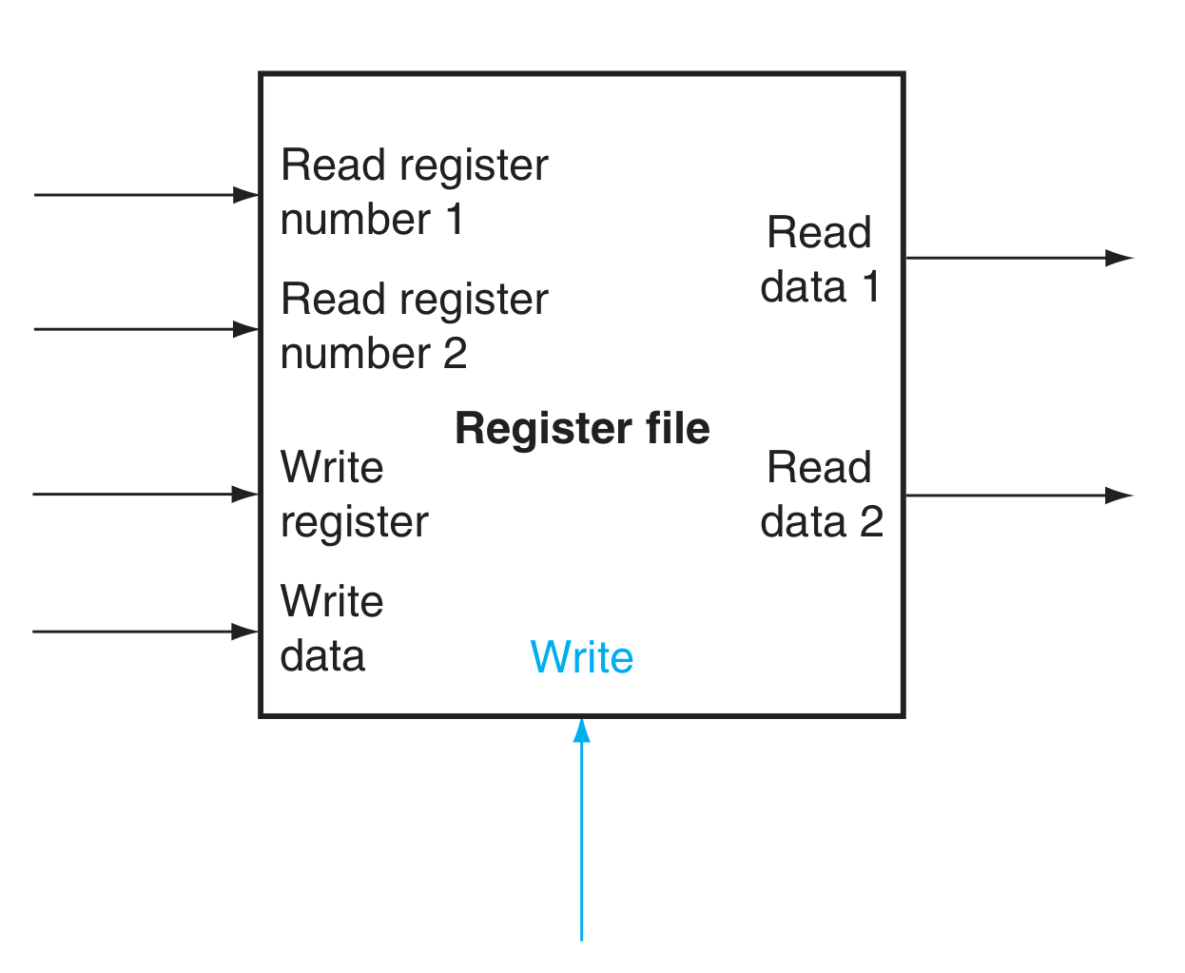
Register file
Two read ports
One write port

Slide 7
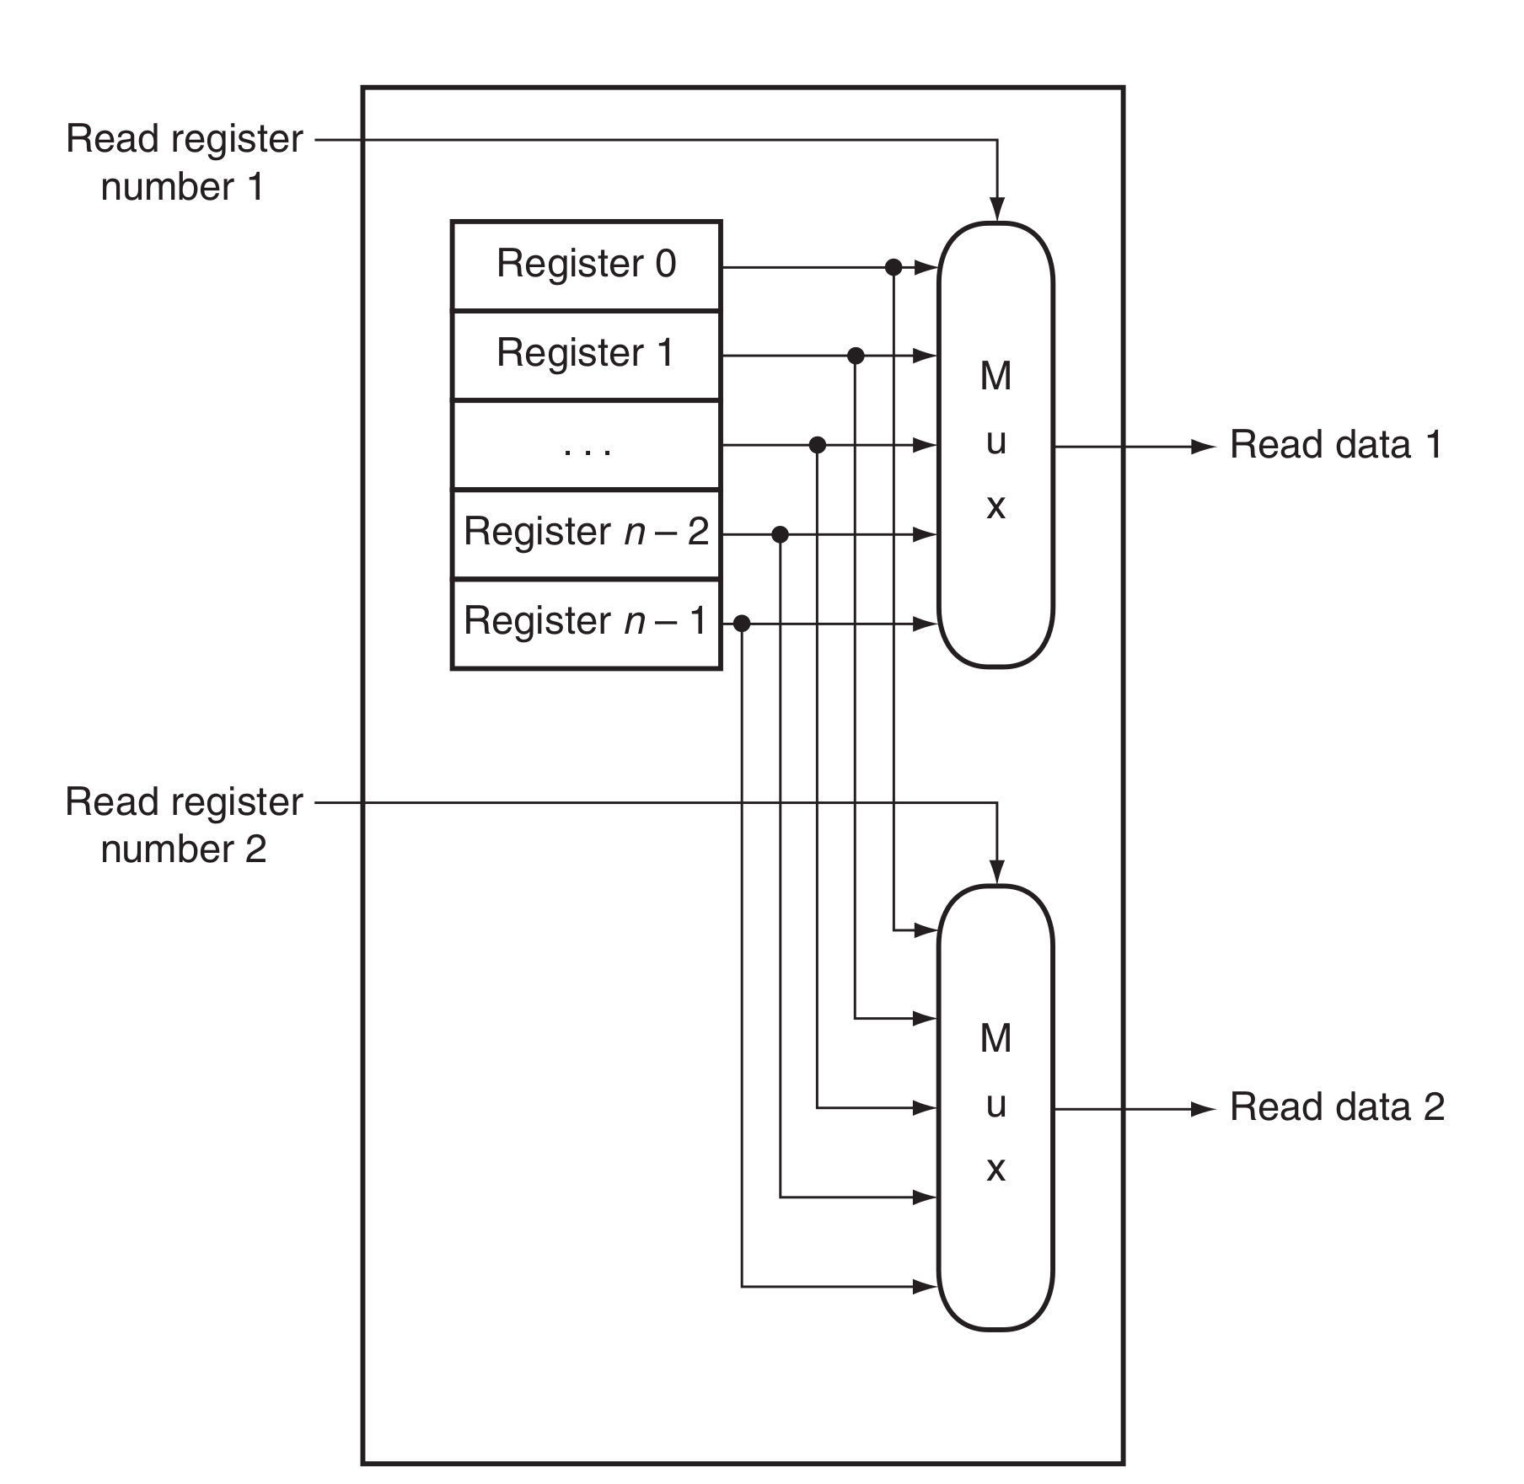
Register file (read ports)
Build from D-flops
Read ports
  Multiplexors
  N-to-1, 32bit wide

Slide 8
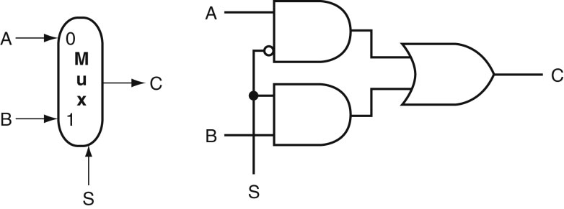
Common Logic Blocks – Multiplexor
Multiplexor or selector: one of N inputs is reflected on the
output depending on the value of the log₂N selector bits
2-input mux
Source: H&P textbook

Slide 9
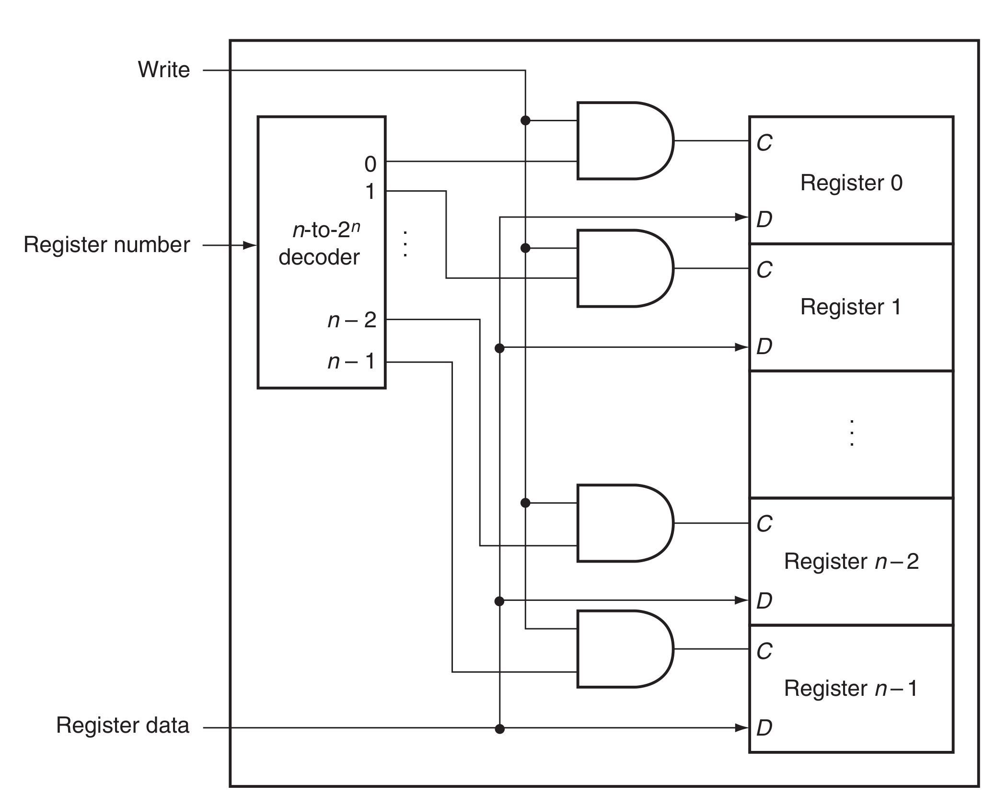
Register file (write ports)
Decoder

Slide 10
Common Logic Blocks – Decoder
Takes in N inputs and activates one of 2^{N} outputs
I₀ I₁ I₂ O₀ O₁ O₂ O₃ O₄ O₅ O₆ O₇
0 0 0 1 0 0 0 0 0 0 0
0 0 1 0 1 0 0 0 0 0 0
0 1 0 0 0 1 0 0 0 0 0
0 1 1 0 0 0 1 0 0 0 0
1 0 0 0 0 0 0 1 0 0 0
1 0 1 0 0 0 0 0 1 0 0
1 1 0 0 0 0 0 0 0 1 0
1 1 1 0 0 0 0 0 0 0 1
3-to-8
Decoder
I₀₋₂
O₀₋₇

Slide 11
Register file (write ports)
What if we read and write the register in the same cycle?
  add $s0, $s0, $s1

Slide 12
MIPS Datapath
Chapter 4 — The Processor — <number>
Notes:
Morgan Kaufmann Publishers
26 October 2022
Chapter 4 — The Processor

Slide 13
SRAM and DRAM

Slide 14
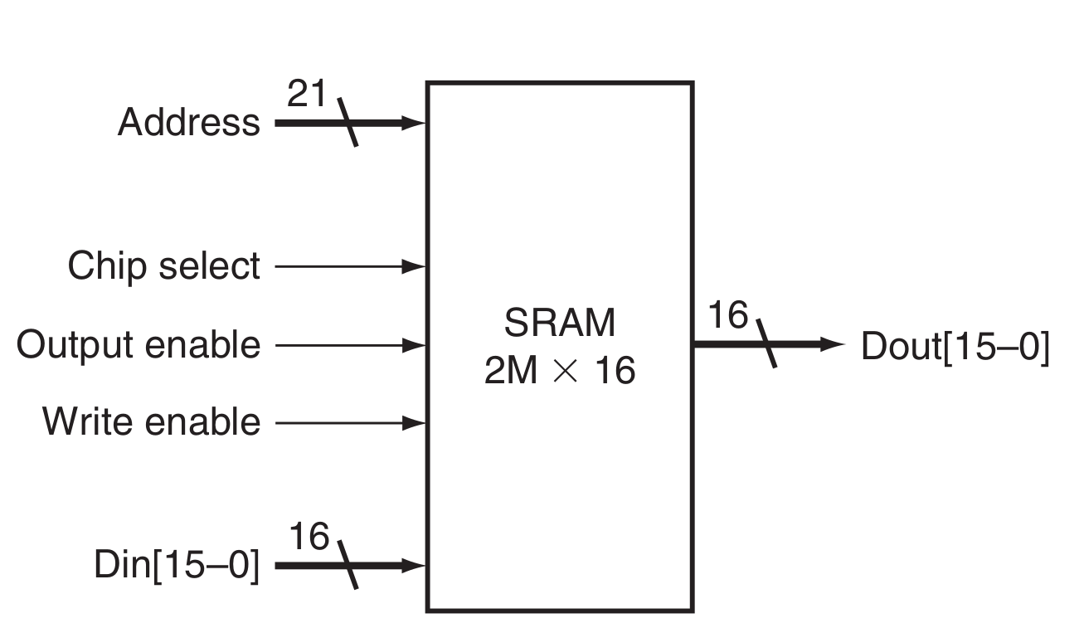
SRAM (Static Random Access Memory)
Chip select to enable read or write
Output enable to read

Slide 15
Register file vs memory
32-to-1 multiplexor

Slide 16
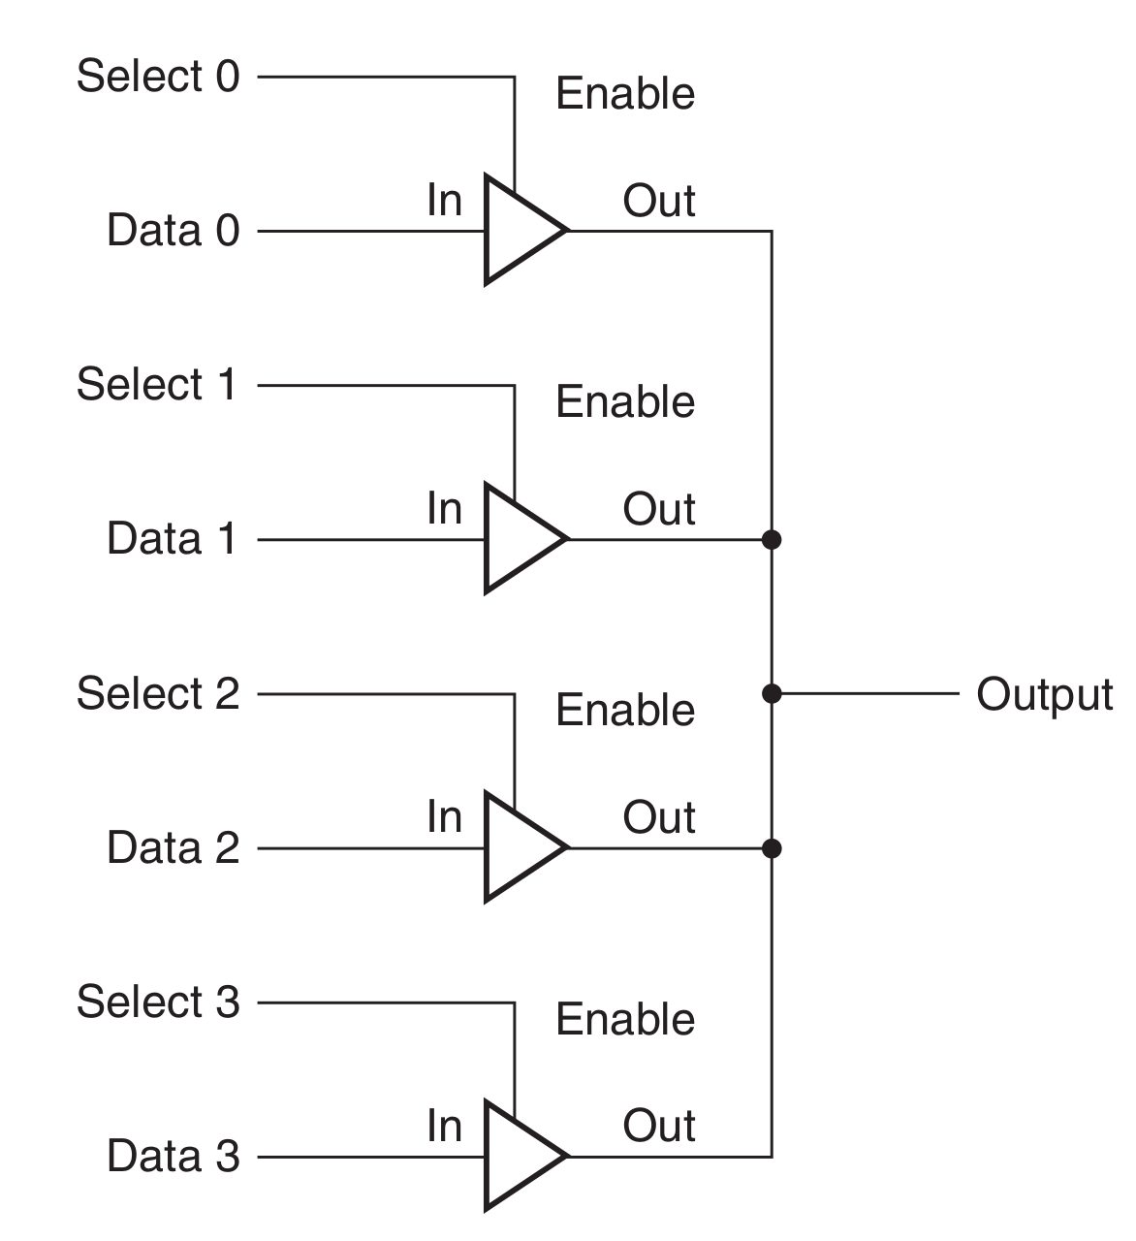
Three-state buffer
64K to 1 multiplexors are not practical
Shared bit line instead
Output
  Asserted, deasserted or high-impedance

Slide 17
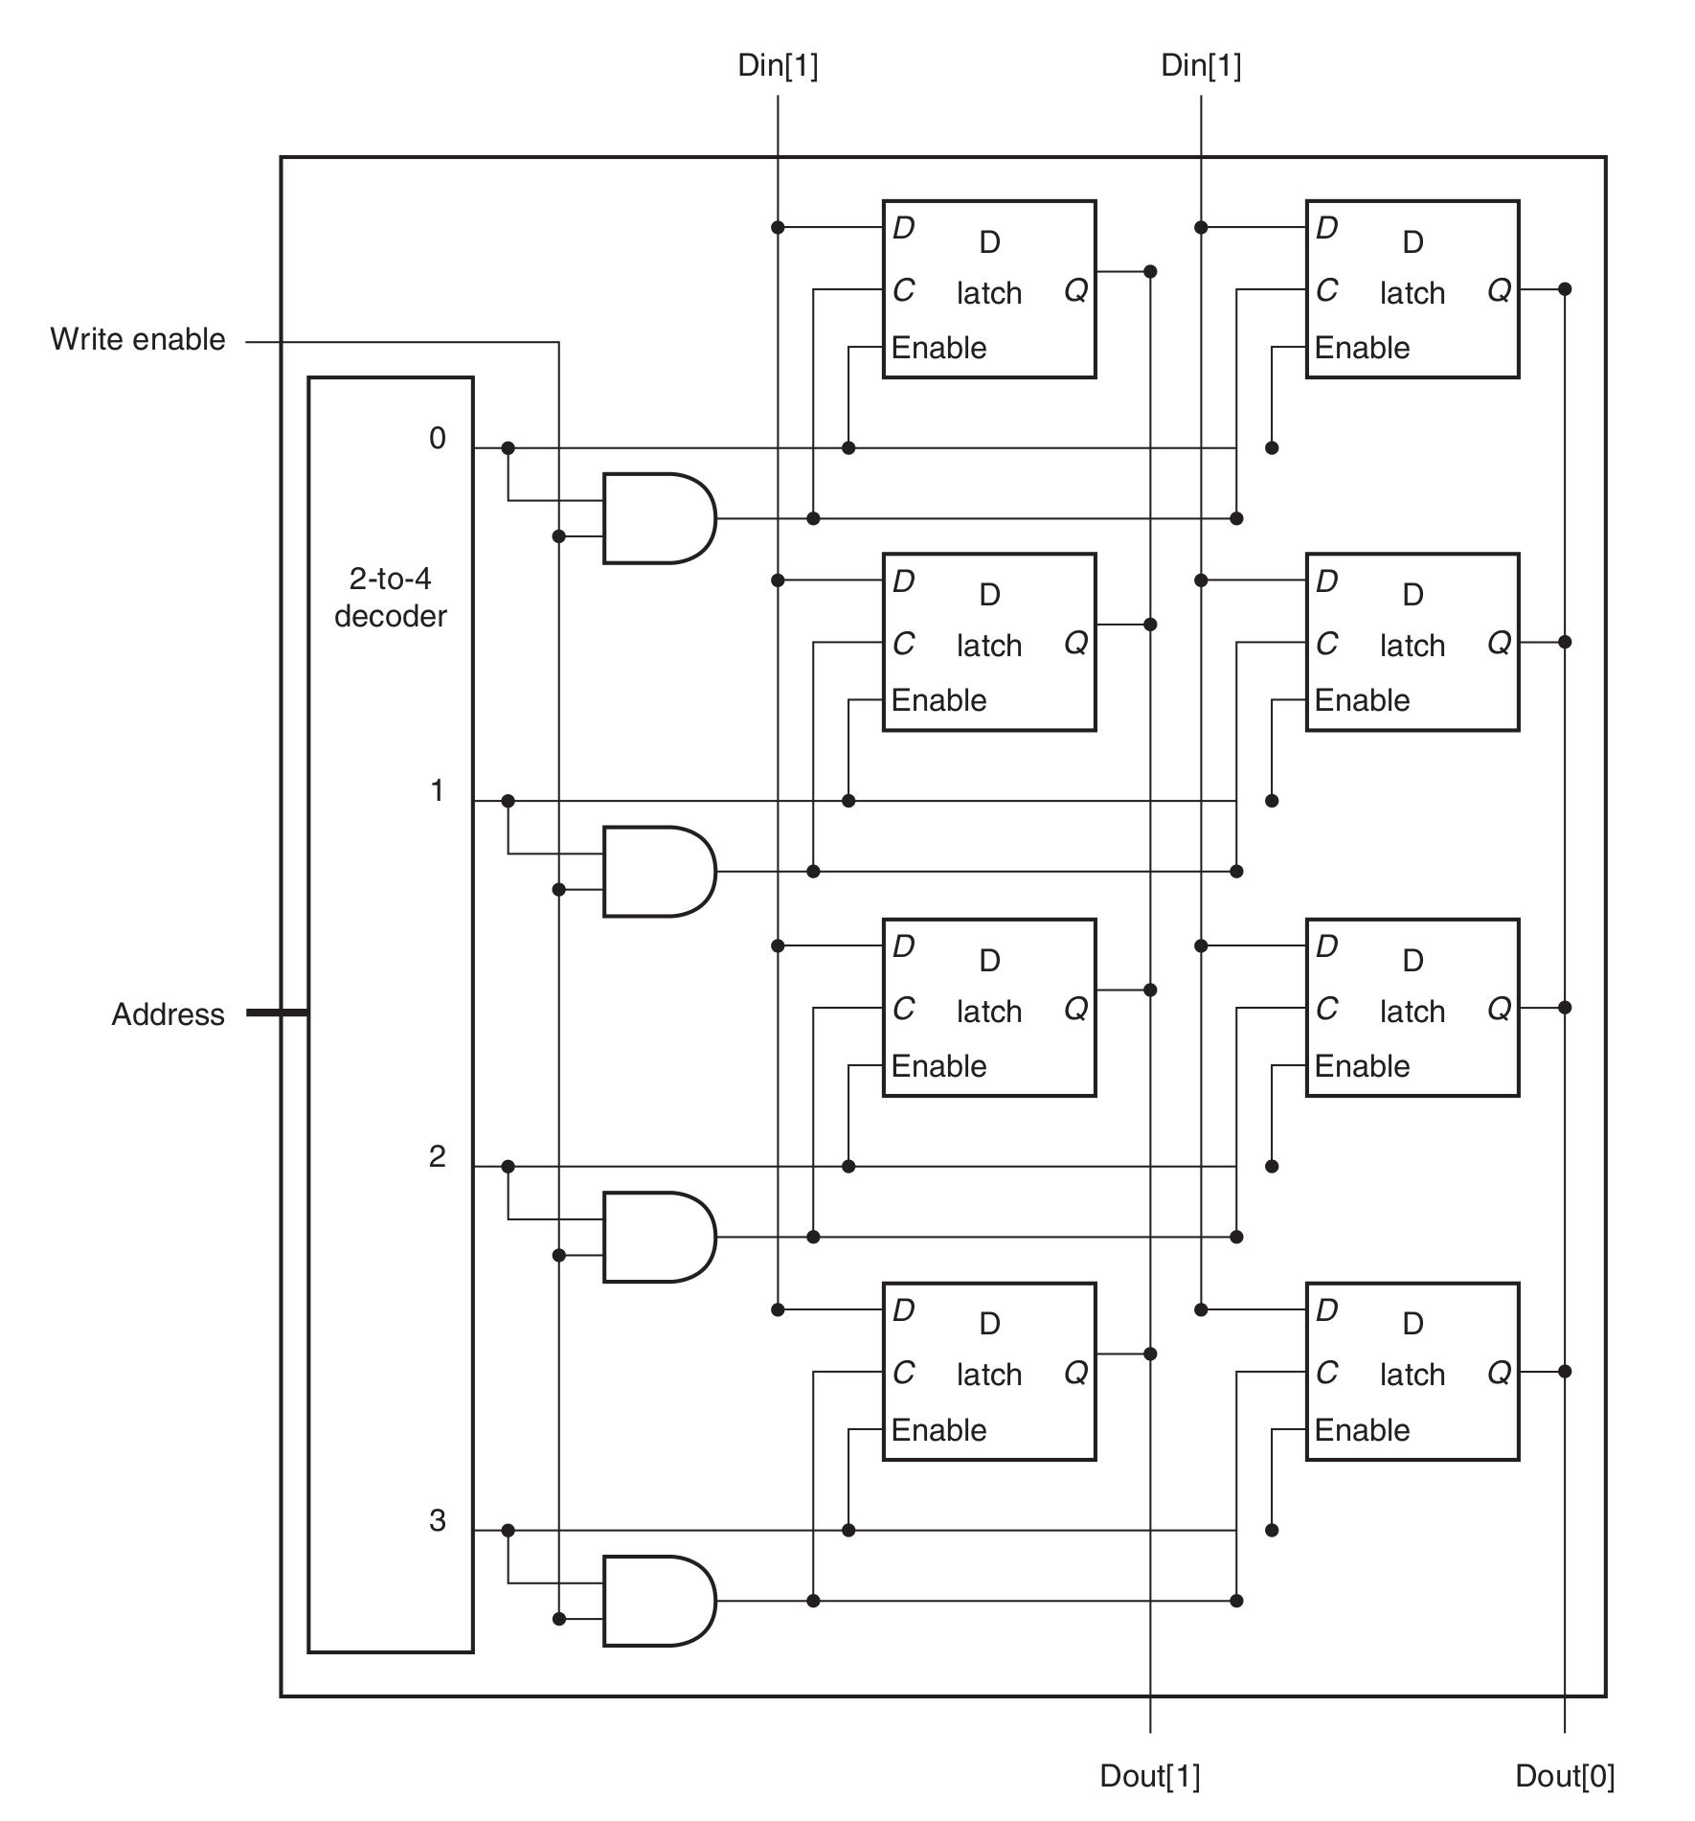
4 x 2 SRAM

Slide 18
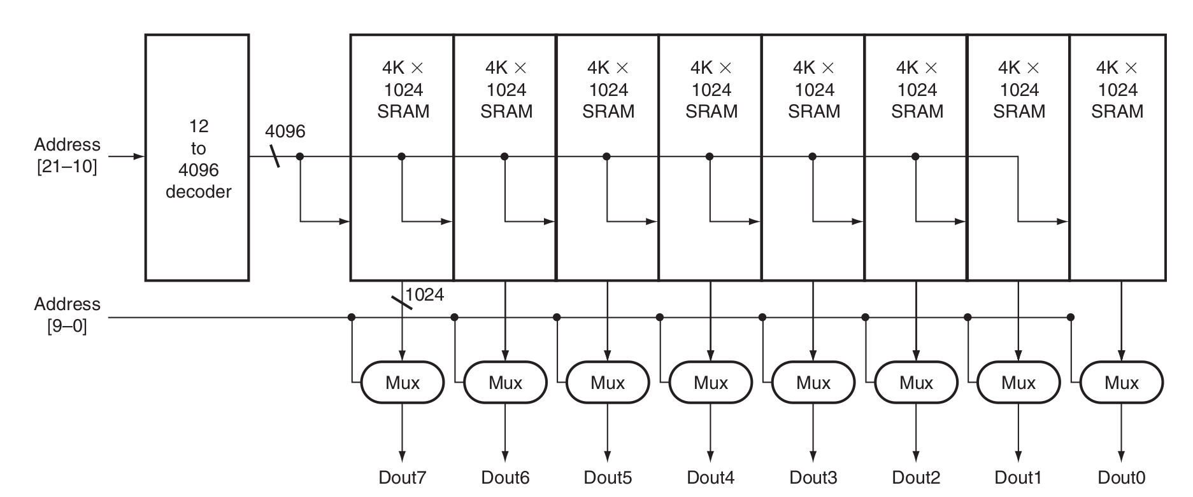
4M x 8 SRAM
Array of 4K x 1024 arrays

Slide 19
DRAM
SRAM
  4-6 transistors
DRAM
  1 transistor

Slide 20
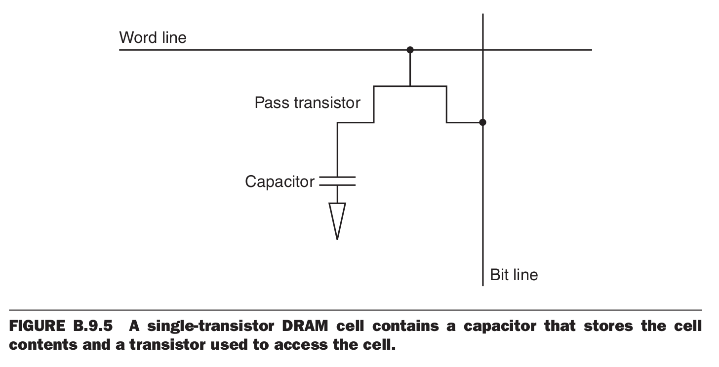
DRAM cell

Slide 21
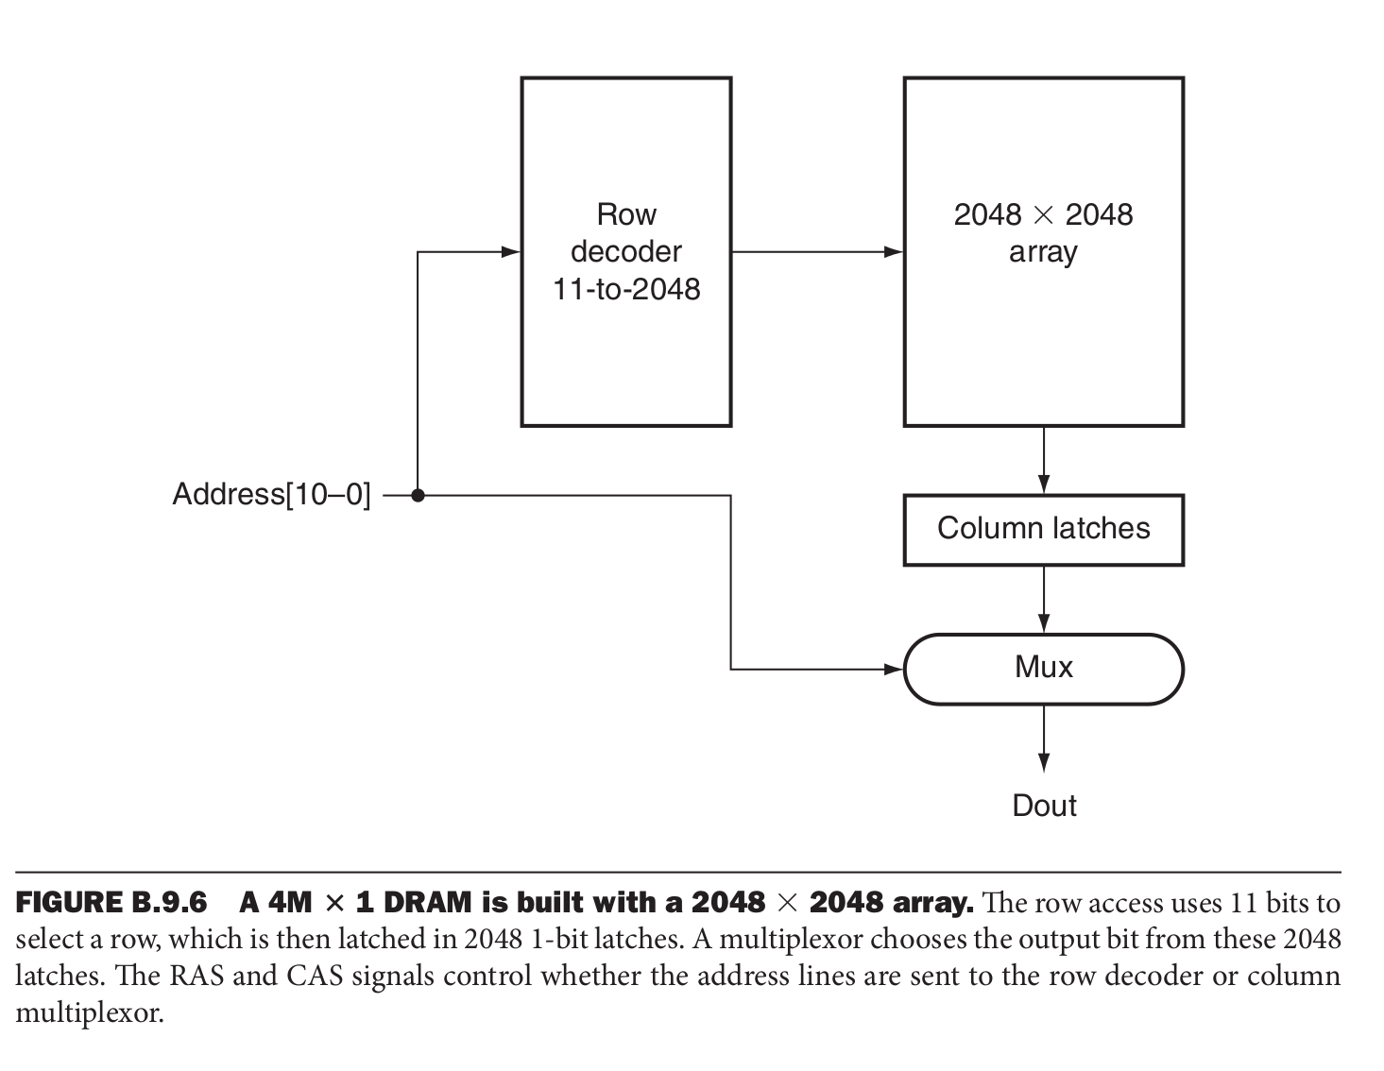
4M x 1 DRAM cell
2048 x 2048 array

Slide 22
Error correction
Parity code
  Counts number of 1s in a word
  Parity bit (1 for odd, 0 for even)
  Detects 1 bit error
  Hence error detection code (EDC)
Error correction codes are also used
  7-8 bits for every 128 bits of data
  Correct 2-bit errors

