Slide 1
CS/EE3810: Computer Organization
Lecture 18: Side channel attacks (Meltdown)
Anton Burtsev
December, 2022

Slide 2

P1 and P2 can't access each other memory

Slide 3

Recap: Can a process read kernel memory?

Slide 4
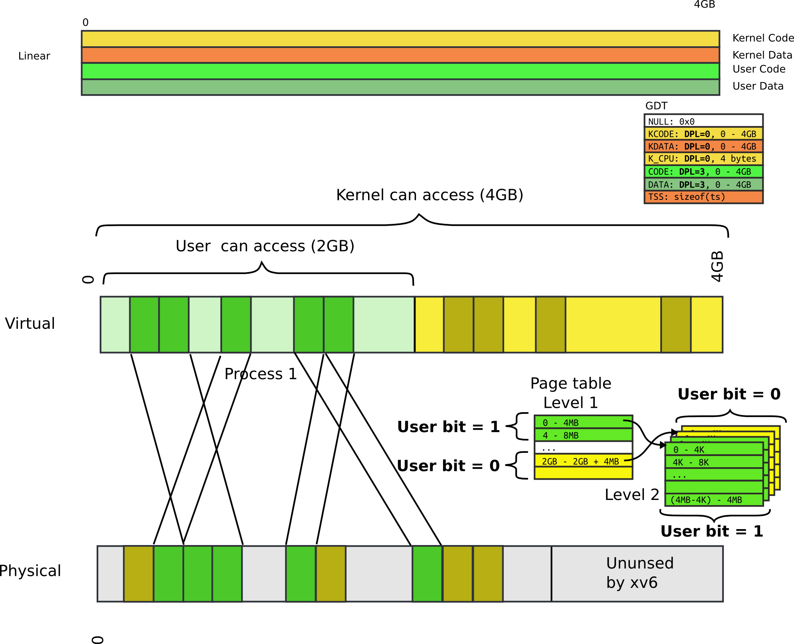

Slide 5
Page tables and protection

Slide 6
The Alpha 21264 Out-of-Order Implementation
Reorder Buffer (ROB)
Branch prediction
and instr fetch
Instr 1
Instr 2
Instr 3
Instr 4
Instr 5
Instr 6
Committed
Reg Map
R1→P1
R2→P2
Register File
P1-P64
R1 ← R1+R2
R2 ← R1+R3
BEQZ R2
R3 ← R1+R2
R1 ← R3+R2
Decode &
Rename
P33 ← P1+P2
P34 ← P33+P3
BEQZ P34
P35 ← P33+P34
P36 ← P35+P34
ALU
ALU
ALU
Speculative
Reg Map
R1→P36
R2→P34
Instr Fetch Queue
Results written to
regfile and tags
broadcast to IQ
Issue Queue (IQ)

Slide 7
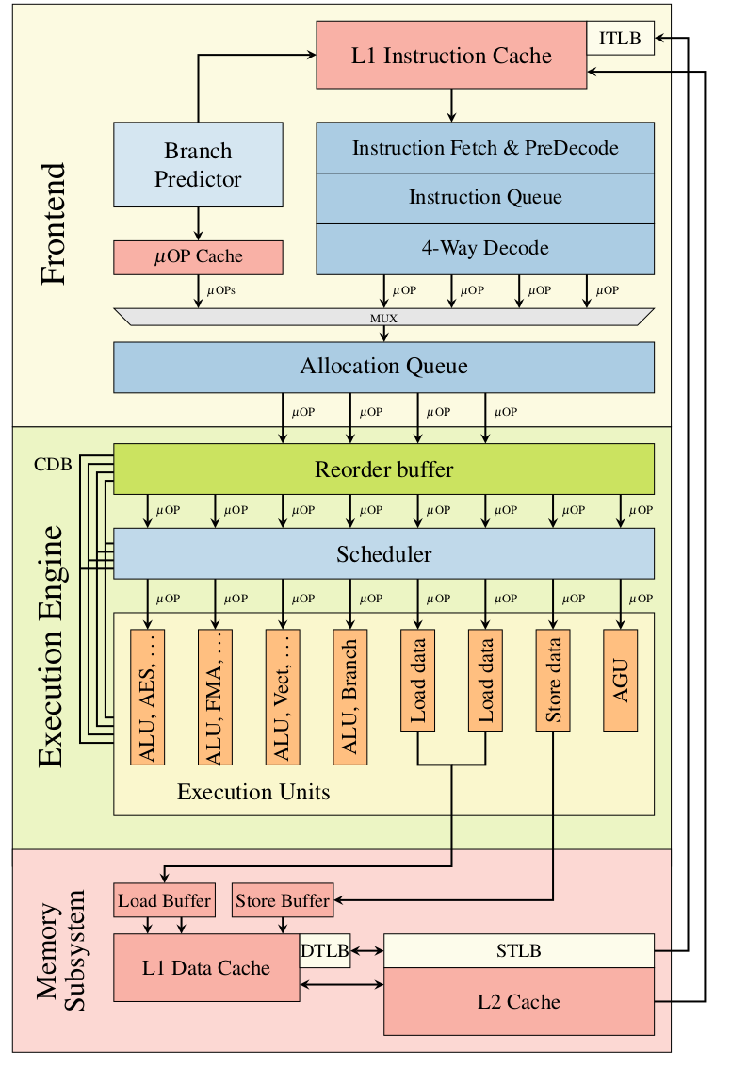
Skylake (simplified)

Slide 8
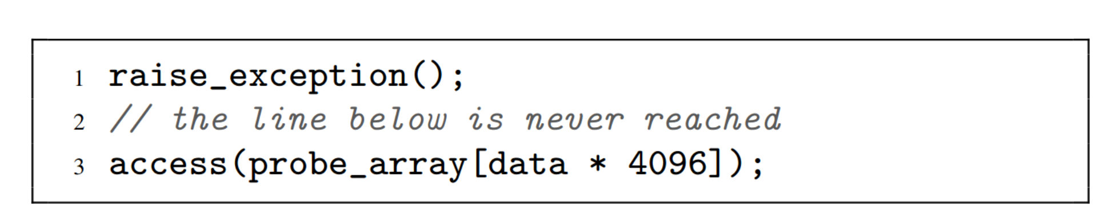
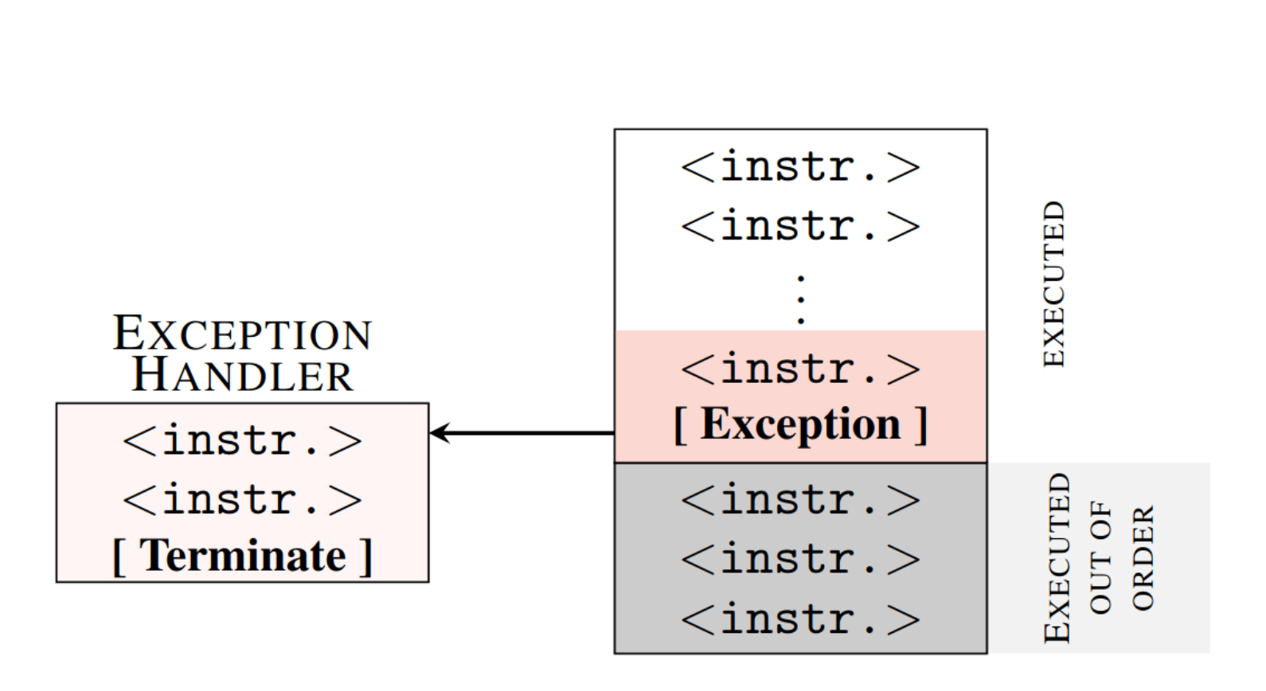
Exceptions and speculation

Slide 9
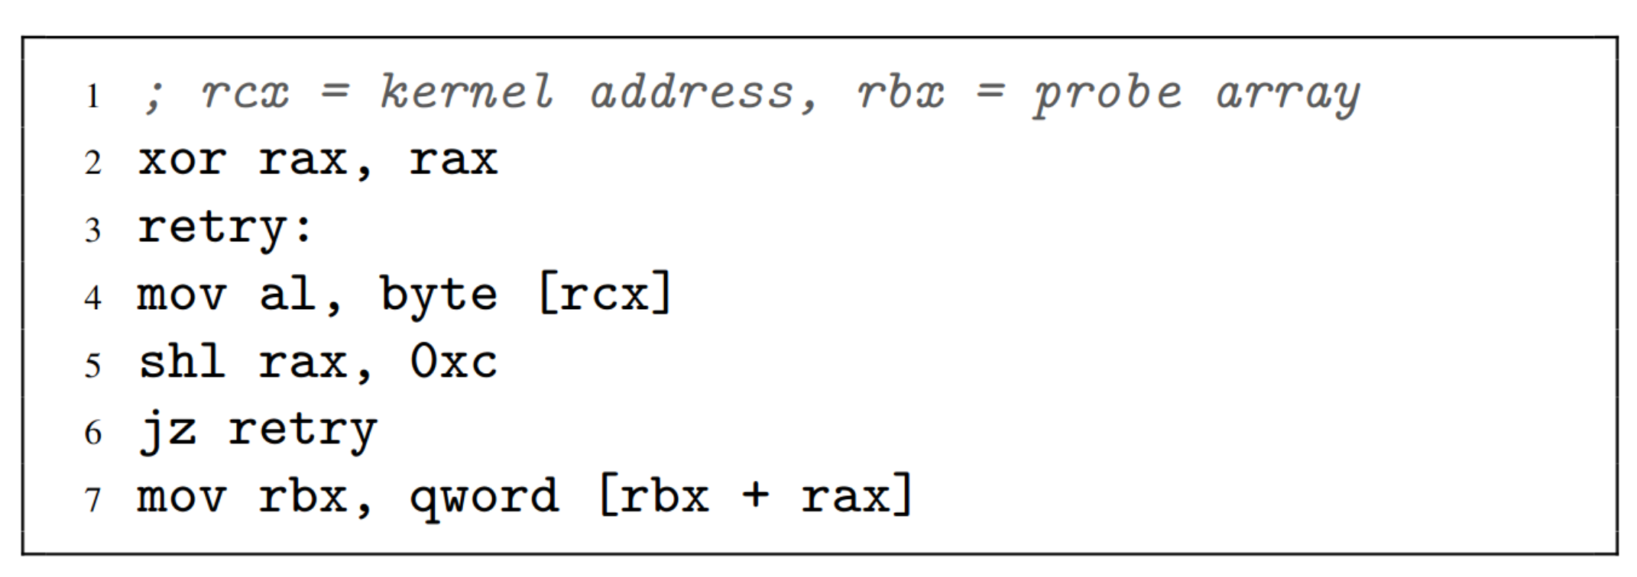
Core of the attack

Slide 11
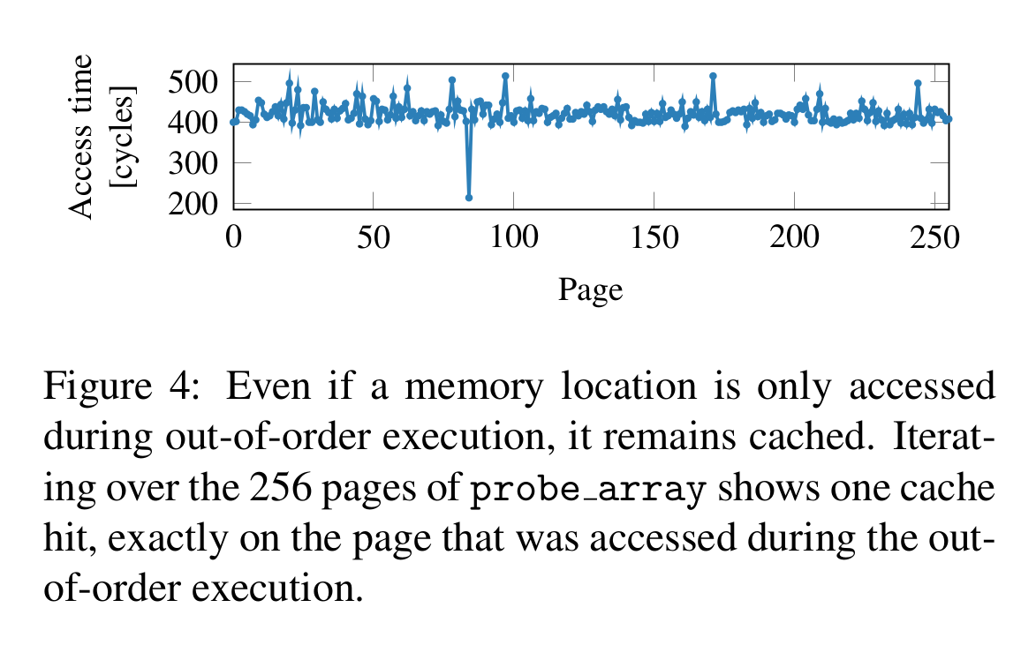
Cache access time
data = 84

Slide 12
Core of the attack

Slide 13
Exception suppression

Slide 14
2-Bit Bimodal Prediction
For each branch, keep track of what happened last time
and use that outcome as the prediction
What are prediction accuracies for branches 1 and 2 below:
while (1) {
for (i=0;i<10;i++) { branch-1
…
}
for (j=0;j<20;j++) { branch-2
…
}
}

Slide 15
Bimodal 2-Bit Predictor
Branch PC
Table of
1K entries
Each
entry is
a bit
10 bits
The table keeps track of what the branch did last time

Slide 16
Thank you!

Slide 17
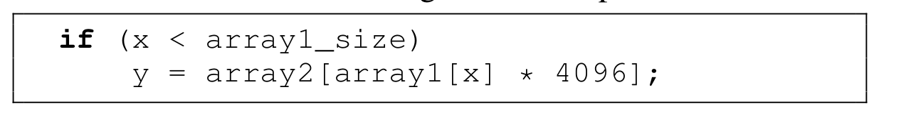
Gadget

Slide 18
Exceptions and speculation

