Slide 1
CS/EE 3810: Computer Organization
Lecture 19: Final Recap
Anton Burtsev
December
, 2022

Slide 2
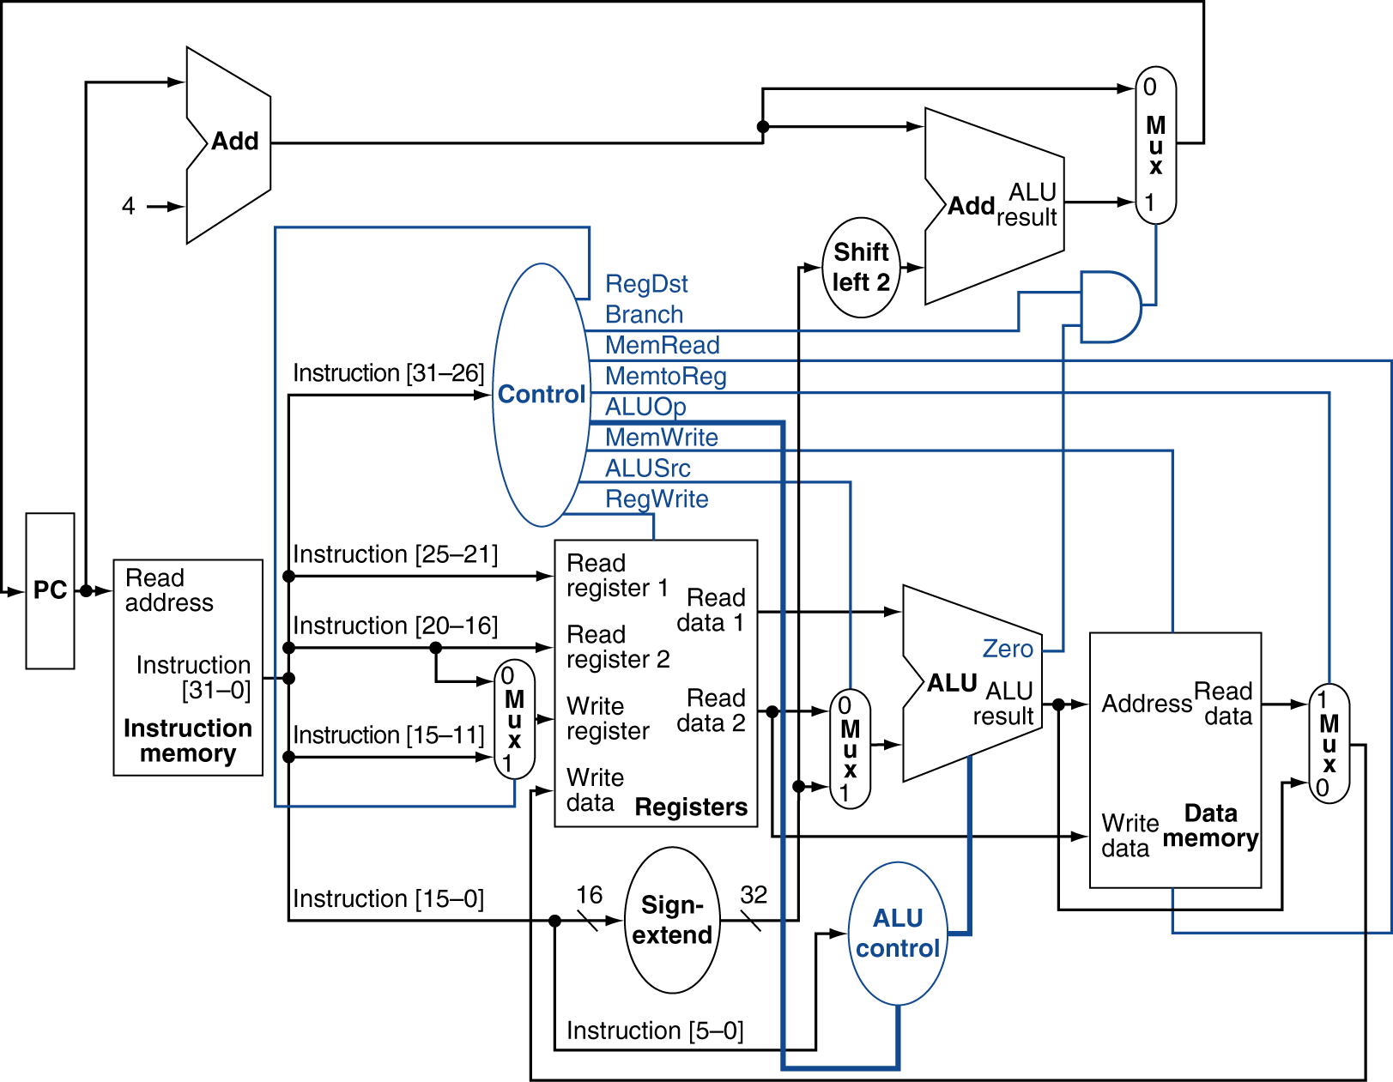
MIPS Datapath
Chapter 4 — The Processor — <number>
Notes:
Morgan Kaufmann Publishers
7 December 2022
Chapter 4 — The Processor

Slide 4
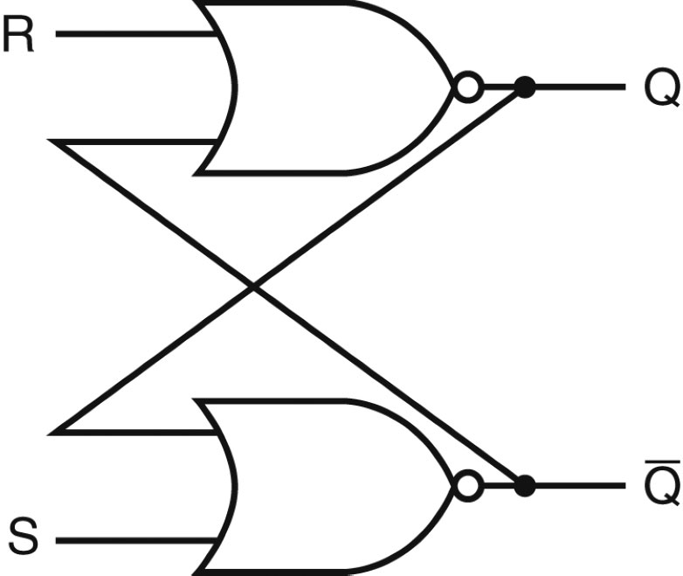
Designing a Latch
An S-R latch: set-reset latch
  When Set is high, a 1 is stored
  When Reset is high, a 0 is stored
  When both are low, the previous state is preserved (hence,
  known as a storage or memory element)
  Both are high – this set of inputs is not allowed
  Verify the above behavior!
Source: H&P textbook

Slide 5
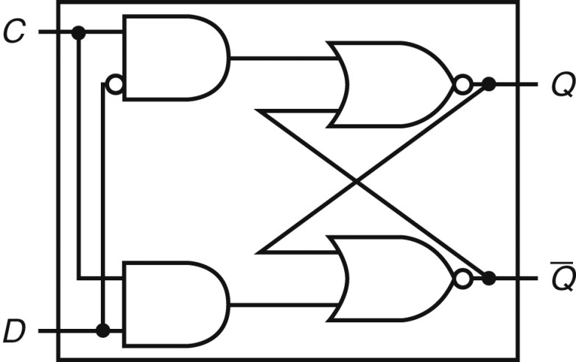
D Latch
Incorporates a clock
The value of the input D signal (data) is stored only when the clock
is high – the previous state is preserved when the clock is low
Source: H&P textbook

Slide 6
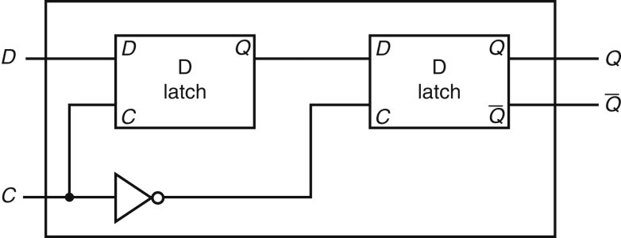
D Flip Flop
Terminology:
Latch: outputs can change any time the clock is high (asserted)
Flip flop: outputs can change only on a clock edge
Two D latches in series – ensures that a value is stored only on
the falling edge of the clock
Source: H&P textbook

Slide 7
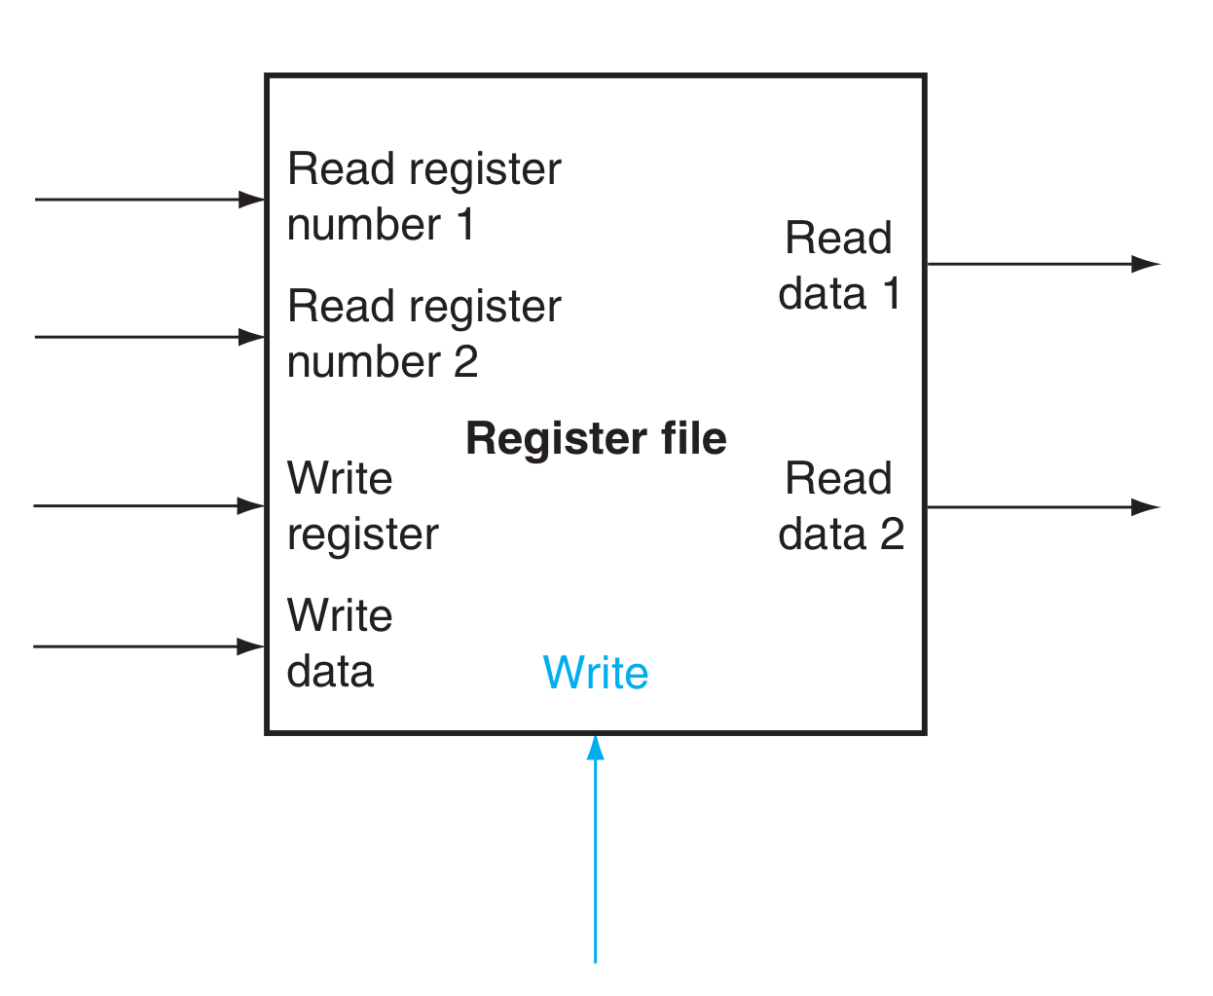
Register file
Two read ports
One write port

Slide 8
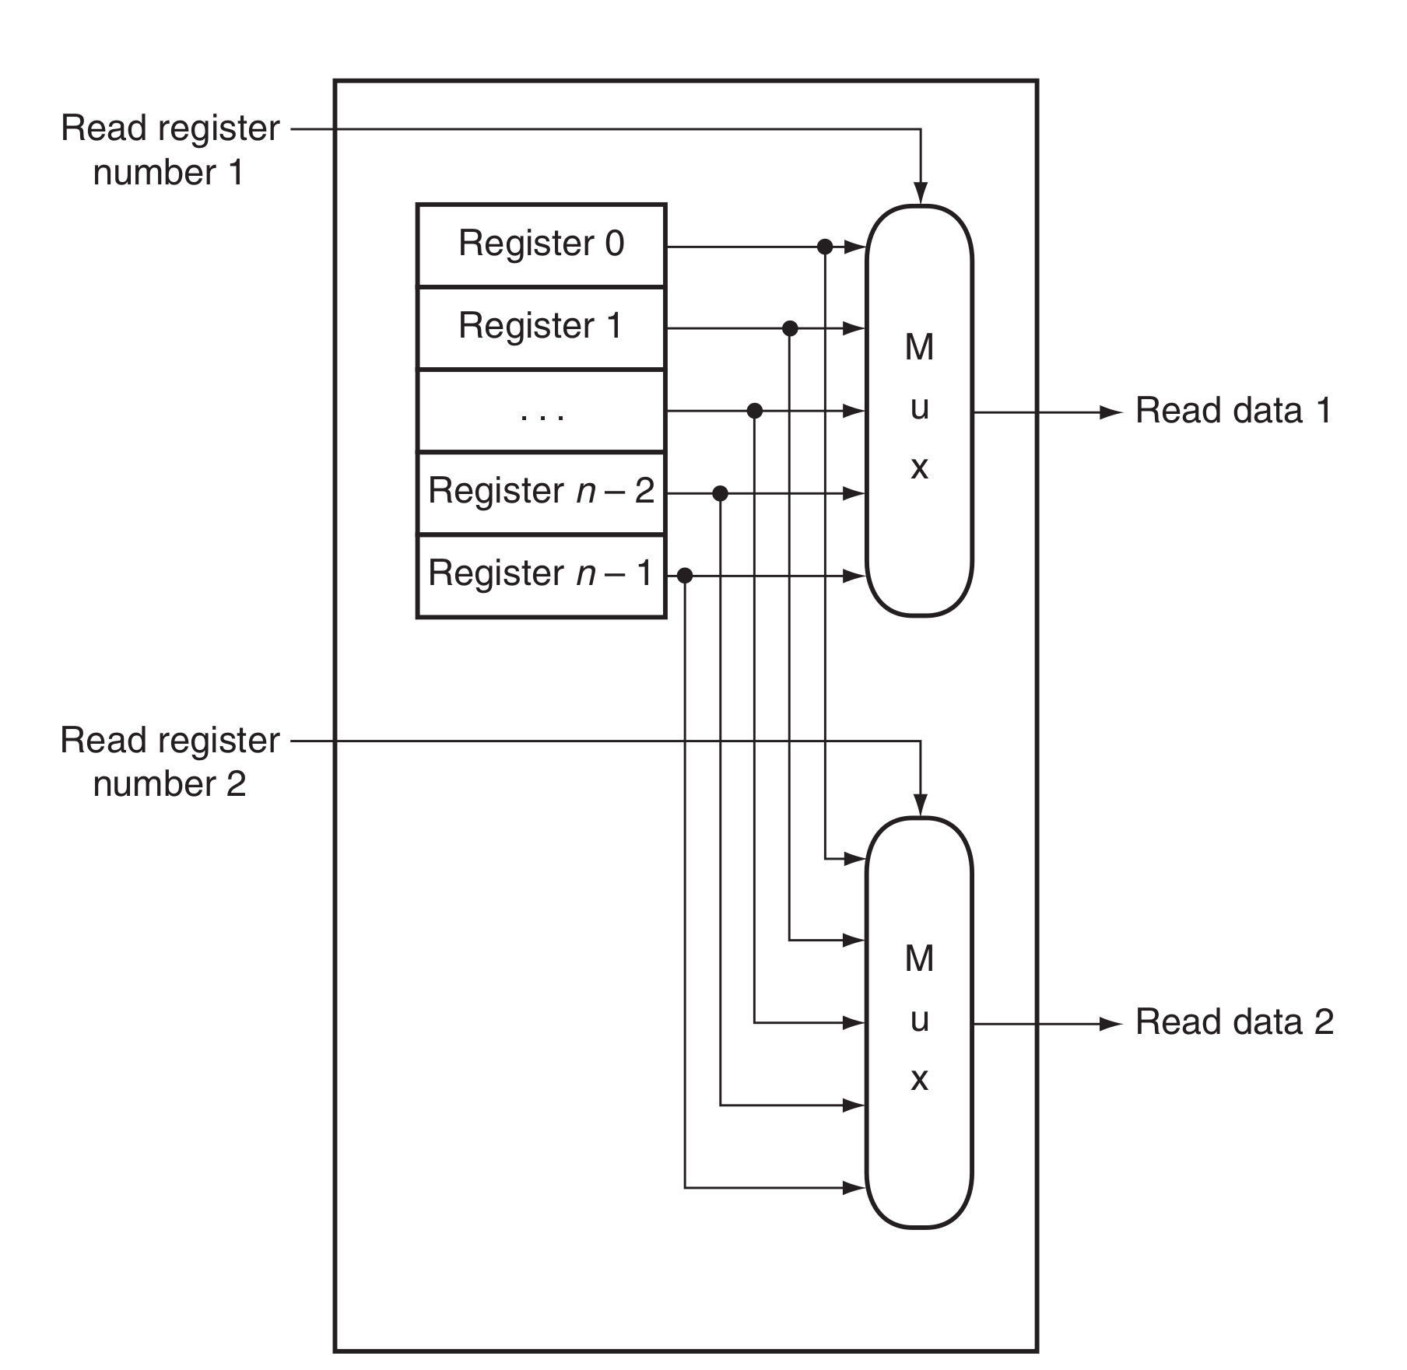
Register file (read ports)
Build from D-flops
Read ports
  Multiplexors
  N-to-1, 32bit wide

Slide 9
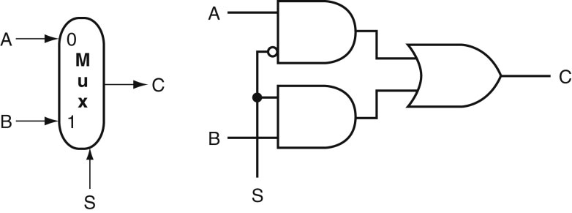
Common Logic Blocks – Multiplexor
Multiplexor or selector: one of N inputs is reflected on the
output depending on the value of the log₂N selector bits
2-input mux
Source: H&P textbook

Slide 10
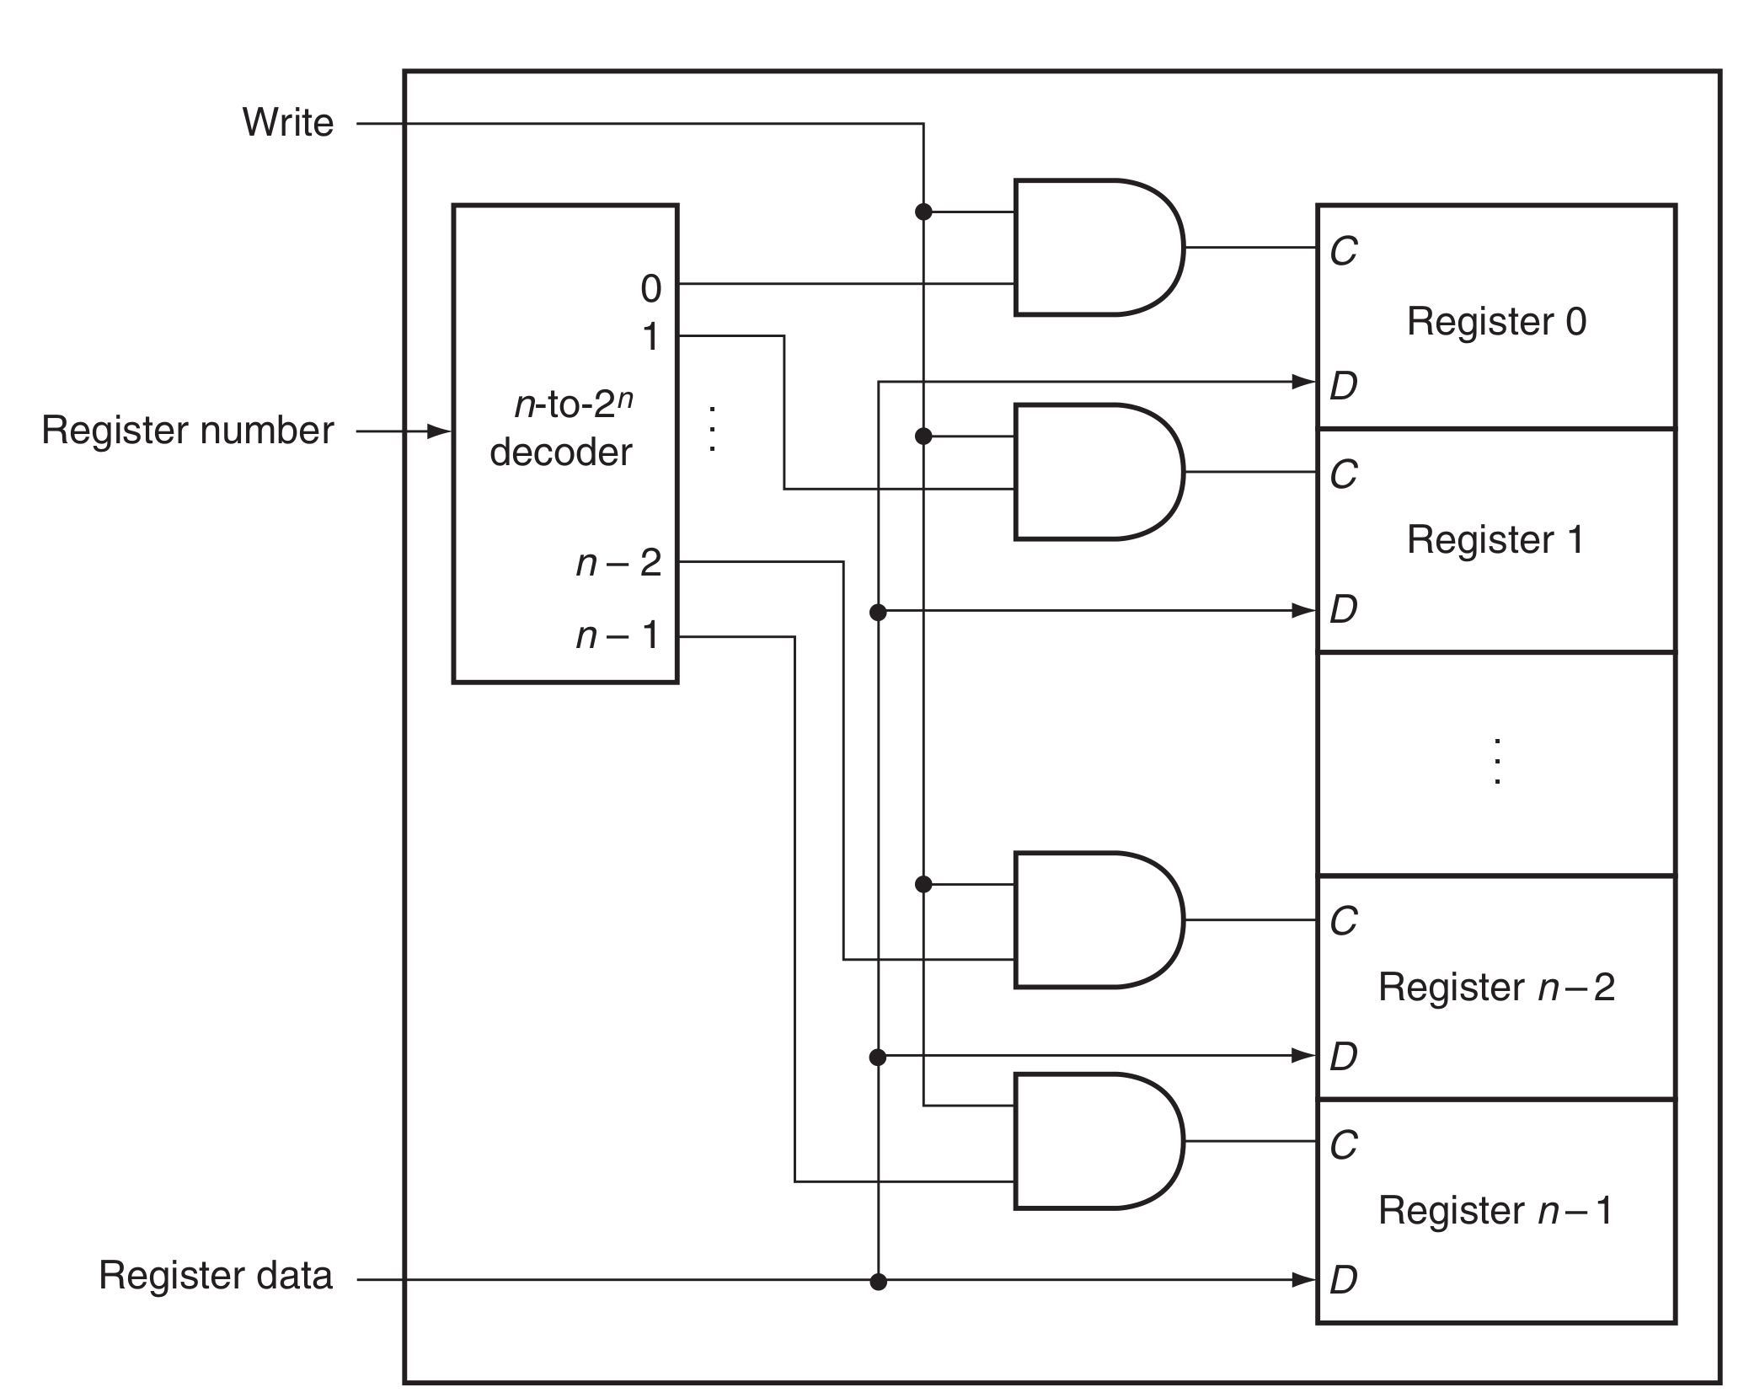
Register file (write ports)
Decoder

Slide 11
Common Logic Blocks – Decoder
Takes in N inputs and activates one of 2^{N} outputs
I₀ I₁ I₂ O₀ O₁ O₂ O₃ O₄ O₅ O₆ O₇
0 0 0 1 0 0 0 0 0 0 0
0 0 1 0 1 0 0 0 0 0 0
0 1 0 0 0 1 0 0 0 0 0
0 1 1 0 0 0 1 0 0 0 0
1 0 0 0 0 0 0 1 0 0 0
1 0 1 0 0 0 0 0 1 0 0
1 1 0 0 0 0 0 0 0 1 0
1 1 1 0 0 0 0 0 0 0 1
3-to-8
Decoder
I₀₋₂
O₀₋₇

Slide 12
Register file (write ports)
What if we read and write the register in the same cycle?
  add $s0, $s0, $s1

Slide 13
MIPS Datapath
Chapter 4 — The Processor — <number>
Notes:
Morgan Kaufmann Publishers
7 December 2022
Chapter 4 — The Processor

Slide 14
Pipelining

Slide 15
Building a Car
Time

Slide 16
Building a Car
Unpipelined
Start and finish a job before moving to the next
Jobs
Time

Slide 17
The Assembly Line
Pipelined
Break the job into smaller stages
A
B
C
A
B
C
A
B
C
Jobs
A
B
C
Time

Slide 18
Performance Improvements?
Does it take longer to finish each individual job?
Does it take shorter to finish a series of jobs?
What assumptions were made while answering these questions?
Is a 10-stage pipeline better than a 5-stage pipeline?

Slide 19
Quantitative Effects
As a result of pipelining:
  Time in ns per instruction goes up
  Each instruction takes more cycles to execute
  But… average CPI remains roughly the same
  Clock speed goes up
  Total execution time goes down, resulting in lower average time per instruction
  Under ideal conditions, speedup
    = ratio of elapsed times between successive instruction completions
    = number of pipeline stages = increase in clock speed

Slide 20
Clocks and Latches
Stage 1
Stage 2

Slide 21
Clocks and Latches
Stage 1
L
Stage 2
L
Clk

Slide 22
Some Equations
Unpipelined: time to execute one instruction = T + Tovh
For an N-stage pipeline, time per stage = T/N + Tovh
Total time per instruction = N (T/N + Tovh) = T + N Tovh
Clock cycle time = T/N + Tovh
Clock speed = 1 / (T/N + Tovh)
Ideal speedup = (T + Tovh) / (T/N + Tovh)
Cycles to complete one instruction = N
Average CPI (cycles per instr) = 1

Slide 23
Hazards

Slide 24
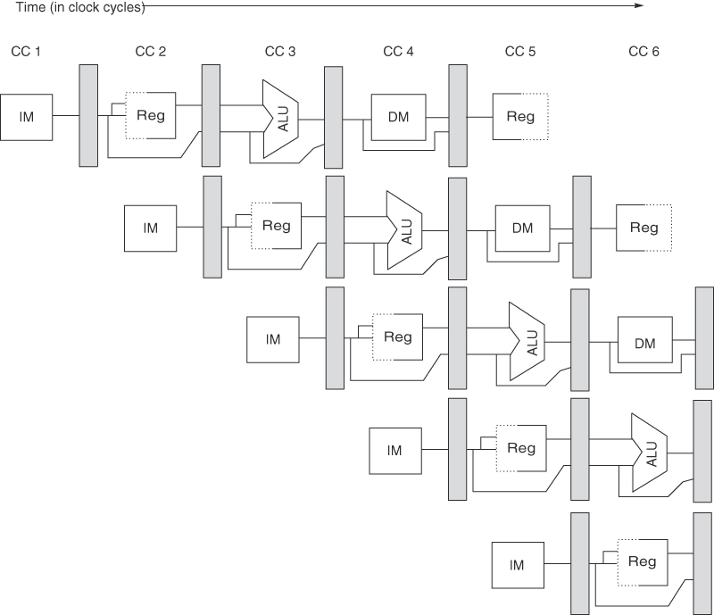
A 5-Stage Pipeline
Source: H&P textbook

Slide 25
Hazards
Structural hazards: different instructions in different stages
(or the same stage) conflicting for the same resource
Data hazards: an instruction cannot continue because it
needs a value that has not yet been generated by an
earlier instruction
Control hazard: fetch cannot continue because it does
not know the outcome of an earlier branch – special case
of a data hazard – separate category because they are
treated in different ways

Slide 26
Structural hazards

Slide 27
A 5-Stage Pipeline
Source: H&P textbook

Slide 28
Structural Hazards
Example: a unified instruction and data cache →
stage 4 (MEM) and stage 1 (IF) can never coincide
The later instruction and all its successors are delayed
until a cycle is found when the resource is free → these
are pipeline bubbles
Structural hazards are easy to eliminate – increase the
number of resources (for example, implement a separate
instruction and data cache)

Slide 29
Data hazards

Slide 30
A 5-Stage Pipeline
Source: H&P textbook

Slide 31
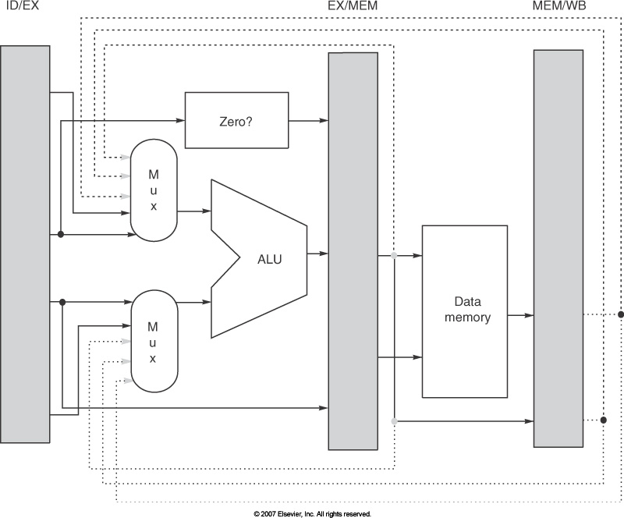
Pipeline Implementation
Signals for the muxes have to be generated – some of this can happen during ID
Need look-up tables to identify situations that merit bypassing/stalling – the
number of inputs to the muxes goes up

Slide 32
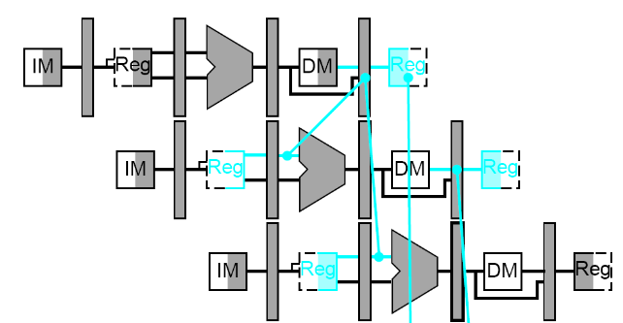
Example
add R1, R2, R3
lw R4, 8(R1)
Source: H&P textbook

Slide 33
Example
lw R1, 8(R2)
lw R4, 8(R1)
Source: H&P textbook

Slide 34
Example
lw R1, 8(R2)
sw R1, 8(R3)
Source: H&P textbook

Slide 35
Summary
For the 5-stage pipeline, bypassing can eliminate delays
between the following example pairs of instructions:
add/sub R1, R2, R3
add/sub/lw/sw R4, R1, R5
lw R1, 8(R2)
sw R1, 4(R3)
The following pairs of instructions will have intermediate
stalls:
lw R1, 8(R2)
add/sub/lw R3, R1, R4 or sw R3, 8(R1)
fmul F1, F2, F3
fadd F5, F1, F4

Slide 36
Control hazards

Slide 37
Hazards
Structural hazards
Data hazards
Control hazards

Slide 38
Control Hazards
Simple techniques to handle control hazard stalls:
  for every branch, introduce a stall cycle (note: every
  6th instruction is a branch on average!)
  assume the branch is not taken and start fetching the
  next instruction – if the branch is taken, need hardware
  to cancel the effect of the wrong-path instructions
  predict the next PC and fetch that instr – if the prediction
  is wrong, cancel the effect of the wrong-path instructions
  fetch the next instruction (branch delay slot) and
  execute it anyway – if the instruction turns out to be
  on the correct path, useful work was done – if the
  instruction turns out to be on the wrong path,
  hopefully program state is not lost

Slide 39
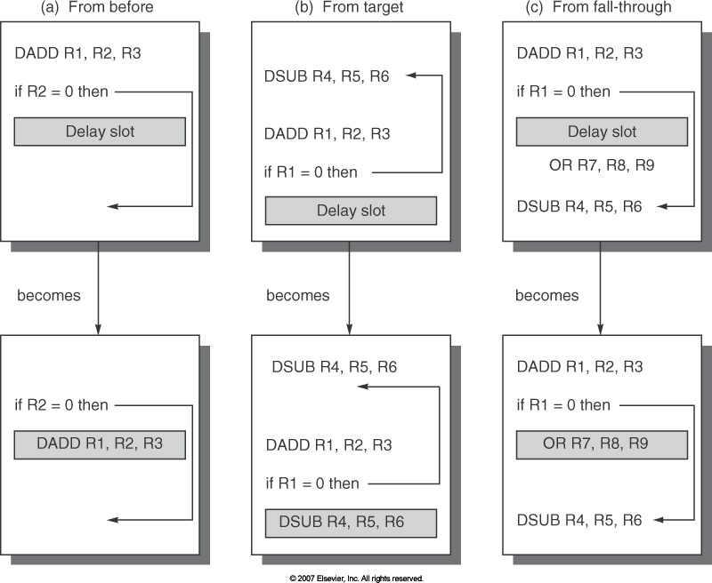
Branch delay slot

Slide 40
Branch prediction

Slide 41
Control Hazards
Simple techniques to handle control hazard stalls:
  for every branch, introduce a stall cycle (note: every
6th instruction is a branch!)
  assume the branch is not taken and start fetching the
next instruction – if the branch is taken, need hardware
to cancel the effect of the wrong-path instruction
  fetch the next instruction (branch delay slot) and
execute it anyway – if the instruction turns out to be
on the correct path, useful work was done – if the
instruction turns out to be on the wrong path,
hopefully program state is not lost
  make a smarter guess and fetch instructions from the
expected target

Slide 42
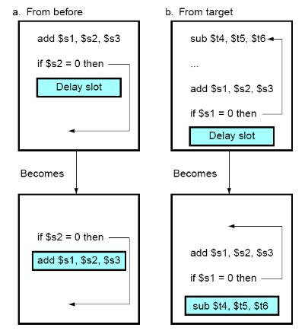
Branch Delay Slots
Source: H&P textbook

Slide 43
Pipeline without Branch Predictor
PC
IF (br)
Reg Read
Compare
Br-target
PC + 4
In the 5-stage pipeline, a branch completes in two cycles →
If the branch went the wrong way, one incorrect instr is fetched →
One stall cycle per incorrect branch

Slide 44
Pipeline with Branch Predictor
PC
IF (br)
Reg Read
Compare
Br-target
Branch
Predictor
In the 5-stage pipeline, a branch completes in two cycles →
If the branch went the wrong way, one incorrect instr is fetched →
One stall cycle per incorrect branch

Slide 45
1-Bit Bimodal Prediction
For each branch, keep track of what happened last time
and use that outcome as the prediction
What are prediction accuracies for branches 1 and 2 below:
while (1) {
for (i=0;i<10;i++) { branch-1
…
}
for (j=0;j<20;j++) { branch-2
…
}
}

Slide 46
2-Bit Bimodal Prediction
For each branch, maintain a 2-bit saturating counter:
if the branch is taken: counter = min(3,counter+1)
if the branch is not taken: counter = max(0,counter-1)
If (counter >= 2), predict taken, else predict not taken
Advantage: a few atypical branches will not influence the
prediction (a better measure of “the common case”)
Especially useful when multiple branches share the same
counter (some bits of the branch PC are used to index
into the branch predictor)
Can be easily extended to N-bits (in most processors, N=2)

Slide 47
Bimodal Predictor
Table of
16K entries
of 2-bit
saturating
counters
14 bits
Branch PC

Slide 48
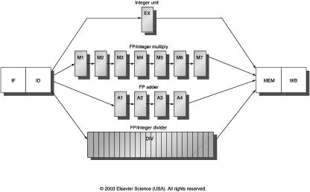
Multicycle Instructions
Multiple parallel pipelines – each pipeline can have a different
number of stages
Instructions can now complete out of order – must make sure
that writes to a register happen in the correct order

Slide 49
The Alpha 21264 Out-of-Order Implementation
Reorder Buffer (ROB)
Branch prediction
and instr fetch
Instr 1
Instr 2
Instr 3
Instr 4
Instr 5
Instr 6
Committed
Reg Map
R1→P1
R2→P2
Register File
P1-P64
R1 ← R1+R2
R2 ← R1+R3
BEQZ R2
R3 ← R1+R2
R1 ← R3+R2
Decode &
Rename
P33 ← P1+P2
P34 ← P33+P3
BEQZ P34
P35 ← P33+P34
P36 ← P35+P34
ALU
ALU
ALU
Speculative
Reg Map
R1→P36
R2→P34
Instr Fetch Queue
Results written to
regfile and tags
broadcast to IQ
Issue Queue (IQ)

Slide 50
Logical and physical registers

Slide 51
Managing Register Names
Temporary values are stored in the register file and not the ROB
Logical
Registers
R1-R32
Physical
Registers
P1-P64
At the start, R1-R32 can be found in P1-P32
Instructions stop entering the pipeline when P64 is assigned
R1 ← R1+R2
R2 ← R1+R3
BEQZ R2
R3 ← R1+R2
P33 ← P1+P2
P34 ← P33+P3
BEQZ P34
P35 ← P33+P34
What happens on commit?

Slide 52
The Commit Process
On commit, no copy is required
The register map table is updated – the “committed” value
of R1 is now in P33 and not P1 – on an exception, P33 is
copied to memory and not P1
An instruction in the issue queue need not modify its
input operand when the producer commits
When instruction-1 commits, we no longer have any use
for P1 – it is put in a free pool and a new instruction can
now enter the pipeline → for every instr that commits, a
new instr can enter the pipeline → number of in-flight
instrs is a constant = number of extra (rename) registers

Slide 53
Additional Details
When does the decode stage stall? When we either run
out of registers, or ROB entries, or issue queue entries
Issue width: the number of instructions handled by each
stage in a cycle. High issue width ➔ high peak ILP
Window size: the number of in-flight instructions in the
pipeline. Large window size ➔ high ILP
No more WAR and WAW hazards because of rename
registers – must only worry about RAW hazards

Slide 54
The Alpha 21264 Out-of-Order Implementation
Reorder Buffer (ROB)
Branch prediction
and instr fetch
Instr 1
Instr 2
Instr 3
Instr 4
Instr 5
Instr 6
Committed
Reg Map
R1→P1
R2→P2
Register File
P1-P64
R1 ← R1+R2
R2 ← R1+R3
BEQZ R2
R3 ← R1+R2
R1 ← R3+R2
Decode &
Rename
P33 ← P1+P2
P34 ← P33+P3
BEQZ P34
P35 ← P33+P34
P36 ← P35+P34
ALU
ALU
ALU
Speculative
Reg Map
R1→P36
R2→P34
Instr Fetch Queue
Results written to
regfile and tags
broadcast to IQ
Issue Queue (IQ)

Slide 55
Additional Details
When does the decode stage stall? When we either run
out of registers, or ROB entries, or issue queue entries
Issue width: the number of instructions handled by each
stage in a cycle. High issue width ➔ high peak ILP
Window size: the number of in-flight instructions in the
pipeline. Large window size ➔ high ILP
No more WAR and WAW hazards because of rename
registers – must only worry about RAW hazards

Slide 56
The Alpha 21264 Out-of-Order Implementation
Reorder Buffer (ROB)
Branch prediction
and instr fetch
Instr 1
Instr 2
Instr 3
Instr 4
Instr 5
Instr 6
Committed
Reg Map
R1→P1
R2→P2
Register File
P1-P64
R1 ← R1+R2
R2 ← R1+R3
BEQZ R2
R3 ← R1+R2
R1 ← R3+R2
Decode &
Rename
P33 ← P1+P2
P34 ← P33+P3
BEQZ P34
P35 ← P33+P34
P36 ← P35+P34
ALU
ALU
ALU
Speculative
Reg Map
R1→P36
R2→P34
Instr Fetch Queue
Results written to
regfile and tags
broadcast to IQ
Issue Queue (IQ)

Slide 57
Caches

Slide 58
Cache Hierarchies
Data and instructions are stored on DRAM chips – DRAM
is a technology that has high bit density, but relatively poor
latency – an access to data in memory can take as many
as 300 cycles today!
Hence, some data is stored on the processor in a structure
called the cache – caches employ SRAM technology, which
is faster, but has lower bit density
Internet browsers also cache web pages – same concept

Slide 59
Memory Hierarchy
As you go further, capacity and latency increase
Disk
1 TB
10M cycles
Memory
16GB
300 cycles
L2 cache
2MB
15 cycles
L1 data or
instruction
Cache
32KB
2 cycles
Registers
1KB
1 cycle

Slide 60
Locality
Why do caches work?
  Temporal locality: if you used some data recently, you
will likely use it again
  Spatial locality: if you used some data recently, you
will likely access its neighbors
No hierarchy: average access time for data = 300 cycles
32KB 1-cycle L1 cache that has a hit rate of 95%:
average access time = 0.95 x 1 + 0.05 x (301)
= 16 cycles

Slide 61
Accessing the Cache
Byte address
101000
Offset
8-byte words
8 words: 3 index bits
Direct-mapped cache:
each address maps to
a unique location in cache
Sets
Data array

Slide 62
The Tag Array
Byte address
101000
Tag
8-byte words
Compare
Direct-mapped cache:
each address maps to
a unique address
Tag array
Data array

Slide 63
Example Access Pattern
Byte address
Assume that addresses are 8 bits long
How many of the following address requests
are hits/misses?
4, 7, 10, 13, 16, 68, 73, 78, 83, 88, 4, 7, 10…
101000
Tag
8-byte words
Compare
Direct-mapped cache:
each address maps to
a unique address
Tag array
Data array

Slide 64
Increasing Line Size
Byte address
A large cache line size → smaller tag array,
fewer misses because of spatial locality
10100000
32-byte cache
line size or
block size
Tag
Offset
Tag array
Data array

Slide 65
Associativity
Byte address
Set associativity → fewer conflicts; wasted power
because multiple data and tags are read
10100000
Tag
Way-1
Way-2
Tag array
Data array
Compare

Slide 66
Associativity
How many offset/index/tag bits if the cache has
64 sets,
each set has 64 bytes,
4 ways
Byte address
10100000
Tag
Way-1
Way-2
Tag array
Data array
Compare

Slide 67
Memory and virtual memory

Slide 68
Paging

Slide 69

Pages

Slide 70

Pages

Slide 71
Paging idea
Break up memory into 4096-byte chunks called pages
  Modern hardware supports 2MB, 4MB, and 1GB pages
Independently control mapping for each page of linear address space
Compare with segmentation (single base + limit)
  many more degrees of freedom

Slide 72
How can we build this translation mechanism?

Slide 73
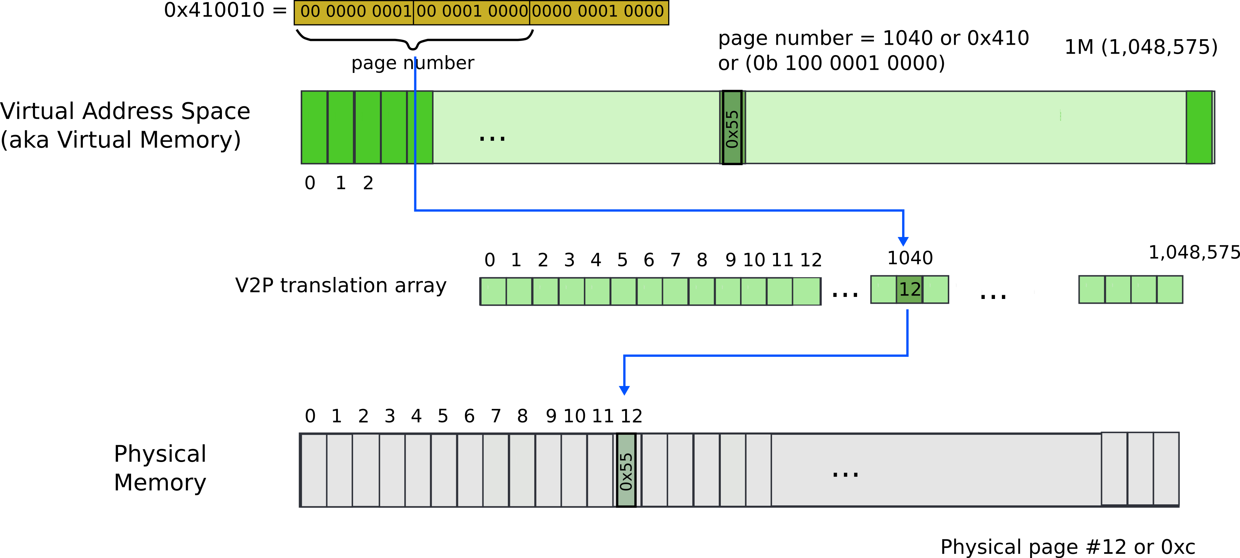
Paging: naive approach: translation array
Virtual address 0x410010

Slide 74
What is wrong?

Slide 75
What is wrong?
We need 4 bytes to relocate each page
  20 bits for physical page number
  12 bits of access flags
  Therefore, we need array of 4 bytes x 1M entries
    4MBs

Slide 76
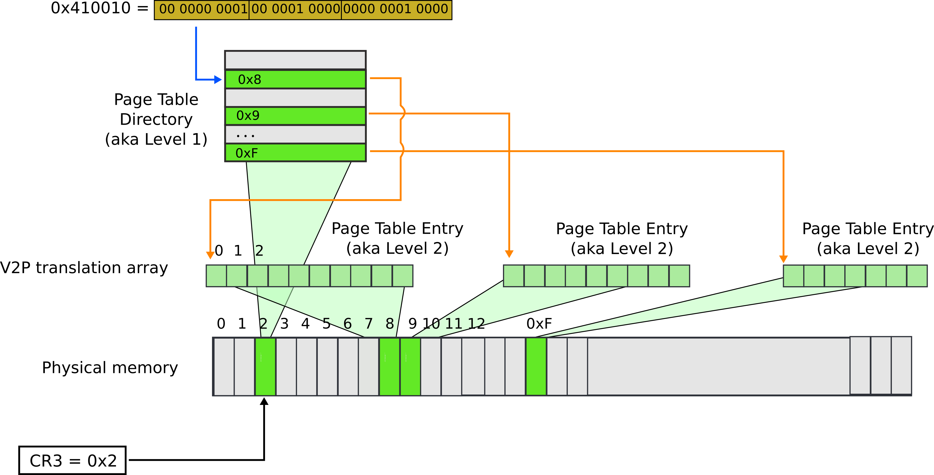
Paging: page table

Slide 77
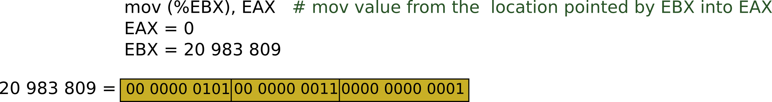






Slide 78



Slide 79





Slide 80




Slide 81



Slide 82
Result:
  EAX = 55

Slide 83
Cache-coherence

Slide 84
Snooping-Based Protocols
Three states for a block: invalid, shared, modified
A write is placed on the bus and sharers invalidate themselves
The protocols are referred to as MSI, MESI, etc.
Processor
Processor
Processor
Processor
Caches
Caches
Caches
Caches
Main Memory
I/O System

Slide 85
Example
P1 reads X: not found in cache-1, request sent on bus, memory responds,
X is placed in cache-1 in shared state
P2 reads X: not found in cache-2, request sent on bus, everyone snoops
this request, cache-1does nothing because this is just a read request,
memory responds, X is placed in cache-2 in shared state
P1
P2
P1 writes X: cache-1 has data in shared
state (shared only provides read perms),
request sent on bus, cache-2 snoops and
then invalidates its copy of X, cache-1
moves its state to modified
P2 reads X: cache-2 has data in invalid
state, request sent on bus, cache-1 snoops
and realizes it has the only valid copy, so it
downgrades itself to shared state and
responds with data, X is placed in cache-2
in shared state, memory is also updated
Cache-1
Cache-2
Main Memory

Slide 86
Example
Request | Cache Hit/Miss | Request on the bus | Who responds | State in Cache 1 | State in Cache 2 | State in Cache 3 | State in Cache 4
 |  |  |  | Inv | Inv | Inv | Inv
P1: Rd X | Miss | Rd X | Memory | S | Inv | Inv | Inv
P2: Rd X | Miss | Rd X | Memory | S | S | Inv | Inv
P2: Wr X | Perms Miss | Upgrade X | No response. Other caches invalidate. | Inv | M | Inv | Inv
P3: Wr X | Write Miss | Wr X | P2 responds | Inv | Inv | M | Inv
P3: Rd X | Read Hit | - | - | Inv | Inv | M | Inv
P4: Rd X | Read Miss | Rd X | P3 responds. Mem wrtbk | Inv | Inv | S | S

Slide 87
Before midterm

Slide 88
Simple program: String Copy
MIPS code:
strcpy:
addi $sp, $sp, -4 # adjust stack for 1 item
sw $s0, 0($sp) # save $s0
add $s0, $zero, $zero # i = 0
L1: add $t1, $s0, $a1 # addr of y[i] in $t1
lbu $t2, 0($t1) # $t2 = y[i]
add $t3, $s0, $a0 # addr of x[i] in $t3
sb $t2, 0($t3) # x[i] = y[i]
beq $t2, $zero, L2 # exit loop if y[i] == 0
addi $s0, $s0, 1 # i = i + 1
j L1 # next iteration of loop
L2: lw $s0, 0($sp) # restore saved $s0
addi $sp, $sp, 4 # pop 1 item from stack
jr $ra # and return
Notes:
The University of Adelaide, School of Computer Science
December 7, 2022
Chapter 2 — Instructions: Language of the Computer

Slide 89
Where is this program stored?
How does it get executed?

Slide 90
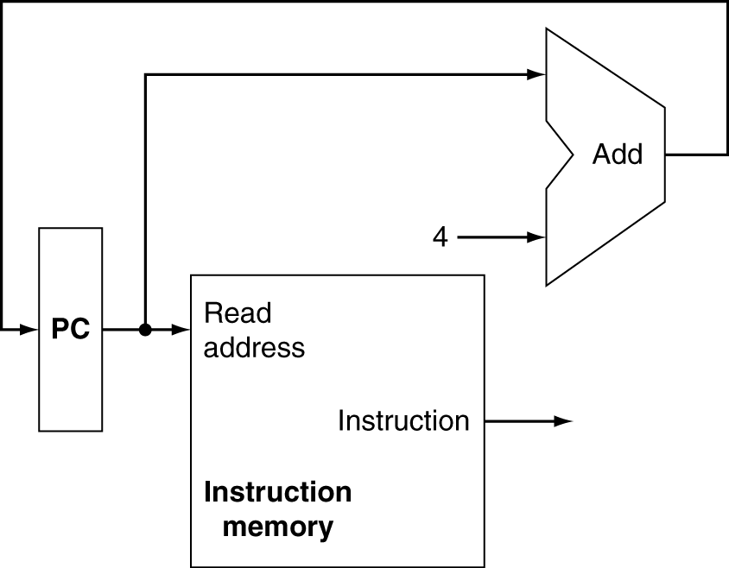
Instruction Fetch
Increment by 4 for next instruction
32-bit register
Chapter 4 — The Processor — <number>
Notes:
Morgan Kaufmann Publishers
7 December 2022
Chapter 4 — The Processor

Slide 91
Three types of instructions
R-Type
  Add, and, jr, nor, or, slt, sll, sub
I-Type
  addi, beq, bne, lw (and other loads), ori, slti, sw (and other stores)
J-Type
  j, jal

Slide 92
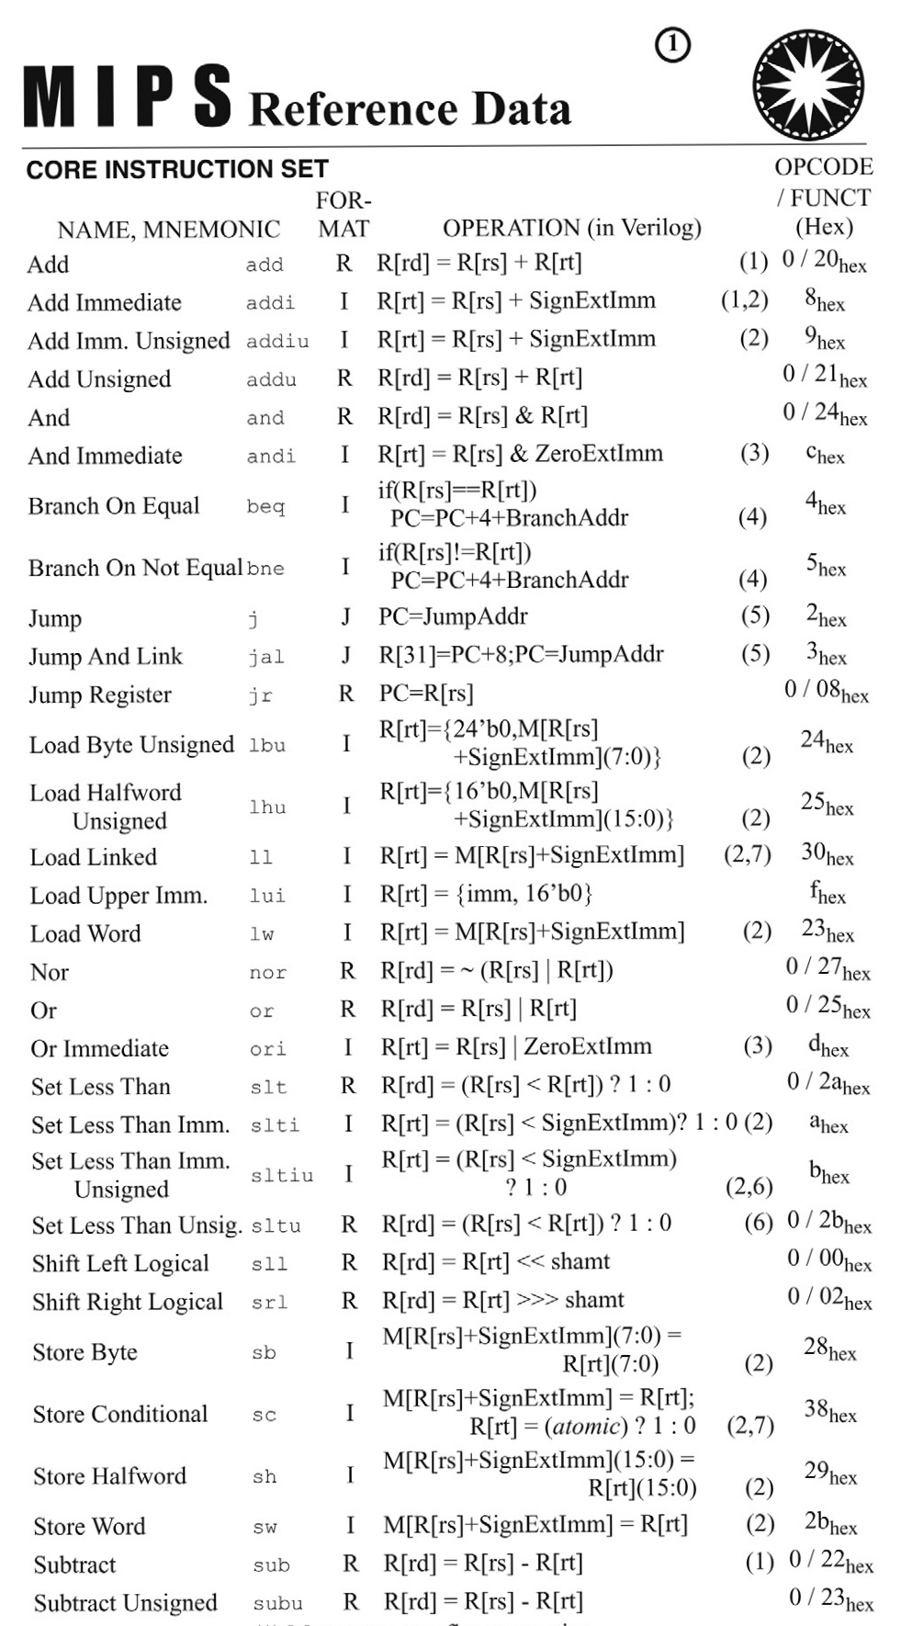
Fits on one page

Slide 93
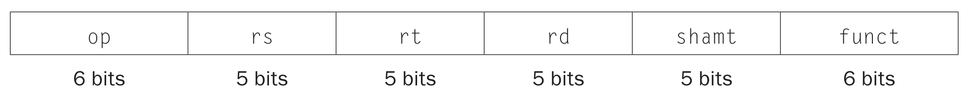
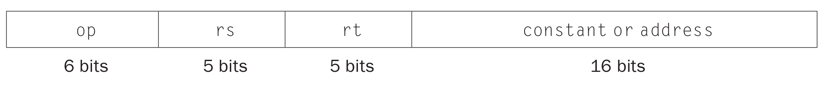
Three types of instructions
R-Type
I-Type
J-Type
op
rs
rt
constant or address
6 bits
5 bits
5 bits
16 bits

Slide 94
Datapath With Control
Chapter 4 — The Processor — <number>
Notes:
Morgan Kaufmann Publishers
7 December 2022
Chapter 4 — The Processor

Slide 95
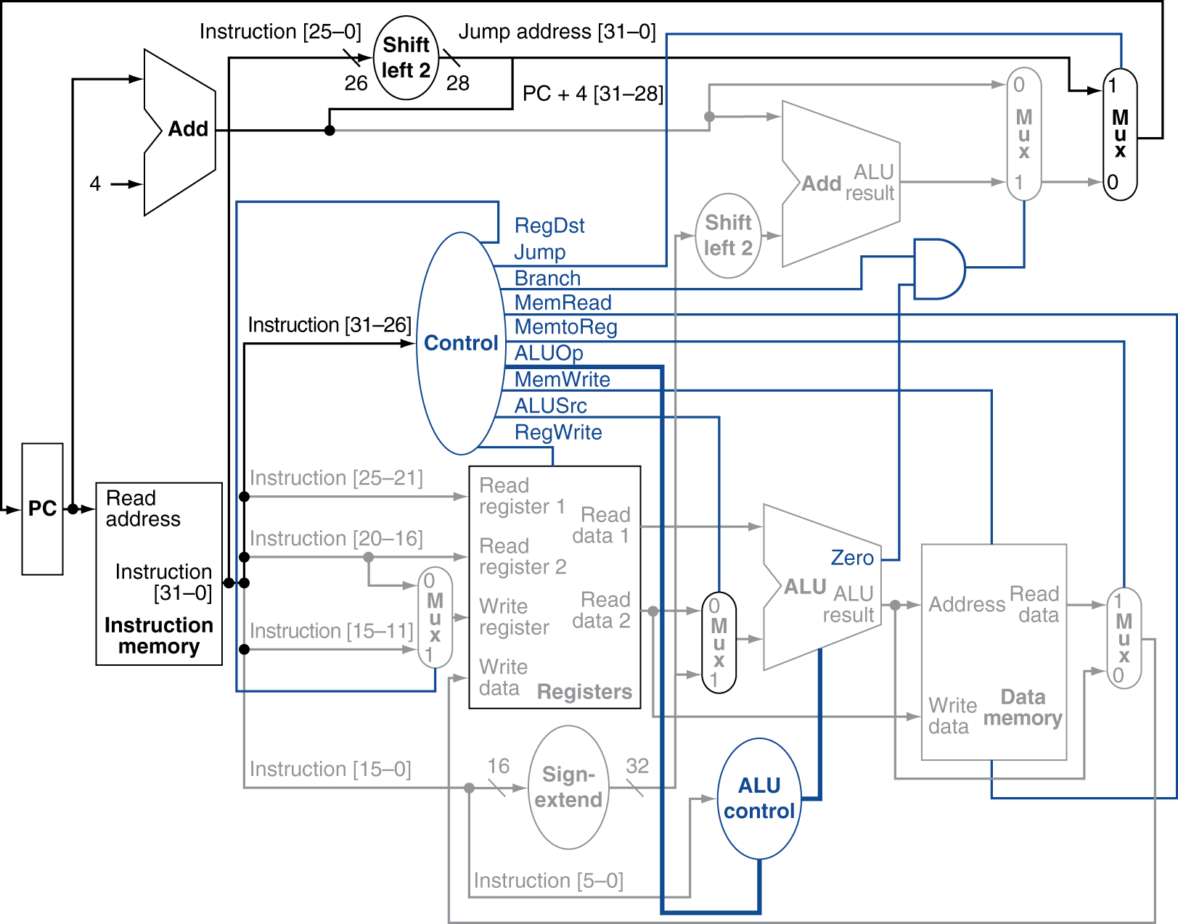
Datapath With Jumps Added
Chapter 4 — The Processor — <number>
Notes:
Morgan Kaufmann Publishers
7 December 2022
Chapter 4 — The Processor

Slide 96
How do we get from high-level languages to MIPS instructions?

Slide 97
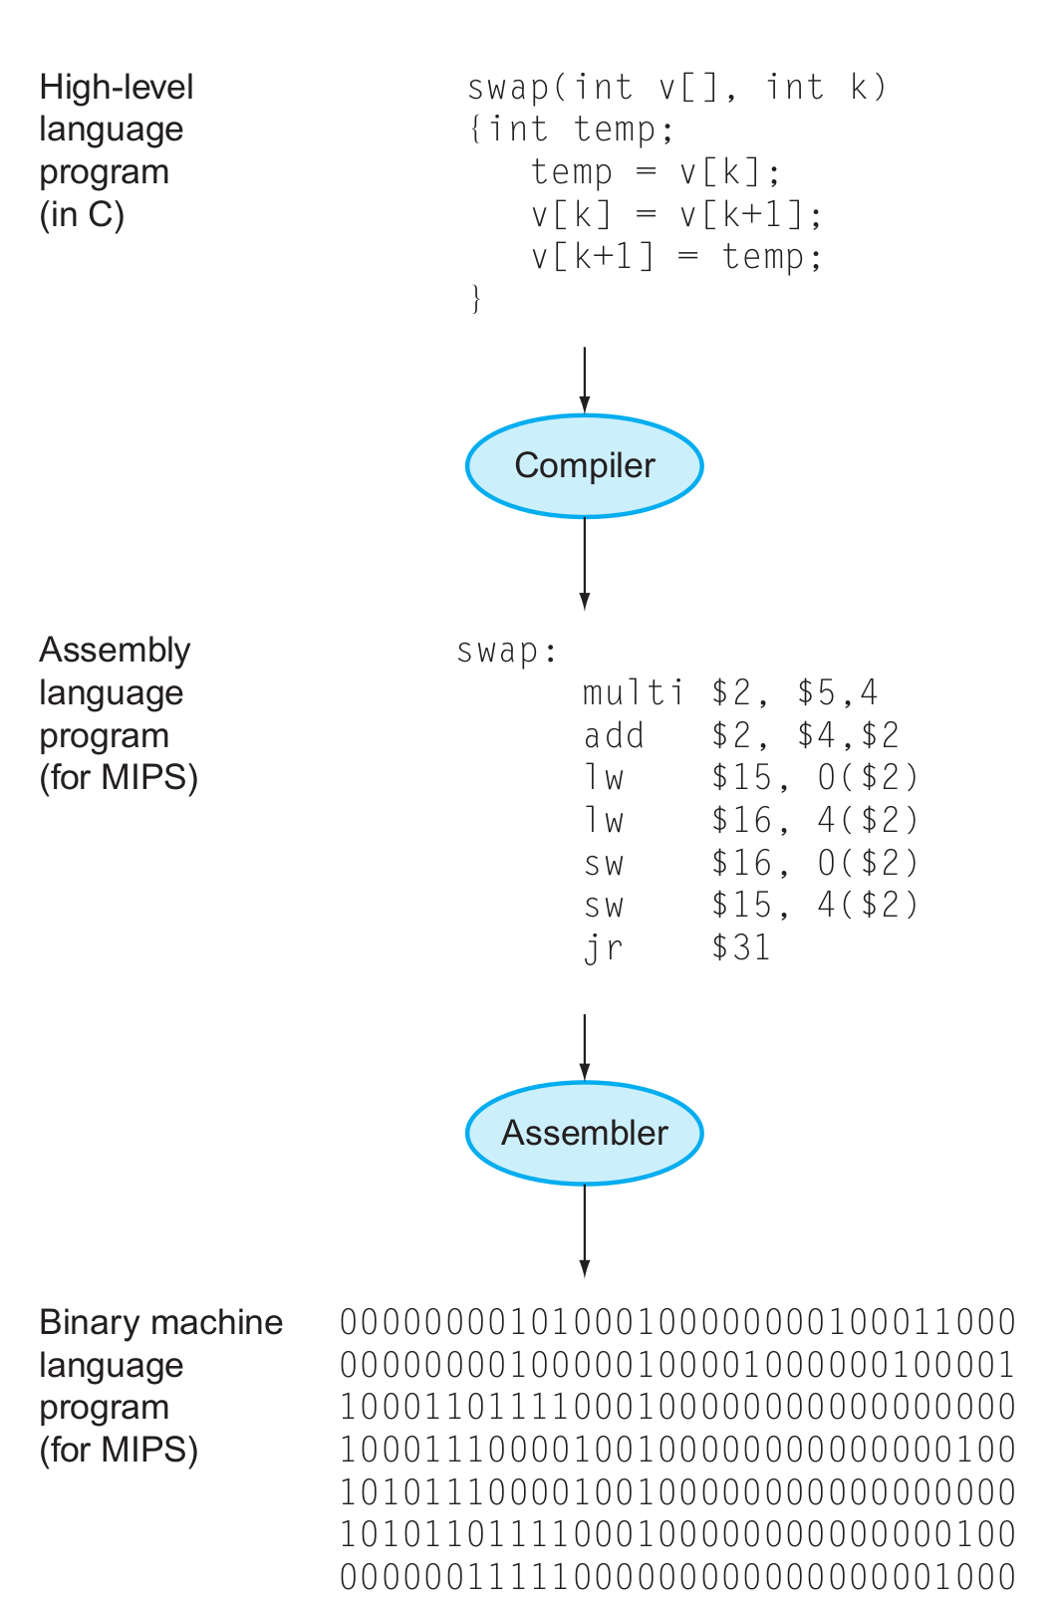
The HW/SW Interface
Application software
Systems software
(OS, compiler)
Hardware

Slide 98
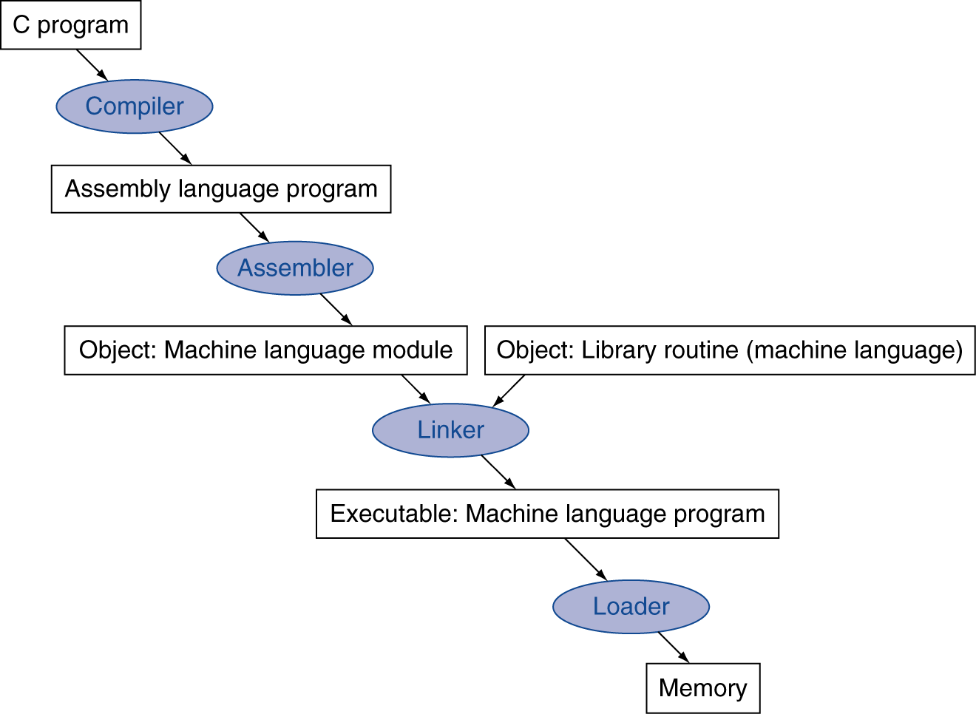
Translation and Startup
Many compilers produce object modules directly
§2.12 Translating and Starting a Program
Static linking
Chapter 2 — Instructions: Language of the Computer — <number>
Notes:
The University of Adelaide, School of Computer Science
December 7, 2022
Chapter 2 — Instructions: Language of the Computer

Slide 99
If then .. else …
if (i == j) f = g + h; else f = g – h;
Assume that f,g, h, i, and j are in $s0, $s1, etc.

Slide 100
If then .. else …
if (i == j) f = g + h; else f = g – h;
Assume that f,g, h, i, and j are in $s0, $s1, etc.
bne $s3,$s4,Else # go to Else if i ≠ j
add $s0,$s1,$s2 # f = g + h (skipped if i ≠ j)
j Exit # unconditional jump to Exit
Else:
sub $s0,$s1,$s2 # f = g – h (skipped if i = j)
Exit:

Slide 101
Loops
while (save[i] == k)
i += 1;
Assume that i and k are in $s3 and $s5

Slide 102
Loops
while (save[i] == k)
i += 1;
Assume that i and k are in $s3 and $s5
Loop: sll $t1,$s3,2
add $t1,$t1,$s6 # $t1 = address of save[i]
lw $t0,0($t1) # Temp reg $t0 = save[i]
bne $t0,$s5, Exit # go to Exit if save[i] ≠ k
addi $s3,$s3,1 # i = i + 1
j Loop # go to Loop
Exit:

Slide 103
Procedures

Slide 104
Calling functions
// some code...
foo();
// more code..
$ra contains information for how to return from a subroutine
  i.e., from foo()
Functions can be called from different places in the program
if (a == 0) {
foo();
…
} else {
foo();
…
}

Slide 105
Procedure Call Instructions
Procedure call: jump and link
jal ProcedureLabel
  Address of following instruction put in $ra
  Jumps to target address
Procedure return: jump register
jr $ra
  Copies $ra to program counter
  Can also be used for computed jumps
    e.g., for case/switch statements
Chapter 2 — Instructions: Language of the Computer — <number>
Notes:
The University of Adelaide, School of Computer Science
December 7, 2022
Chapter 2 — Instructions: Language of the Computer

Slide 106
Calling conventions
Goal: re-entrant programs
  How to pass arguments
    On the stack?
    In registers?
  How to return values
    On the stack?
    In registers?
  What registers have to be preserved
    All? Some subset?
Conventions differ from compiler, optimizations, etc.

Slide 107
Passing arguments
First 4 arguments in registers
  $a0 - $a3
Other arguments on the stack
Return values in registers
  $v0 - $v1

Slide 108
Preserving registers
$t0 – $t9: temporaries
  Can be overwritten by callee
$s0 – $s7: saved
  Must be saved/restored by callee

Slide 109
Leaf Procedure Example
C code:
int leaf_example (int g, h, i, j)
{ int f;
f = (g + h) - (i + j);
return f;
}
  Arguments g, …, j in $a0, …, $a3
  f in $s0 (hence, need to save $s0 on stack)
  Result in $v0
Chapter 2 — Instructions: Language of the Computer — <number>
Notes:
The University of Adelaide, School of Computer Science
December 7, 2022
Chapter 2 — Instructions: Language of the Computer

Slide 110
Leaf Procedure Example
MIPS code:
leaf_example:
addi $sp, $sp, -4
sw $s0, 0($sp)
add $t0, $a0, $a1
add $t1, $a2, $a3
sub $s0, $t0, $t1
add $v0, $s0, $zero
lw $s0, 0($sp)
addi $sp, $sp, 4
jr $ra
Save $s0 on stack
Procedure body
Result
Restore $s0
Return
Chapter 2 — Instructions: Language of the Computer — <number>
Notes:
The University of Adelaide, School of Computer Science
December 7, 2022
Chapter 2 — Instructions: Language of the Computer

Slide 111
Recursive invocations
foo(int a) {
if (a == 0)
return;
a--;
foo(a);
return;
}
foo(4);

Slide 112
Non-Leaf Procedures
Procedures that call other procedures
For nested call, caller needs to save on the stack:
  Its return address
  Any arguments and temporaries needed after the call
Restore from the stack after the call
Chapter 2 — Instructions: Language of the Computer — <number>
Notes:
The University of Adelaide, School of Computer Science
December 7, 2022
Chapter 2 — Instructions: Language of the Computer

Slide 113
Non-Leaf Procedure Example
C code:
int fact (int n)
{
if (n < 1) return f;
else return n * fact(n - 1);
}
  Argument n in $a0
  Result in $v0
Chapter 2 — Instructions: Language of the Computer — <number>
Notes:
The University of Adelaide, School of Computer Science
December 7, 2022
Chapter 2 — Instructions: Language of the Computer

Slide 114
Non-Leaf Procedure Example
MIPS code:
fact:
addi $sp, $sp, -8 # adjust stack for 2 items
sw $ra, 4($sp) # save return address
sw $a0, 0($sp) # save argument
slti $t0, $a0, 1 # test for n < 1
beq $t0, $zero, L1
addi $v0, $zero, 1 # if so, result is 1
addi $sp, $sp, 8 # pop 2 items from stack
jr $ra # and return
L1: addi $a0, $a0, -1 # else decrement n
jal fact # recursive call
lw $a0, 0($sp) # restore original n
lw $ra, 4($sp) # and return address
addi $sp, $sp, 8 # pop 2 items from stack
mul $v0, $a0, $v0 # multiply to get result
jr $ra # and return
Notes:
The University of Adelaide, School of Computer Science
December 7, 2022
Chapter 2 — Instructions: Language of the Computer

Slide 115
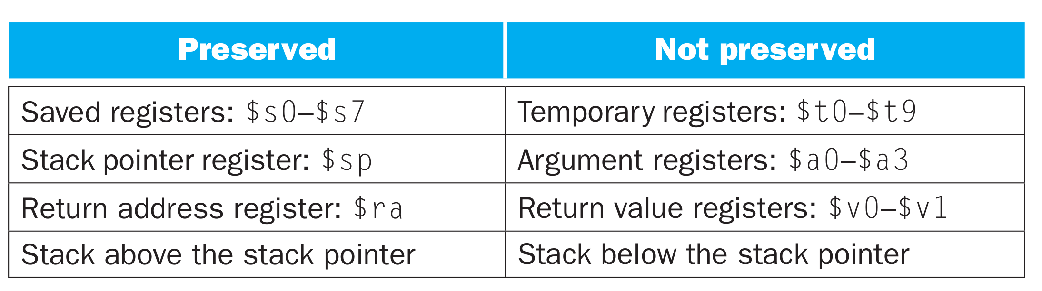
Calling convention (again)

Slide 116
Translation and Startup
Many compilers produce object modules directly
§2.12 Translating and Starting a Program
Static linking
Chapter 2 — Instructions: Language of the Computer — <number>
Notes:
The University of Adelaide, School of Computer Science
December 7, 2022
Chapter 2 — Instructions: Language of the Computer

Slide 117
Translation and Startup
Many compilers produce object modules directly
§2.12 Translating and Starting a Program
Static linking
Chapter 2 — Instructions: Language of the Computer — <number>
Notes:
The University of Adelaide, School of Computer Science
December 7, 2022
Chapter 2 — Instructions: Language of the Computer

Slide 118
Translation and Startup
Many compilers produce object modules directly
§2.12 Translating and Starting a Program
Static linking
Chapter 2 — Instructions: Language of the Computer — <number>
Notes:
The University of Adelaide, School of Computer Science
December 7, 2022
Chapter 2 — Instructions: Language of the Computer

Slide 119
Translation and Startup
Many compilers produce object modules directly
§2.12 Translating and Starting a Program
Static linking
Chapter 2 — Instructions: Language of the Computer — <number>
Notes:
The University of Adelaide, School of Computer Science
December 7, 2022
Chapter 2 — Instructions: Language of the Computer

Slide 120


Slide 121
Relocation
(What needs to be done to move the program in memory?)

Slide 122
What types of variables do you know?
Or where these variables are allocated in memory?

Slide 123
What types of variables do you know?
Global variables
  Initialized → data section
  Uninitalized → BSS
Dynamic variables
  Heap
Local variables
  Stack

Slide 124
Global variables
#include <stdio.h>
char hello[] = "Hello";
int main(int ac, char **av)
{
static char world[] = "world!";
printf("%s %s\n", hello, world);
return 0;
}

Slide 125
Global variables
#include <stdio.h>
char hello[] = "Hello";
int main(int ac, char **av)
{
static char world[] = "world!";
printf("%s %s\n", hello, world);
return 0;
}
Allocated in the data section
  It is split in initialized (non-zero), and non-initialized (zero)
  As well as read/write, and read only data section

Slide 126
Global variables

Slide 127
Dynamic variables (heap)
#include <stdio.h>
#include <string.h>
#include <stdlib.h>
char hello[] = "Hello";
int main(int ac, char **av)
{
char world[] = "world!";
char *str = malloc(64);
memcpy(str, "beautiful", 64);
printf("%s %s %s\n", hello, str, world);
return 0;
}

Slide 128
Dynamic variables (heap)
#include <stdio.h>
#include <string.h>
#include <stdlib.h>
char hello[] = "Hello";
int main(int ac, char **av)
{
char world[] = "world!";
char *str = malloc(64);
memcpy(str, "beautiful", 64);
printf("%s %s %s\n", hello, str, world);
return 0;
}
Allocated on the heap
  Special area of memory provided by the OS from where malloc() can allocate memory

Slide 129
Local variables
Local variables
#include <stdio.h>
char hello[] = "Hello";
int main(int ac, char **av)
{
//static char world[] = "world!";
char world[] = "world!";
printf("%s %s\n", hello, world);
return 0;
}

Slide 130
1 # "Hello World" in MIPS assembly
2 # From: http://labs.cs.upt.ro/labs/so2/html/resources/nachos-doc/mipsf.html
3
4 # All program code is placed after the
5 # .text assembler directive
6 .text
7
8 # Declare main as a global function
9 .globl main
10
11 # The label 'main' represents the starting point
12 main:
13 # Run the print_string syscall which has code 4
14 li $v0,4 # Code for syscall: print_string
15 la $a0, msg # Pointer to string (load the address of msg)
16 syscall
17 li $v0,10 # Code for syscall: exit
18 syscall
19
20 # All memory structures are placed after the
21 # .data assembler directive
22 .data
23
24 # The .asciiz assembler directive creates
25 # an ASCII string in memory terminated by
26 # the null character. Note that strings are
27 # surrounded by double-quotes
28 msg: .asciiz "Hello World!\n"

Slide 131
What needs to be relocated?
User Text Segment [00400000]..[00440000]
[00400000] 8fa40000 lw $4, 0($29) ; 183: lw $a0 0($sp) # argc
[00400004] 27a50004 addiu $5, $29, 4 ; 184: addiu $a1 $sp 4 # argv
[00400008] 24a60004 addiu $6, $5, 4 ; 185: addiu $a2 $a1 4 # envp
[0040000c] 00041080 sll $2, $4, 2 ; 186: sll $v0 $a0 2
[00400010] 00c23021 addu $6, $6, $2 ; 187: addu $a2 $a2 $v0
[00400014] 0c100009 jal 0x00400024 [main] ; 188: jal main
[00400018] 00000000 nop ; 189: nop
[0040001c] 3402000a ori $2, $0, 10 ; 191: li $v0 10
[00400020] 0000000c syscall ; 192: syscall # syscall 10 (exit)
[00400024] 34020004 ori $2, $0, 4 ; 14: li $v0,4 # Code for syscall:
; print_string
[00400028] 3c011001 lui $1, 4097 [msg] ; 15: la $a0, msg # Pointer to string ; (load the address of msg)
[0040002c] 34240000 ori $4, $1, 0 [msg]
[00400030] 0000000c syscall ; 16: syscall
[00400034] 3402000a ori $2, $0, 10 ; 17: li $v0,10 # Code for syscall: ; exit
[00400038] 0000000c syscall ; 18: syscall

Slide 132
What needs to be relocated?
User Text Segment [00400000]..[00440000]
[00400000] 8fa40000 lw $4, 0($29) ; 183: lw $a0 0($sp) # argc
[00400004] 27a50004 addiu $5, $29, 4 ; 184: addiu $a1 $sp 4 # argv
[00400008] 24a60004 addiu $6, $5, 4 ; 185: addiu $a2 $a1 4 # envp
[0040000c] 00041080 sll $2, $4, 2 ; 186: sll $v0 $a0 2
[00400010] 00c23021 addu $6, $6, $2 ; 187: addu $a2 $a2 $v0
[00400014] 0c100009 jal 0x00400024 [main] ; 188: jal main
[00400018] 00000000 nop ; 189: nop
[0040001c] 3402000a ori $2, $0, 10 ; 191: li $v0 10
[00400020] 0000000c syscall ; 192: syscall # syscall 10 (exit)
[00400024] 34020004 ori $2, $0, 4 ; 14: li $v0,4 # Code for syscall:
; print_string
[00400028] 3c011001 lui $1, 4097 [msg] ; 15: la $a0, msg # Pointer to string ; (load the address of msg)
[0040002c] 34240000 ori $4, $1, 0 [msg]
[00400030] 0000000c syscall ; 16: syscall
[00400034] 3402000a ori $2, $0, 10 ; 17: li $v0,10 # Code for syscall: ; exit
[00400038] 0000000c syscall ; 18: syscall

Slide 133
Translation and Startup
Many compilers produce object modules directly
§2.12 Translating and Starting a Program
Static linking
Chapter 2 — Instructions: Language of the Computer — <number>
Notes:
The University of Adelaide, School of Computer Science
December 7, 2022
Chapter 2 — Instructions: Language of the Computer

Slide 134

Memory layout of a process

Slide 135
Where do these areas come from?

Slide 136
Memory layout of a process
OS kernel
Compiler and linker

Slide 137

Load program in memory

Slide 138
Translation and Startup
Many compilers produce object modules directly
§2.12 Translating and Starting a Program
Static linking
Chapter 2 — Instructions: Language of the Computer — <number>
Notes:
The University of Adelaide, School of Computer Science
December 7, 2022
Chapter 2 — Instructions: Language of the Computer

Slide 139
Thank you!

