Slide 1
143A: Principles of Operating Systems
Lecture 5: Address translation
Anton Burtsev
October, 2017

Slide 2

Two programs one memory

Slide 3
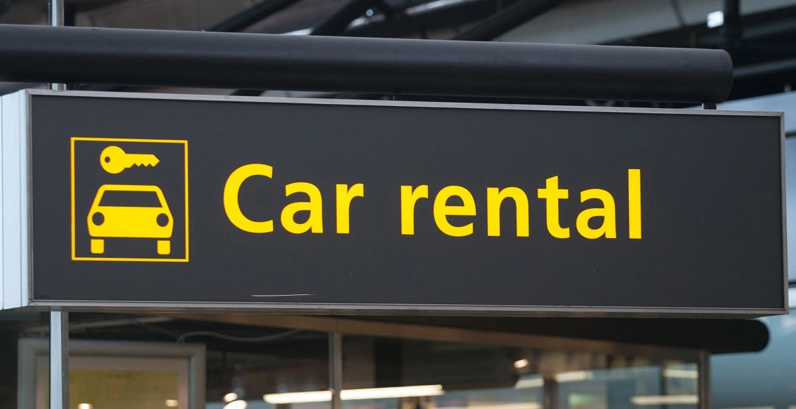
Very much like car sharing

Slide 4
What are we aiming for?
Illusion of a private address space
  Identical copy of an address space in multiple programs
    Remember fork()?
  Simplifies software architecture
    One program is not restricted by the memory layout of the others

Slide 5

Two processes, one memory?

Slide 6

Two processes, one memory?

Slide 7
This is called segmentation

Slide 8

All addresses are logical address
They consist of two parts
  Segment selector (16 bit) + offset (32 bi

Slide 9
Segment selector (16 bit)
  Is simply an index into an array (Descriptor Table)
  That holds segment descriptors
    Base and limit (size) for each segment

Slide 10

Elements of that array are segment descriptors
Base address
  0 – 4 GB
Limit (size)
  0 – 4 GB
Access rights
  Executable, readable, writable
  Privilege level (0 - 3)

Slide 11

Segment descriptors

Slide 12
Offsets into segments (x in our example) or “Effective addresses” are in registers

Slide 13
Logical addresses are translated into physical
  Effective address + DescriptorTable[selector].Base

Slide 14
Logical addresses are translated into physical
  Effective address + DescriptorTable[selector].Base

Slide 15
Logical addresses are translated into physical
  Effective address + DescriptorTable[selector].Base

Slide 16
Logical addresses are translated into physical
  Effective address + DescriptorTable[selector].Base

Slide 17
Same picture

Slide 18
Offsets (effective addresses) are in registers
  Effective address + DescriptorTable[selector].Base
  But where is the selector?

Slide 19
Right! Segment registers
Hold 16 bit segment selectors
  Pointers into a special table
  Global or local descriptor table
Segments are associated with one of three types of storage
  Code
  Data
  Stack

Slide 20
Programming model
Segments for: code, data, stack, “extra”
  A program can have up to 6 total segments
  Segments identified by registers: cs, ds, ss, es, fs, gs
Prefix all memory accesses with desired segment:
  mov eax, ds:0x80 (load offset 0x80 from data into eax)
  jmp cs:0xab8 (jump execution to code offset 0xab8)
  mov ss:0x40, ecx (move ecx to stack offset 0x40)

Slide 21
Segmented programming (not real)
static int x = 1;
int y; // stack
if (x) {
y = 1;
printf (“Boo”);
} else
y = 0;
ds:x = 1; // data
ss:y; // stack
if (ds:x) {
ss:y = 1;
cs:printf(ds:“Boo”);
} else
ss:y = 0;

Slide 22
Programming model, cont.
This is cumbersome, so infer code, data and stack segments by instruction type:
  Control-flow instructions use code segment (jump, call)
  Stack management (push/pop) uses stack
  Most loads/stores use data segment
Extra segments (es, fs, gs) must be used explicitly

Slide 23
Code segment
Code
  CS register
  EIP is an offset inside the segment stored in CS
Can only be changed with
  procedure calls,
  interrupt handling, or
  task switching

Slide 24
Data segment
Data
  DS, ES, FS, GS
  4 possible data segments can be used at the same time

Slide 25
Stack segment
Stack
  SS
Can be loaded explicitly
  OS can set up multiple stacks
  Of course, only one is accessible at a time

Slide 26

Segmentation is ok... but

Slide 27

What if process needs more memory?

Slide 28

What if process needs more memory?

Slide 29

You can relocate P2

Slide 30

Or even swap it out to disk

Slide 31
Problems with segments
But it's inefficient
  Relocating or swapping the entire process takes time
Memory gets fragmented
  There might be no space (gap) for the swapped out process to come in
  Will have to swap out other processes

Slide 32
Paging

Slide 33

Pages

Slide 34

Pages

Slide 35
Paging idea
Break up memory into 4096-byte chunks called pages
  Modern hardware supports 2MB, 4MB, and 1GB pages
Independently control mapping for each page of linear address space
Compare with segmentation (single base + limit)
  many more degrees of freedom

Slide 36

Page translation

Slide 37
Page translation

Slide 38
Page directory entry (PDE)
20 bit address of the page table
  Pages 4KB each, we need 1M to cover 4GB
R/W – writes allowed?
  To a 4MB region controlled by this entry
U/S – user/supervisor
  If 0 – user-mode access is not allowed
A – accessed

Slide 39
Page table entry (PTE)
20 bit address of the 4KB page
  Pages 4KB each, we need 1M to cover 4GB
R/W – writes allowed?
  To a 4KB page
U/S – user/supervisor
  If 0 user-mode access is not allowed
A – accessed
D – dirty – software has written to this page

Slide 40
Page translation

Slide 41
Back of the envelope
If a page is 4K and an entry is 4 bytes, how many entries per page?
  1k
How large of an address space can 1 page represent?
  1k entries * 1page/entry * 4K/page = 4MB
How large can we get with a second level of translation?
  1k tables/dir * 1k entries/table * 4k/page = 4 GB
  Nice that it works out that way!

