Slide 1
Operating Systems
Address translation
(Segmentation and Paging)
Anton Burtsev

Slide 2

Two programs one memory

Slide 3
Two programs one memory
How can we do this?

Slide 4
Relocation
One way to achieve this is to relocate program at different addresses
  Remember relocation (from linking and loading)

Slide 5
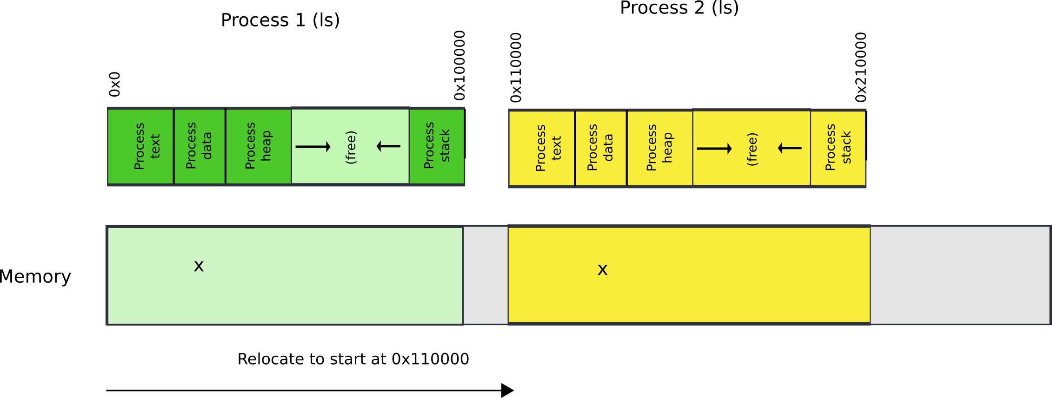
Relocate binaries to work at different addresses

Slide 6
One way to achieve this is to relocate program at different addresses
  Remember relocation (from linking and loading)
  This works! But not ideal.
What is the problem?

Slide 7
One way to achieve this is to relocate program at different addresses
  Remember relocation (from linking and loading)
  This works! But not ideal.
What is the problem?
  Isolation can be enforced in software
  Software Fault Isolation (SFI)
    Google NaCl (Chrome Sandbox)
    WASM (Web Assembly, another sandbox standard)

Slide 8
Another way is to ask for hardware support

Slide 9
Segmentation

Slide 10
What are we aiming for?
Illusion of a private address space
  Identical copy of an address space in multiple programs
  Simplifies software architecture
    One program is not restricted by the memory layout of the others

Slide 11
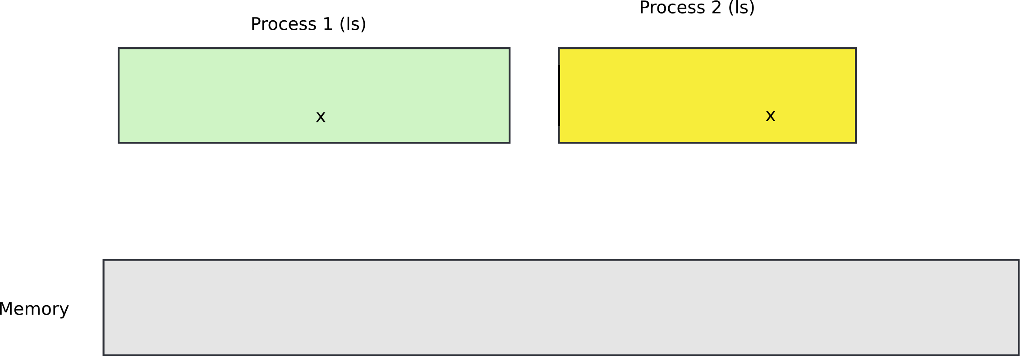
Two processes, one memory?

Slide 12
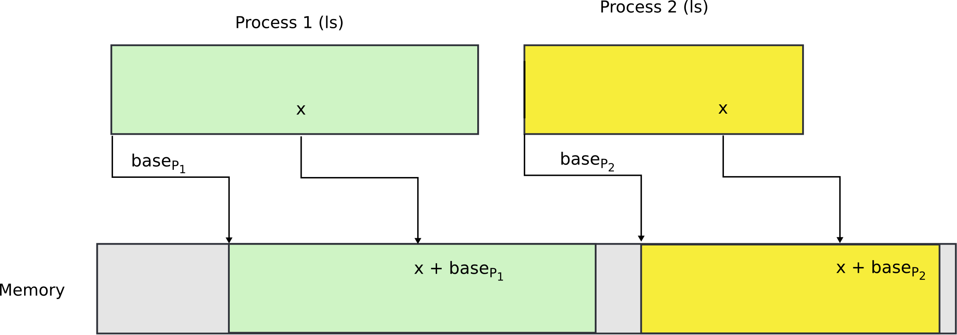
Two processes, one memory?
We want hardware to add base value to every address used in the program

Slide 13
Seems easy
One problem
  Where does this base address come from?

Slide 14
Seems easy
One problem
  Where does this base address come from?
  Hardware can maintain a table of base addresses
    One base for each process
  Dedicate a special register to keep an index into that table

Slide 15
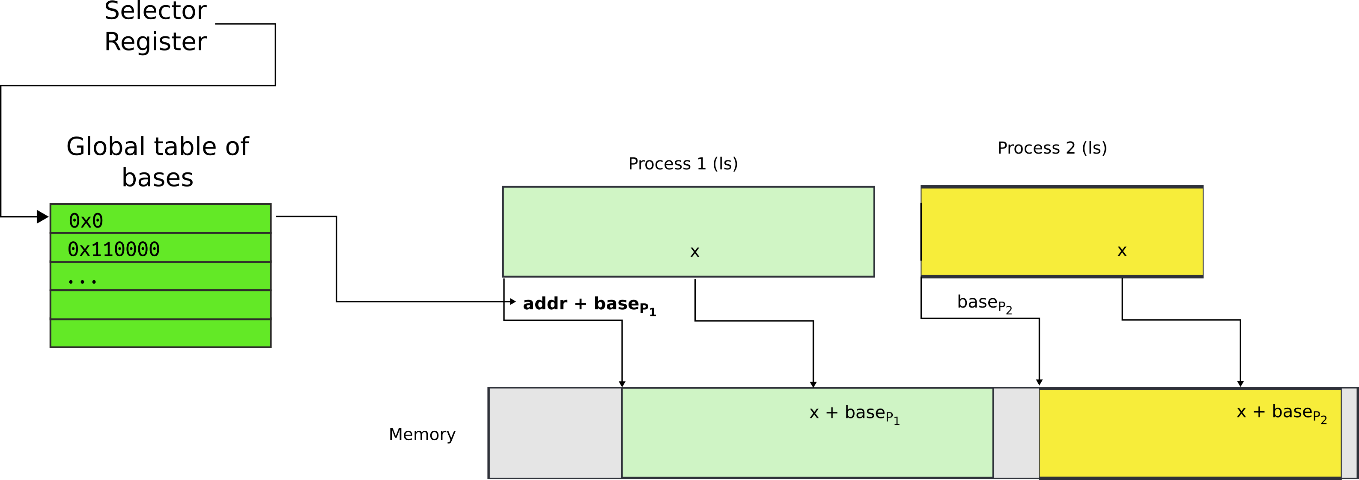
One problem
  Where does this base address come from?
  Hardware can maintain a table of base addresses
    One base for each process
  Dedicate a special register to keep an index into that table

Slide 16
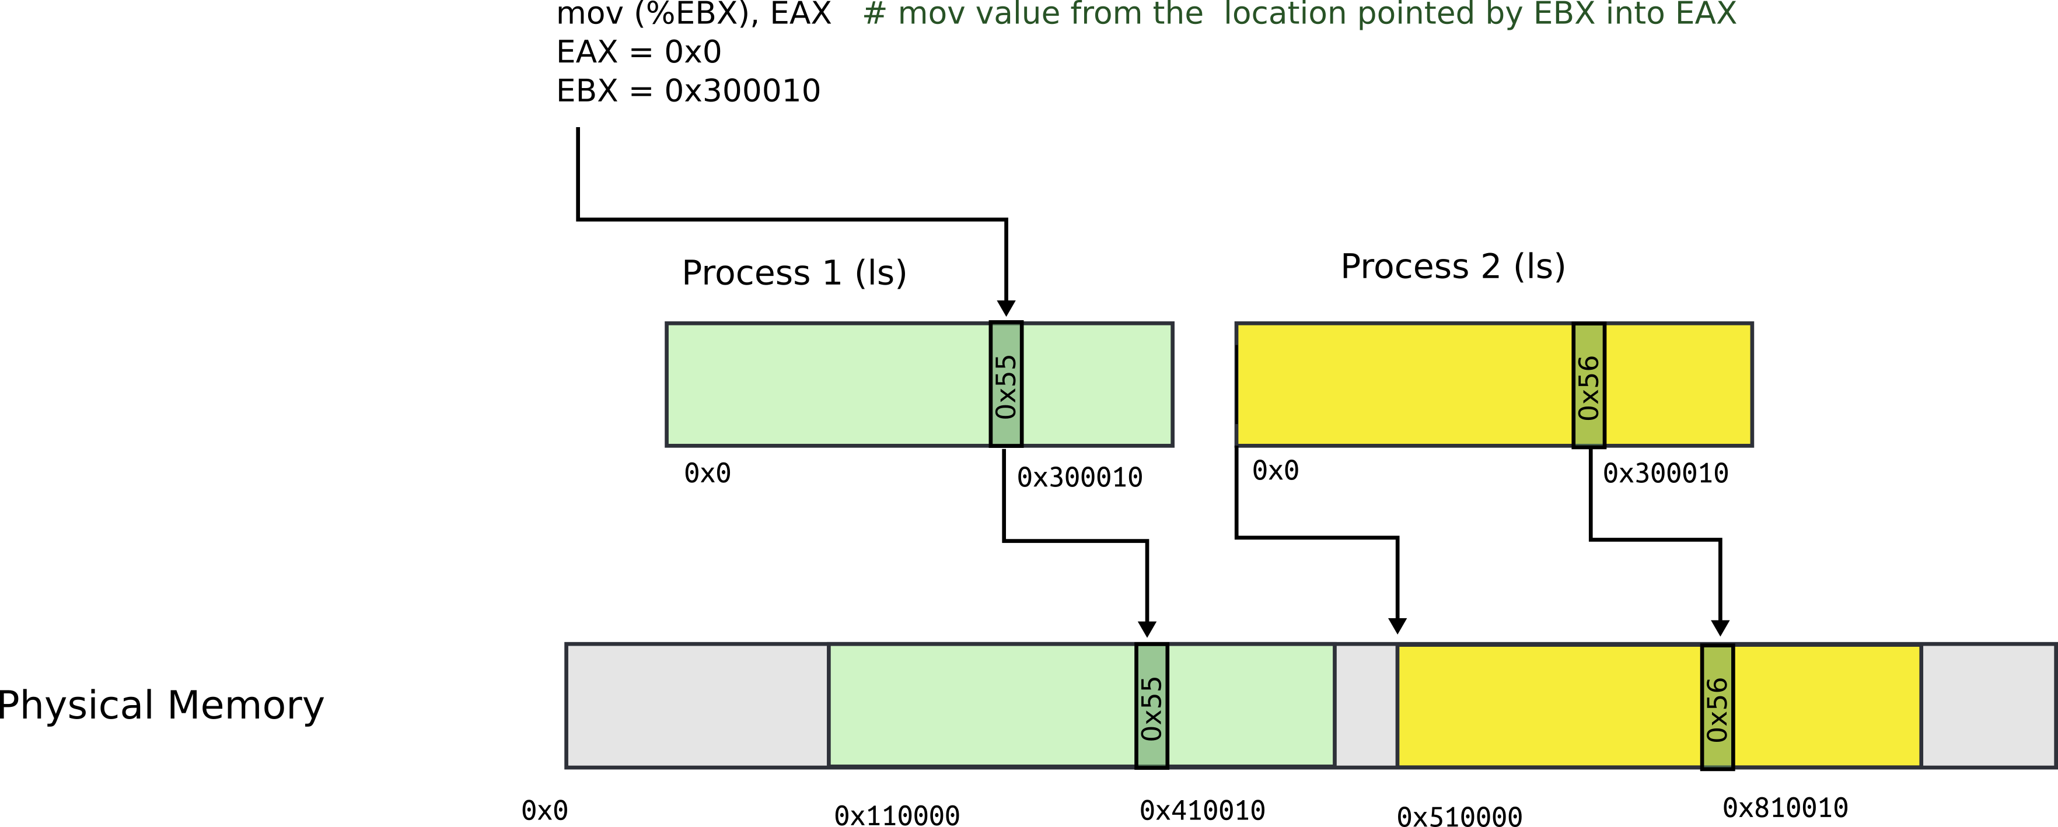
Segmentation: example

Slide 17
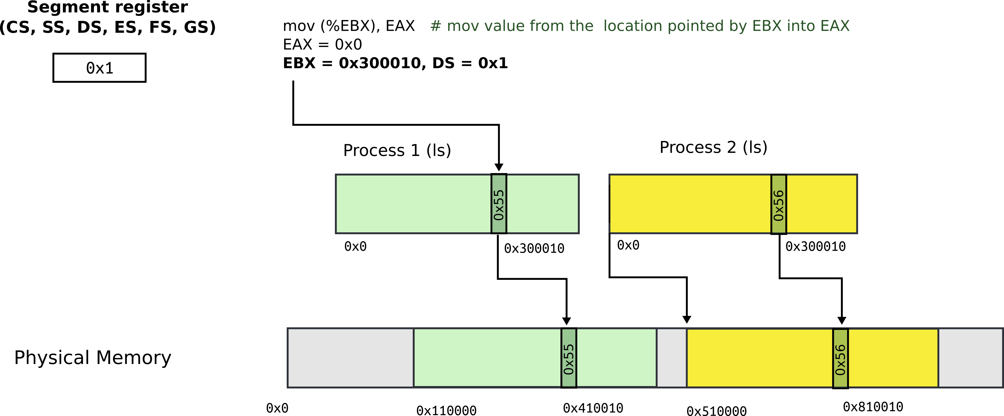
Segmentation: address consists of two parts
Segment register contains segment selector
General registers contain offsets
Intel calls this address: “logical address”

Slide 18
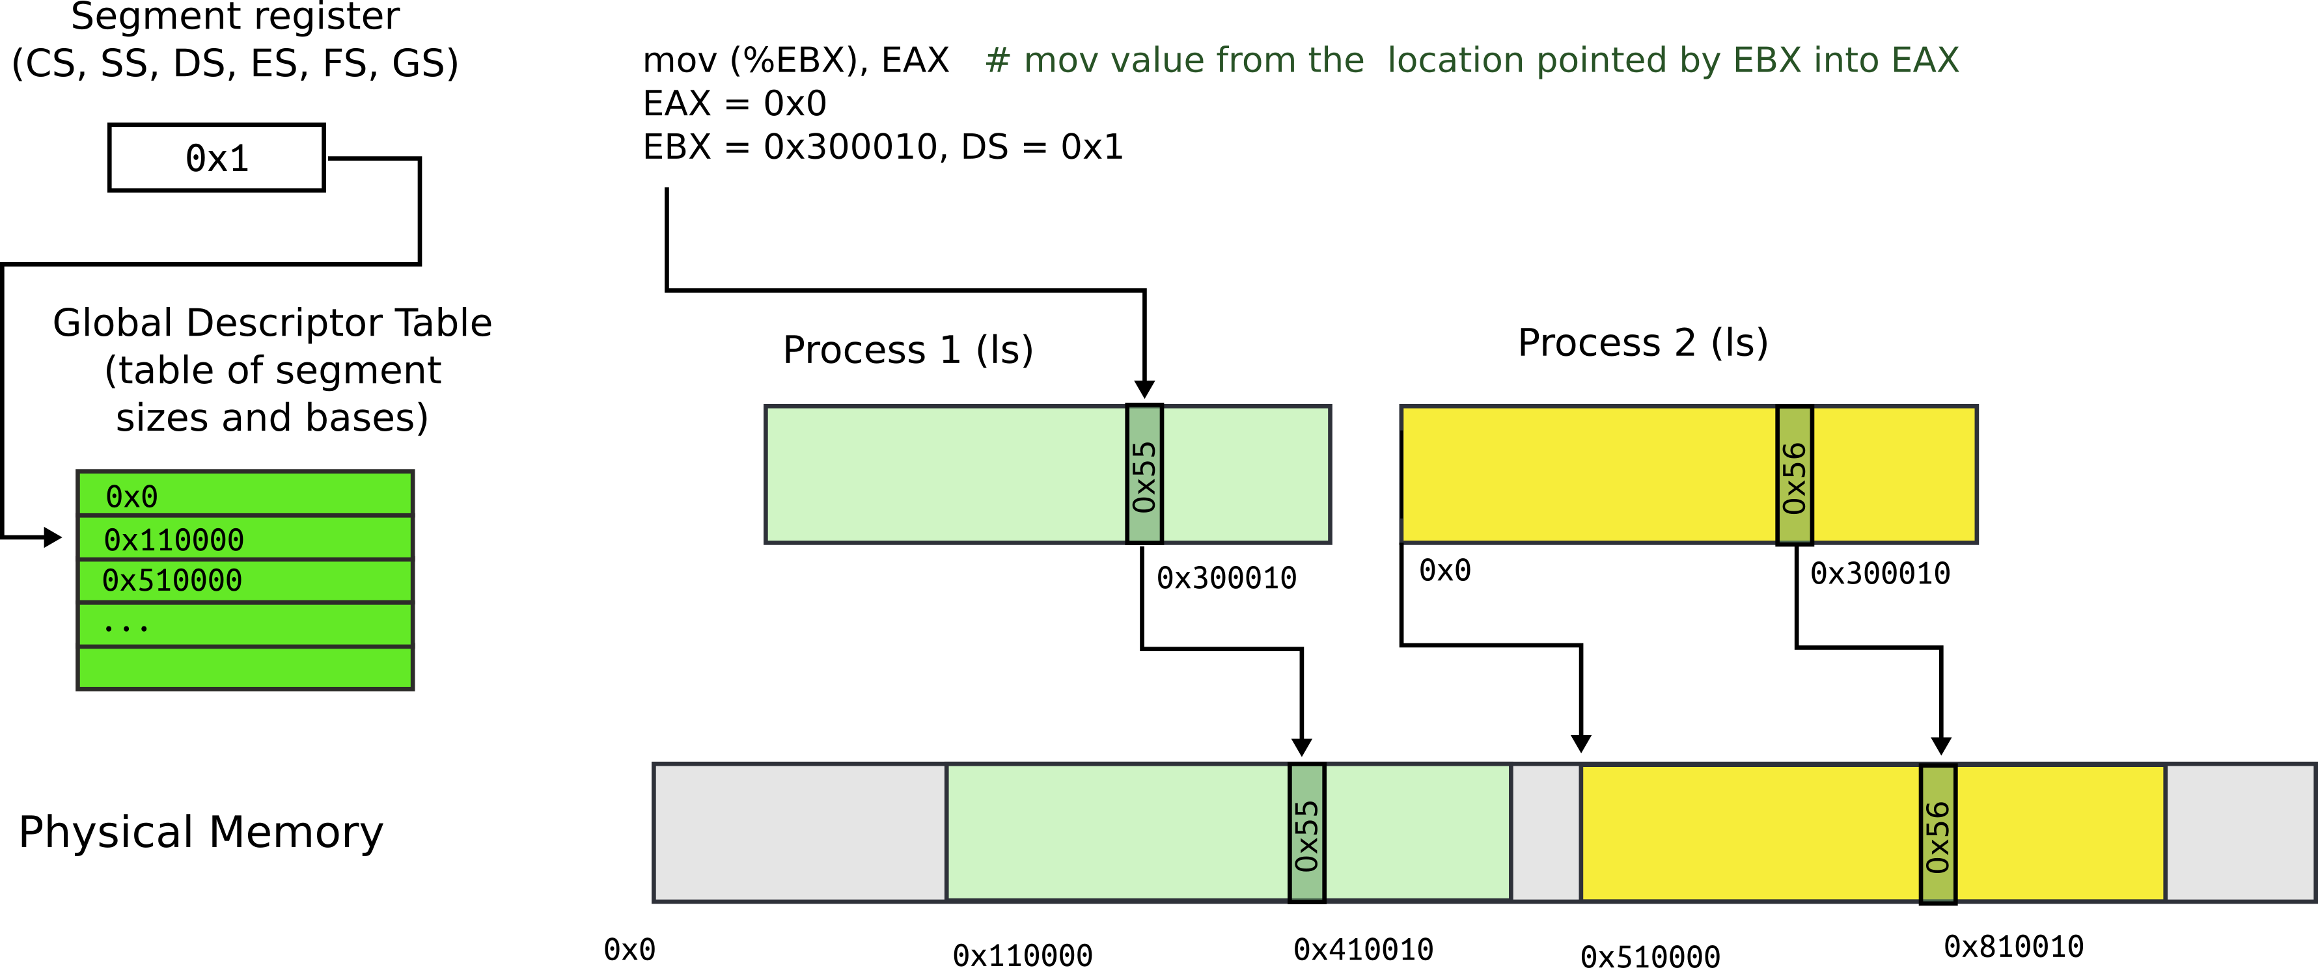
Segmentation: Global Descriptor Table
GDT is an array of segment descriptors
  Each descriptor contains base and limit for the segment
  Plus access control flags

Slide 19
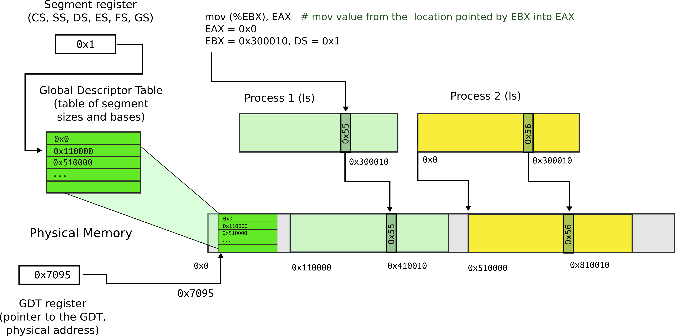
Segmentation: Global Descriptor Table
Location of GDT in physical memory is pointed by the GDT register

Slide 20
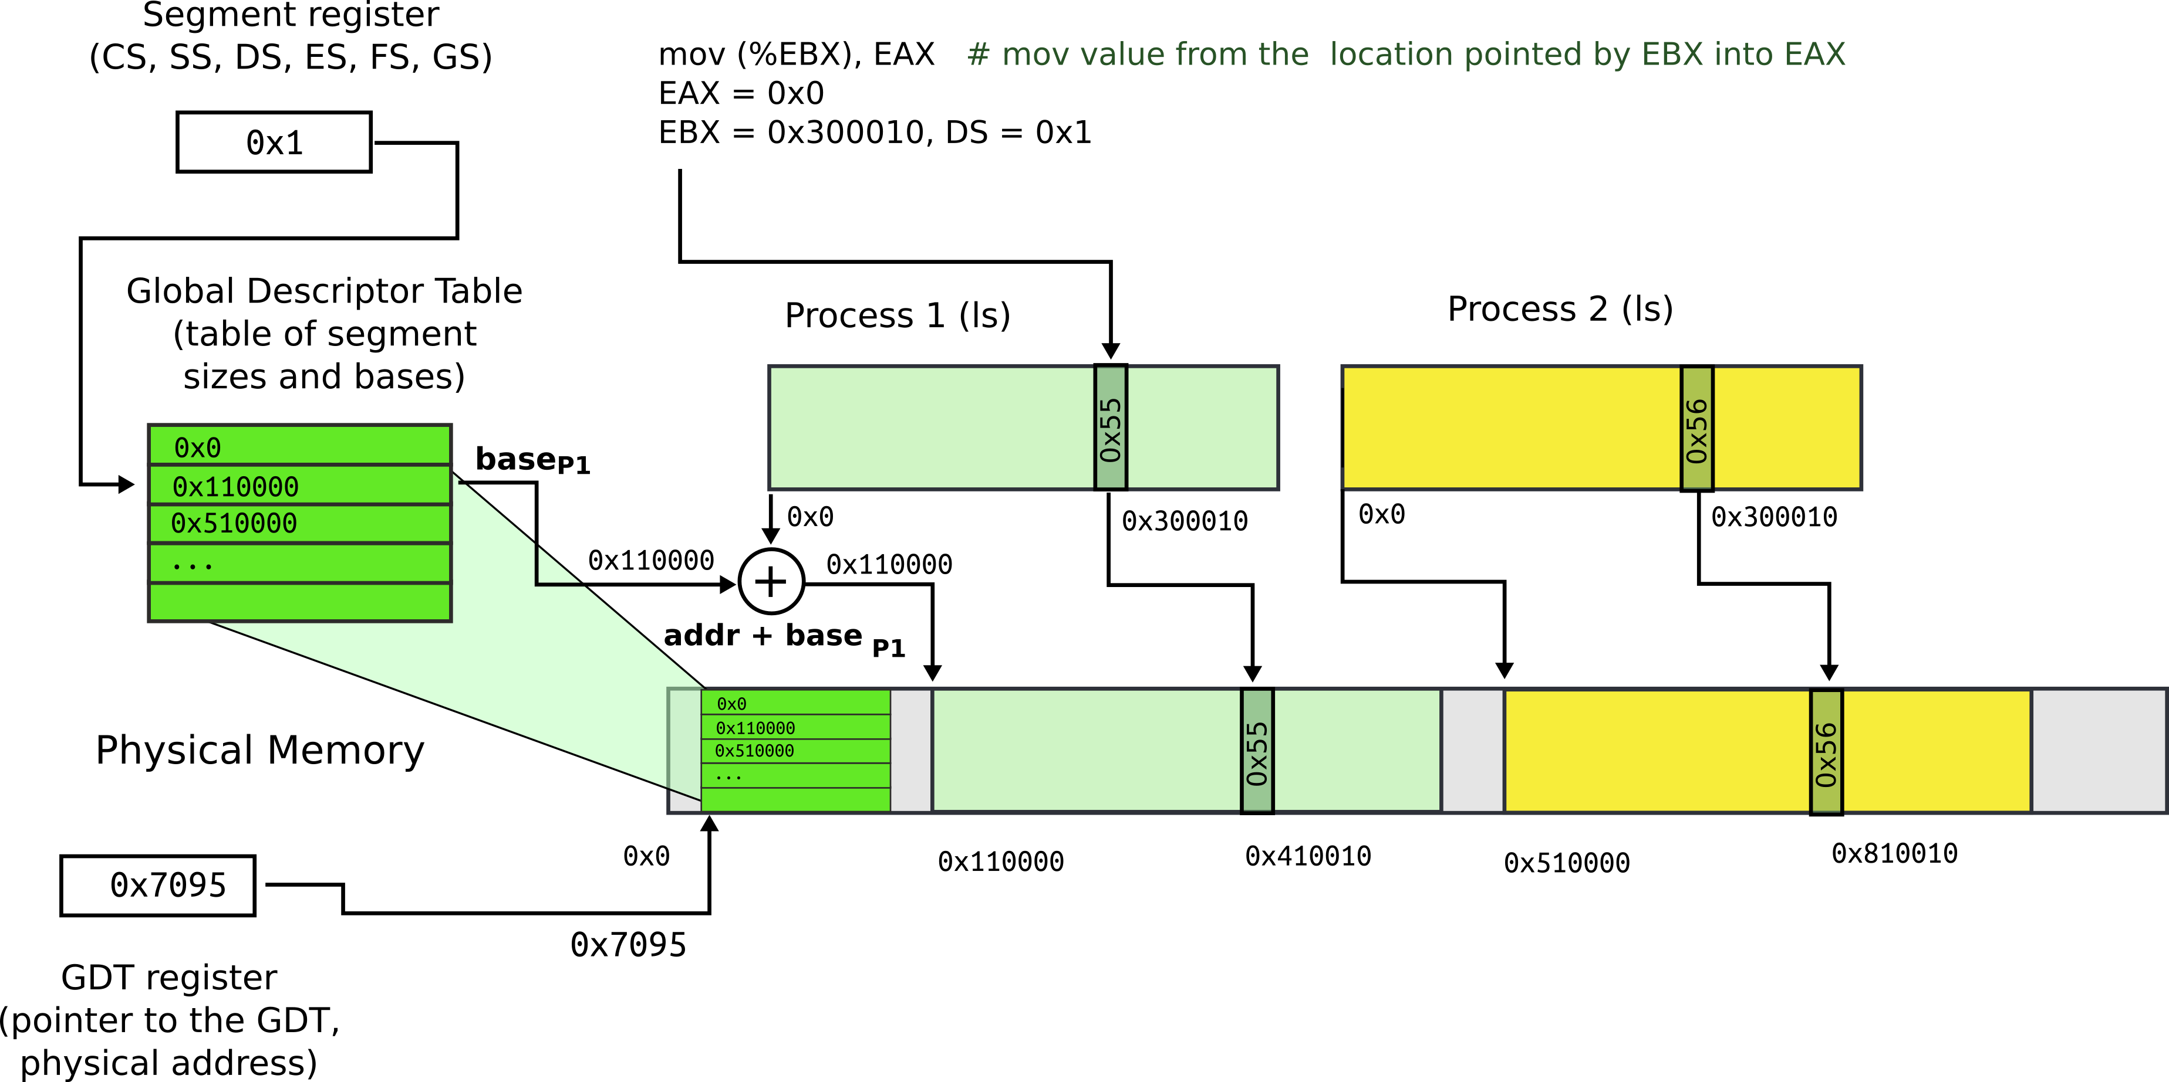
Segmentation: base + offset
Segment register (0x1) chooses an entry in GDT
This entry contains base of the segment (0x110000) and limit (size) of the segment (not shown)

Slide 21

Segmentation: base + offset
Physical address:
  0x410010 = 0x300010 (offset) + 0x110000 (base)
  Intel calls this address “linear”

Slide 22
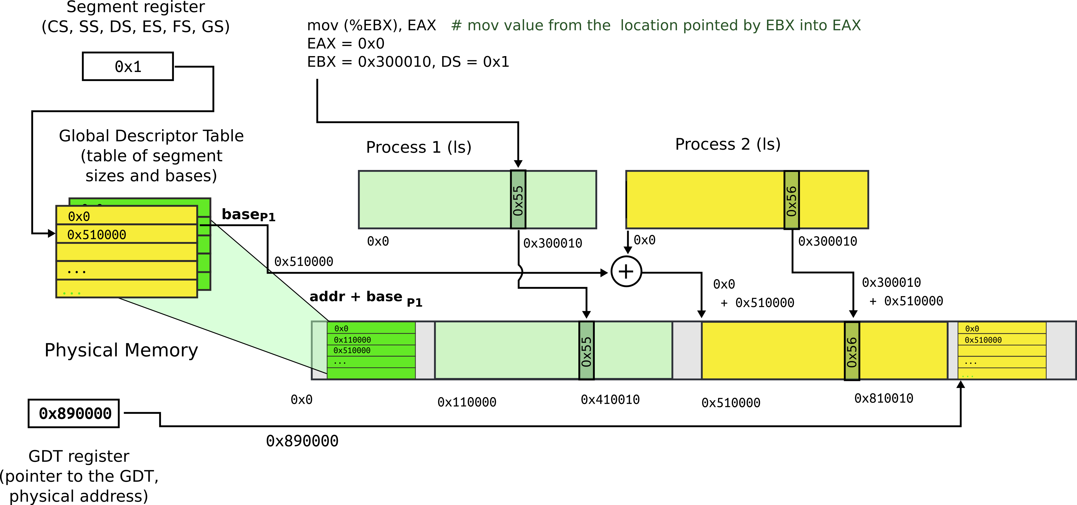
Segmentation: process 2
Each process has a private GDT
  OS will switch between GDTs

Slide 23
New addressing mode:
“logical addresses”

Slide 24
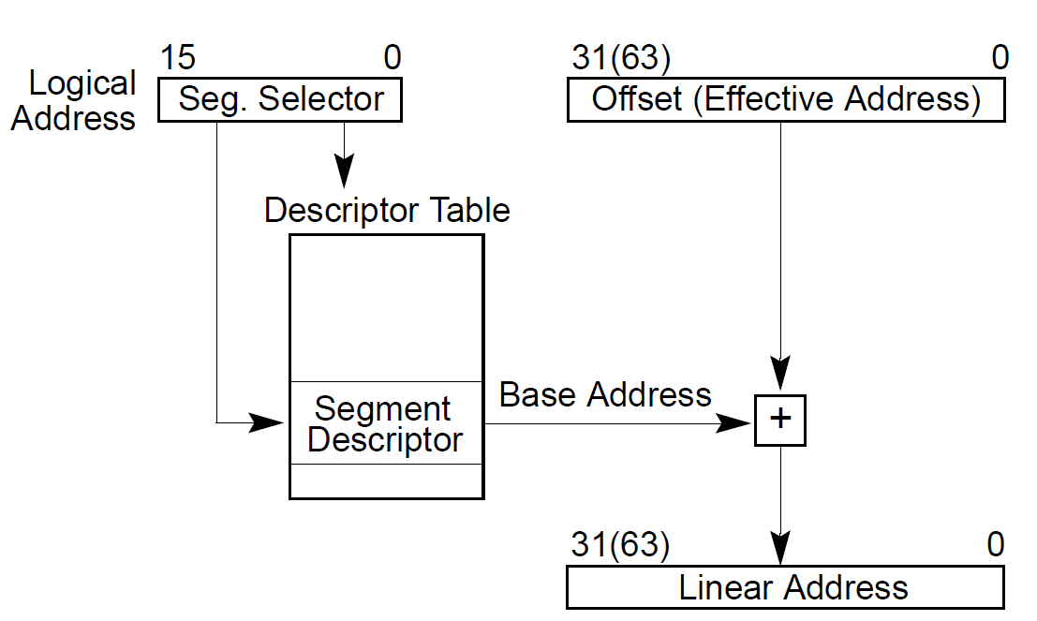
All addresses are logical address
They consist of two parts
  Segment selector (16 bit) + offset (32 bit)

Slide 25
Segment selector (16 bit)
  Is simply an index into an array (Descriptor Table)
  That holds segment descriptors
    Base and limit (size) for each segment

Slide 26
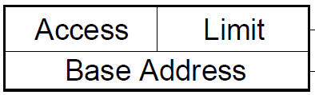
Elements of the descriptor table are segment descriptors
Base address
  0 – 4 GB
Limit (size)
  0 – 4 GB
Access rights
  Executable, readable, writable
  Privilege level (0 - 3)

Slide 27
Offsets into segments (x in our example) or “Effective addresses” are in registers

Slide 28
Logical addresses are translated into physical
  Effective address + DescriptorTable[selector].Base

Slide 29
Logical addresses are translated into physical
  Effective address + DescriptorTable[selector].Base

Slide 30
Logical addresses are translated into physical
  Effective address + DescriptorTable[selector].Base

Slide 31
Logical addresses are translated into physical
  Effective address + DescriptorTable[selector].Base

Slide 32
Physical address =
  Effective address + DescriptorTable[selector].Base
  Effective addresses (or offsets) are in registers
  Selector is in a special register

Slide 33
Segment registers
Hold 16 bit segment selectors
  Indexes into GDT
Segments are associated with one of three types of storage
  Code
  Data
  Stack

Slide 34
Segmented programming (not real)
static int x = 1;
int y; // stack
if (x) {
y = 1;
printf (“Boo”);
} else
y = 0;
ds:x = 1; // data
ss:y; // stack
if (ds:x) {
ss:y = 1;
cs:printf(ds:“Boo”);
} else
ss:y = 0;

Slide 35
Programming model
Segments for: code, data, stack, “extra”
  A program can have up to 6 total segments
  Segments identified by registers: cs, ds, ss, es, fs, gs
Prefix all memory accesses with desired segment:
  mov eax, ds:0x80 (load offset 0x80 from data into eax)
  jmp cs:0xab8 (jump execution to code offset 0xab8)
  mov ss:0x40, ecx (move ecx to stack offset 0x40)

Slide 36
Programming model, cont.
This is cumbersome,
Instead the idea is: infer code, data and stack segments from the instruction type:
  Control-flow instructions use code segment (jump, call)
  Stack management (push/pop) uses stack
  Most loads/stores use data segment
Extra segments (es, fs, gs) must be used explicitly

Slide 37
Code segment
Code
  CS register
  EIP is an offset inside the segment stored in CS
Can only be changed with
  procedure calls,
  interrupt handling, or
  task switching

Slide 38
Data segment
Data
  DS, ES, FS, GS
  4 possible data segments can be used at the same time

Slide 39
Stack segment
Stack
  SS
Can be loaded explicitly
  OS can set up multiple stacks
  Of course, only one is accessible at a time

Slide 40
Segmentation: what did we achieve
Illusion of a private address space
  Identical copy of an address space in multiple programs
    We can implement fork()
Isolation
  Processes cannot access memory outside of their segments

Slide 41
Segmentation works for isolation, i.e., it does provide programs with illusion of private memory

Slide 42
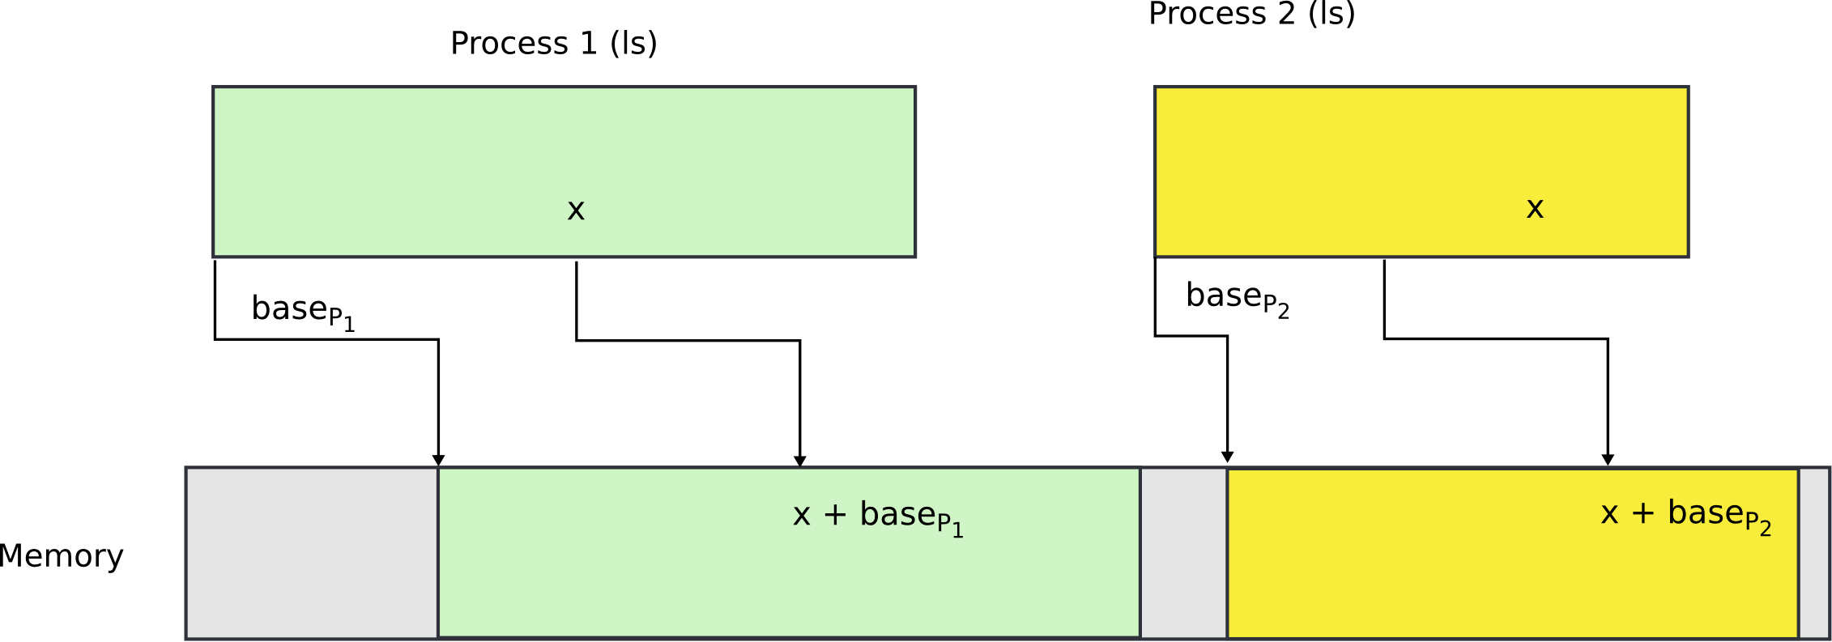
Segmentation is ok... but

Slide 43
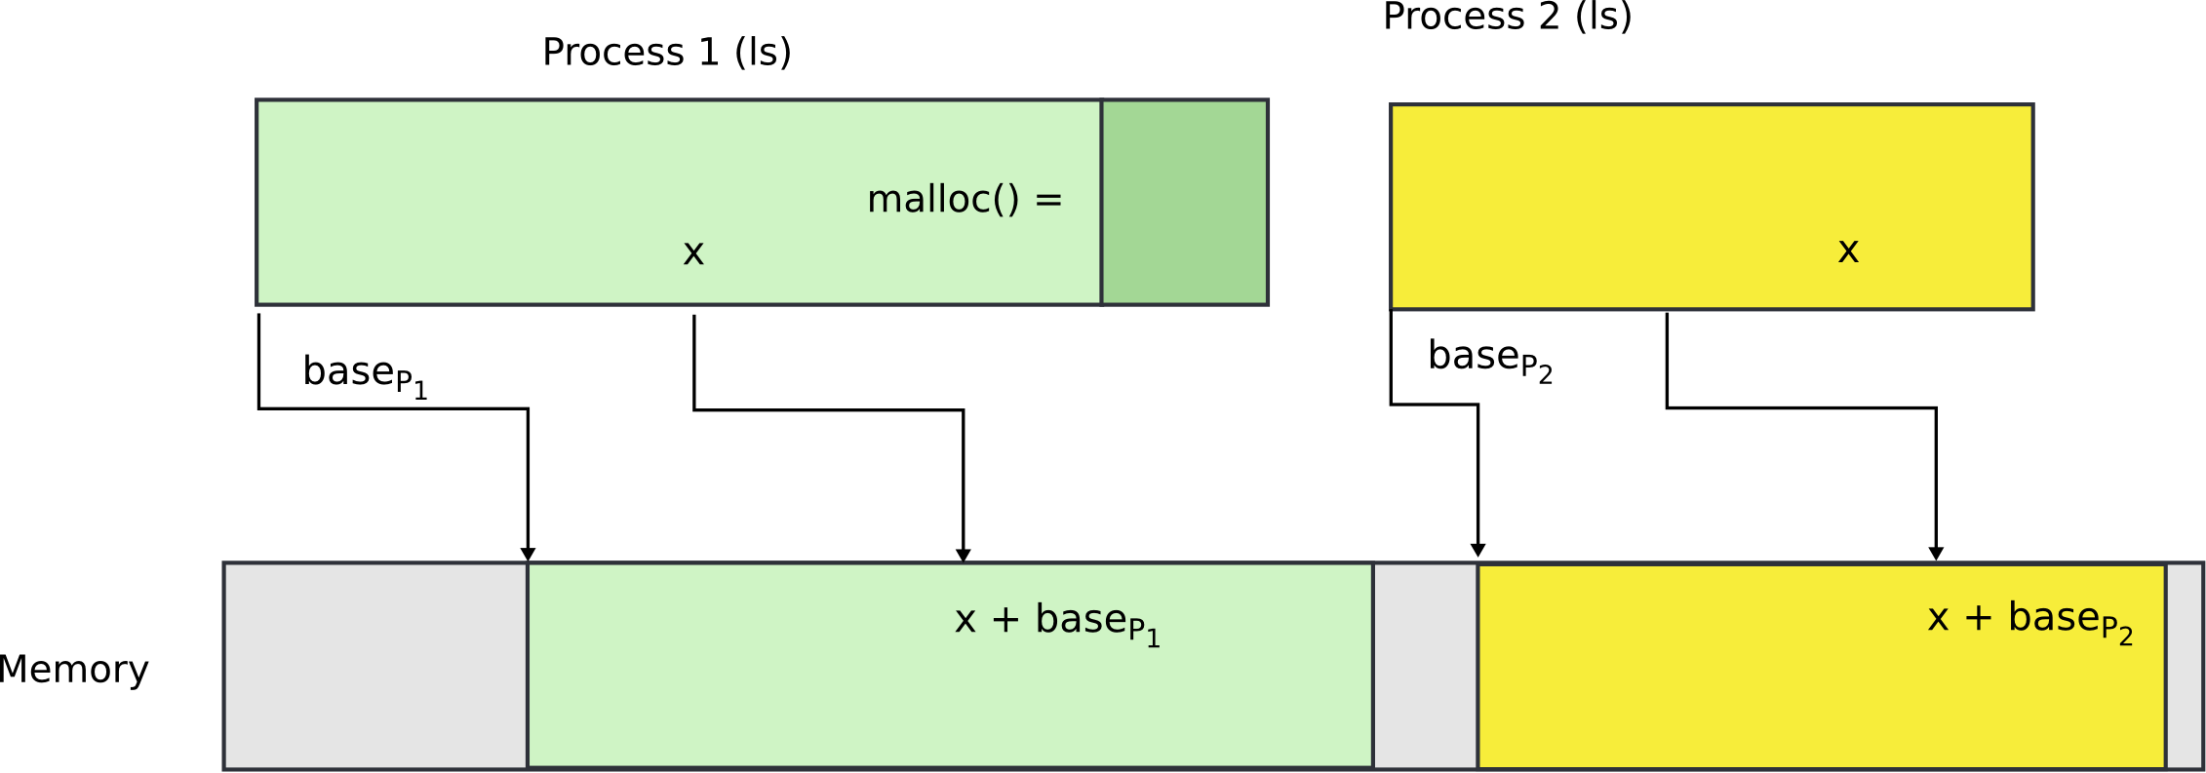
What if process needs more memory?

Slide 44
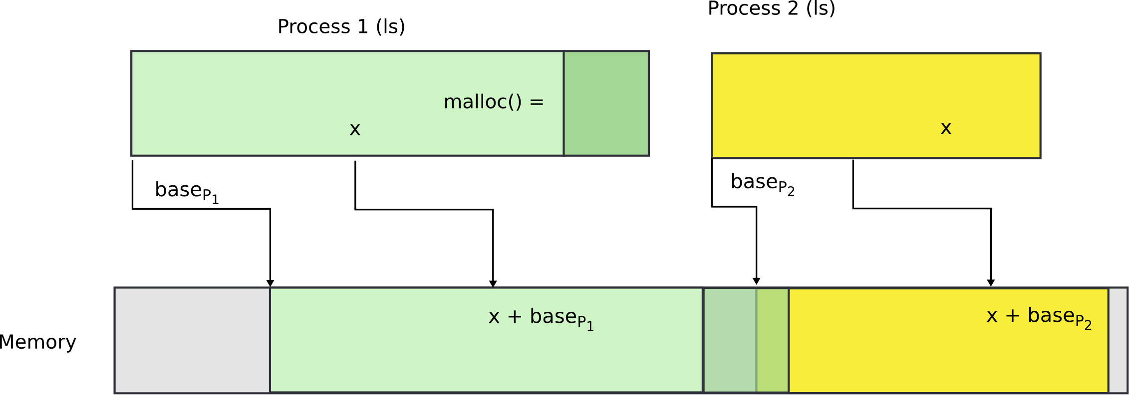
What if process needs more memory?

Slide 45
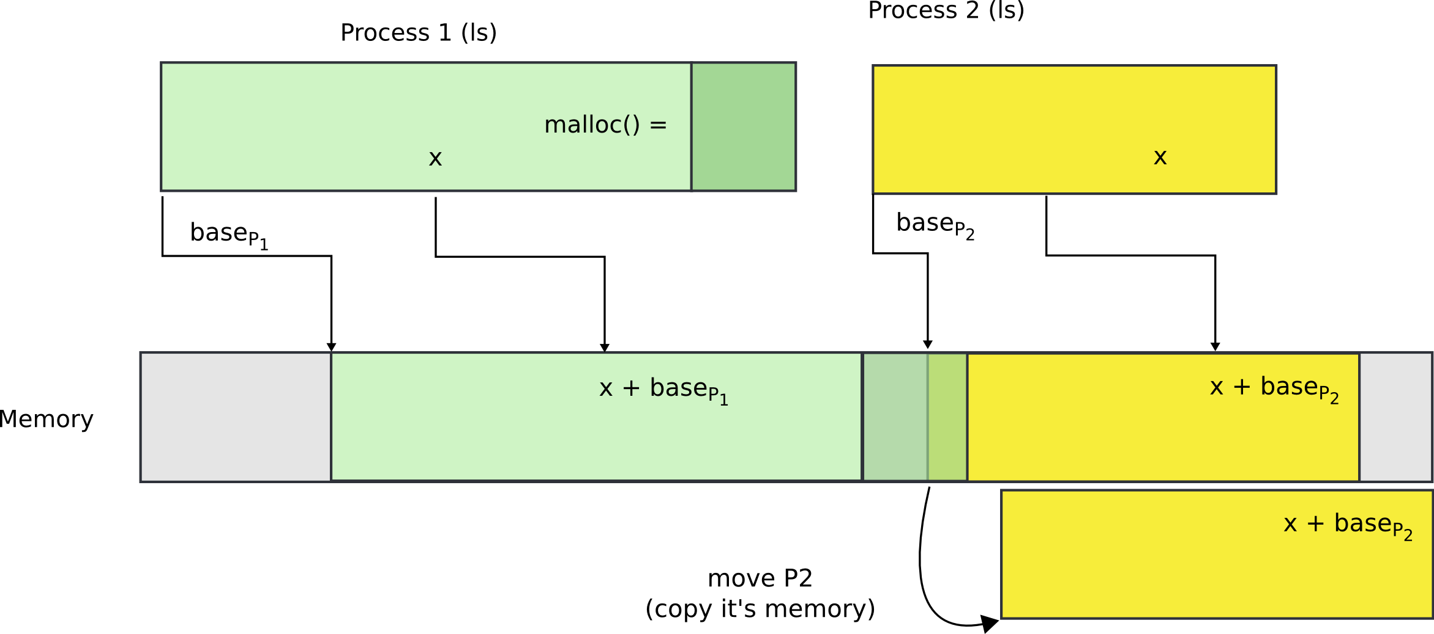
You can move P2 in memory

Slide 46
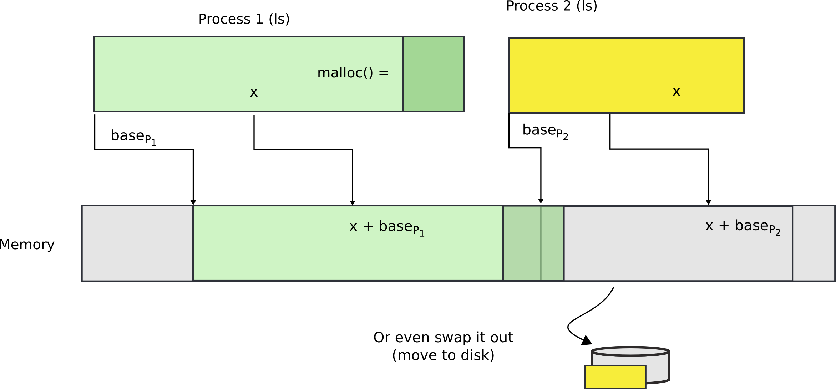
Or even swap it out to disk

Slide 47
Problems with segments
Segments are somewhat inconvenient
  Relocating or swapping the entire process takes time
Memory gets fragmented
  There might be no space (gap) for the swapped out process to come in
  Will have to swap out other processes

Slide 48
Paging

Slide 49
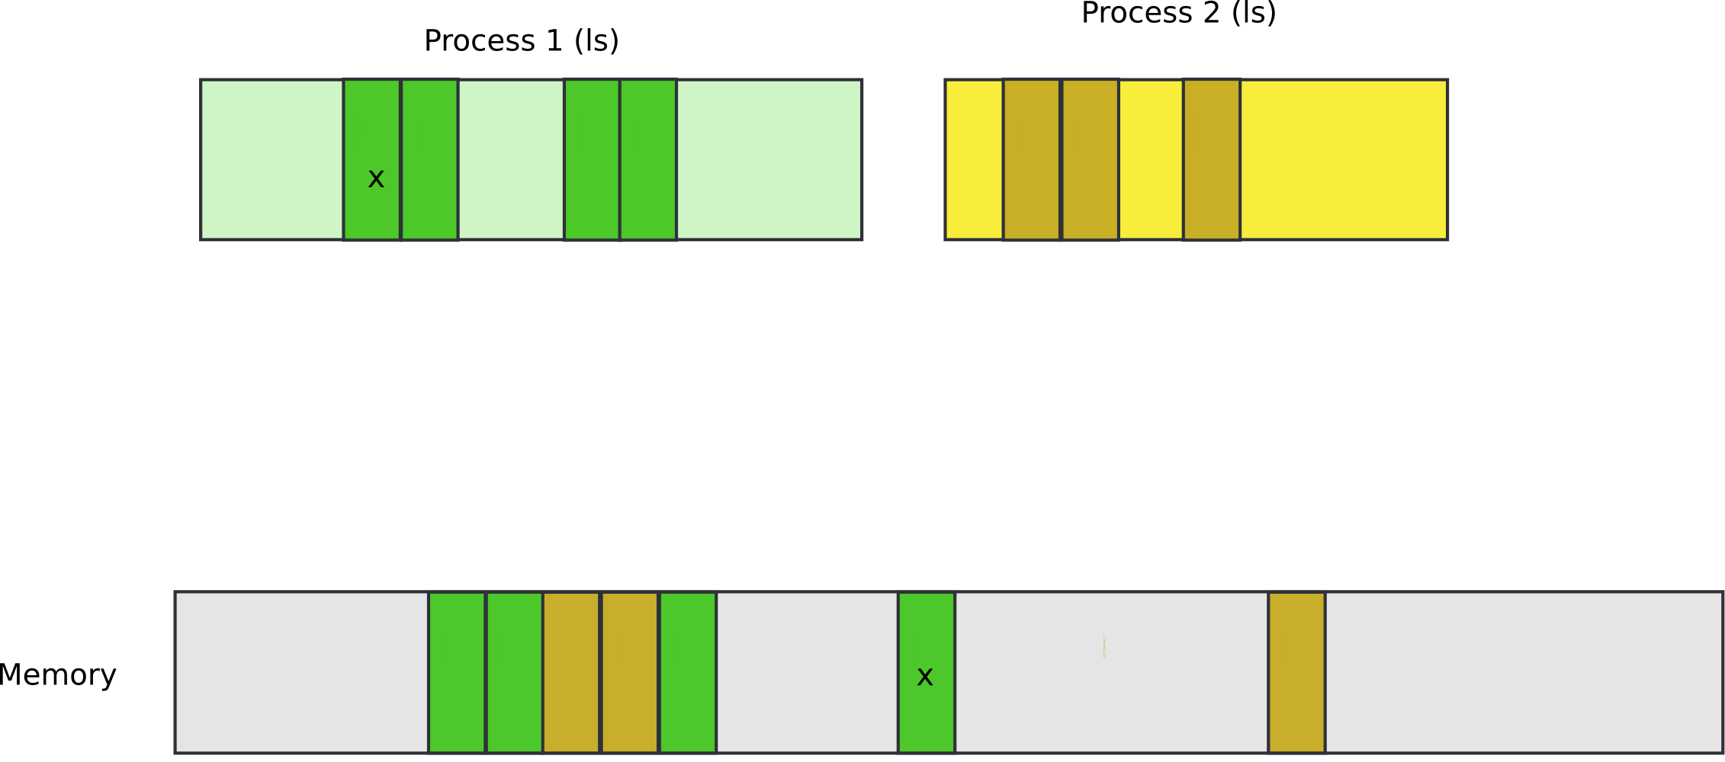
Pages

Slide 50

Pages

Slide 51
Paging idea
Break up memory into 4096-byte chunks called pages
  Modern hardware supports 2MB, 4MB, and 1GB pages
Independently control mapping for each page of linear address space
Compare with segmentation (single base + limit)
  many more degrees of freedom

Slide 52
How can we build this translation mechanism?

Slide 53
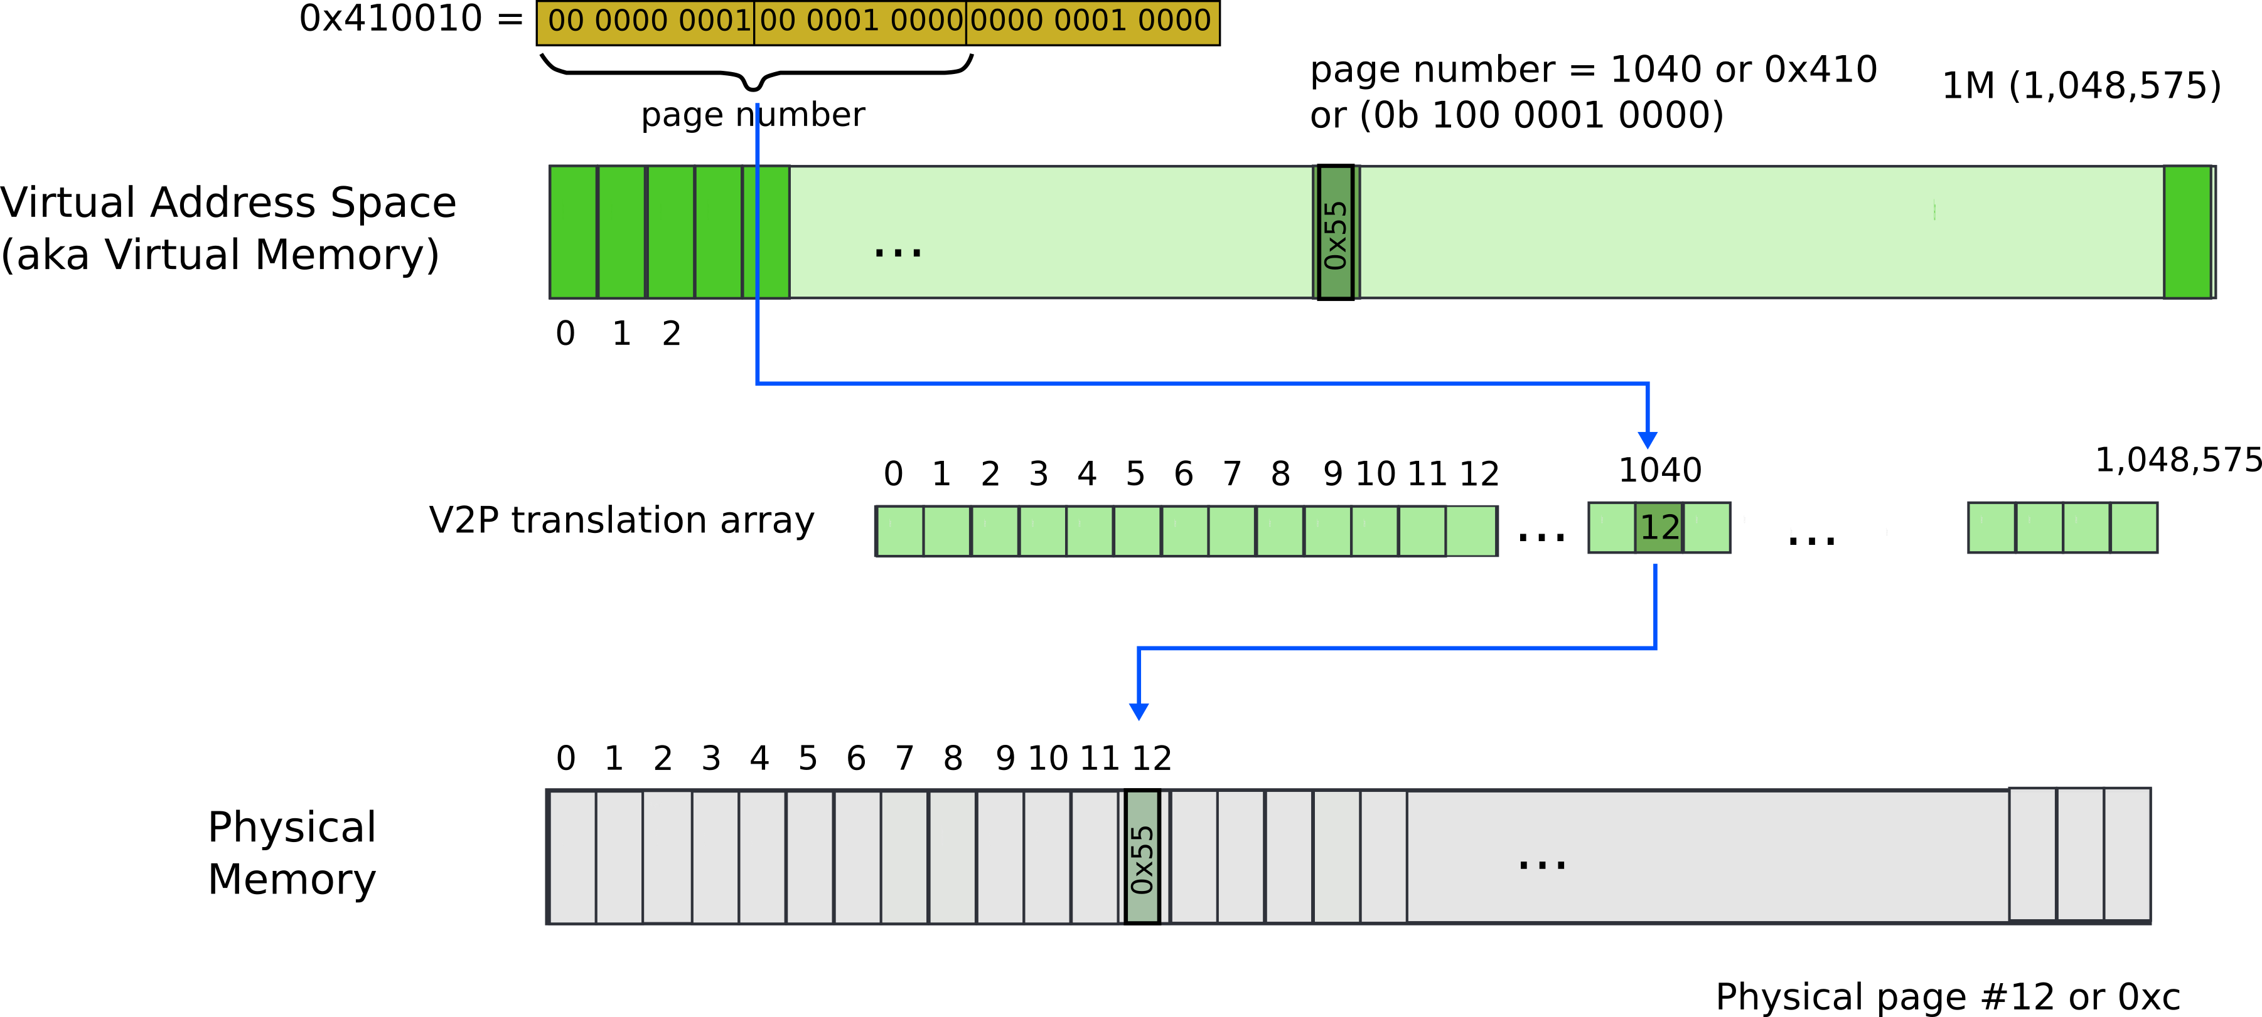
Paging: naive approach: translation array
Linear address 0x410010
  Remember it’s result of logical to linear translation (aka segmentation)
    0x410010 = 0x300010 (offset) + 0x110000 (base)

Slide 54
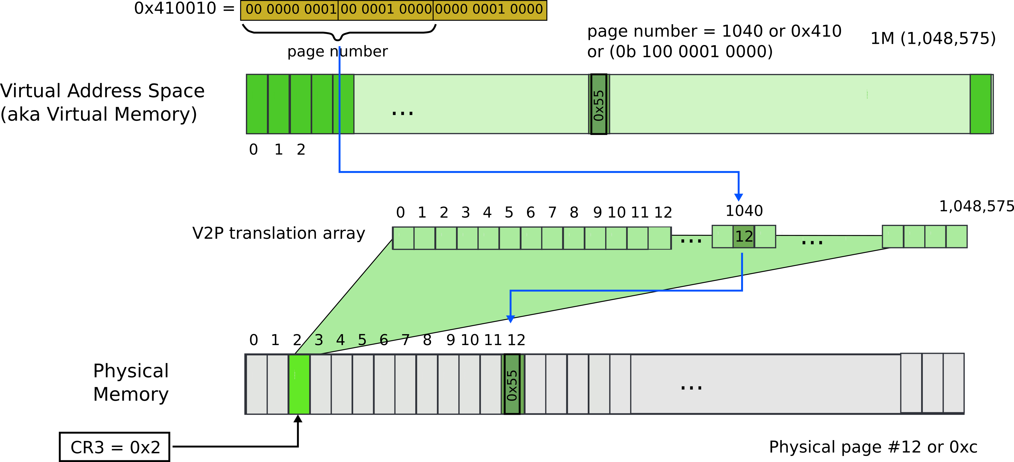
Paging: naive approach: translation array
Linear address 0x410010
  Remember it’s result of logical to linear translation (aka segmentation)
    0x410010 = 0x300010 (offset) + 0x110000 (base)

Slide 55
What is wrong?

Slide 56
What is wrong?
We need 4 bytes to relocate each page
  20 bits for physical page number
  12 bits of access flags
  Therefore, we need array of 4 bytes x 1M entries
    4MBs

Slide 57
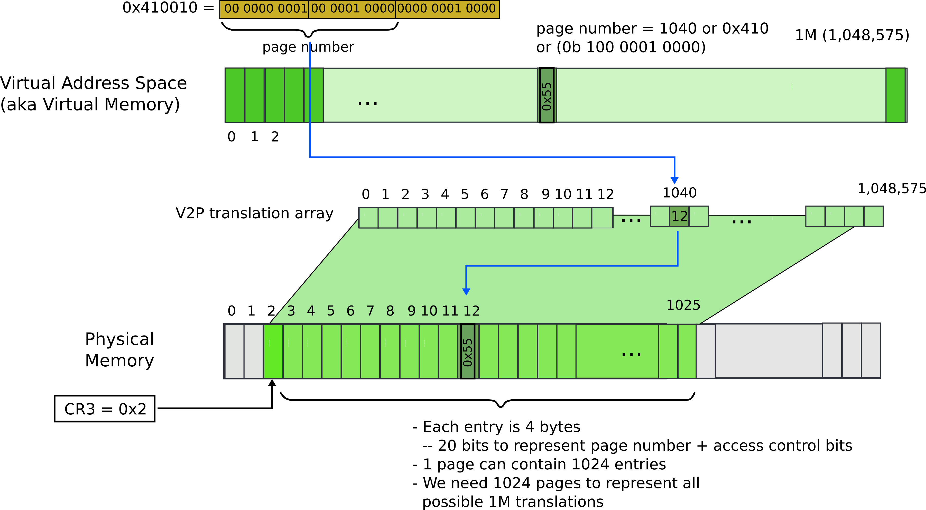
Paging: naive approach: translation array

Slide 58
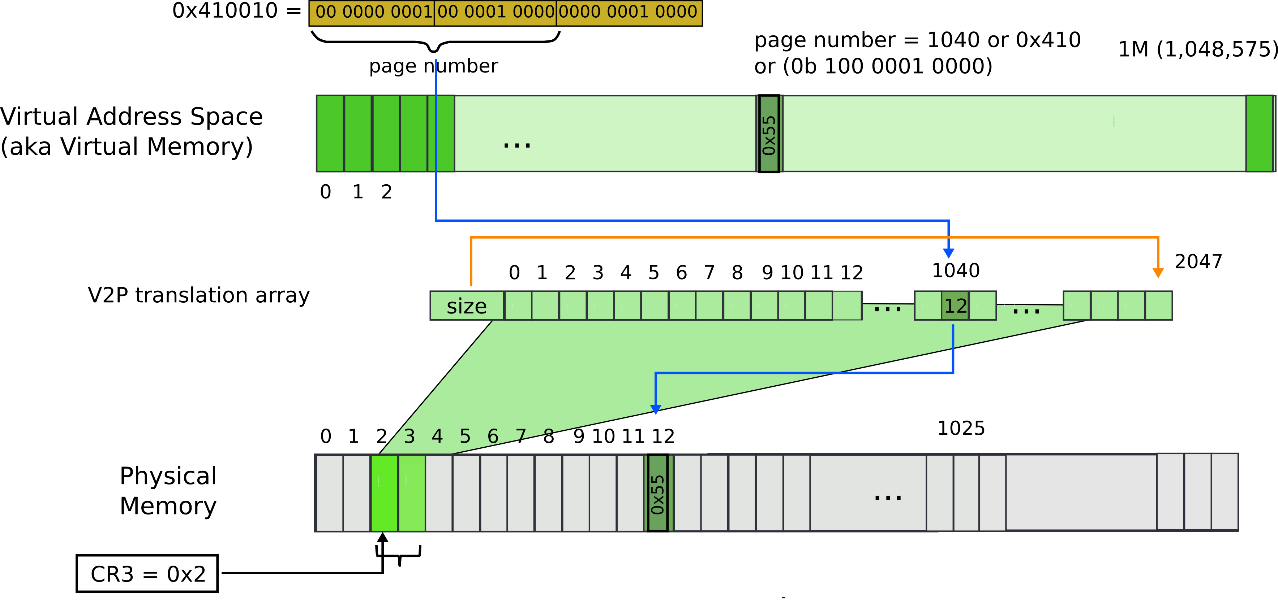
Paging: array with size
The size controls how many entries are required

Slide 59
But still what may go wrong?

Slide 60
Paging: array with size

Slide 61
Paging: array with size

Slide 62
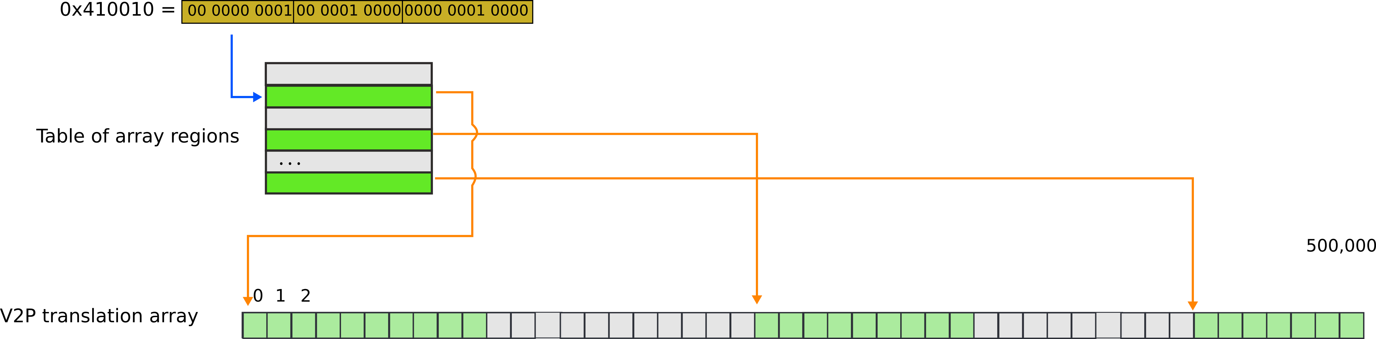
Paging: array with chunks

Slide 63
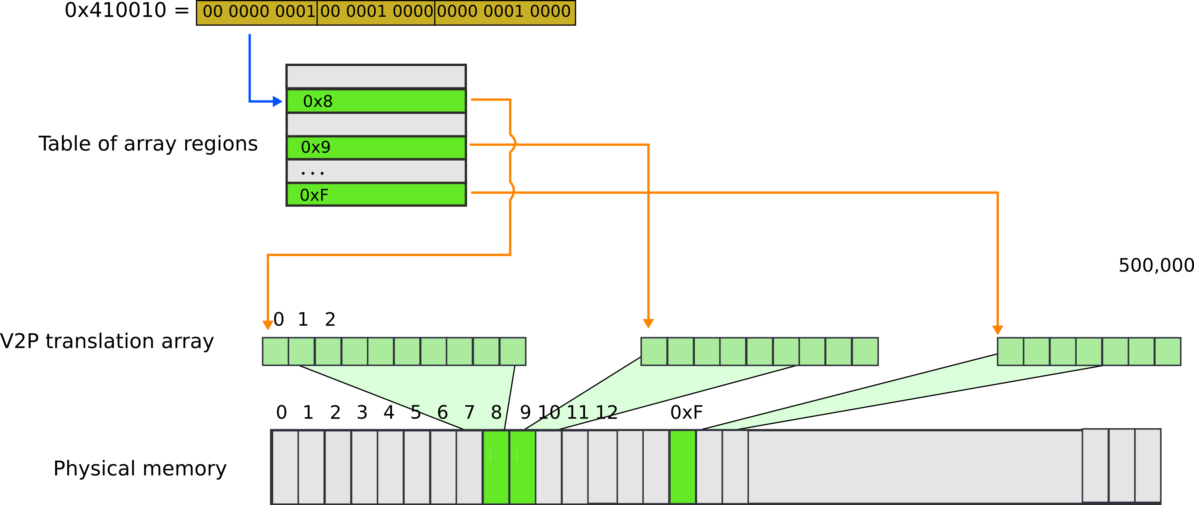
Paging: array with chunks

Slide 64
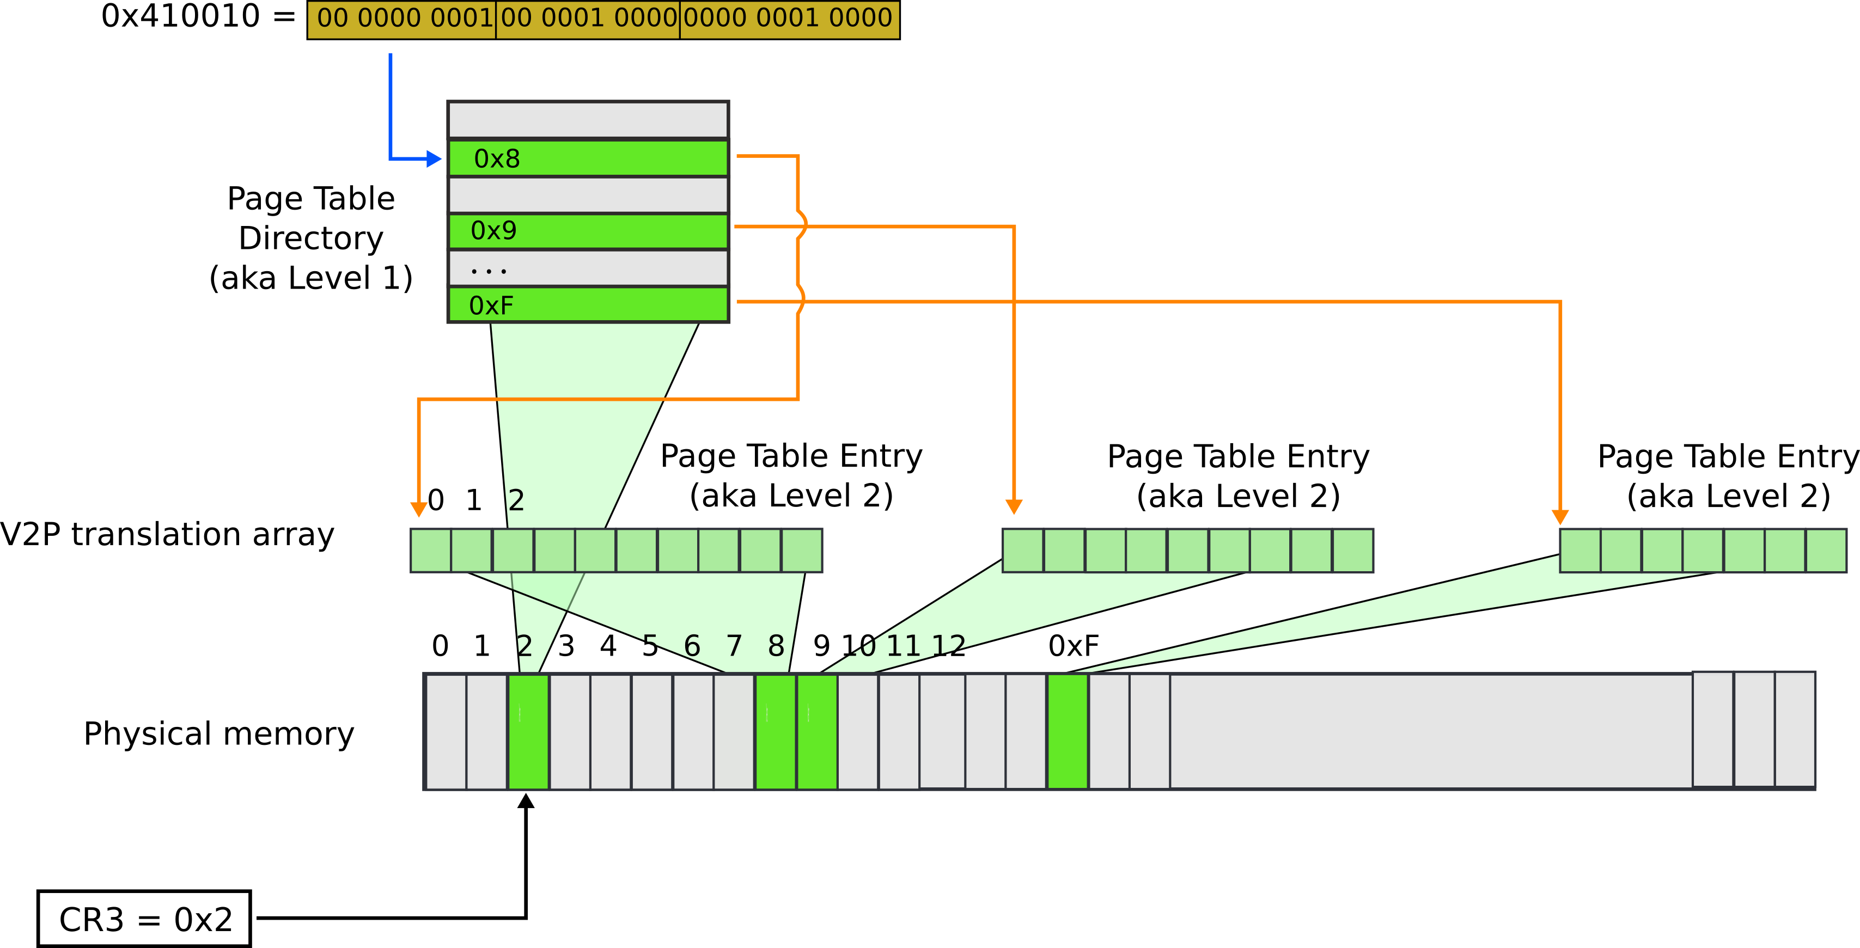
Paging: page table

Slide 65



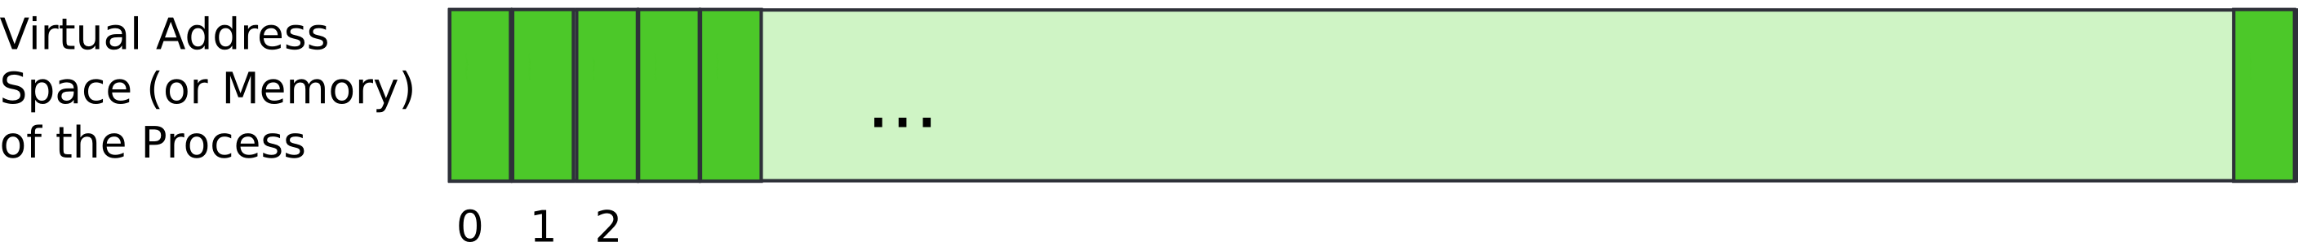
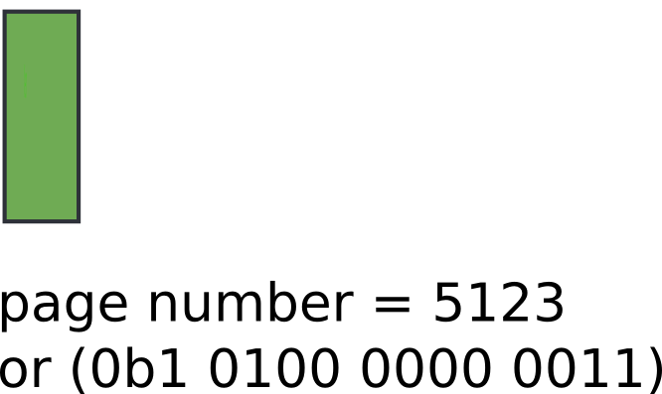
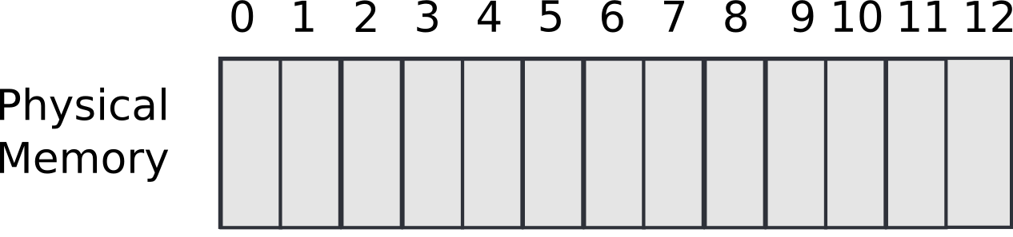

Slide 66



Slide 67
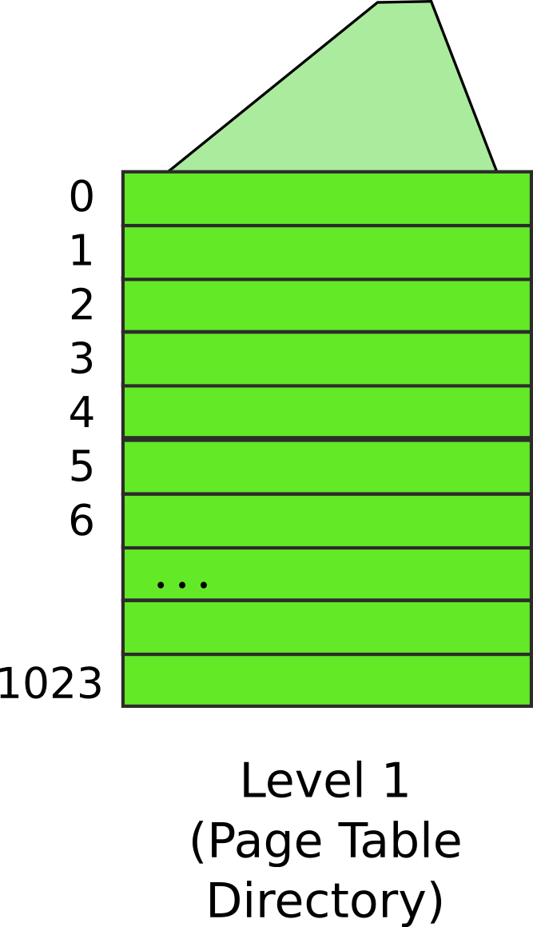
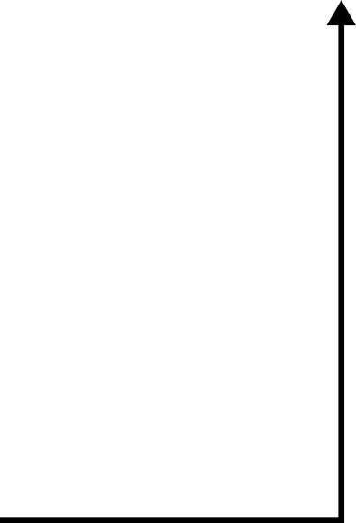
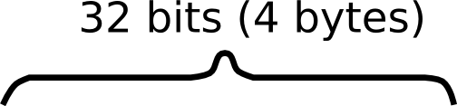


Slide 68
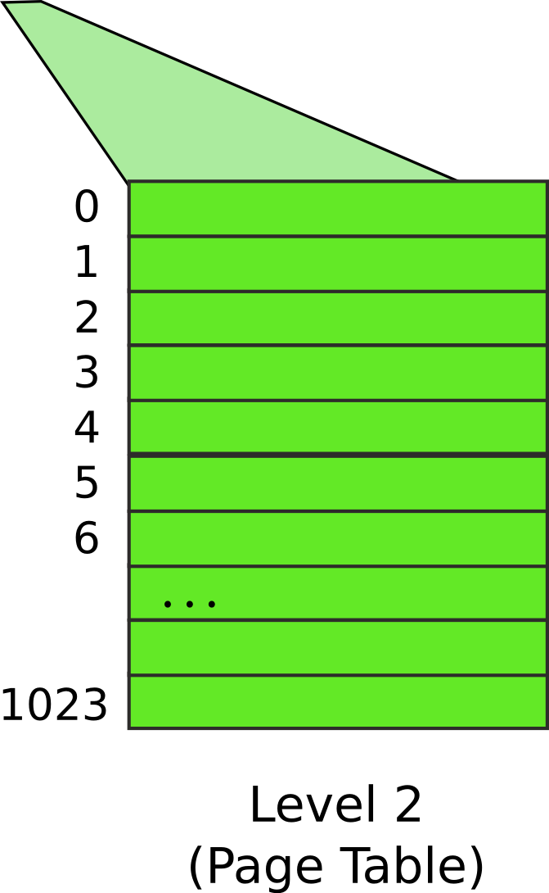
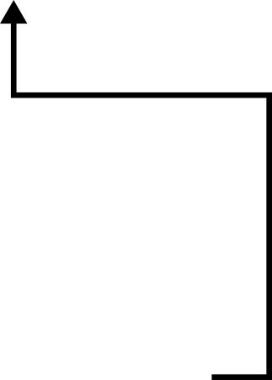


Slide 69
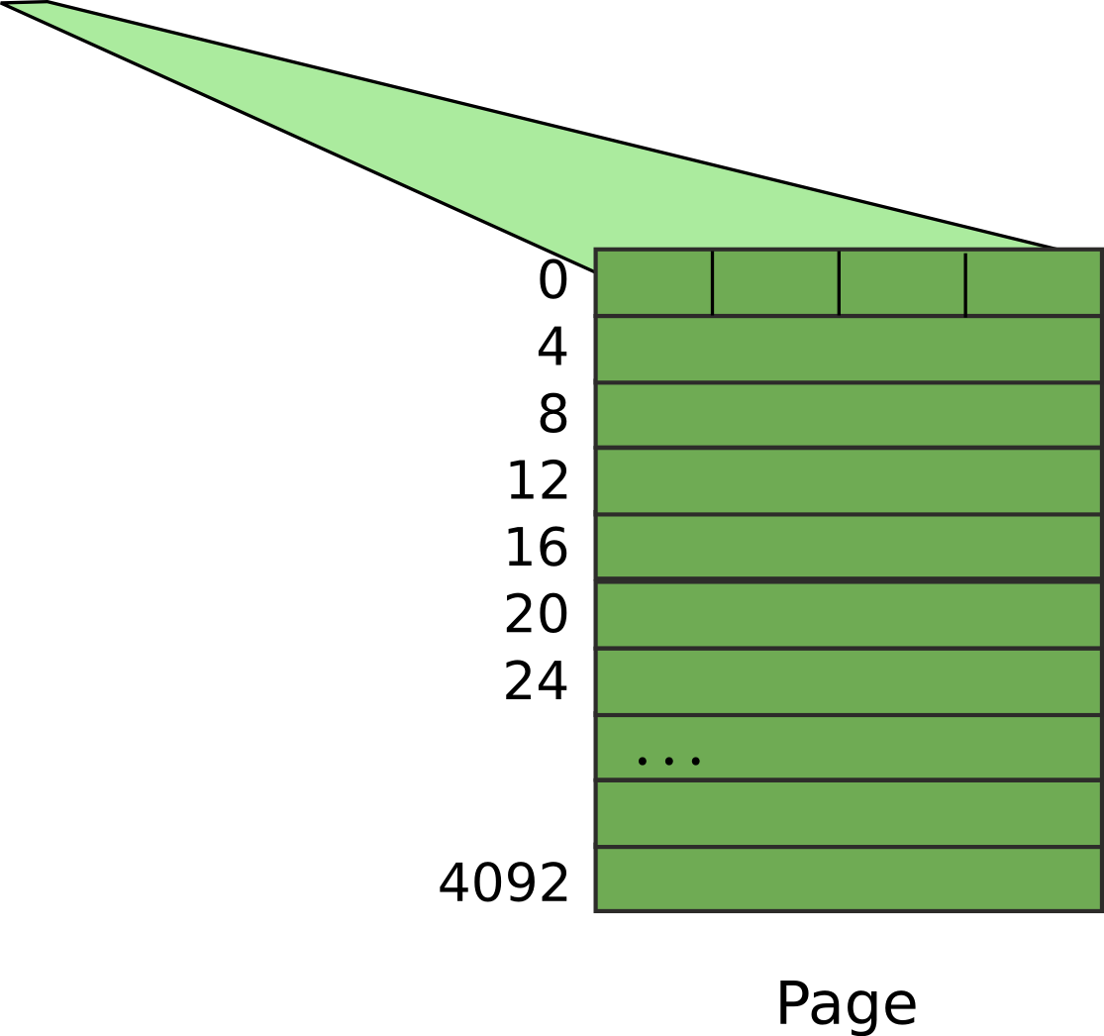


Slide 70
Result:
  EAX = 55

Slide 71
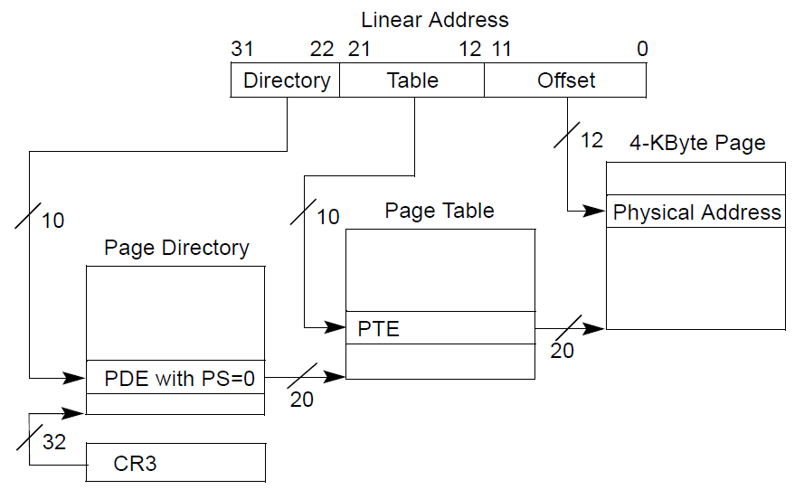
Page translation

Slide 72
Page translation

Slide 73
Page directory entry (PDE)
20 bit address of the page table

Slide 74
Page directory entry (PDE)
20 bit address of the page table
Wait... 20 bit address, but we need 32 bits

Slide 75
Page directory entry (PDE)
20 bit address of the page table
Wait... 20 bit address, but we need 32 bits
  Pages 4KB each, we need 1M to cover 4GB
  Pages start at 4KB (page aligned boundary)

Slide 76
Page translation

Slide 77
Page table entry (PTE)
20 bit address of the 4KB page
  Pages 4KB each, we need 1M to cover 4GB

Slide 78
Page translation

Slide 79
Benefit of page tables
… Compared to arrays?
Page tables represent sparse address space more efficiently
  An entire array has to be allocated upfront
  But if the address space uses a handful of pages
  Only page tables (Level 1 and 2 need to be allocated to describe translation)
On a dense address space this benefit goes away
  I'll assign a homework!

Slide 80
What about isolation?
Two programs, one memory?
Each process has its own page table
  OS switches between them

Slide 81

P1 and P2 can't access each other memory

Slide 82
Compared to segments pages allow ...
Emulate large virtual address space on a smaller physical memory
  In our example we had only 12 physical pages
  But the program can access all 1M pages in its 4GB address space
  The OS will move other pages to disk

Slide 83
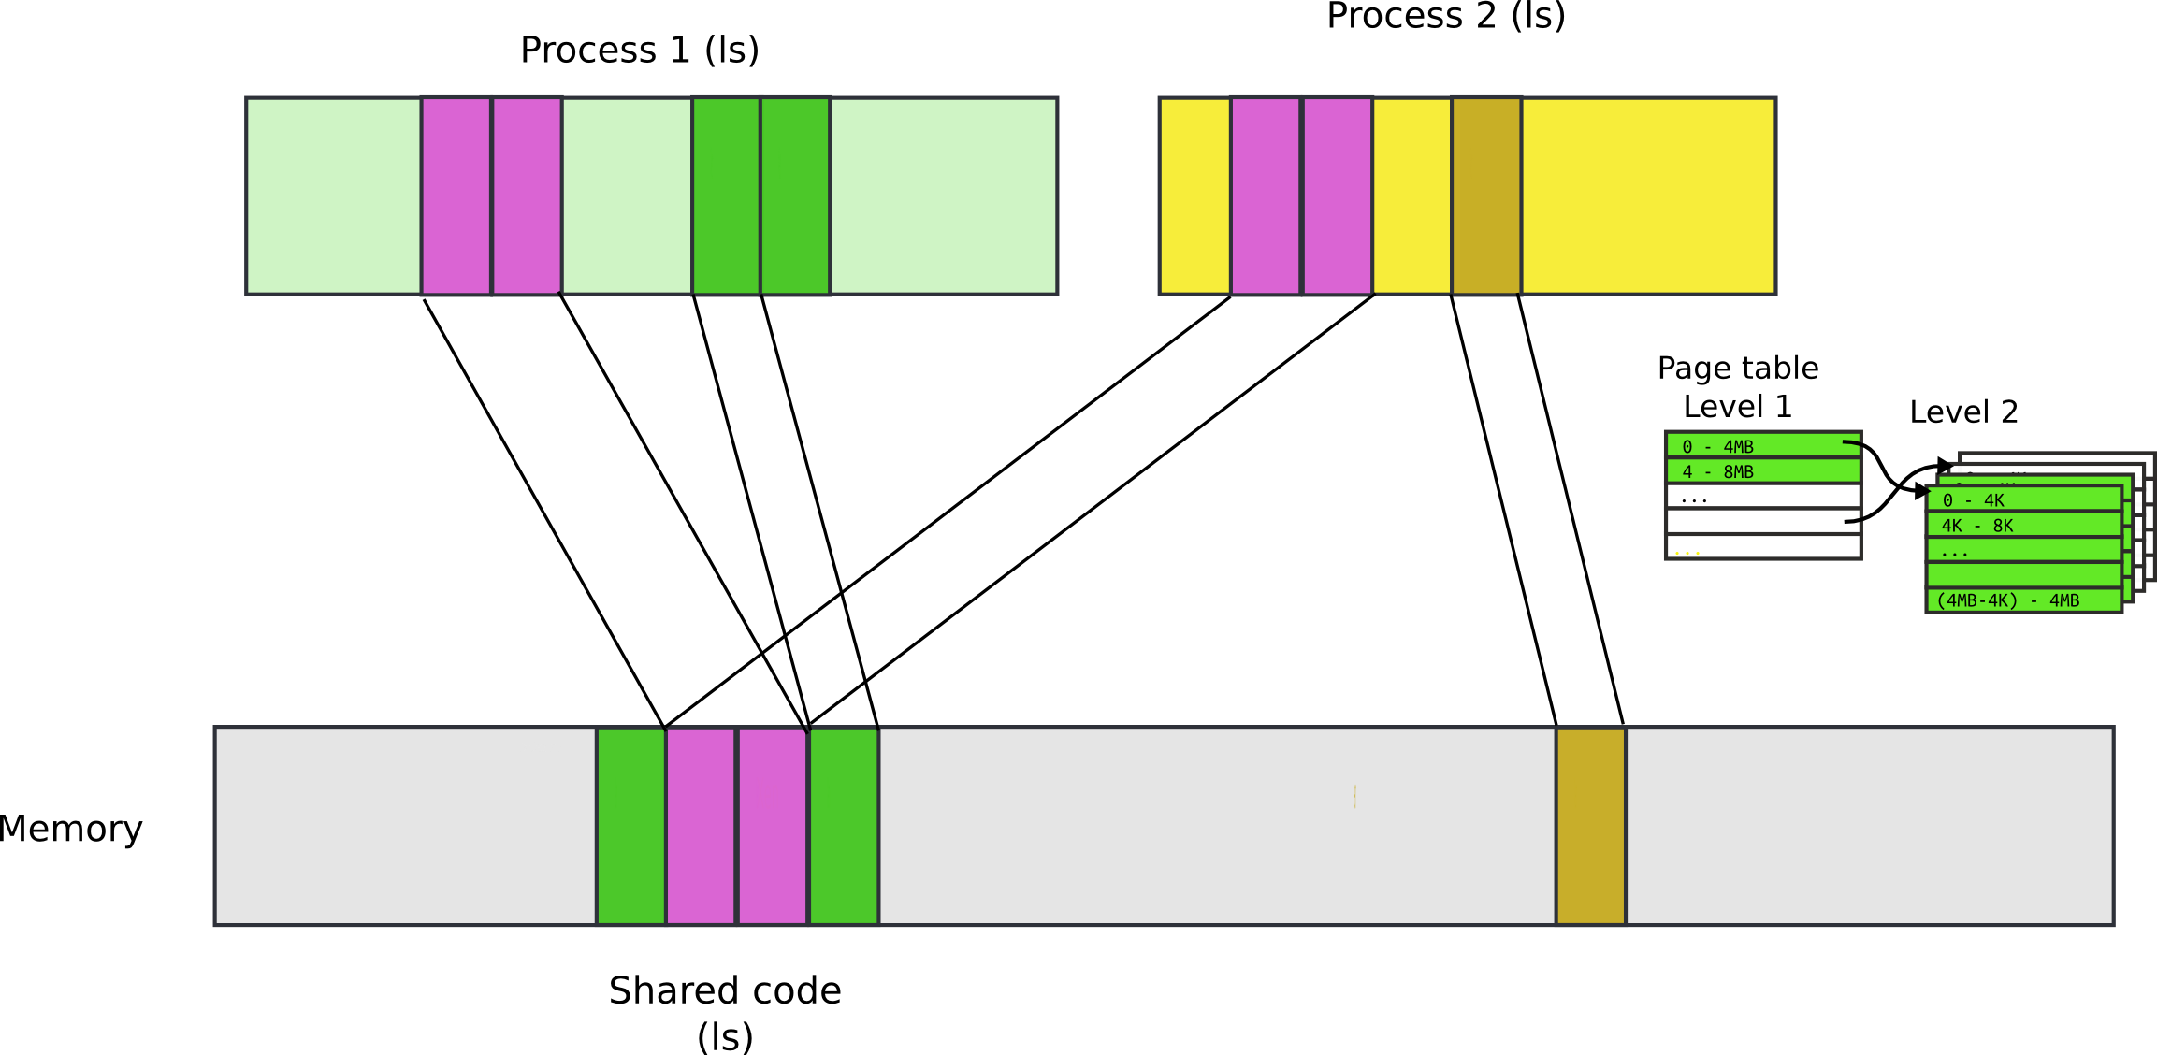
Compared to segments pages allow ...
Share a region of memory across multiple programs
  Well… segments allow this too
  Communication (shared buffer of messages)
  Shared libraries

Slide 84

Recap: complete address translation

Slide 85


Slide 93
32bit x86 supports two page sizes
4KB pages
4MB pages

Slide 94
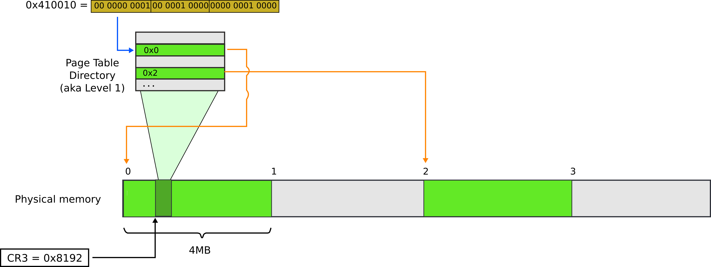
Page translation for 4MB pages

Slide 95

Page translation for 4MB pages

Slide 96
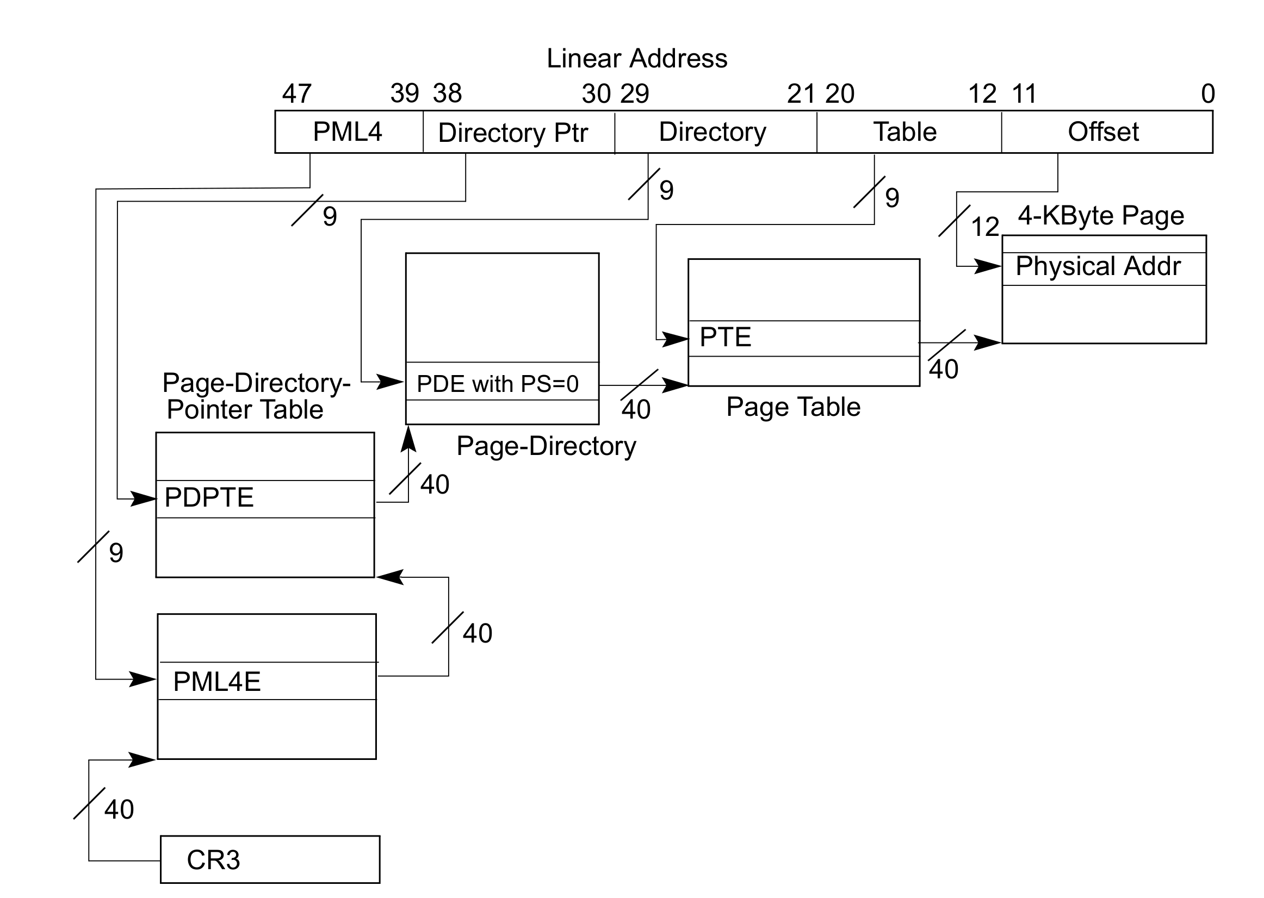
Page translation in 64bit mode
Virtual addresses are 48 bits
Physical addresses are 52 bits

Slide 97
Questions?

Slide 98
What pages are used for
Protect parts of the program
  E.g., map code as read-only
    Disable code modification attacks
    Remember R/W bit in PTD/PTE entries!
  E.g., map stack as non-executable
    Protects from stack smashing attacks
    Non-executable bit

Slide 99
More paging tricks
Determine a working set of a program?

Slide 100
More paging tricks
Determine a working set of a program?
  Use “accessed” bit

Slide 101
More paging tricks
Determine a working set of a program?
  Use “accessed” bit
Iterative copy of a working set?
  Used for virtual machine migration

Slide 102
More paging tricks
Determine a working set of a program?
  Use “accessed” bit
Iterative copy of a working set?
  Used for virtual machine migration
  Use “dirty” bit

Slide 103
More paging tricks
Determine a working set of a program?
  Use “accessed” bit
Iterative copy of a working set?
  Used for virtual machine migration
  Use “dirty” bit
Copy-on-write memory, e.g. lightweigh fork()?

Slide 104
More paging tricks
Determine a working set of a program?
  Use “accessed” bit
Iterative copy of a working set?
  Used for virtual machine migration
  Use “dirty” bit

Slide 105


TLB
Walking page table is slow
  Each memory access is 240 (local) - 360 (one QPI hop away) cycles on modern hardware
  L3 cache access is 50 cycles
cr3

Slide 106
TLB
CPU caches results of page table walks
  In translation lookaside buffer (TLB)
Virt | Phys
0xf0231000 | 0x1000
0x00b31000 | 0x1f000
0xb0002000 | 0xc1000
- | -

Slide 107
TLB invalidation
TLB is a cache (in CPU)
  It is not coherent with memory
  If page table entry is changes, TLB remains the same and is out of sync
cr3
Virt | Phys
0xf0231000 | 0x1000
0x00b31000 | 0x1f000
0xb0002000 | 0xc1000
- | -
Same
Virt Addr.
No Change!!!

Slide 108
TLB invalidation
After every page table update, OS needs to manually invalidate cached values
  Flush TLB
    Either one specific entry
    Or entire TLB, e.g., when CR3 register is loaded
    This happens when OS switches from one process to another
  This is expensive
    Refilling the TLB with new values takes time

Slide 109
Tagged TLBs
Modern CPUs have “tagged TLBs”,
  Each TLB entry has a “tag” – identifier of a process
  No need to flush TLBs on context switch
On Intel this mechanism is called
  Process-Context Identifiers (PCIDs)
Virt | Phys | Tag
0xf0231000 | 0x1000 | P1
0x00b31000 | 0x1f000 | P2
0xb0002000 | 0xc1000 | P1

Slide 110
When would you disable paging?

Slide 111
When would you disable paging?
Imagine you're running a memcached
  Key/value cache
You serve 1024 byte values (typical) on 10Gbps connection
  1024 byte packets can leave every 835ns, or 1670 cycles (2GHz machine)
  This is your target budget per packet

Slide 112
When would you disable paging?
Now, to cover 32GB RAM with 4K pages
  You need 64MB space
  64bit architecture, 4-level page tables (or 5-levels now)
Page tables do not fit in L3 cache
  Modern servers come with 32MB cache
Every cache miss results in up to 4 cache misses due to page walk (remember 4-level page tables)
  Each cache miss is 250 cycles
Solution: 1GB pages

Slide 113
Back of the envelope
If a page is 4K and an entry is 4 bytes, how many entries per page?

Slide 114
Back of the envelope
If a page is 4K and an entry is 4 bytes, how many entries per page?
  1k

Slide 115
Back of the envelope
If a page is 4K and an entry is 4 bytes, how many entries per page?
  1k
How large of an address space can 1 page represent?

Slide 116
Back of the envelope
If a page is 4K and an entry is 4 bytes, how many entries per page?
  1k
How large of an address space can 1 page represent?
  1k entries * 1page/entry * 4K/page = 4MB

Slide 117
Back of the envelope
If a page is 4K and an entry is 4 bytes, how many entries per page?
  1k
How large of an address space can 1 page represent?
  1k entries * 1page/entry * 4K/page = 4MB
How large can we get with a second level of translation?

Slide 118
Back of the envelope
If a page is 4K and an entry is 4 bytes, how many entries per page?
  1k
How large of an address space can 1 page represent?
  1k entries * 1page/entry * 4K/page = 4MB
How large can we get with a second level of translation?
  1k tables/dir * 1k entries/table * 4k/page = 4 GB
  Nice that it works out that way!

Slide 119
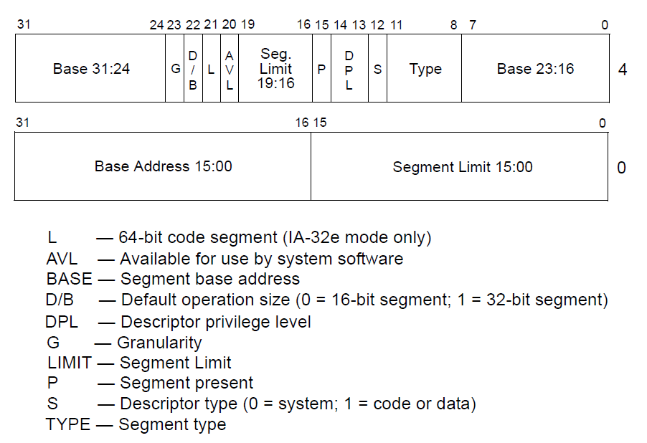
Segment descriptors

Slide 120
Page translation

Slide 121
Page translation

Slide 122
Page directory entry (PDE)
20 bit address of the page table

Slide 123
Page directory entry (PDE)
20 bit address of the page table
Wait... 20 bit address, but we need 32 bits

Slide 124
Page directory entry (PDE)
20 bit address of the page table
Wait... 20 bit address, but we need 32 bits
  Pages 4KB each, we need 1M to cover 4GB
  Pages start at 4KB (page aligned boundary)

Slide 125
Page directory entry (PDE)
Bit #1: R/W – writes allowed?
  But allowed where?

Slide 126
Page directory entry (PDE)
Bit #1: R/W – writes allowed?
  But allowed where?
  One page directory entry controls 1024 Level 2 page tables
    Each Level 2 maps 4KB page
  So it's a region of 4KB x 1024 = 4MB

Slide 127
Page directory entry (PDE)
Bit #2: U/S – user/supervisor
  If 0 – user-mode access is not allowed
  Allows protecting kernel memory from user-level applications

Slide 128
Page translation

Slide 129
Page table entry (PTE)
20 bit address of the 4KB page
  Pages 4KB each, we need 1M to cover 4GB
Bit #1: R/W – writes allowed?
  To a 4KB page
Bit #2: U/S – user/supervisor
  If 0 user-mode access is not allowed
Bit #5: A – accessed
Bit #6: D – dirty – software has written to this page

Slide 130
Page translation

Slide 131
Questions?

