Slide 1
143A: Operating Systems
Lecture 3: Stack, function invocations, and calling conventions
Anton Burtsev
October, 2019

Slide 2
Last two lectures: x86 instruction set
Three main groups
  Data movement (from memory and between registers)
  Arithmetic operations (addition, subtraction, etc.)
  Control flow (jumps, function calls)

Slide 3
This is enough to write all programs you can think of

Slide 4
Stack and procedure calls

Slide 5
What is stack?

Slide 6
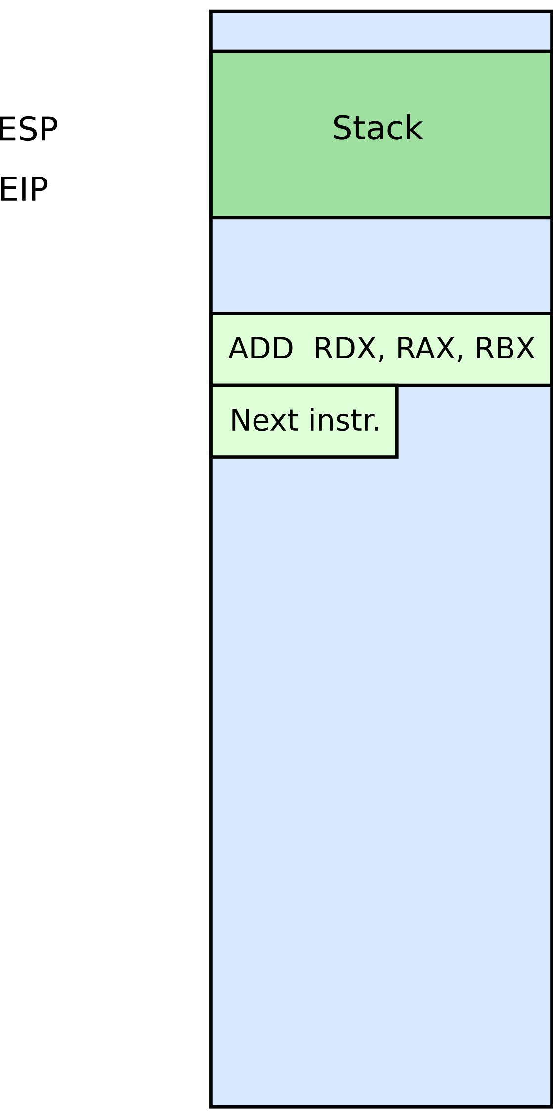




Stack
It's just a region of memory
  Pointed by a special register ESP
You can change ESP
  Get a new stack

Slide 7
Why do we need stack?

Slide 8
Calling functions
// some code...
foo();
// more code..
Stack contains information for how to return from a subroutine
  i.e., from foo()
Functions can be called from different places in the program
if (a == 0) {
foo();
…
} else {
foo();
…
}

Slide 9





Stack
Main purpose:
  Store the return address for the current procedure
  Caller pushes return address on the stack
  Callee pops it and jumps

Slide 10
Stack
Main purpose:
  Store the return address for the current procedure
  Caller pushes return address on the stack
  Callee pops it and jumps

Slide 11
Call/return
CALL instruction
  Makes an unconditional jump to a subprogram and pushes the address of the next instruction on the stack
push eip + sizeof(CALL); save return
; address
jmp _my_function
RET instruction
  Pops off an address and jumps to that address

Slide 12
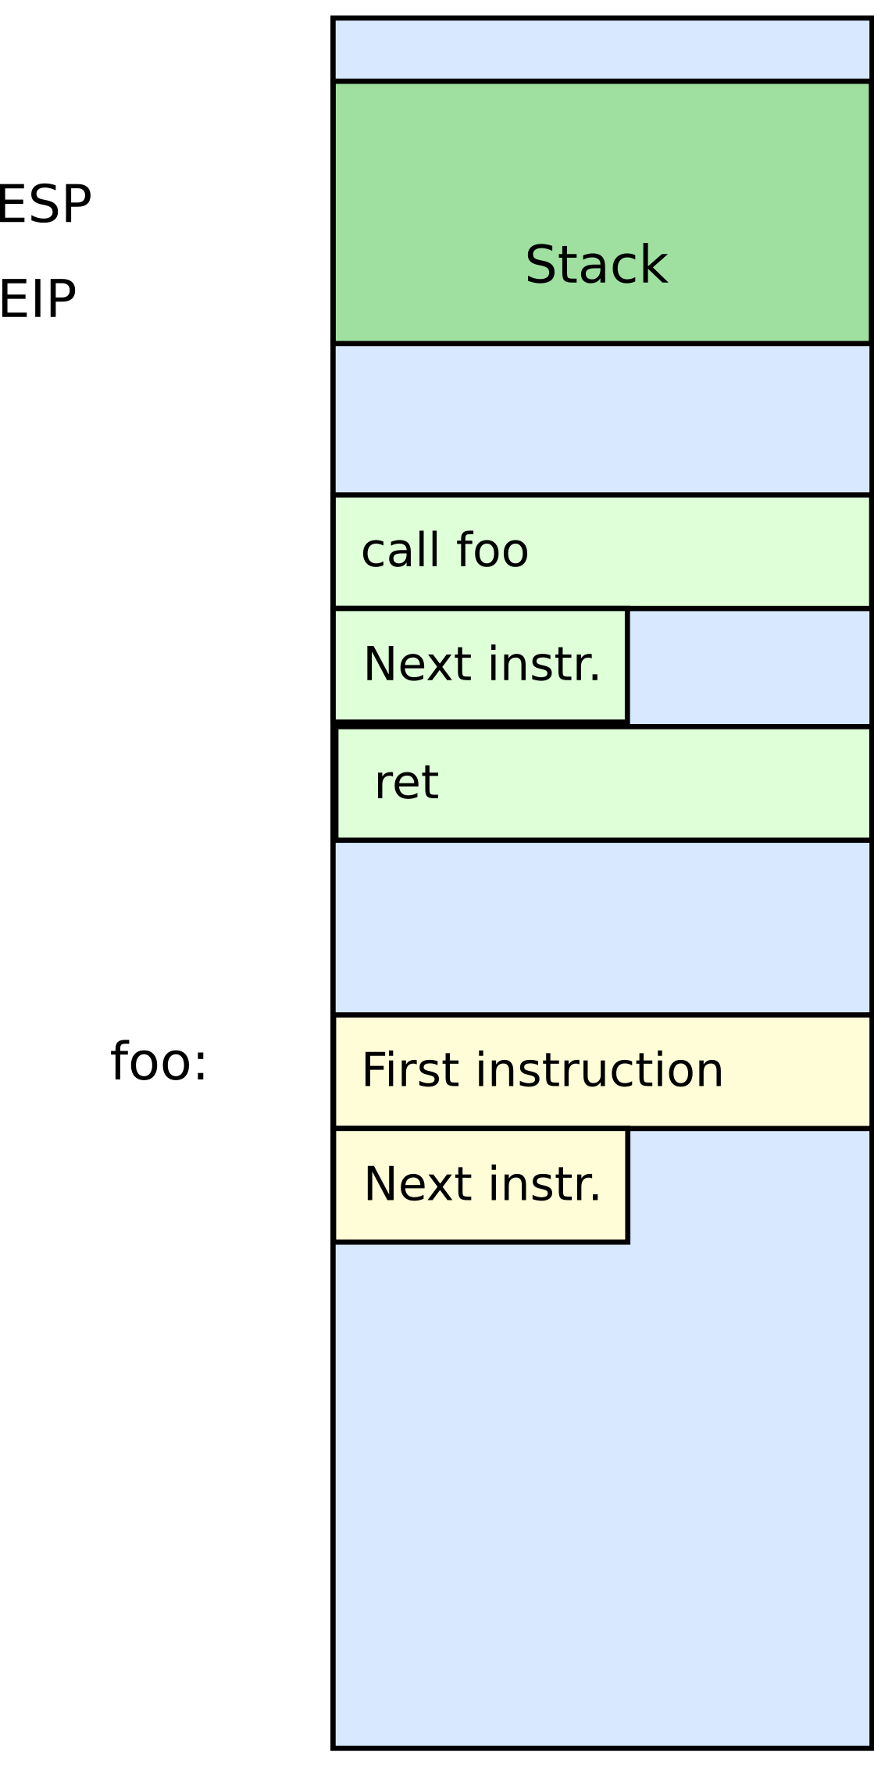
Stack
Other uses:
  Local data storage
  Parameter passing
  Evaluation stack
    Register spill

Slide 13
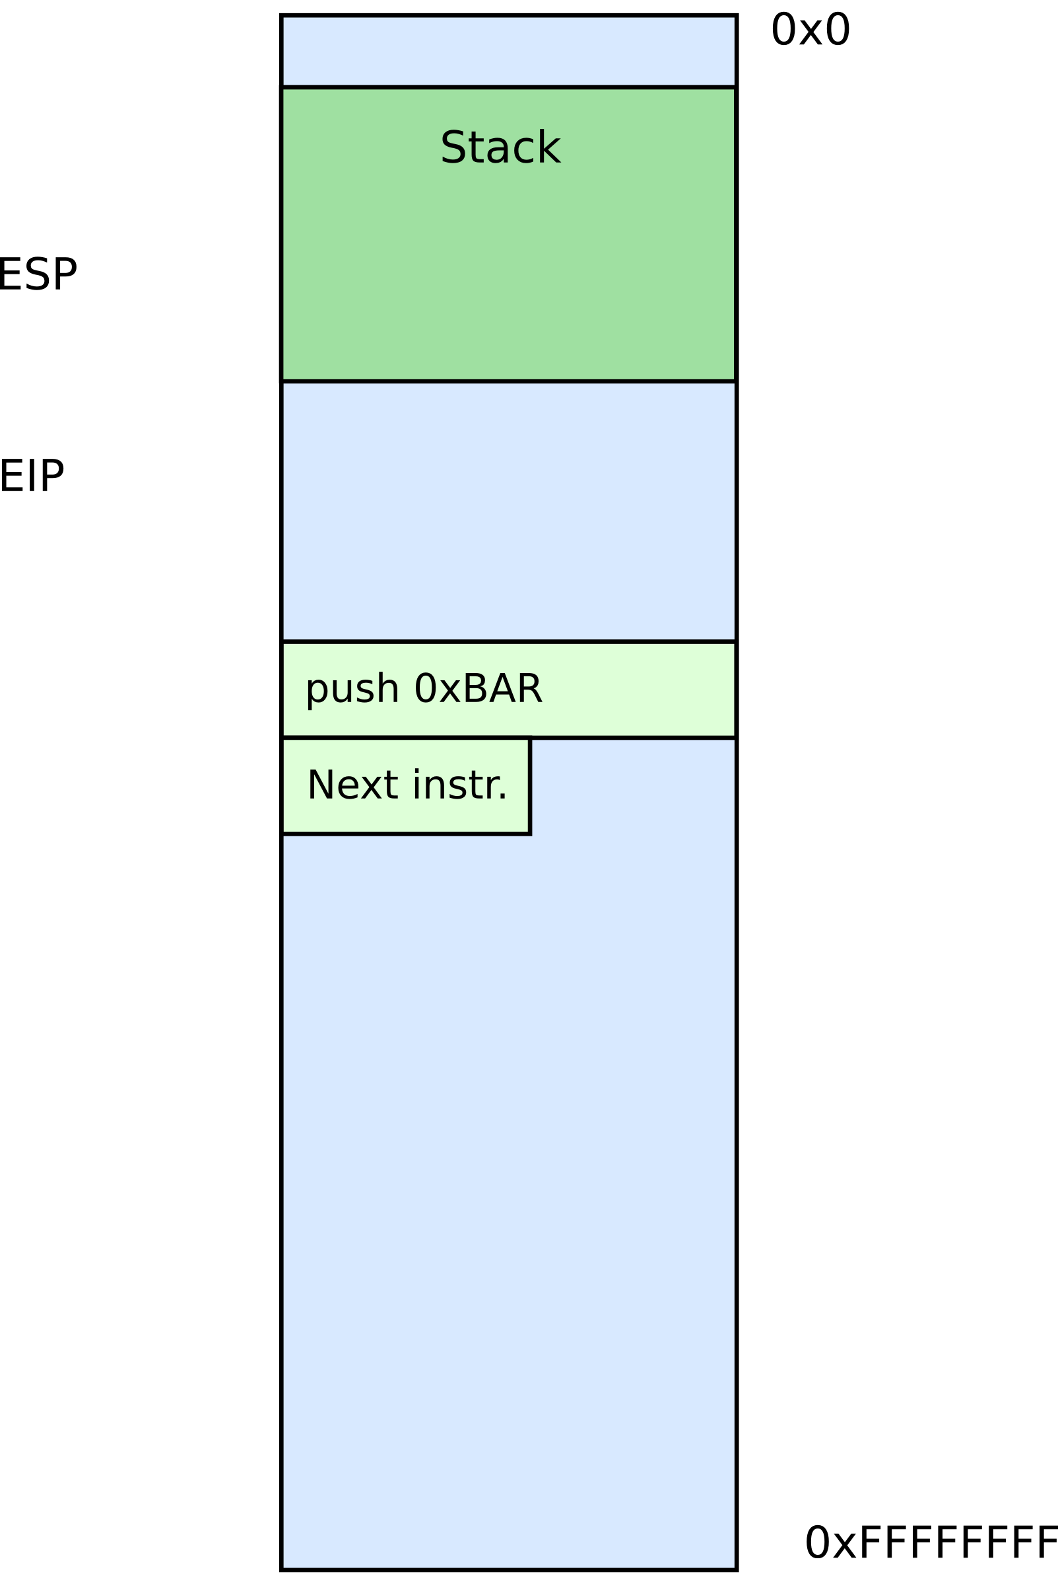


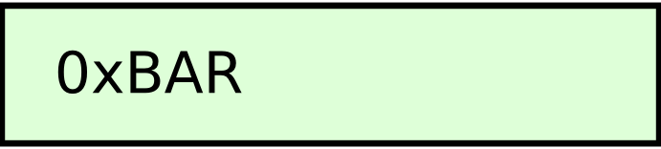
Manipulating stack
ESP register
  Contains the memory address of the topmost element in the stack
PUSH instruction
push 0xBAR
  Subtract 4 from ESP
  Insert data on the stack

Slide 14
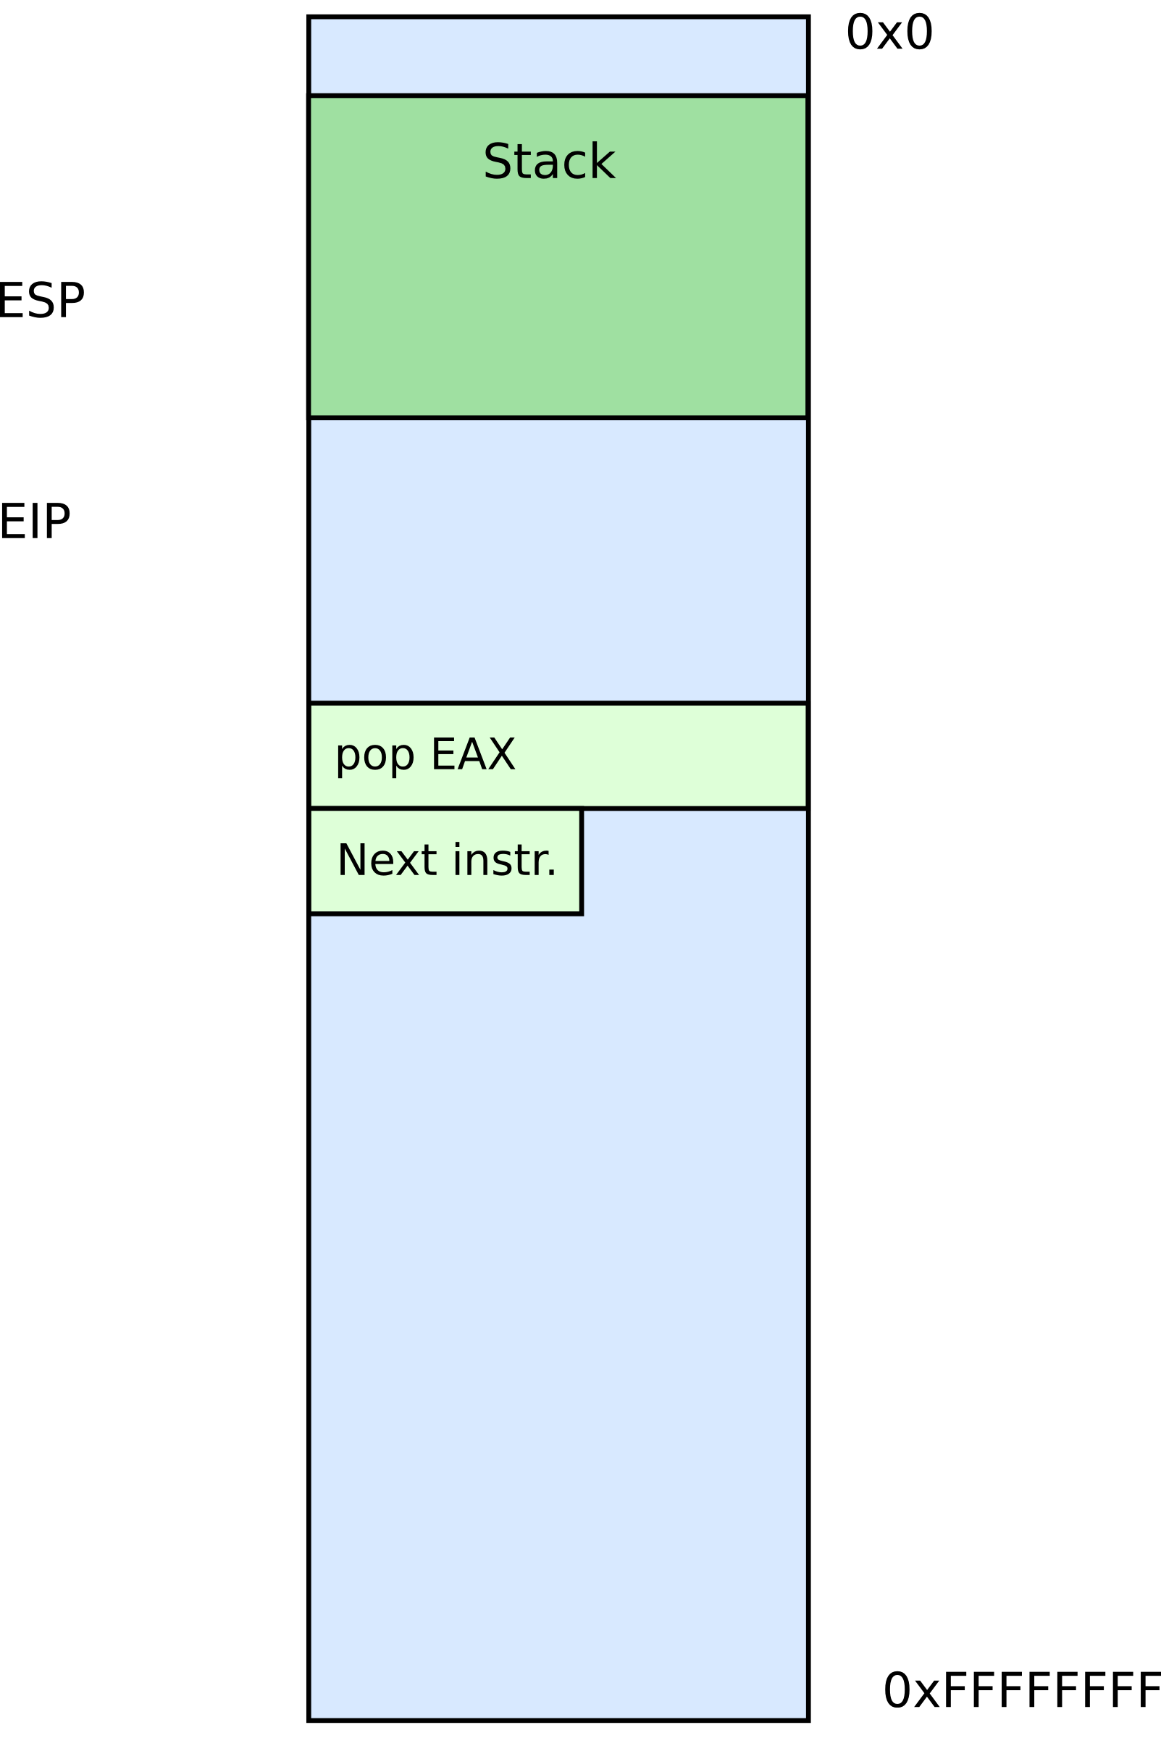

Manipulating stack
POP instruction
pop EAX
  Removes data from the stack
  Saves in register or memory
  Adds 4 to ESP

Slide 15
Calling conventions

Slide 16
Calling conventions
Goal: re-entrant programs
  How to pass arguments
    On the stack?
    In registers?
  How to return values
    On the stack?
    In registers?
Conventions differ from compiler, optimizations, etc.

Slide 17

Maintain stack as frames
Each function has a new frame
void DrawSquare(...)
{
...
DrawLine(x, y, z);
}
Use dedicated register EBP (frame pointer)
  Points to the base of the frame

Slide 18
Maintain stack as frames
Each function has a new frame
void DrawSquare(...)
{
...
DrawLine(x, y, z);
}
Use dedicated register EBP (frame pointer)
  Points to the base of the frame

Slide 19
Stack consists of frames
Each function has a new frame
void DrawSquare(...)
{
...
DrawLine(x, y, z);
}
Use dedicated register EBP (frame pointer)
  Points to the base of the frame

Slide 20
Prologue/epilogue
Each function maintains the frame
  A dedicated register EBP is used to keep the frame pointer
  Each function uses prologue code (blue), and epilogue (yellow) to maintain the frame
my_function:
push ebp ; save original EBP value on stack
mov ebp, esp ; new EBP = ESP
…. ; function body
pop ebp ; restore original EBP value
ret

Slide 21
Local variables

Slide 22
What types of variables do you know?
Or where these variables are in memory?

Slide 23
What types of variables do you know?
Global variables
  Initialized → data section
  Uninitalized → BSS
Dynamic variables
  Heap
Local variables
  Stack

Slide 24
Global variables
#include <stdio.h>
char hello[] = "Hello";
int main(int ac, char **av)
{
static char world[] = "world!";
printf("%s %s\n", hello, world);
return 0;
}

Slide 25
Global variables
#include <stdio.h>
char hello[] = "Hello";
int main(int ac, char **av)
{
static char world[] = "world!";
printf("%s %s\n", hello, world);
return 0;
}
Allocated in the data section
  It is split in initialized (non-zero), and non-initialized (zero)
  As well as read/write, and read only data section

Slide 26
Dynamic variables (heap)
#include <stdio.h>
#include <string.h>
#include <stdlib.h>
char hello[] = "Hello";
int main(int ac, char **av)
{
char world[] = "world!";
char *str = malloc(64);
memcpy(str, "beautiful", 64);
printf("%s %s %s\n", hello, str, world);
return 0;
}

Slide 27
Dynamic variables (heap)
#include <stdio.h>
#include <string.h>
#include <stdlib.h>
char hello[] = "Hello";
int main(int ac, char **av)
{
char world[] = "world!";
char *str = malloc(64);
memcpy(str, "beautiful", 64);
printf("%s %s %s\n", hello, str, world);
return 0;
}
Allocated on the heap
  Special area of memory provided by the OS from where malloc() can allocate memory

Slide 28
Local variables
Local variables
#include <stdio.h>
char hello[] = "Hello";
int main(int ac, char **av)
{
//static char world[] = "world!";
char world[] = "world!";
printf("%s %s\n", hello, world);
return 0;
}

Slide 29
Local variables...
Each function has private instances of local
variables
foo(int x) {
int a, b, c;
...
return;
}
Function can be called recursively
foo(int x) {
int a, b, c;
a = x + 1;
if ( a < 100 )
foo(a);
return;
}

Slide 30
How to allocate local variables?
void my_function()
{
int a, b, c;
…
}

Slide 31
How to allocate local variables?
void my_function()
{
int a, b, c;
…
}
On the stack!

Slide 32
Allocating local variables
Stored right after the saved EBP value in the stack
Allocated by subtracting the number of bytes required from ESP
_my_function:
push ebp ; save original EBP value on stack
mov ebp, esp ; new EBP = ESP
sub esp, LOCAL_BYTES ; = # bytes needed by locals
… ; function body
mov esp, ebp ; deallocate locals
pop ebp ; restore original EBP value
ret

Slide 33
Example
void my_function() {
int a, b, c;
…
_my_function:
push ebp ; save the value of ebp
mov ebp, esp ; ebp = esp, set ebp to be top of the stack (esp)
sub esp, 12 ; move esp down to allocate space for the
; local variables on the stack
With frames local variables can be accessed by dereferencing EBP
mov [ebp - 4], 10 ; location of variable a
mov [ebp - 8], 5 ; location of b
mov [ebp - 12], 2 ; location of c

Slide 34
Example
void my_function() {
int a, b, c;
…
_my_function:
push ebp ; save the value of ebp
mov ebp, esp ; ebp = esp, set ebp to be top of the stack (esp)
sub esp, 12 ; move esp down to allocate space for the
; local variables on the stack
With frames local variables can be accessed by dereferencing EBP
mov [ebp - 4], 10 ; location of variable a
mov [ebp - 8], 5 ; location of b
mov [ebp - 12], 2 ; location of c

Slide 35
Example
void my_function() {
int a, b, c;
…
_my_function:
push ebp ; save the value of ebp
mov ebp, esp ; ebp = esp, set ebp to be top of the stack (esp)
sub esp, 12 ; move esp down to allocate space for the
; local variables on the stack
With frames local variables can be accessed by dereferencing EBP
mov [ebp - 4], 10 ; location of variable a
mov [ebp - 8], 5 ; location of b
mov [ebp - 12], 2 ; location of c

Slide 36
Example
void my_function() {
int a, b, c;
…
_my_function:
push ebp ; save the value of ebp
mov ebp, esp ; ebp = esp, set ebp to be top of the stack (esp)
sub esp, 12 ; move esp down to allocate space for the
; local variables on the stack
With frames local variables can be accessed by dereferencing EBP
mov [ebp - 4], 10 ; location of variable a
mov [ebp - 8], 5 ; location of b
mov [ebp - 12], 2 ; location of c

Slide 37
How to pass arguments?
Possible options:
  In registers
  On the stack

Slide 38
How to pass arguments?
x86 32 bit
  Pass arguments on the stack
  Return value is in EAX and EDX
x86 64 bit – more registers!
  Pass first 6 arguments in registers
    RDI, RSI, RDX, RCX, R8, and R9
  The rest on the stack
  Return value is in RAX and RDX

Slide 39
x86_32: passing arguments on the stack
Example function
void my_function(int x, int y, int z)
{ … }
Example invocation
my_function(2, 5, 10);
Generated code
push 10
push 5
push 2
call _my_function

Slide 40
Example stack
: :
| 10 | [ebp + 16] (3rd function argument)
| 5 | [ebp + 12] (2nd argument)
| 2 | [ebp + 8] (1st argument)
| RA | [ebp + 4] (return address)
| FP | [ebp] (old ebp value) ← EBP points here
| | [ebp - 4] (1st local variable)
: :
: :
| | [ebp - X] (esp - the current stack pointer)

Slide 41
Example stack
: :
| 10 | [ebp + 16] (3rd function argument)
| 5 | [ebp + 12] (2nd argument)
| 2 | [ebp + 8] (1st argument)
| RA | [ebp + 4] (return address)
| FP | [ebp] (old ebp value) ← EBP points here
| | [ebp - 4] (1st local variable)
: :
: :
| | [ebp - X] (esp - the current stack pointer)

Slide 42
Example stack
: :
| 10 | [ebp + 16] (3rd function argument)
| 5 | [ebp + 12] (2nd argument)
| 2 | [ebp + 8] (1st argument)
| RA | [ebp + 4] (return address)
| FP | [ebp] (old ebp value) ← EBP points here
| | [ebp - 4] (1st local variable)
: :
: :
| | [ebp - X] (esp - the current stack pointer)

Slide 43
Example stack
: :
| 10 | [ebp + 16] (3rd function argument)
| 5 | [ebp + 12] (2nd argument)
| 2 | [ebp + 8] (1st argument)
| RA | [ebp + 4] (return address)
| FP | [ebp] (old ebp value) ← EBP points here
| | [ebp - 4] (1st local variable)
: :
: :
| | [ebp - X] (esp - the current stack pointer)

Slide 44
Example: caller side code
caller:
; manage own stack frame
push ebp
mov ebp, esp
; push call arguments
push 3
push 2
push 1
; call subroutine 'callee'
call callee
; remove arguments from frame
add esp, 12
; use subroutine result
add eax, 5
; restore old call frame
pop ebp
; return
ret
int callee(int, int, int);
int caller(void)
{
int ret;
ret = callee(1, 2, 3);
ret += 5;
return ret;
}

Slide 45
Example: caller side code
caller:
; manage own stack frame
push ebp
mov ebp, esp
; push call arguments
push 3
push 2
push 1
; call subroutine 'callee'
call callee
; remove arguments from frame
add esp, 12
; use subroutine result
add eax, 5
; restore old call frame
pop ebp
; return
ret
int callee(int, int, int);
int caller(void)
{
int ret;
ret = callee(1, 2, 3);
ret += 5;
return ret;
}

Slide 46
Example: caller side code
caller:
; manage own stack frame
push ebp
mov ebp, esp
; push call arguments
push 3
push 2
push 1
; call subroutine 'callee'
call callee
; remove arguments from frame
add esp, 12
; use subroutine result
add eax, 5
; restore old call frame
pop ebp
; return
ret
int callee(int, int, int);
int caller(void)
{
int ret;
ret = callee(1, 2, 3);
ret += 5;
return ret;
}

Slide 47
Example: caller side code
caller:
; manage own stack frame
push ebp
mov ebp, esp
; push call arguments
push 3
push 2
push 1
; call subroutine 'callee'
call callee
; remove arguments from frame
add esp, 12
; use subroutine result
add eax, 5
; restore old call frame
pop ebp
; return
ret
int callee(int, int, int);
int caller(void)
{
int ret;
ret = callee(1, 2, 3);
ret += 5;
return ret;
}

Slide 48
Example: caller side code
caller:
; manage own stack frame
push ebp
mov ebp, esp
; push call arguments
push 3
push 2
push 1
; call subroutine 'callee'
call callee
; remove arguments from frame
add esp, 12
; use subroutine result
add eax, 5
; restore old call frame
pop ebp
; return
ret
int callee(int, int, int);
int caller(void)
{
int ret;
ret = callee(1, 2, 3);
ret += 5;
return ret;
}

Slide 49
Example: caller side code
caller:
; manage own stack frame
push ebp
mov ebp, esp
; push call arguments
push 3
push 2
push 1
; call subroutine 'callee'
call callee
; remove arguments from frame
add esp, 12
; use subroutine result
add eax, 5
; restore old call frame
pop ebp
; return
ret
int callee(int, int, int);
int caller(void)
{
int ret;
ret = callee(1, 2, 3);
ret += 5;
return ret;
}

Slide 50
Wait, where is “return ret;” ?
caller:
; manage own stack frame
push ebp
mov ebp, esp
; push call arguments
push 3
push 2
push 1
; call subroutine 'callee'
call callee
; remove arguments from frame
add esp, 12
; use subroutine result
add eax, 5
; restore old call frame
pop ebp
; return
ret
int callee(int, int, int);
int caller(void)
{
int ret;
ret = callee(1, 2, 3);
ret += 5;
return ret;
}

Slide 51
Example: callee side code
void my_function(int x, int y, int z)
{
int a, b, c;
…
return;
}
_my_function:
push ebp
mov ebp, esp
sub esp, 12 ; allocate local varaibles
; sizeof(a) + sizeof(b) + sizeof(c)
; x = [ebp + 8], y = [ebp + 12], z = [ebp + 16]
; a=[ebp-4]=[esp+8],
; b=[ebp-8]=[esp+4], c=[ebp-12] = [esp]
mov esp, ebp ; deallocate local variables
pop ebp
ret

Slide 52
Example: callee side code
void my_function(int x, int y, int z)
{
int a, b, c;
…
return;
}
_my_function:
push ebp
mov ebp, esp
sub esp, 12 ; allocate local varaibles
; sizeof(a) + sizeof(b) + sizeof(c)
; x = [ebp + 8], y = [ebp + 12], z = [ebp + 16]
; a=[ebp-4]=[esp+8],
; b=[ebp-8]=[esp+4], c=[ebp-12] = [esp]
mov esp, ebp ; deallocate local variables
pop ebp
ret

Slide 53
Example: callee side code
void my_function(int x, int y, int z)
{
int a, b, c;
…
return;
}
_my_function:
push ebp
mov ebp, esp ; ebp = esp
sub esp, 12 ; allocate local varaibles
; sizeof(a) + sizeof(b) + sizeof(c)
; x = [ebp + 8], y = [ebp + 12], z = [ebp + 16]
; a=[ebp-4]=[esp+8],
; b=[ebp-8]=[esp+4], c=[ebp-12] = [esp]
mov esp, ebp ;deallocate local variables (esp = ebp)
pop ebp
ret

Slide 54
Example: callee side code
void my_function(int x, int y, int z)
{
int a, b, c;
…
return;
}
_my_function:
push ebp
mov ebp, esp ; ebp = esp
sub esp, 12 ; allocate local varaibles
; sizeof(a) + sizeof(b) + sizeof(c)
; x = [ebp + 8], y = [ebp + 12], z = [ebp + 16]
; a=[ebp-4]=[esp+8],
; b=[ebp-8]=[esp+4], c=[ebp-12] = [esp]
mov esp, ebp ;deallocate local variables (esp = ebp)
pop ebp
ret

Slide 55
Example: callee side code
void my_function(int x, int y, int z)
{
int a, b, c;
…
return;
}
_my_function:
push ebp
mov ebp, esp ; ebp = esp
sub esp, 12 ; allocate local varaibles
; sizeof(a) + sizeof(b) + sizeof(c)
; x = [ebp + 8], y = [ebp + 12], z = [ebp + 16]
; a=[ebp-4]=[esp+8],
; b=[ebp-8]=[esp+4], c=[ebp-12] = [esp]
mov esp, ebp ;deallocate local variables (esp = ebp)
pop ebp
ret

Slide 56
leave instruction
void my_function(int x, int y, int z)
{
int a, b, c;
…
return;
}
_my_function:
push ebp
mov ebp, esp ; ebp = esp
sub esp, 12 ; allocate local varaibles
; sizeof(a) + sizeof(b) + sizeof(c)
; x = [ebp + 8], y = [ebp + 12], z = [ebp + 16]
; a=[ebp-4]=[esp+8],
; b=[ebp-8]=[esp+4], c=[ebp-12] = [esp]
mov esp, ebp
pop ebp
ret
x86 has a special instruction for this
  leave

Slide 57
Back to stack frames, so why do we need them?
… They are not strictly required
GCC compiler option -fomit-frame-pointer can disable them
Don't keep the frame pointer in a register for functions that don't need one. This avoids the instructions to save, set up and restore frame pointers; it also makes an extra register available in many functions. It also makes debugging impossible on some machines.

Slide 58


Referencing args without frames
Initially parameter is
  [ESP + 4]
Later as the function pushes things on the stack it changes, e.g.
  [ESP + 8]

Slide 59
Debugging becomes hard
  As ESP changes one has to manually keep track where local variables are relative to ESP (ESP + 4 or +8)
    Compiler can easily do this and generate correct code!
    But it's hard for a human
  It's hard to unwind the stack in case of a crash
    To print out a backtrace

Slide 60
And you only save...
A couple instructions required to maintain the stack frame
And 1 register (EBP)
  x32 has 8 registers (and one is ESP)
    So taking another one is 12.5% of register space
    Sometimes its worse it!
  x64 has 16 registers, so it doesn't really matter
That said, GCC sets -fomit-frame-pointer to “on”
  At -O, -O1, -O2 …
  Don't get surprised

Slide 61
Relevant part of the GCC manual
3.10 Options That Control Optimization
https://gcc.gnu.org/onlinedocs/gcc/Optimize-Options.html
-O
-O1
With -O, the compiler tries to reduce code size and execution time, without performing any optimizations that take a great deal of compilation time.
-O turns on the following optimization flags:
-fauto-inc-dec
-fbranch-count-reg
...
-fomit-frame-pointer
-freorder-blocks

Slide 62
Saving and restoring registers

Slide 63
Saving register state across invocations
Processor doesn't save registers
  General purpose, segment, flags
Again, a calling convention is needed
  Agreement on what gets saved by the callee and the caller

Slide 64
Saving register state across invocations
Registers EAX, ECX, and EDX are caller-saved
  The function is free to use them
... the rest are callee-saved
  If the function uses them it has to restore them to the original values

Slide 65
In general there multiple calling conventions
  We described cdecl
  Make sure you know what you're doing
  https://en.wikipedia.org/wiki/X86_calling_conventions#List_of_x86_calling_conventions
  It's easy as long as you know how to read the table

Slide 66
Questions?

Slide 67
References
https://en.wikibooks.org/wiki/X86_Disassembly/Functions_and_Stack_Frames
https://en.wikipedia.org/wiki/Calling_convention
https://en.wikipedia.org/wiki/X86_calling_conventions
http://stackoverflow.com/questions/14666665/trying-to-understand-gcc-option-fomit-frame-pointer

