Slide 1
143A: Principles of Operating Systems
Lecture 5: Address translation
(Part 2)
Anton Burtsev
October, 2018

Slide 2
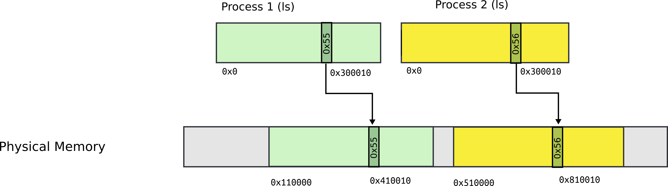
Segmentation

Slide 3
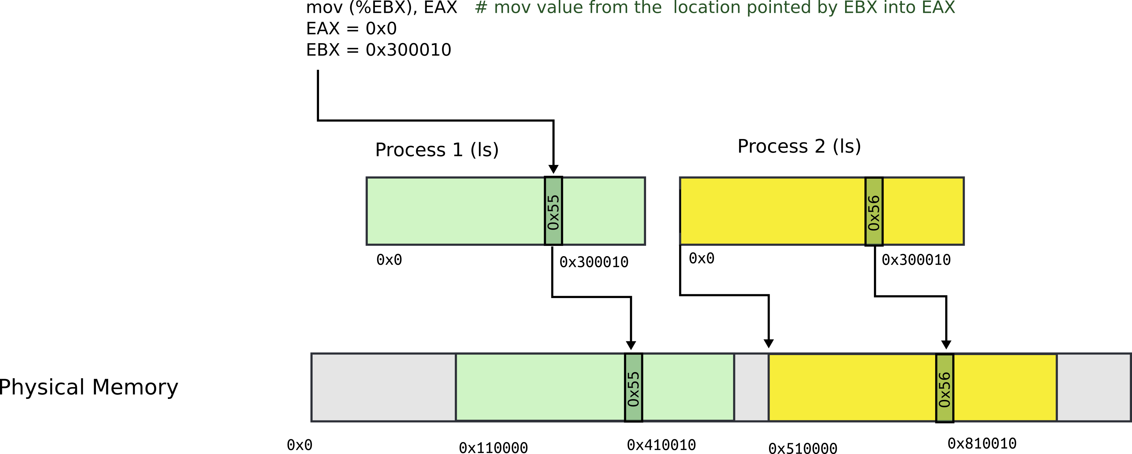
Segmentation: example

Slide 4
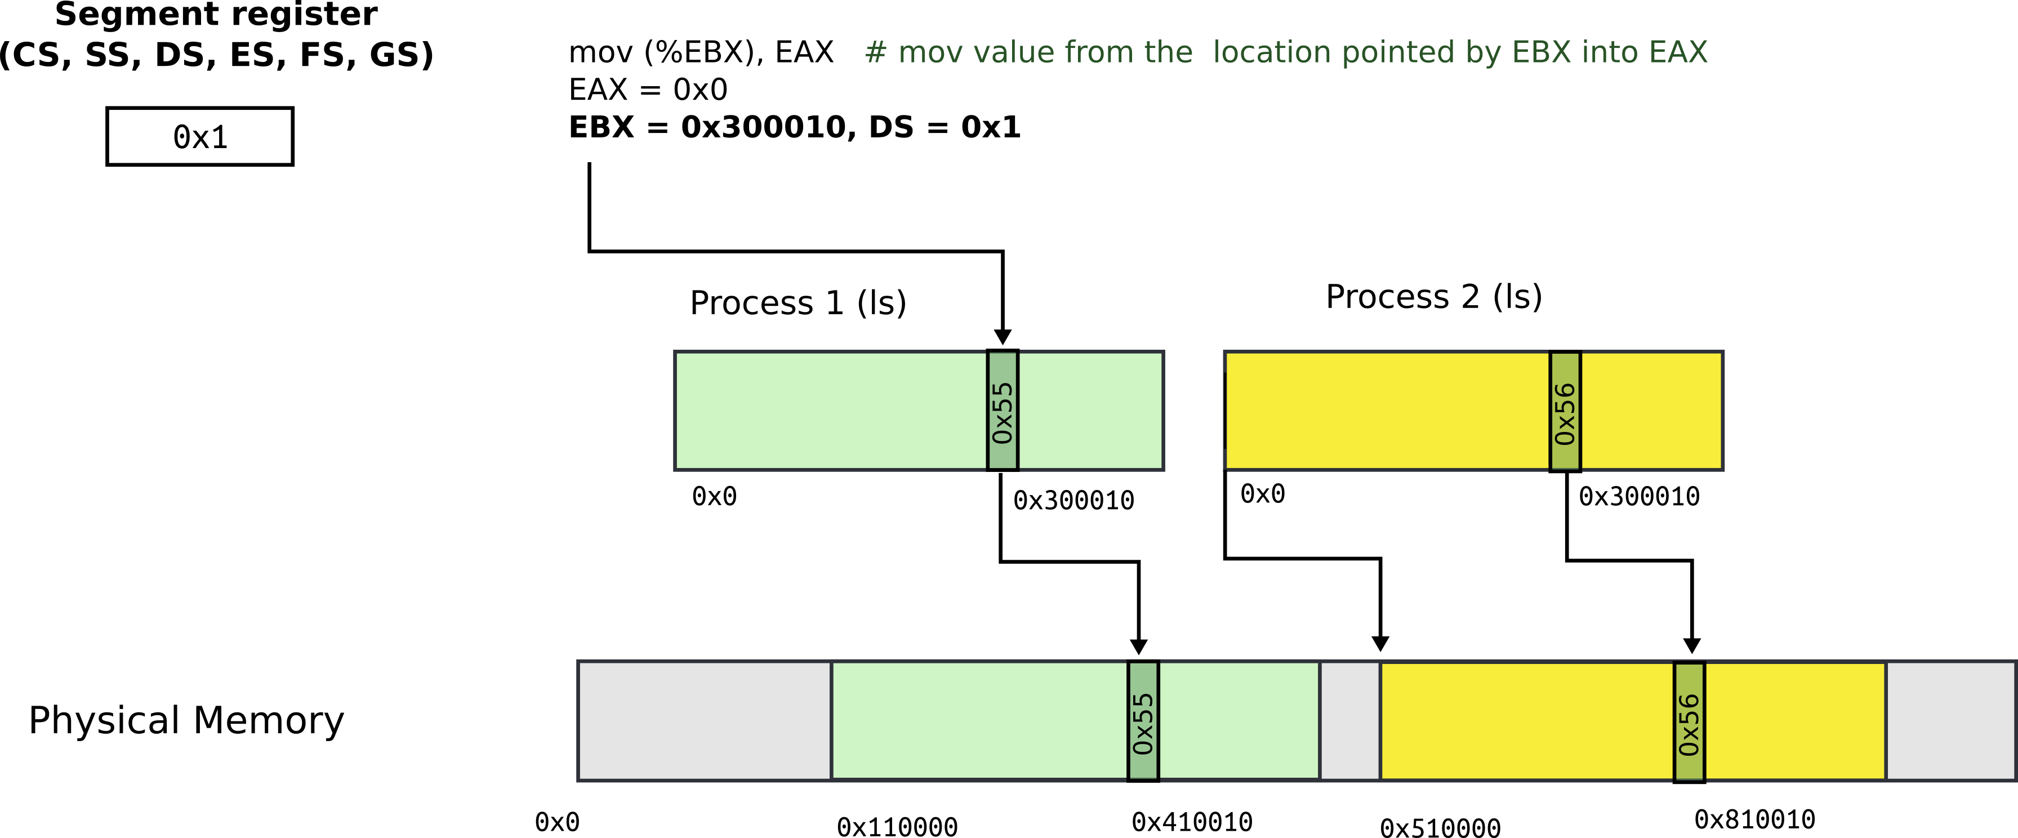
Segmentation: address consists of two parts
Segment register contains segment selector
General registers contain offsets
Intel calls this address: “logical address”

Slide 5
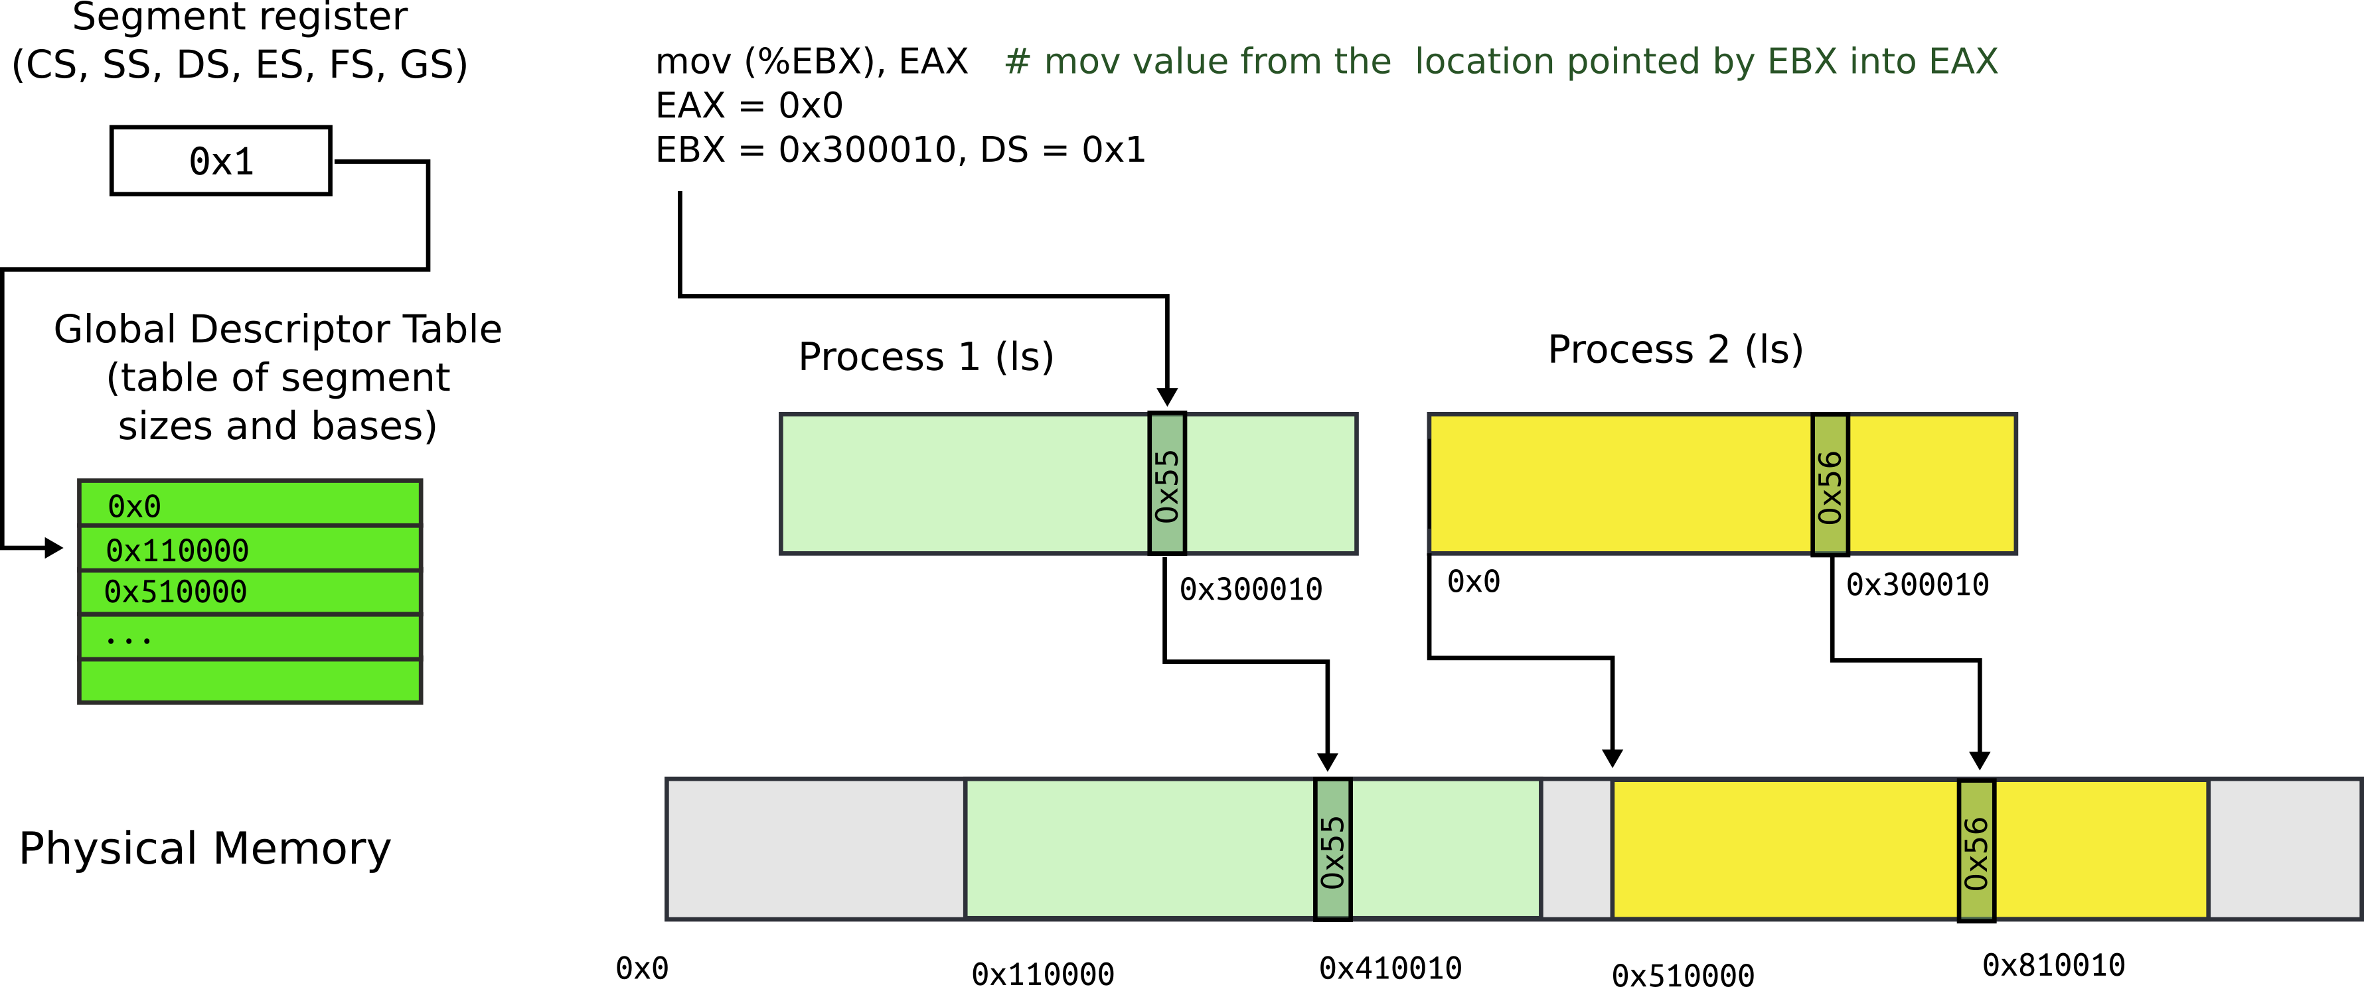
Segmentation: Global Descriptor Table
GDT is an array of segment descriptors
  Each descriptor contains base and limit for the segment
  Plus access control flags

Slide 6
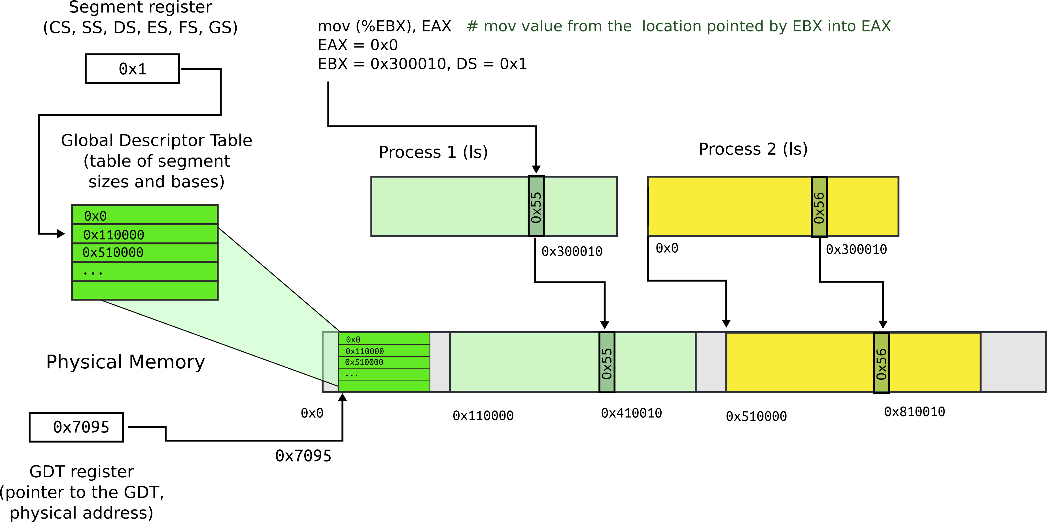
Segmentation: Global Descriptor Table
Location of GDT in physical memory is pointed by the GDT register

Slide 7
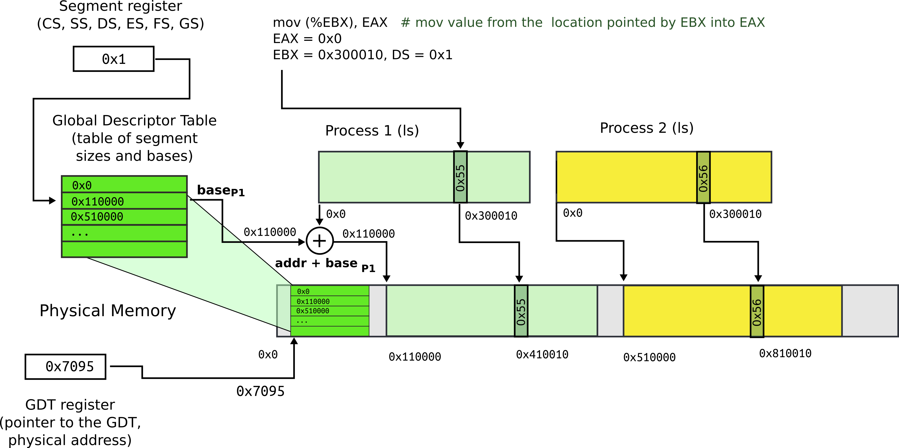
Segmentation: base + offset
Segment register (0x1) chooses an entry in GDT
This entry contains base of the segment (0x110000) and limit (size) of the segment (not shown)

Slide 8

Segmentation: base + offset
Physical address:
  0x410010 = 0x300010 (offset) + 0x110000 (base)
  Intel calls this address “linear”

Slide 9
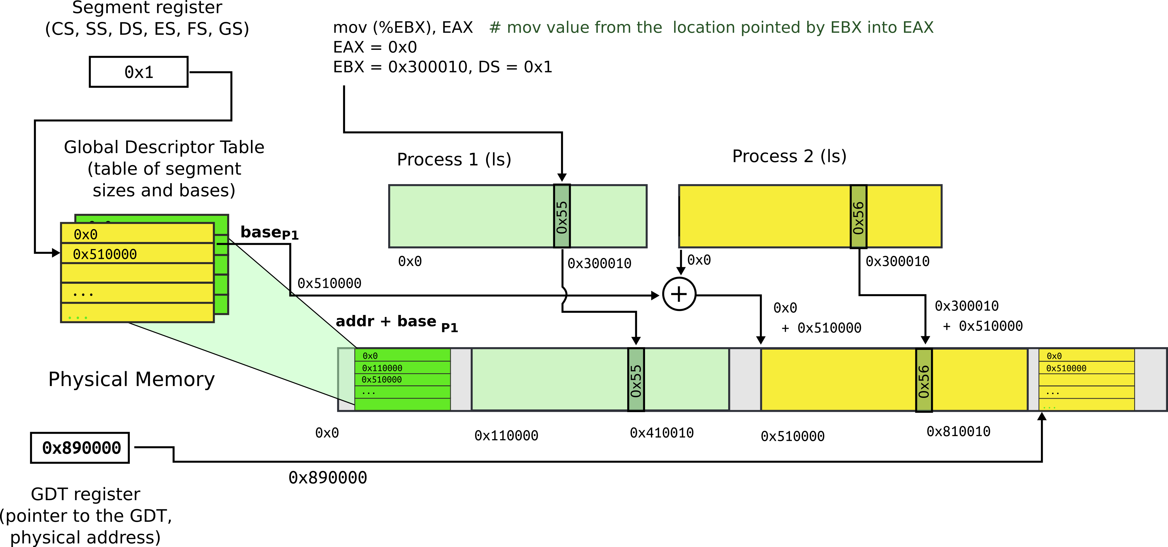
Segmentation: process 2
Each process has a private GDT
  OS will switch between GDTs

Slide 10
Segmentation: what did we achieve
Illusion of a private address space
  Identical copy of an address space in multiple programs
    We can implement fork()
Isolation
  Processes cannot access memory outside of their segments

Slide 11

Paging

Slide 12
Paging idea
Break up memory into 4096-byte chunks called pages
  Modern hardware supports 2MB, 4MB, and 1GB pages
Independently control mapping for each page of linear address space
Compare with segmentation (single base + limit)
  many more degrees of freedom

Slide 13
How can we build this translation mechanism?

Slide 14
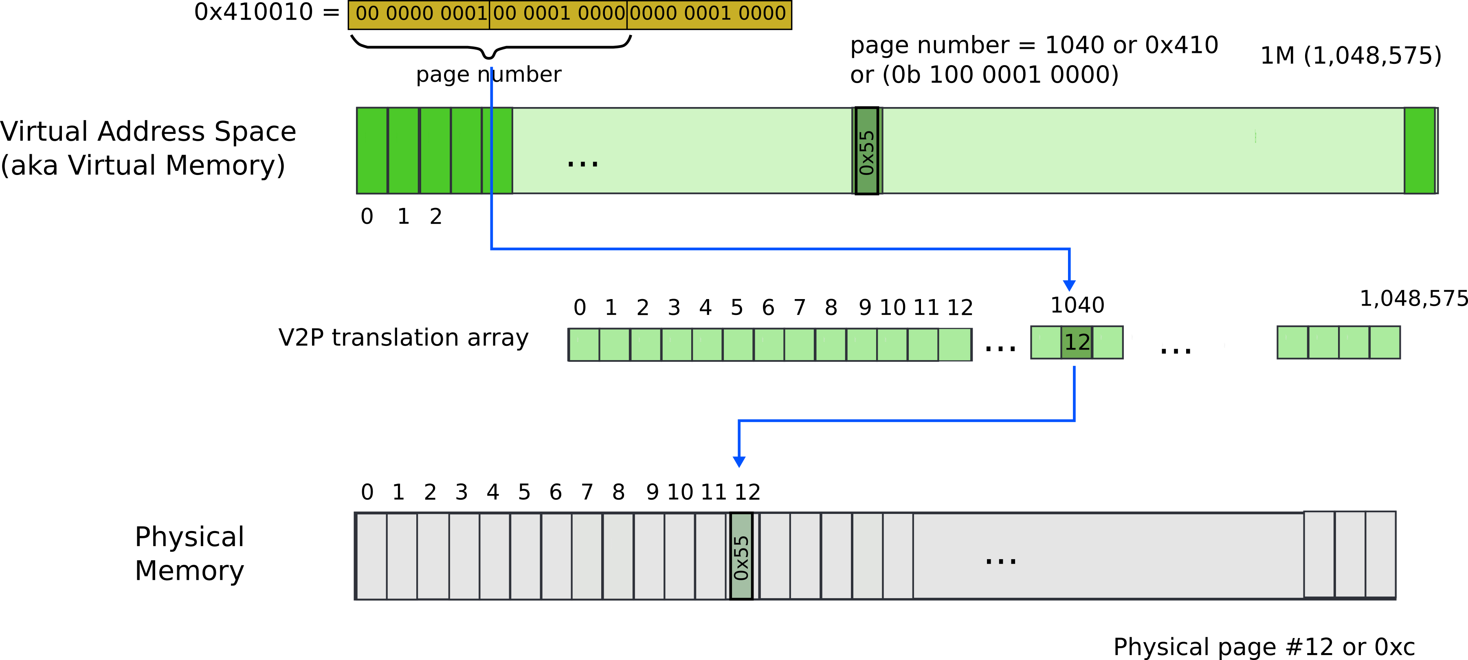
Paging: naive approach: translation array
Linear address 0x410010
  Remember it’s result of logical to linear translation (aka segmentation)
    0x410010 = 0x300010 (offset) + 0x110000 (base)

Slide 15
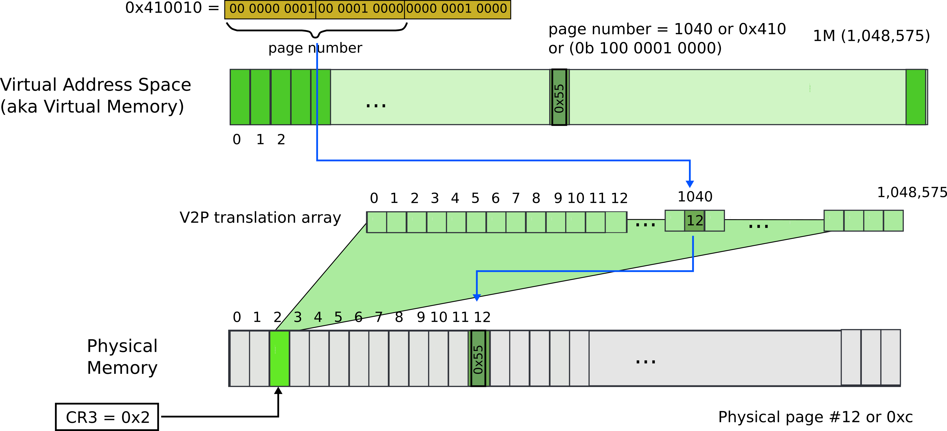
Paging: naive approach: translation array
Linear address 0x410010
  Remember it’s result of logical to linear translation (aka segmentation)
    0x410010 = 0x300010 (offset) + 0x110000 (base)

Slide 16
What is wrong?

Slide 17
What is wrong?
We need 4 bytes to relocate each page
  20 bits for physical page number
  12 bits of access flags
  Therefore, we need array of 4 bytes x 1M entries
    4MBs

Slide 18
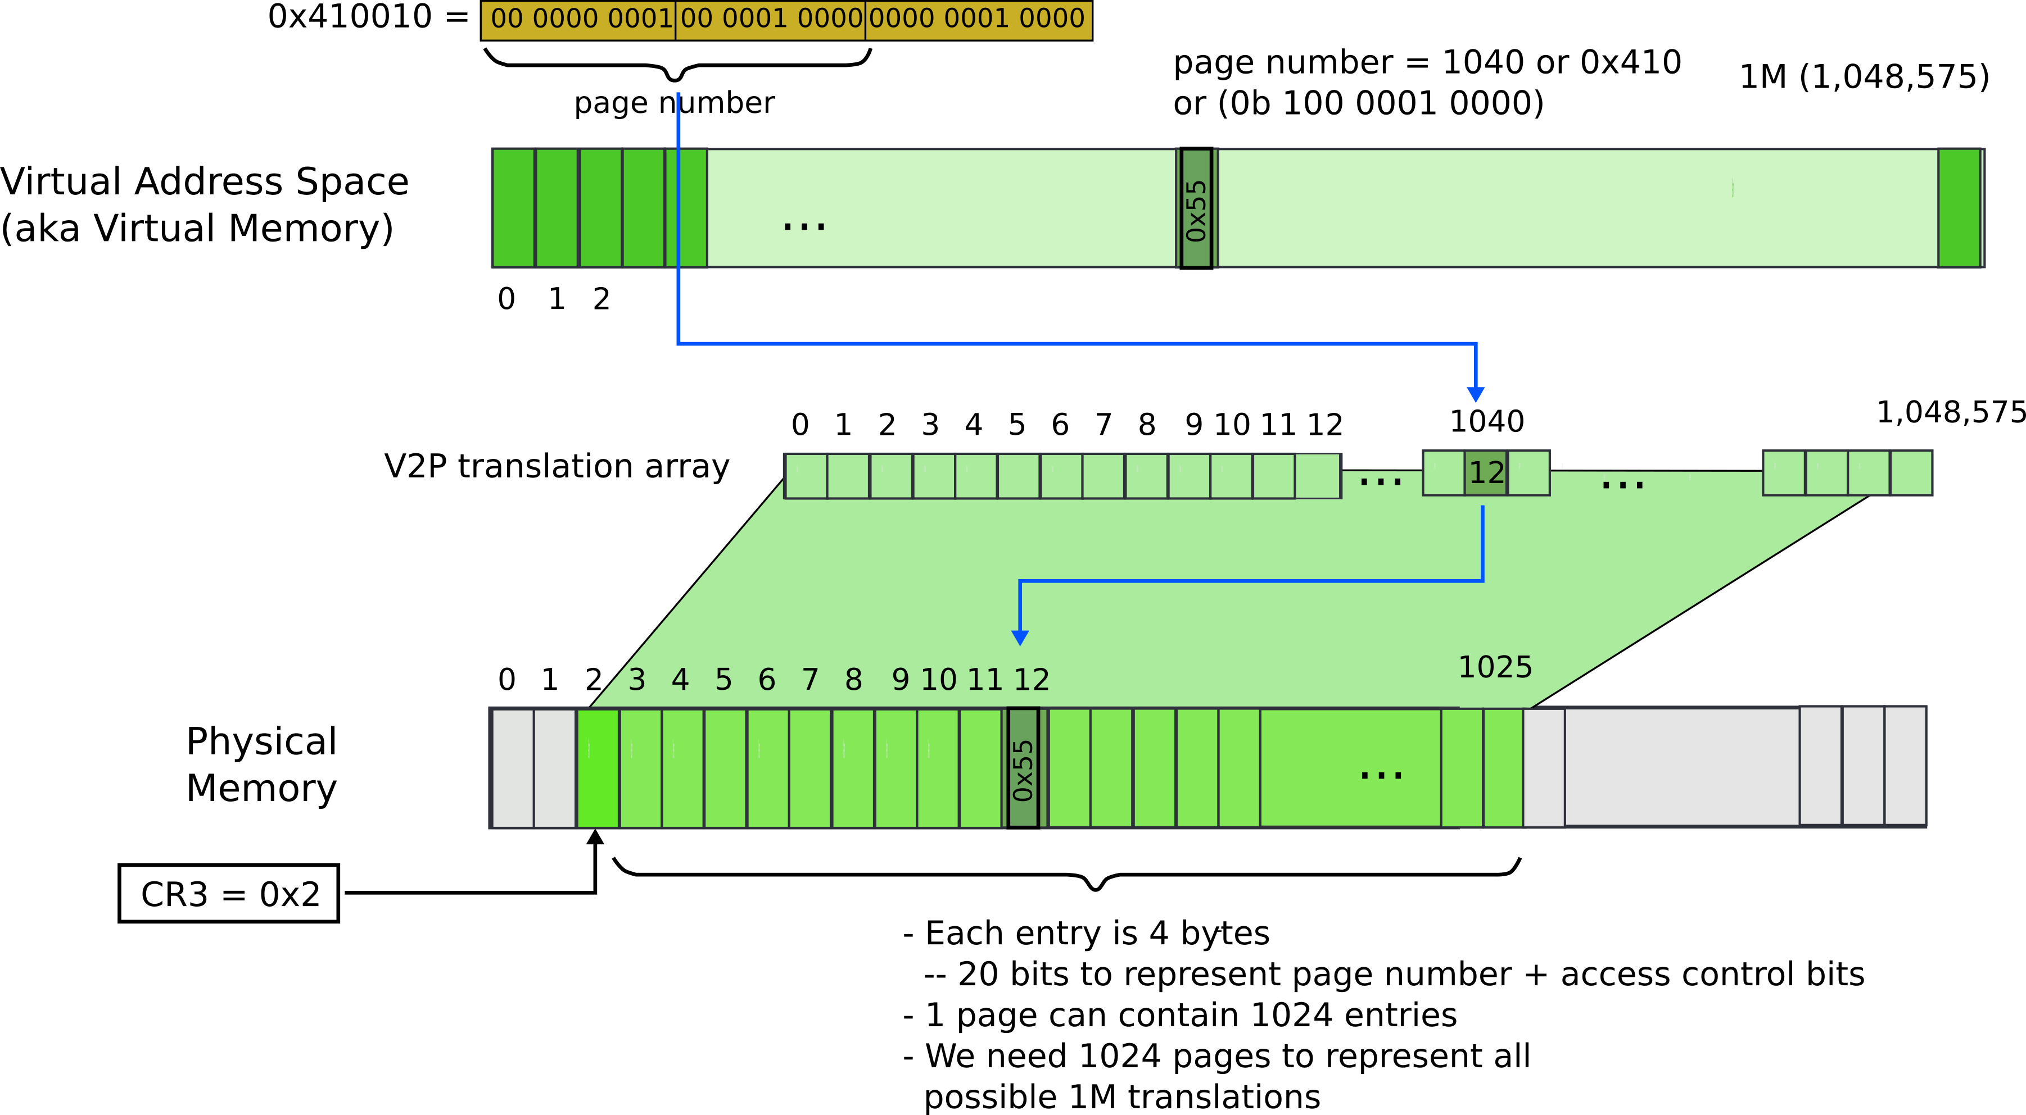
Paging: naive approach: translation array

Slide 19
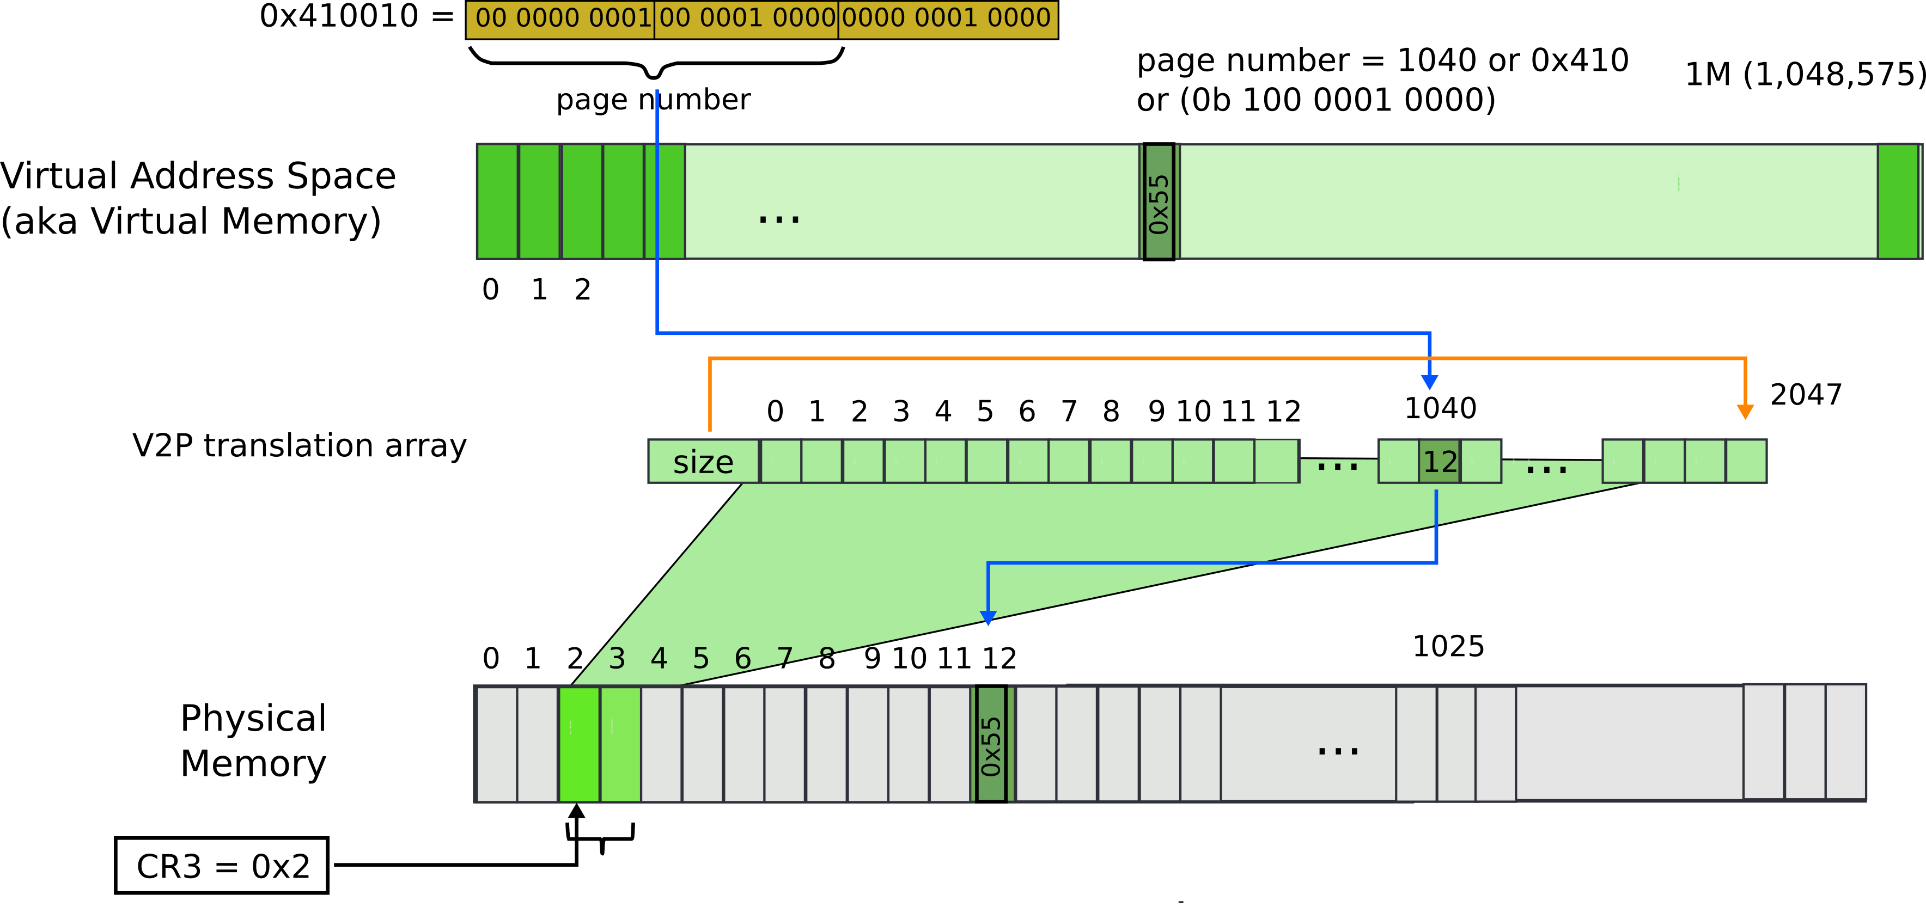
Paging: array with size
The size controls how many entries are required

Slide 20
But still what may go wrong?

Slide 21
Paging: array with size

Slide 22
Paging: array with size

Slide 23
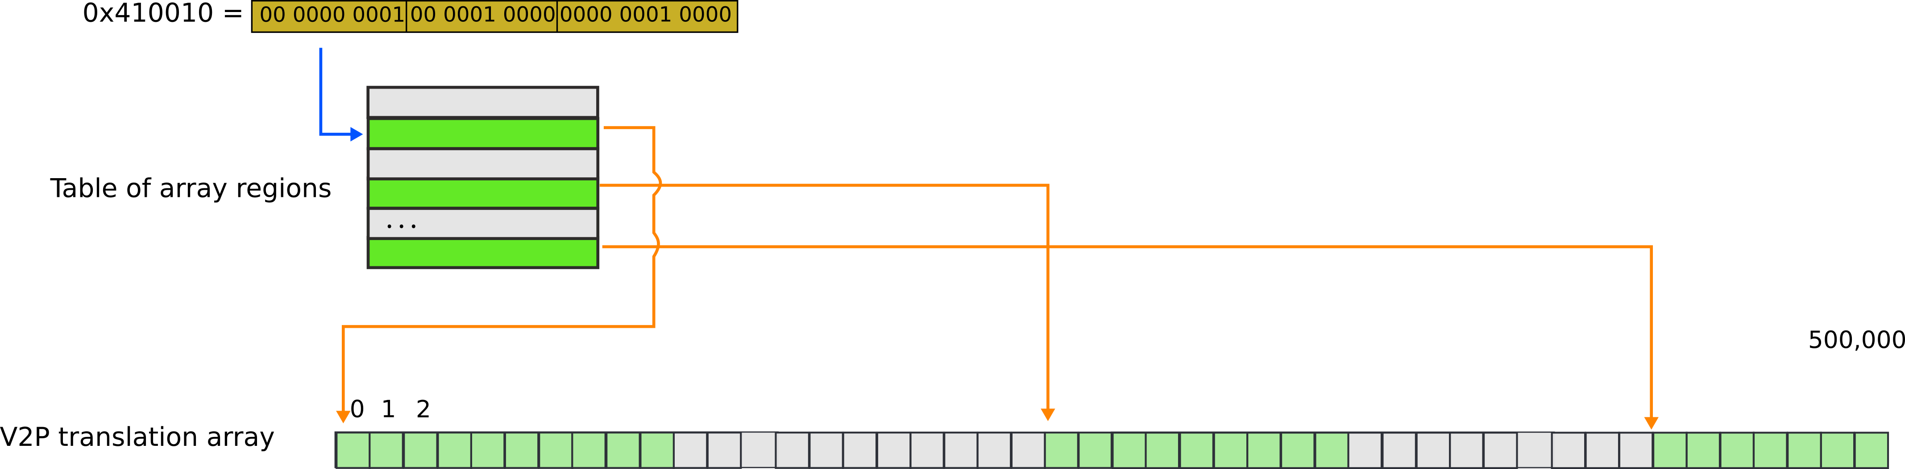
Paging: array with chunks

Slide 24
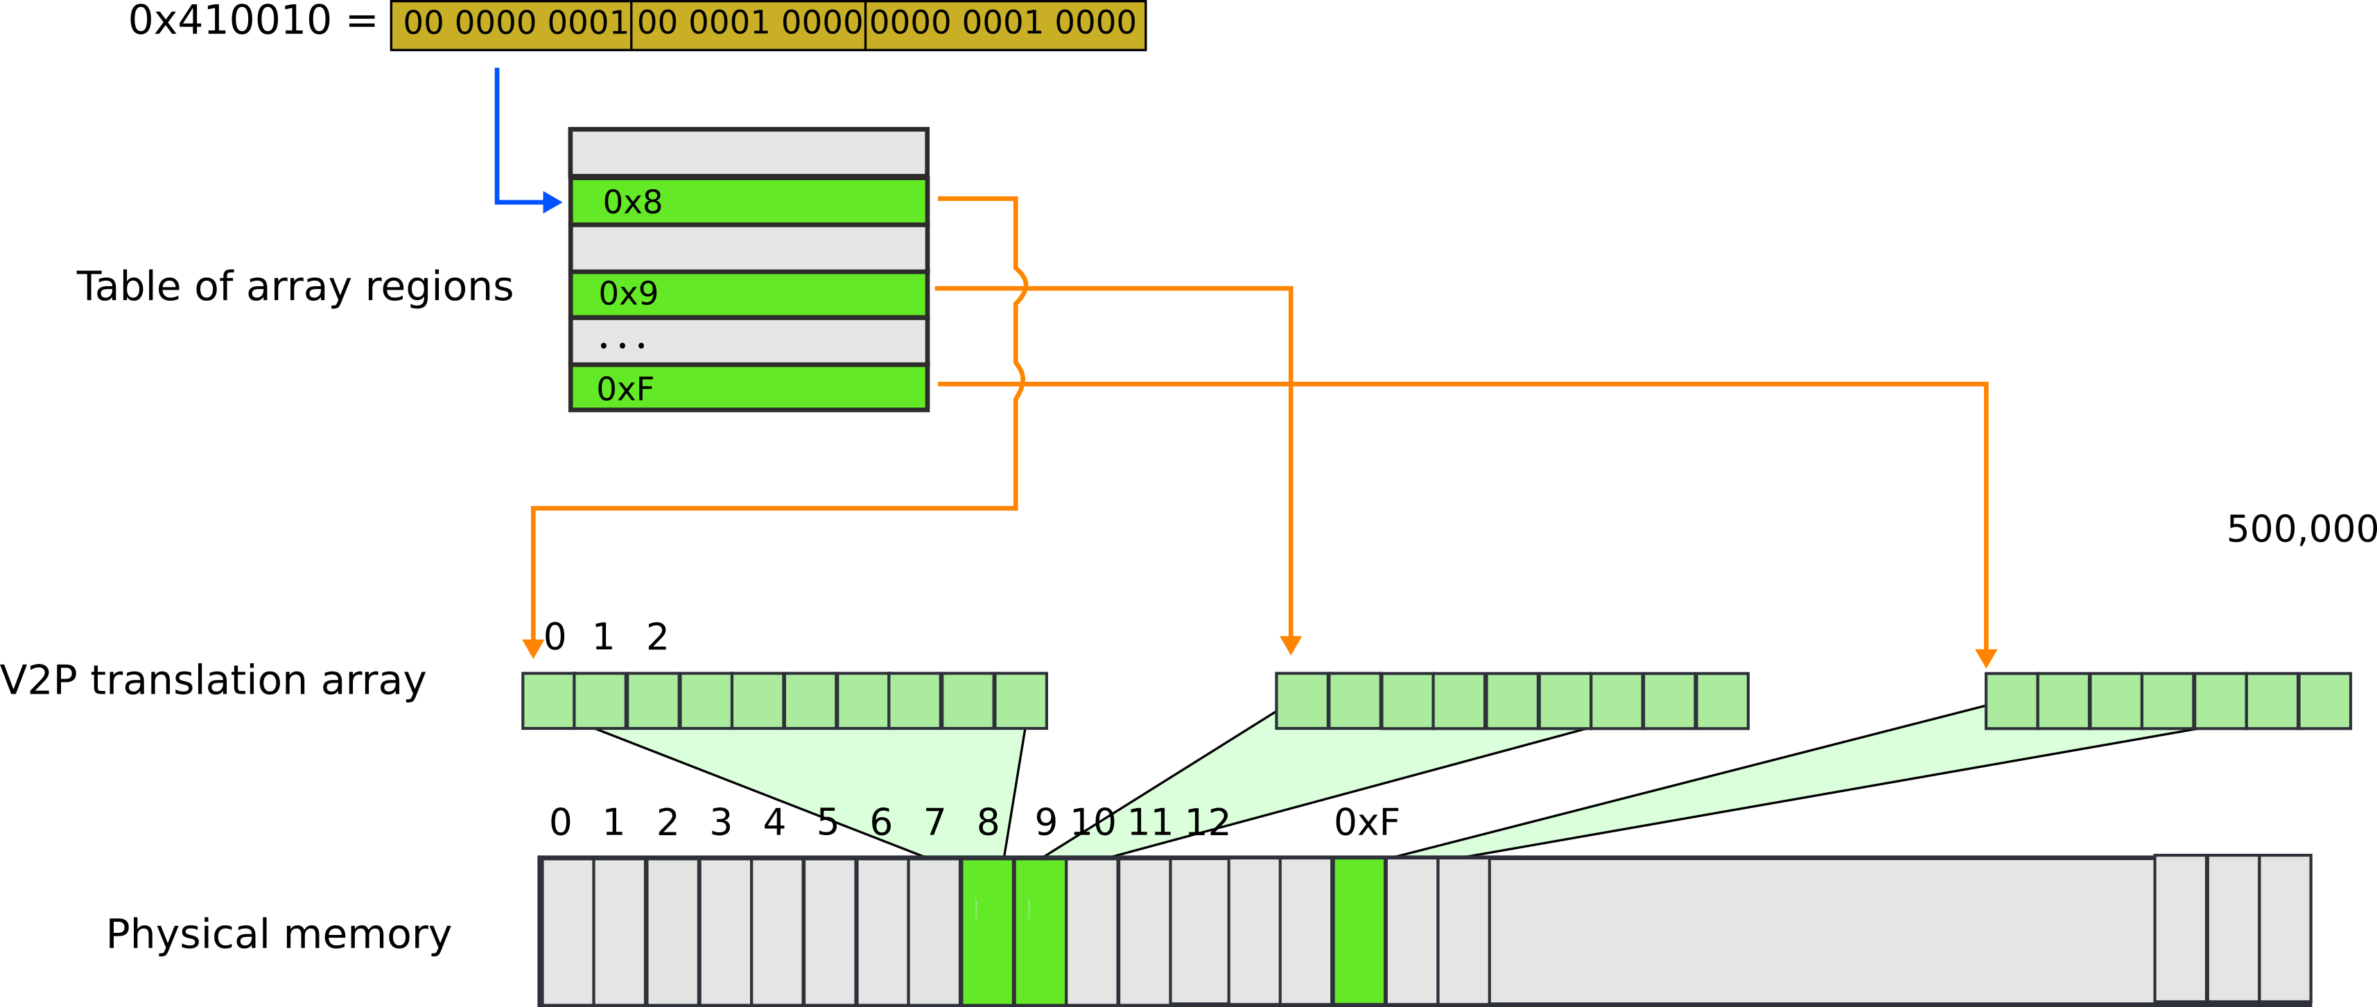
Paging: array with chunks

Slide 25
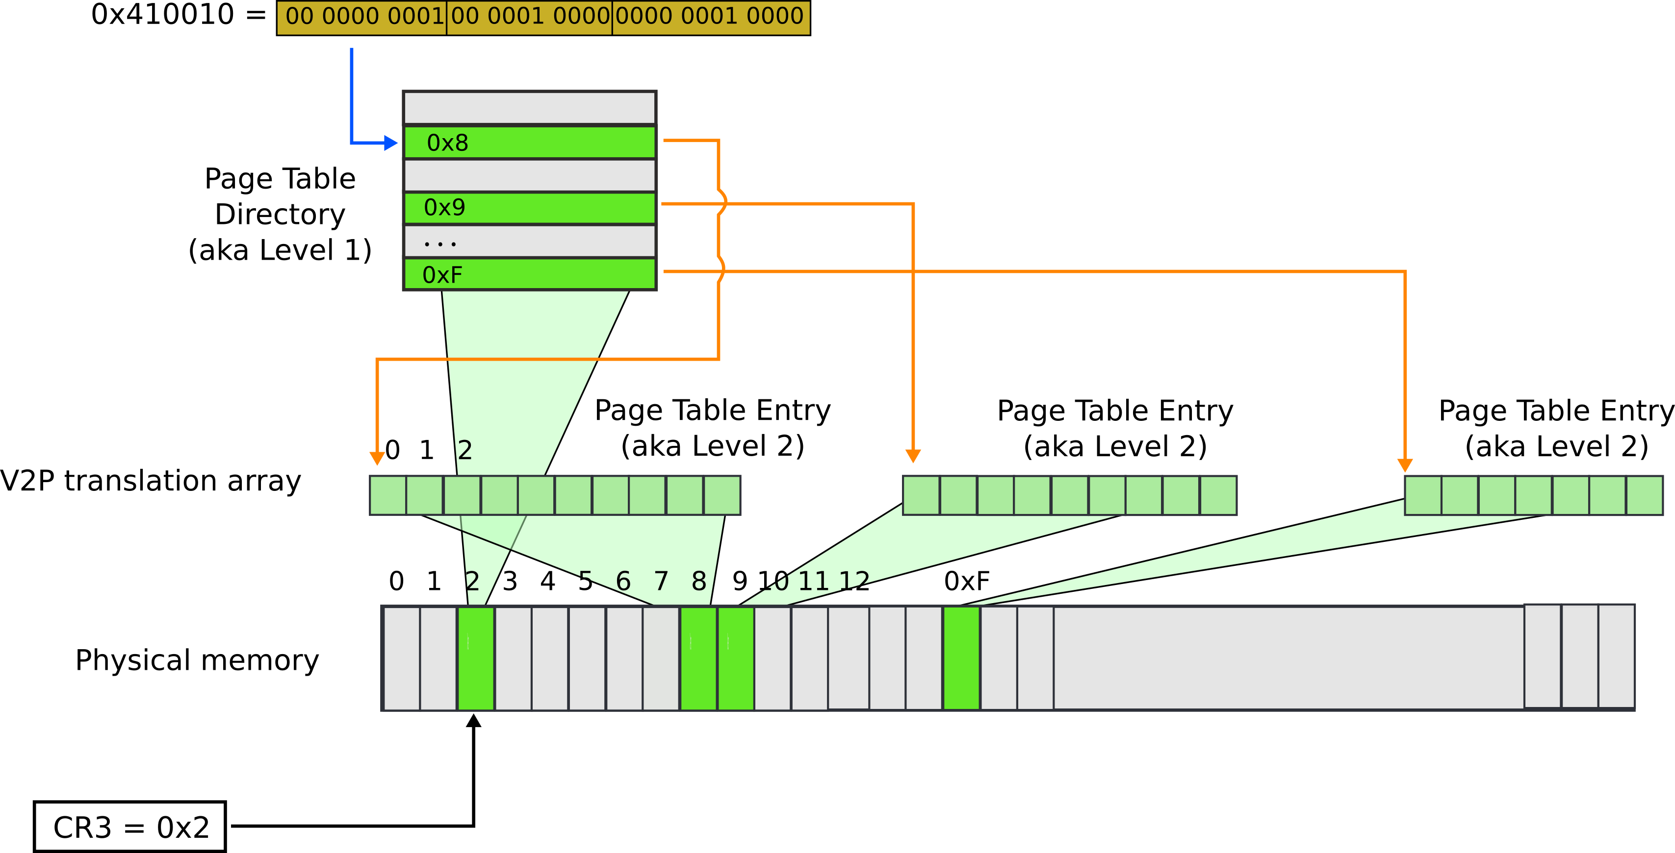
Paging: page table

Slide 26
Back to real page tables
Physical address:
  0x410010 = 0x300010 (offset) + 0x110000 (base)
  Intel calls this address “linear”

Slide 27
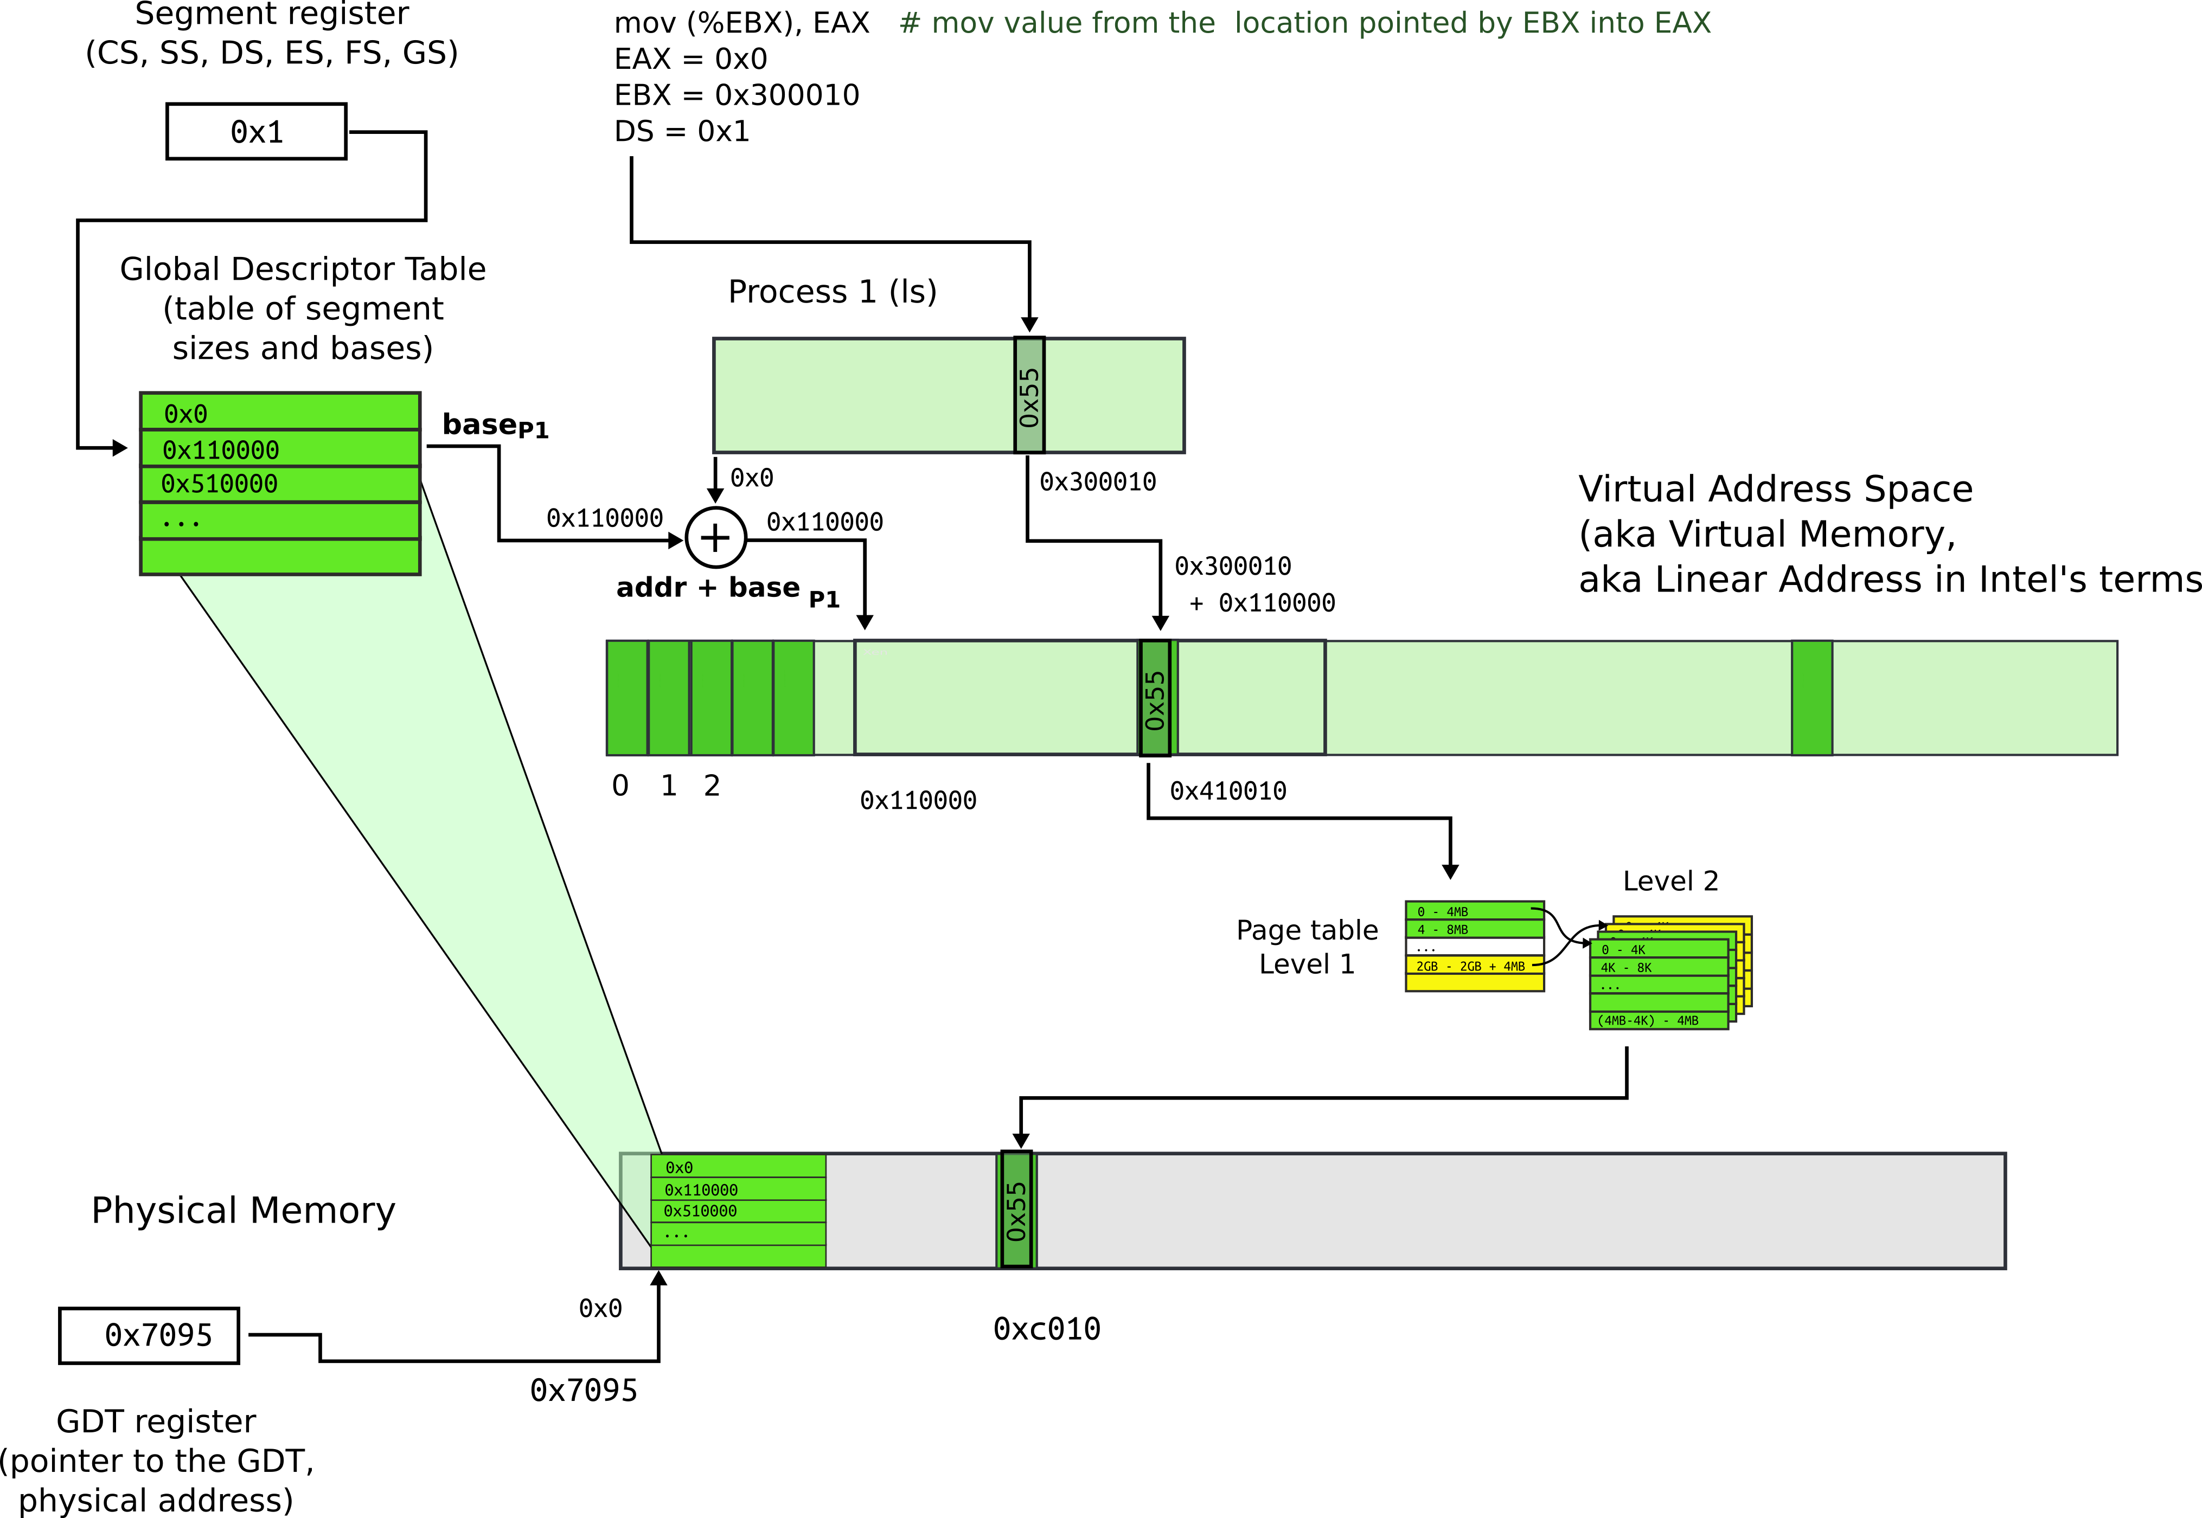
Paging
Each process has a private GDT
  OS will switch between GDTs

Slide 28
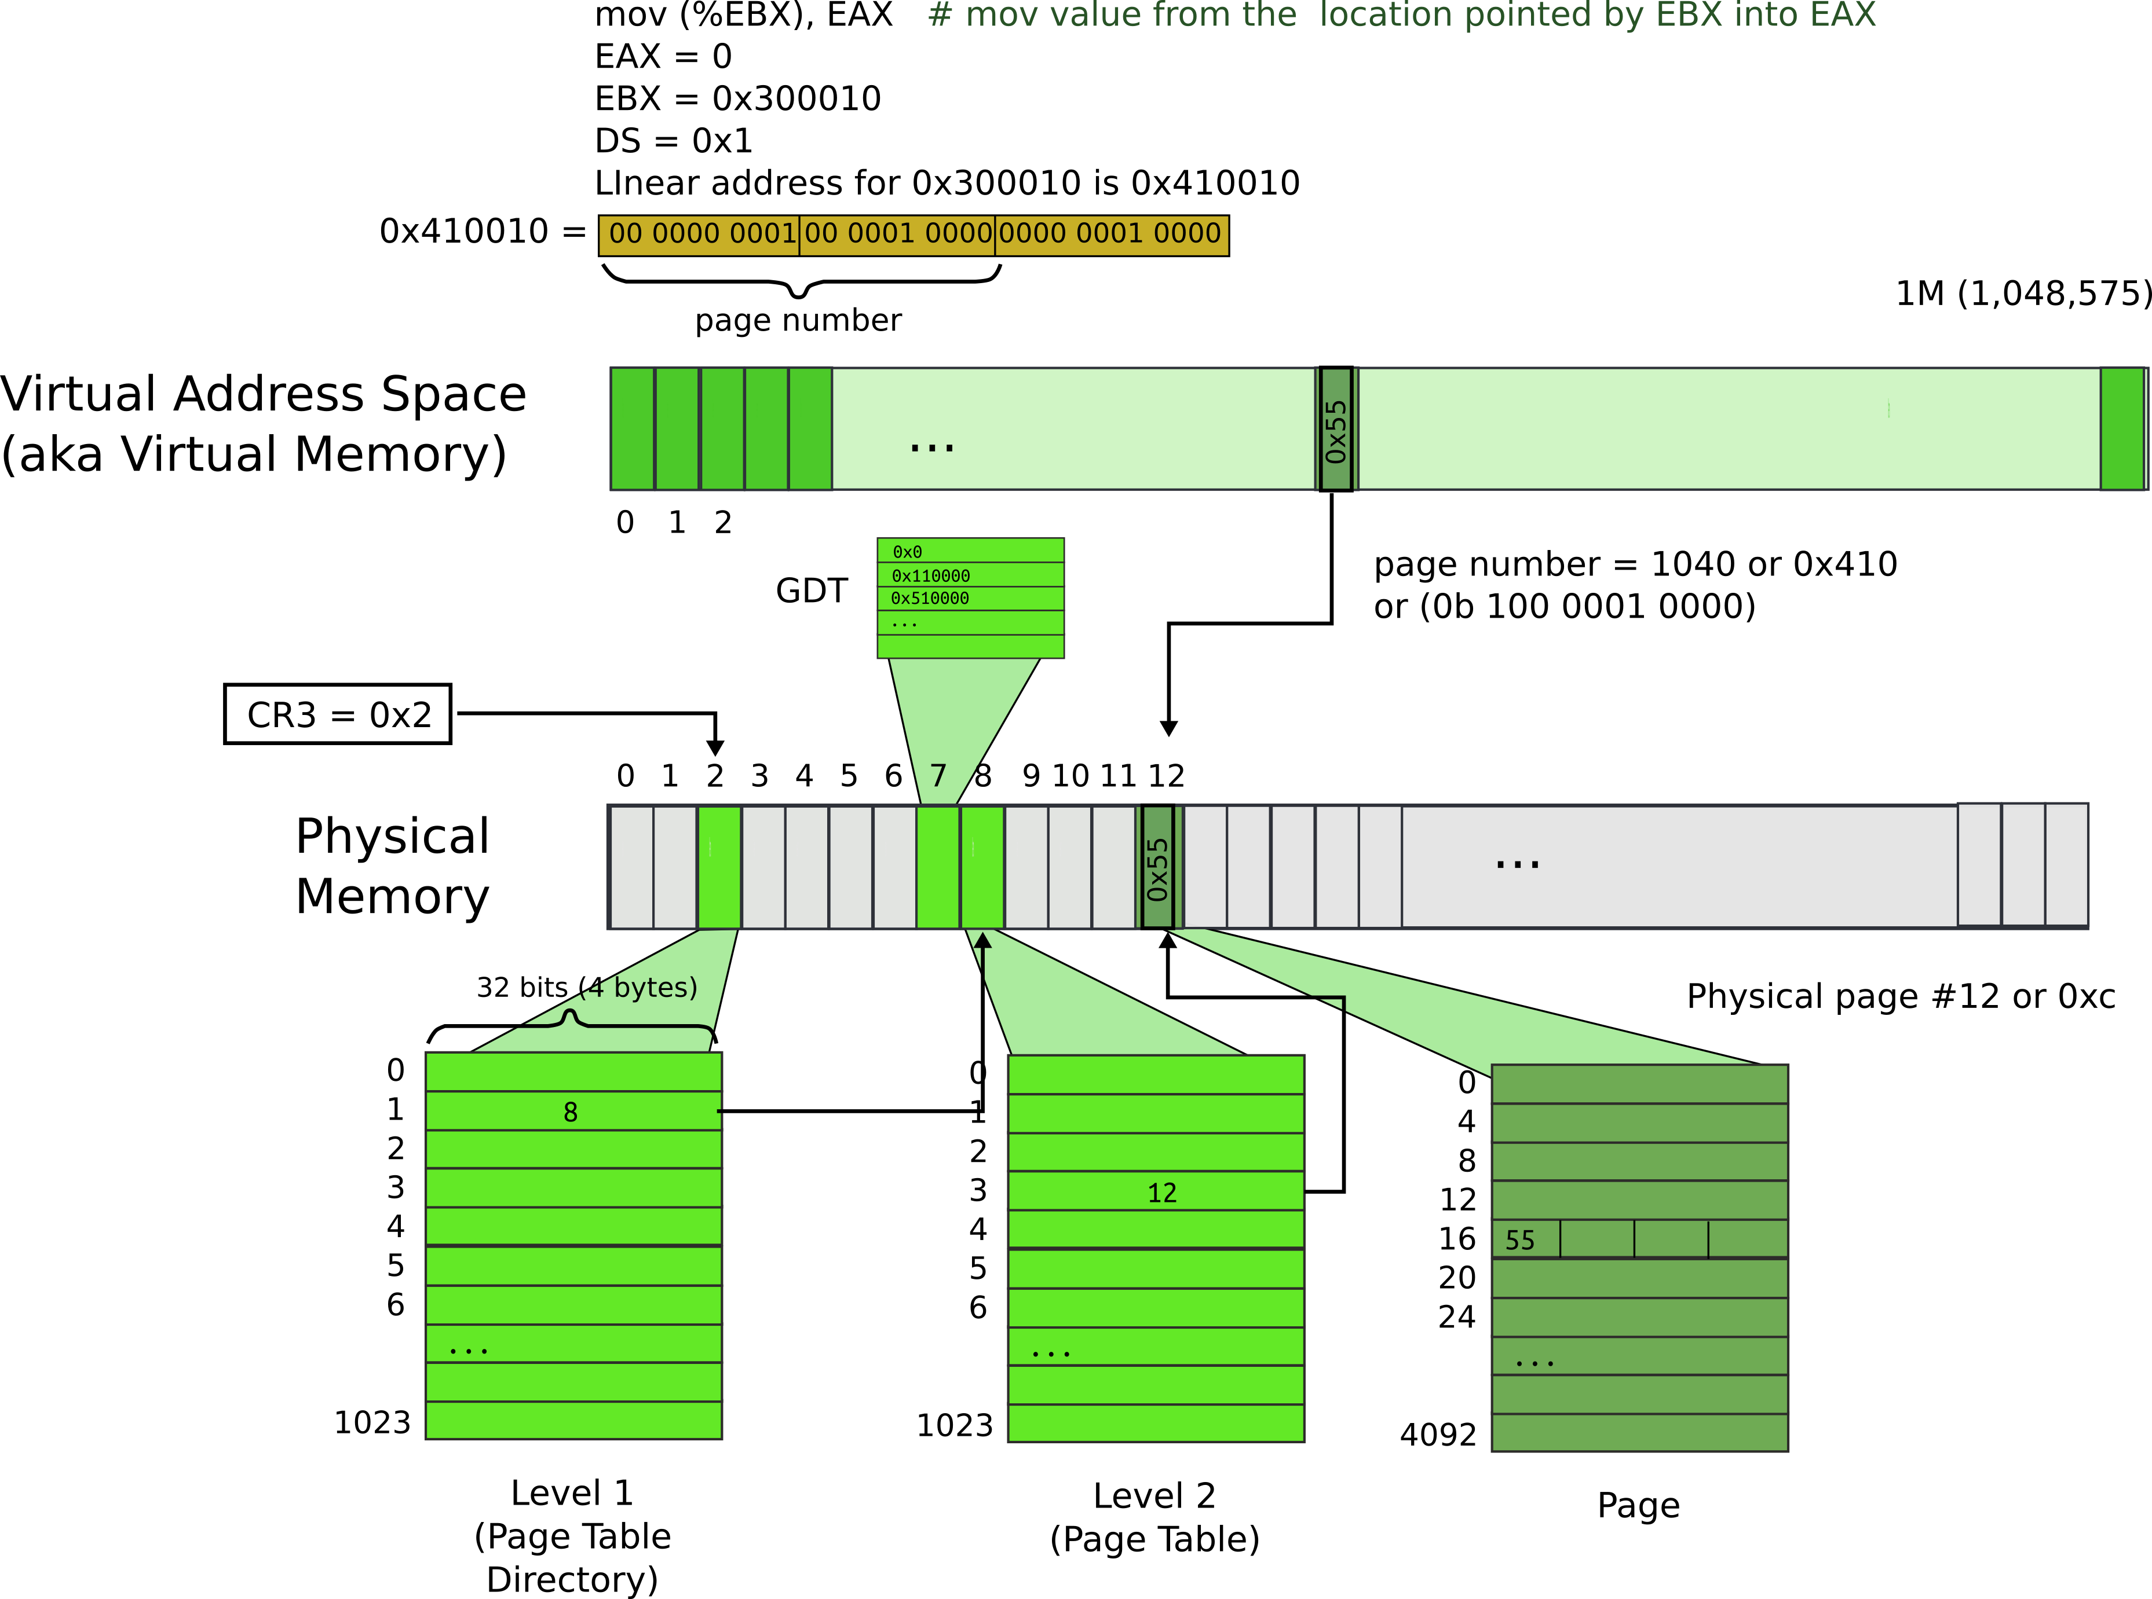
Paging

Slide 29
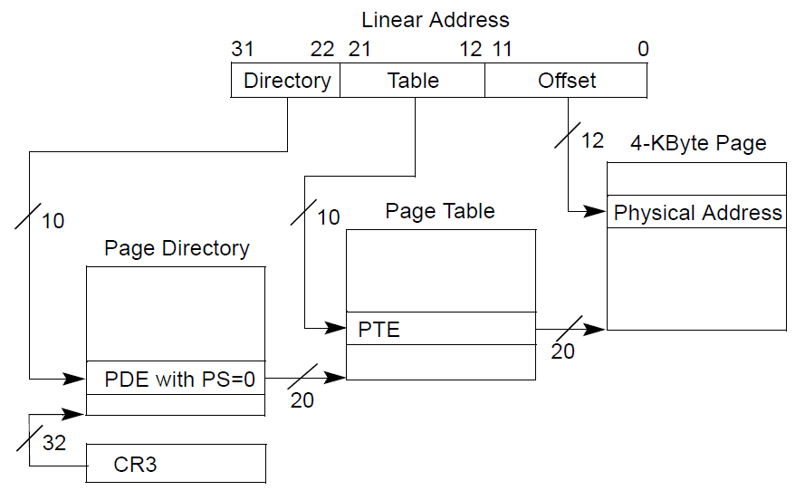
Page translation

Slide 30
Page translation

Slide 31
Page directory entry (PDE)
20 bit address of the page table

Slide 32
Page directory entry (PDE)
20 bit address of the page table
Wait... 20 bit address, but we need 32 bits

Slide 33
Page directory entry (PDE)
20 bit address of the page table
Wait... 20 bit address, but we need 32 bits
  Pages 4KB each, we need 1M to cover 4GB
  Pages start at 4KB (page aligned boundary)

Slide 34
Page translation

Slide 35
Page table entry (PTE)
20 bit address of the 4KB page
  Pages 4KB each, we need 1M to cover 4GB

Slide 36
Page translation

Slide 37



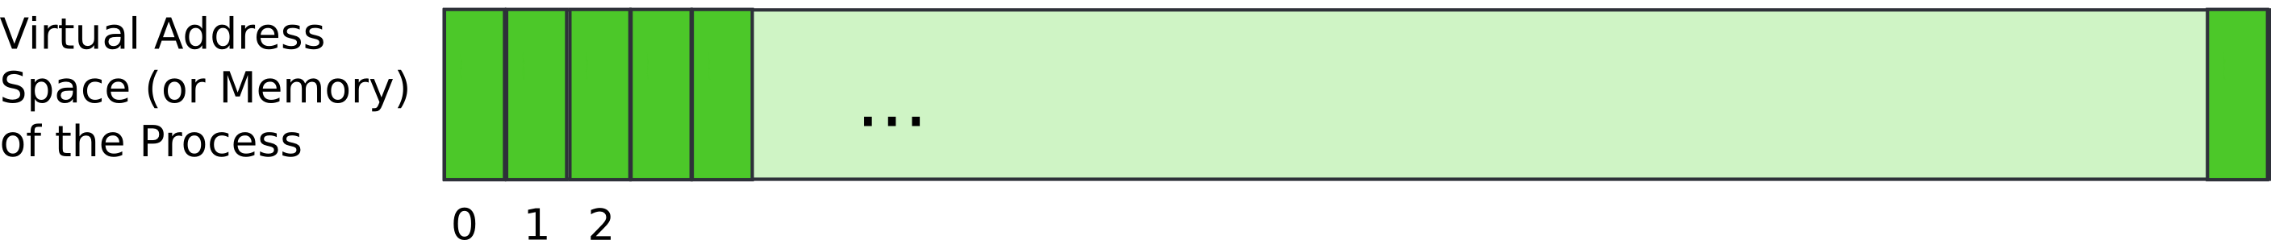
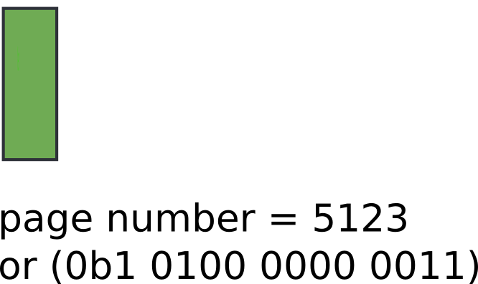
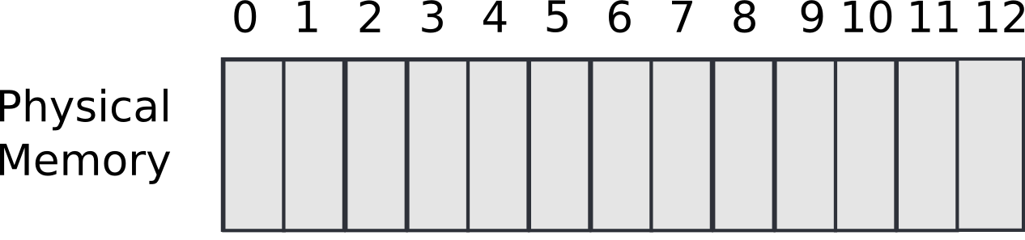

Slide 38



Slide 39
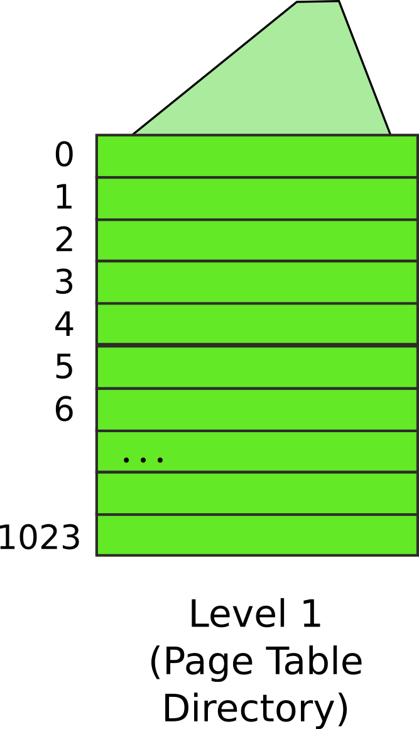
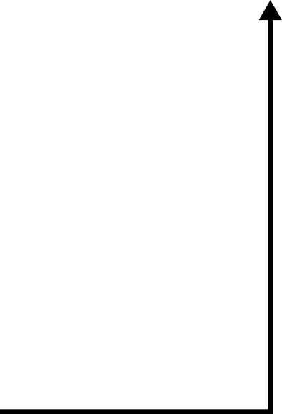
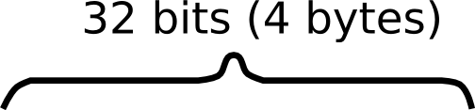


Slide 40
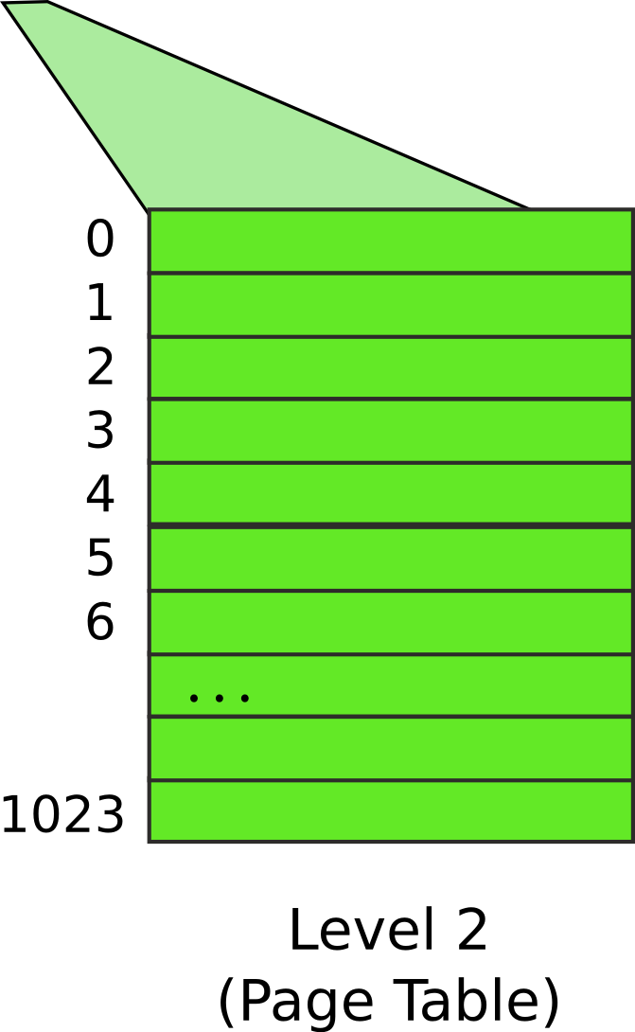
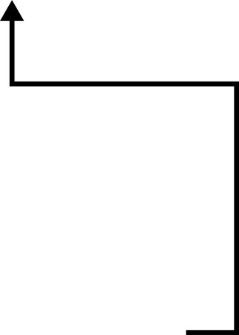


Slide 41
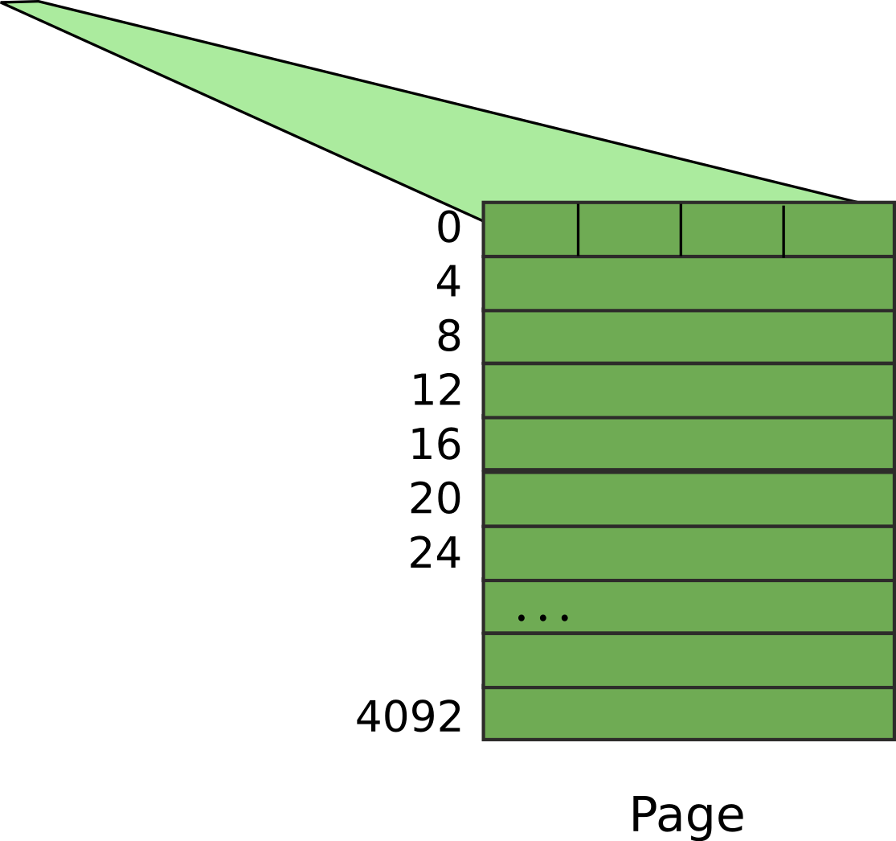


Slide 42
Result:
  EAX = 55

Slide 43
Benefit of page tables
… Compared to arrays?
Page tables represent sparse address space more efficiently
  An entire array has to be allocated upfront
  But if the address space uses a handful of pages
  Only page tables (Level 1 and 2 need to be allocated to describe translation)
On a dense address space this benefit goes away
  I'll assign a homework!

Slide 44

What about isolation?
Two programs, one memory?
Each process has its own page table
  OS switches between them

Slide 45

P1 and P2 can't access each other memory

Slide 46
Compared to segments pages allow ...
Emulate large virtual address space on a smaller physical memory
  In our example we had only 12 physical pages
  But the program can access all 1M pages in its 4GB address space
  The OS will move other pages to disk

Slide 47
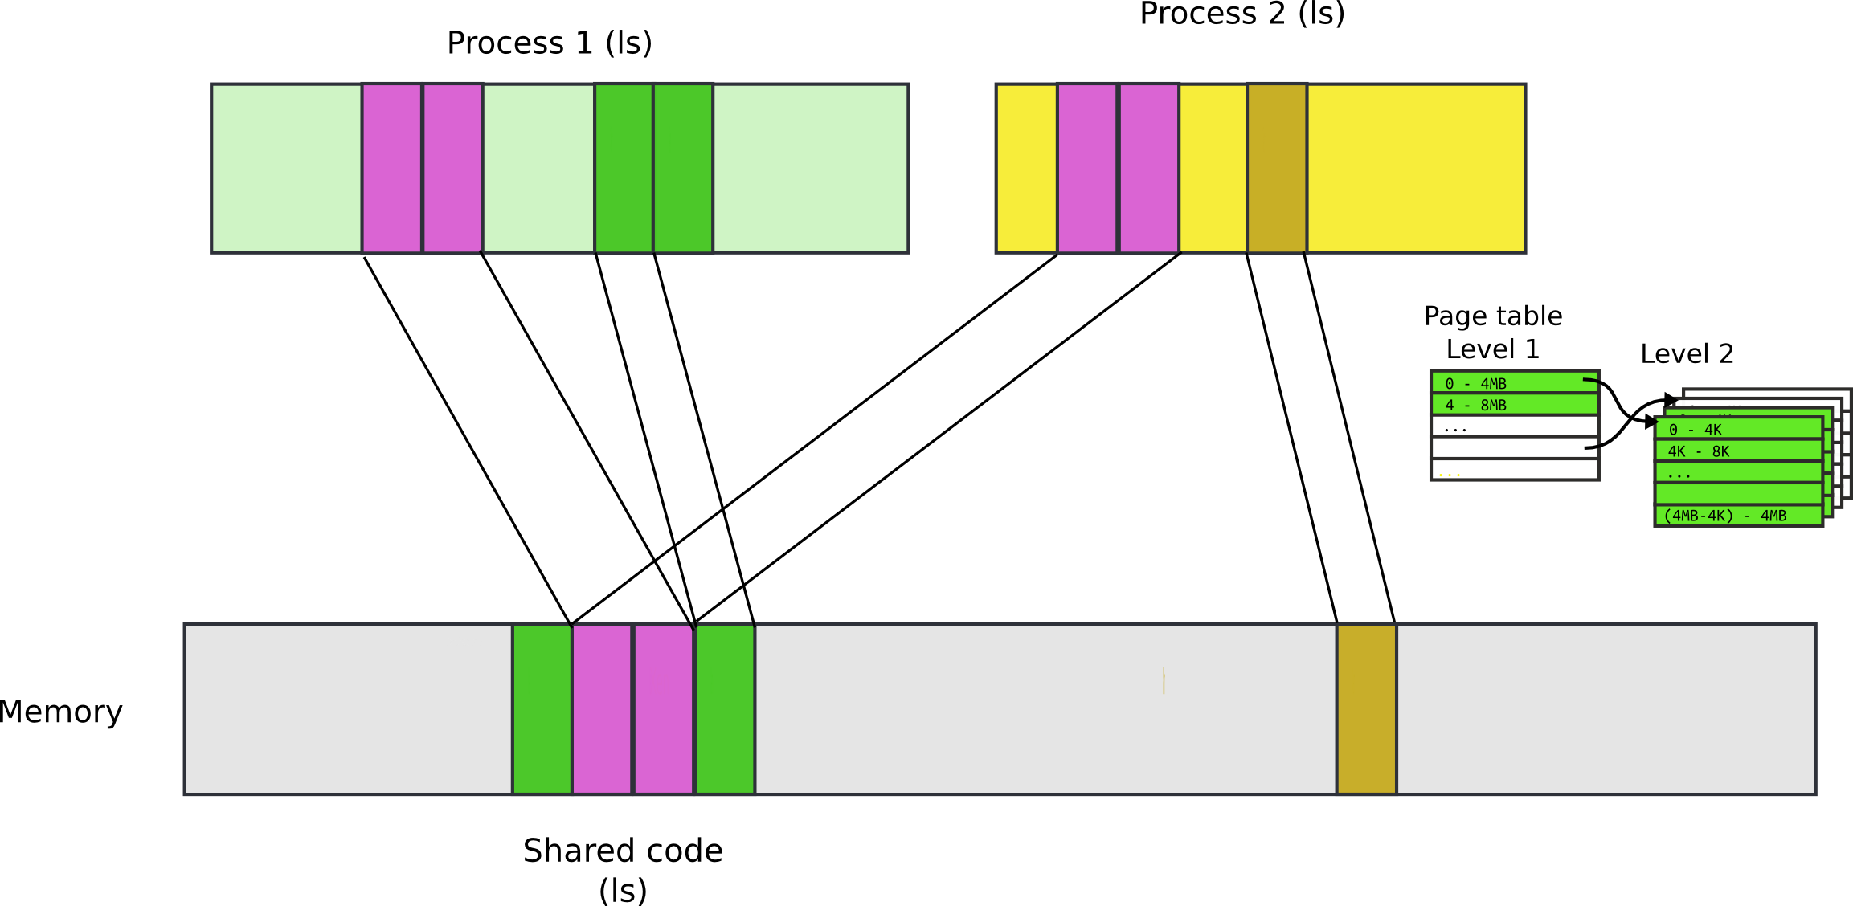
Compared to segments pages allow ...
Share a region of memory across multiple programs
  Communication (shared buffer of messages)
  Shared libraries

Slide 48
More paging tricks
Protect parts of the program
  E.g., map code as read-only
    Disable code modification attacks
    Remember R/W bit in PTD/PTE entries!
  E.g., map stack as non-executable
    Protects from stack smashing attacks
    Non-executable bit

Slide 49
More paging tricks
Determine a working set of a program?

Slide 50
More paging tricks
Determine a working set of a program?
  Use “accessed” bit

Slide 51
More paging tricks
Determine a working set of a program?
  Use “accessed” bit
Iterative copy of a working set?
  Used for virtual machine migration

Slide 52
More paging tricks
Determine a working set of a program?
  Use “accessed” bit
Iterative copy of a working set?
  Used for virtual machine migration
  Use “dirty” bit

Slide 53
More paging tricks
Determine a working set of a program?
  Use “accessed” bit
Iterative copy of a working set?
  Used for virtual machine migration
  Use “dirty” bit
Copy-on-write memory, e.g. lightweigh fork()?

Slide 54
More paging tricks
Determine a working set of a program?
  Use “accessed” bit
Iterative copy of a working set?
  Used for virtual machine migration
  Use “dirty” bit
Copy-on-write memory, e.g. lightweight fork()?
  Map page as read/only

Slide 55


TLB
Walking page table is slow
  Each memory access is 240 (local) - 360 (one QPI hop away) cycles on modern hardware
  L3 cache access is 50 cycles
cr3

Slide 56
TLB
CPU caches results of page table walks
  In translation lookaside buffer (TLB)
Virt | Phys
0xf0231000 | 0x1000
0x00b31000 | 0x1f000
0xb0002000 | 0xc1000
- | -

Slide 57
TLB invalidation
TLB is a cache (in CPU)
  It is not coherent with memory
  If page table entry is changes, TLB remains the same and is out of sync
cr3
Virt | Phys
0xf0231000 | 0x1000
0x00b31000 | 0x1f000
0xb0002000 | 0xc1000
- | -
Same
Virt Addr.
No Change!!!

Slide 58
TLB invalidation
After every page table update, OS needs to manually invalidate cached values
  Flush TLB
    Either one specific entry
    Or entire TLB, e.g., when CR3 register is loaded
    This happens when OS switches from one process to another
  This is expensive
    Refilling the TLB with new values takes time

Slide 59
Tagged TLBs
Modern CPUs have “tagged TLBs”,
  Each TLB entry has a “tag” – identifier of a process
  No need to flush TLBs on context switch
On Intel this mechanism is called
  Process-Context Identifiers (PCIDs)
Virt | Phys | Tag
0xf0231000 | 0x1000 | P1
0x00b31000 | 0x1f000 | P2
0xb0002000 | 0xc1000 | P1

Slide 60
When would you disable paging?

Slide 61
When would you disable paging?
Imagine you're running a memcached
  Key/value cache
You serve 1024 byte values (typical) on 10Gbps connection
  1024 byte packets can leave every 835ns, or 1670 cycles (2GHz machine)
  This is your target budget per packet

Slide 62
When would you disable paging?
Now, to cover 32GB RAM with 4K pages
  You need 64MB space
  64bit architecture, 3-level page tables
Page tables do not fit in L3 cache
  Modern servers come with 32MB cache
Every cache miss results in up to 3 cache misses due to page walk (remember 3-level page tables)
  Each cache miss is 250 cycles
Solution: 1GB pages

Slide 63

Page translation for 4MB pages

Slide 64

Recap: complete address translation

Slide 65


Slide 73
Questions?

Slide 74
Back of the envelope
If a page is 4K and an entry is 4 bytes, how many entries per page?

Slide 75
Back of the envelope
If a page is 4K and an entry is 4 bytes, how many entries per page?
  1k

Slide 76
Back of the envelope
If a page is 4K and an entry is 4 bytes, how many entries per page?
  1k
How large of an address space can 1 page represent?

Slide 77
Back of the envelope
If a page is 4K and an entry is 4 bytes, how many entries per page?
  1k
How large of an address space can 1 page represent?
  1k entries * 1page/entry * 4K/page = 4MB

Slide 78
Back of the envelope
If a page is 4K and an entry is 4 bytes, how many entries per page?
  1k
How large of an address space can 1 page represent?
  1k entries * 1page/entry * 4K/page = 4MB
How large can we get with a second level of translation?

Slide 79
Back of the envelope
If a page is 4K and an entry is 4 bytes, how many entries per page?
  1k
How large of an address space can 1 page represent?
  1k entries * 1page/entry * 4K/page = 4MB
How large can we get with a second level of translation?
  1k tables/dir * 1k entries/table * 4k/page = 4 GB
  Nice that it works out that way!

Slide 80
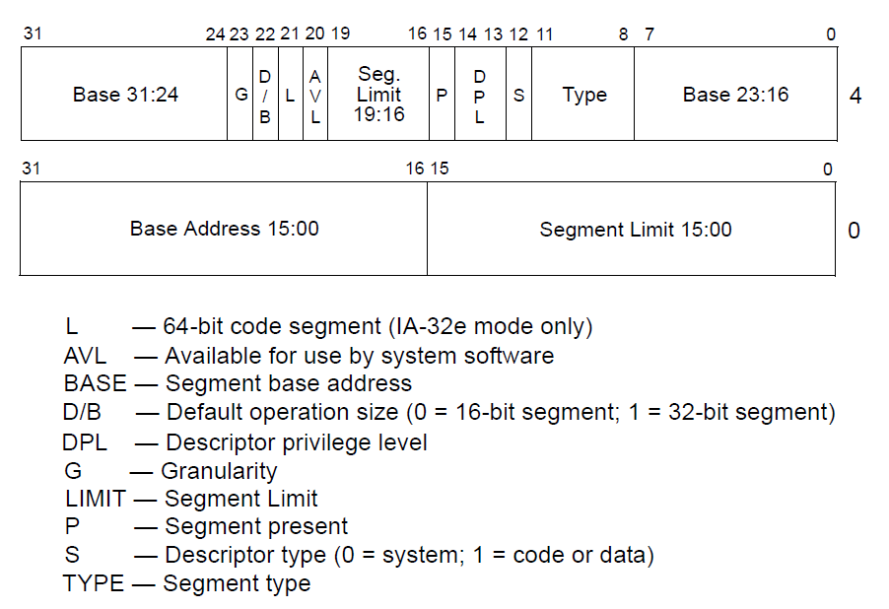
Segment descriptors

