Slide 1
143A: Principles of Operating Systems
Lecture 5: Address translation
Anton Burtsev
October, 2018

Slide 2

Two programs one memory

Slide 3
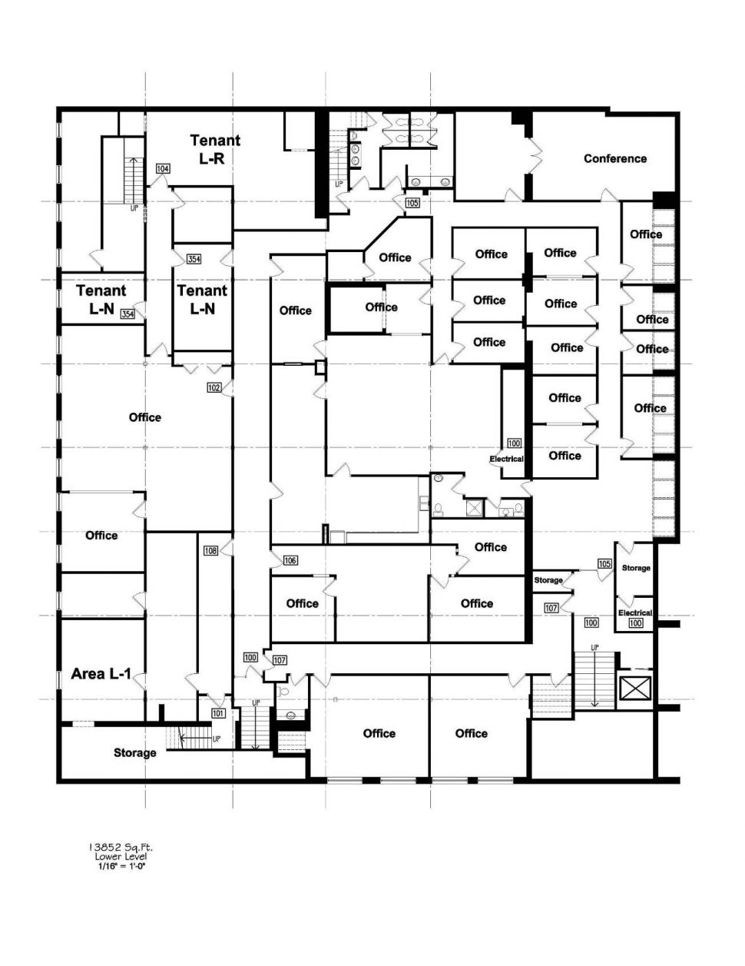
Or more like renting a set of rooms in an office building

Slide 4
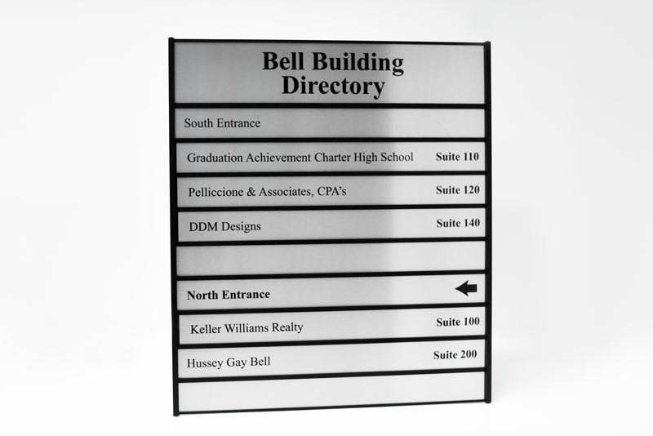
Or more like renting a set of rooms in an office building

Slide 5
Relocation
One way to achieve this is to relocate program at different addresses
  Remember relocation (from linking and loading)

Slide 6
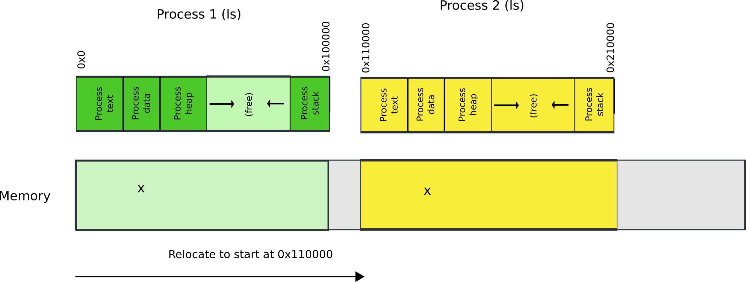
Relocate binaries to work at different addresses

Slide 7
One way to achieve this is to relocate program at different addresses
What is the problem?

Slide 8
One way to achieve this is to relocate program at different addresses
What is the problem?
  No isolation

Slide 9
Another way is to ask for hardware support

Slide 10
This is called segmentation

Slide 11
What are we aiming for?
Illusion of a private address space
  Identical copy of an address space in multiple programs
    Remember fork()?
  Simplifies software architecture
    One program is not restricted by the memory layout of the others

Slide 12

Two processes, one memory?

Slide 13

Two processes, one memory?
We want hardware to add base value to every address used in the program

Slide 14
Seems easy
One problem
  Where does this base address come from?

Slide 15
Seems easy
One problem
  Where does this base address come from?
  Hardware can maintain a table of base addresses
    One base for each process
  Dedicate a special register to keep an index into that table

Slide 16
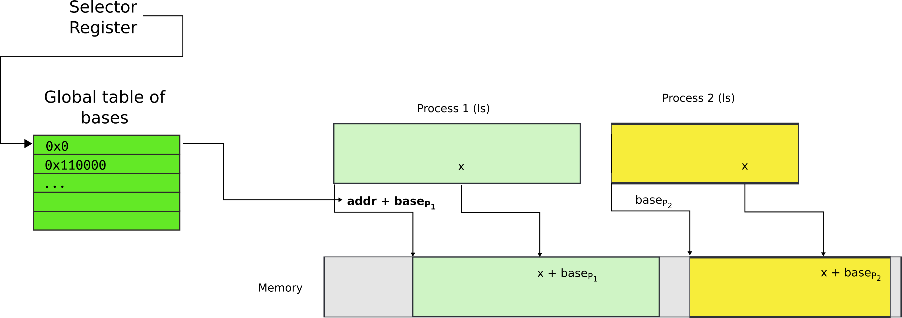
One problem
  Where does this base address come from?
  Hardware can maintain a table of base addresses
    One base for each process
  Dedicate a special register to keep an index into that table

Slide 17
New addressing mode

Slide 18

All addresses are logical address
They consist of two parts
  Segment selector (16 bit) + offset (32 bi

Slide 19
Segment selector (16 bit)
  Is simply an index into an array (Descriptor Table)
  That holds segment descriptors
    Base and limit (size) for each segment

Slide 20

Elements of the descriptor table are segment descriptors
Base address
  0 – 4 GB
Limit (size)
  0 – 4 GB
Access rights
  Executable, readable, writable
  Privilege level (0 - 3)

Slide 21
Offsets into segments (x in our example) or “Effective addresses” are in registers

Slide 22
Logical addresses are translated into physical
  Effective address + DescriptorTable[selector].Base

Slide 23
Logical addresses are translated into physical
  Effective address + DescriptorTable[selector].Base

Slide 24
Logical addresses are translated into physical
  Effective address + DescriptorTable[selector].Base

Slide 25
Logical addresses are translated into physical
  Effective address + DescriptorTable[selector].Base

Slide 26
Physical address =
  Effective address + DescriptorTable[selector].Base
  Effective addresses (or offsets) are in registers
  Selector is in a special register

Slide 27
Offsets (effective addresses) are in registers
  Effective address + DescriptorTable[selector].Base
  But where is the selector?

Slide 28
Segment registers
Hold 16 bit segment selectors
  Pointers into a special table
  Global or local descriptor table
Segments are associated with one of three types of storage
  Code
  Data
  Stack

Slide 29
Segmented programming (not real)
static int x = 1;
int y; // stack
if (x) {
y = 1;
printf (“Boo”);
} else
y = 0;
ds:x = 1; // data
ss:y; // stack
if (ds:x) {
ss:y = 1;
cs:printf(ds:“Boo”);
} else
ss:y = 0;

Slide 30
Programming model
Segments for: code, data, stack, “extra”
  A program can have up to 6 total segments
  Segments identified by registers: cs, ds, ss, es, fs, gs
Prefix all memory accesses with desired segment:
  mov eax, ds:0x80 (load offset 0x80 from data into eax)
  jmp cs:0xab8 (jump execution to code offset 0xab8)
  mov ss:0x40, ecx (move ecx to stack offset 0x40)

Slide 31
Programming model, cont.
This is cumbersome,
Instead the idea is: infer code, data and stack segments from the instruction type:
  Control-flow instructions use code segment (jump, call)
  Stack management (push/pop) uses stack
  Most loads/stores use data segment
Extra segments (es, fs, gs) must be used explicitly

Slide 32
Code segment
Code
  CS register
  EIP is an offset inside the segment stored in CS
Can only be changed with
  procedure calls,
  interrupt handling, or
  task switching

Slide 33
Data segment
Data
  DS, ES, FS, GS
  4 possible data segments can be used at the same time

Slide 34
Stack segment
Stack
  SS
Can be loaded explicitly
  OS can set up multiple stacks
  Of course, only one is accessible at a time

Slide 35
Segmentation works for isolation, i.e., it does provide programs with illusion of private memory

Slide 36

Segmentation is ok... but

Slide 37

What if process needs more memory?

Slide 38

What if process needs more memory?

Slide 39

You can move P2 in memory

Slide 40

Or even swap it out to disk

Slide 41
Problems with segments
But it's inefficient
  Relocating or swapping the entire process takes time
Memory gets fragmented
  There might be no space (gap) for the swapped out process to come in
  Will have to swap out other processes

Slide 42
Paging

Slide 43

Pages

Slide 44

Pages

Slide 45
Paging idea
Break up memory into 4096-byte chunks called pages
  Modern hardware supports 2MB, 4MB, and 1GB pages
Independently control mapping for each page of linear address space
Compare with segmentation (single base + limit)
  many more degrees of freedom

Slide 46

Page translation

Slide 47
Page translation

Slide 48
Page directory entry (PDE)
20 bit address of the page table

Slide 49
Page directory entry (PDE)
20 bit address of the page table
Wait... 20 bit address, but we need 32 bits

Slide 50
Page directory entry (PDE)
20 bit address of the page table
Wait... 20 bit address, but we need 32 bits
  Pages 4KB each, we need 1M to cover 4GB
  Pages start at 4KB (page aligned boundary)

Slide 51
Page directory entry (PDE)
Bit #1: R/W – writes allowed?
  But allowed where?

Slide 52
Page directory entry (PDE)
Bit #1: R/W – writes allowed?
  But allowed where?
  One page directory entry controls 1024 Level 2 page tables
    Each Level 2 maps 4KB page
  So it's a region of 4KB x 1024 = 4MB

Slide 53
Page directory entry (PDE)
Bit #2: U/S – user/supervisor
  If 0 – user-mode access is not allowed
  Allows protecting kernel memory from user-level applications

Slide 54
Page translation

Slide 55
Page table entry (PTE)
20 bit address of the 4KB page
  Pages 4KB each, we need 1M to cover 4GB
Bit #1: R/W – writes allowed?
  To a 4KB page
Bit #2: U/S – user/supervisor
  If 0 user-mode access is not allowed
Bit #5: A – accessed
Bit #6: D – dirty – software has written to this page

Slide 56
Page translation

Slide 57
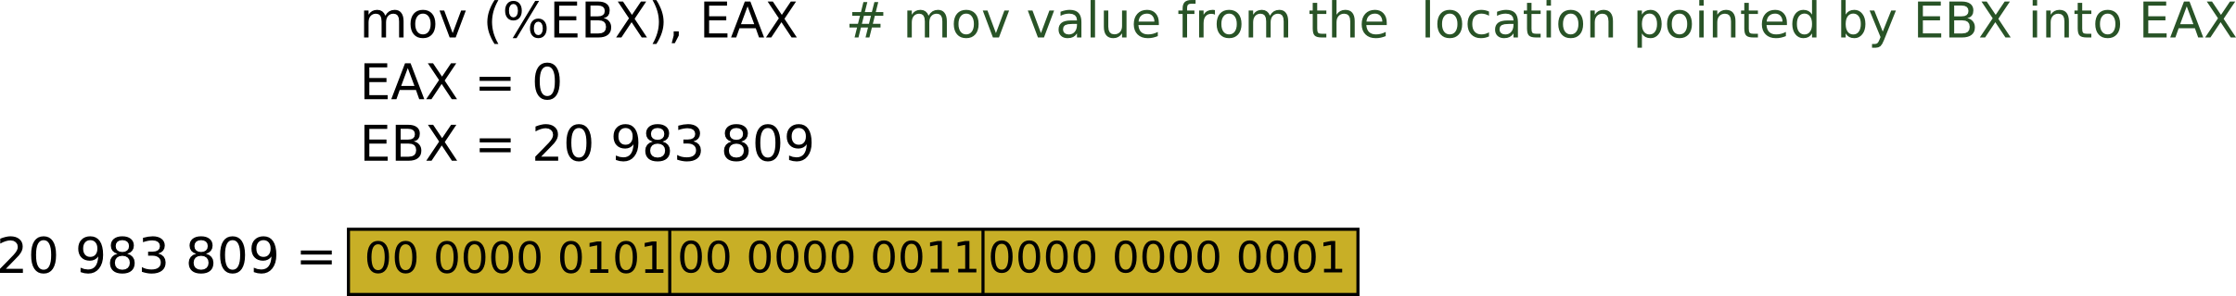






Slide 58



Slide 59





Slide 60

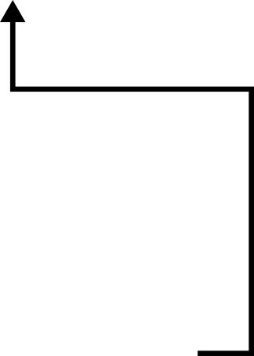


Slide 61



Slide 62
Result:
  EAX = 55

Slide 63
But why do we need page tables
… Instead of arrays?
Page tables represent sparse address space more efficiently
  An entire array has to be allocated upfront
  But if the address space uses a handful of pages
  Only page tables (Level 1 and 2 need to be allocated to describe translation)
On a dense address space this benefit goes away
  I'll assign a homework!

Slide 64
What about isolation?
Two programs, one memory?

Slide 65
What about isolation?
Two programs, one memory?
Each process has its own page table
  OS switches between them

Slide 66

P1 and P2 can't access each other memory

Slide 67
Compared to segments pages allow ...
Emulate large virtual address space on a smaller physical memory
  In our example we had only 12 physical pages
  But the program can access all 1M pages in its 4GB address space
  The OS will move other pages to disk

Slide 68
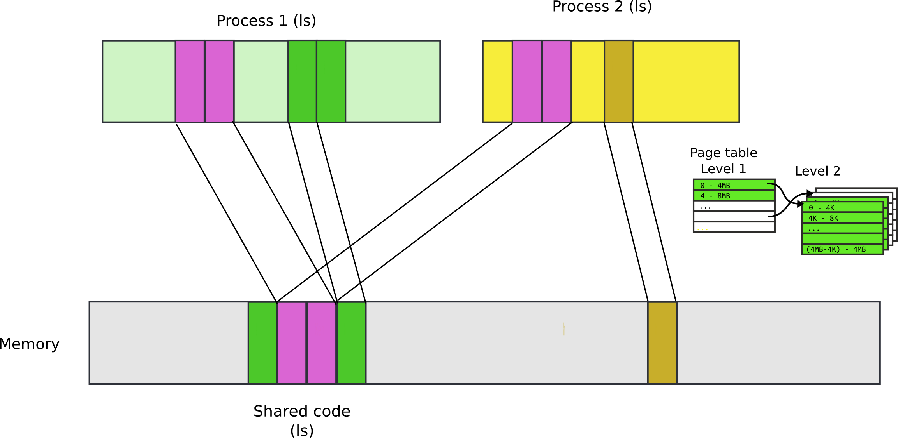
Compared to segments pages allow ...
Share a region of memory across multiple programs
  Communication (shared buffer of messages)
  Shared libraries

Slide 69
More paging tricks
Protect parts of the program
  E.g., map code as read-only
    Disable code modification attacks
    Remember R/W bit in PTD/PTE entries!
  E.g., map stack as non-executable
    Protects from stack smashing attacks
    Non-executable bit

Slide 70

Recap: complete address translation

Slide 71


Slide 79
Why do we need paging?
Compared to segments pages provide fine-grained control over memory layout
  No need to relocate/swap the entire segment
    One page is enough
You're trading flexibility (granularity) for overhead of data structures required for translation

Slide 80
Questions?

