Slide 1
COMPSCI: Principles of Operating Systems
Lecture 1: Introduction
Anton Burtsev
January, 2017

Slide 2
Class details
Undergraduate
  22 students
Instructor: Anton Burtsev
Meeting time: 9:00-9:50am (M, W, F)
  Discussions: 1:00-1:50am (F)
    No regular discussion section unless scheduled
    Feel free to stop by my office with questions (DBH 3066)
No TAs
Web page
  http://www.ics.uci.edu/~aburtsev/143A

Slide 3
This course
Inspired by
  MIT 6.828: Operating System Engineering
  https://pdos.csail.mit.edu/6.828/2016/
  Adapted for undergraduate students
We will use xv6
  Relatively simple (9K lines of code)
  Reasonably complete UNIX kernel
  https://pdos.csail.mit.edu/6.828/2016/xv6.html
xv6 comes with a book
  https://pdos.csail.mit.edu/6.828/2016/xv6/book-rev9.pdf
And source code printout
  https://pdos.csail.mit.edu/6.828/2016/xv6/xv6-rev9.pdf

Slide 4
Course Book
“Operating Systems: Three Easy Pieces” Remzi H. Arpaci-Dusseau and Andrea C. Arpaci-Dusseau
  Free online versionhttp://pages.cs.wisc.edu/~remzi/OSTEP/

Slide 5
Course organization
Lectures
  High level concepts and abstractions
Reading
  Xv6 book + source code
  OSTEP book
Homeworks
  Coding real parts of the xv6 kernel
Design riddles
  Understanding design tradeoffs, explaining parts of xv6

Slide 6
Prerequisites
Solid C coding skills
  Xv6 is written in C
  You need to read, code and debug
  All homeworks are in C
  Many questions will require explaining xv6 code
Be able to work and code in Linux/UNIX
Some assembly skills

Slide 7
What is an operating system?

Slide 8
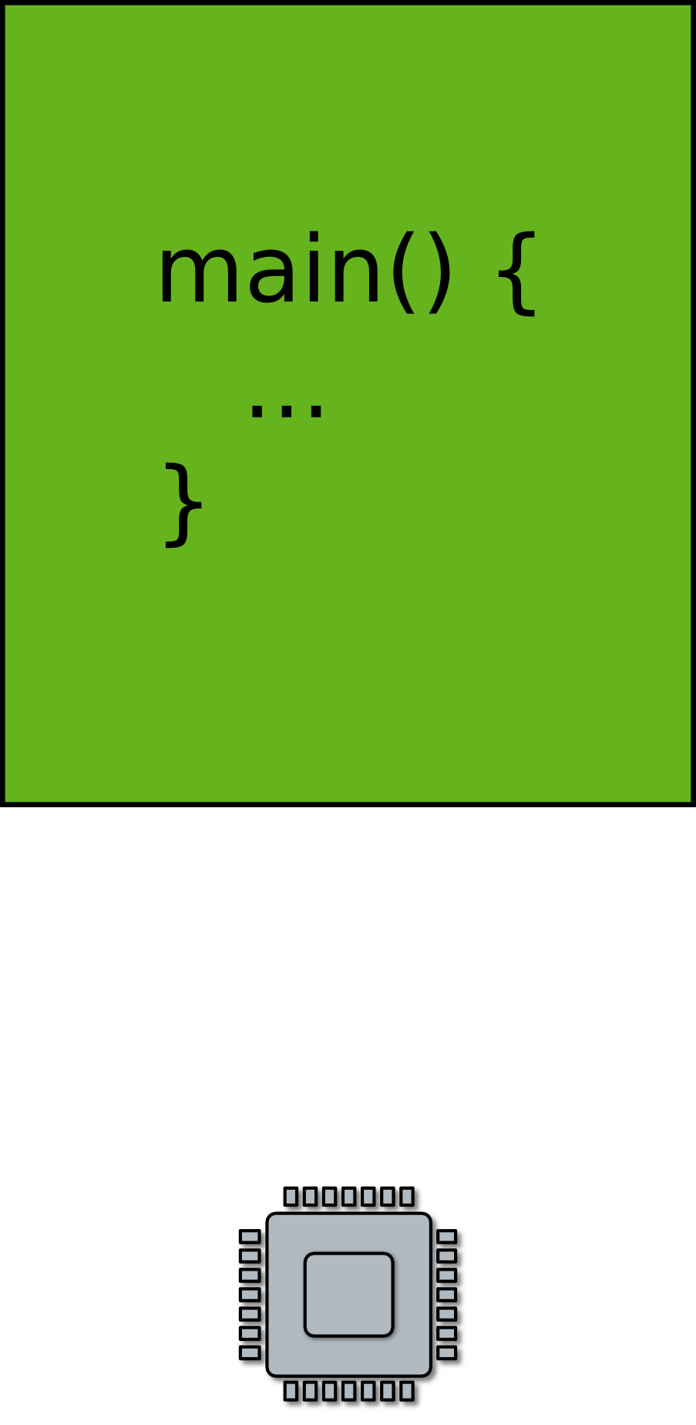
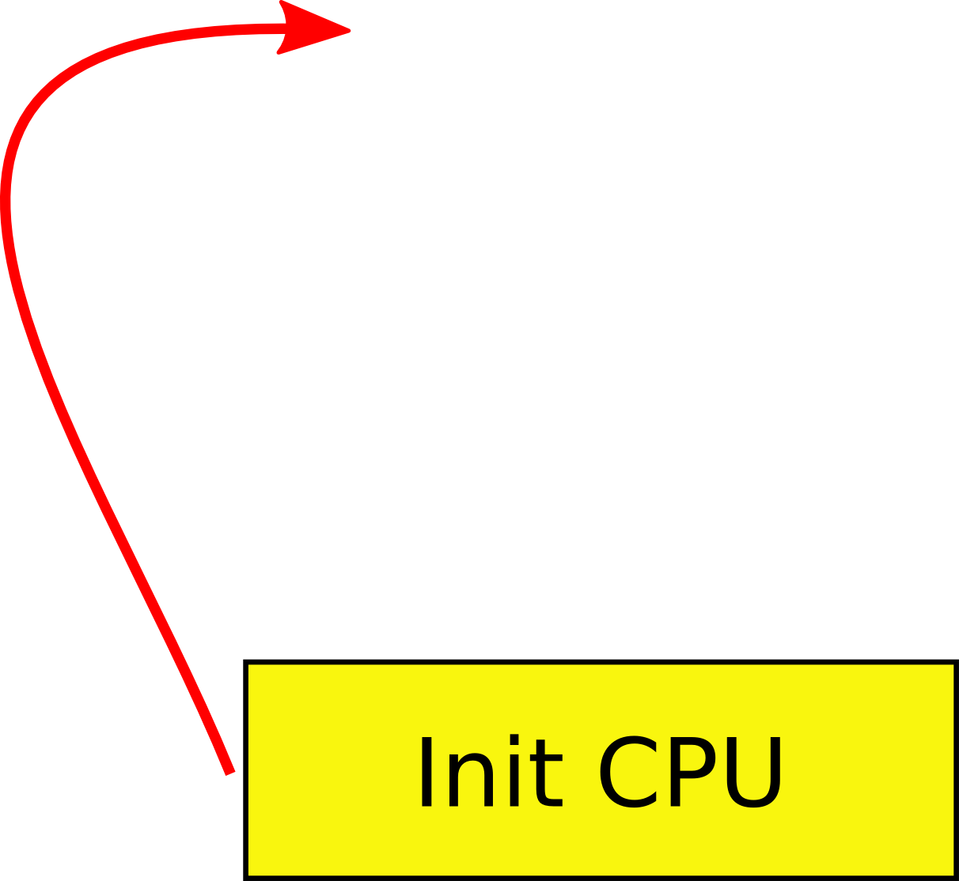
Goal: Run your code on a piece of hardware
Read CPU manual
A tiny boot layer
  Initialize CPU, memory
  Jump to your code
main()
  This is your OS!

Slide 9
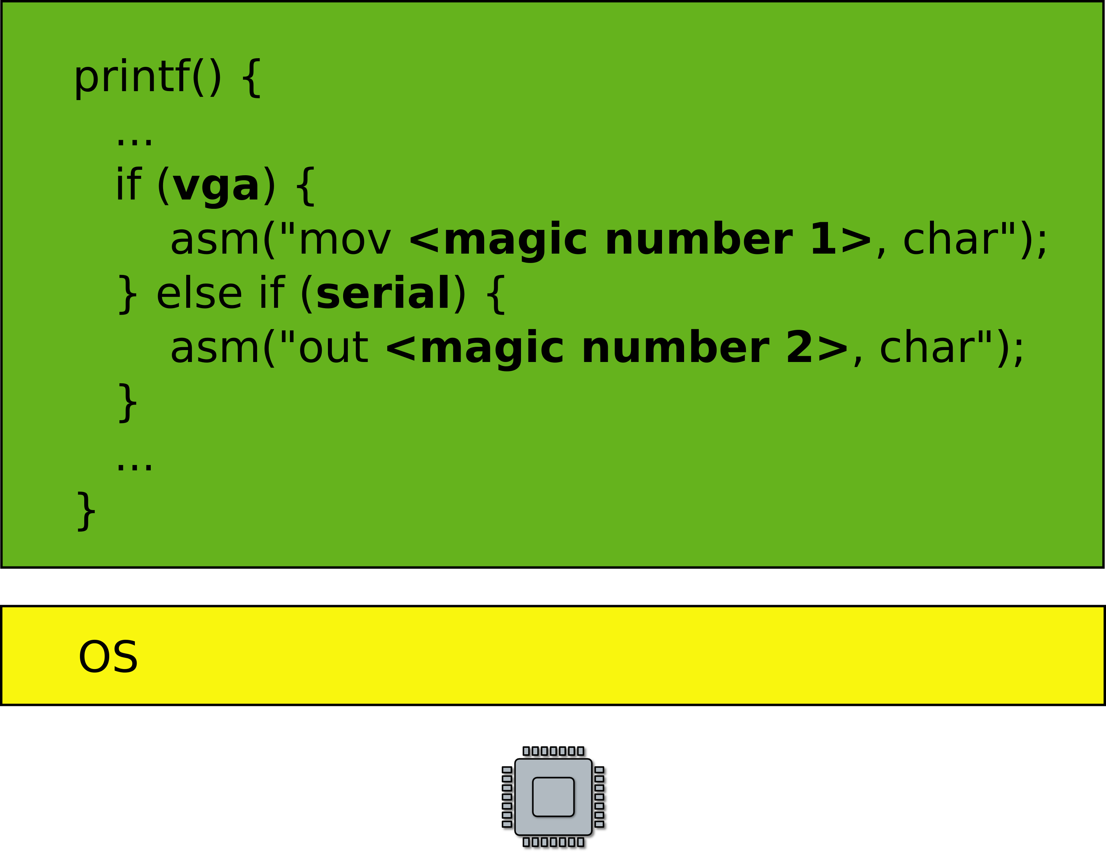
Print out a string
  On the screen or serial line

Slide 10
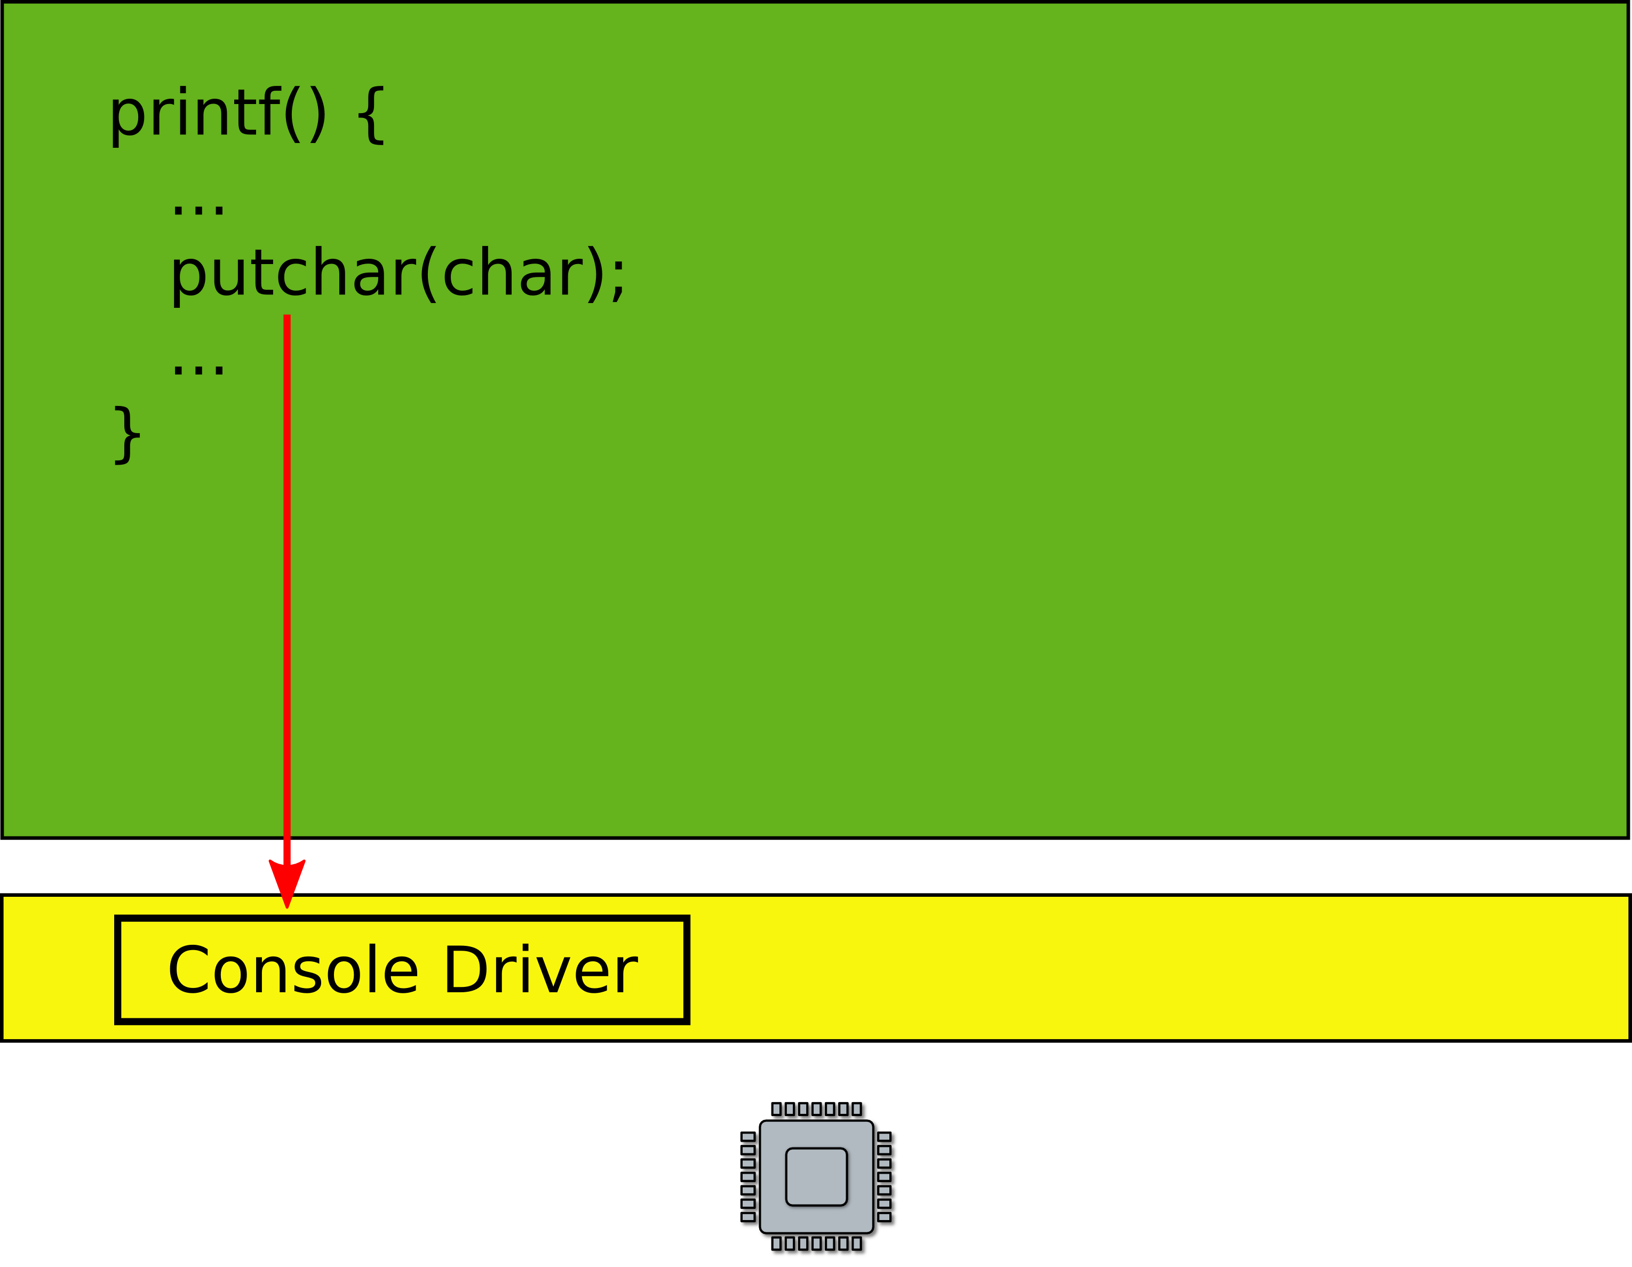
A more general interface
  First device driver

Slide 11
Device drivers
Abstract hardware
  Provide high-level interface
  Hide minor differences
  Implement some optimizations
    Batch requests
Examples
  Console, disk, network interface
  ...virtually any piece of hardware you know

Slide 12
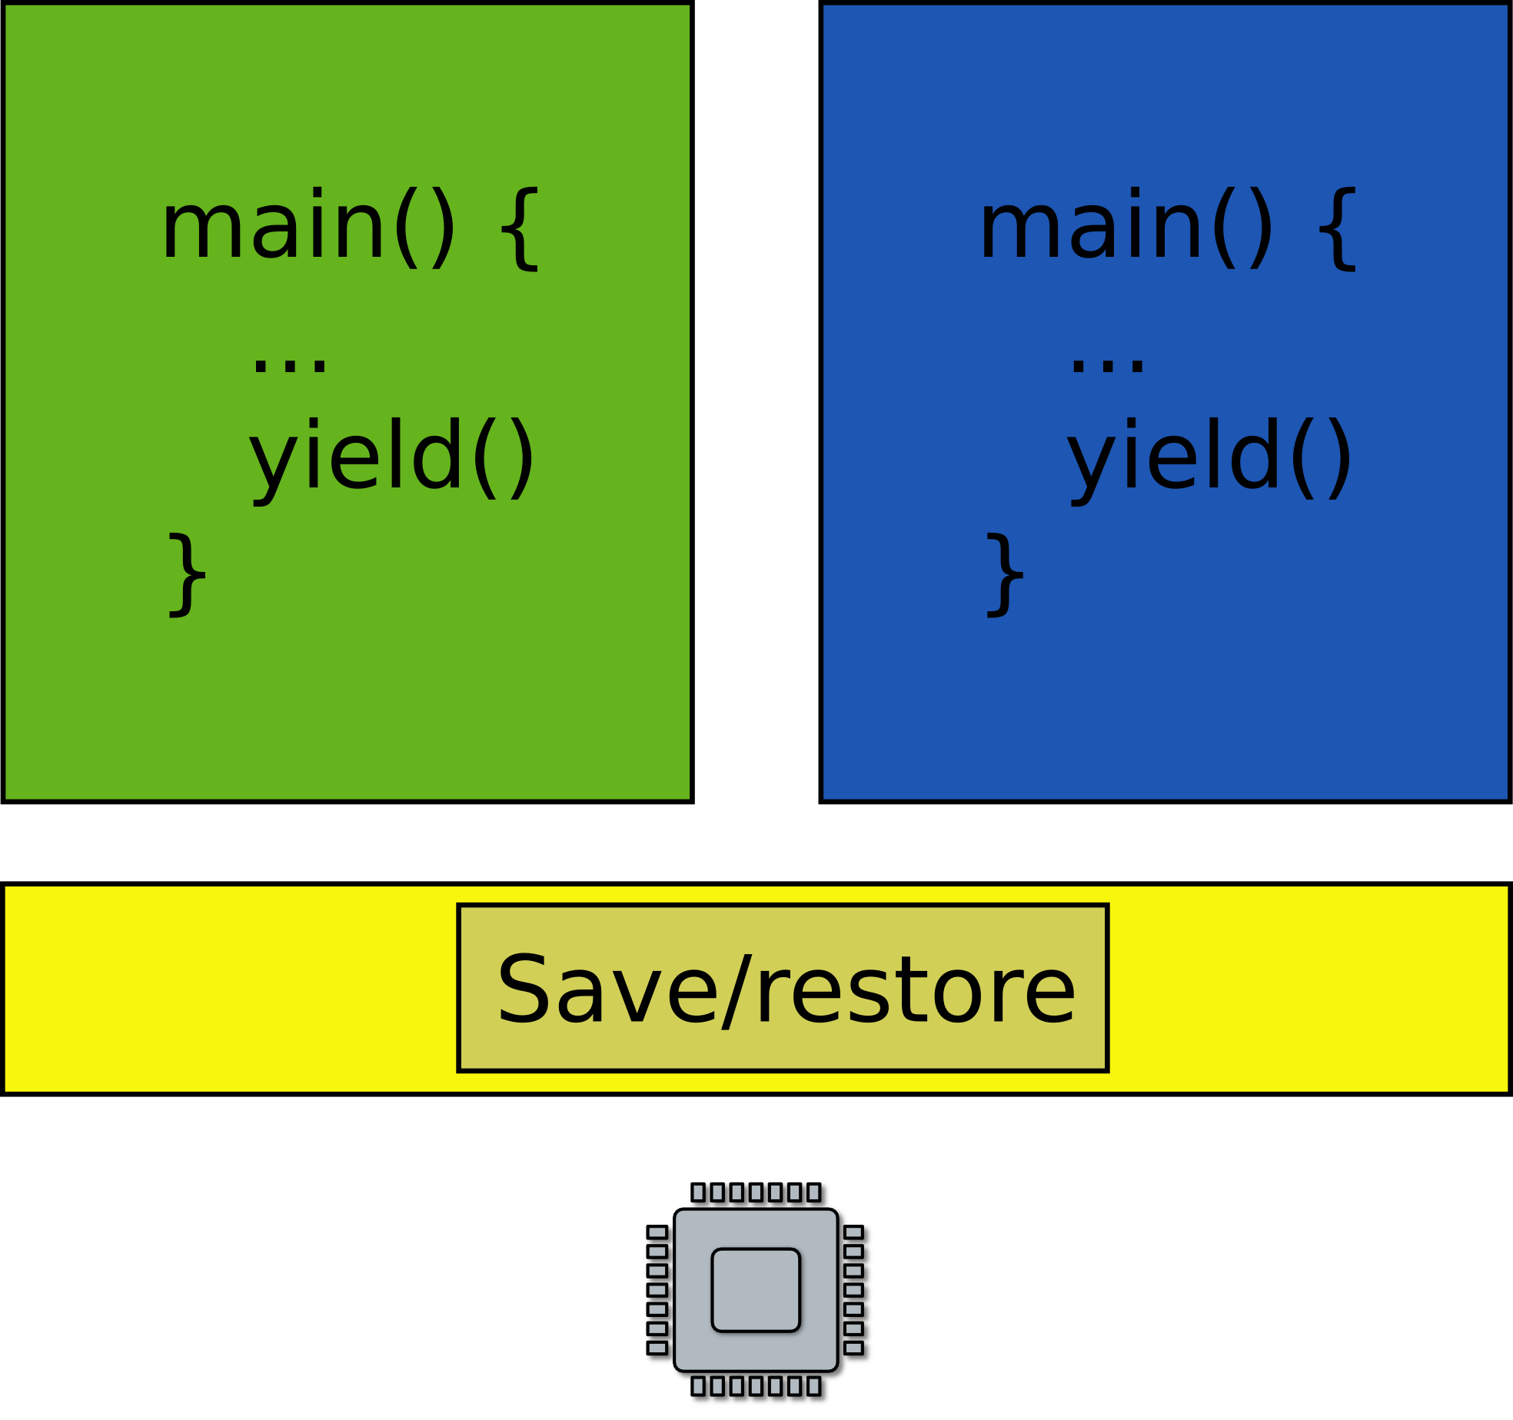
Goal: Want to run two programs
What does it mean?
  Only one CPU
Run one, then run another one

Slide 13

Goal: Want to run two programs
Exit into the kernel periodically
Context switch
  Save and restore context
  Essentially registers

Slide 14
What! Two programs, one memory?
Linker magic?

Slide 15
Virtual address spaces
Illusion of a private memory for each application
  Keep a description of an address space
  In one of the registers
All normal program addresses are inside the address space
OS maintains description of address spaces
  Switches between them

Slide 16
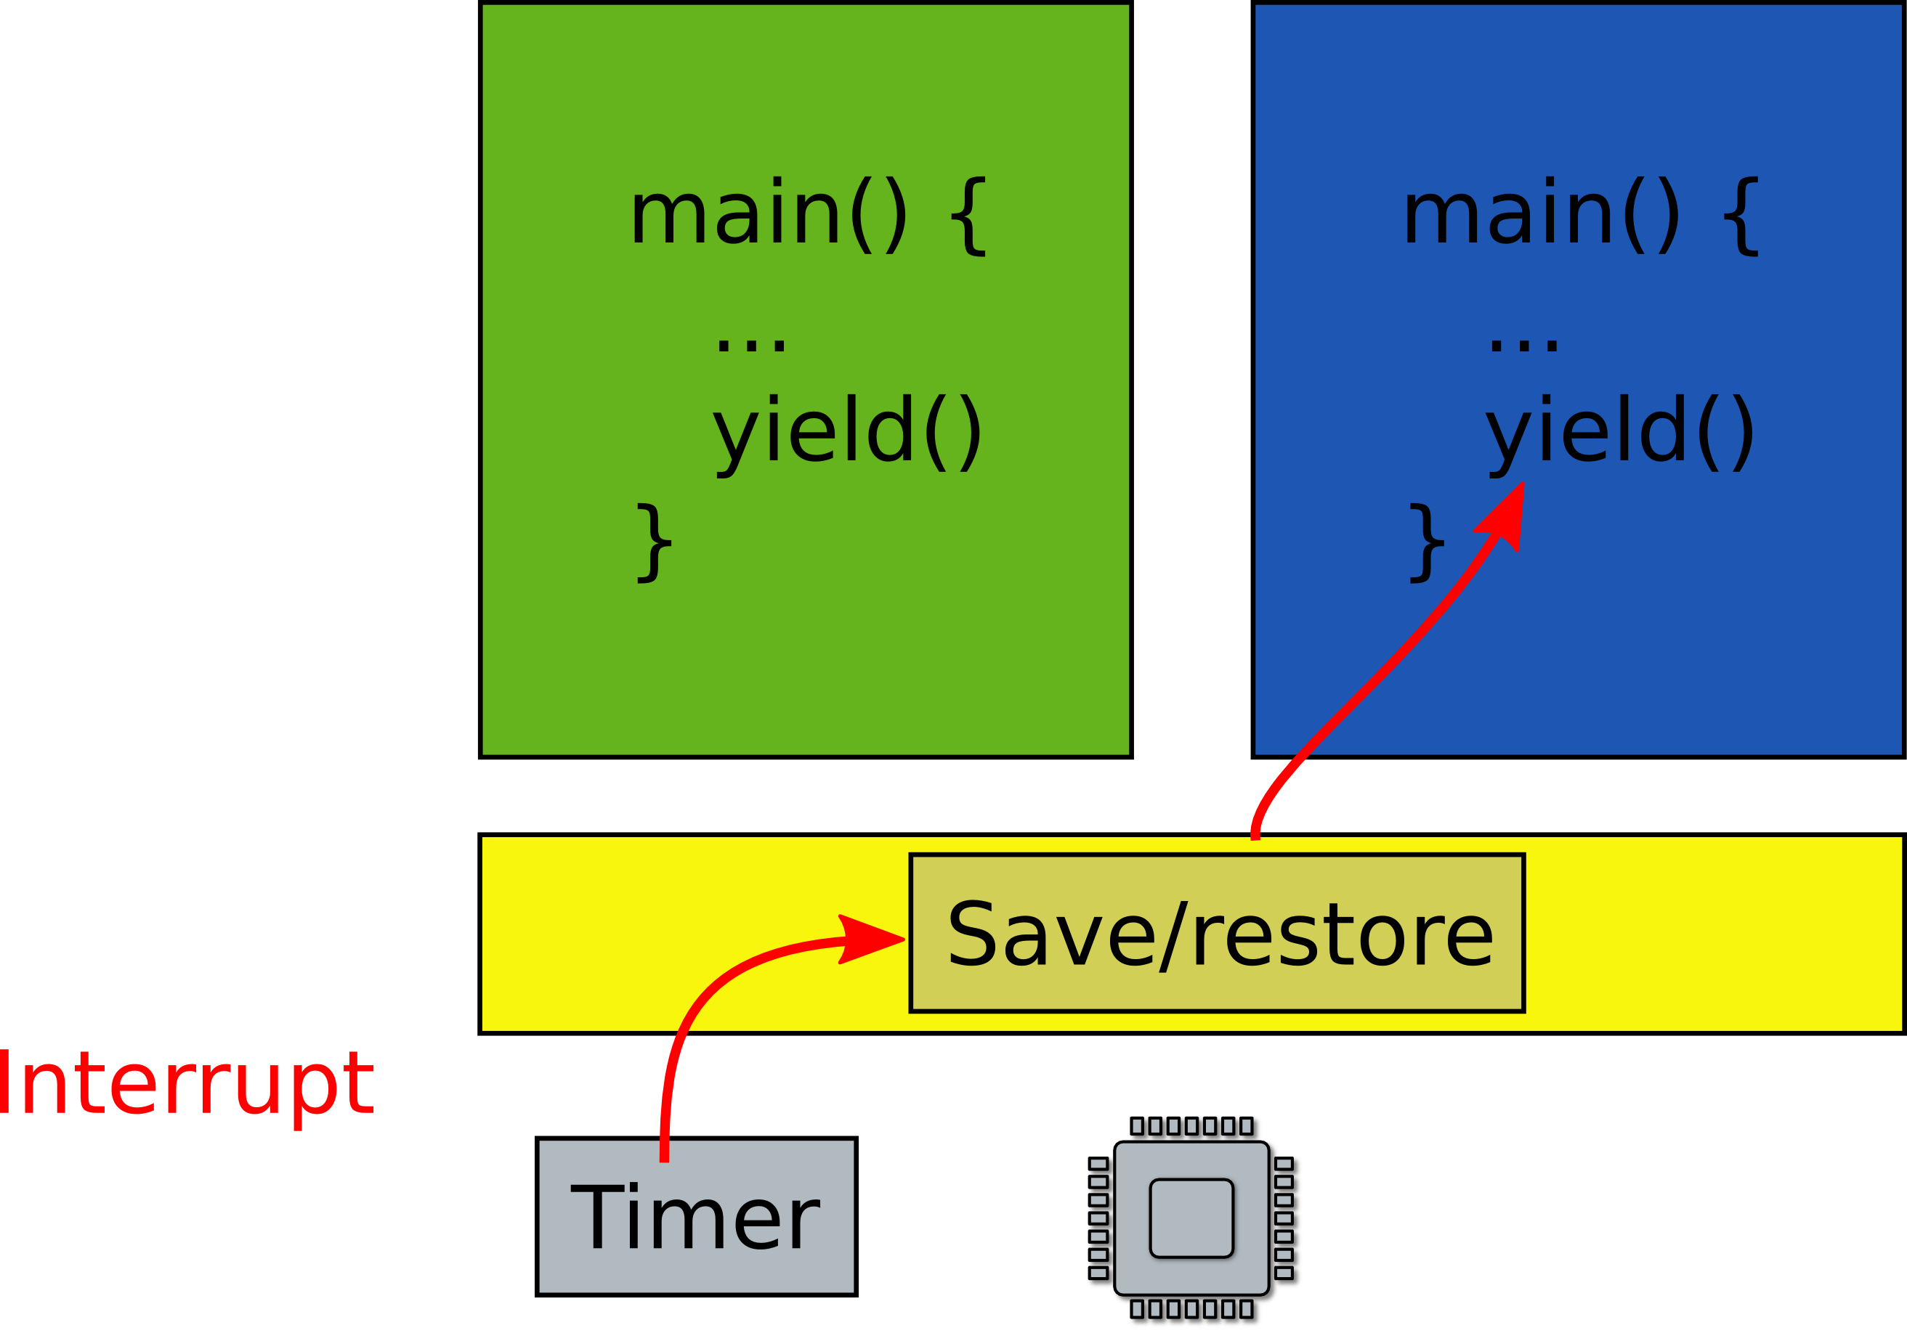
What if one program fails to release the CPU?
It will run forever. Need a way to preempt it. How?

Slide 17
Scheduling
Pick which application to run next
  And for how long
Illusion of a private CPU for each task
  Frequent context switching

Slide 18
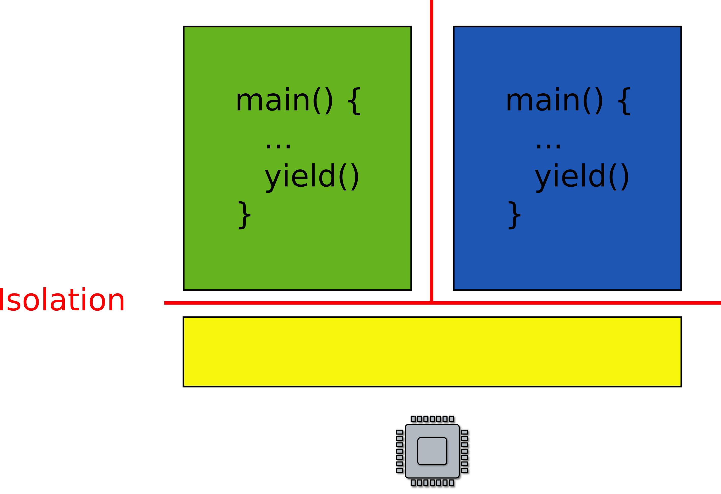
What if one faulty program corrupts the kernel?
Or other programs?

Slide 19
Isolation
Today is done with address spaces in hardware
  Many issues, e.g. shared device drivers, files, etc.
Can it be done in software?

Slide 20
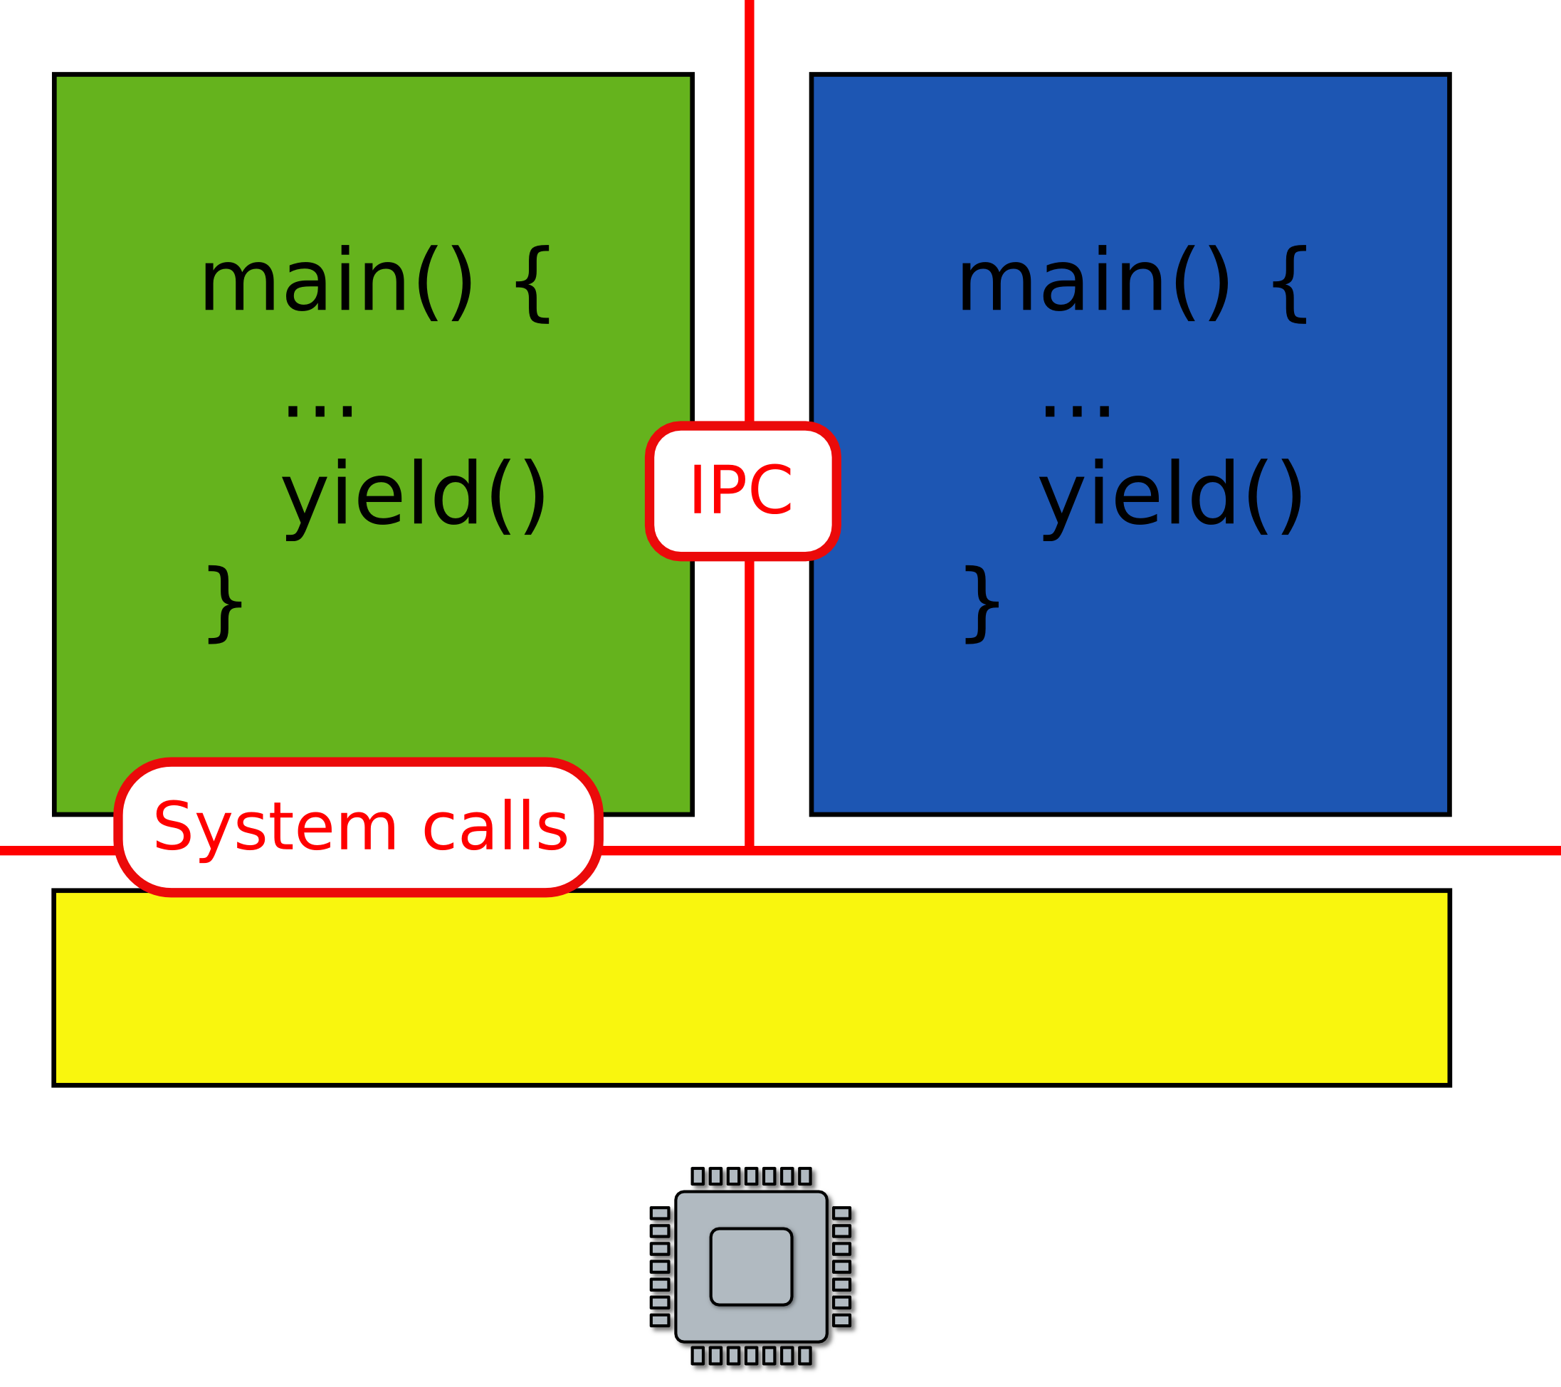
What about communication?
Can we invoke a function in a kernel?

Slide 21
What if you want to save some data?
Permanent storage
  E.g., disks
But disks are just arrays of blocks
  wrtie(block_number, block_data)
Files
  High level abstraction for saving data
  fd = open(“contacts.txt”);
  fpritnf(fd, “Name:%s\n”, name);

Slide 22
What if you want to send data over the network?
Network interfaces
  Send/receive Ethernet packets (Level 2)
  Two low level
Sockets
  High level abstraction for sending data

Slide 23
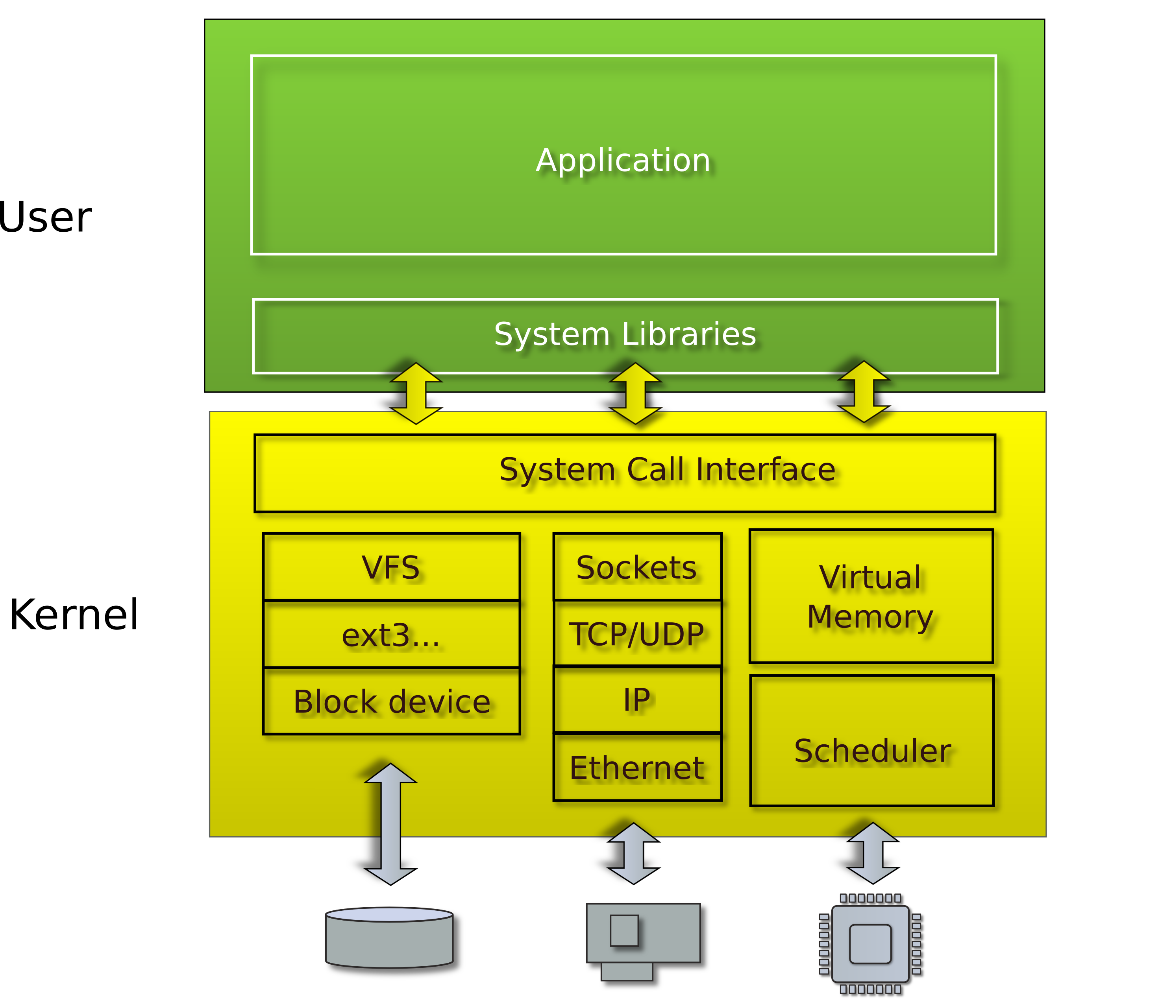
Linux/Windows/Mac

Slide 24
Multiple levels of abstraction
Multiple programs
  Each has illusion of a private memory and CPU
  Context switching, scheduling, isolation, communication
File systems
  Multiple files, concurrent I/O requests
  Consistency, caching
Network protocols
  Multiple virtual network connections
Memory management

Slide 25
Virtualization

Slide 26
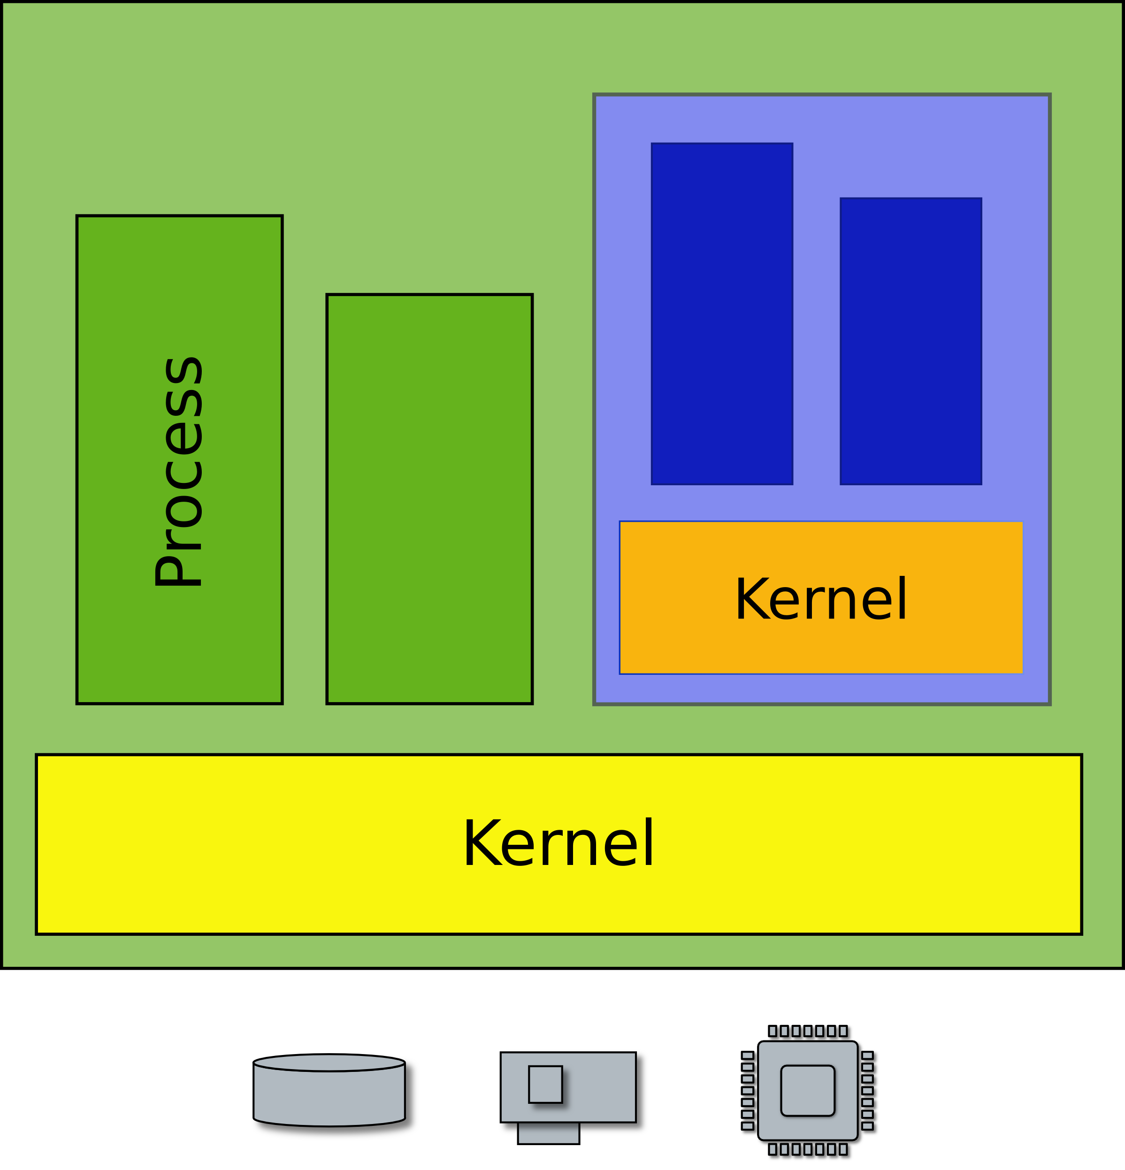
Want to run a Windows application on Linux?

Slide 27
Want to run a Windows application on Linux?

Slide 28
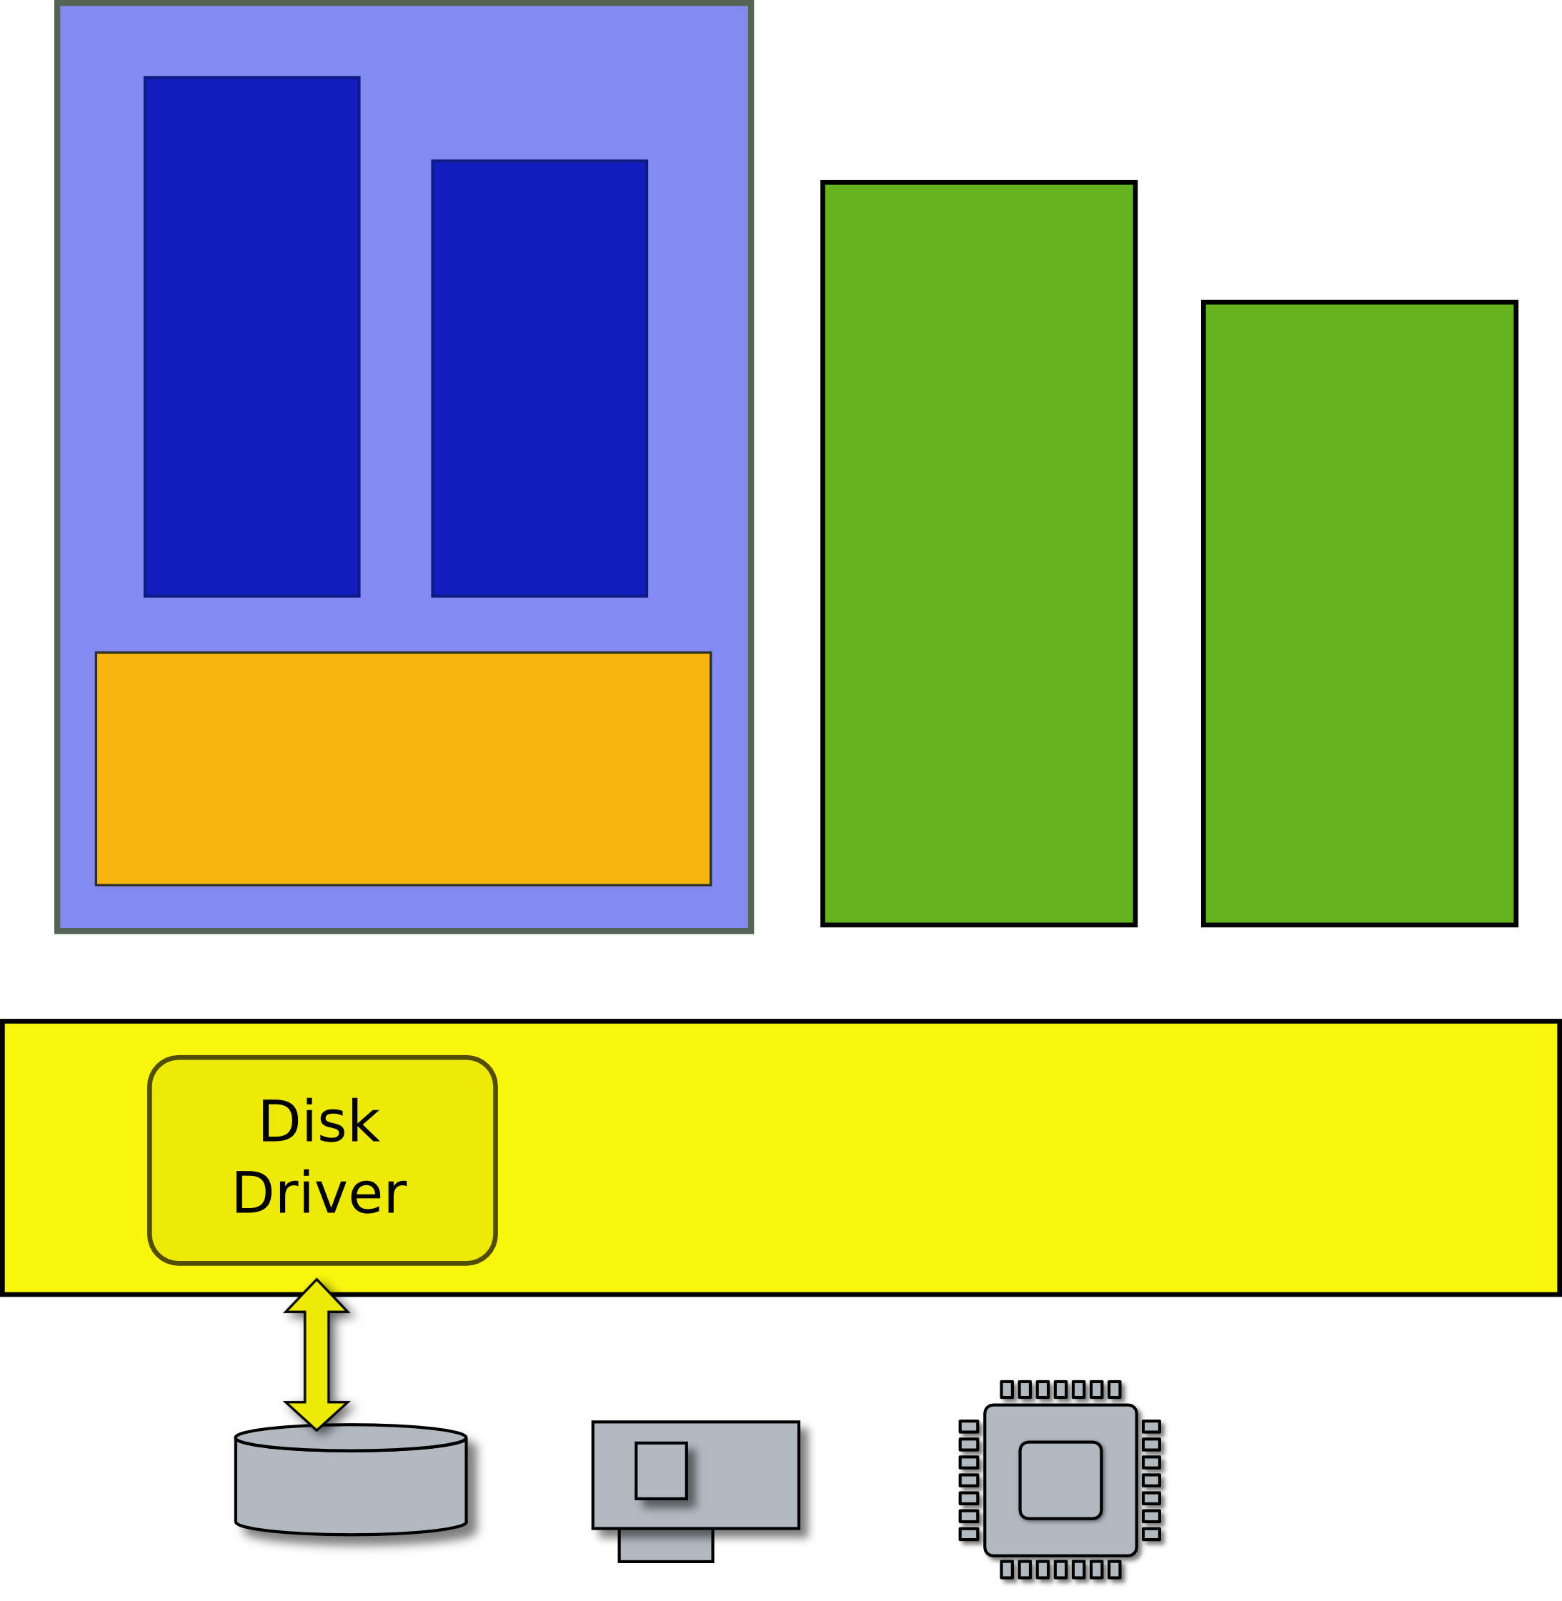


What is the problem?
Hardware is not designed to be multiplexed
Loss of isolation

Slide 29
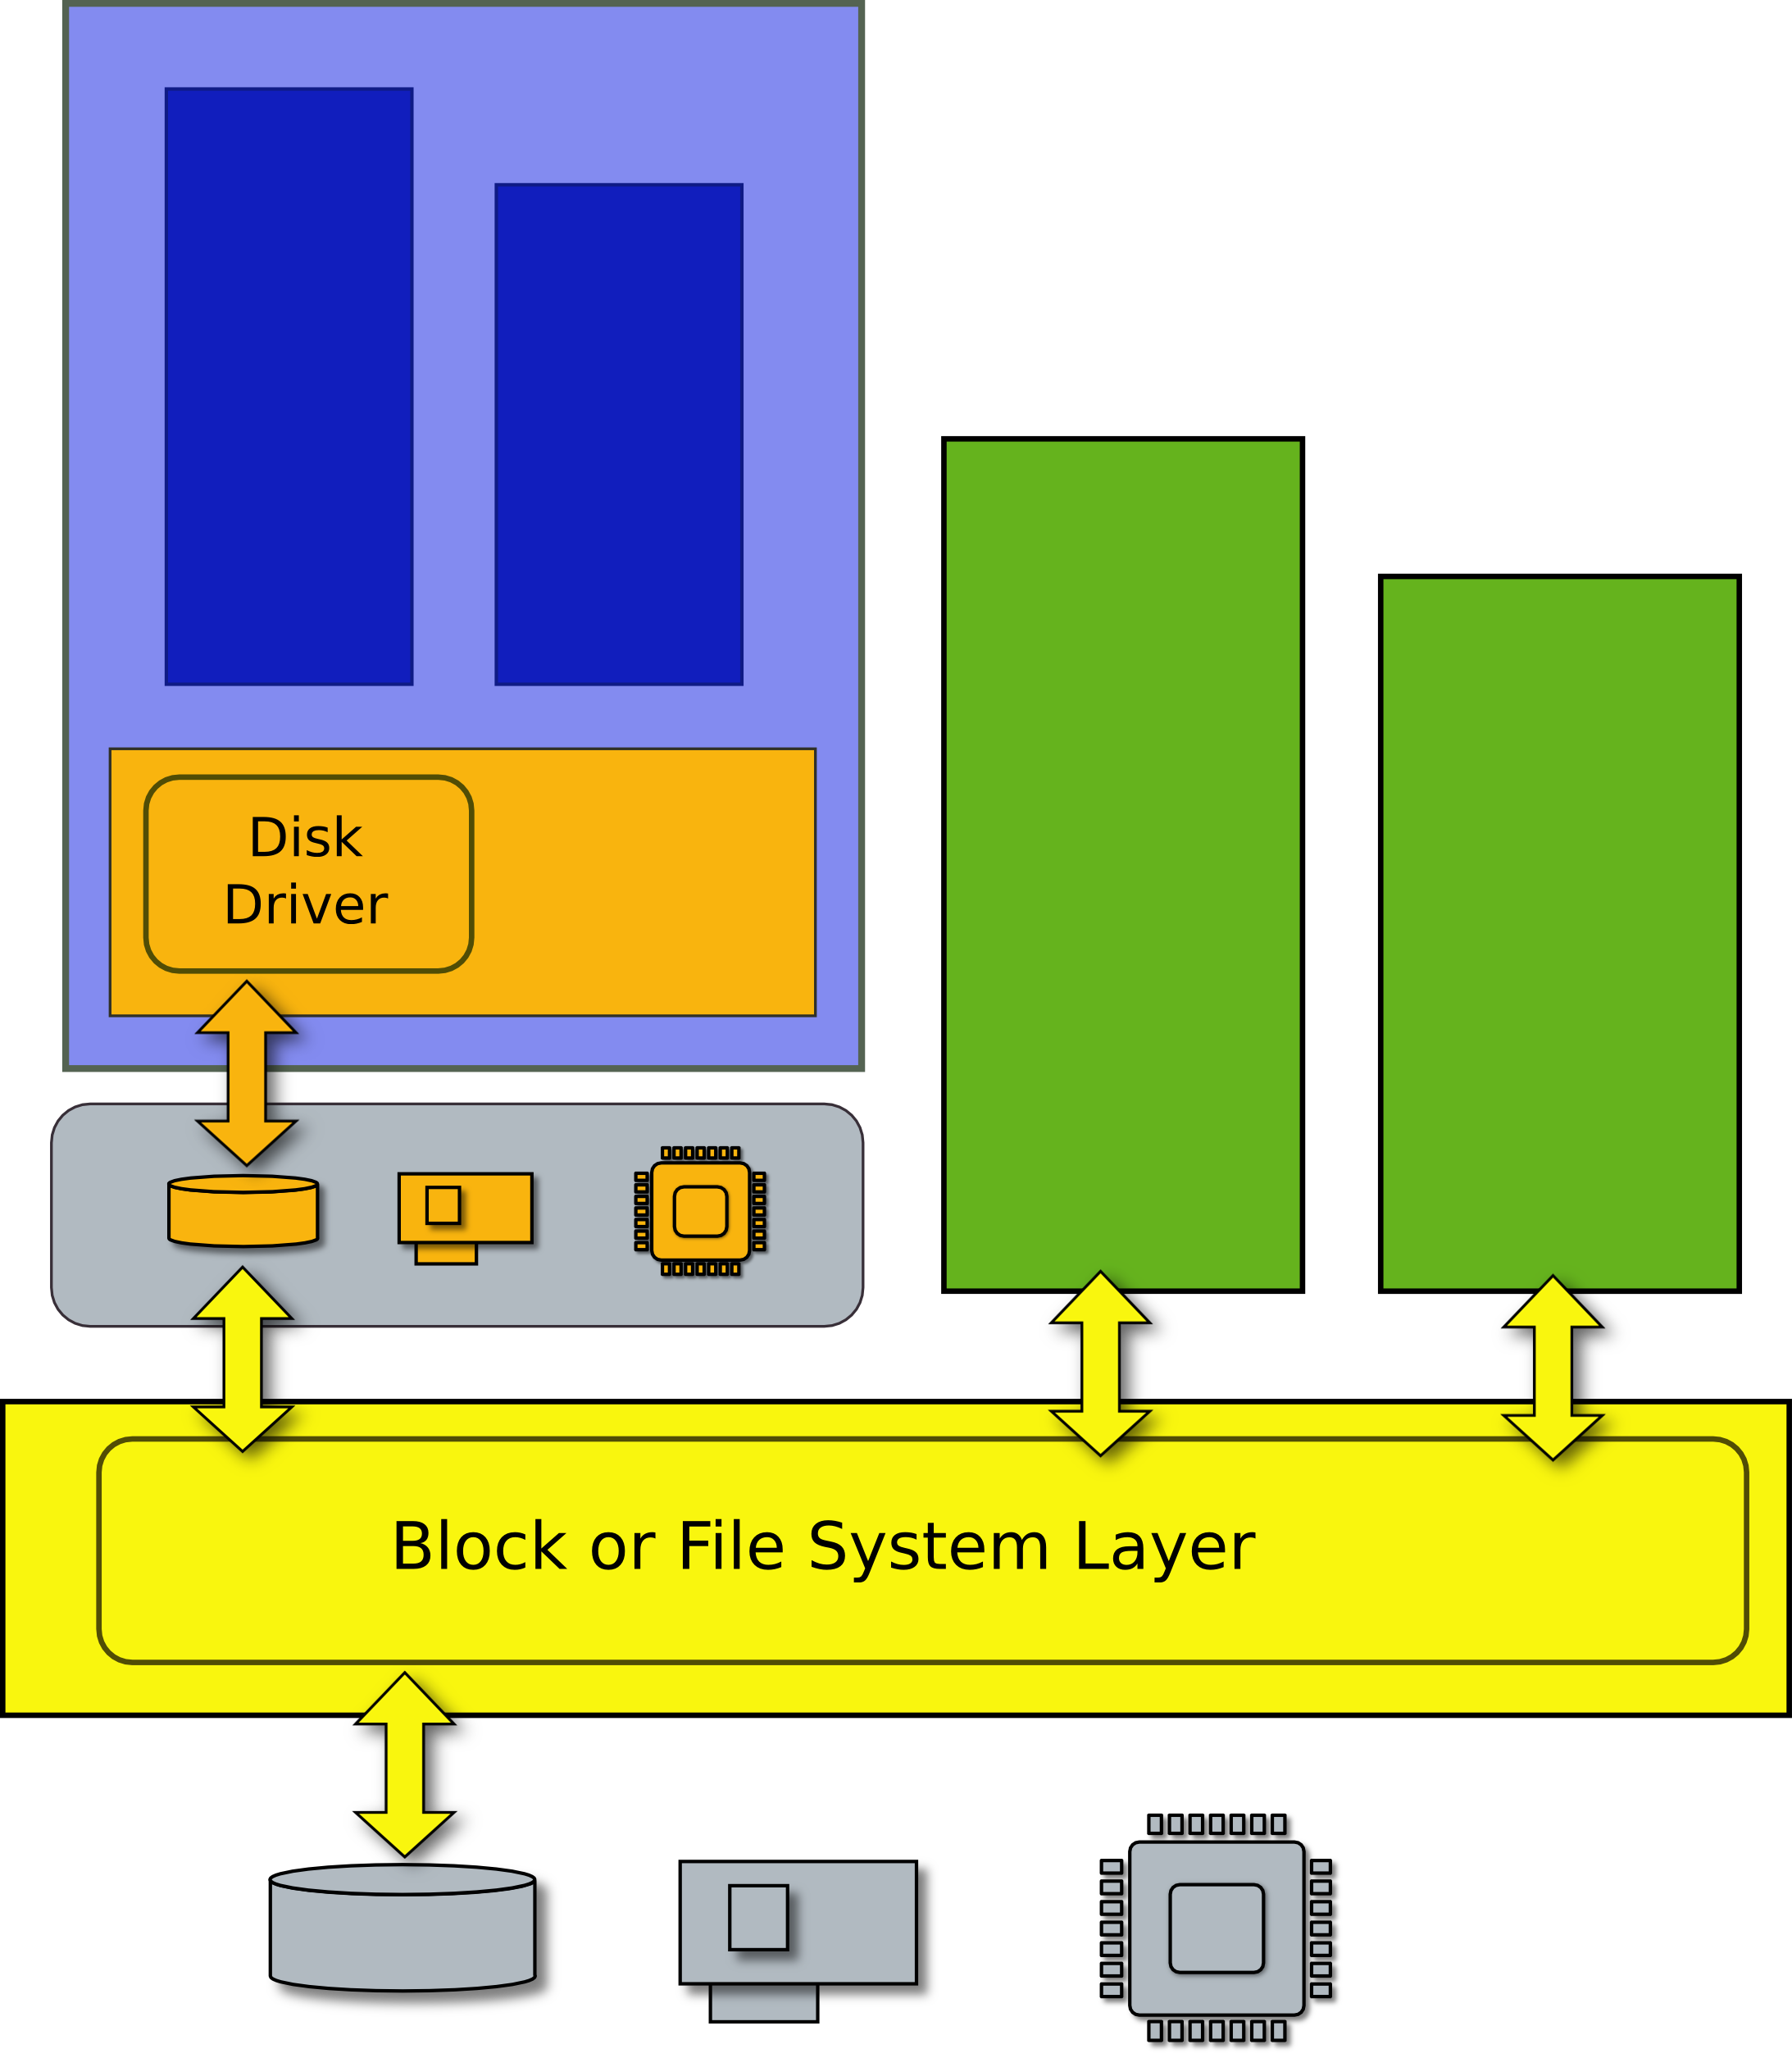
Virtual machine
Efficient duplicate of a real machine
Compatibility
Performance
Isolation

Slide 30
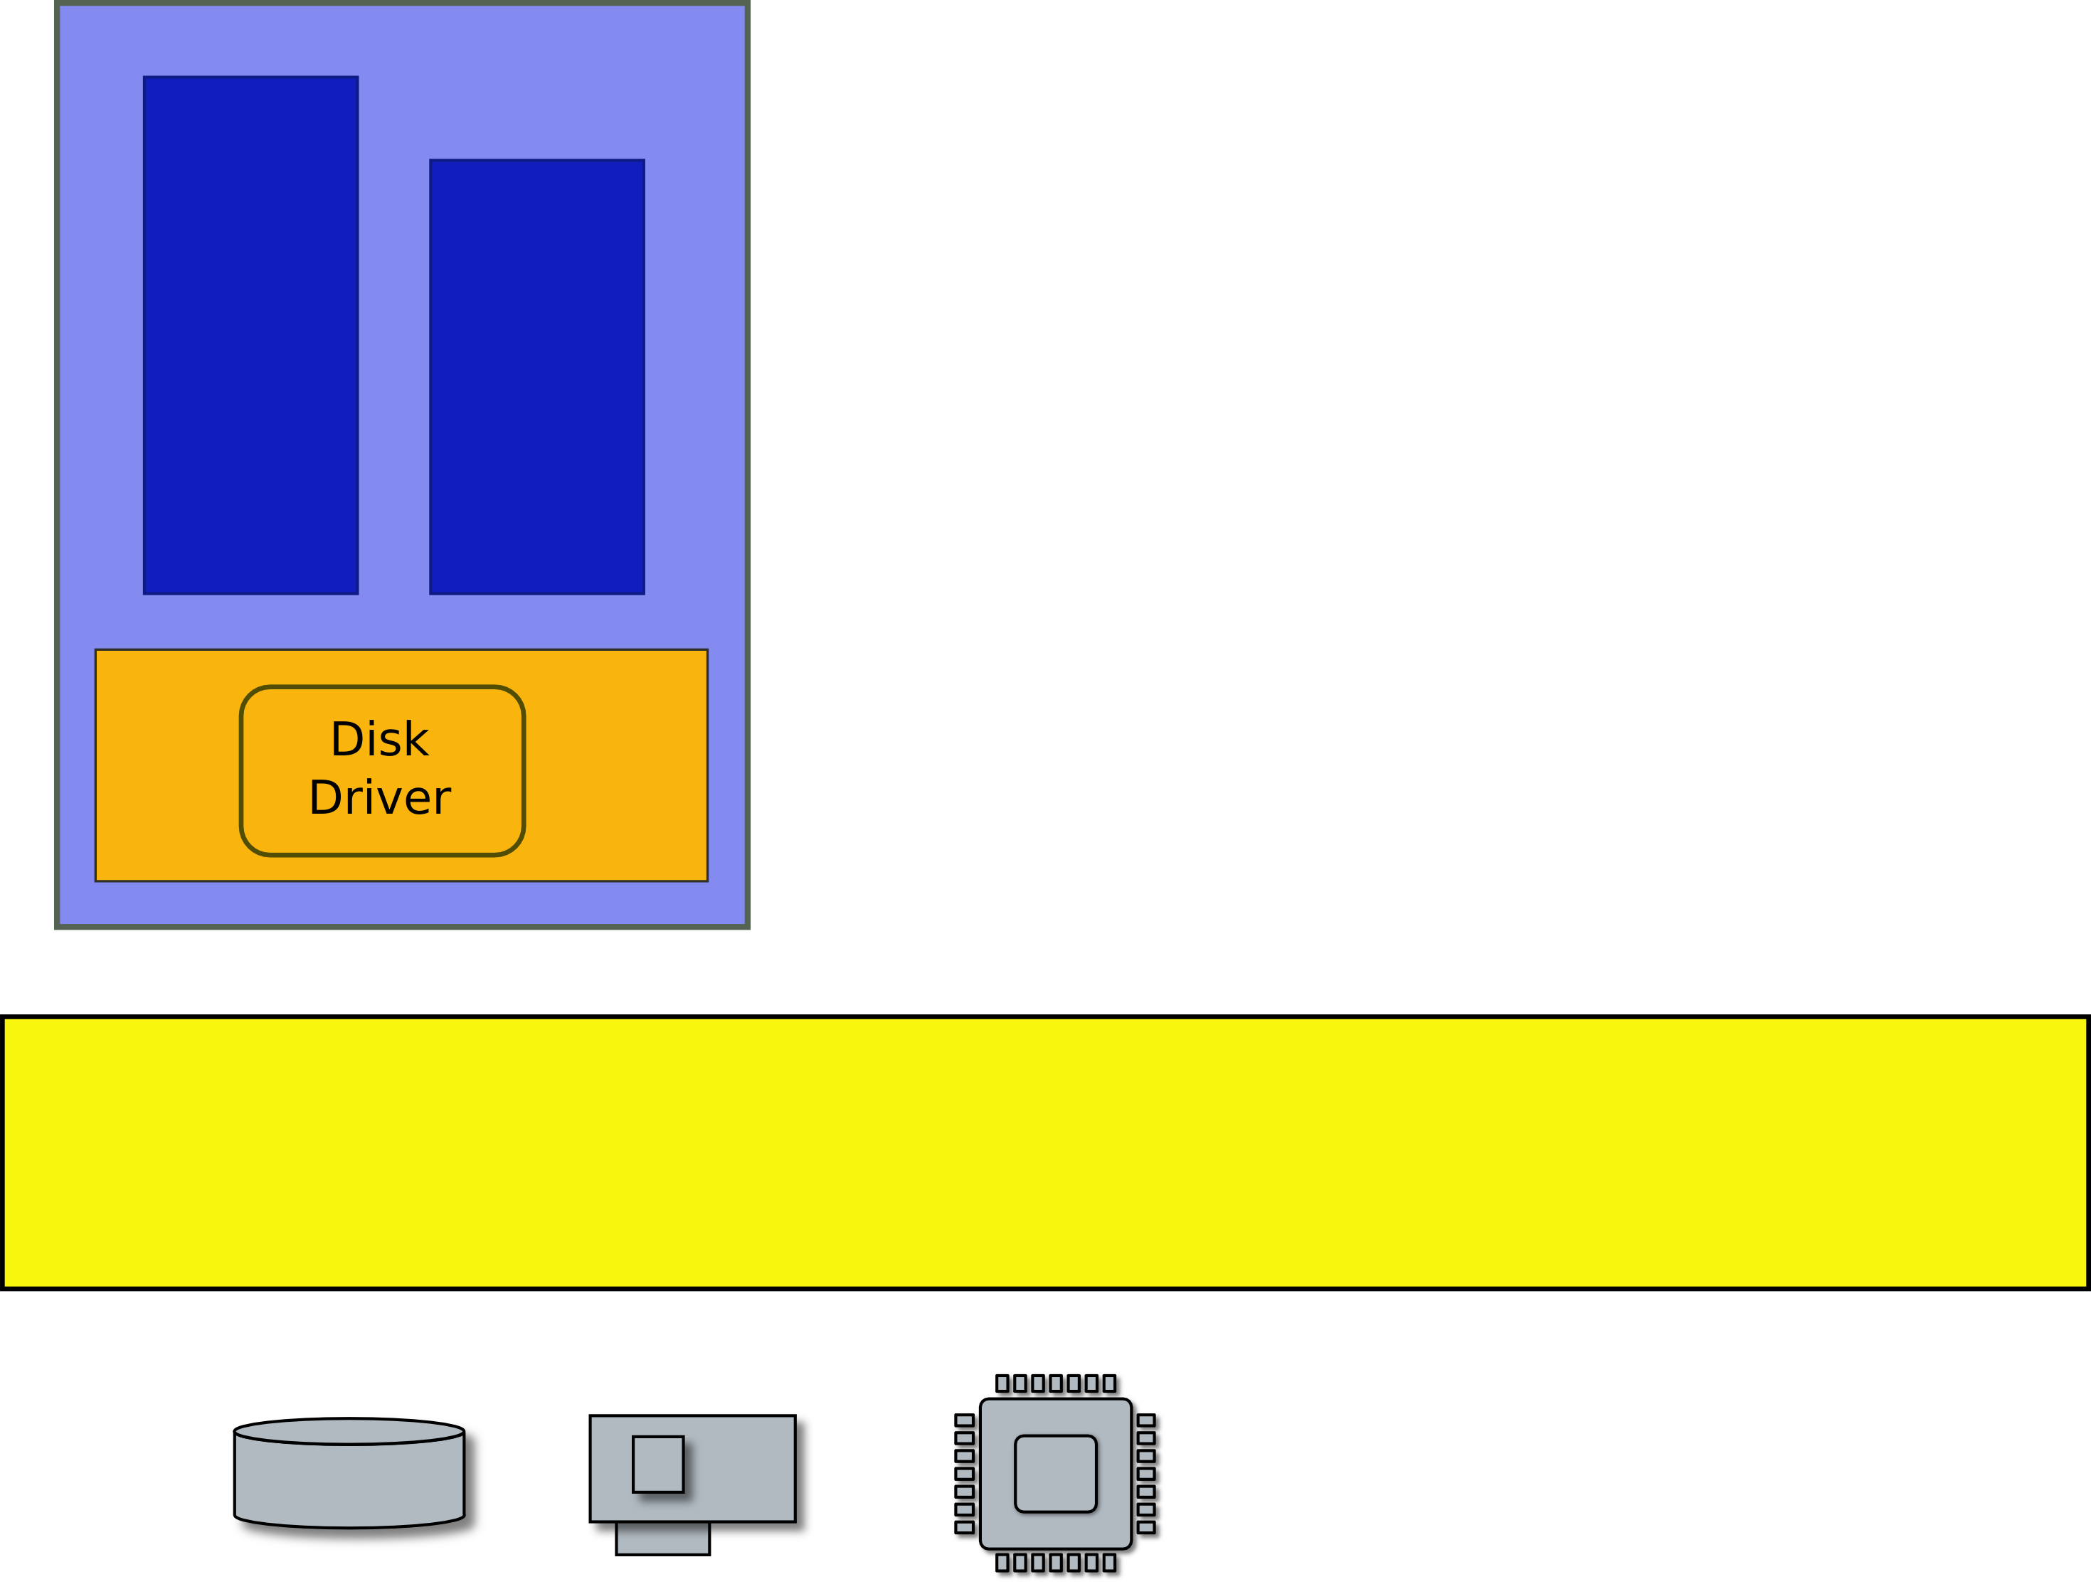
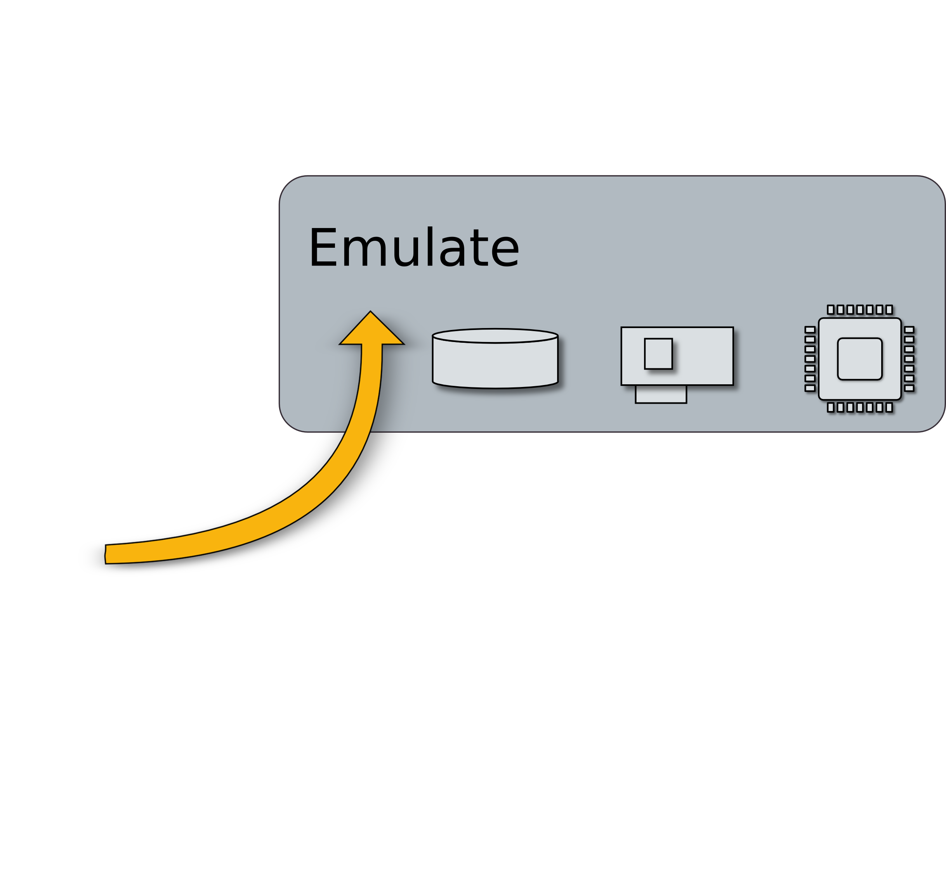
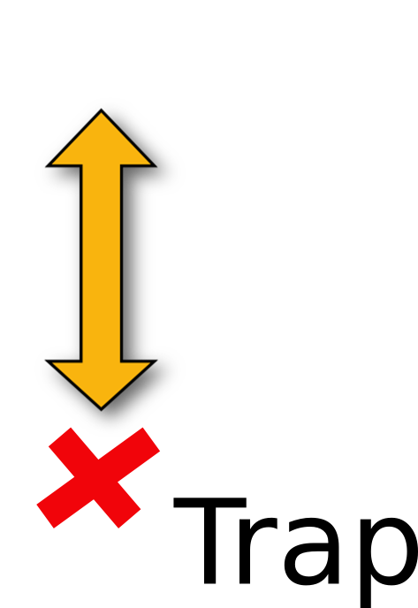
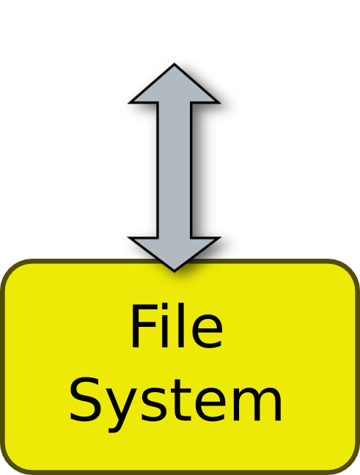
Trap and emulate

Slide 31
Questions?

