Slide 1
143A: Principles of Operating Systems
Lecture 10: Address spaces
(Kernel memory allocator)
Anton Burtsev
October, 2017

Slide 2
Recap of the boot sequence
Setup segments (data and code)
Switched to protected mode
  Loaded GDT (segmentation is on)
Setup stack (to call C functions)
Loaded kernel from disk
Setup first page table
  2 entries [ 0 : 4MB ] and [ 2GB : (2GB + 4MB) ]
Setup high-address stack
Jumped to main()

Slide 3
What's next?

Slide 4
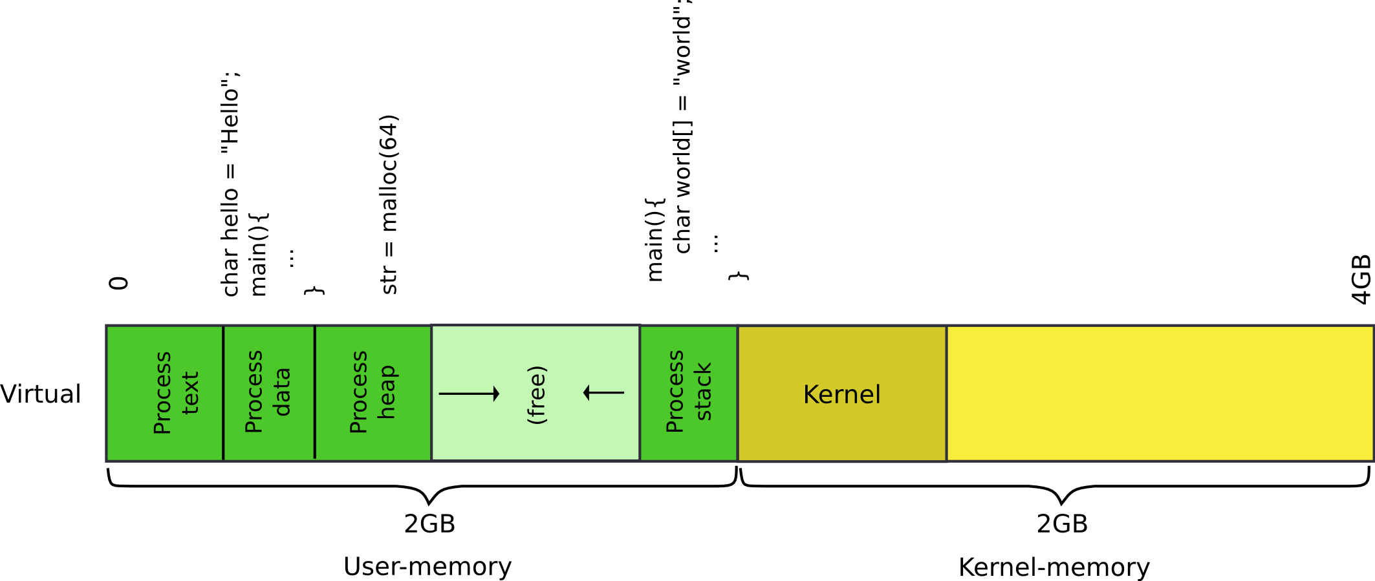
Our goal: 2GB/2GB address space

Slide 5
Kernel needs normal 2 level page table
  Right now we have only two entries
  And current page table is only good for 4MB pages
But to create page tables we need memory
  Where can it come from?

Slide 6
Physical page allocator
Goal:
  List of free physical pages
  To allocate page tables, stacks, data structures, etc.
  Remember current page table is only 1! page
Where to get memory to keep the list itself?
  1 level, only 4MB entries
    You don't even have space to keep the second level page tables

Slide 7

Physical page allocator

Slide 8
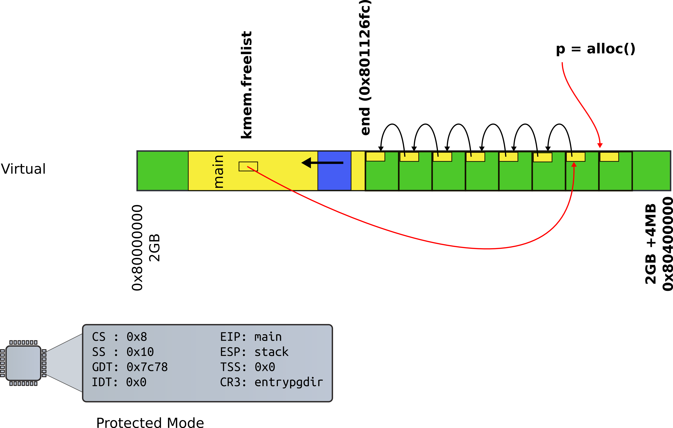
Physical page allocator

Slide 9
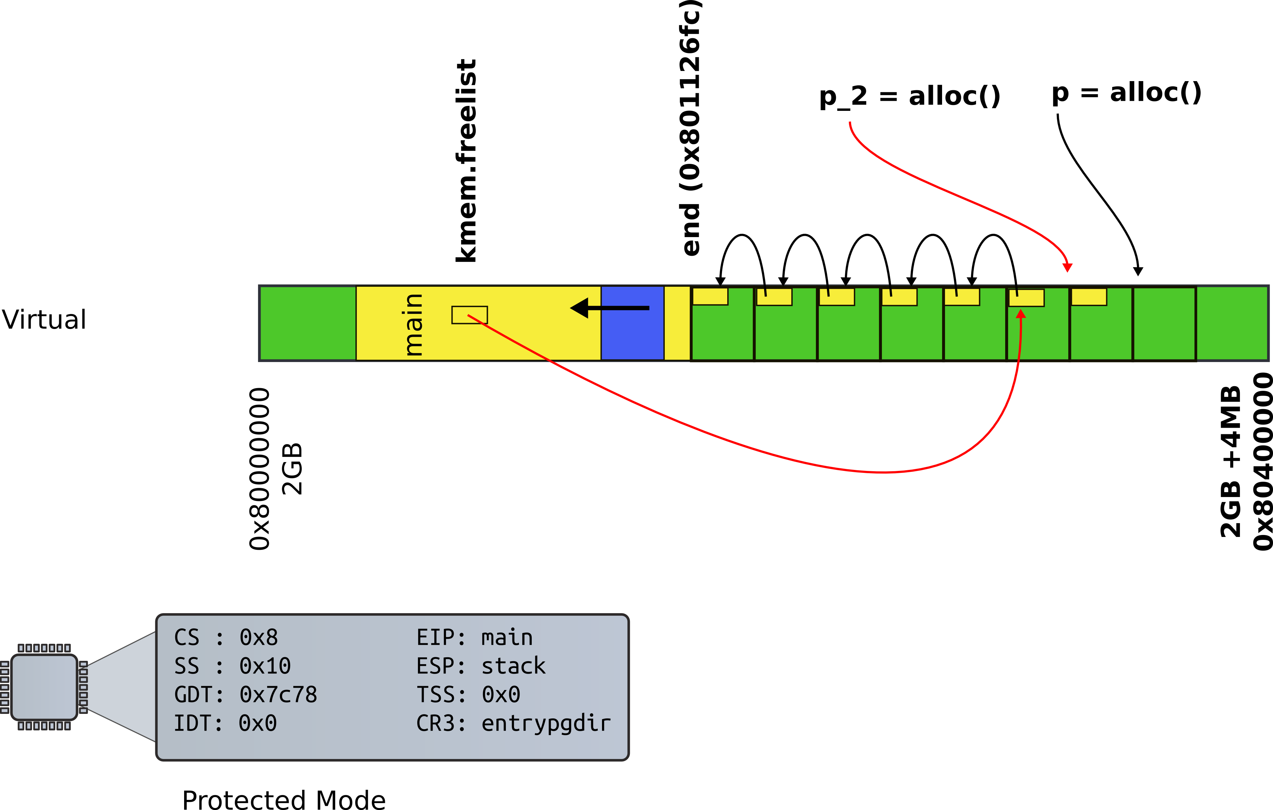
Physical page allocator

Slide 10
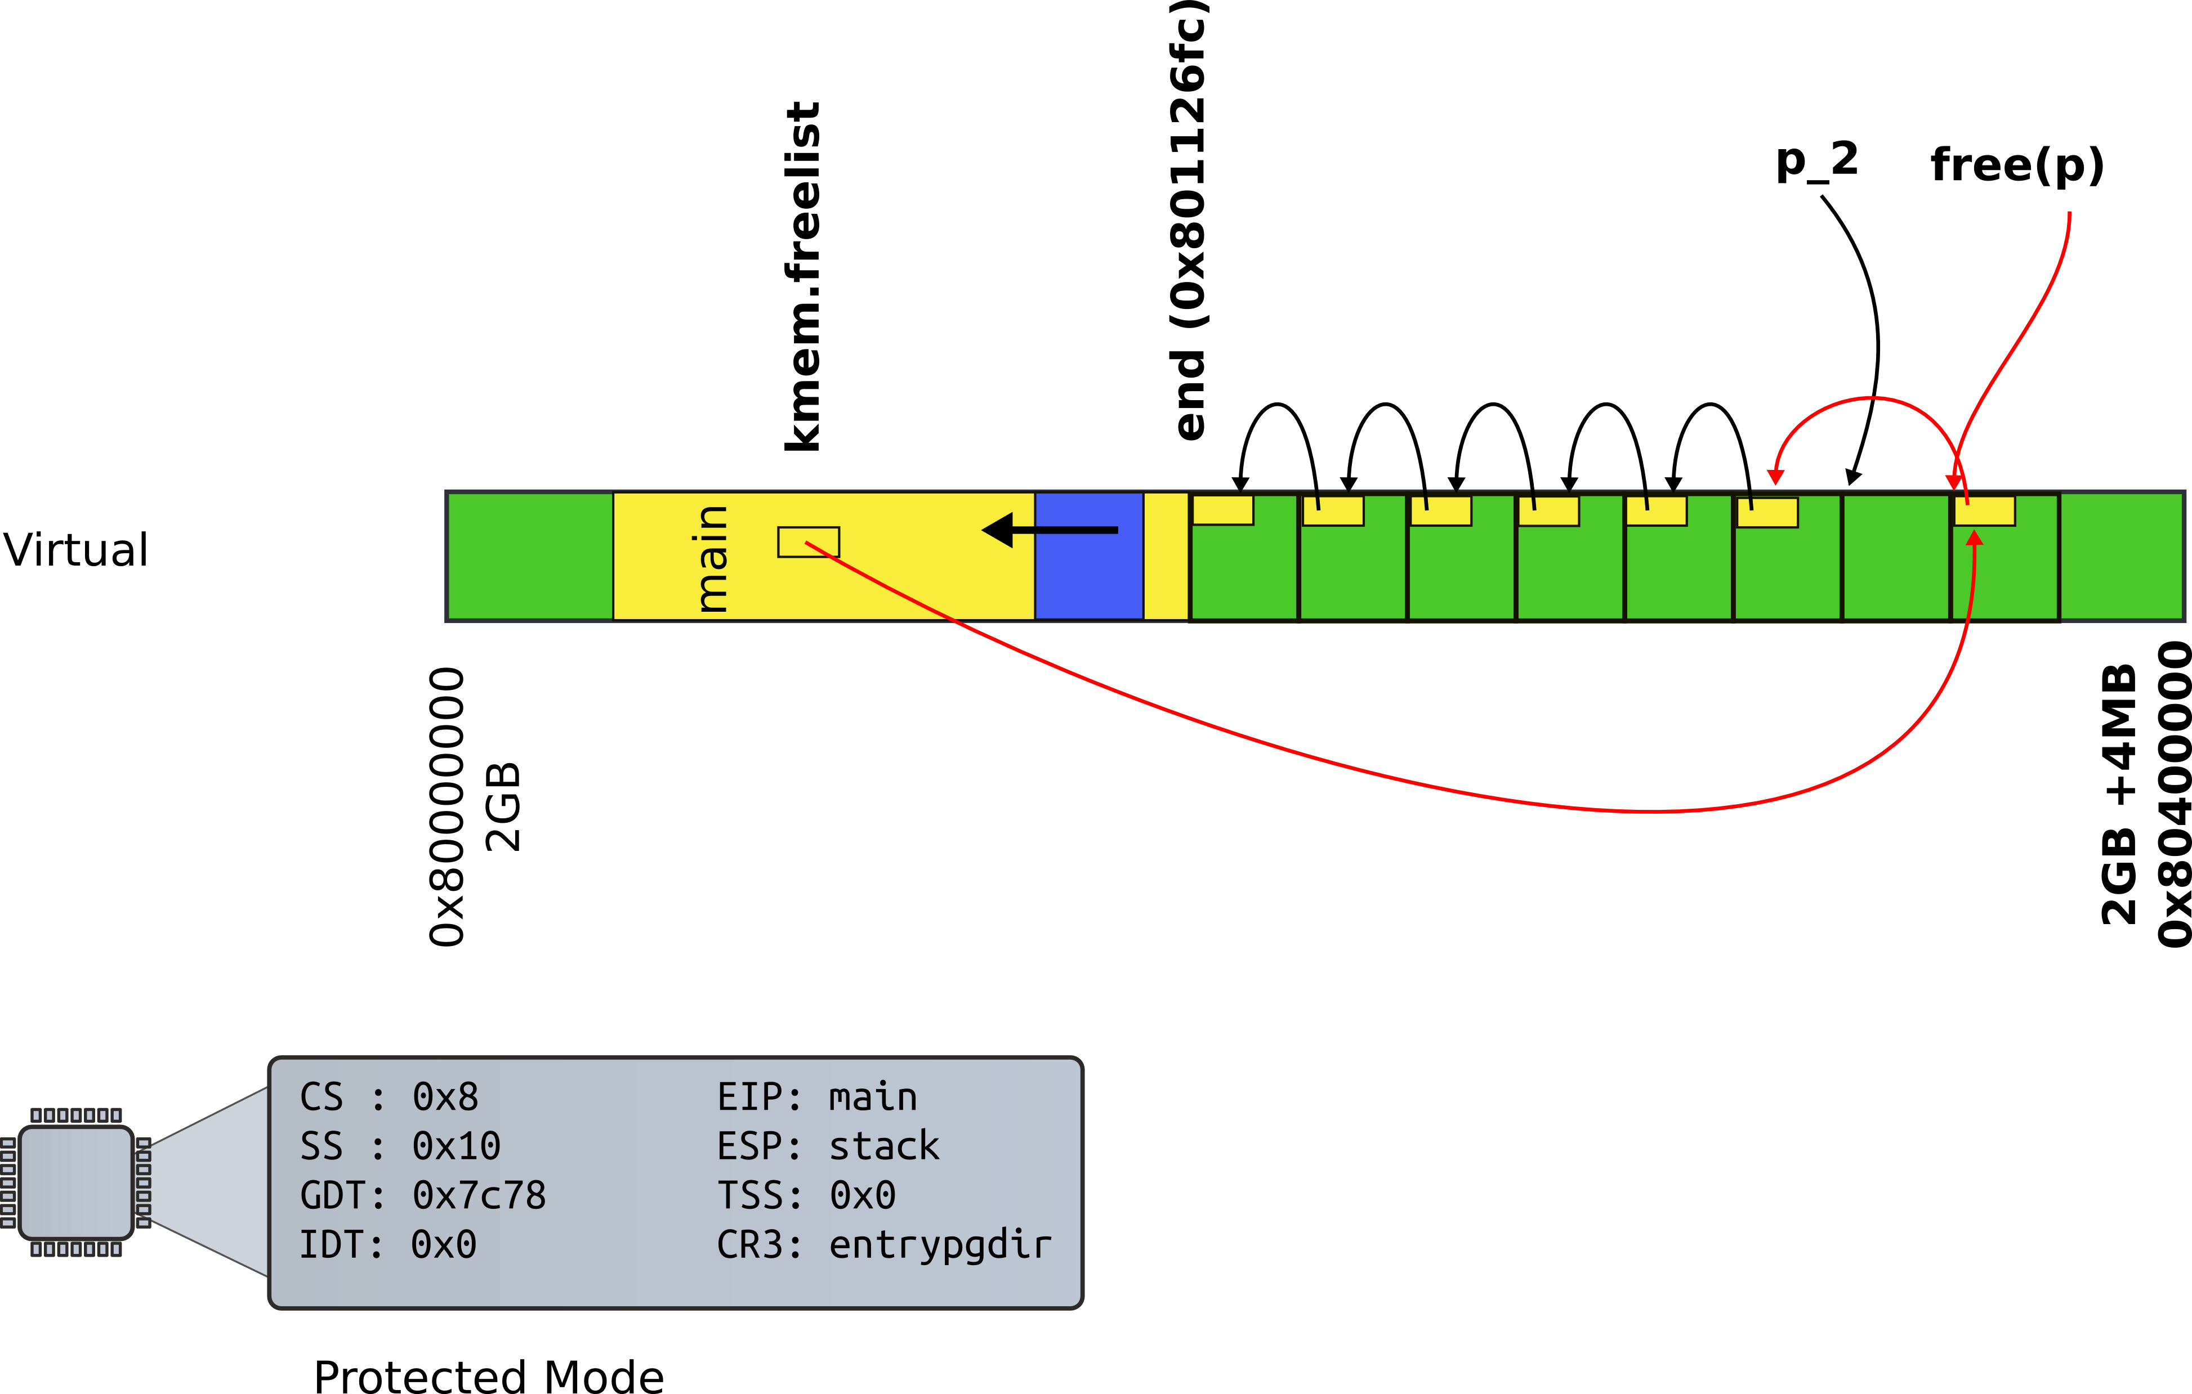
Physical page allocator

Slide 11
kalloc() - kernel allocator
3087 char*
3088 kalloc(void)
3089 {
3080 struct run *r;
...
3094 r = kmem.freelist;
3095 if(r)
3096 kmem.freelist = r−>next;
…
3099 return (char*)r;
3099 }

Slide 12
3065 kfree(char *v)
3066 {
3067 struct run *r;
...
3077 r = (struct run*)v;
3078 r−>next = kmem.freelist;
3079 kmem.freelist = r;
...
2832 }

Slide 13
Kernel needs malloc()
1316 int
1317 main(void)
1318 {
1319 kinit1(end, P2V(4*1024*1024)); // phys page allocator
1320 kvmalloc(); // kernel page table
1321 mpinit(); // detect other processors
1322 lapicinit(); // interrupt controller
1323 seginit(); // segment descriptors
1324 cprintf("\ncpu%d: starting xv6\n\n", cpunum());
1325 picinit(); // another interrupt controller
1326 ioapicinit(); // another interrupt controller
1327 consoleinit(); // console hardware
1328 uartinit(); // serial port
...
1340 }

Slide 14
Back to kinit1()
3030 kinit1(void *vstart, void *vend)
3031 {
...
3034 freerange(vstart, vend);
3035 }
3051 freerange(void *vstart, void *vend)
3052 {
3053 char *p;
3054 p = (char*)PGROUNDUP((uint)vstart);
3055 for(; p + PGSIZE <= (char*)vend; p += PGSIZE)
3056 kfree(p);
3057 }

Slide 15
Wait! Where do we start?
1316 int
1317 main(void)
1318 {
1319 kinit1(end, P2V(4*1024*1024)); // phys page allocator
1320 kvmalloc(); // kernel page table
1321 mpinit(); // detect other processors
What is this end?
1311 extern char end[];

Slide 16
Wait! Where do we start?
1316 int
1317 main(void)
1318 {
1319 kinit1(end, P2V(4*1024*1024)); // phys page allocator
1320 kvmalloc(); // kernel page table
1321 mpinit(); // detect other processors
What is this end?
1311 extern char end[]; // first address after
kernel loaded from ELF file

Slide 17
Back to main(): Kernel page table
1316 int
1317 main(void)
1318 {
1319 kinit1(end, P2V(4*1024*1024)); // phys page allocator
1320 kvmalloc(); // kernel page table
1321 mpinit(); // detect other processors
1322 lapicinit(); // interrupt controller
1323 seginit(); // segment descriptors
1324 cprintf("\ncpu%d: starting xv6\n\n", cpunum());
1325 picinit(); // another interrupt controller
1326 ioapicinit(); // another interrupt controller
1327 consoleinit(); // console hardware
1328 uartinit(); // serial port
...
1340 }

Slide 18
What do you think has to happen?
  i.e., how to allocate page tables?

Slide 19
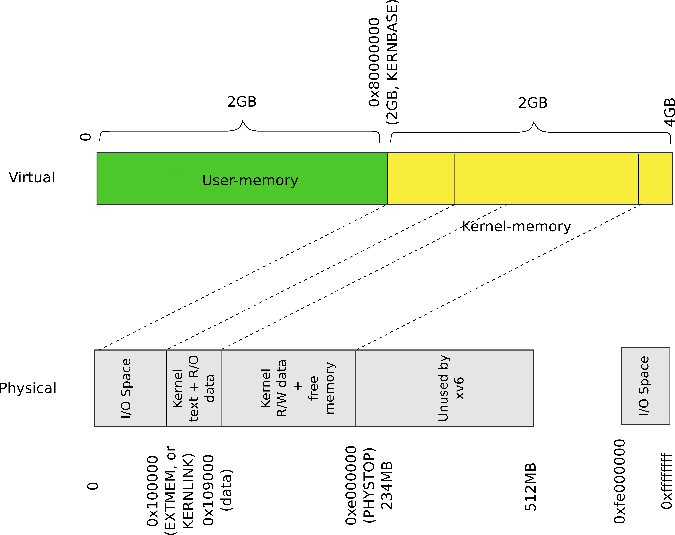
Recap: our goal

Slide 20
Conclusion
Kernel has a memory allocator
  It allocates memory in chunks of 4KB
  Good enough to maintain kernel data structures

Slide 21
Thank you!

