Slide 1
ICS143A: Principles of Operating Systems
Midterm recap, sample questions
Anton Burtsev
February, 2017

Slide 2
Describe the x86 address translation pipeline (draw figure), explain stages.

Slide 3

Address translation

Slide 4


Slide 12
What is the linear address? What address is in the registers, e.g., in %eax?

Slide 13

Logical and linear addresses
Segment selector (16 bit) + offset (32 bit)

Slide 14
What segments do the following instructions use? push, jump, mov

Slide 15
Programming model
Segments for: code, data, stack, “extra”
  A program can have up to 6 total segments
  Segments identified by registers: cs, ds, ss, es, fs, gs
Prefix all memory accesses with desired segment:
  mov eax, ds:0x80 (load offset 0x80 from data into eax)
  jmp cs:0xab8 (jump execution to code offset 0xab8)
  mov ss:0x40, ecx (move ecx to stack offset 0x40)

Slide 16
Segmented programming (not real)
static int x = 1;
int y; // stack
if (x) {
y = 1;
printf (“Boo”);
} else
y = 0;
ds:x = 1; // data
ss:y; // stack
if (ds:x) {
ss:y = 1;
cs:printf(ds:“Boo”);
} else
ss:y = 0;

Slide 17
Describe the linear to physical address translation with the paging mechanism (use provided diagram, mark and explain the steps).

Slide 18

Page translation

Slide 19
Page translation

Slide 20
Page directory entry (PDE)
20 bit address of the page table
  Pages 4KB each, we need 1M to cover 4GB
R/W – writes allowed?
  To a 4MB region controlled by this entry
U/S – user/supervisor
  If 0 – user-mode access is not allowed
A – accessed

Slide 21
Page translation

Slide 22
Page table entry (PTE)
20 bit address of the 4KB page
  Pages 4KB each, we need 1M to cover 4GB
R/W – writes allowed?
  To a 4KB page
U/S – user/supervisor
  If 0 user-mode access is not allowed
A – accessed
D – dirty – software has written to this page

Slide 23
Page translation

Slide 24
Consider the following 32-bit x86 page table setup.
%cr3 holds 0x00001000.
The Page Directory Page at physical address 0x00001000:
PDE 0: PPN=0x00002, PTE_P, PTE_U, PTE_W
PDE 1: PPN=0x00003, PTE_P, PTE_U, PTE_W
PDE 2: PPN=0x00002, PTE_P, PTE_U, PTE_W
... all other PDEs are zero
The Page Table Page at physical address 0x00002000 (which is PPN 0x00002):
PTE 0: PPN=0x00005, PTE_P, PTE_U, PTE_W
PTE 1: PPN=0x00006, PTE_P, PTE_U, PTE_W
... all other PTEs are zero
The Page Table Page at physical address 0x00003000:
PTE 0: PPN=0x00005, PTE_P, PTE_U, PTE_W
PTE 1: PPN=0x00005, PTE_P, PTE_U, PTE_W
... all other PTEs are zero
List all virtual addresses that map to physical address 0x00005555

Slide 25
Consider the following 32-bit x86 page table setup.
%cr3 holds 0x00001000.
The Page Directory Page at physical address 0x00001000:
PDE 0: PPN=0x00002, PTE_P, PTE_U, PTE_W
PDE 1: PPN=0x00003, PTE_P, PTE_U, PTE_W
PDE 2: PPN=0x00002, PTE_P, PTE_U, PTE_W
... all other PDEs are zero
The Page Table Page at physical address 0x00002000 (which is PPN 0x00002):
PTE 0: PPN=0x00005, PTE_P, PTE_U, PTE_W
PTE 1: PPN=0x00006, PTE_P, PTE_U, PTE_W
... all other PTEs are zero
The Page Table Page at physical address 0x00003000:
PTE 0: PPN=0x00005, PTE_P, PTE_U, PTE_W
PTE 1: PPN=0x00005, PTE_P, PTE_U, PTE_W
... all other PTEs are zero
List all virtual addresses that map to physical address 0x00005555
Answer: 0x00000555, 0x00400555, 0x00401555, 0x00800555

Slide 26
What's on the stack? Describe layout of a stack and how it changes during function invocation?

Slide 27
Example stack
: :
| 10 | [ebp + 16] (3rd function argument)
| 5 | [ebp + 12] (2nd argument)
| 2 | [ebp + 8] (1st argument)
| RA | [ebp + 4] (return address)
| FP | [ebp] (old ebp value)
| | [ebp - 4] (1st local variable)
: :
: :
| | [ebp - X] (esp - the current stack pointer)

Slide 28
Describe the steps and data structures involved into a user to kernel transition (draw diagrams)

Slide 29
Interrupt path

Slide 30
What segment is specified in the interrupt descriptor? Why?

Slide 31
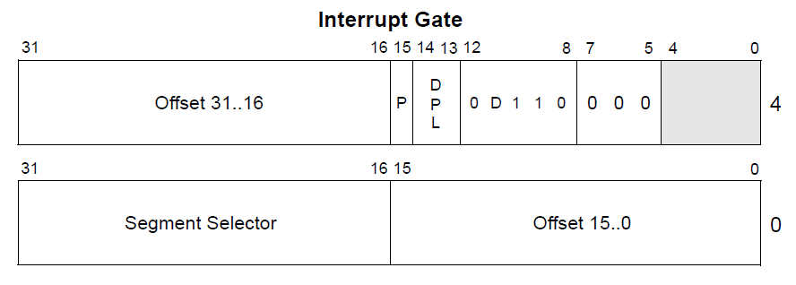
Interrupt descriptor

Slide 32
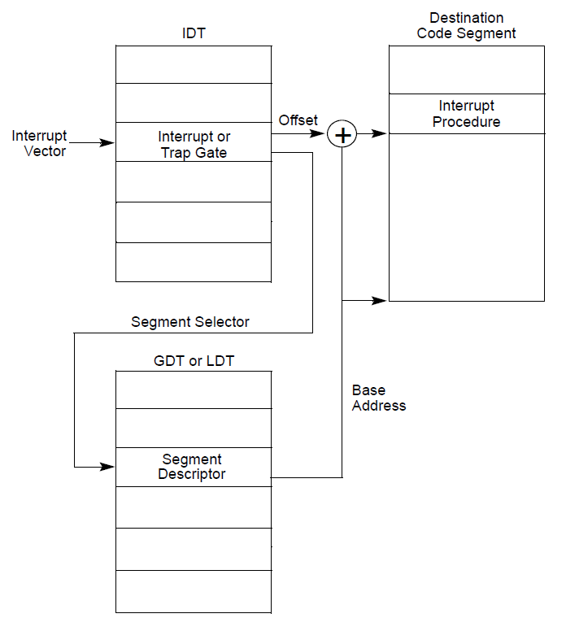
Interrupt gate disables interrupts
  Clears the IF flag in EFLAGS register
Trap gate doesn't
  IF flag is unchanged

Slide 33
Which stack is used for execution of an interrupt handler? How does hardware find it?

Slide 34
Interrupt path

Slide 35
Describe organization of the memory allocator in xv6?

Slide 36

Physical page allocator

Slide 37
Where did free memory came from?

Slide 38
Describe how a per-CPU variables are stored in xv6?

Slide 39
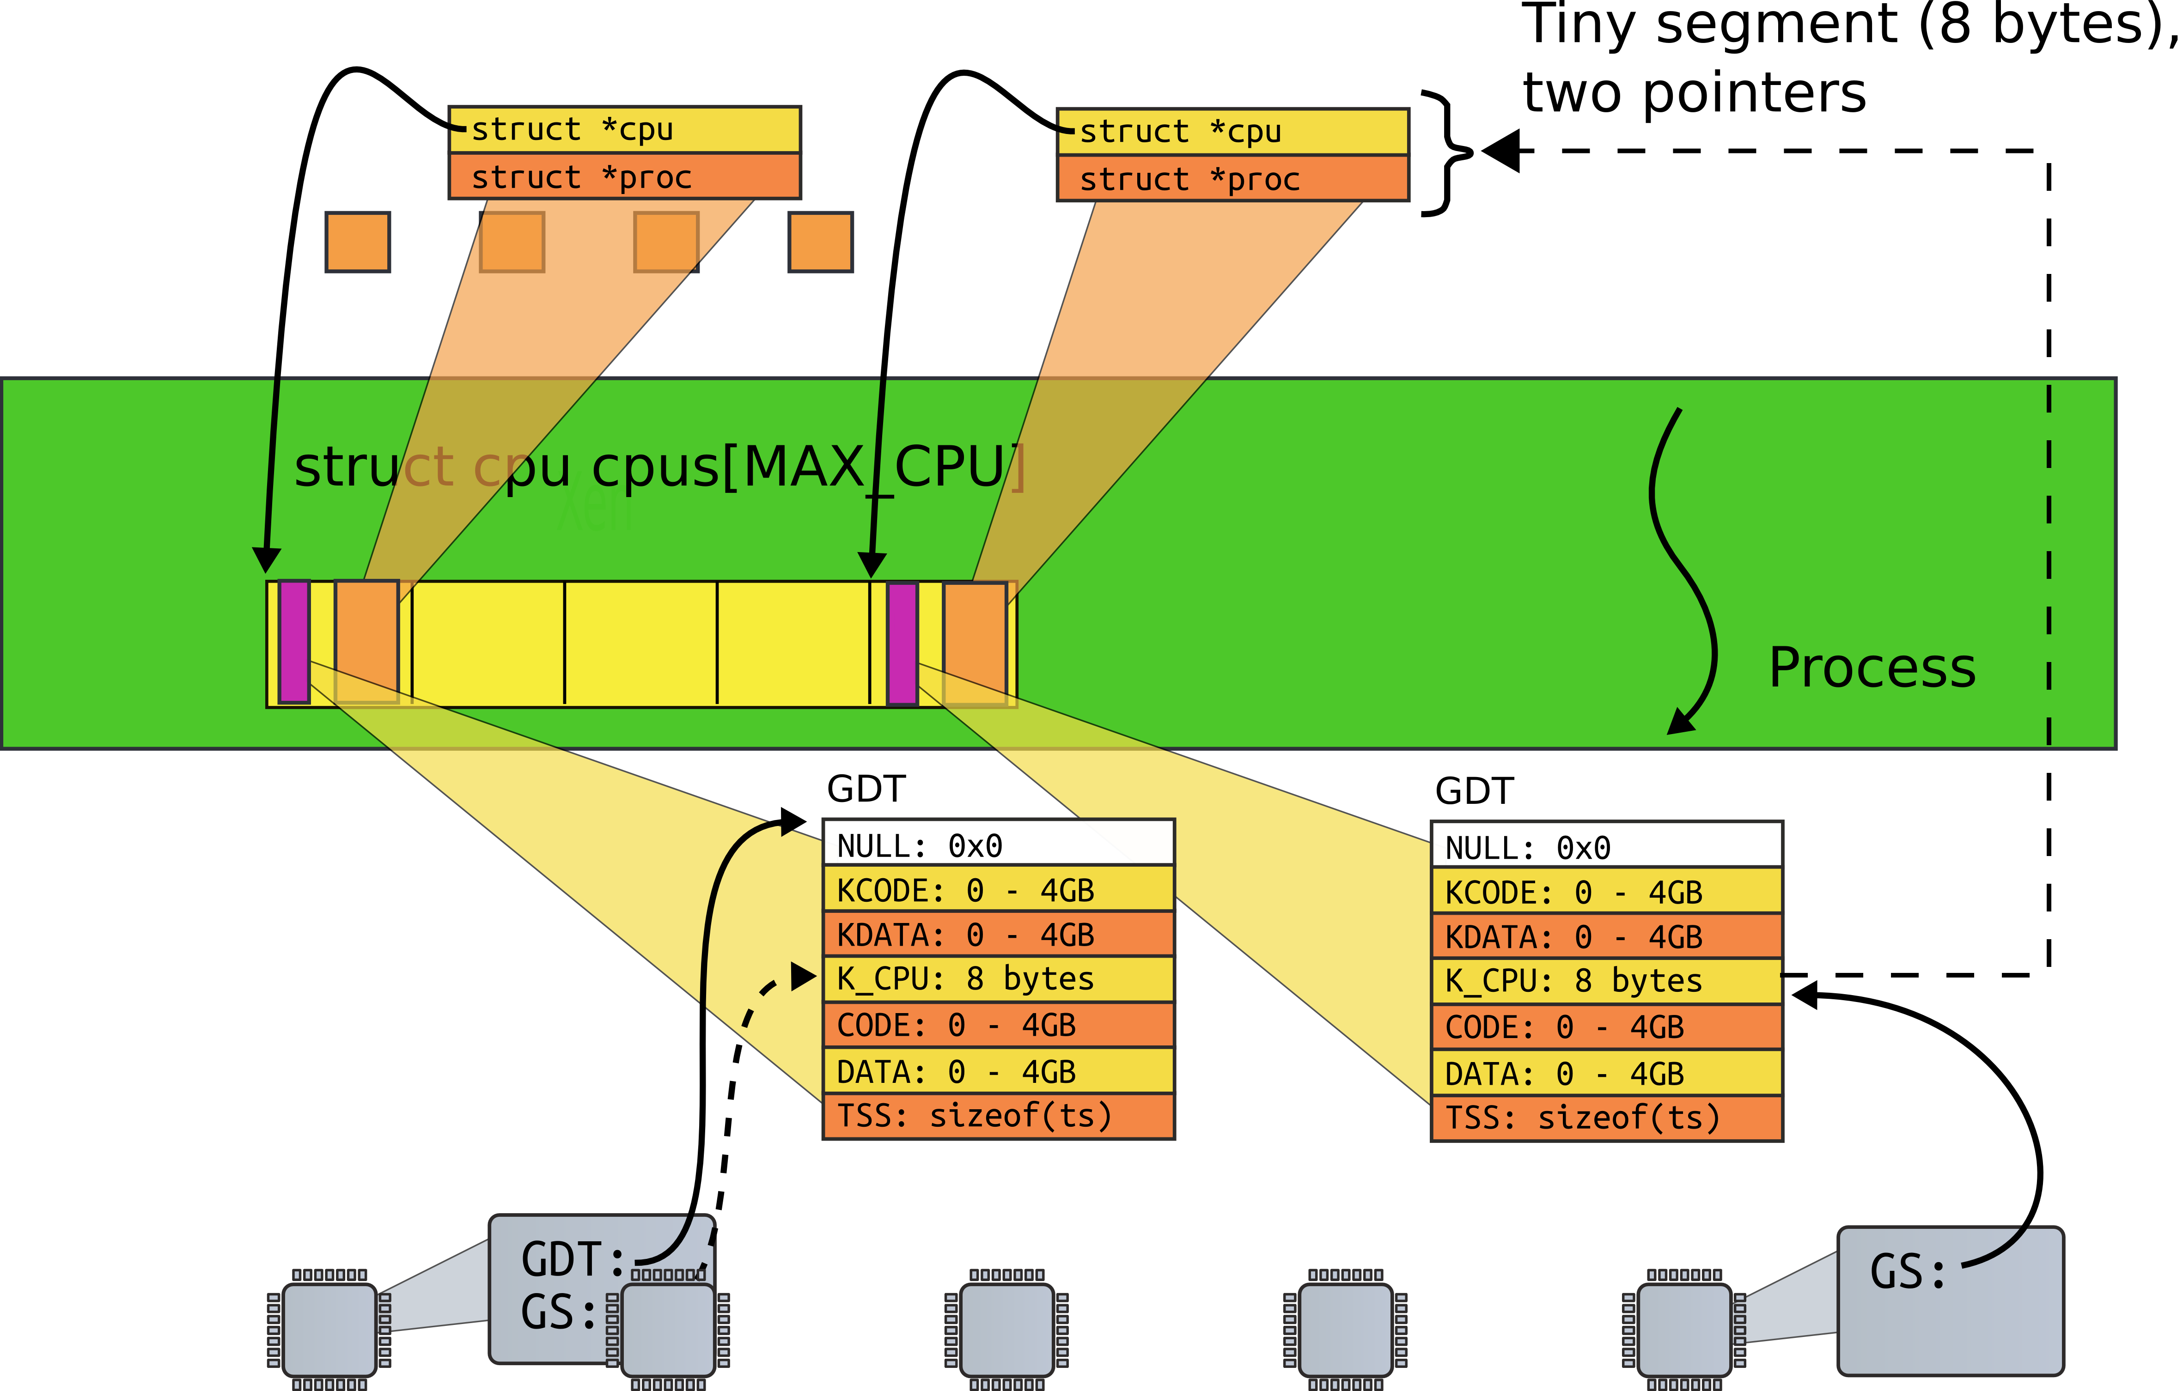

Slide 40
swtch in xv6 doesn’t explicitly save and restore all ﬁelds of struct context. Why is it okay that swtch doesn’t contain any code that saves %eip?

Slide 41
swtch()
2958 swtch:
2959 movl 4(%esp), %eax
2960 movl 8(%esp), %edx
2961
2962 # Save old callee−save registers
2963 pushl %ebp
2964 pushl %ebx
2965 pushl %esi
2966 pushl %edi
2967
2968 # Switch stacksh
2969 movl %esp, (%eax)
2970 movl %edx, %esp
2971
2972 # Load new callee−save registers
2973 popl %edi
2974 popl %esi
2975 popl %ebx
2976 popl %ebp
2977 ret
2093 struct context {
2094 uint edi;
2095 uint esi;
2096 uint ebx;
2097 uint ebp;
2098 uint eip;
2099 };

Slide 42
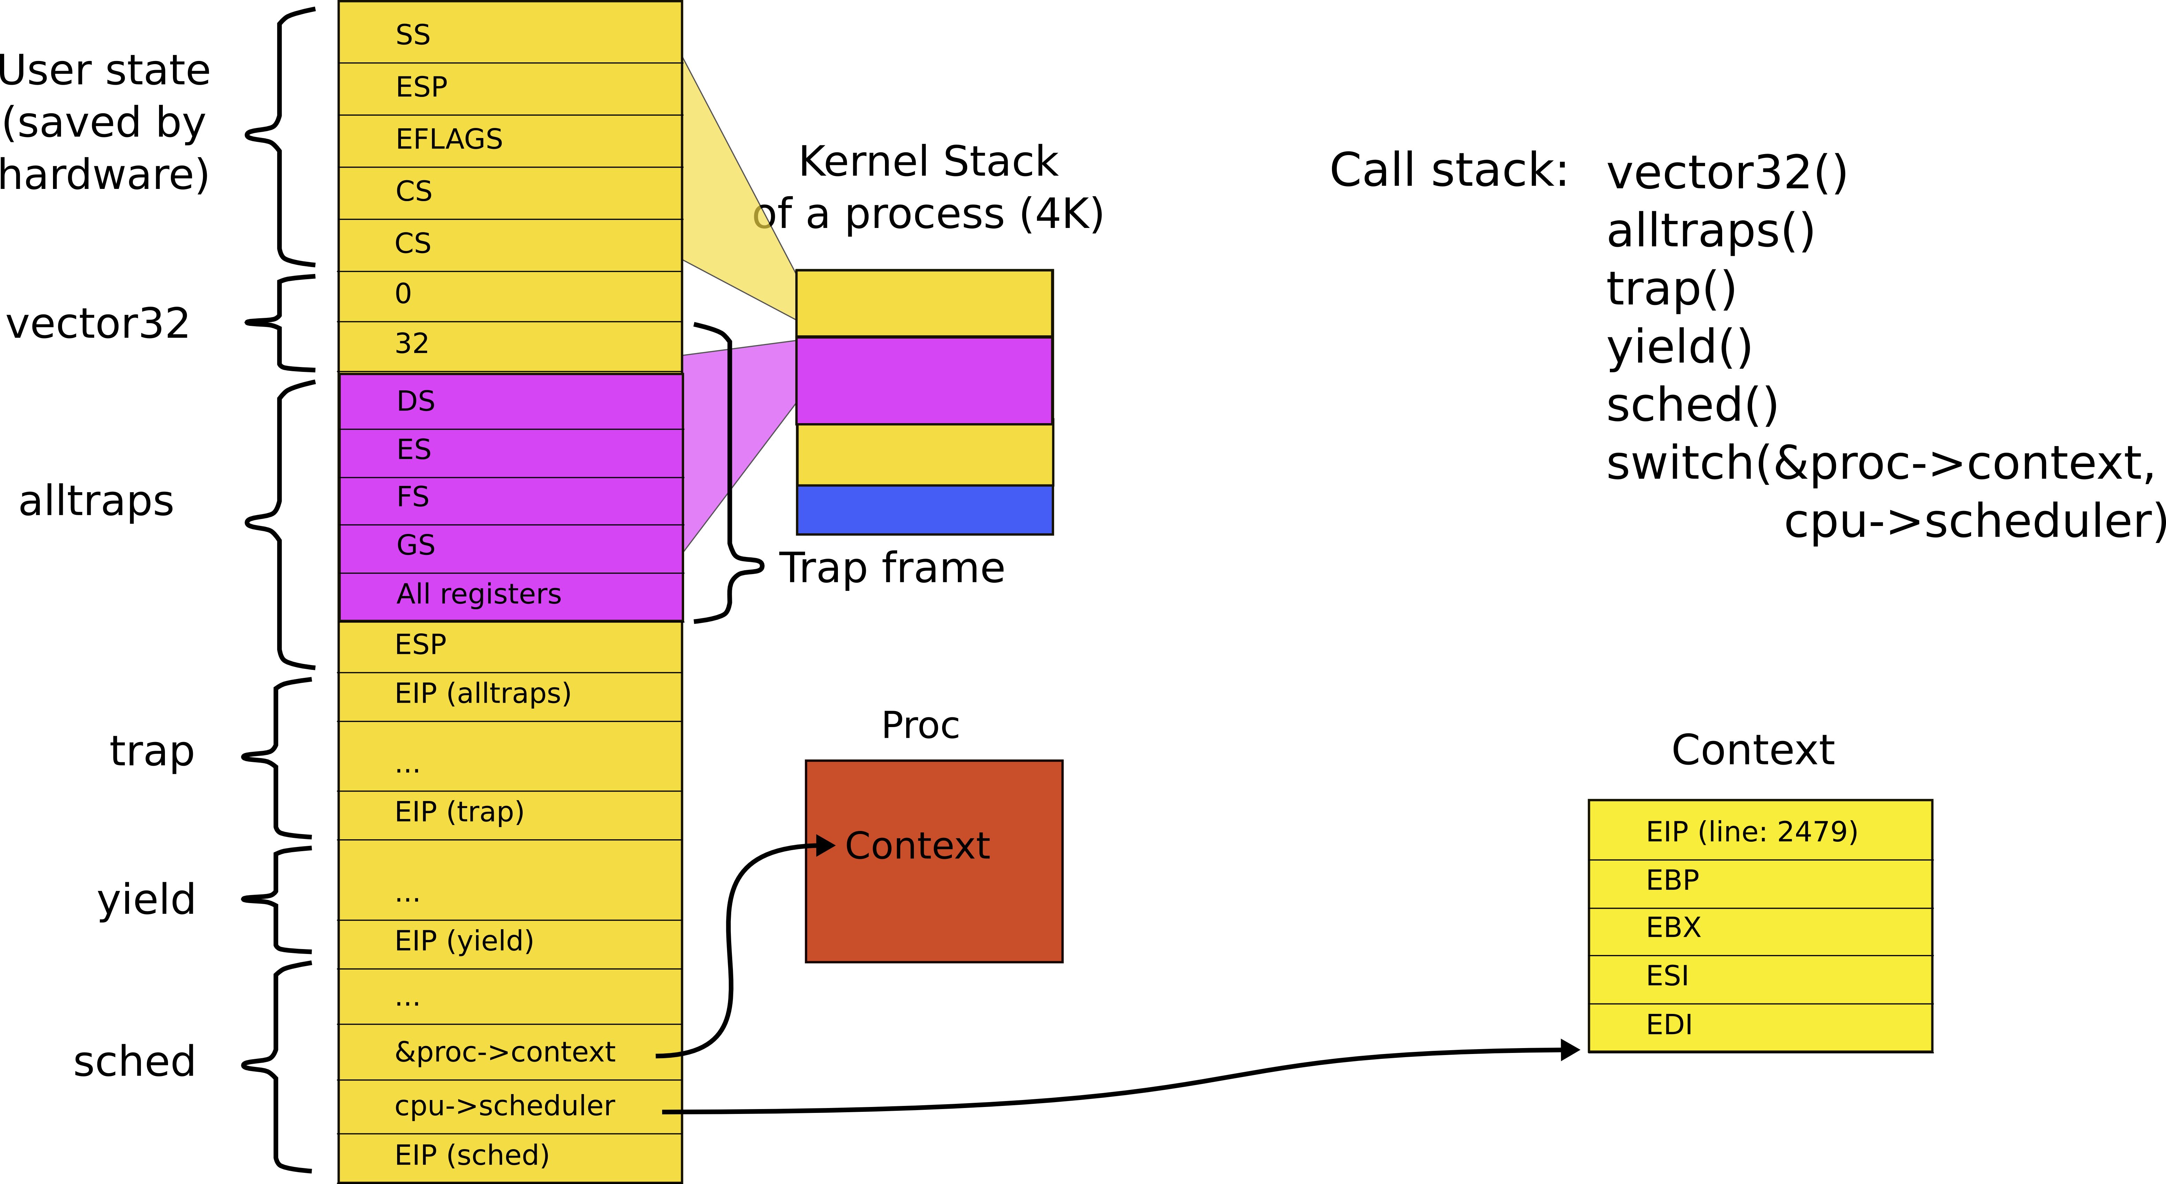
Stack inside swtch()

Slide 43
Suppose you wanted to change the system call interface in xv6 so that, instead of returning the system call result in EAX, the kernel pushed the result on to the user space stack. Fill in the code below to implement this. For the purposes of this question, you can assume that the user stack pointer points to valid memory.

Slide 44
3374 void
3375 syscall(void)
3376 {
3377 int num;
3378
3379 num = proc−>tf−>eax;
3380 if(num > 0 && num < NELEM(syscalls) && syscalls[num]) {
3381 proc−>tf−>eax = syscalls[num]();
3382 } else {
3383 cprintf("%d %s: unknown sys call %d\n",
3384 proc−>pid, proc−>name, num);
3385 proc−>tf−>eax = −1;
3386 }
3387 }

Slide 45
3374 void
3375 syscall(void)
3376 {
3377 int num;
3378
3379 num = proc−>tf−>eax;
3380 if(num > 0 && num < NELEM(syscalls) && syscalls[num]) {
3381 // proc−>tf−>eax = syscalls[num]();
proc->tf->esp -= 4;
*(int*)ptoc->tf->esp = syscalls[num]();
3382 } else {
3383 cprintf("%d %s: unknown sys call %d\n",
3384 proc−>pid, proc−>name, num);
3385 // proc−>tf−>eax = −1;
proc->tf->esp -= 4;
*(int*)ptoc->tf->esp = -1;
3386 }
3387 }

Slide 46
Thank you!

