Slide 1
143A: Principles of Operating Systems
Lecture 3: PC Hardware
Anton Burtsev
October, 2017

Slide 2
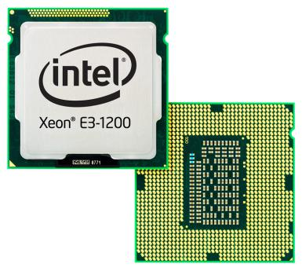
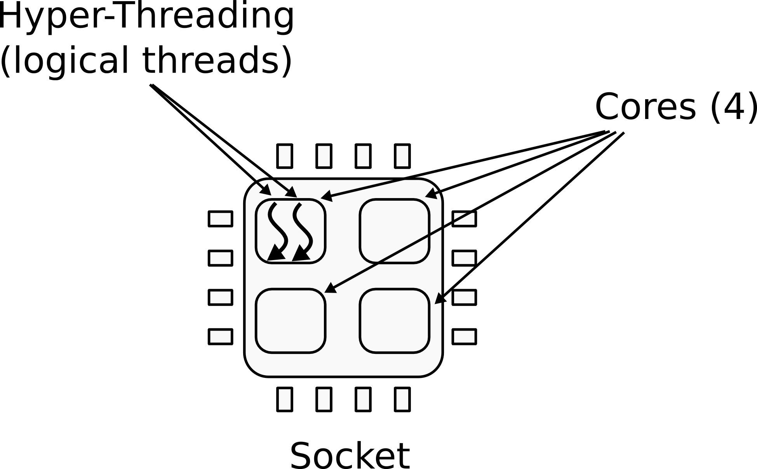
CPU
1 CPU socket
  4 cores
  2 logical (HT) threads each

Slide 3
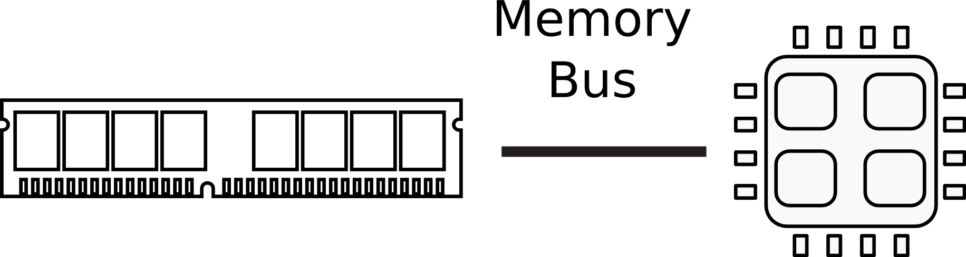
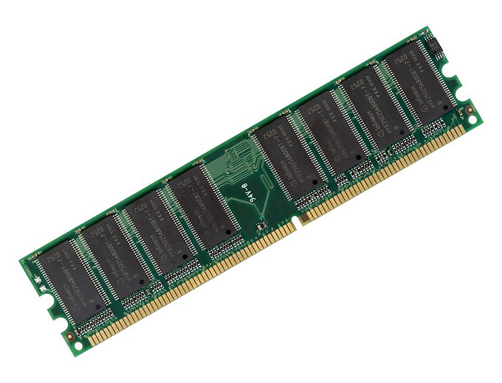
Memory

Slide 4
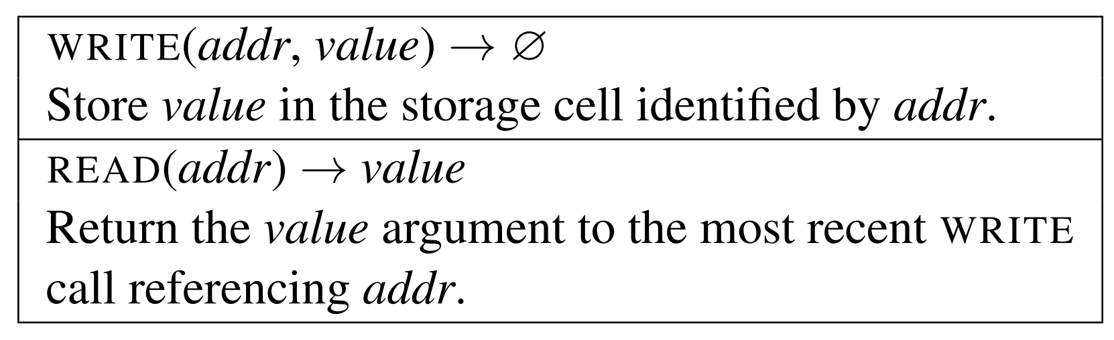
Memory abstraction
x86 assembly examples:
mov eax, [ebx] ; Move 4 bytes in memory at the address contained in EBX into EAX
mov [var], ebx ; Move the contents of EBX into the 4 bytes at memory address var.
mov eax, [esi-4] ; Move 4 bytes at memory address ESI + (-4) into EAX
mov [esi+eax], cl ; Move the contents of CL into the byte at address ESI+EAX
mov edx, [esi+4*ebx] ; Move the 4 bytes of data at address ESI+4*EBX into EDX

Slide 5
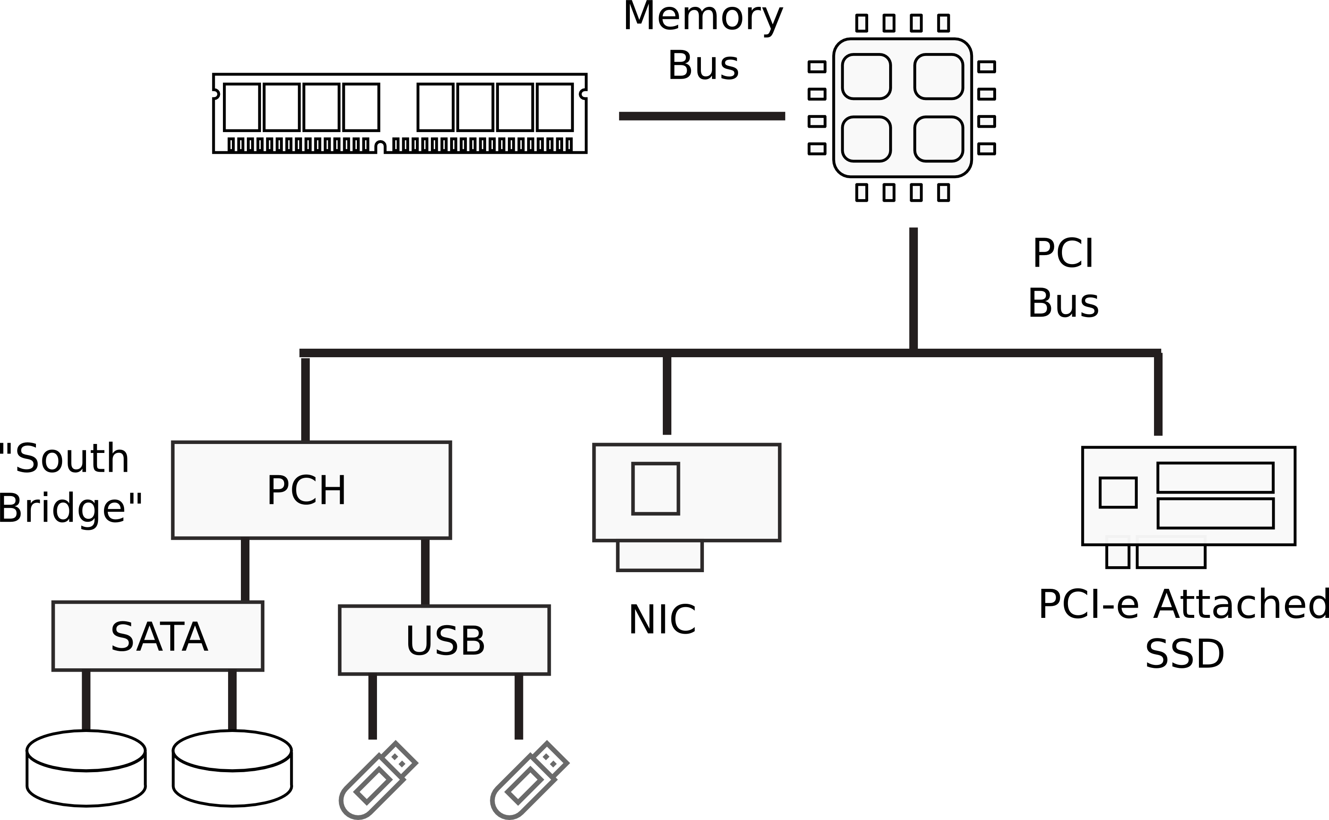
I/O Devices

Slide 6
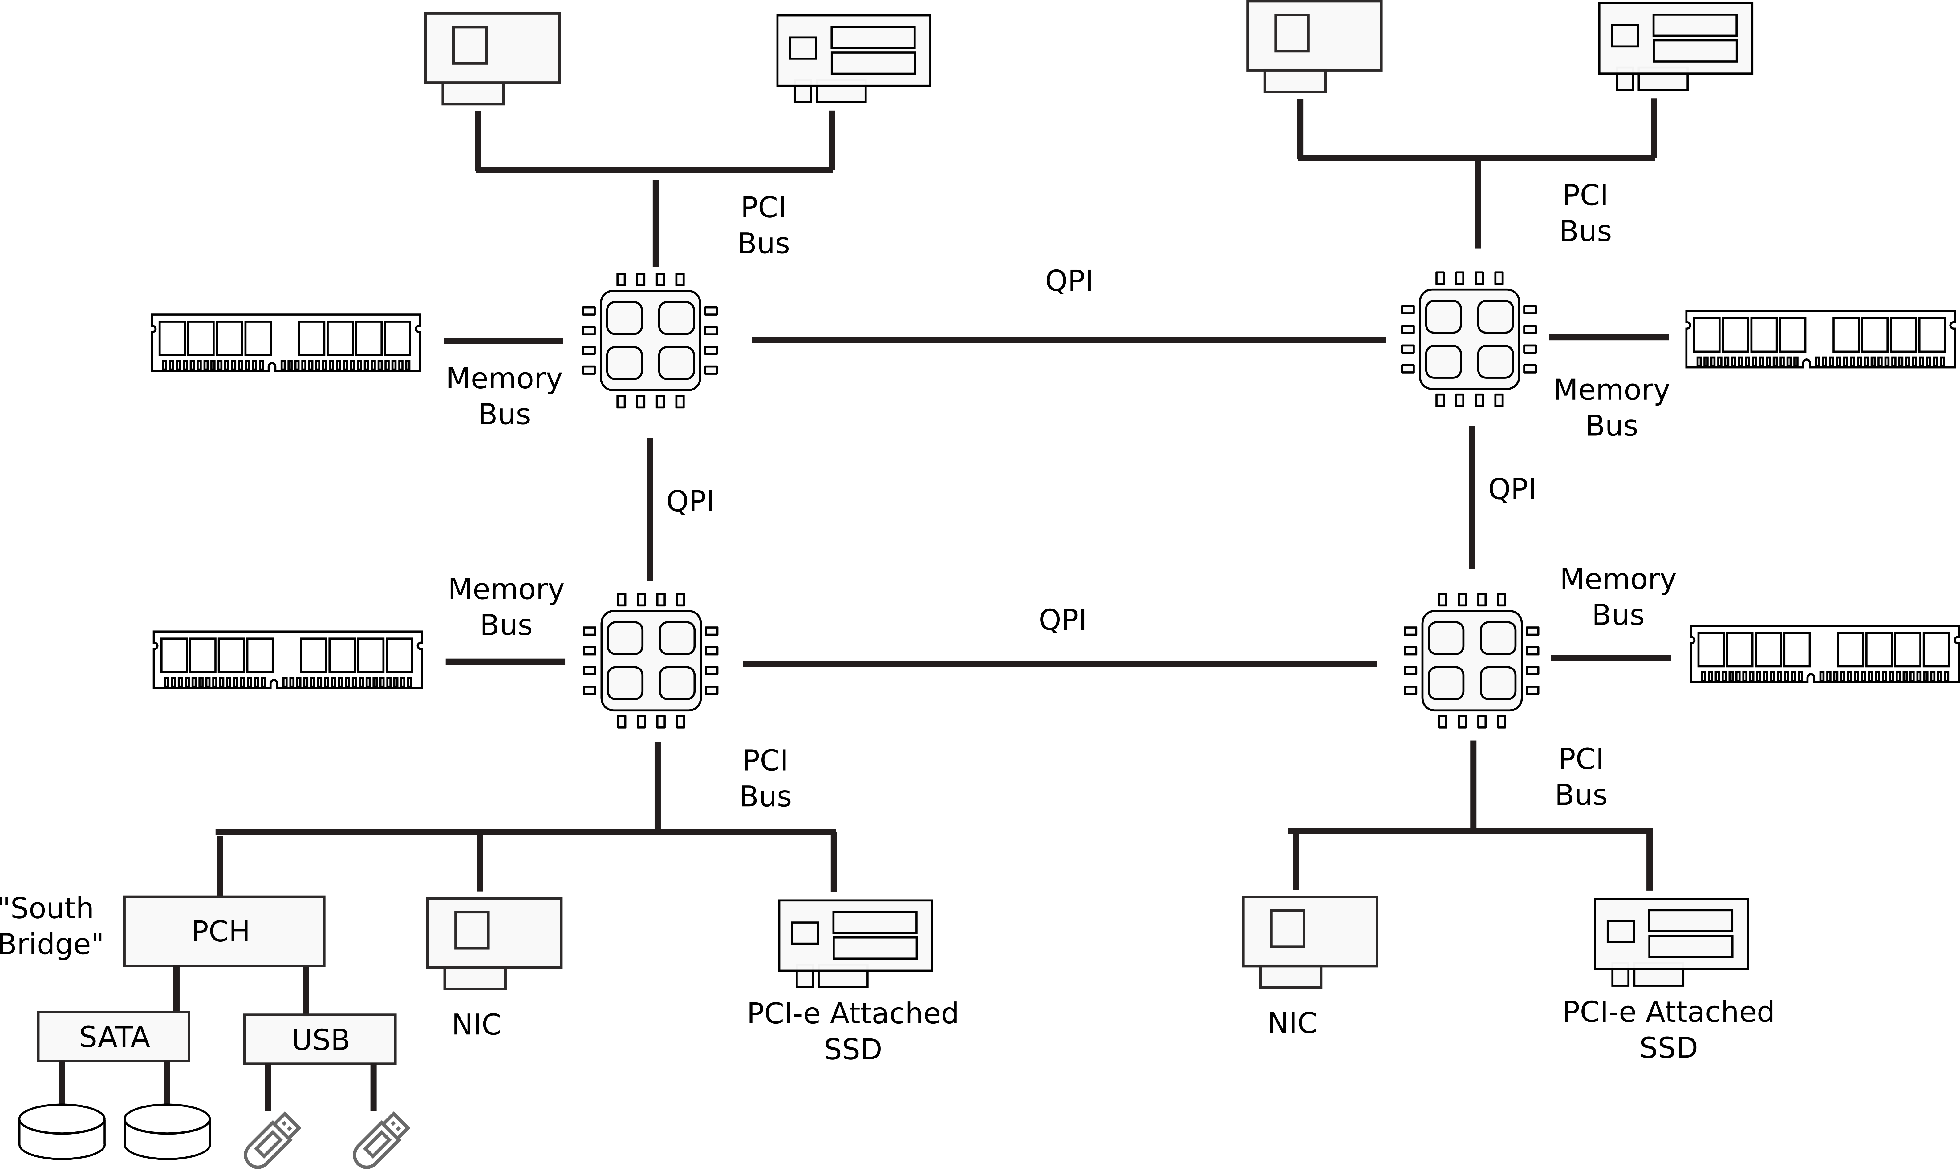
Multi-socket machines

Slide 7
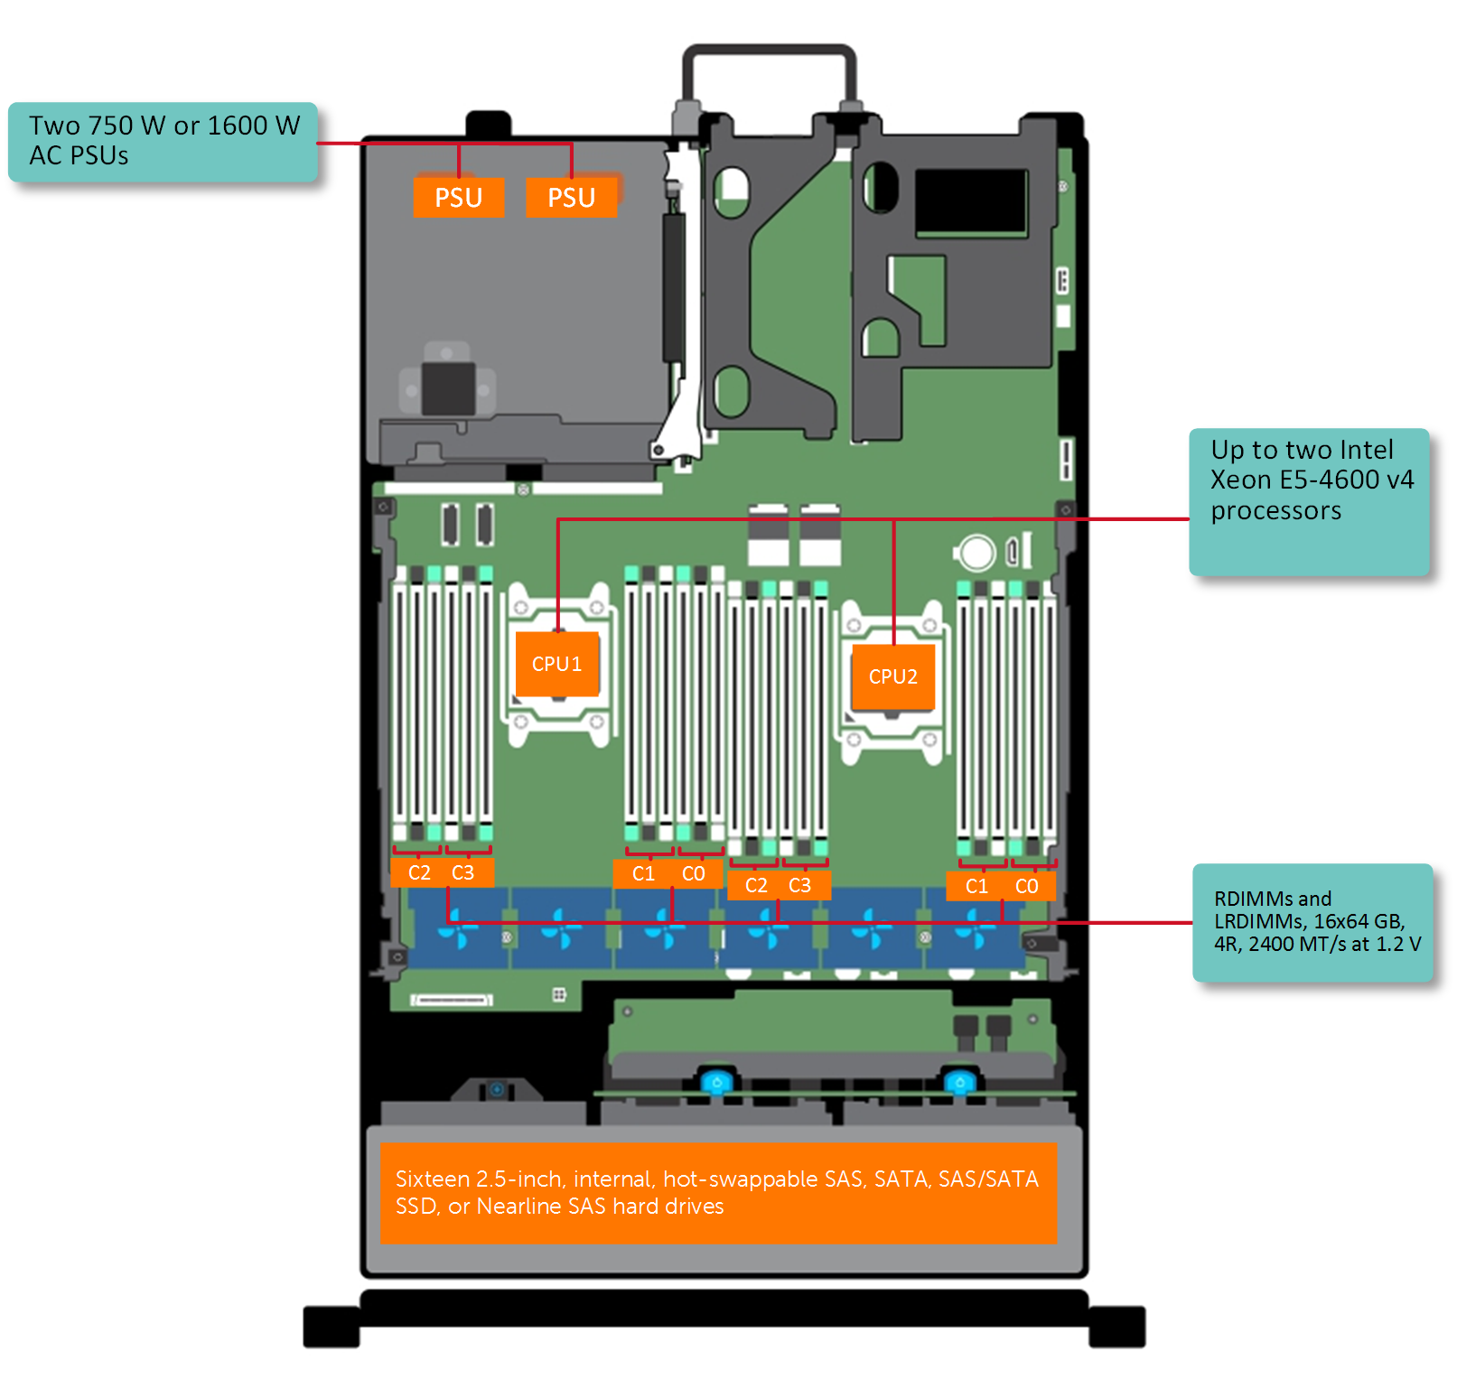
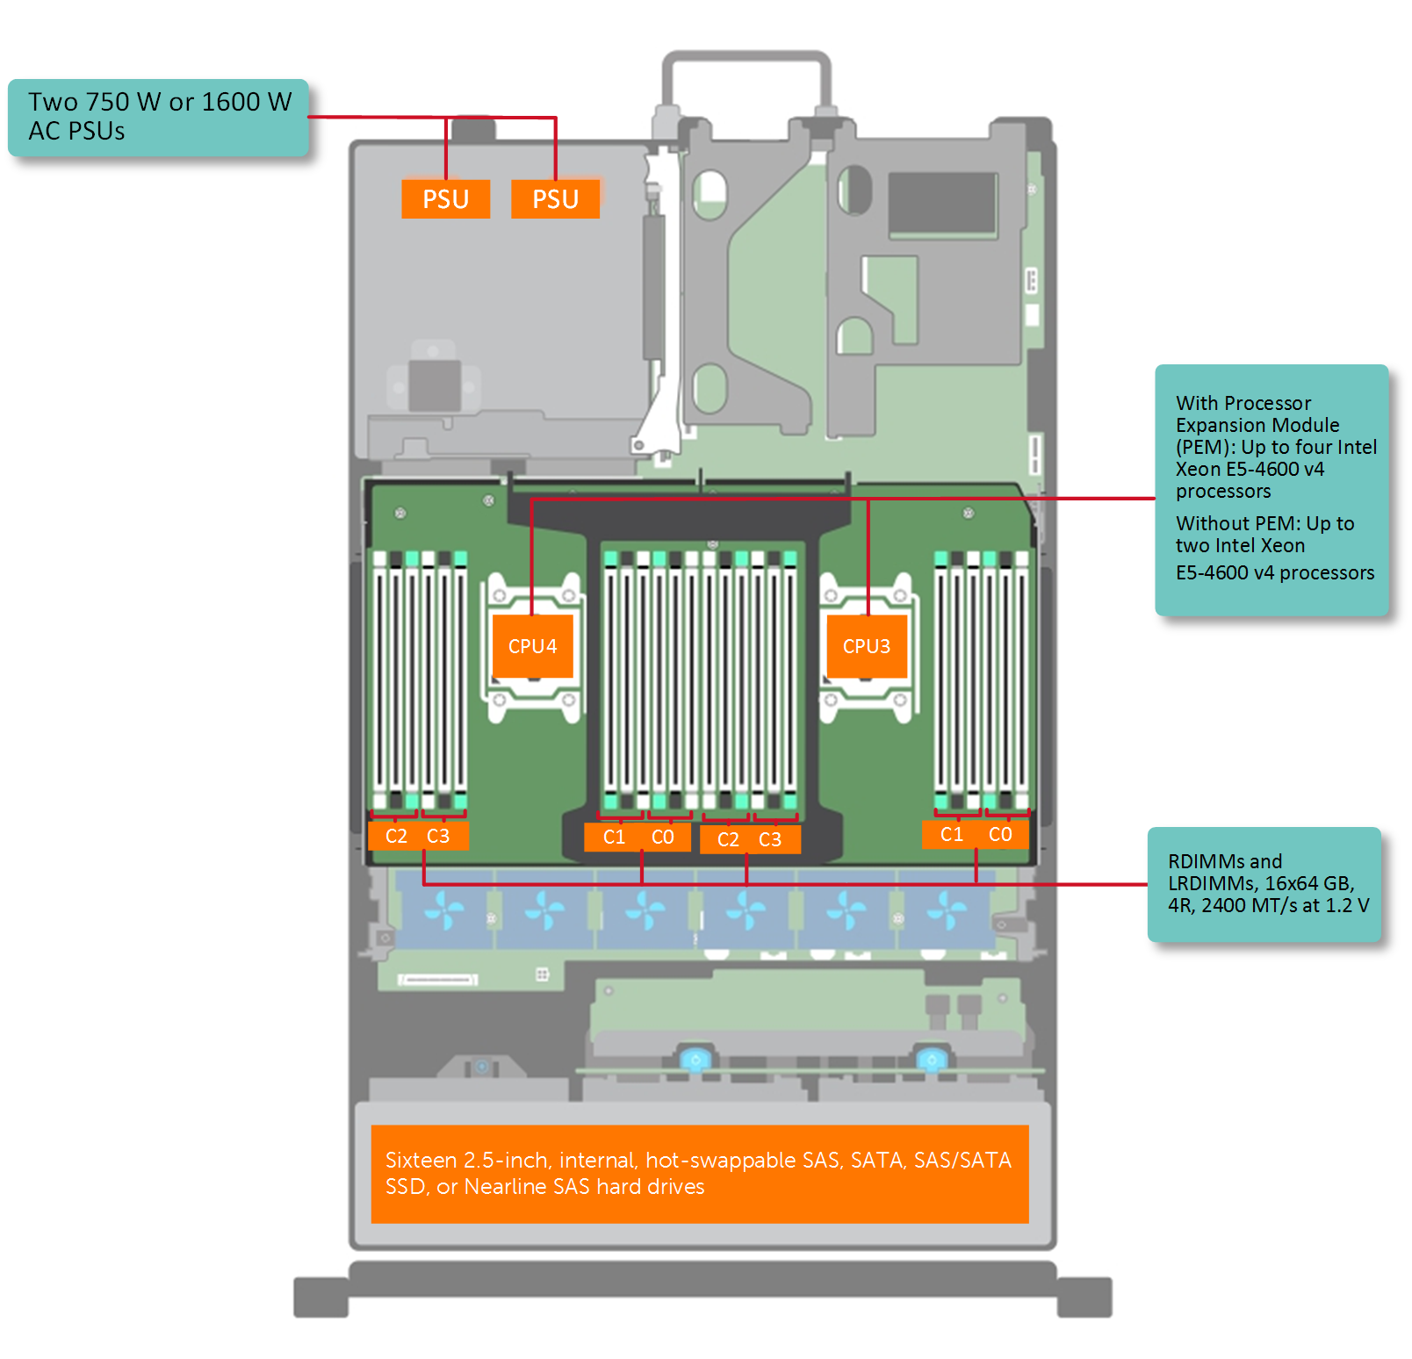
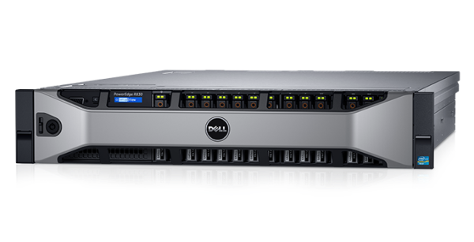
Dell R830 4-socket server
Dell Poweredge R830 System Server with 2 sockets on the main floor and 2 sockets on the expansion
http://www.dell.com/support/manuals/us/en/19/poweredge-r830/r830_om/supported-configurations-for-the-poweredge-r830-system?guid=guid-01303b2b-f884-4435-b4e2-57bec2ce225a&lang=en-us

Slide 8
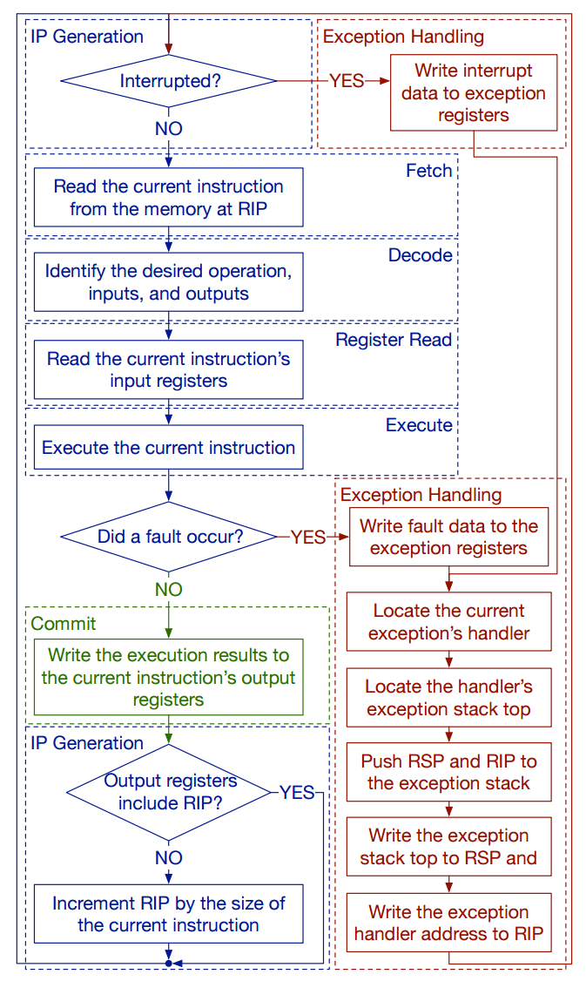
CPU execution loop
CPU repeatedly reads instructions from memory
Executes them
Example
ADD EDX, EAX, EBX
// EDX = EAX + EBX

Slide 9
CPU execution loop
Fault
  Instruction's preconditions are not met
Examples
  Division by zero
  Page not mapped

Slide 10
Memory hierarchy

Slide 11
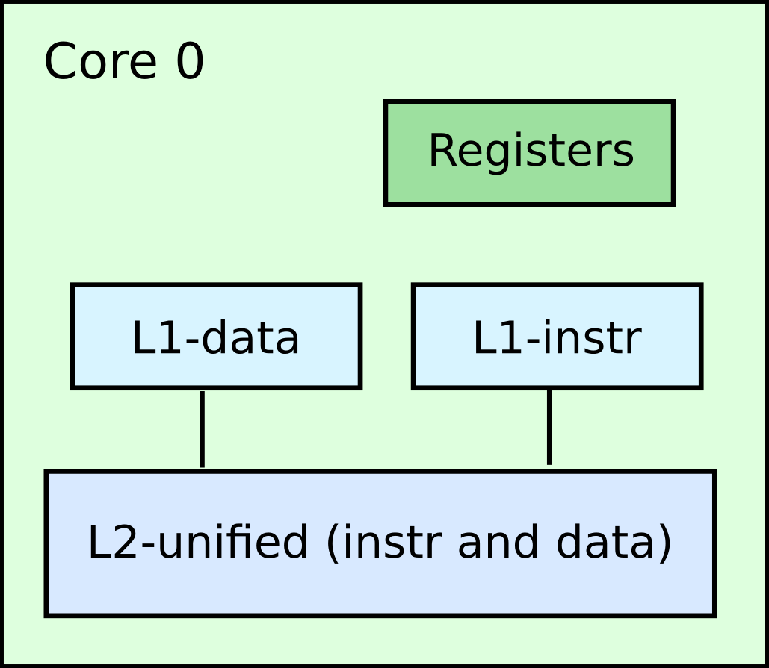
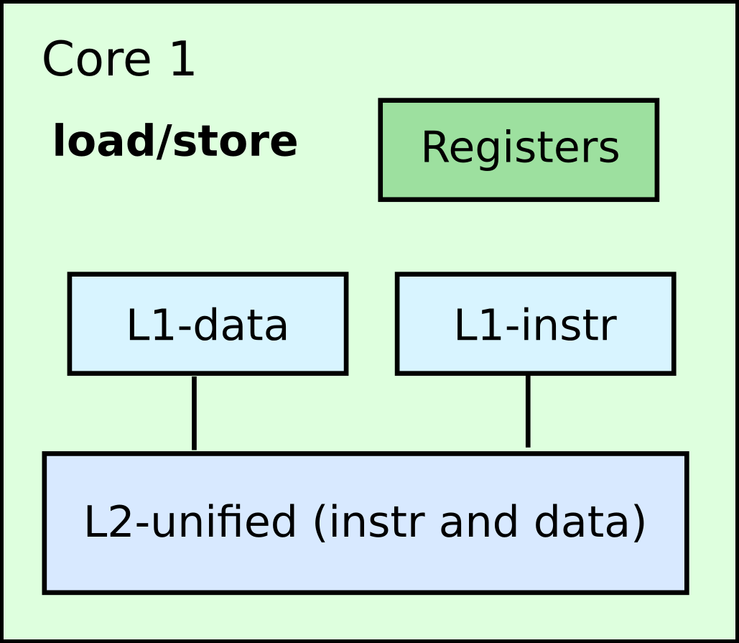

Slide 12
Overview (latencies)

Slide 13
Registers
The processor has an internal memory
  Register file

Slide 14
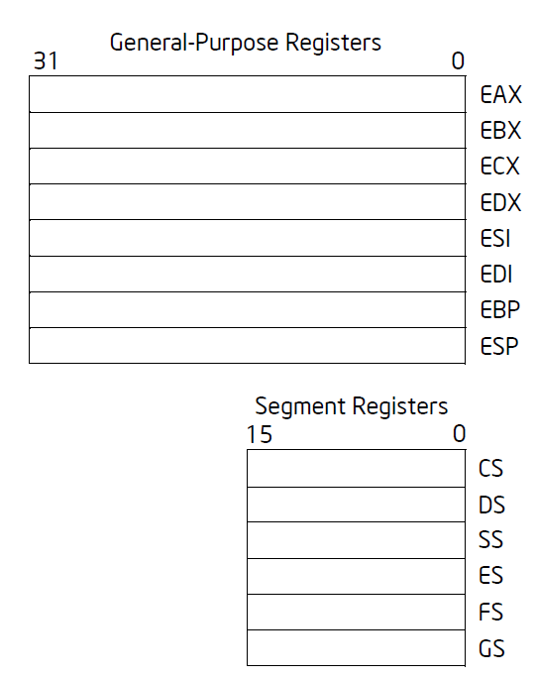
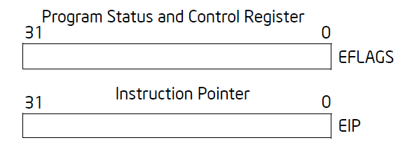
Registers

Slide 15
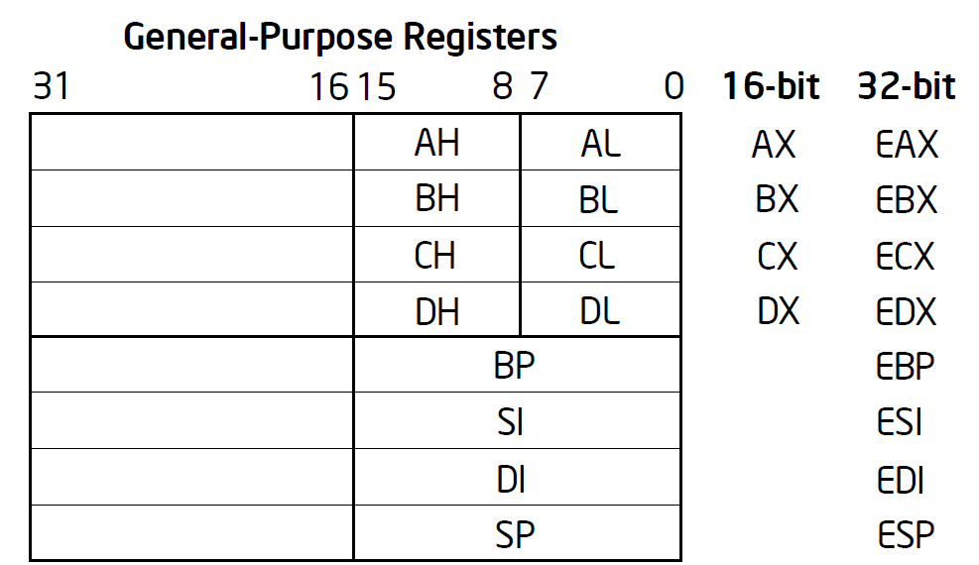

Slide 16
General registers
EAX — Accumulator for operands and results data
EBX — Pointer to data in the DS segment
ECX — Counter for string and loop operations
EDX — I/O pointer
ESI — Pointer to data in the segment pointed to by the DS register; source pointer for string operations
EDI — Pointer to data (or destination) in the segment pointed to by the ES register; destination pointer for string operations
ESP — Stack pointer (in the SS segment)
EBP — Pointer to data on the stack (in the SS segment)

Slide 17
Caches

Slide 18
Cache-coherence

Slide 19
Virtual memory

Slide 21
I/O devices

Slide 22
Questions?

