Slide 1
238P: Operating Systems
Lecture 5: Address translation
Anton Burtsev
October, 2018

Slide 2

Two programs one memory

Slide 3
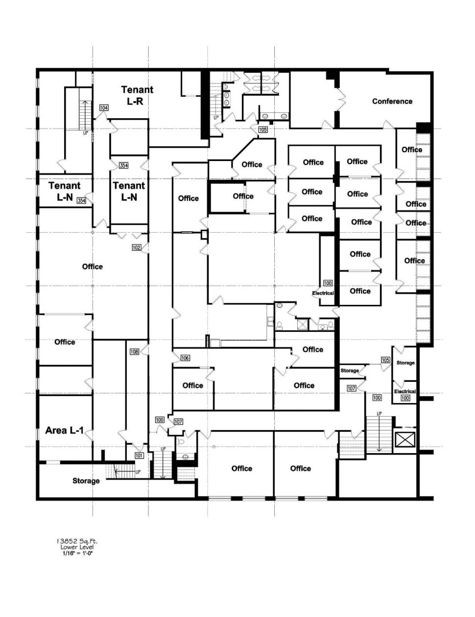
Or more like renting a set of rooms in an office building

Slide 4
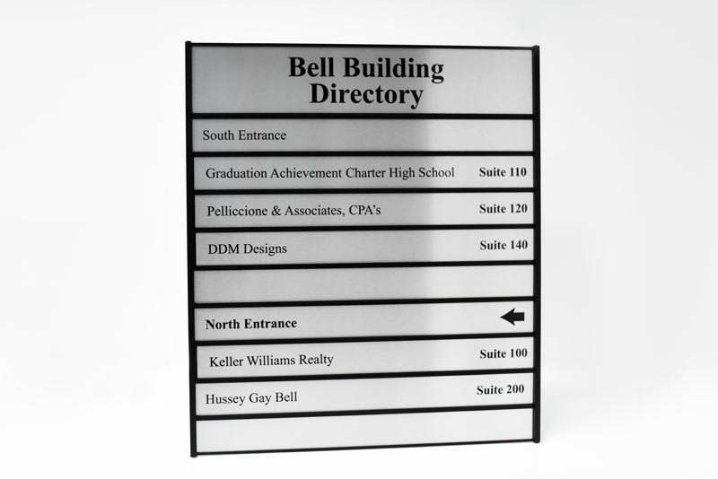
Or more like renting a set of rooms in an office building

Slide 5
Relocation
One way to achieve this is to relocate program at different addresses
  Remember relocation (from linking and loading)

Slide 6
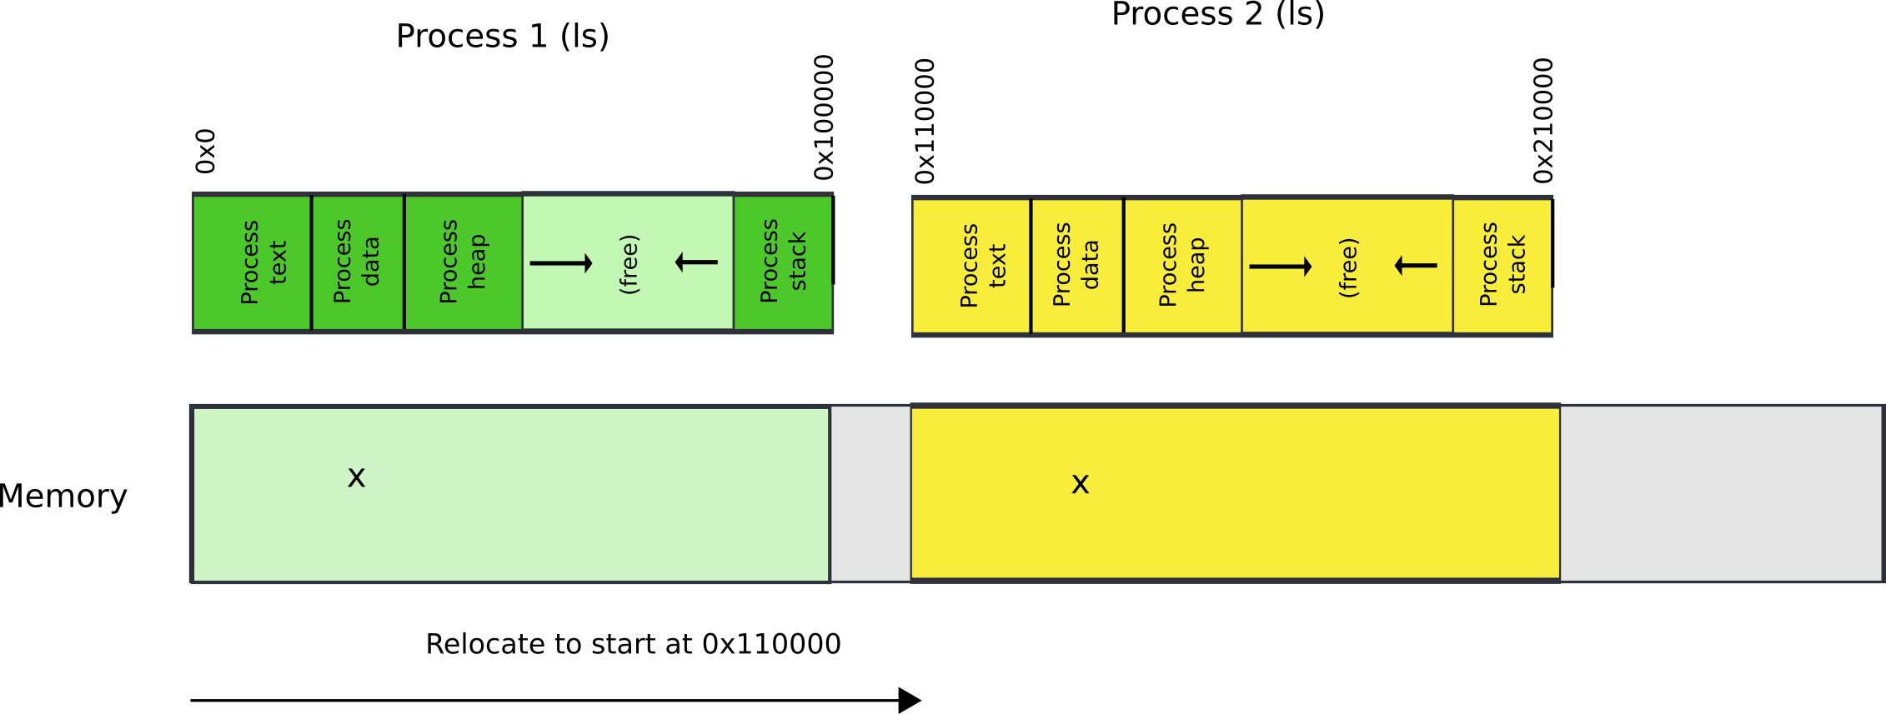
Relocate binaries to work at different addresses

Slide 7
One way to achieve this is to relocate program at different addresses
What is the problem?

Slide 8
One way to achieve this is to relocate program at different addresses
What is the problem?
  No isolation

Slide 9
Another way is to ask for hardware support

Slide 10
This is called segmentation

Slide 11
What are we aiming for?
Illusion of a private address space
  Identical copy of an address space in multiple programs
    Remember fork()?
  Simplifies software architecture
    One program is not restricted by the memory layout of the others

Slide 12

Two processes, one memory?

Slide 13

Two processes, one memory?
We want hardware to add base value to every address used in the program

Slide 14
Seems easy
One problem
  Where does this base address come from?

Slide 15
Seems easy
One problem
  Where does this base address come from?
  Hardware can maintain a table of base addresses
    One base for each process
  Dedicate a special register to keep an index into that table

Slide 16
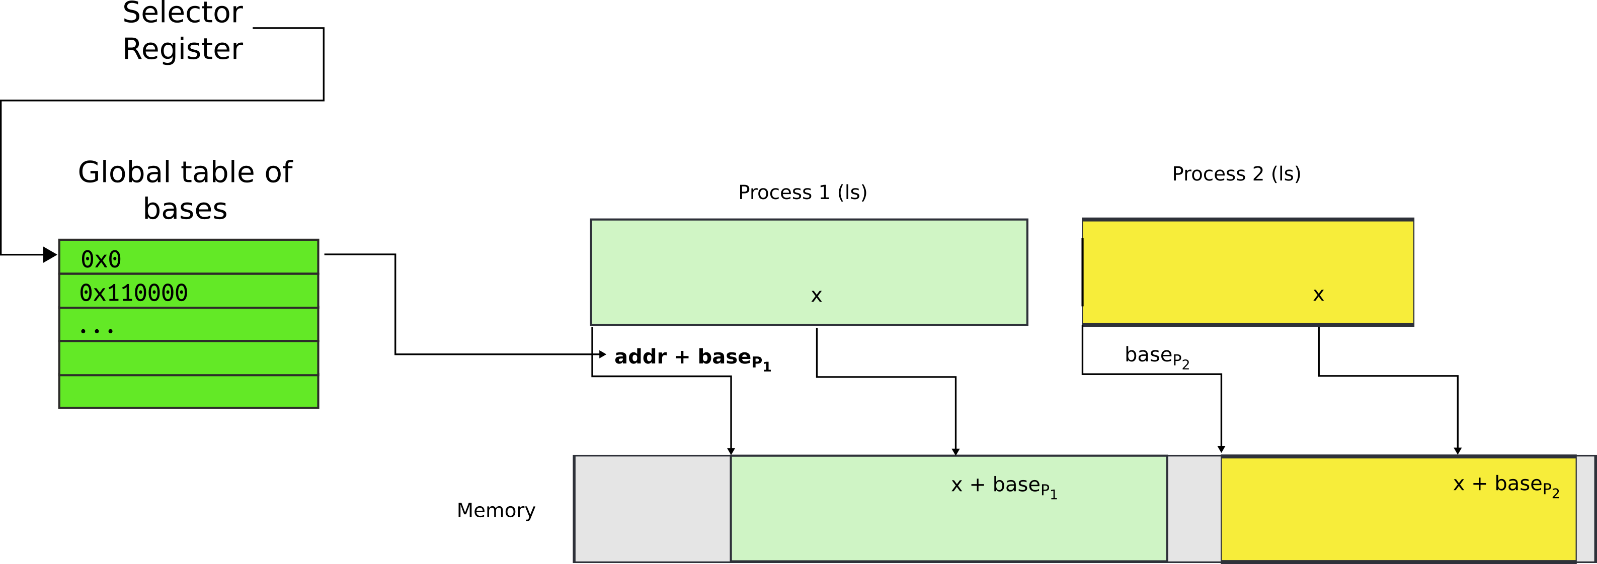
One problem
  Where does this base address come from?
  Hardware can maintain a table of base addresses
    One base for each process
  Dedicate a special register to keep an index into that table

Slide 17
New addressing mode

Slide 18

All addresses are logical address
They consist of two parts
  Segment selector (16 bit) + offset (32 bi

Slide 19
Segment selector (16 bit)
  Is simply an index into an array (Descriptor Table)
  That holds segment descriptors
    Base and limit (size) for each segment

Slide 20

Elements of the descriptor table are segment descriptors
Base address
  0 – 4 GB
Limit (size)
  0 – 4 GB
Access rights
  Executable, readable, writable
  Privilege level (0 - 3)

Slide 21
Offsets into segments (x in our example) or “Effective addresses” are in registers

Slide 22
Logical addresses are translated into physical
  Effective address + DescriptorTable[selector].Base

Slide 23
Logical addresses are translated into physical
  Effective address + DescriptorTable[selector].Base

Slide 24
Logical addresses are translated into physical
  Effective address + DescriptorTable[selector].Base

Slide 25
Logical addresses are translated into physical
  Effective address + DescriptorTable[selector].Base

Slide 26
Physical address =
  Effective address + DescriptorTable[selector].Base
  Effective addresses (or offsets) are in registers
  Selector is in a special register

Slide 27
Offsets (effective addresses) are in registers
  Effective address + DescriptorTable[selector].Base
  But where is the selector?

Slide 28
Segment registers
Hold 16 bit segment selectors
  Pointers into a special table
  Global or local descriptor table
Segments are associated with one of three types of storage
  Code
  Data
  Stack

Slide 29
Segmented programming (not real)
static int x = 1;
int y; // stack
if (x) {
y = 1;
printf (“Boo”);
} else
y = 0;
ds:x = 1; // data
ss:y; // stack
if (ds:x) {
ss:y = 1;
cs:printf(ds:“Boo”);
} else
ss:y = 0;

Slide 30
Programming model
Segments for: code, data, stack, “extra”
  A program can have up to 6 total segments
  Segments identified by registers: cs, ds, ss, es, fs, gs
Prefix all memory accesses with desired segment:
  mov eax, ds:0x80 (load offset 0x80 from data into eax)
  jmp cs:0xab8 (jump execution to code offset 0xab8)
  mov ss:0x40, ecx (move ecx to stack offset 0x40)

Slide 31
Programming model, cont.
This is cumbersome,
Instead the idea is: infer code, data and stack segments from the instruction type:
  Control-flow instructions use code segment (jump, call)
  Stack management (push/pop) uses stack
  Most loads/stores use data segment
Extra segments (es, fs, gs) must be used explicitly

Slide 32
Code segment
Code
  CS register
  EIP is an offset inside the segment stored in CS
Can only be changed with
  procedure calls,
  interrupt handling, or
  task switching

Slide 33
Data segment
Data
  DS, ES, FS, GS
  4 possible data segments can be used at the same time

Slide 34
Stack segment
Stack
  SS
Can be loaded explicitly
  OS can set up multiple stacks
  Of course, only one is accessible at a time

Slide 35
Segmentation works for isolation, i.e., it does provide programs with illusion of private memory

Slide 36

Segmentation is ok... but

Slide 37

What if process needs more memory?

Slide 38

What if process needs more memory?

Slide 39

You can move P2 in memory

Slide 40

Or even swap it out to disk

Slide 41
Problems with segments
But it's inefficient
  Relocating or swapping the entire process takes time
Memory gets fragmented
  There might be no space (gap) for the swapped out process to come in
  Will have to swap out other processes

Slide 42
Paging

Slide 43

Pages

Slide 44

Pages

Slide 45
Paging idea
Break up memory into 4096-byte chunks called pages
  Modern hardware supports 2MB, 4MB, and 1GB pages
Independently control mapping for each page of linear address space
Compare with segmentation (single base + limit)
  many more degrees of freedom

Slide 46

Page translation

Slide 47
Page translation

Slide 48
Page directory entry (PDE)
20 bit address of the page table

Slide 49
Page directory entry (PDE)
20 bit address of the page table
Wait... 20 bit address, but we need 32 bits

Slide 50
Page directory entry (PDE)
20 bit address of the page table
Wait... 20 bit address, but we need 32 bits
  Pages 4KB each, we need 1M to cover 4GB
  Pages start at 4KB (page aligned boundary)

Slide 51
Page directory entry (PDE)
Bit #1: R/W – writes allowed?
  But allowed where?

Slide 52
Page directory entry (PDE)
Bit #1: R/W – writes allowed?
  But allowed where?
  One page directory entry controls 1024 Level 2 page tables
    Each Level 2 maps 4KB page
  So it's a region of 4KB x 1024 = 4MB

Slide 53
Page directory entry (PDE)
Bit #2: U/S – user/supervisor
  If 0 – user-mode access is not allowed
  Allows protecting kernel memory from user-level applications

Slide 54
Page translation

Slide 55
Page table entry (PTE)
20 bit address of the 4KB page
  Pages 4KB each, we need 1M to cover 4GB
Bit #1: R/W – writes allowed?
  To a 4KB page
Bit #2: U/S – user/supervisor
  If 0 user-mode access is not allowed
Bit #5: A – accessed
Bit #6: D – dirty – software has written to this page

Slide 56
Page translation

Slide 57
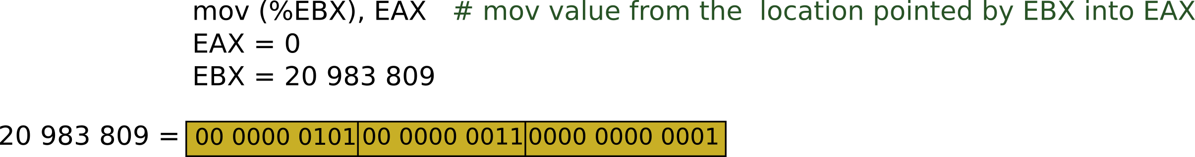






Slide 58



Slide 59





Slide 60

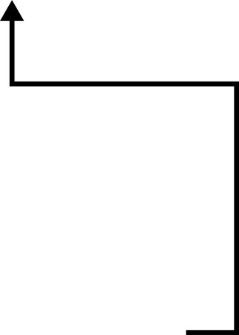


Slide 61



Slide 62
Result:
  EAX = 55

Slide 63
But why do we need page tables
… Instead of arrays?
Page tables represent sparse address space more efficiently
  An entire array has to be allocated upfront
  But if the address space uses a handful of pages
  Only page tables (Level 1 and 2 need to be allocated to describe translation)
On a dense address space this benefit goes away
  I'll assign a homework!

Slide 64
What about isolation?
Two programs, one memory?

Slide 65
What about isolation?
Two programs, one memory?
Each process has its own page table
  OS switches between them

Slide 66

P1 and P2 can't access each other memory

Slide 67
Compared to segments pages allow ...
Emulate large virtual address space on a smaller physical memory
  In our example we had only 12 physical pages
  But the program can access all 1M pages in its 4GB address space
  The OS will move other pages to disk

Slide 68
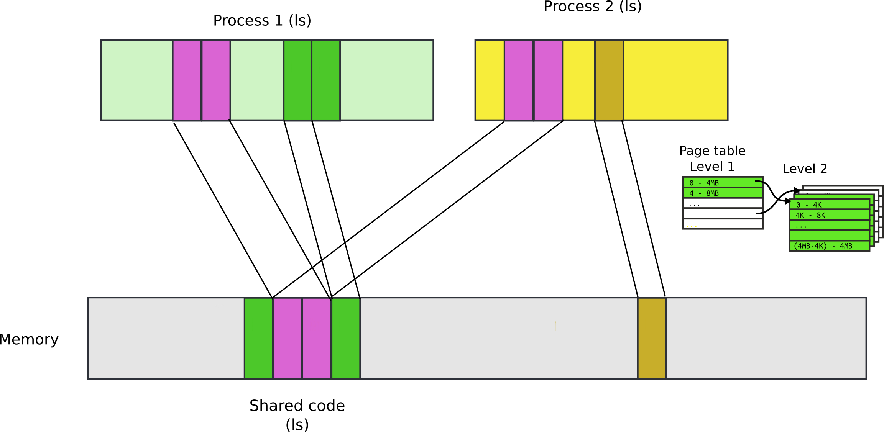
Compared to segments pages allow ...
Share a region of memory across multiple programs
  Communication (shared buffer of messages)
  Shared libraries

Slide 69
More paging tricks
Protect parts of the program
  E.g., map code as read-only
    Disable code modification attacks
    Remember R/W bit in PTD/PTE entries!
  E.g., map stack as non-executable
    Protects from stack smashing attacks
    Non-executable bit

Slide 70

Recap: complete address translation

Slide 71


Slide 79
Why do we need paging?
Compared to segments pages provide fine-grained control over memory layout
  No need to relocate/swap the entire segment
    One page is enough
You're trading flexibility (granularity) for overhead of data structures required for translation

Slide 80
Example 1: Ultimate flexibility
Each byte can be relocated anywhere in physical memory
What's the overhead of page tables?
  Imagine we use array instead of page tables (for simplicity)

Slide 81
Example 1: Ultimate flexibility
Each byte can be relocated anywhere in physical memory
What's the overhead of page tables?
  Imagine we use array instead of page tables (for simplicity)
  We need 4 bytes to relocate each other byte
    4 bytes describe 32bit address
  Therefore, we need array of 4 bytes x 4B entries
    16GBs

Slide 82
Example 2: Reasonable flexibility
Each 4K bytes (a page) can be relocated anywhere in physical memory
What's the overhead of page tables?
  Again, imagine we use array instead of page tables (for simplicity)

Slide 83
Example 2: Reasonable flexibility
Each 4K bytes (a page) can be relocated anywhere in physical memory
What's the overhead of page tables?
  Again, imagine we use array instead of page tables (for simplicity)
  We need 4 bytes to relocate each 4KB page
    4 bytes describe 32bit address
  Therefore, we need array of 4 bytes x 1M entries
    If we split 4GB address space, into 4GB pages, we need 1M pages
  We need 4MB array

Slide 84
Example 3: Less flexibility
Each 1M bytes (a 1MB page) can be relocated anywhere in physical memory
What's the overhead of page tables?
  Again, imagine we use array instead of page tables (for simplicity)
  We need 4 bytes to relocate each 1MB page
    4 bytes describe 32bit address
  Therefore, we need array of 4 bytes x 4K entries
    If we split 4GB address space, into 1MB pages, we need 4K pages
  We need 16KB array
    Wow! That's much less than 4MB required for 4KB pages

Slide 85
But why do we need page tables
Instead of arrays?

Slide 86


TLB
Walking page table is slow
  Each memory access is 240 (local) - 360 (one QPI hop away) cycles on modern hardware
  L3 cache access is 50 cycles
cr3

Slide 87
TLB
CPU caches results of page table walks
  In translation lookaside buffer (TLB)
Virt | Phys
0xf0231000 | 0x1000
0x00b31000 | 0x1f000
0xb0002000 | 0xc1000
- | -

Slide 88
TLB invalidation
TLB is a cache (in CPU)
  It is not coherent with memory
  If page table entry is changes, TLB remains the same and is out of sync
cr3
Virt | Phys
0xf0231000 | 0x1000
0x00b31000 | 0x1f000
0xb0002000 | 0xc1000
- | -
Same
Virt Addr.
No Change!!!

Slide 89
TLB invalidation
After every page table update, OS needs to manually invalidate cached values
  Flush TLB
    Either one specific entry
    Or entire TLB, e.g., when CR3 register is loaded
    This happens when OS switches from one process to another
  This is expensive
    Refilling the TLB with new values takes time

Slide 90
Tagged TLBs
Modern CPUs have “tagged TLBs”,
  Each TLB entry has a “tag” – identifier of a process
  No need to flush TLBs on context switch
On Intel this mechanism is called
  Process-Context Identifiers (PCIDs)
Virt | Phys | Tag
0xf0231000 | 0x1000 | P1
0x00b31000 | 0x1f000 | P2
0xb0002000 | 0xc1000 | P1

Slide 91
When would you disable paging?

Slide 92
When would you disable paging?
Imagine you're running a memcached
  Key/value cache
You serve 1024 byte values (typical) on 10Gbps connection
  1024 byte packets can leave every 835ns, or 1670 cycles (2GHz machine)
  This is your target budget per packet

Slide 93
When would you disable paging?
Now, to cover 32GB RAM with 4K pages
  You need 64MB space
  64bit architecture, 3-level page tables
Page tables do not fit in L3 cache
  Modern servers come with 32MB cache
Every cache miss results in up to 3 cache misses due to page walk (remember 3-level page tables)
  Each cache miss is 250 cycles
Solution: 1GB pages

Slide 94

Page translation for 4MB pages

Slide 95
Questions?

Slide 96
More paging tricks
Determine a working set of a program?

Slide 97
More paging tricks
Determine a working set of a program?
  Use “accessed” bit

Slide 98
More paging tricks
Determine a working set of a program?
  Use “accessed” bit
Iterative copy of a working set?
  Used for virtual machine migration

Slide 99
More paging tricks
Determine a working set of a program?
  Use “accessed” bit
Iterative copy of a working set?
  Used for virtual machine migration
  Use “dirty” bit

Slide 100
More paging tricks
Determine a working set of a program?
  Use “accessed” bit
Iterative copy of a working set?
  Used for virtual machine migration
  Use “dirty” bit
Copy-on-write memory, e.g. lightweigh fork()?

Slide 101
More paging tricks
Determine a working set of a program?
  Use “accessed” bit
Iterative copy of a working set?
  Used for virtual machine migration
  Use “dirty” bit
Copy-on-write memory, e.g. lightweight fork()?
  Map page as read/only

Slide 102
Back of the envelope
If a page is 4K and an entry is 4 bytes, how many entries per page?

Slide 103
Back of the envelope
If a page is 4K and an entry is 4 bytes, how many entries per page?
  1k

Slide 104
Back of the envelope
If a page is 4K and an entry is 4 bytes, how many entries per page?
  1k
How large of an address space can 1 page represent?

Slide 105
Back of the envelope
If a page is 4K and an entry is 4 bytes, how many entries per page?
  1k
How large of an address space can 1 page represent?
  1k entries * 1page/entry * 4K/page = 4MB

Slide 106
Back of the envelope
If a page is 4K and an entry is 4 bytes, how many entries per page?
  1k
How large of an address space can 1 page represent?
  1k entries * 1page/entry * 4K/page = 4MB
How large can we get with a second level of translation?

Slide 107
Back of the envelope
If a page is 4K and an entry is 4 bytes, how many entries per page?
  1k
How large of an address space can 1 page represent?
  1k entries * 1page/entry * 4K/page = 4MB
How large can we get with a second level of translation?
  1k tables/dir * 1k entries/table * 4k/page = 4 GB
  Nice that it works out that way!

Slide 108

Segment descriptors

