Slide 1
ICS143A: Principles of Operating Systems
Lecture 14: System calls & the first process (again!)
Anton Burtsev
February, 2017

Slide 2
System calls

Slide 3
  User mode
  Two stacks
    Kernel and user
    Kernel stack is empty

Slide 4
Page table
GDT

Slide 5
Page table
GDT

Slide 6
Timer interrupt

Slide 7
Interrupt path

Slide 8
Initialize IDT
3316 void
3317 tvinit(void)
3318 {
3319 int i;
3320
3321 for(i = 0; i < 256; i++)
3322 SETGATE(idt[i], 0, SEG_KCODE<<3, vectors[i], 0);
3323 SETGATE(idt[T_SYSCALL], 1, SEG_KCODE<<3,
vectors[T_SYSCALL], DPL_USER);
3324
3325 initlock(&tickslock, "time");
3326 }
tvinit() is called from main()

Slide 9
Initialize IDT
3316 void
3317 tvinit(void)
3318 {
3319 int i;
3320
3321 for(i = 0; i < 256; i++)
3322 SETGATE(idt[i], 0, SEG_KCODE<<3, vectors[i], 0);
3323 SETGATE(idt[T_SYSCALL], 1, SEG_KCODE<<3,
vectors[T_SYSCALL], DPL_USER);
3324
3325 initlock(&tickslock, "time");
3326 }
A couple of important details

Slide 10
Initialize IDT
3316 void
3317 tvinit(void)
3318 {
3319 int i;
3320
3321 for(i = 0; i < 256; i++)
3322 SETGATE(idt[i], 0, SEG_KCODE<<3, vectors[i], 0);
3323 SETGATE(idt[T_SYSCALL], 1, SEG_KCODE<<3,
vectors[T_SYSCALL], DPL_USER);
3324
3325 initlock(&tickslock, "time");
3326 }
Only int T_SYSCALL can be called from user-level

Slide 11
Initialize IDT
3316 void
3317 tvinit(void)
3318 {
3319 int i;
3320
3321 for(i = 0; i < 256; i++)
3322 SETGATE(idt[i], 0, SEG_KCODE<<3, vectors[i], 0);
3323 SETGATE(idt[T_SYSCALL], 1, SEG_KCODE<<3,
vectors[T_SYSCALL], DPL_USER);
3324
3325 initlock(&tickslock, "time");
3326 }
Syscall is a “trap”
i.e., doesn't disable interrupts

Slide 12
Where does IDT
(entry 64) point to?
vector64:
pushl $0 // error code
pushl $64 // vector #
jmp alltraps
Automatically generated
From vectors.pl
  vector.S

Slide 13

Kernel stack after interrupt

Slide 14

Kernel stack after interrupt

Slide 15
Syscall number
System call number is passed in the %eax register
  To distinguish which syscall to process, e.g., sys_read, sys_exec, etc.
alltrap() saves it as rest of the registers

Slide 16
alltraps()
3254 alltraps:
3255 # Build trap frame.
3256 pushl %ds
3257 pushl %es
3258 pushl %fs
3259 pushl %gs
3260 pushal
3261
3262 # Set up data and per−cpu segments.
3263 movw $(SEG_KDATA<<3), %ax
3264 movw %ax, %ds
3265 movw %ax, %es
3266 movw $(SEG_KCPU<<3), %ax
3267 movw %ax, %fs
3268 movw %ax, %gs
3269
3270 # Call trap(tf), where tf=%esp
3271 pushl %esp
3272 call trap

Slide 17
Remember we went to trap() to handle timer interrup
3351 trap(struct trapframe *tf)
3352 {
...
3363 switch(tf−>trapno){
3364 case T_IRQ0 + IRQ_TIMER:
3365 if(cpu−>id == 0){
3366 acquire(&tickslock);
3367 ticks++;
3368 wakeup(&ticks);
3369 release(&tickslock);
3370 }
3372 break;
...
3423 if(proc && proc−>state == RUNNING
&& tf−>trapno == T_IRQ0+IRQ_TIMER)
3424 yield();

Slide 18
Same for syscalls
3351 trap(struct trapframe *tf)
3352 {
3353 if(tf−>trapno == T_SYSCALL){
3354 if(proc−>killed)
3355 exit();
3356 proc−>tf = tf;
3357 syscall();
3358 if(proc−>killed)
3359 exit();
3360 return;
3361 }
3362
3363 switch(tf−>trapno){
3364 case T_IRQ0 + IRQ_TIMER:

Slide 19
syscall(): get the number from trap frame
3625 syscall(void)
3626 {
3627 int num;
3628
3629 num = proc−>tf−>eax;
3630 if(num > 0 && num < NELEM(syscalls) && syscalls[num]) {
3631 proc−>tf−>eax = syscalls[num]();
3632 } else {
3633 cprintf("%d %s: unknown sys call %d\n",
3634 proc−>pid, proc−>name, num);
3635 proc−>tf−>eax = −1;
3636 }
3637 }

Slide 20
syscall(): process a syscall from the table
3625 syscall(void)
3626 {
3627 int num;
3628
3629 num = proc−>tf−>eax;
3630 if(num > 0 && num < NELEM(syscalls) && syscalls[num]) {
3631 proc−>tf−>eax = syscalls[num]();
3632 } else {
3633 cprintf("%d %s: unknown sys call %d\n",
3634 proc−>pid, proc−>name, num);
3635 proc−>tf−>eax = −1;
3636 }
3637 }

Slide 21
System call table
3600 static int (*syscalls[])(void) = {
3601 [SYS_fork] sys_fork,
3602 [SYS_exit] sys_exit,
3603 [SYS_wait] sys_wait,
3604 [SYS_pipe] sys_pipe,
3605 [SYS_read] sys_read,
3606 [SYS_kill] sys_kill,
3607 [SYS_exec] sys_exec,
3608 [SYS_fstat] sys_fstat,
3609 [SYS_chdir] sys_chdir,
3610 [SYS_dup] sys_dup,
3611 [SYS_getpid] sys_getpid,
3612 [SYS_sbrk] sys_sbrk,
3613 [SYS_sleep] sys_sleep,
3614 [SYS_uptime] sys_uptime,
3615 [SYS_open] sys_open,
3616 [SYS_write] sys_write,
3617 [SYS_mknod] sys_mknod,
3618 [SYS_unlink] sys_unlink,
3619 [SYS_link] sys_link,
3620 [SYS_mkdir] sys_mkdir,
3621 [SYS_close] sys_close,
3622 };

Slide 22
What do you think is the first system call xv6 executes?

Slide 23
1317 main(void)
1318 {
1319 kinit1(end, P2V(4*1024*1024)); // phys page allocator
1320 kvmalloc(); // kernel page table
1321 mpinit(); // detect other processors
...
1323 seginit(); // segment descriptors
...
1330 tvinit(); // trap vectors
...
1338 userinit(); // first user process
1339 mpmain(); // finish this processor’s setup
1340 }

Slide 24
Userinit() – create first process
Allocate process structure
  Information about the process

Slide 25
2502 userinit(void)
2503 {
2504 struct proc *p;
2505 extern char _binary_initcode_start[],
_binary_initcode_size[];
...
2509 p = allocproc();
2510 initproc = p;
2511 if((p−>pgdir = setupkvm()) == 0)
2512 panic("userinit: out of memory?");
2513 inituvm(p−>pgdir, _binary_initcode_start,
(int)_binary_initcode_size);
2514 p−>sz = PGSIZE;
2515 memset(p−>tf, 0, sizeof(*p−>tf));
...
2530 }

Slide 26
2103 struct proc {
2104 uint sz; // Size of process memory (bytes)
2105 pde_t* pgdir; // Page table
2106 char *kstack; // Bottom of kernel stack for this process
2107 enum procstate state; // Process state
2108 volatile int pid; // Process ID
2109 struct proc *parent; // Parent process
2110 struct trapframe *tf; // Trap frame for current syscall
2111 struct context *context; // swtch() here to run
2112 void *chan; // If non−zero, sleeping on chan
2113 int killed; // If non−zero, have been killed
2114 struct file *ofile[NOFILE]; // Open files
2115 struct inode *cwd; // Current directory
2116 char name[16]; // Process name (debugging)
2117 };

Slide 27
Userinit() – create first process
Allocate process structure
  Information about the process
Create a page table
  Map only kernel space

Slide 28
2502 userinit(void)
2503 {
2504 struct proc *p;
2505 extern char _binary_initcode_start[],
_binary_initcode_size[];
...
2509 p = allocproc();
2510 initproc = p;
2511 if((p−>pgdir = setupkvm()) == 0)
2512 panic("userinit: out of memory?");
2513 inituvm(p−>pgdir, _binary_initcode_start,
(int)_binary_initcode_size);
2514 p−>sz = PGSIZE;
2515 memset(p−>tf, 0, sizeof(*p−>tf));
...
2530 }

Slide 29

Remember: each process maps kernel in its page table

Slide 30
Userinit() – create first process
Allocate process structure
  Information about the process
Create a page table
  Map only kernel space
Allocate a page for the user init code
  Map this page

Slide 31
2502 userinit(void)
2503 {
2504 struct proc *p;
2505 extern char _binary_initcode_start[],
_binary_initcode_size[];
...
2509 p = allocproc();
2510 initproc = p;
2511 if((p−>pgdir = setupkvm()) == 0)
2512 panic("userinit: out of memory?");
2513 inituvm(p−>pgdir, _binary_initcode_start,
(int)_binary_initcode_size);
2514 p−>sz = PGSIZE;
2515 memset(p−>tf, 0, sizeof(*p−>tf));
...
2530 }

Slide 32
1903 inituvm(pde_t *pgdir, char *init, uint sz)
1904 {
1905 char *mem;
1906
1907 if(sz >= PGSIZE)
1908 panic("inituvm: more than a page");
1909 mem = kalloc();
1910 memset(mem, 0, PGSIZE);
1911 mappages(pgdir, 0, PGSIZE, V2P(mem),
PTE_W|PTE_U);
1912 memmove(mem, init, sz);
1913 }

Slide 33
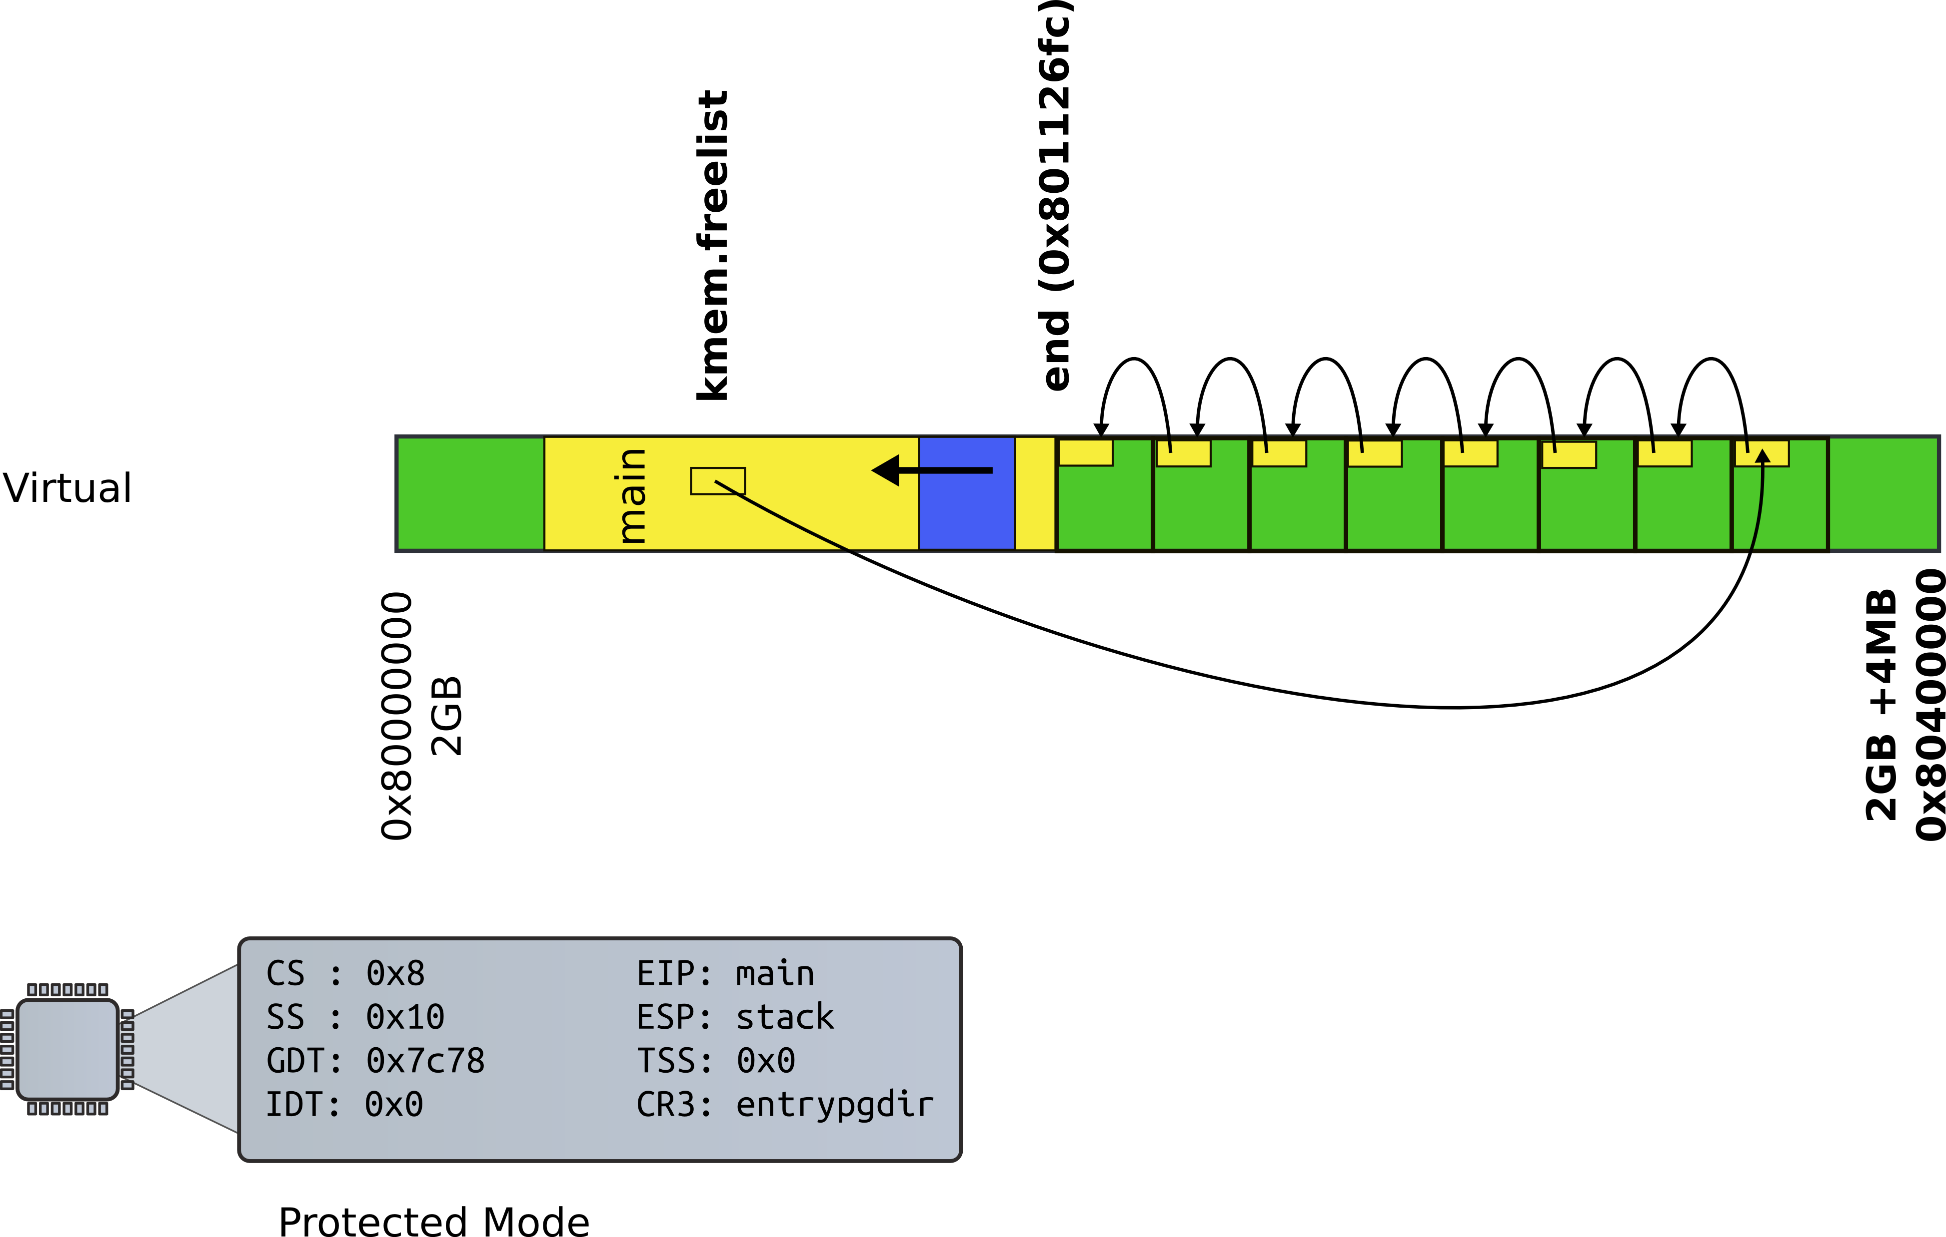
Recap: kalloc() – allocate page

Slide 34
1903 inituvm(pde_t *pgdir, char *init, uint sz)
1904 {
1905 char *mem;
1906
1907 if(sz >= PGSIZE)
1908 panic("inituvm: more than a page");
1909 mem = kalloc();
1910 memset(mem, 0, PGSIZE);
1911 mappages(pgdir, 0, PGSIZE, V2P(mem),
PTE_W|PTE_U);
1912 memmove(mem, init, sz);
1913 }

Slide 35
2502 userinit(void)
2503 {
2504 struct proc *p;
2505 extern char _binary_initcode_start[],
_binary_initcode_size[];
...
2509 p = allocproc();
2510 initproc = p;
2511 if((p−>pgdir = setupkvm()) == 0)
2512 panic("userinit: out of memory?");
2513 inituvm(p−>pgdir, _binary_initcode_start,
(int)_binary_initcode_size);
2514 p−>sz = PGSIZE;
2515 memset(p−>tf, 0, sizeof(*p−>tf));
...
2530 }

Slide 36
1903 inituvm(pde_t *pgdir, char *init, uint sz)
1904 {
1905 char *mem;
1906
1907 if(sz >= PGSIZE)
1908 panic("inituvm: more than a page");
1909 mem = kalloc();
1910 memset(mem, 0, PGSIZE);
1911 mappages(pgdir, 0, PGSIZE, V2P(mem),
PTE_W|PTE_U);
1912 memmove(mem, init, sz);
1913 }

Slide 37
8409 start:
8410 pushl $argv
8411 pushl $init
8412 pushl $0 // where caller pc would be
8413 movl $SYS_exec, %eax
8414 int $T_SYSCALL
8415
...
8422 # char init[] = "/init\0";
8423 init:
8424 .string "/init\0"
8425
8426 # char *argv[] = { init, 0 };
8427 .p2align 2
8428 argv:
8429 .long init
8430 .long 0
Userinit.S: call exec(“/init”, argv);

Slide 38
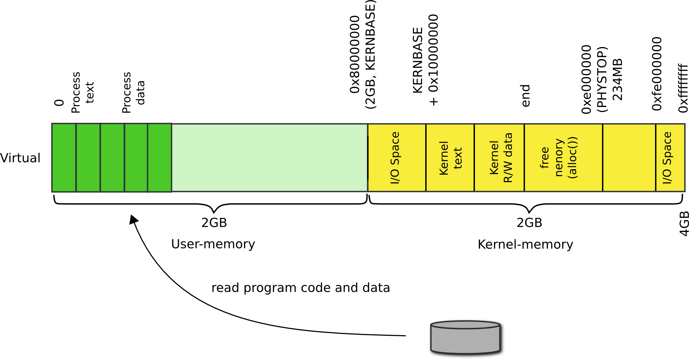
Where does userinit.S go?

Slide 39
Userinit() – create first process
Allocate process structure
  Information about the process
Create a page table
  Map only kernel space
Allocate a page for the user init code
  Map this page
Configure trap frame for “iret”

Slide 40
Kernel stack after interrupt/syscall

Slide 41
2103 struct proc {
2104 uint sz; // Size of process memory (bytes)
2105 pde_t* pgdir; // Page table
2106 char *kstack; // Bottom of kernel stack for this process
2107 enum procstate state; // Process state
2108 volatile int pid; // Process ID
2109 struct proc *parent; // Parent process
2110 struct trapframe *tf; // Trap frame
2111 struct context *context; // swtch() here to run
2112 void *chan; // If non−zero, sleeping on chan
2113 int killed; // If non−zero, have been killed
2114 struct file *ofile[NOFILE]; // Open files
2115 struct inode *cwd; // Current directory
2116 char name[16]; // Process name (debugging)
2117 };

Slide 42
2456 allocproc(void)
2457 {
...
2470 // Allocate kernel stack.
2471 if((p−>kstack = kalloc()) == 0){
2472 p−>state = UNUSED;
2473 return 0;
2474 }
2475 sp = p−>kstack + KSTACKSIZE;
2476
2477 // Leave room for trap frame.
2478 sp −= sizeof *p−>tf;
2479 p−>tf = (struct trapframe*)sp;
2480
...
2492 }
Trap frame is on the
kernel stack of the process

Slide 43
2502 userinit(void)
2503 {
...
2513 inituvm(p−>pgdir, _binary_initcode_start,
(int)_binary_initcode_size);
2514 p−>sz = PGSIZE;
2515 memset(p−>tf, 0, sizeof(*p−>tf));
2516 p−>tf−>cs = (SEG_UCODE << 3) | DPL_USER;
2517 p−>tf−>ds = (SEG_UDATA << 3) | DPL_USER;
2518 p−>tf−>es = p−>tf−>ds;
2519 p−>tf−>ss = p−>tf−>ds;
2520 p−>tf−>eflags = FL_IF;
2521 p−>tf−>esp = PGSIZE;
2522 p−>tf−>eip = 0; // beginning of initcode.S
...
2530 }

Slide 44
Kernel stack after interrupt/syscall

Slide 45
2502 userinit(void)
2503 {
...
2515 memset(p−>tf, 0, sizeof(*p−>tf));
2516 p−>tf−>cs = (SEG_UCODE << 3) | DPL_USER;
2517 p−>tf−>ds = (SEG_UDATA << 3) | DPL_USER;
2518 p−>tf−>es = p−>tf−>ds;
2519 p−>tf−>ss = p−>tf−>ds;
2520 p−>tf−>eflags = FL_IF;
2521 p−>tf−>esp = PGSIZE;
2522 p−>tf−>eip = 0; // beginning of initcode.S
2523
2524 safestrcpy(p−>name, "initcode", sizeof(p−>name));
2525 p−>cwd = namei("/");
2526
2527 p−>state = RUNNABLE;
...
2530 }

Slide 46
Wait, we mapped process memory, created trap frame, but it doesn't really run...

Slide 47

Remember what scheduler does?

Slide 48
2456 allocproc(void)
2457 {
...
2477 // Leave room for trap frame.
2478 sp −= sizeof *p−>tf;
2479 p−>tf = (struct trapframe*)sp;
2480
2481 // Set up new context to start executing at forkret,
2482 // which returns to trapret.
2483 sp −= 4;
2484 *(uint*)sp = (uint)trapret;
2485
2486 sp −= sizeof *p−>context;
2487 p−>context = (struct context*)sp;
2488 memset(p−>context, 0, sizeof *p−>context);
2489 p−>context−>eip = (uint)forkret;
...
2492 }
Trap frame is on the
kernel stack of the process

Slide 49
2788 forkret(void)
2789 {
...
2803 // Return to "caller",
actually trapret (see allocproc).
2804 }
forkret(): just returns

Slide 50
Kernel stack after interrupt/syscall

Slide 51
3276 .globl trapret
3277 trapret:
3278 popal
3279 popl %gs
3280 popl %fs
3281 popl %es
3282 popl %ds
3283 addl $0x8, %esp # trapno and
errcode
3284 iret
forkret(): just returns

Slide 52
Back to the first system call:
exec()

Slide 53
Summary
We've finally learned how the first process came to life
We're half way into system calls

Slide 54
Thank you

Slide 55
sys_exec()
6225 sys_exec(void)
6226 {
6227 char *path, *argv[MAXARG];
6228 int i;
6229 uint uargv, uarg;
6230
6231 if(argstr(0, &path) < 0 || argint(1, (int*)&uargv) < 0){
6232 return −1;
6233 }
6234 memset(argv, 0, sizeof(argv));
6235 for(i=0;; i++){
6236 if(i >= NELEM(argv))
6237 return −1;
6238 if(fetchint(uargv+4*i, (int*)&uarg) < 0)
6239 return −1;
6240 if(uarg == 0){
6241 argv[i] = 0;
6242 break;
6243 }
6244 if(fetchstr(uarg, &argv[i]) < 0)
6245 return −1;
6246 }
6247 return exec(path, argv);
6248 }

Slide 56
sys_exec()
6225 sys_exec(void)
6226 {
6227 char *path, *argv[MAXARG];
6228 int i;
6229 uint uargv, uarg;
6230
6231 if(argstr(0, &path) < 0
|| argint(1, (int*)&uargv) < 0){
6232 return −1;
6233 }
...
6247 return exec(path, argv);
6248 }

