Slide 1
CS238P: Operating Systems
Lecture 12: Synchronization
(and Scalability)
Anton Burtsev
March, 2018

Slide 2
Spinlocks

Slide 3
Critical sections with spinlocks
struct spin_lock {
int locked;
};
insert(int data)
{
struct list *l;
l = malloc(sizeof *l);
spinlock_acquire(&spin_lock);
l->data = data;
l->next = list;
list = l;
spinlock_release(&spin_lock);
}
Critical section

Slide 4
Correct implementation
1573 void
1574 spinlock_acquire(struct spinlock *lk)
1575 {
...
1580 // The xchg is atomic.
1581 while(xchg(&lk−>locked, 1) != 0)
1582 ;
...
1592 }

Slide 5
xchgl instruction
0568 static inline uint
0569 xchg(volatile uint *addr, uint newval)
0570 {
0571 uint result;
0572
0573 // The + in "+m" denotes a read−modify−write
operand.
0574 asm volatile("lock; xchgl %0, %1" :
0575 "+m" (*addr), "=a" (result) :
0576 "1" (newval) :
0577 "cc");
0578 return result;
0579 }

Slide 6
Correct implementation
1573 void
1574 acquire(struct spinlock *lk)
1575 {
...
1580 // The xchg is atomic.
1581 while(xchg(&lk−>locked, 1) != 0)
1582 ;
1584 // Tell the C compiler and the processor to not move loads or stores
1585 // past this point, to ensure that the critical section’s memory
1586 // references happen after the lock is acquired.
1587 __sync_synchronize();
...
1592 }

Slide 7
Mutexes

Slide 8
Critical sections with mutexes
struct mutex {
int locked;
};
insert(int data)
{
struct list *l;
l = malloc(sizeof *l);
mutex_acquire(&spin_lock);
l->data = data;
l->next = list;
list = l;
mutex_release(&spin_lock);
}
Critical section

Slide 9
Mutexes
void
mutex_acquire(struct mutex *m)
{
// The xchg is atomic.
while(xchg(&m->locked, 1) != 0)
yield();
__sync_synchronize();
}
void
mutex_unlock(struct mutex *m)
{
__sync_synchronize();
m->locked = 0;
}

Slide 10
Conditional variables

Slide 11
Conditional variables
pthread_mutex_lock(&m);
while (count < 10) {
pthread_cond_wait(&cv, &m);
}
pthread_mutex_unlock(&m);
while (1) {
pthread_mutex_lock(&m);
count++;
pthread_cond_signal(&cv);
pthread_mutex_unlock(&m);
}

Slide 12
Semaphores

Slide 13
Suppose a library has 10 identical study rooms, to be used by one student at a time. Students must request a room from the front desk if they wish to use a study room. If no rooms are free, students wait at the desk until someone relinquishes a room. When a student has finished using a room, the student must return to the desk and indicate that one room has become free.

Slide 14
Semaphore
typedef struct sem_t {
int count;
mutex_t m;
condition_t cv;
} sem_t;
int sem_init(sem_t *s, int value) {
s->count = value;
mutex_init(&s->m, NULL);
cond_init(&s->cv, NULL);
return 0;
}

Slide 15
Semaphores
sem_wait(sem_t *s) {
mutex_lock(&s->m);
while (s->count == 0) {
cond_wait(&s->cv, &s->m);
}
s->count--;
mutex_unlock(&s->m);
}
sem_post(sem_t *s) {
mutex_lock(&s->m);
s->count++;
cond_signal(&s->cv);
pthread_mutex_unlock(&s->m);
}

Slide 16
Semaphores as mutexes
Mutexes can be implemented as binary semaphores
  count = 1
  However watch out for recursive use of the mutex

Slide 17
Back to spinlocks

Slide 18
Spinlock implementation
1573 void
1574 spinlock_acquire(struct spinlock *lk)
1575 {
...
1580 // The xchg is atomic.
1581 while(xchg(&lk−>locked, 1) != 0)
1582 ;
...
1592 }

Slide 19
What is really wrong with locks?

Slide 20
What is really wrong with locks?
Scalability

Slide 21
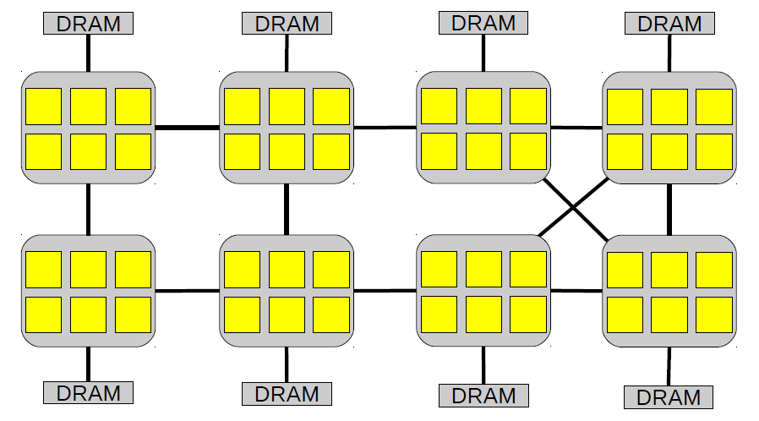
48-core AMD server

Slide 22
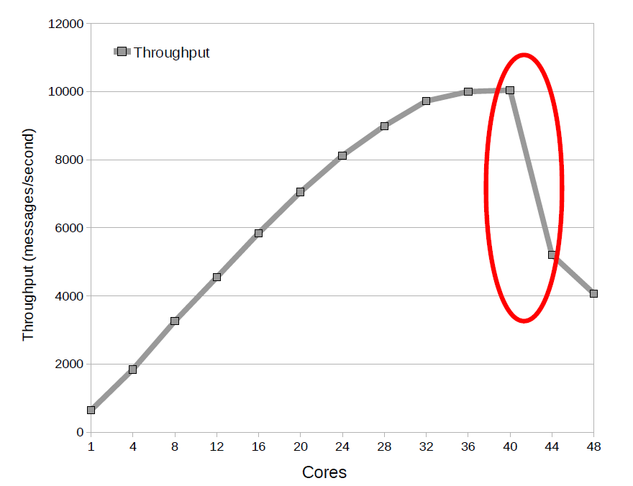
Exim collapse

Slide 23
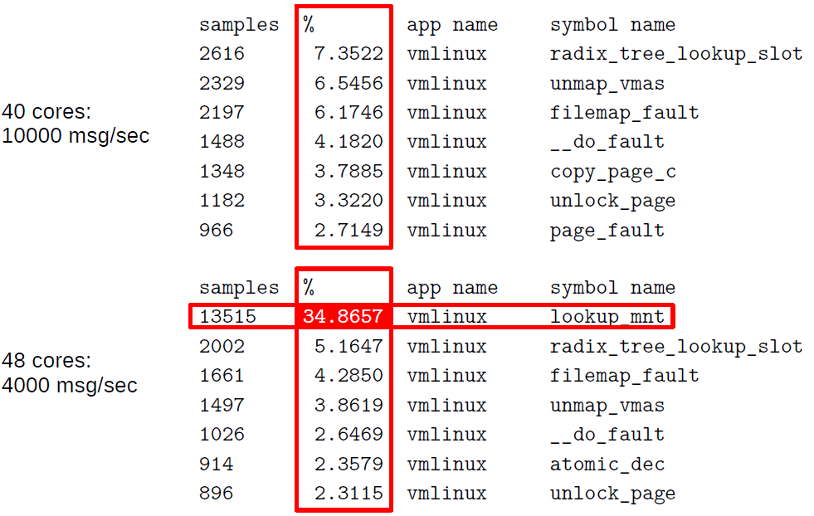
Oprofile results

Slide 24
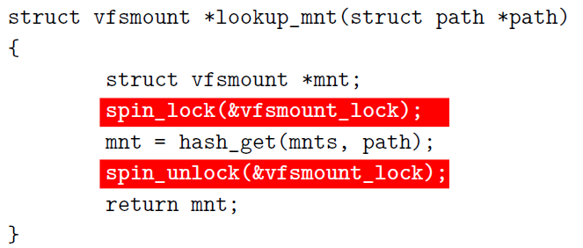
Exim collapse
sys_open eventually calls:

Slide 25
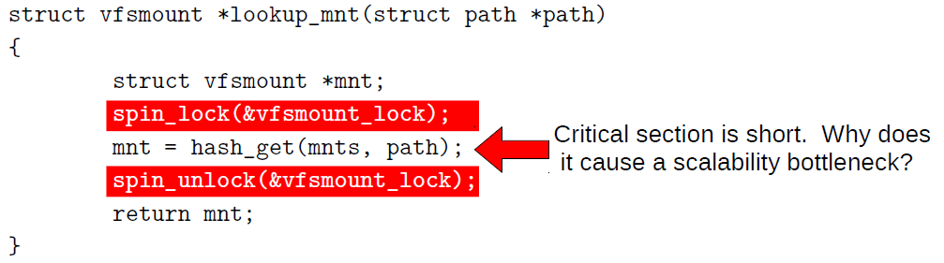
Exim collapse
sys_open eventually calls:
spin_lock and spin_unlock use many more cycles than the critical section

Slide 26
Ticket lock in Linux
struct spinlock_t {
int current_ticket ;
int next_ticket ;
}
void spin_lock ( spinlock_t *lock)
{
int t = atomic_fetch_and_inc (&lock -> next_ticket );
while (t != lock -> current_ticket )
; /* spin */
}
void spin_unlock ( spinlock_t *lock)
{
lock -> current_ticket ++;
}

Slide 27
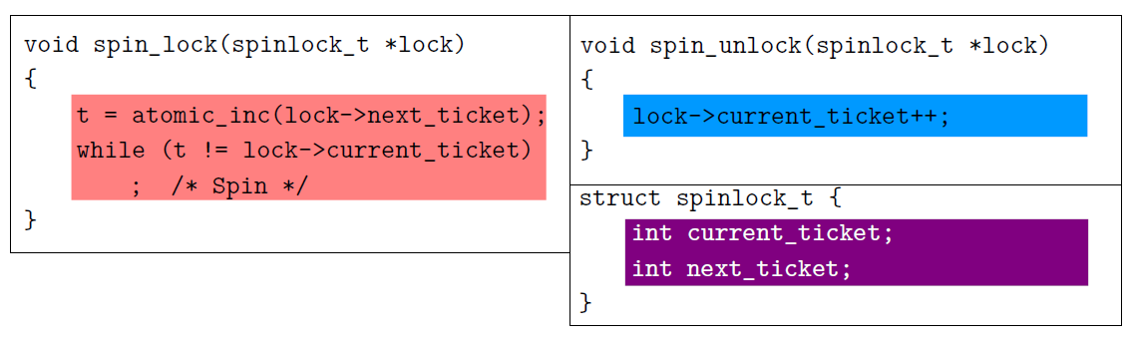
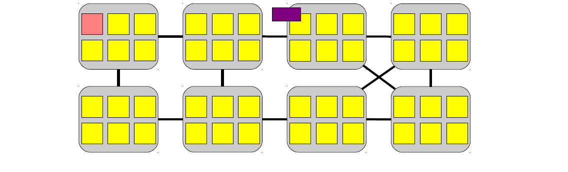
Spin lock implementation

Slide 28
Spin lock implementation
Allocate a ticket

Slide 29
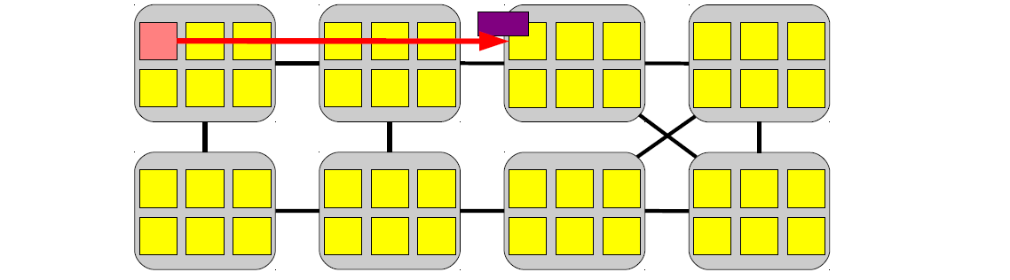
Spin lock implementation
Allocate a ticket

Slide 30
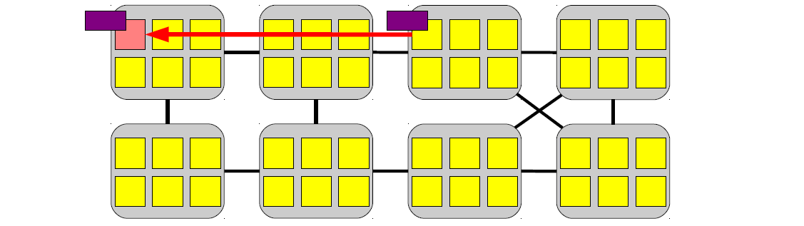
Spin lock implementation
Allocate a ticket

Slide 31
Spin lock implementation
Allocate a ticket
120-420 cycles

Slide 32
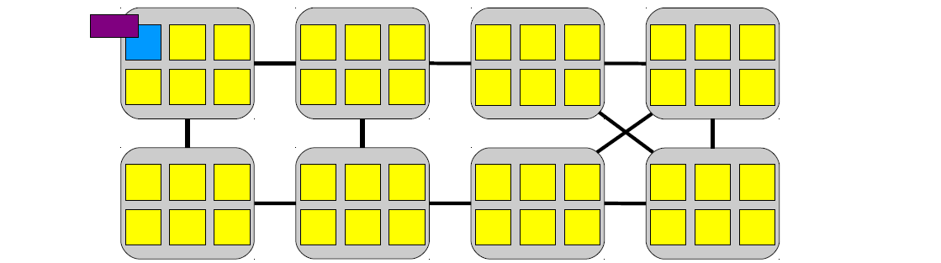
Spin lock implementation
Update the ticket value

Slide 33
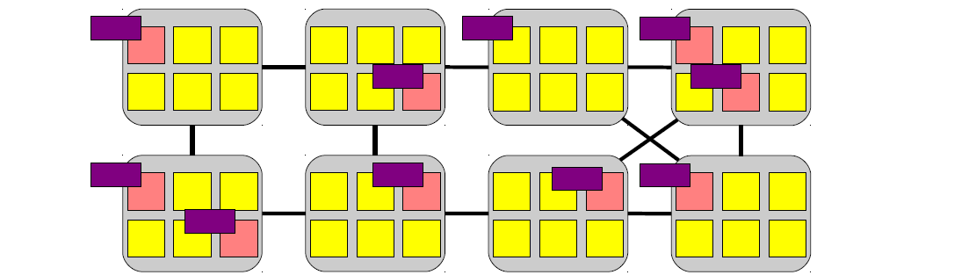
Spin lock implementation
Bunch of cores are
spinning

Slide 34
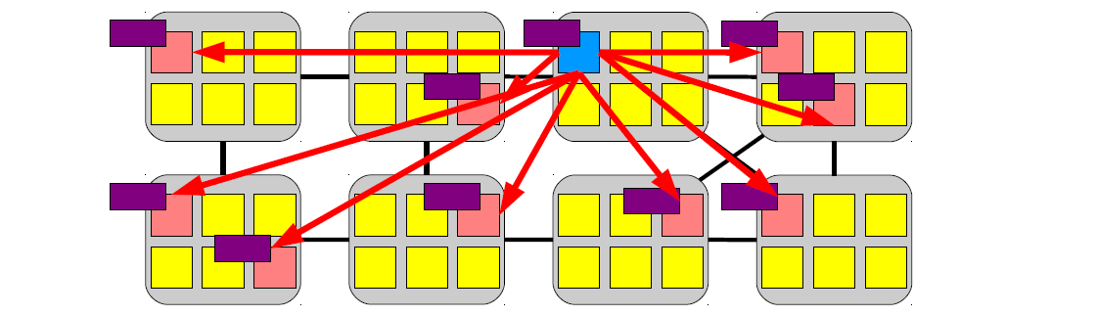
Spin lock implementation
Broadcast message
(invalidate the value)

Slide 35
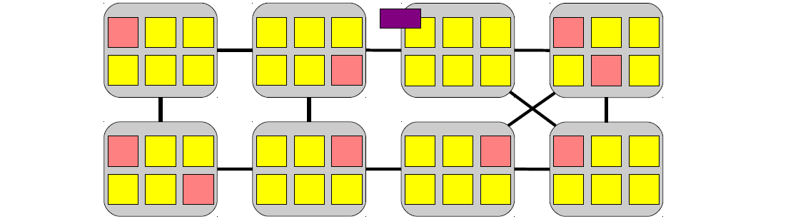
Spin lock implementation
Cores don't have the
value of current_ticket

Slide 36
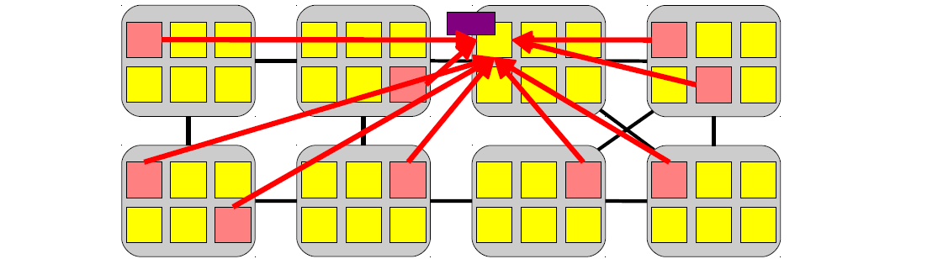
Spin lock implementation
Re-read the value

Slide 37
Spin lock implementation
(120-420) * N/2 cycles

Slide 38
In most architectures, the cache-coherence reads are serialized (either by a shared bus or at the cache line’s home or directory node)
Thus completing them all takes time proportional to the number of cores.
The core that is next in line for the lock can expect to receive its copy of the cache line midway through this process.
  N/2

Slide 39
Atomic synchronization primitives
do not scale well

Slide 40
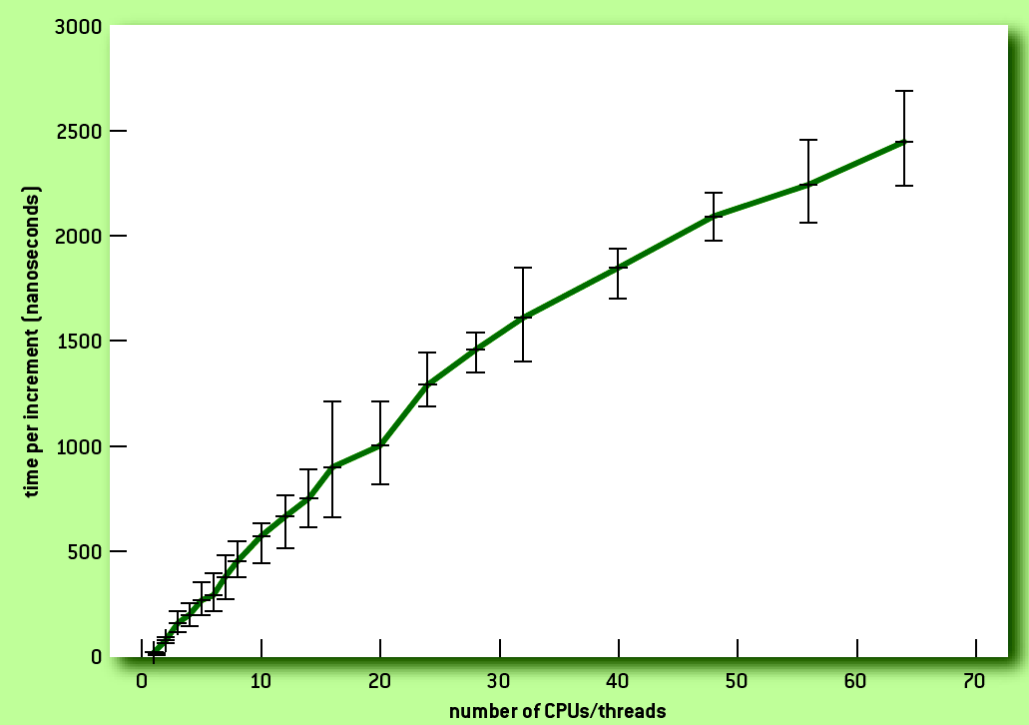
Atomic increment on 64 cores

Slide 41
What can we do about it?

Slide 42
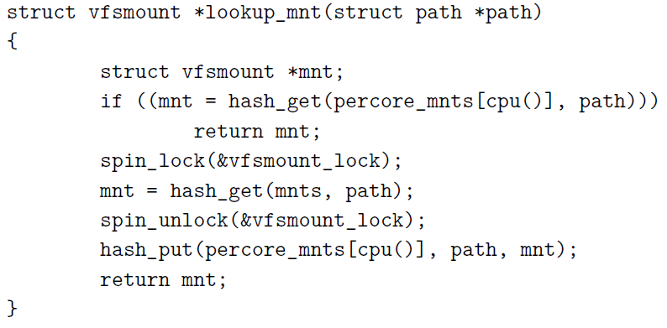
Solution #1: per-core mount tables
Observation: mount table is rarely modified

Slide 43
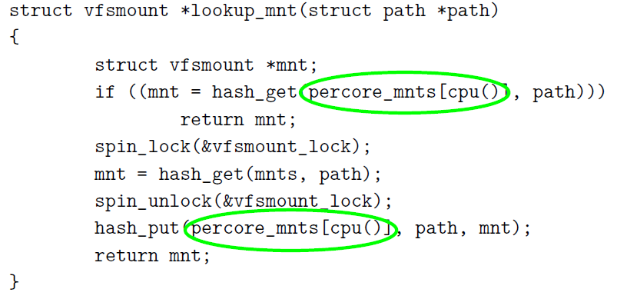
Solution #1: per-core mount tables
Observation: mount table is rarely modified

Slide 44
Solution #1: per-core mount tables
Observation: mount table is rarely modified
Fast path: local hash lookup

Slide 45
Solution #1: per-core mount tables
Observation: mount table is rarely modified
Slow path: lookup global mount table, then update local, per-core copy

Slide 46
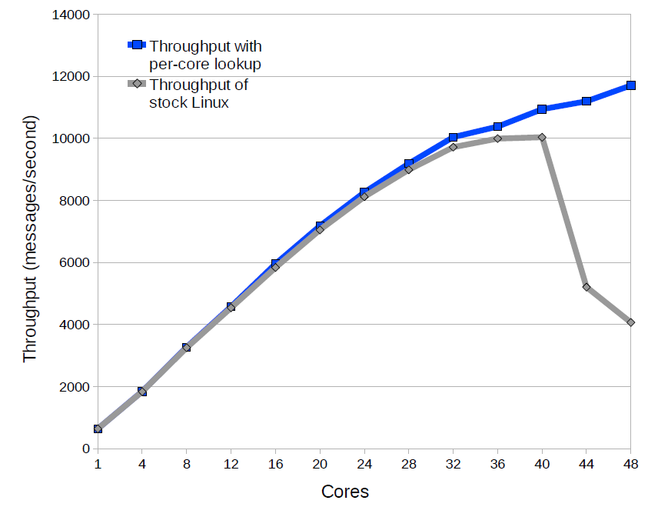

Slide 47
Solution #2:
Is it possible to build scalable spinlocks?

Slide 48
MCS lock
(Mellor-Crummey and M. L. Scott)
struct qnode {
volatile void *next;
volatile char locked;
};
typedef struct {
struct qnode *v;
} mcslock_t;
arch_mcs_lock(mcslock_t *l, volatile struct qnode *mynode) {
struct qnode *predecessor;
mynode->next = NULL;
predecessor = (struct qnode *)xchg((long *)&l->v, (long)mynode);
if (predecessor) {
mynode->locked = 1;
barrier();
predecessor->next = mynode;
while (mynode->locked) ;
}
}

Slide 49
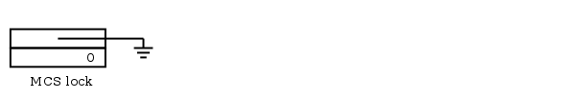
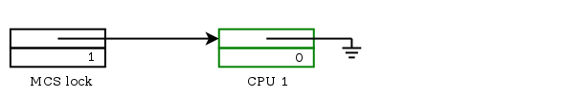
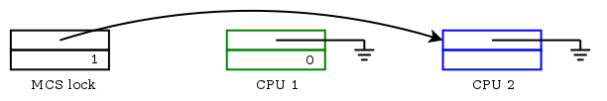
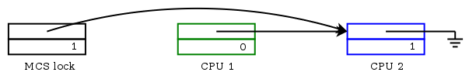
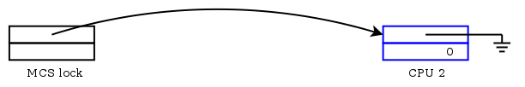
MCS lock

Slide 50
unlock
arch_mcs_lock(mcslock_t *l, volatile struct qnode *mynode) {
struct qnode *predecessor;
mynode->next = NULL;
predecessor = (struct qnode *)xchg((long *)&l->v, (long)mynode);
if (predecessor) {
mynode->locked = 1;
barrier();
predecessor->next = mynode;
while (mynode->locked) ;
}
}
arch_mcs_unlock(mcslock_t *l, volatile struct qnode *mynode) {
if (!mynode->next) {
if (cmpxchg((long *)&l->v, (long)mynode, 0) == (long)mynode)
return;
while (!mynode->next) ;
}
((struct qnode *)mynode->next)->locked = 0;
}

Slide 51
Why does this scale?

Slide 52
Ticket spinlock
Remember O(N) re-fetch messages after invalidation broadcast

Slide 53
One re-fetch message after invalidation
arch_mcs_lock(mcslock_t *l, volatile struct qnode *mynode) {
struct qnode *predecessor;
mynode->next = NULL;
predecessor = (struct qnode *)xchg((long *)&l->v, (long)mynode);
if (predecessor) {
mynode->locked = 1;
barrier();
predecessor->next = mynode;
while (mynode->locked) ;
}
}
arch_mcs_unlock(mcslock_t *l, volatile struct qnode *mynode) {
if (!mynode->next) {
if (cmpxchg((long *)&l->v, (long)mynode, 0) == (long)mynode)
return;
while (!mynode->next) ;
}
((struct qnode *)mynode->next)->locked = 0;
}

Slide 54
Cache line isolation
struct qnode {
volatile void *next;
volatile char locked;
char __pad[0] __attribute__((aligned(64)));
};
typedef struct {
struct qnode *v __attribute__((aligned(64)));
} mcslock_t;

Slide 55
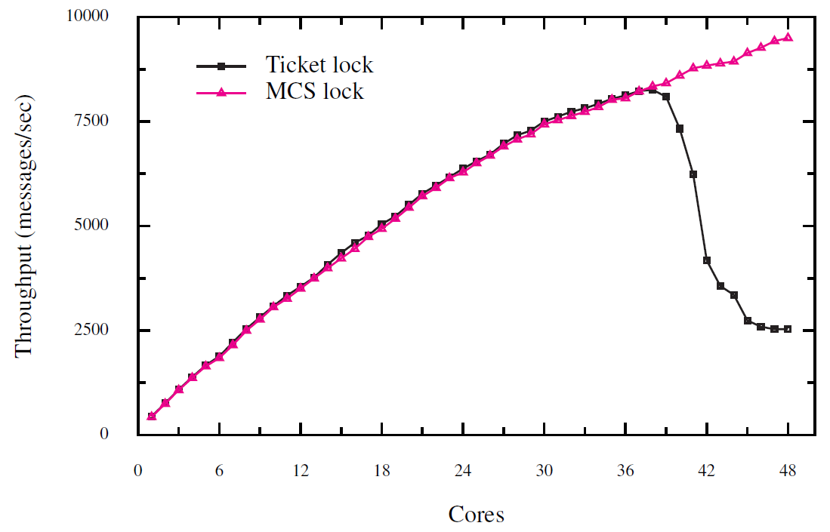
Exim: MCS vs ticket lock

Slide 56
RCU: Read Copy Update

Slide 57
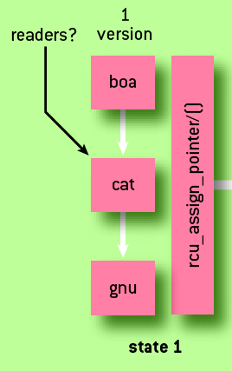
Read copy update
Goal: remove “cat” from the list
  There might be some readers of “cat”
Idea: control the pointer dereference
  Make it atomic

Slide 58
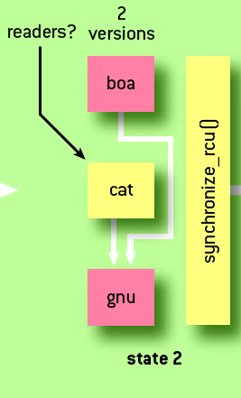
Read copy update (2)
Remove “cat”
  Update the “boa” pointer
  All subsequent readers will get “gnu” as boa->next

Slide 59
Read copy update (2)
Wait for all readers to finish
  synchronize_rcu()

Slide 60
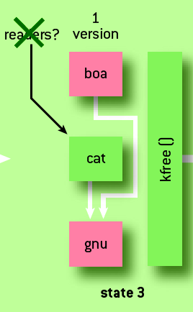
Read copy update (3)
Readers finished
  Safe to deallocate “cat”

Slide 61
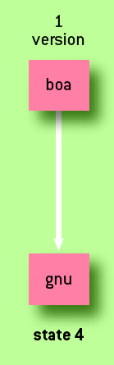
Read copy update (4)
New state of the list

Slide 62
How can we build this?
Disable preemption while using the RCU data
  rcu_lock(), rcu_unlock()
Wait for all RCU readers to finish
  Schedule something on each CPU
  If you managed to run on a CPU
    You preempted a thread on that CPU
    Thus this thread exited the RCU lock/unlock section

Slide 63
RCU implementation
void rcu_read_lock()
{
preempt_disable[cpu_id()]++;
}
void rcu_read_unlock()
{
preempt_disable[cpu_id()]--;
}
void synchronize_rcu(void)
{
for_each_cpu(int cpu)
run_on(cpu);
}

Slide 64
What does it mean to run on a CPU?
In xv6 scheduler() function goes through a list of all processes
  If we keep a mask of allowable CPUs for each process
  On each CPU the scheduler() function will pick processes with a proper mask
run_on(cpu)
  sets the mask for the current process
  Invokes scheduler()
    Calls yield(), which in turn calls swtch()

Slide 65
In practice...
Linux just waits for all CPUs to pass through a context switch
  Instead of scheduling the updater on each CPU

Slide 66
RCU example: lookup_mnt()
struct vfsmount *lookup_mnt(struct path *path)
{
struct vfsmount *local_mnts;
struct vfsmount *mnt;
rcu_read_lock();
local_mnts = rcu_dereference(mnts);
mnt = lookup_mnt(local_mnts, path);
rcu_read_unlock();
return mnt;
}

Slide 67
Why do we need rcu_dereference()?
struct vfsmount *lookup_mnt(struct path *path)
{
...
rcu_read_lock();
local_mnts = rcu_dereference(mnts);
mnt = lookup_mnt(local_mnts, path);
rcu_read_unlock();
...
}

Slide 68
Memory barriers
#define __rcu_assign_pointer(p, v, space) \
do { \
smp_wmb(); \
(p) = (typeof(*v) __force space *)(v); \
} while (0)

Slide 69
Example: dynamic system call table
syscall_t *table;
spinlock_t table_lock;
int invoke_syscall(int number, void *args...)
{
syscall_t *local_table;
int r = -1;
rcu_read_lock();
local_table = rcu_deference(table);
if (local_table != NULL)
r = local_table[number](args);
rcu_read_unlock();
return r;
}

Slide 70
Table update (well, removal)
void retract_table()
{
syscall_t *local_table;
spin_lock(&table_lock);
local_table = table;
rcu_assign_pointer(&table, NULL);
spin_unlock(&table_lock);
synchronize_rcu();
kfree(local_table);
}

Slide 71
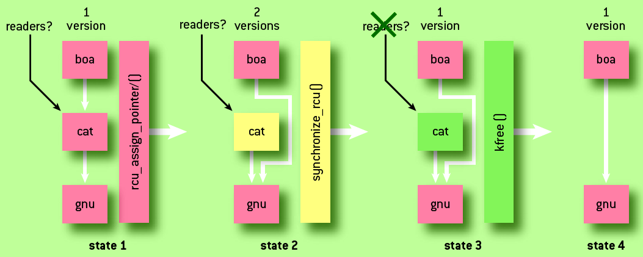
Recap: read copy update

Slide 72
Conclusion
What RCU is good for?

Slide 73
Conclusion
What RCU is good for?
  Read-heavy workload
  Updates are rare
    synchronize_rcu is slow
  System call example:
    You acquire a lock every time you execute a system call
    But really the table might never change
What if you need fast updates?

Slide 74
Conclusion
What RCU is good for?
  Read-heavy workload
  Updates are rare
    synchronize_rcu is slow
  System call example:
    You acquire a lock every time you execute a system call
    But really the table might never change
What if you need fast updates?
  Fine-grained, scalable spinlocks
  Lock-free synchronization
  Transactional memory

Slide 75
Thank you!

