Slide 1
CS-143A
Principles of Operating Systems
Discussion 01
Instructor: Prof. Anton Burtsev
Assistant: Claudio A. Parra

Slide 2
In this episode...
Connecting with Andromeda.
Linux. A survival guide.

Slide 3
Andromeda
Server with Linux managed by the ICS.
You must have an “@ics.uci.edu” account.
Your server number is:
  ser_num = (<ucinetid>%75)+1
The server you will connect is:
  andromeda-<ser_num>.ics.uci.edu

Slide 4
How to connect to it
We need a secure shell client (ssh).
In Linux: integrated.
In Windows: integrated (win10), or Putty.
In Mac-OS: integrated.
ssh username@andromeda-XX.ics.uci.edu

Slide 5
Welcome to Linux, now what?
A couple of notes:
/ is the root directory, everything is under it.
~/ is your home directory, it is an alias for
/home/yourUsername/
./ is the current directory.
../ is the parent directory.
Passwords are invisible.
Case matters, “A” and “a” are different.

Slide 6
Some commands
ls [options] [dir]
List information about the FILEs (the current directory by default).
  -R: recursive.
  -l: long format, shows info of each file
  -a: show all files, including hidden files, those that start with a “.”
  -h: file sizes in a nice way

Slide 7
Some commands
cd [dir]
Change the shell working directory.
If no directory is given, it changes to the home directory.

Slide 8
Some commands
pwd
Print the name of the current working directory.

Slide 9
Some commands
mkdir <dir_name>
Create the directory <dir_name>, if it does not already exist.

Slide 10
Some commands
touch -c <filename>
Creates a new empty file.

Slide 11
Some commands
cp <source> <dest>
Copy the source file to the destination.
Example:
cp myFile.txt ./aDirectory/newFile.txt

Slide 12
Some commands
mv <source> <dest>
Move or rename the source file to the destination file.
Example moving:
mv myFile.txt ./aDirectory/newFile.txt
Example renaming:
mv myFile.txt newName.txt

Slide 13

Some commands
rm [op] <filename> <dir>
delete a file in the specified directory. If no directory is given, uses the current one.
-r: recursive.
-d: remove empty directories.
-i: interactive, ask before each file.
DO NOT TRY THIS: rm -rd ./

Slide 14
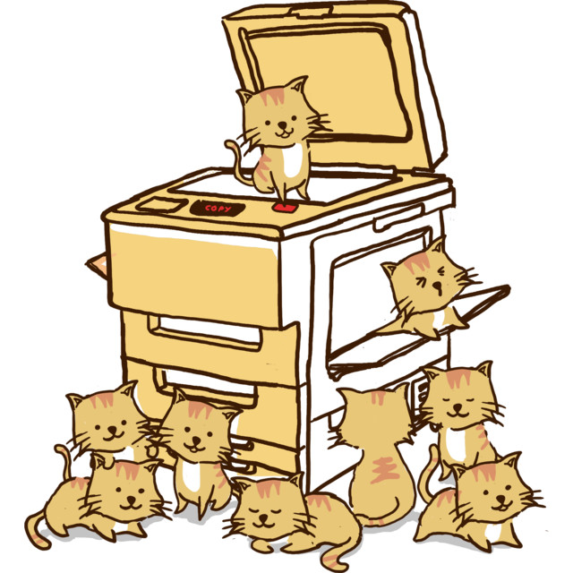
Some commands
cat [filename]
Print the content of a file to standard output. If no file is given, then prints what comes from standard input (most of the cases the keyboard)

Slide 15
Some commands
head <filename>
Print the first 10 lines of the filename to standard output.
-n X: prints the first X lines

Slide 16
Some commands
tail <op> <filename>
Print the last 10 lines of the filename to standard output.
-n X: prints the last X lines

Slide 17
Some commands
grep <pattern> ​[file]
Search for <pattern> in the given file.
If no file is given, grep searches recursively in the working directory.
Using -e <pattern>, grep interprets the pattern as an extended regular expression.

Slide 18
Some commands
find -name <filename> ​<dir>
Find a file named <filename> in the directory <dir>
There is a lot of other options.

Slide 19
Some commands
echo “<message>”
Print the <message> in the standar output
-e: enable interpretation of backslash escapes, example:
echo -e “first line\nsecond line”

Slide 20
Other useful tools
“>” and “<”
Redirect the standard input or output.
Example: ls -l > myContent.txt
Example: cat < myContent.txt

Slide 21
Other useful tools
“>>”
Append.
Example:
echo “Dear diary” > log.txt
echo “Today I...” >> log.txt

Slide 22
Other useful tools
“|”
Pipe, passes the output of a command to another as input.
Example:
ls -R | grep “myFile”

Slide 23
Editors
emacs
C = Ctrl, M = Alt
C-x C-f visit (open) a file
C-n next line
C-p previous line
C-b back (move left)
C-f forward (move right)
C-a beginning of line
C-e end of line
C-x C-s save
C-z suspend (minimize)
C-x C-c close (exit)
C-space toggle selection
M-w copy
C-w kill (cut)
C-y yank (paste)
C-/ undo
C-s search
C-x 2 split windows horizontally
C-x 3 split windows vertically
C-x 0 clear this splitting
C-x 1 clear all splitting
C-h getting help

Slide 24
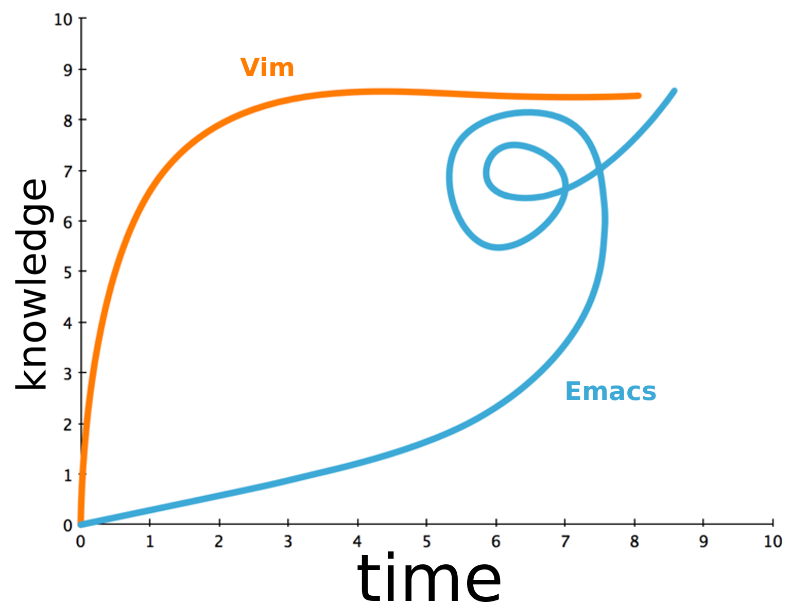
Editors
Learning Curve

Slide 25
Editors
Danger:
Editor choice can break friendships.

Slide 26
Copying things
scp <source> <destination>:<dir>
Copy files from one machine to another through ssh. Easier if you run it in your local machine
Example local to remote:
scp ~/localFile peter@andromeda-XX.ics.uci.edu:~/remoteFile
Example remote to local:
scp peter@andromeda-XX.ics.uci.edu:~/remoteFile ~/localFile

