Slide 1
CS5460/6460: Operating Systems
Lecture 9: Finishing system boot, and system init
Anton Burtsev
January, 2014

Slide 2

First stack

Slide 3
Invoke first C function
9166 movl $start, %esp
9167 call bootmain
xv6/bootasm.S

Slide 4
bootmain(): read kernel from disk
9216 void
9217 bootmain(void)
9218 {
9219 struct elfhdr *elf;
9220 struct proghdr *ph, *eph;
9221 void (*entry)(void);
9222 uchar* pa;
9223
9224 elf = (struct elfhdr*)0x10000; // scratch space
9225
9226 // Read 1st page off disk
9227 readseg((uchar*)elf, 4096, 0);
9228
9229 // Is this an ELF executable?
9230 if(elf−>magic != ELF_MAGIC)
9231 return; // let bootasm.S handle error
9232
xv6/bootmain.c

Slide 5
bootmain(): read kernel from disk
9232
9233 // Load each program segment (ignores ph flags).
9234 ph = (struct proghdr*)((uchar*)elf + elf−>phoff);
9235 eph = ph + elf−>phnum;
9236 for(; ph < eph; ph++){
9237 pa = (uchar*)ph−>paddr;
9238 readseg(pa, ph−>filesz, ph−>off);
9239 if(ph−>memsz > ph−>filesz)
9240 stosb(pa + ph−>filesz, 0, ph−>memsz − ph−>filesz);
9241 }
9242
9243 // Call the entry point from the ELF header.
9244 // Does not return!
9245 entry = (void(*)(void))(elf−>entry);
9246 entry();
9247 }
xv6/bootmain.c

Slide 6
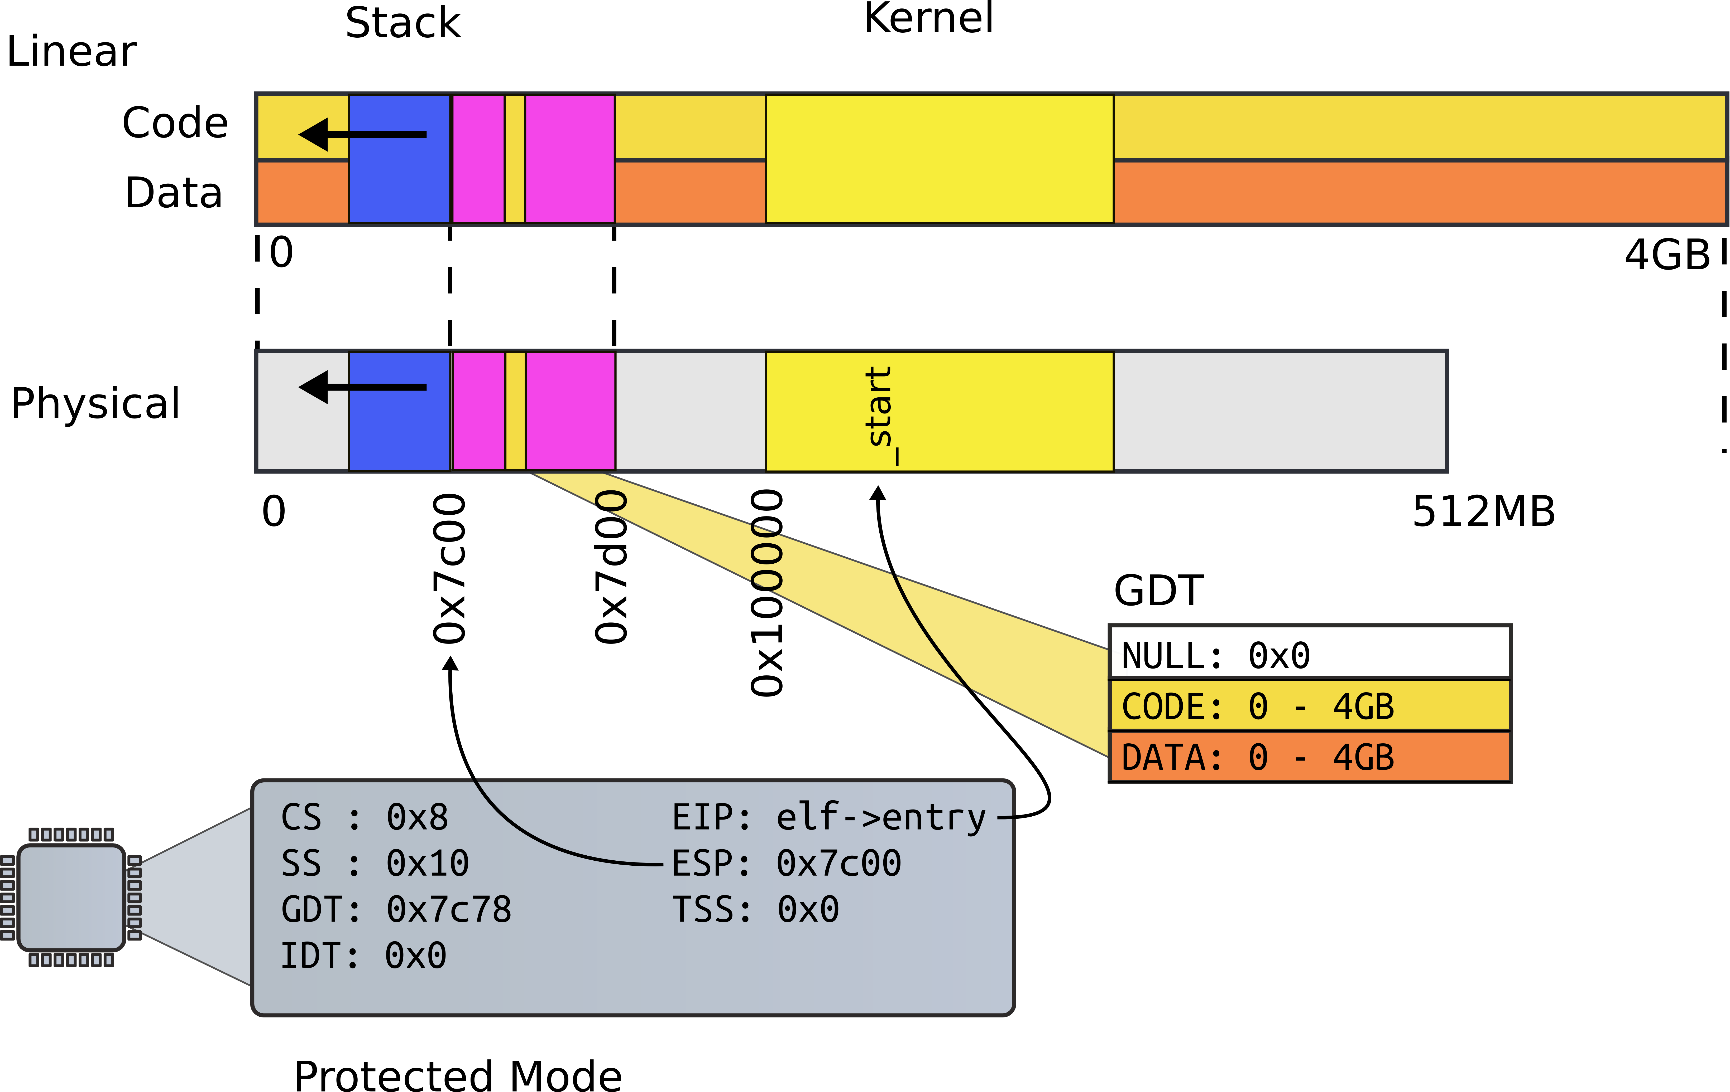
Kernel

Slide 7
entry(): kernel ELF entry
1039 .globl entry
1136 # By convention, the _start symbol specifies the ELF entry point.
1137 # Since we haven’t set up virtual memory yet, our entry point is
1138 # the physical address of ’entry’.
1139 .globl _start
1140 _start = V2P_WO(entry)
1141
1142 # Entering xv6 on boot processor, with paging off.
1143 .globl entry
1144 entry:
1145 # Turn on page size extension for 4Mbyte pages
1146 movl %cr4, %eax
1147 orl $(CR4_PSE), %eax
1148 movl %eax, %cr4
xv6/entry.S

Slide 8
Set up page directory
1149 # Set page directory
1150 movl $(V2P_WO(entrypgdir)), %eax
1151 movl %eax, %cr3
xv6/entry.S

Slide 9


Slide 10
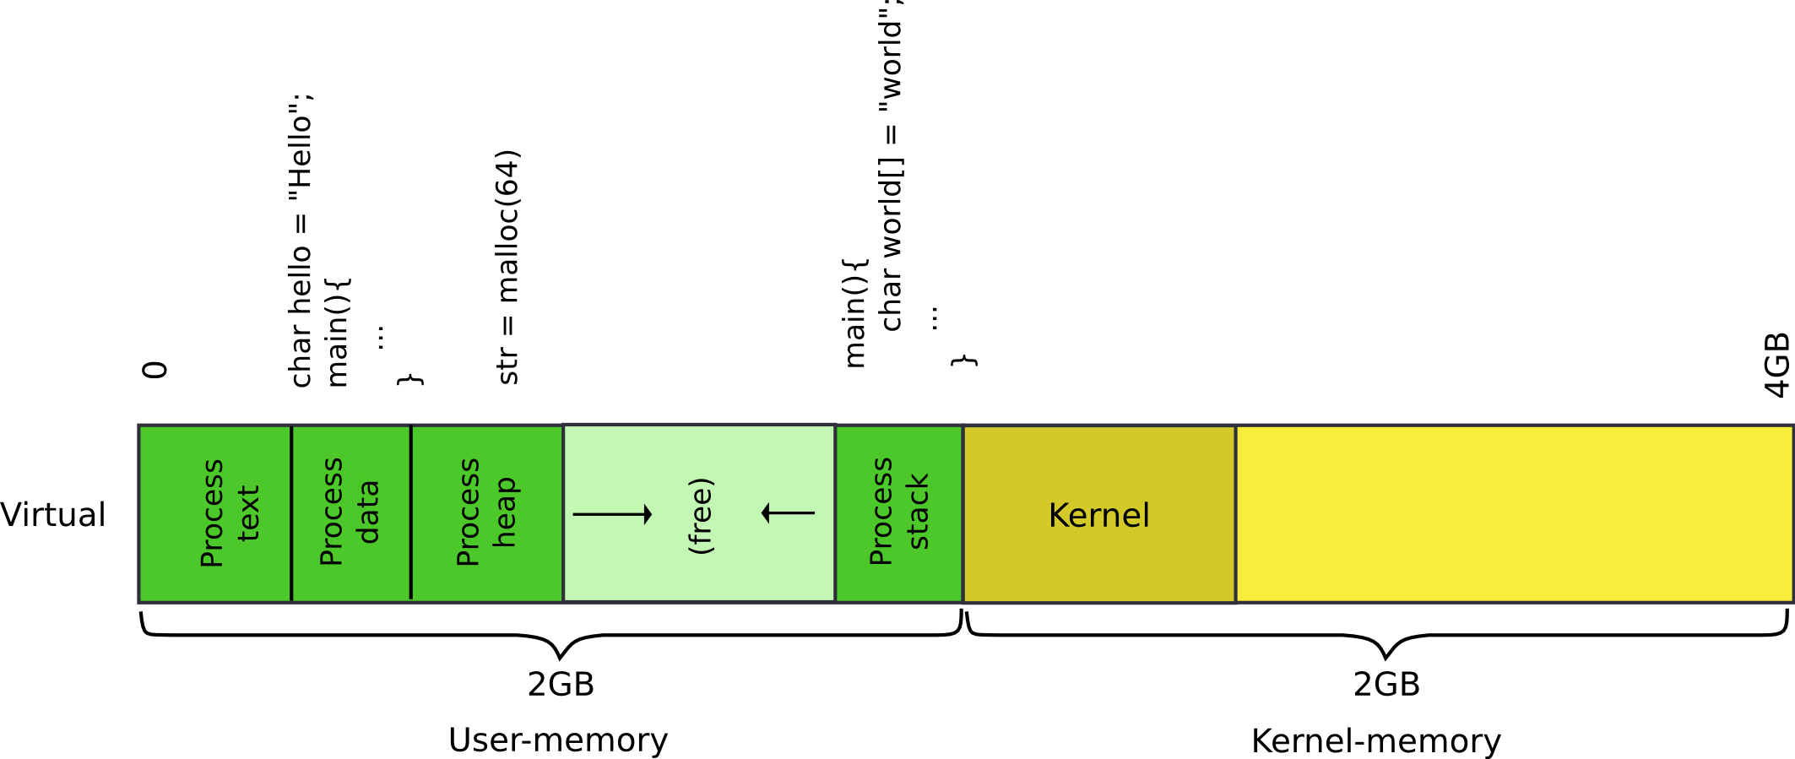
Our goal: 2GB/2GB address space

Slide 11
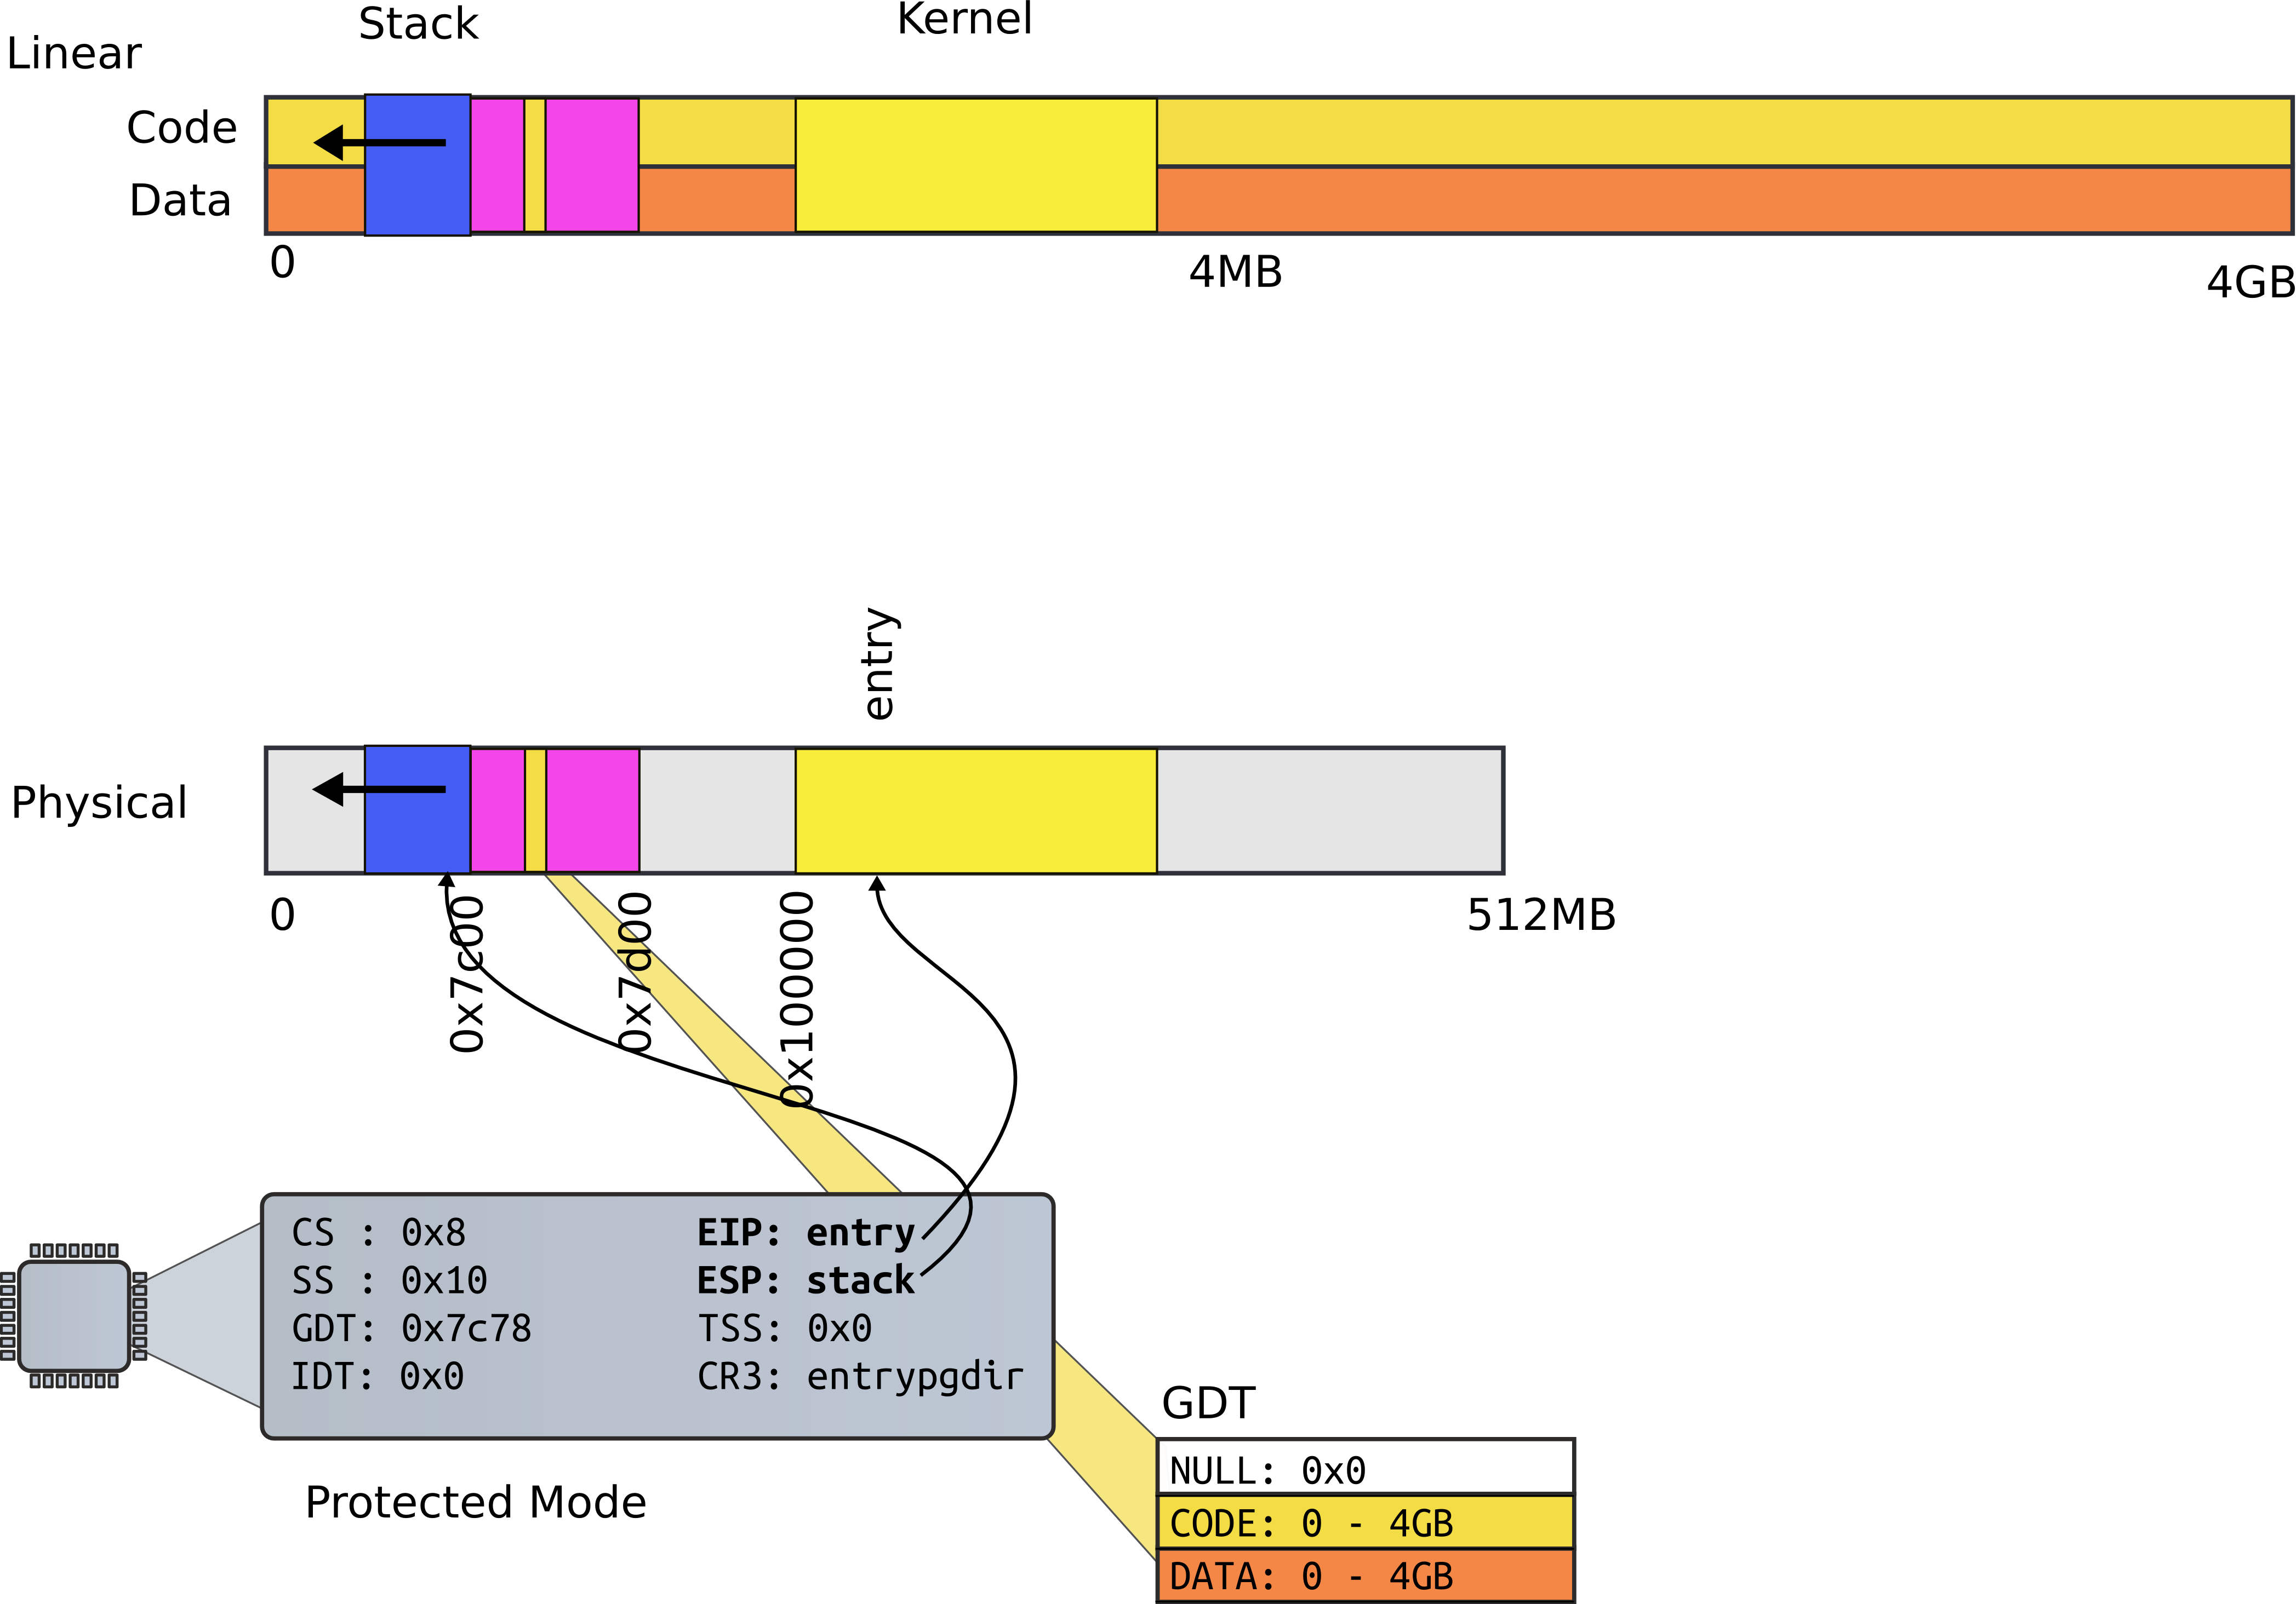

Slide 12
First page table
Two 4MB entries (large pages)
Entry #0
  0x0 – 4MB → 0x0:0x400000
Entry #960
  0x0 – 4MB → 0x8000000:0x80400000

Slide 13
First page table
1406 // The boot page table used in entry.S and entryother.S.
1407 // Page directories (and page tables) must start on page boundaries,
1408 // hence the __aligned__ attribute.
1409 // PTE_PS in a page directory entry enables 4Mbyte pages.
1410
1411 __attribute__((__aligned__(PGSIZE)))
1412 pde_t entrypgdir[NPDENTRIES] = {
1413 // Map VA’s [0, 4MB) to PA’s [0, 4MB)
1414 [0] = (0) | PTE_P | PTE_W | PTE_PS,
1415 // Map VA’s [KERNBASE, KERNBASE+4MB) to PA’s [0, 4MB)
1416 [KERNBASE>>PDXSHIFT] = (0) | PTE_P | PTE_W | PTE_PS,
1417 };

Slide 14
First page table
1406 // The boot page table used in entry.S and entryother.S.
1407 // Page directories (and page tables) must start on page boundaries,
1408 // hence the __aligned__ attribute.
1409 // PTE_PS in a page directory entry enables 4Mbyte pages.
1410
1411 __attribute__((__aligned__(PGSIZE)))
1412 pde_t entrypgdir[NPDENTRIES] = {
1413 // Map VA’s [0, 4MB) to PA’s [0, 4MB)
1414 [0] = (0) | PTE_P | PTE_W | PTE_PS,
1415 // Map VA’s [KERNBASE, KERNBASE+4MB) to PA’s [0, 4MB)
1416 [KERNBASE>>PDXSHIFT] = (0) | PTE_P | PTE_W | PTE_PS,
1417 };

Slide 15
First page table
1406 // The boot page table used in entry.S and entryother.S.
1407 // Page directories (and page tables) must start on page boundaries,
1408 // hence the __aligned__ attribute.
1409 // PTE_PS in a page directory entry enables 4Mbyte pages.
1410
1411 __attribute__((__aligned__(PGSIZE)))
1412 pde_t entrypgdir[NPDENTRIES] = {
1413 // Map VA’s [0, 4MB) to PA’s [0, 4MB)
1414 [0] = (0) | PTE_P | PTE_W | PTE_PS,
1415 // Map VA’s [KERNBASE, KERNBASE+4MB) to PA’s [0, 4MB)
1416 [KERNBASE>>PDXSHIFT] = (0) | PTE_P | PTE_W | PTE_PS,
1417 };

Slide 16
First page table
1406 // The boot page table used in entry.S and entryother.S.
1407 // Page directories (and page tables) must start on page boundaries,
1408 // hence the __aligned__ attribute.
1409 // PTE_PS in a page directory entry enables 4Mbyte pages.
1410
1411 __attribute__((__aligned__(PGSIZE)))
1412 pde_t entrypgdir[NPDENTRIES] = {
1413 // Map VA’s [0, 4MB) to PA’s [0, 4MB)
1414 [0] = (0) | PTE_P | PTE_W | PTE_PS,
1415 // Map VA’s [KERNBASE, KERNBASE+4MB) to PA’s [0, 4MB)
1416 [KERNBASE>>PDXSHIFT] = (0) | PTE_P | PTE_W | PTE_PS,
1417 };

Slide 17
First page table
1406 // The boot page table used in entry.S and entryother.S.
1407 // Page directories (and page tables) must start on page boundaries,
1408 // hence the __aligned__ attribute.
1409 // PTE_PS in a page directory entry enables 4Mbyte pages.
1410
1411 __attribute__((__aligned__(PGSIZE)))
1412 pde_t entrypgdir[NPDENTRIES] = {
1413 // Map VA’s [0, 4MB) to PA’s [0, 4MB)
1414 [0] = (0) | PTE_P | PTE_W | PTE_PS,
1415 // Map VA’s [KERNBASE, KERNBASE+4MB) to PA’s [0, 4MB)
1416 [KERNBASE>>PDXSHIFT] = (0) | PTE_P | PTE_W | PTE_PS,
1417 };

Slide 18
First page table (cont)
0870 // Page directory and page table constants.
0871 #define NPDENTRIES 1024

Slide 19
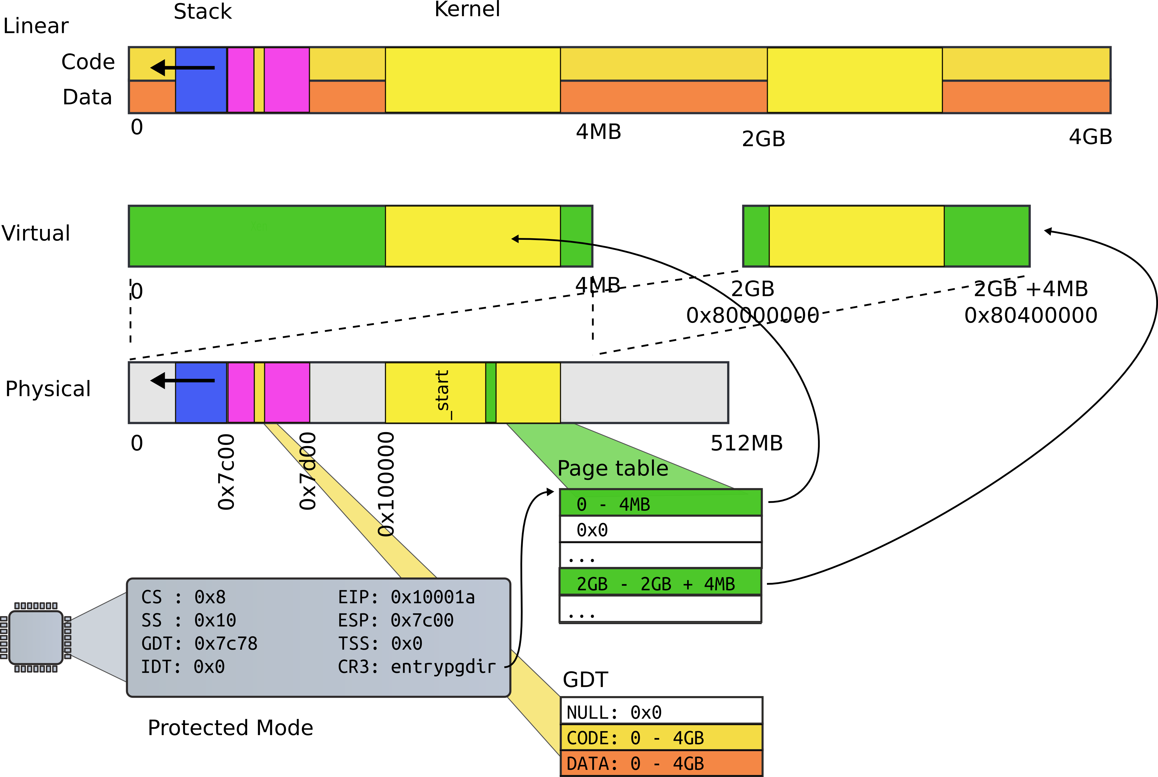
First page table

Slide 20
Turn on paging
1152 # Turn on paging.
1153 movl %cr0, %eax
1154 orl $(CR0_PG|CR0_WP), %eax
1155 movl %eax, %cr0

Slide 21
High address stack (4K)
1157 # Set up the stack pointer.
1158 movl $(stack + KSTACKSIZE), %esp
1159
...
1167 .comm stack, KSTACKSIZE
0151 #define KSTACKSIZE 4096 // size of
per−process kernel stack

Slide 22
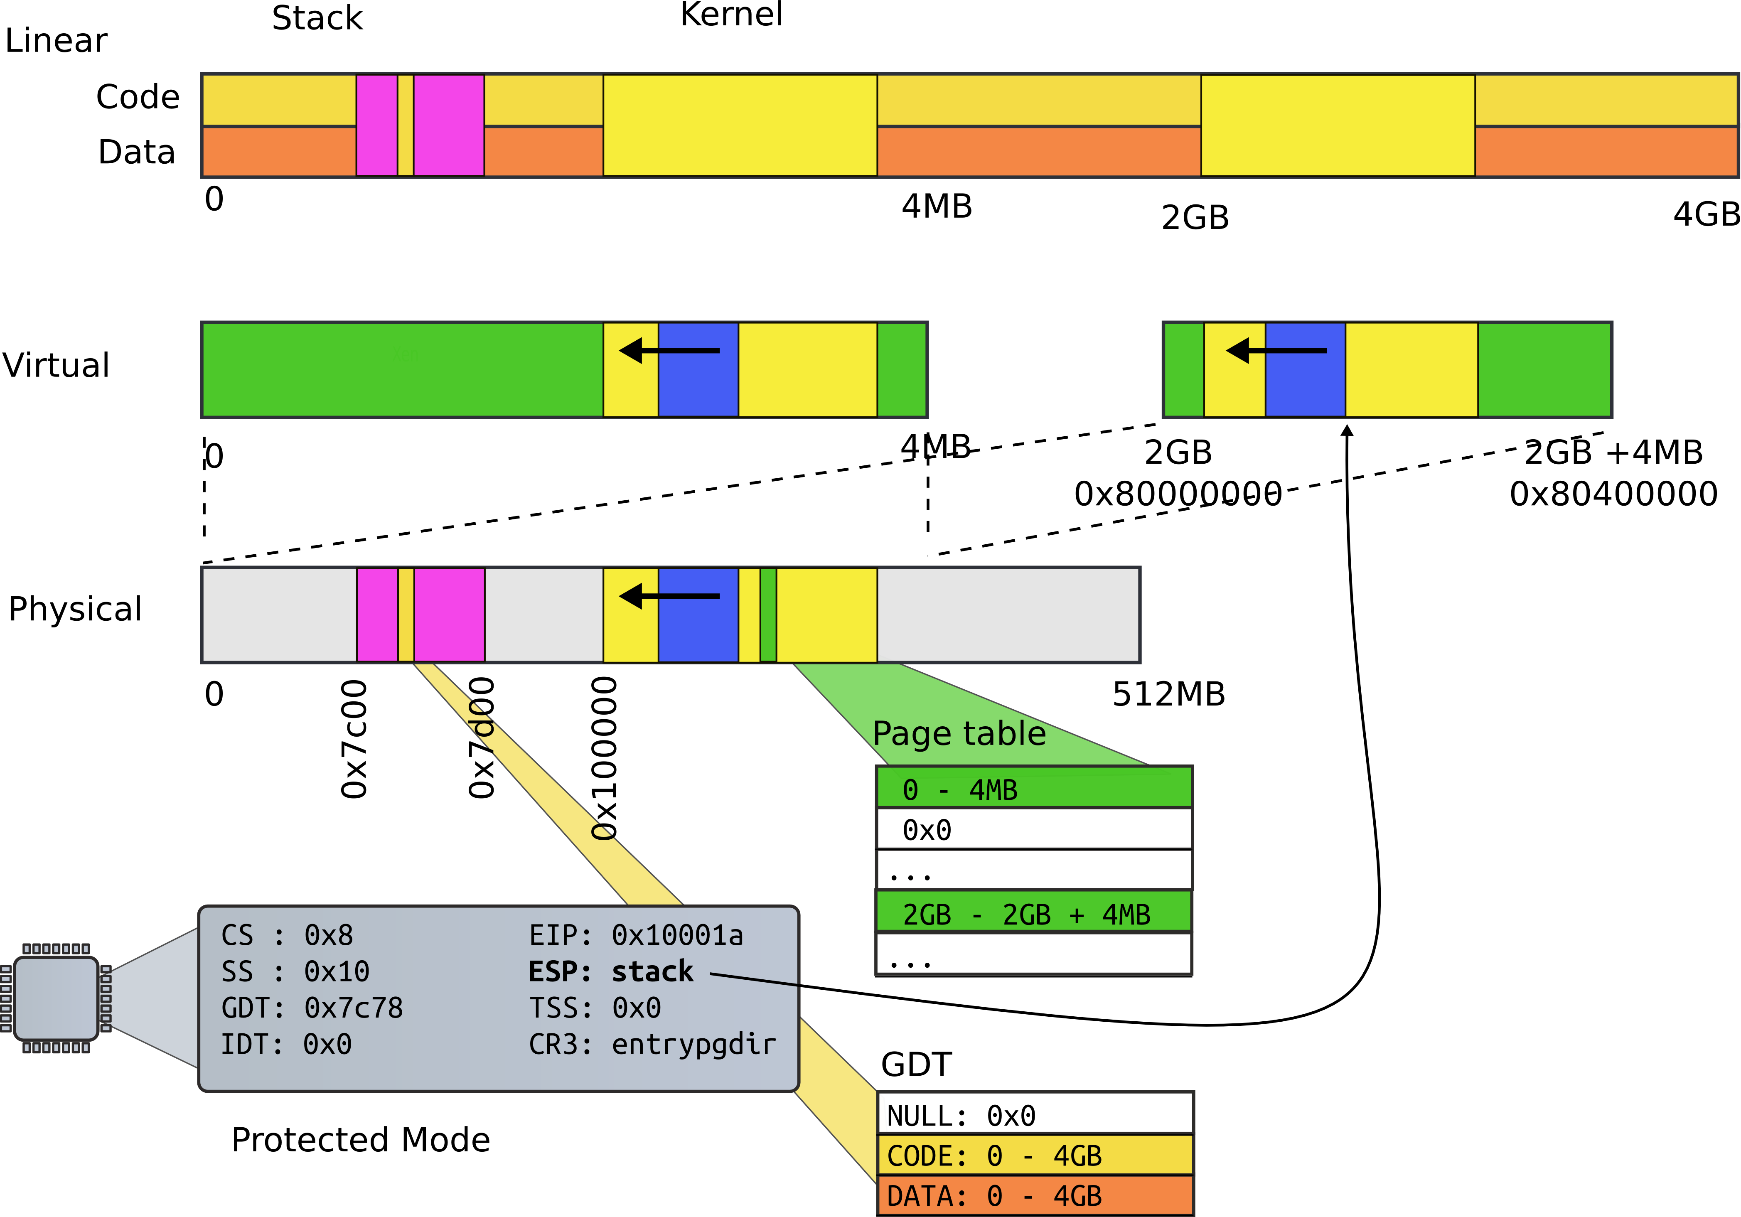
High address stack (4K)

Slide 23
Jump to main()
1160 # Jump to main(), and switch to executing at
1161 # high addresses. The indirect call is
needed because
1162 # the assembler produces a PC−relative
instruction
1163 # for a direct jump.
1164 mov $main, %eax
1165 jmp *%eax
1166

Slide 24
Running in main()
1313 // Bootstrap processor starts running C code here.
1314 // Allocate a real stack and switch to it, first
1315 // doing some setup required for memory allocator to work.
1316 int
1317 main(void)
1318 {
1319 kinit1(end, P2V(4*1024*1024)); // phys page allocator
1320 kvmalloc(); // kernel page table
1321 mpinit(); // detect other processors
1322 lapicinit(); // interrupt controller
1323 seginit(); // segment descriptors
1324 cprintf("\ncpu%d: starting xv6\n\n", cpunum());
...
1340 }

Slide 25
Recap of the boot sequence
Setup segments (data and code)
Switched to protected mode
  Loaded GDT (segmentation is on)
Setup stack (to call C functions)
Loaded kernel from disk
Setup first page table
  2 entries [ 0 : 4MB ] and [ 2GB : (2GB + 4MB) ]
Setup high-address stack
Jumped to main()

Slide 26
Conclusion
We've booted
  We're running in main()
Next time:
  2-level page tables
  Process and kernel address space

Slide 27
Thank you!

Slide 28
Thank you!

