Slide 1
Lecture 01: Introduction
Anton Burtsev

Slide 2
Lets take a brief look at how computers work

Slide 3

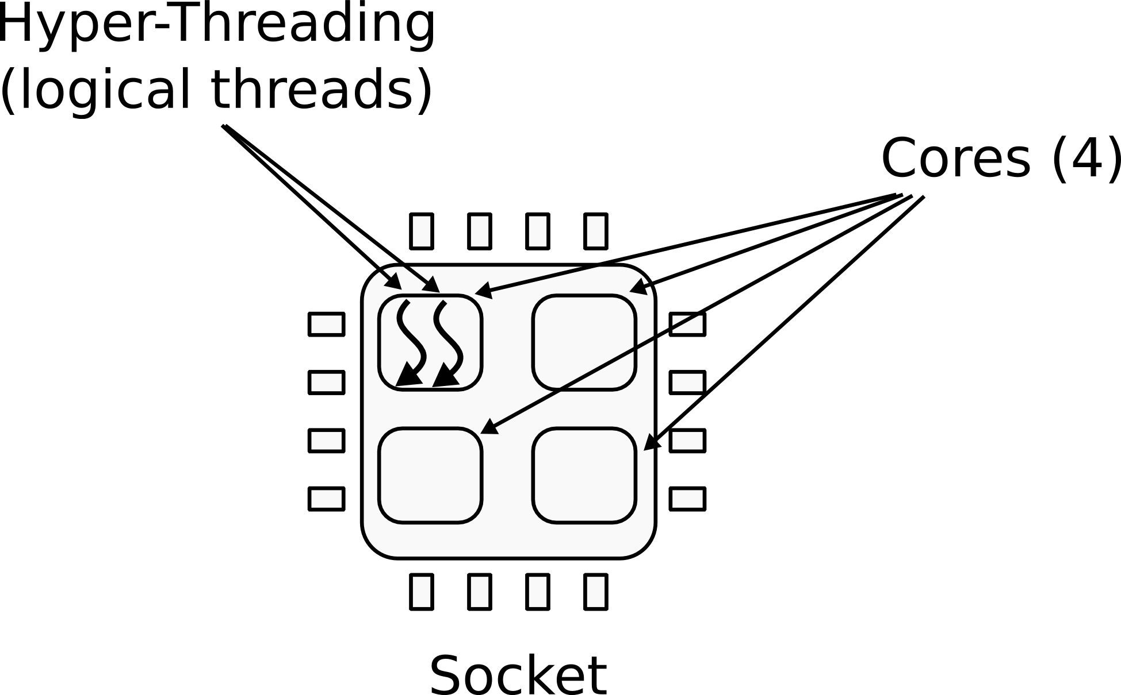
CPU
1 CPU
  4 cores
  2 logical (HT) threads each

Slide 4
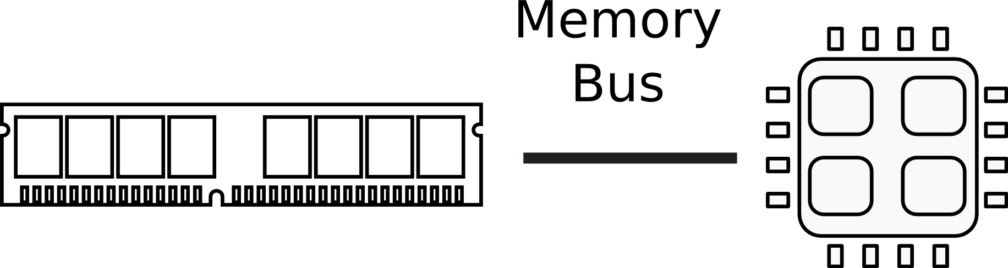

Memory

Slide 5

Memory abstraction

Slide 6
What does CPU do internally?

Slide 7

CPU execution loop
CPU repeatedly reads instructions from memory
Executes them
Example
ADD EAX, EBX
// EAX = EAX + EBX

Slide 8
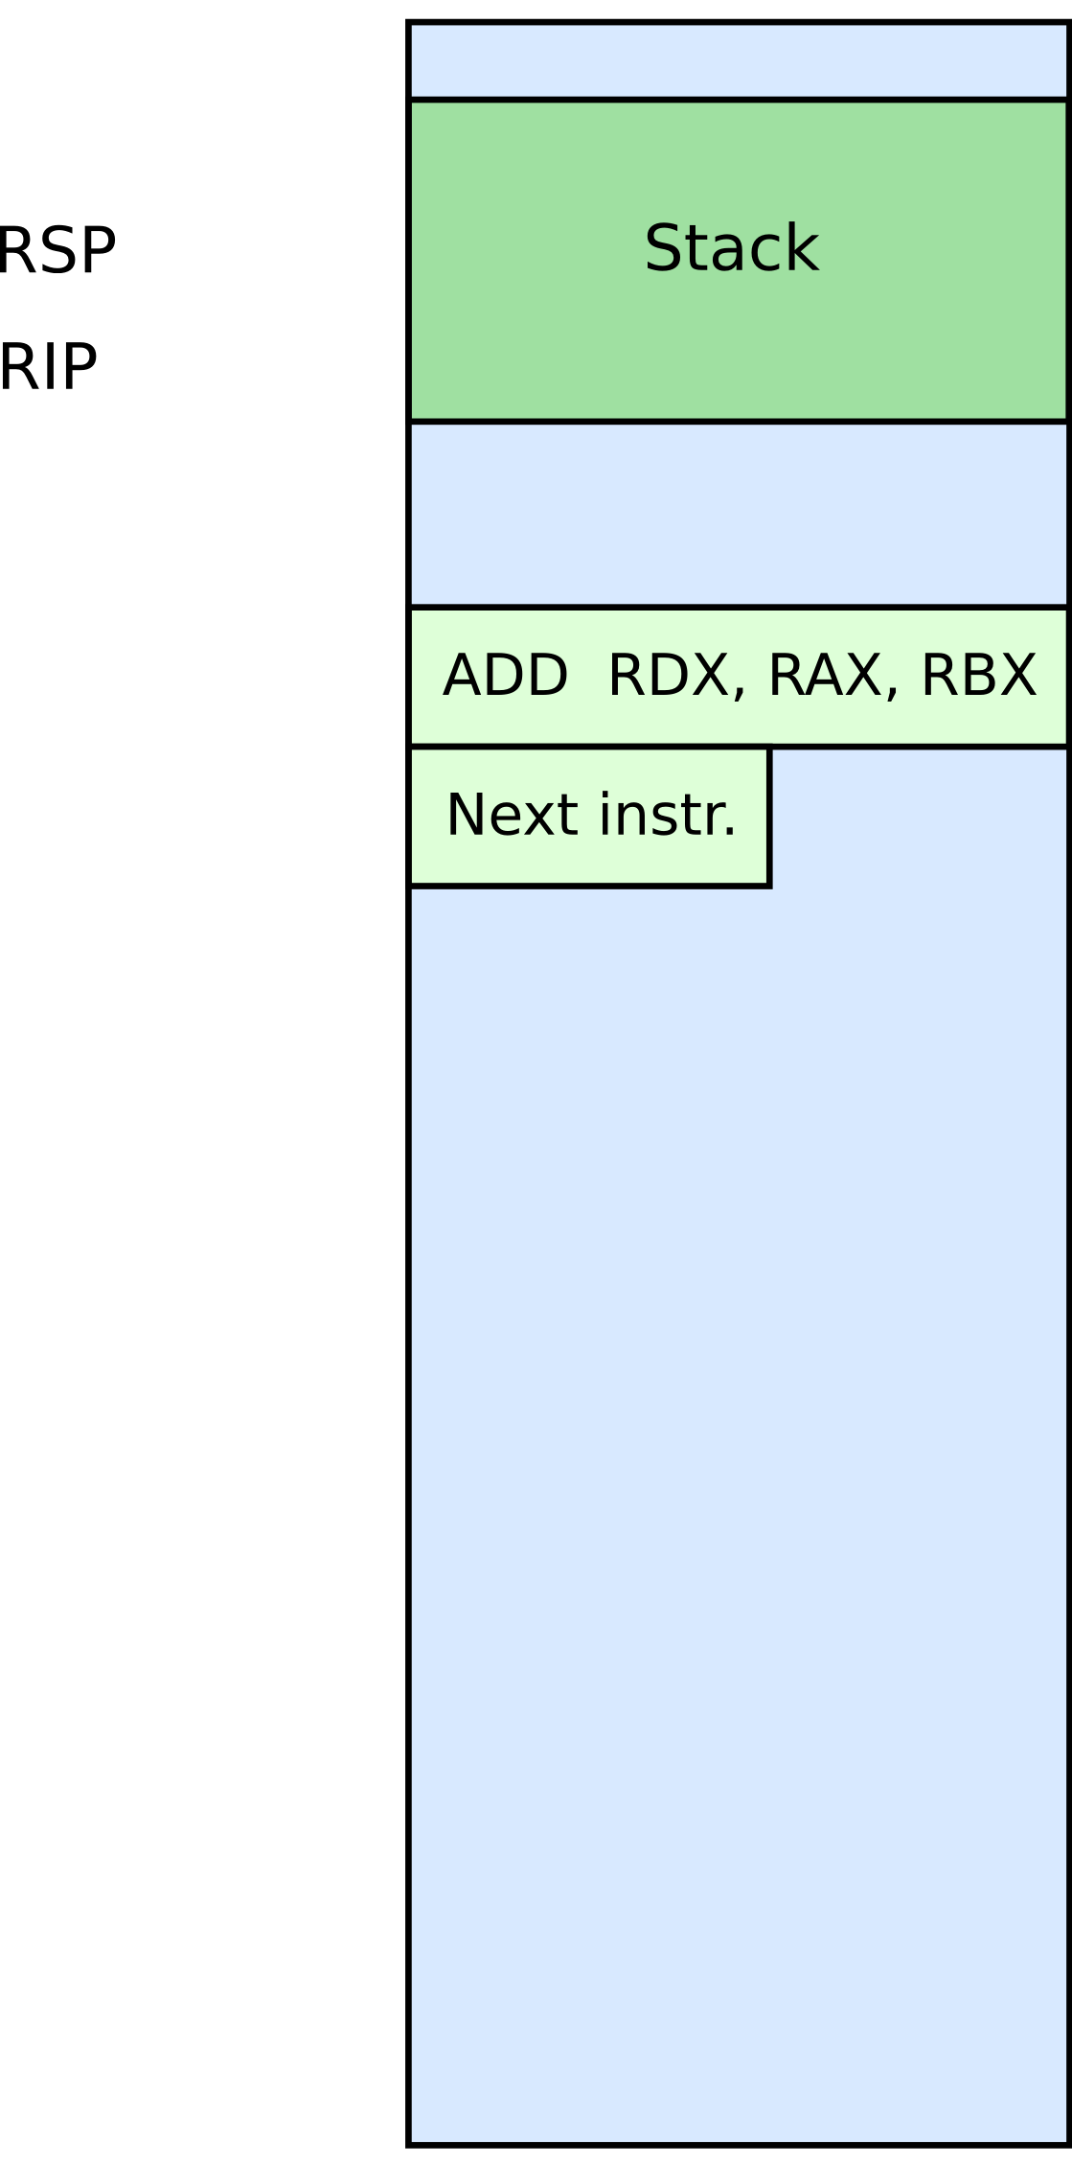




Slide 9
Simple observation
Hardware executes instructions one by one

Slide 10
What is an operating system?

Slide 11
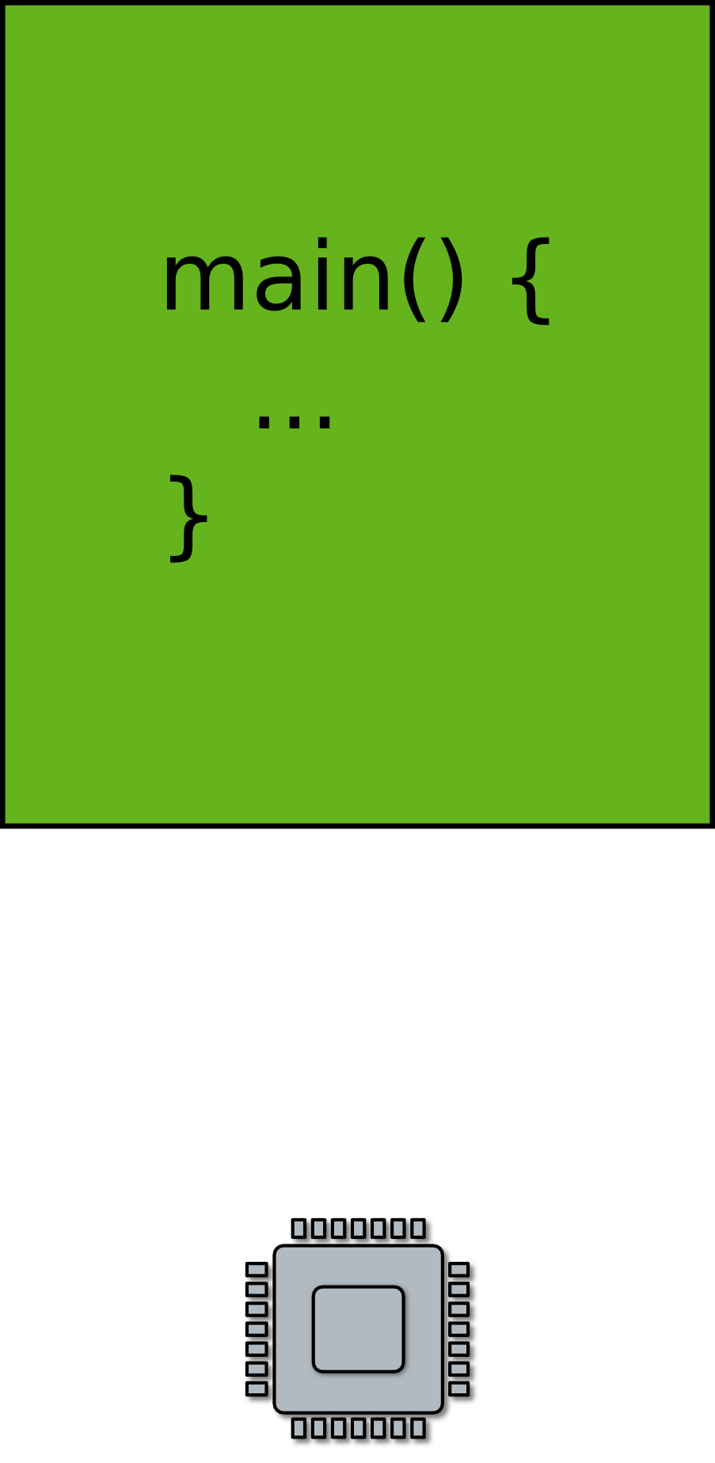
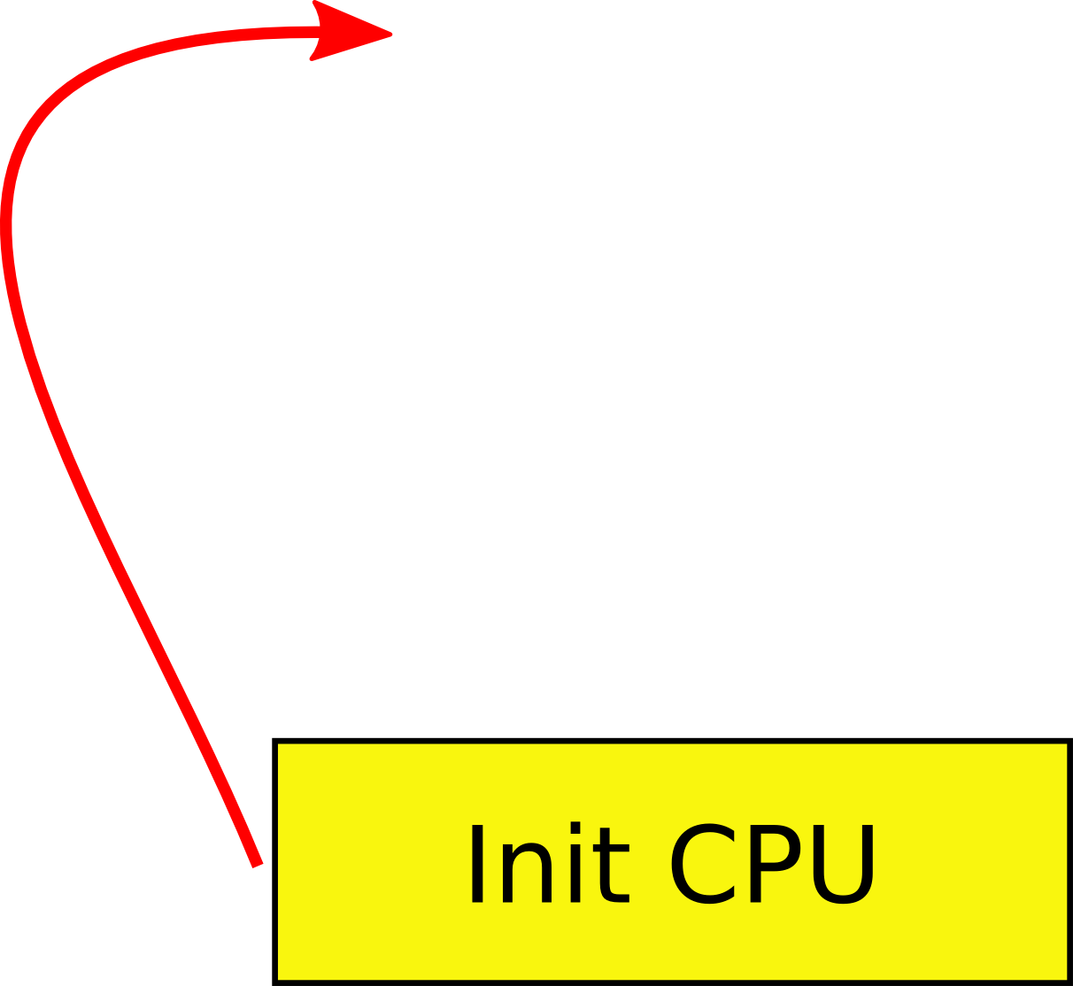
Task #1: Run your code on a piece of hardware
Read CPU manual
A tiny boot layer
  Initialize CPU
  Jump to the entry point of your program
    main()
  This can be the beginning of your OS!

Slide 12
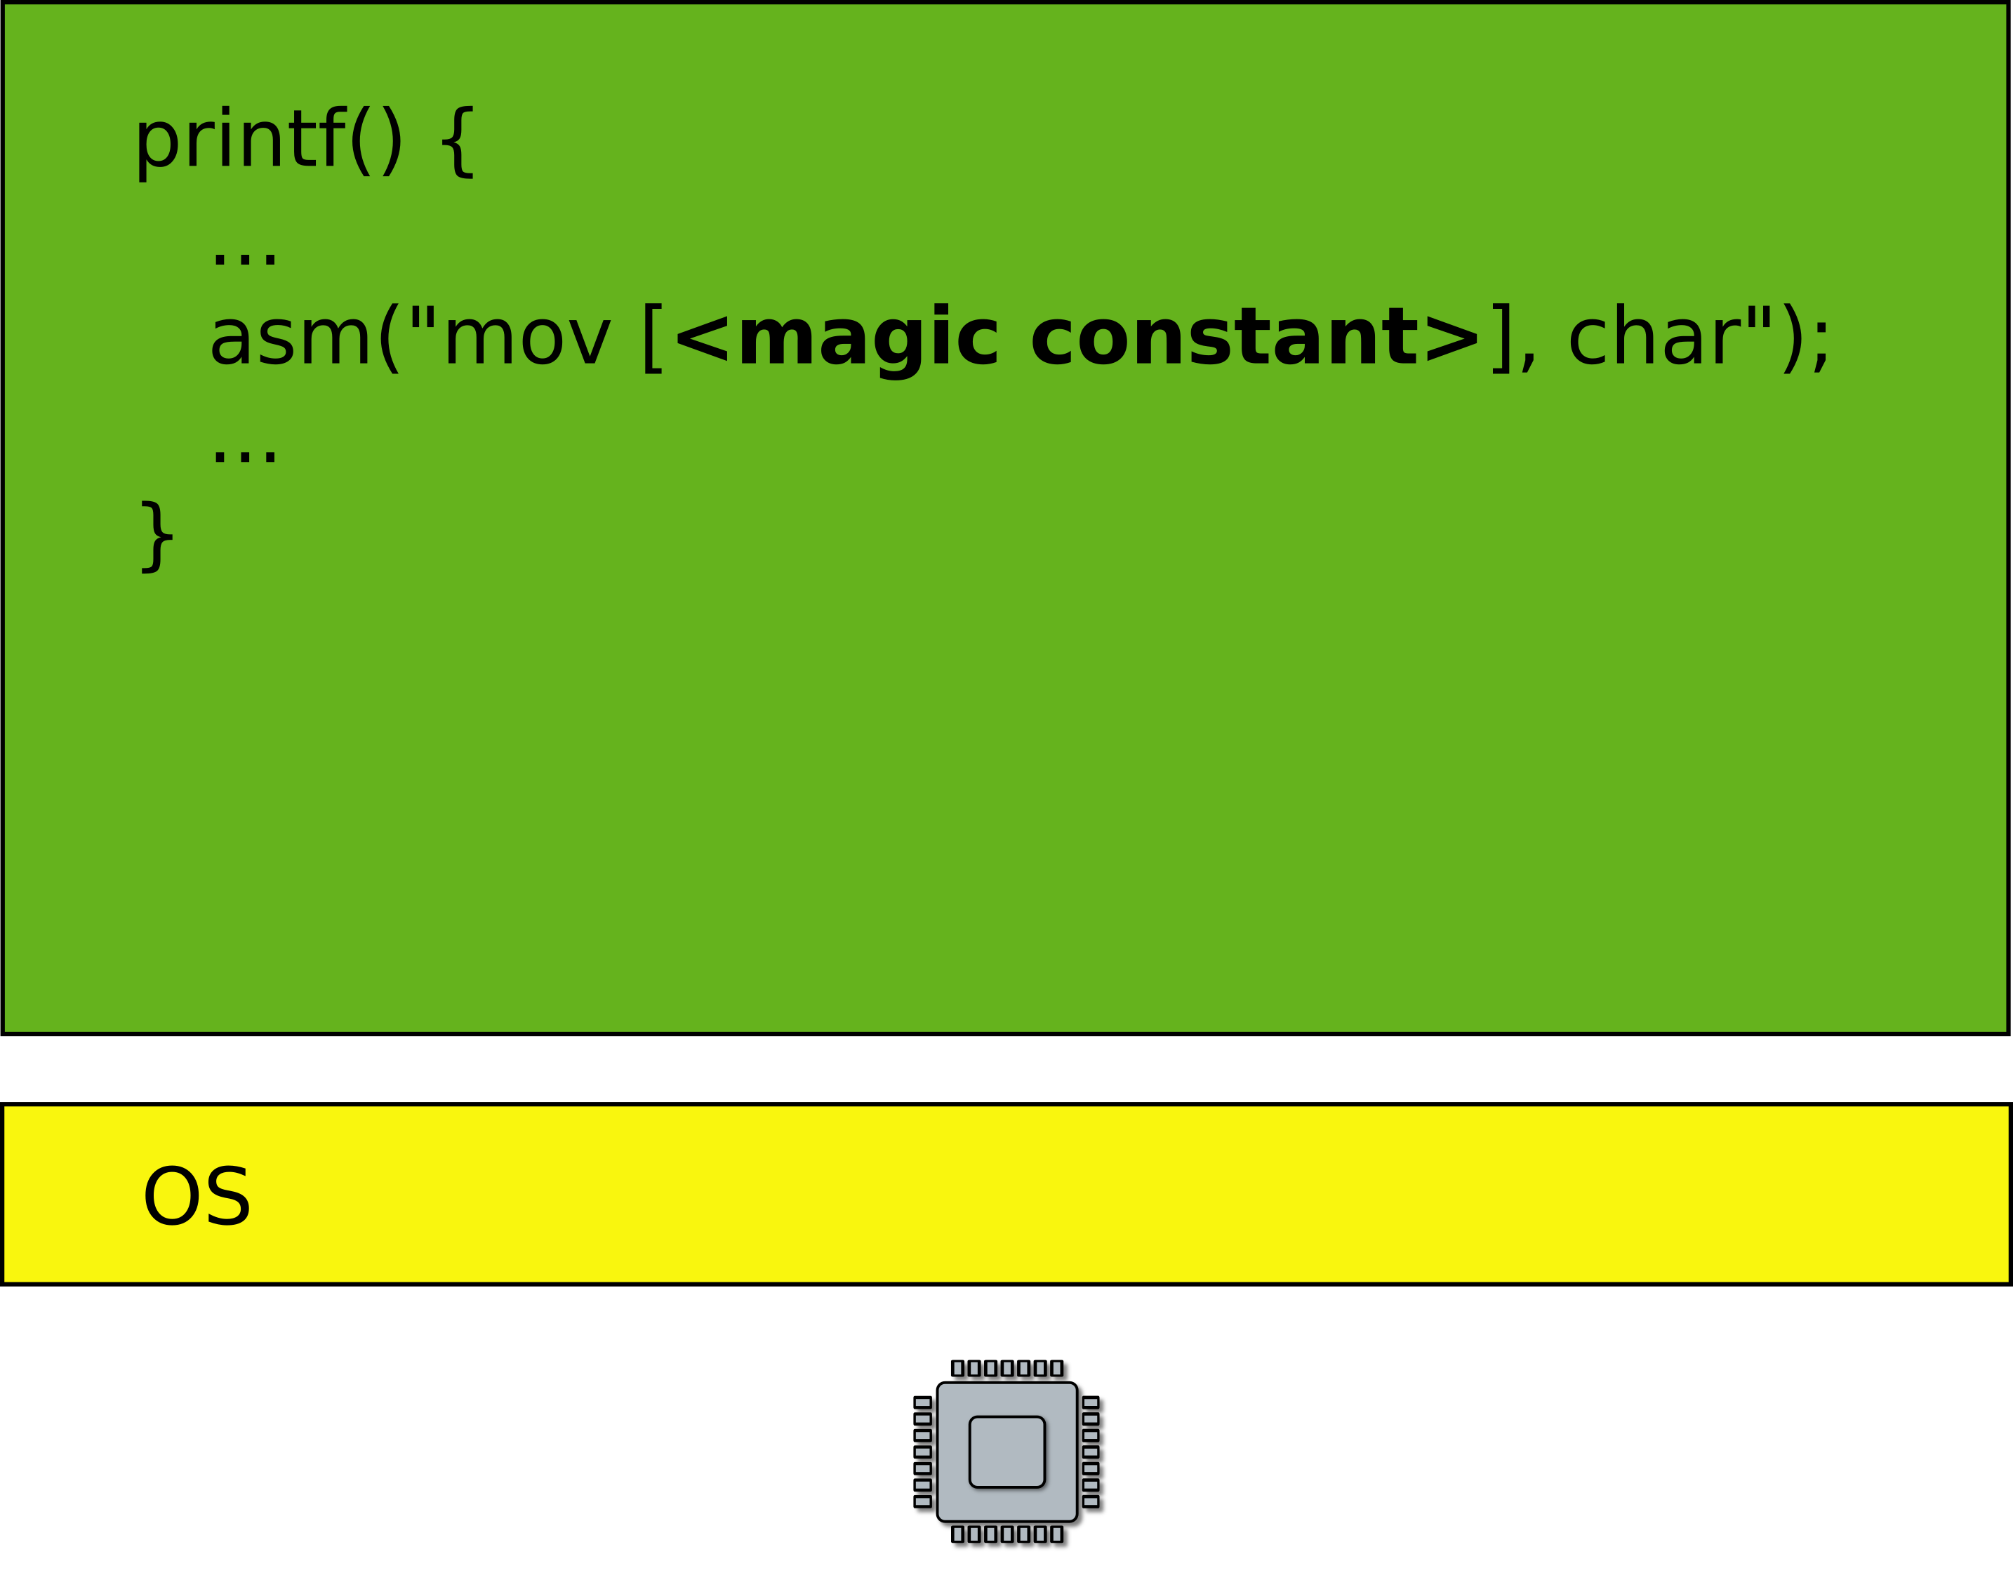
Task #2: Print something on the screen
  On the screen or serial line

Slide 13

I/O Devices

Slide 14
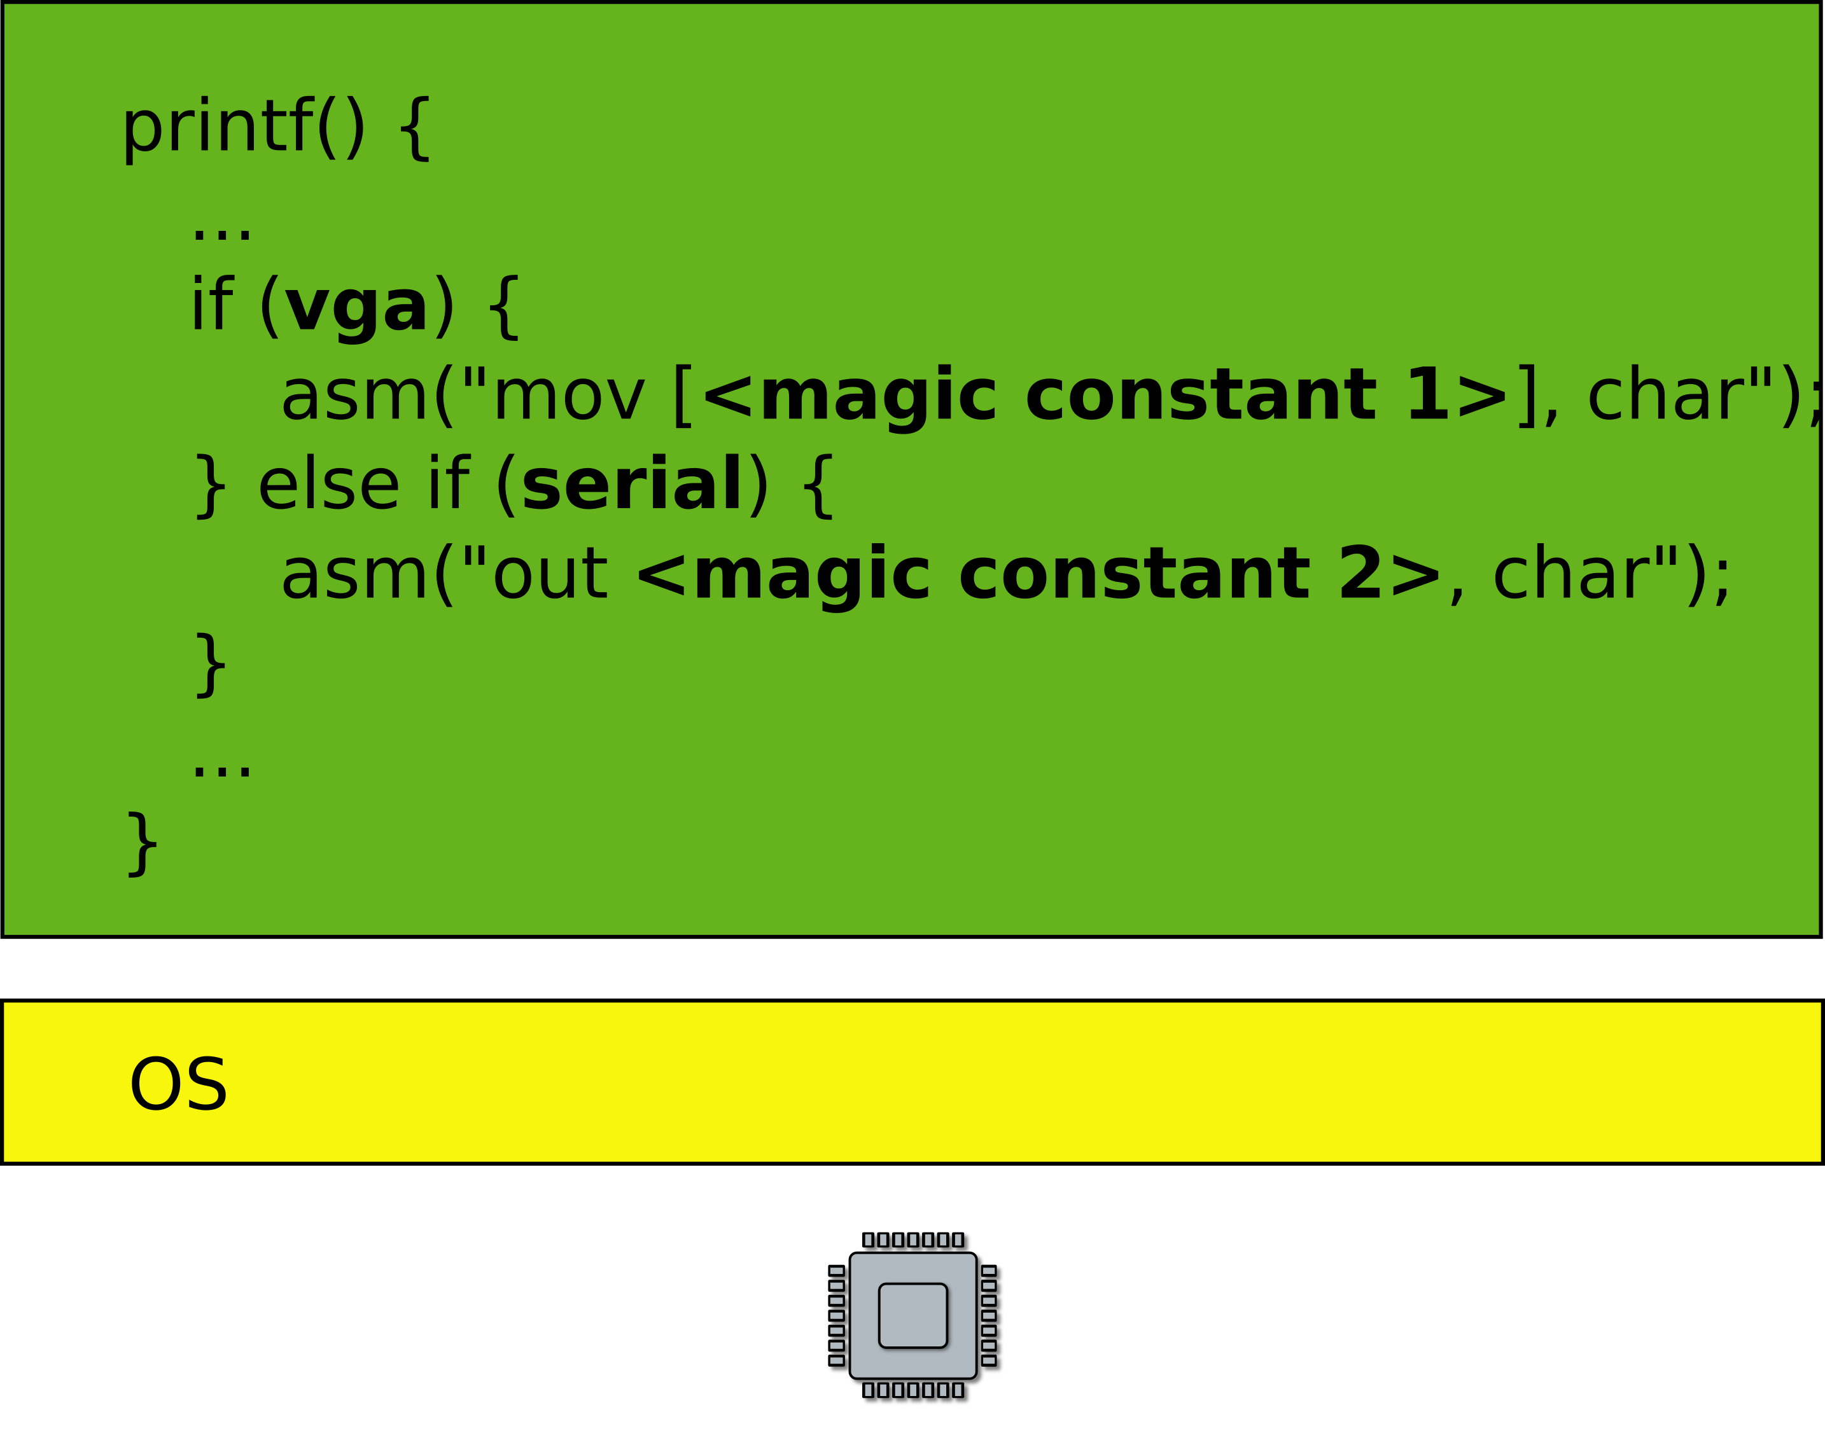
Task #2: Print something on the screen
  On the screen or serial line

Slide 15
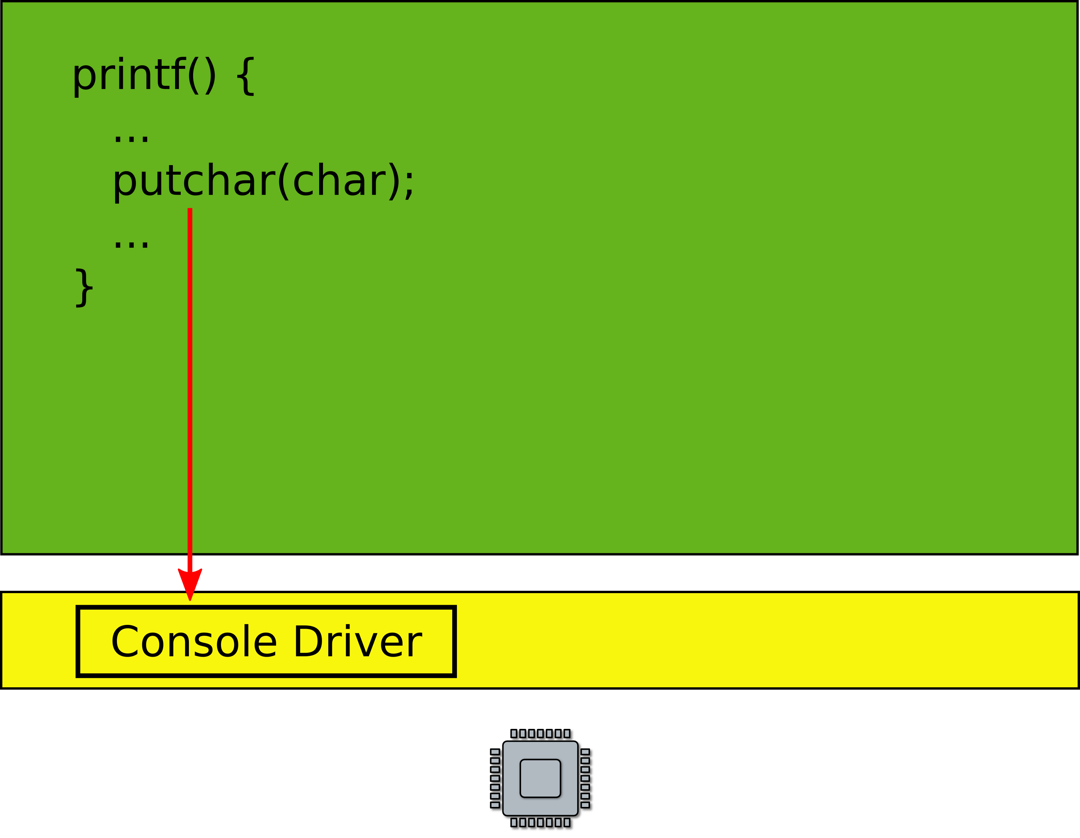
A more general interface
  First device driver

Slide 16
Device drivers
Abstract hardware
  Provide high-level interface
  Hide minor differences
  Implement some optimizations
    Batch requests
Examples
  Console, disk, network interface
  ...virtually any piece of hardware you know

Slide 17
OS is like a library that provides a collection of useful functions

Slide 18
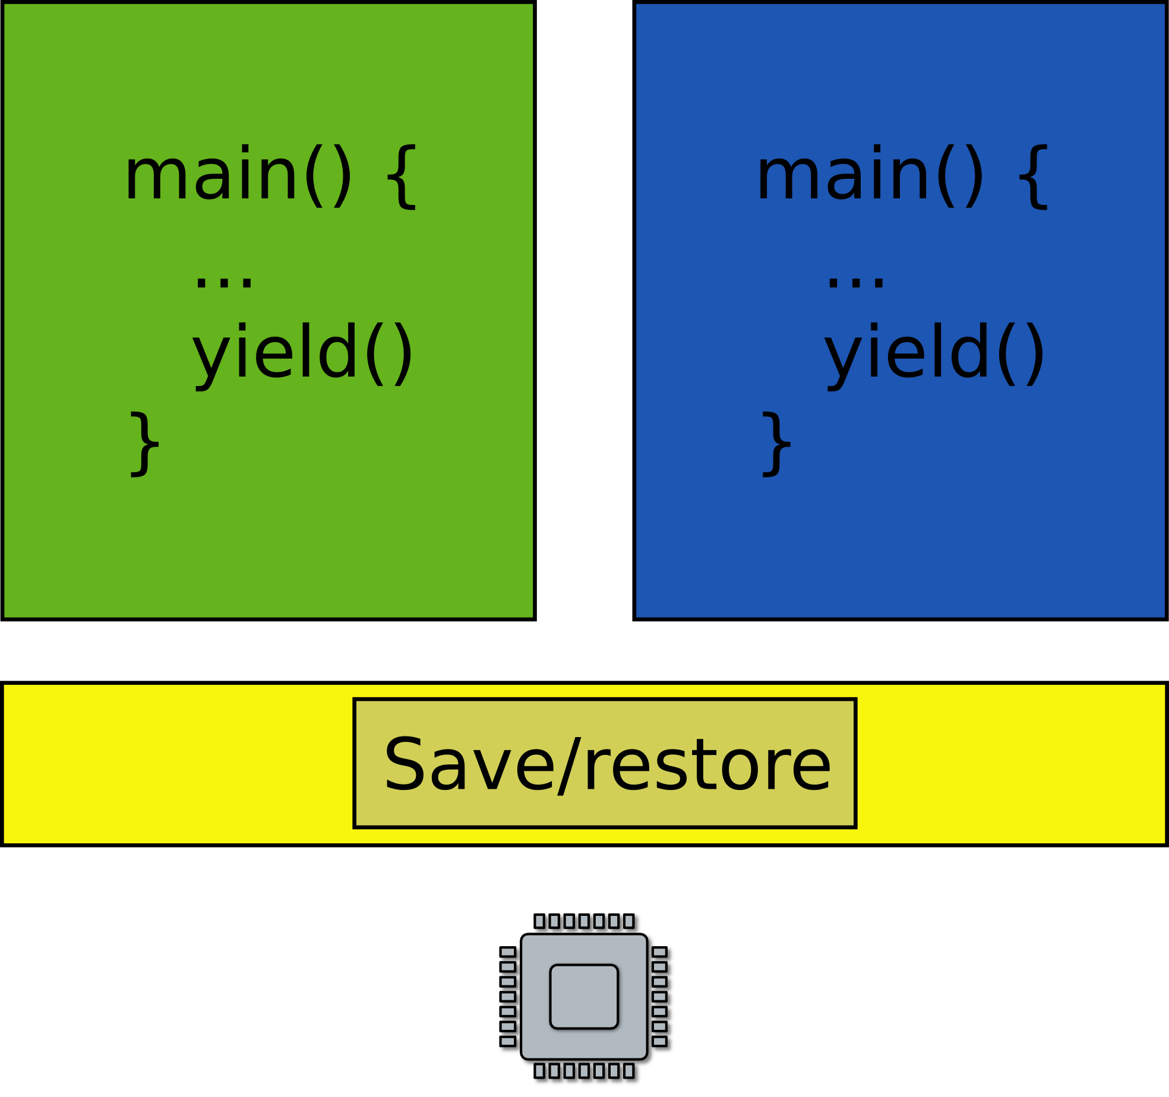
Task #3: Want to run two programs
What does it mean?
  Only one CPU
Run one, then run another one

Slide 19
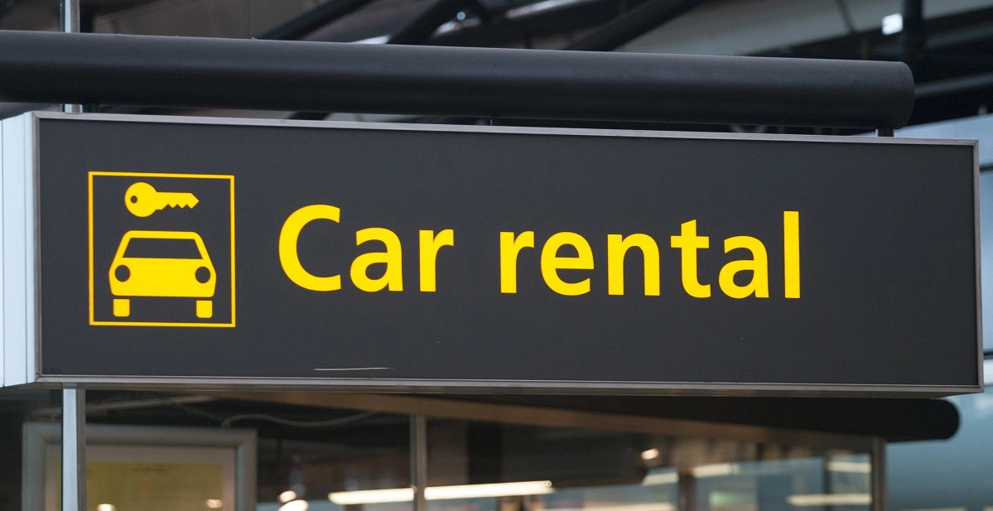
Very much like car sharing

Slide 20
Time sharing
Programs use CPU in turns
  One program runs
  Then OS takes control
  Launches another program
  Then another program runs
  OS takes control again
  ...

Slide 21

Task #3: Want to run two programs
Exit into the kernel periodically
Context switch
  Save state of one program
  Restore state of another program

Slide 22
What is this state?

Slide 23
State of the program
Roughly it’s
  Registers
  Memory
  Plus some state (data structures) in the kernel associated with the program
    Information about files opened by the program, i.e. file descriptors
    Information about network flows
    Information about address space, loaded libraries, communication channels to other programs, etc.

Slide 24
Saving and restoring state
Note that you do not really have to save/restore in-kernel state on the context switch
  It’s in the kernel already, i.e., in some part of the memory where kernel keeps its data structures
  You only have to switch from using one to using another
    i.e., instead of using the file descriptor table (can be as simple as array) for program X start using at file descriptor table for program Y

Slide 25
What about memory?

Slide 26
Two programs, one memory?

Slide 27
Time-share memory
Well you can copy in and out the state of the program into a region of memory where it can run
  Similar to time-sharing the CPU

Slide 28
Time-share memory
Well you can copy in and out the state of the program into a region of memory where it can run
  Similar to time-sharing the CPU
What do you think is wrong with this approach?

Slide 29
Time-share memory
Well you can copy in and out the state of the program into a region of memory where it can run
  Similar to time-sharing the CPU
What do you think is wrong with this approach?
  Unlike registers the state of the program in memory can be large
  Takes time to copy it in and out

Slide 30
Virtual address spaces
Illusion of a private memory for each application
  Keep a description of an address space
  In one of the registers
OS maintains description of address spaces
  Switches between them

Slide 31

Address spaces with page tables

Slide 32
Staying in control

Slide 33
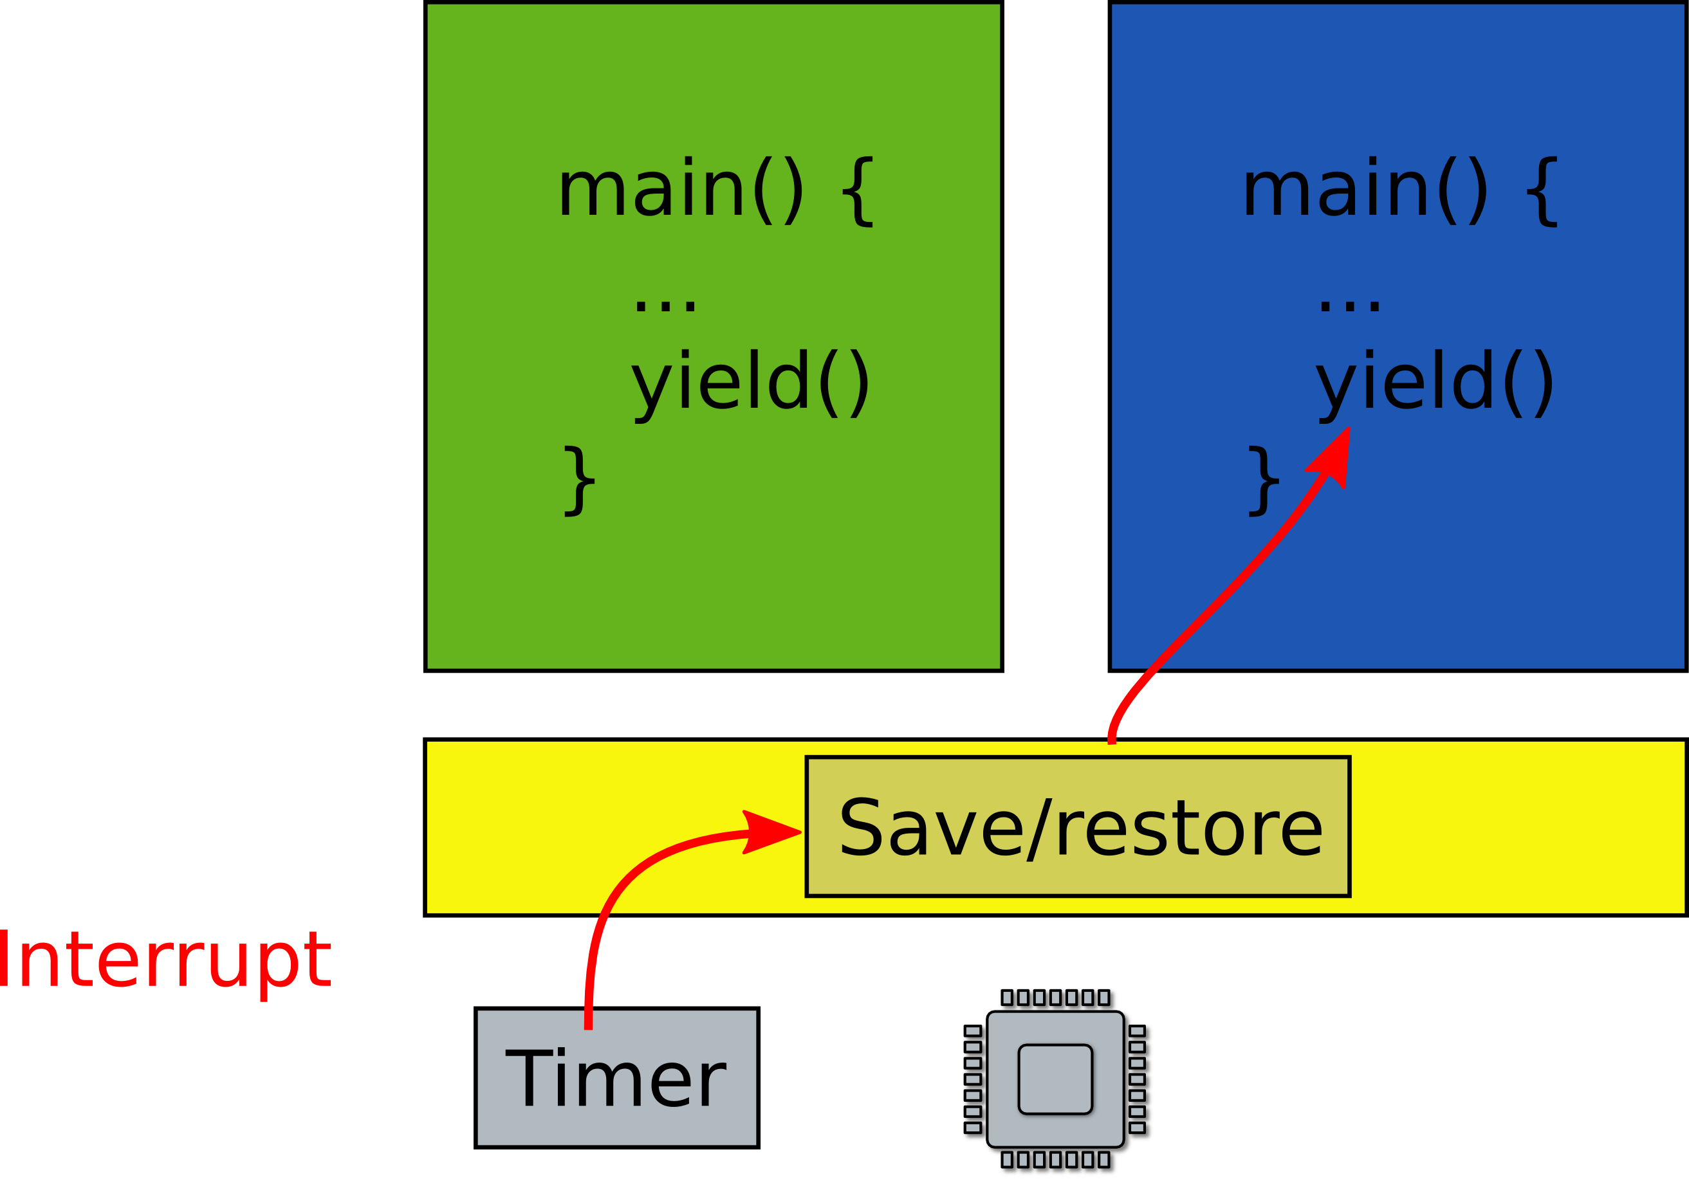
What if one program fails to release the CPU?
It will run forever. Need a way to preempt it. How?

Slide 34
Scheduling
Pick which application to run next
  And for how long
Illusion of a private CPU for each task
  Frequent context switching

Slide 35
Isolation

Slide 36
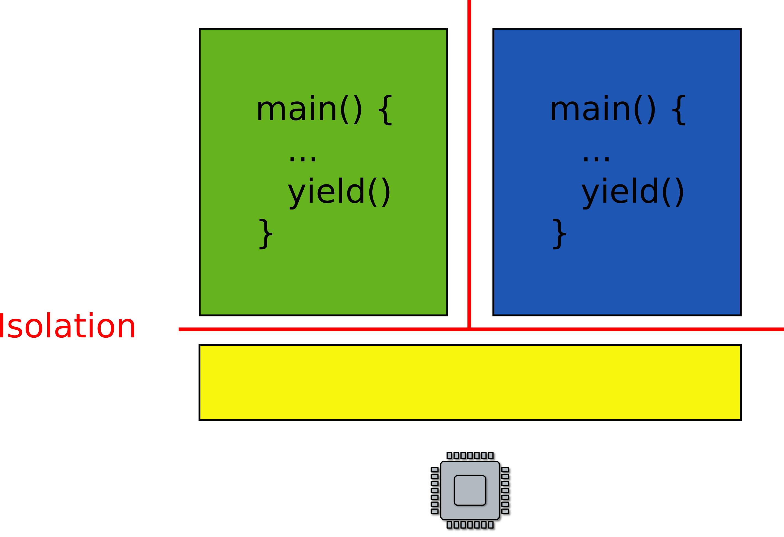
What if one faulty program corrupts the kernel?
Or other programs?

Slide 37
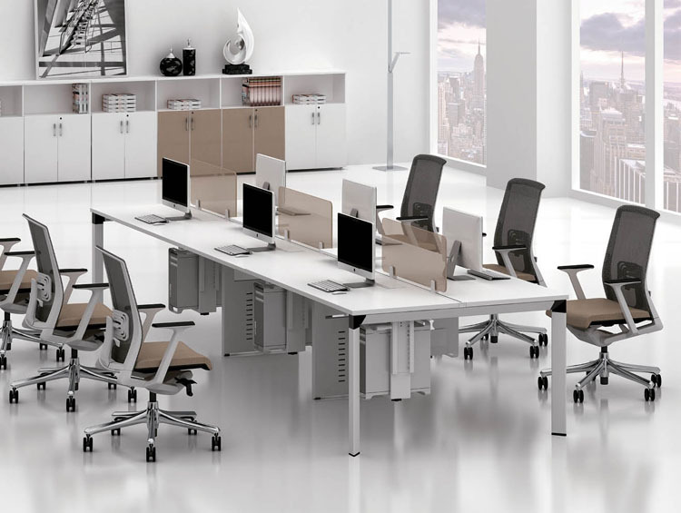
No isolation: open space office

Slide 38
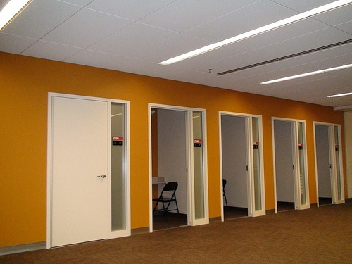
Isolated rooms

Slide 39
Each process has a private address space

Slide 40

P1 and P2 can't access each other memory

Slide 41
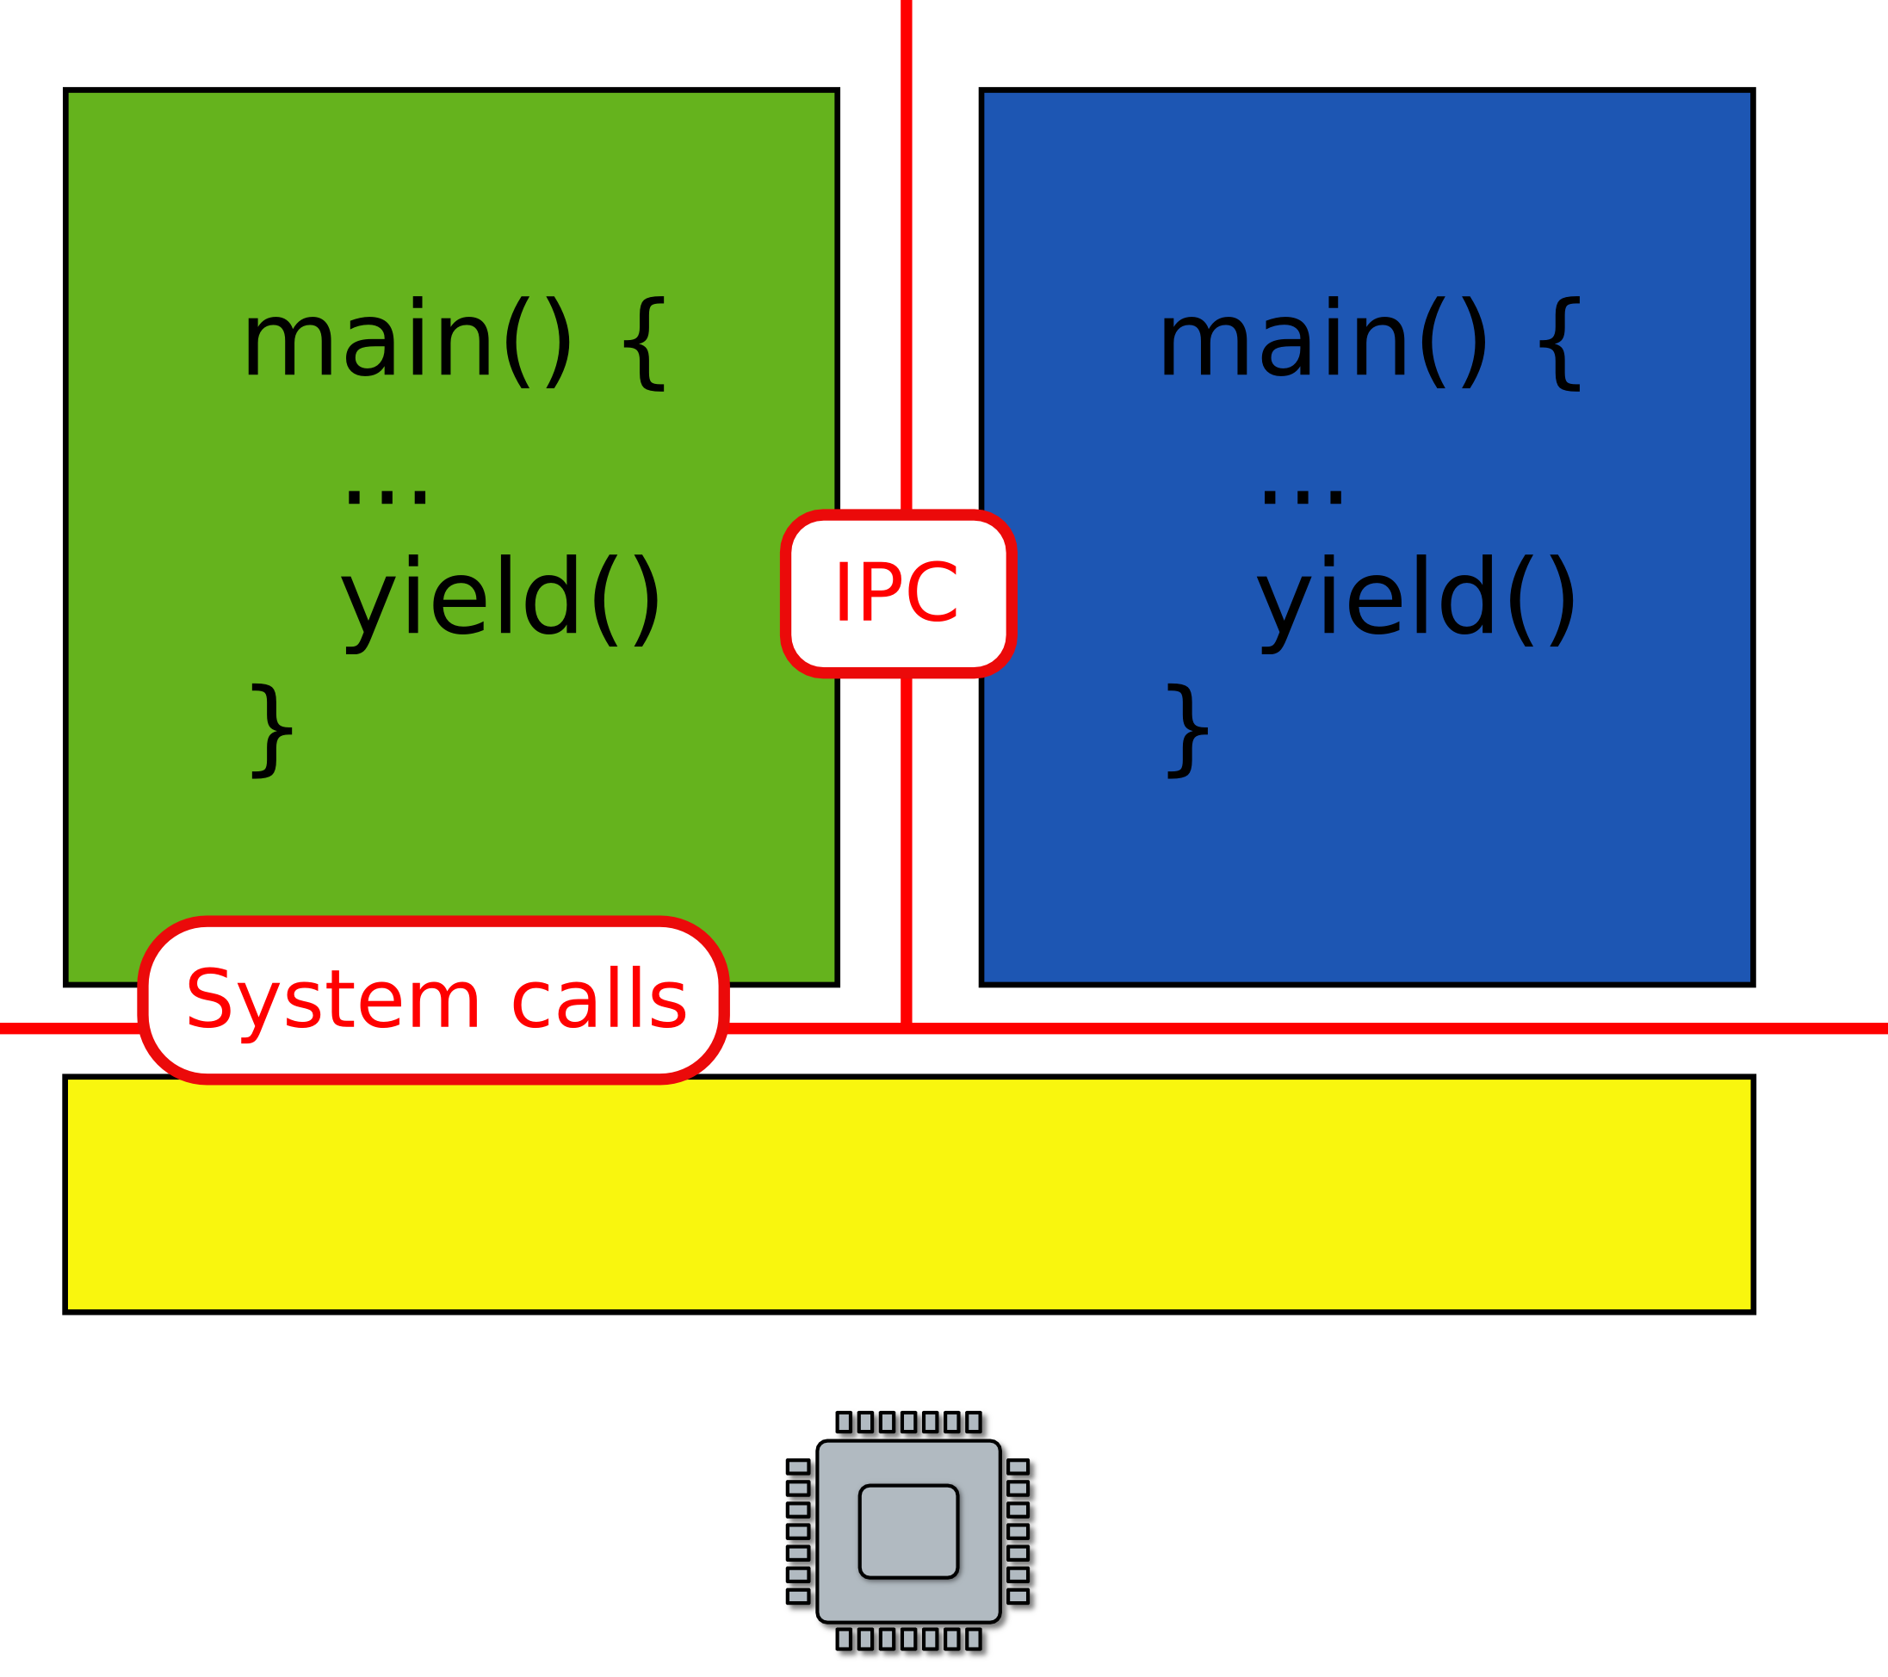
What about communication?
Can we invoke a function in a kernel?

Slide 42
Files and network

Slide 43
Want to save some data to a file?

Slide 44
Want to save some data in a file?
Permanent storage
  E.g., disks
Disks are just arrays of blocks
  write(block_number, block_data)

Slide 45
File system and block device provide similar abstractions
Permanent storage
  E.g., disks
Disks are just arrays of blocks
  write(block_number, block_data)
Files
  High level abstraction for saving data
  fd = open(“contacts.txt”);
  fpritnf(fd, “Name:%s\n”, name);

Slide 46
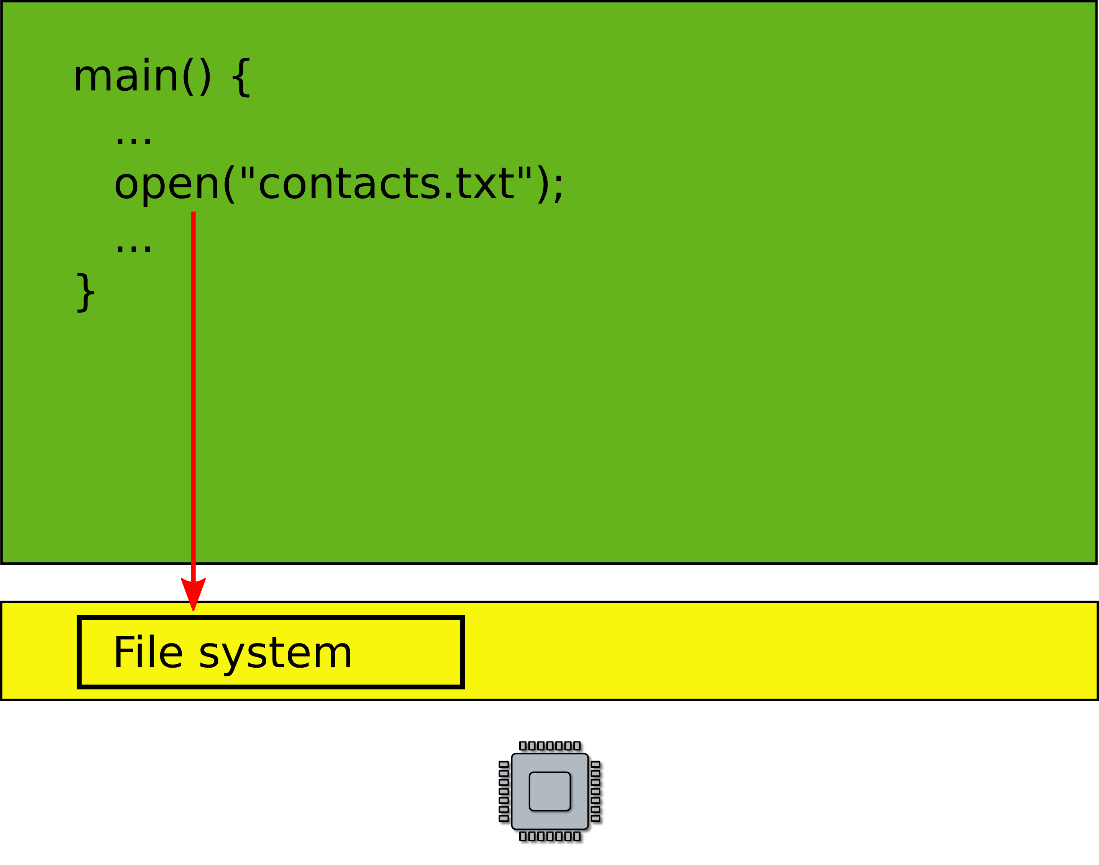
File system

Slide 47
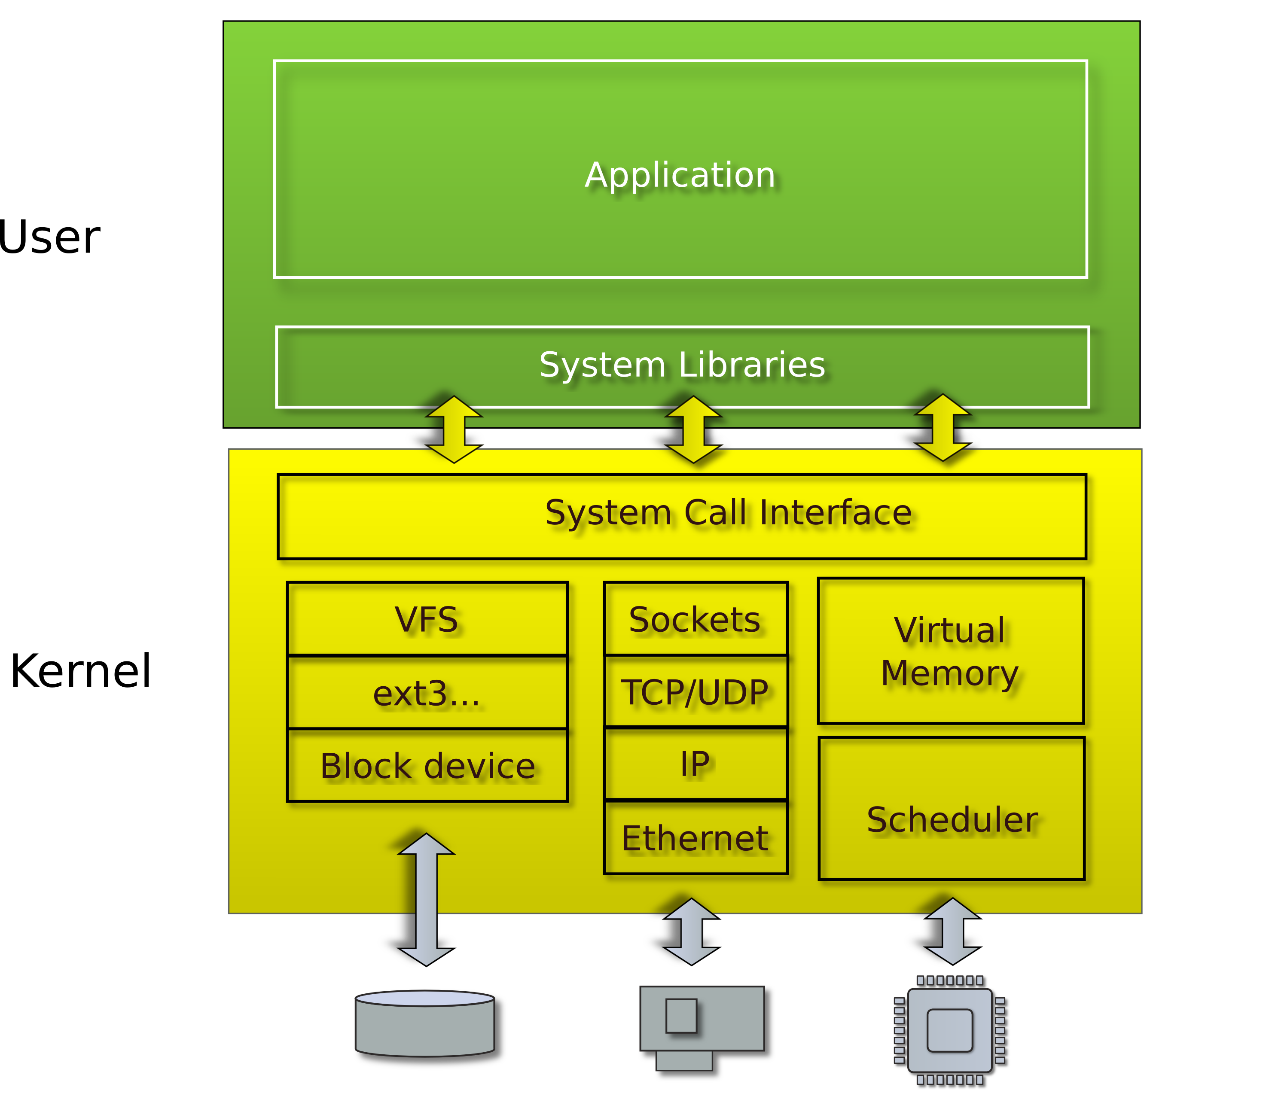
Linux/Windows/Mac

Slide 48
Recap
Run multiple programs
  Each has illusion of a private memory and CPU
    Context switching
    Isolation and protection
  Management of resources
    Scheduling (management of CPU)
    Memory management (management of physical memory)
High-level abstractions for I/O
  File systems
    Multiple files, concurrent I/O requests
    Consistency, caching
  Network protocols
    Multiple virtual network connections

Slide 49
Questions?

Slide 50
How hard it is to boot into main and print something on the screen?
  If you want to run this demo
  https://github.com/mars-research/hello-os.git
  printf(“Hello world\n”);

