Slide 1
COMPSCI: Principles of Operating Systems
Lecture 2: OS Interfaces
(Whiteboard Discussion)
Anton Burtsev
January, 2017

Slide 2
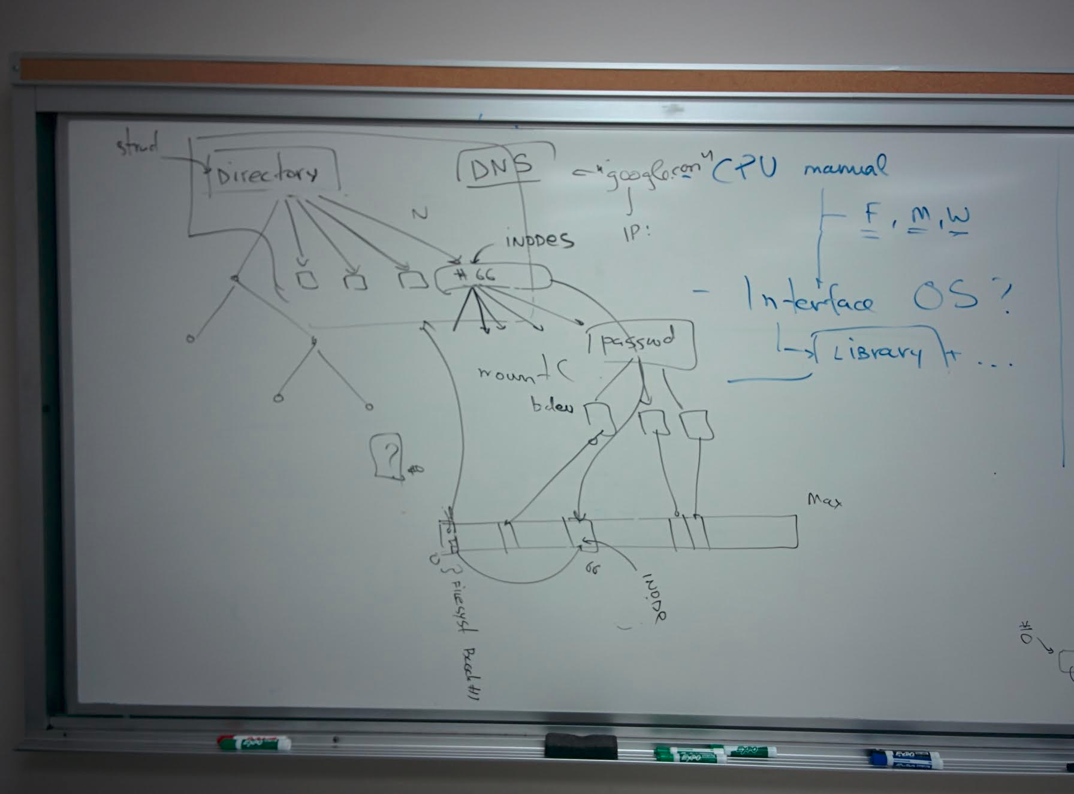

Slide 3
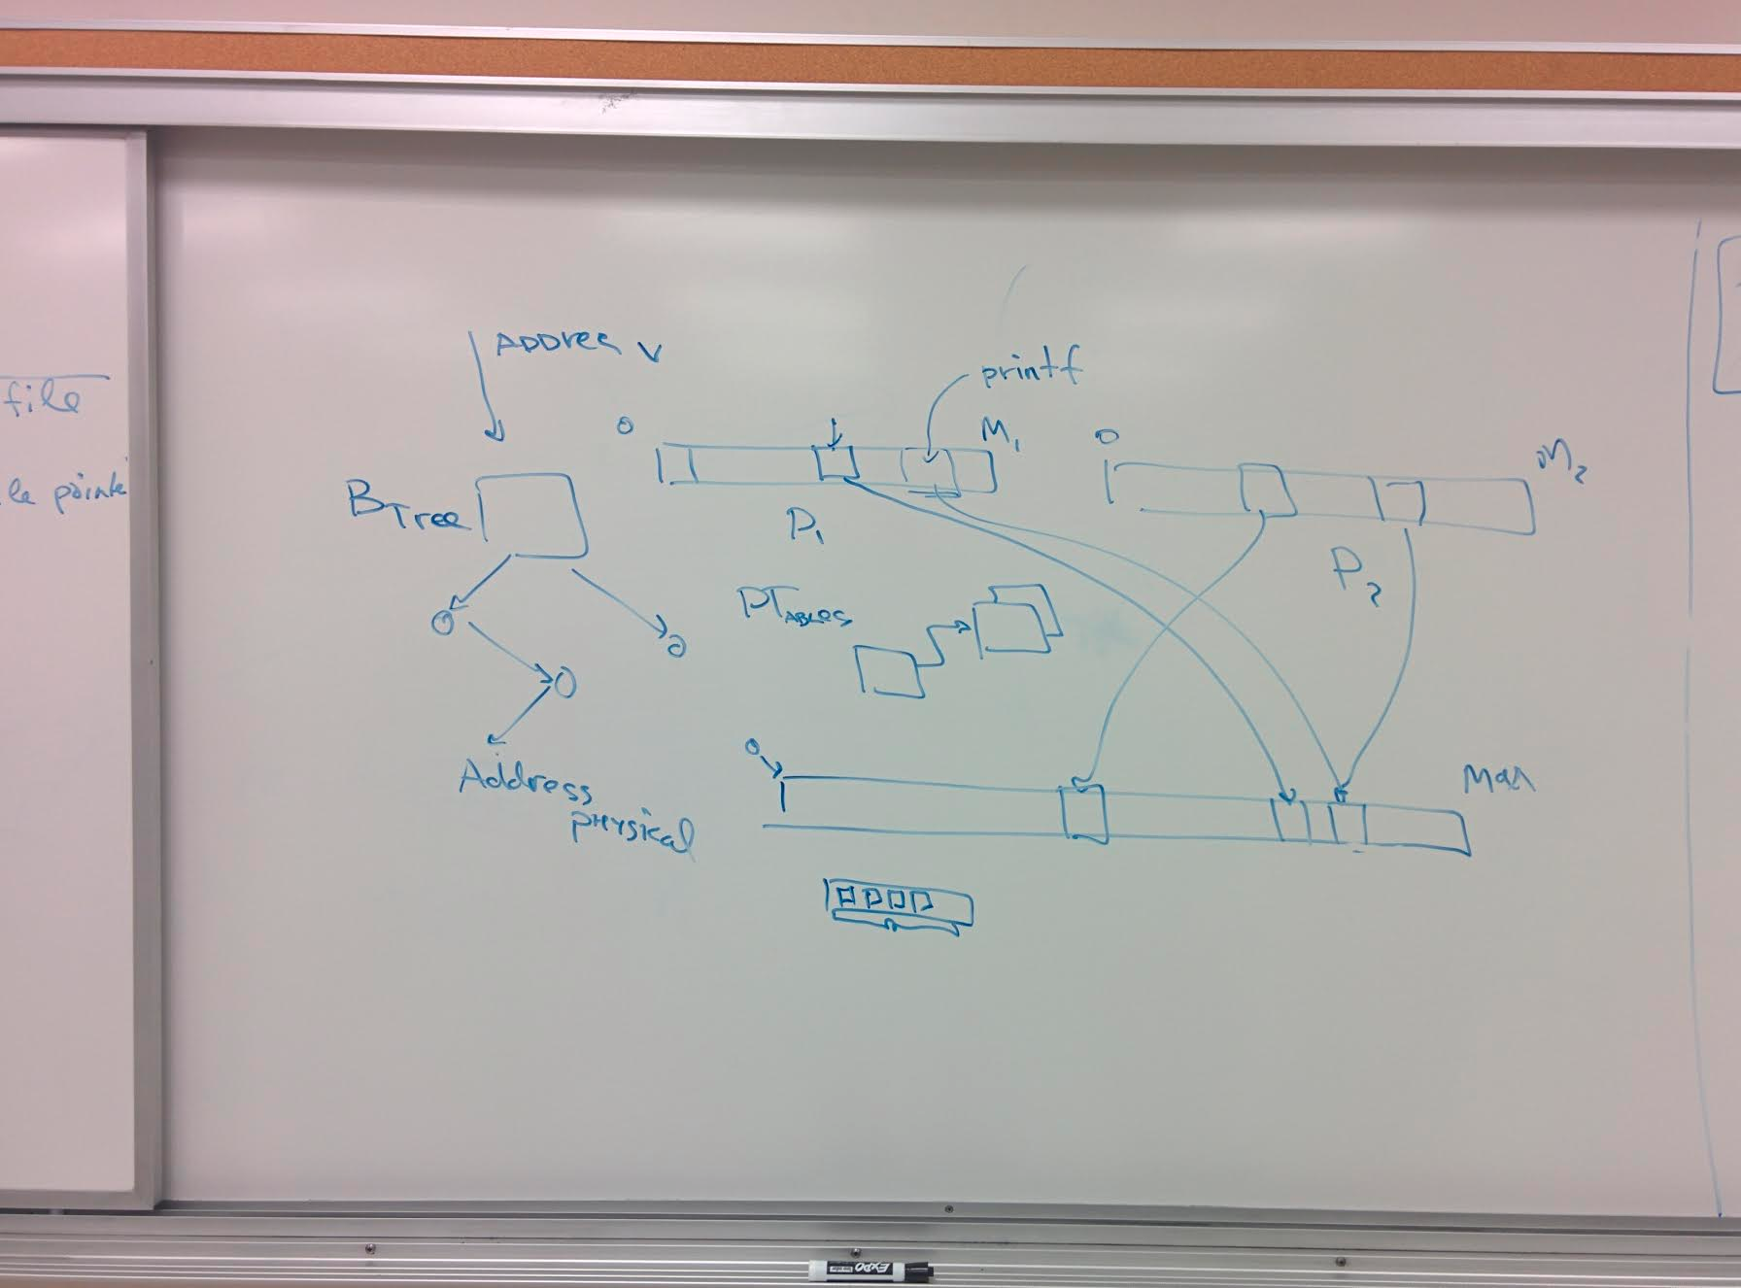

Slide 4
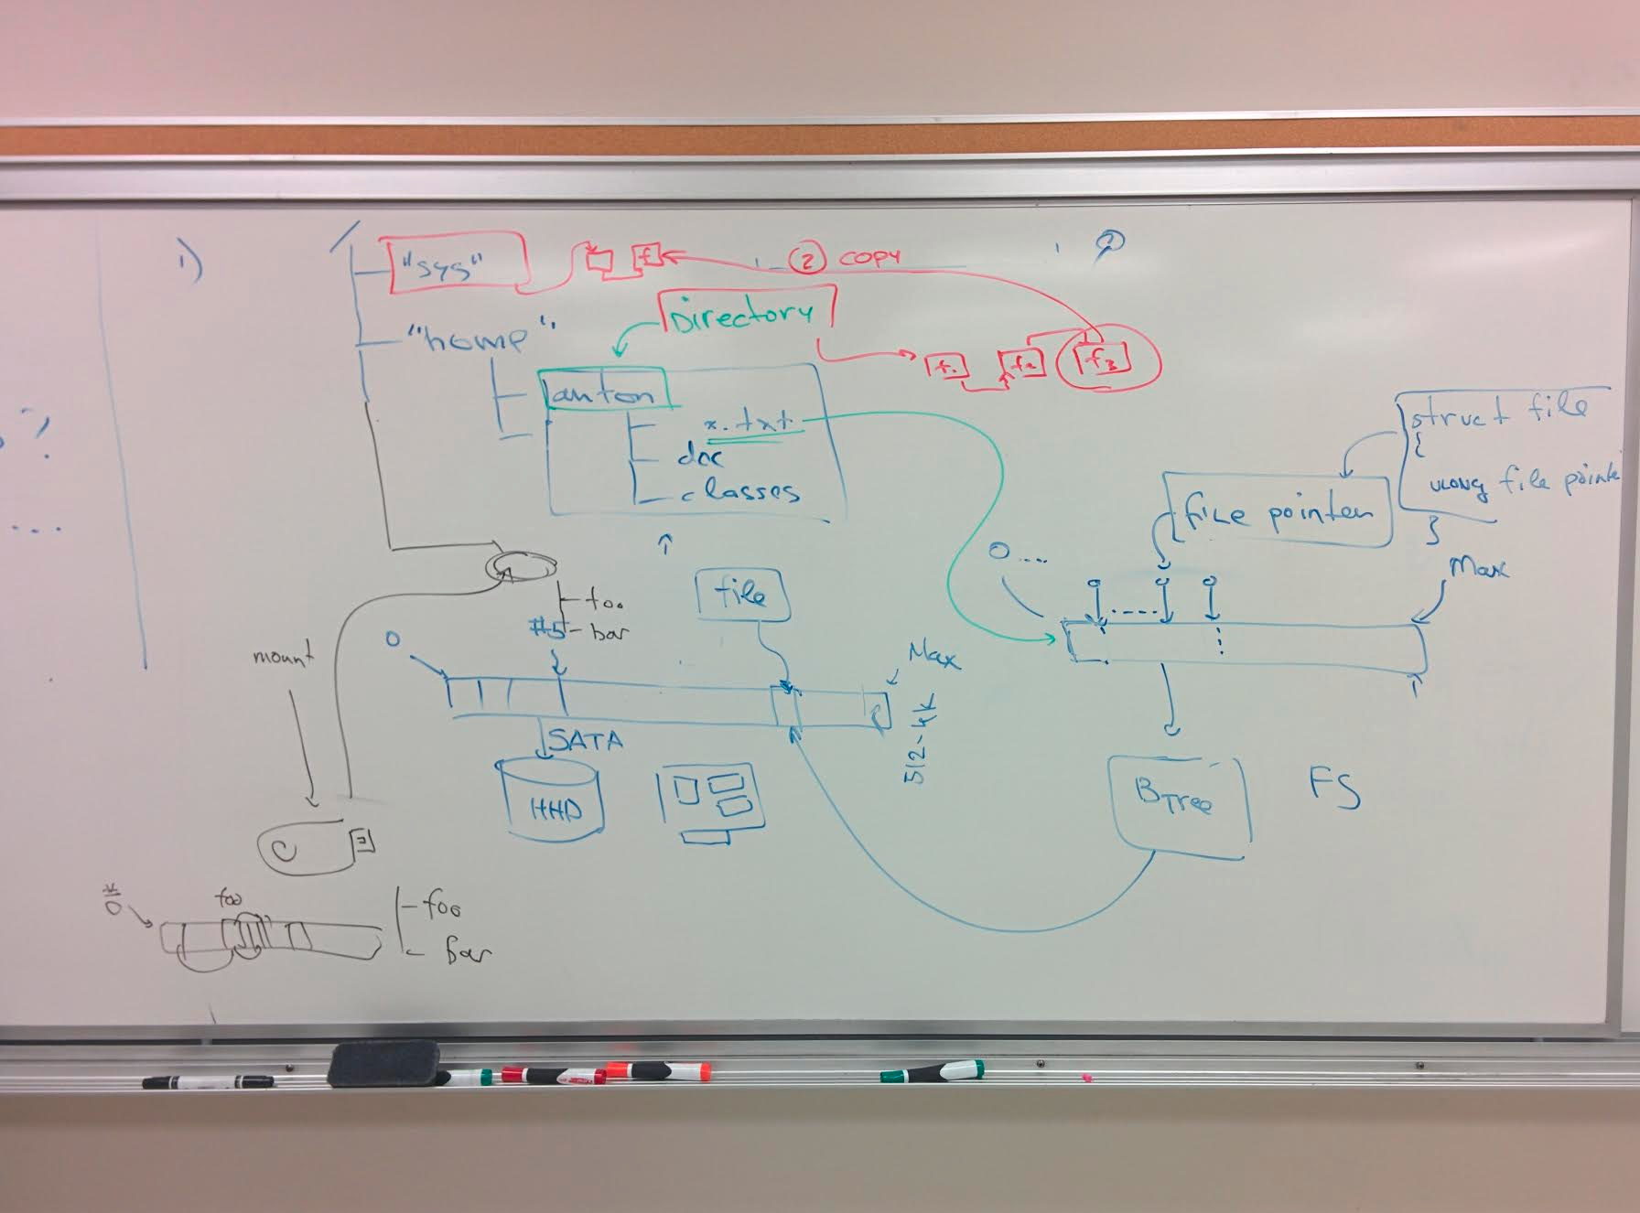

Slide 5
