Slide 1
143A: Principles of Operating Systems
Lecture 4: PC Harware
Anton Burtsev
January, 2017

Slide 2
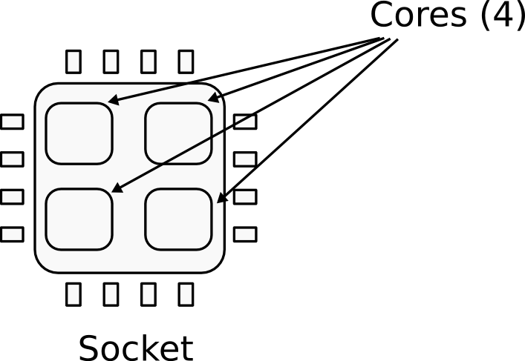

CPU
CPU socket
  4 cores

Slide 3
Register
The processor has an internal memory
  Register file

Slide 4
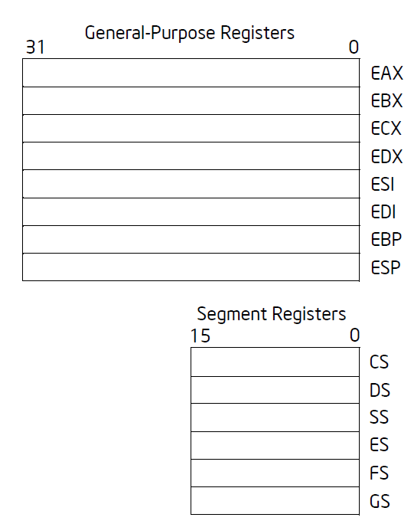
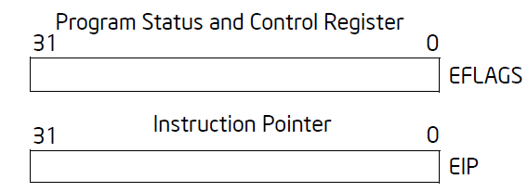
Registers

Slide 5
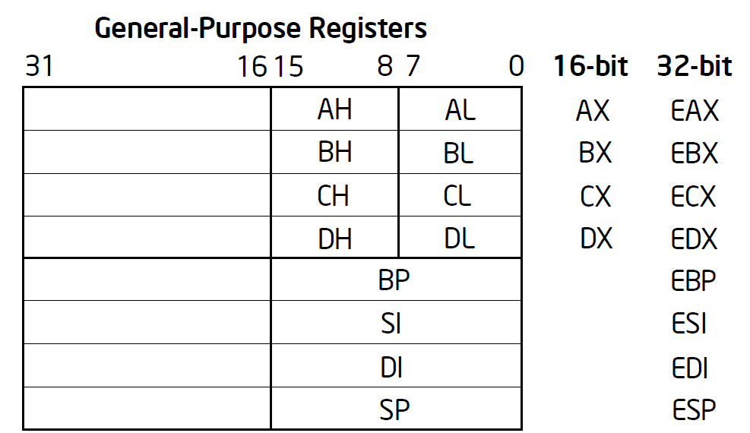

Slide 6
General registers
EAX — Accumulator for operands and results data
EBX — Pointer to data in the DS segment
ECX — Counter for string and loop operations
EDX — I/O pointer
ESI — Pointer to data in the segment pointed to by the DS register; source pointer for string operations
EDI — Pointer to data (or destination) in the segment pointed to by the ES register; destination pointer for string operations
ESP — Stack pointer (in the SS segment)
EBP — Pointer to data on the stack (in the SS segment)

Slide 7
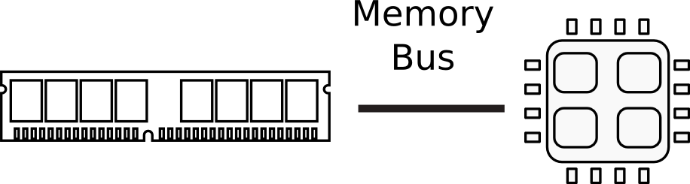

Memory

Slide 8

Memory abstraction
x86 assembly examples:
mov eax, [ebx] ; Move 4 bytes in memory at the address contained in EBX into EAX
mov [var], ebx ; Move the contents of EBX into the 4 bytes at memory address var.
mov eax, [esi-4] ; Move 4 bytes at memory address ESI + (-4) into EAX
mov [esi+eax], cl ; Move the contents of CL into the byte at address ESI+EAX
mov edx, [esi+4*ebx] ; Move the 4 bytes of data at address ESI+4*EBX into EDX

Slide 9

CPU execution loop
CPU repeatedly reads instructions from memory
Executes them
Example
  ADD EDX, EAX, EBX
  EDX = EAX + EBX

Slide 10
CPU execution loop
Fault
  Instruction's preconditions are not met
Examples
  Division by zero
  Page not mapped

Slide 11
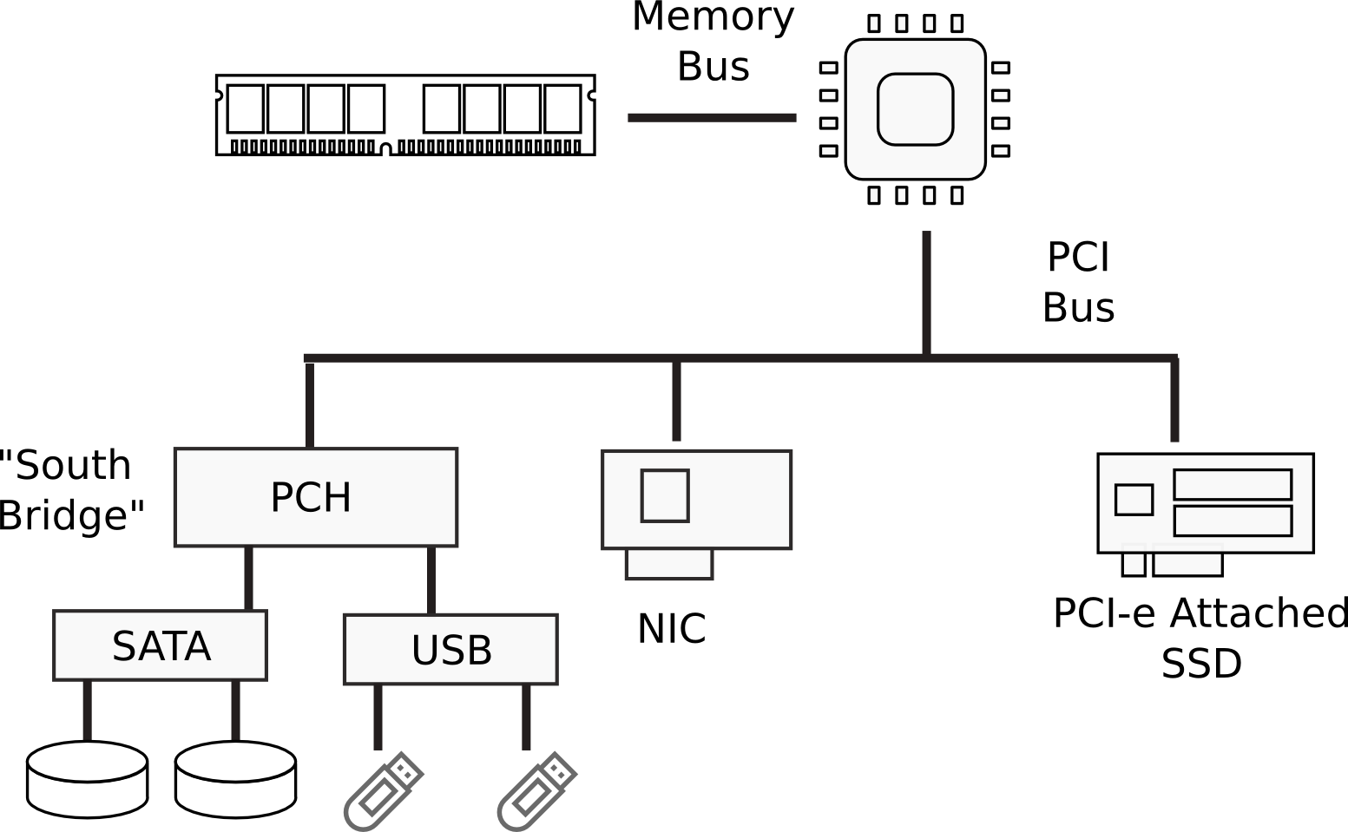
I/O Devices

Slide 12
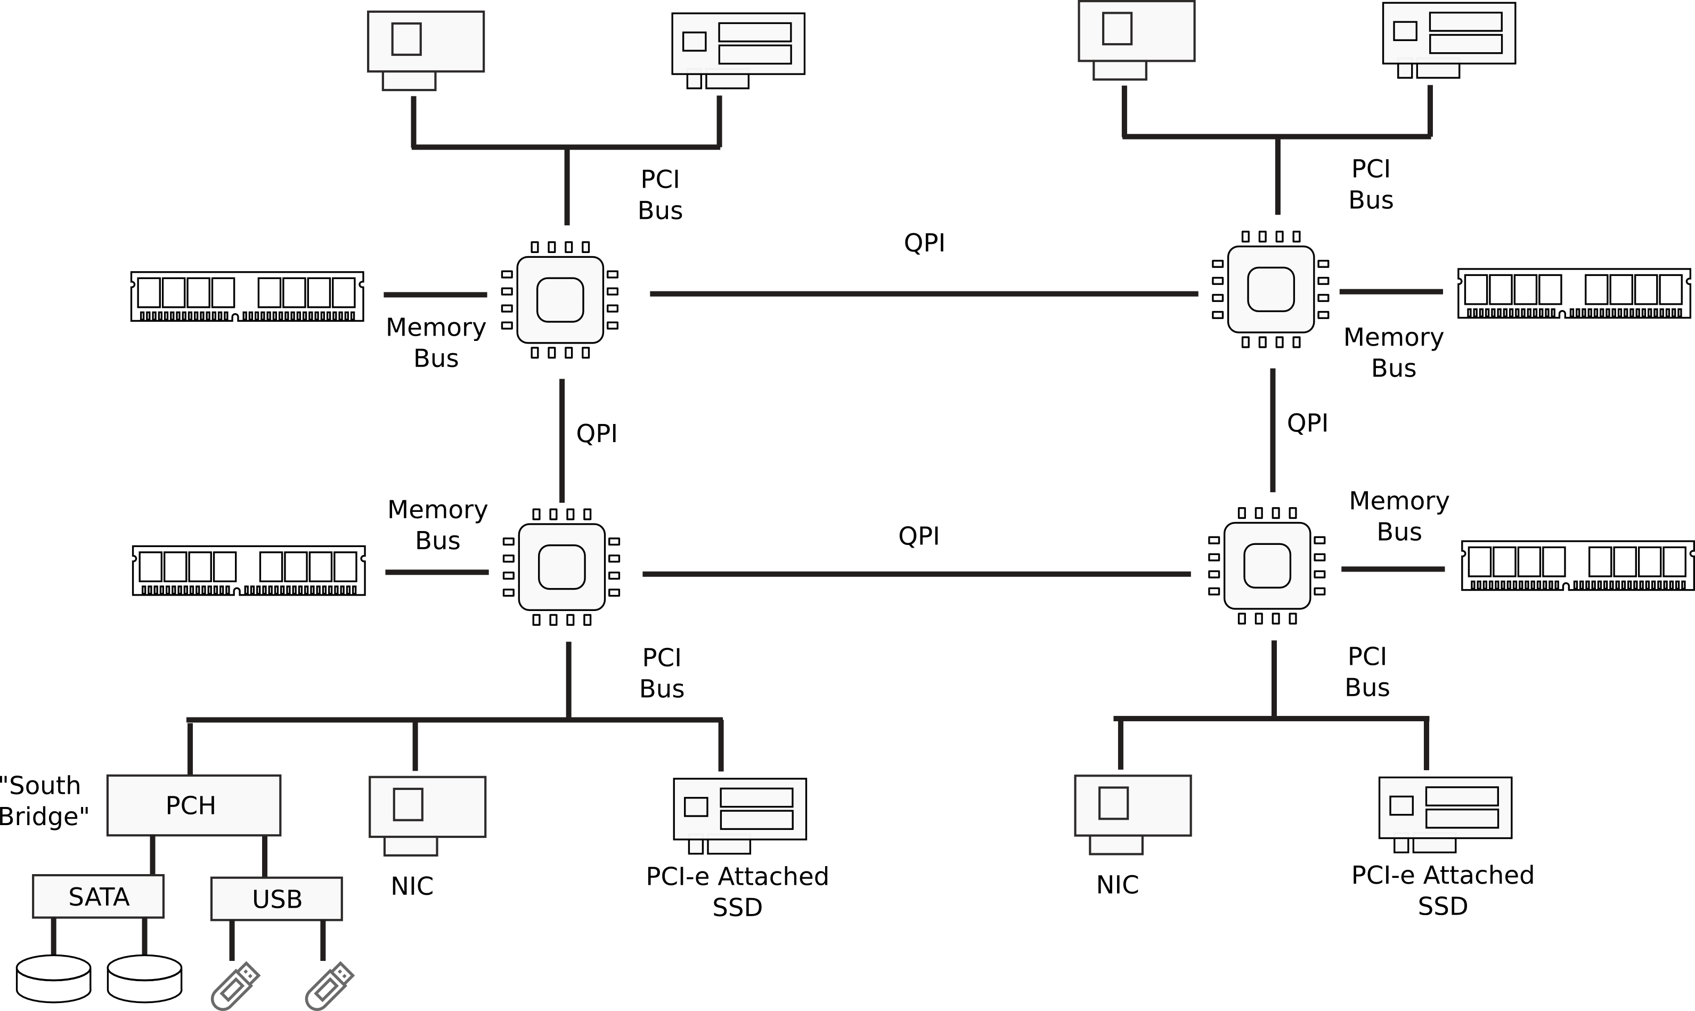
Multi-socket machines

Slide 13
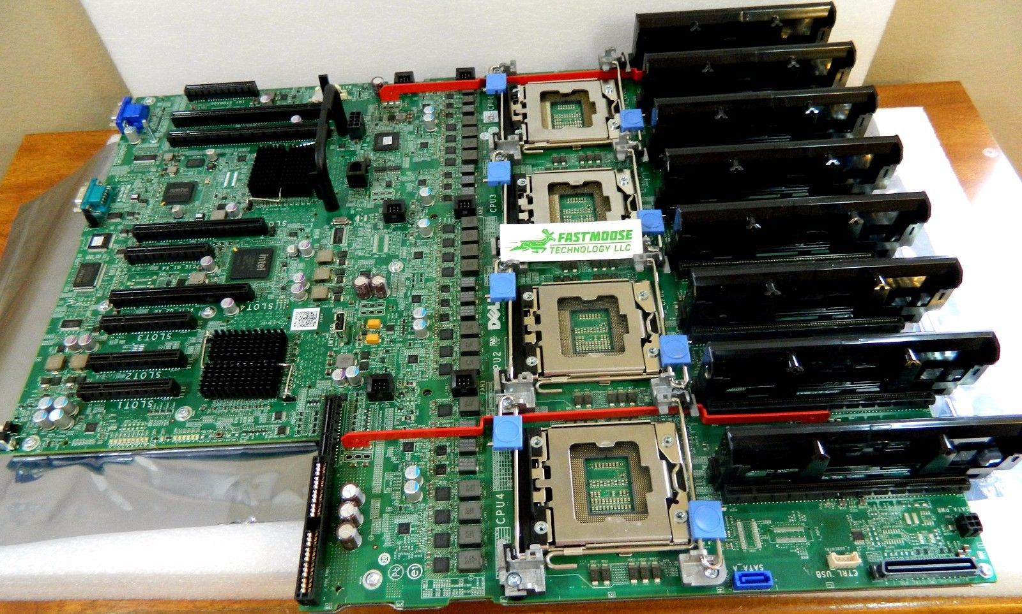
Dell Poweredge R910 System Server 4-socket Lga1567 Motherboard P658h

Slide 14
Questions?

