Slide 1
143A: Principles of Operating Systems
Lecture 09: Address spaces
Anton Burtsev
January, 2017

Slide 2
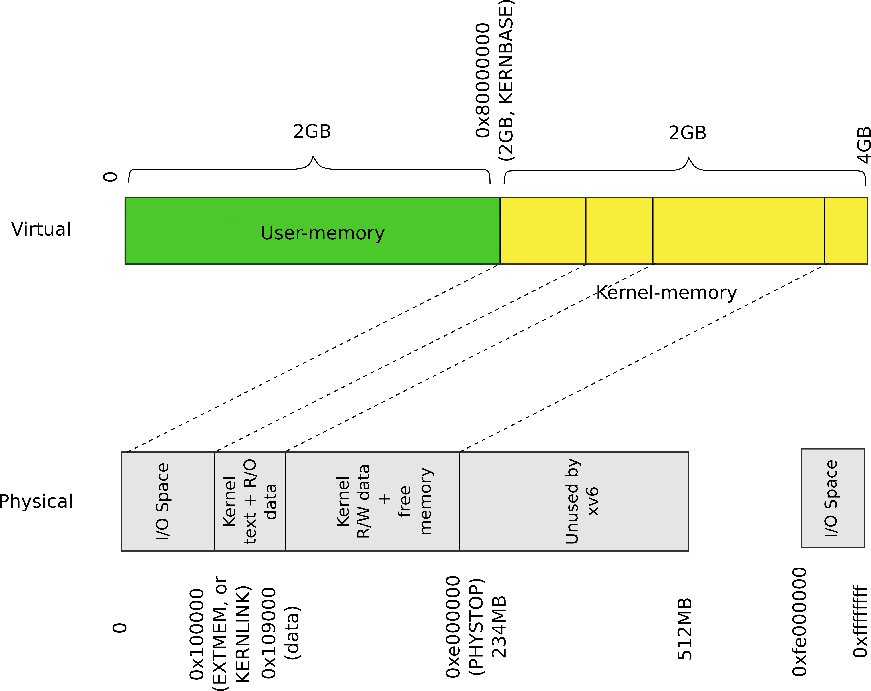
Our goal

Slide 3
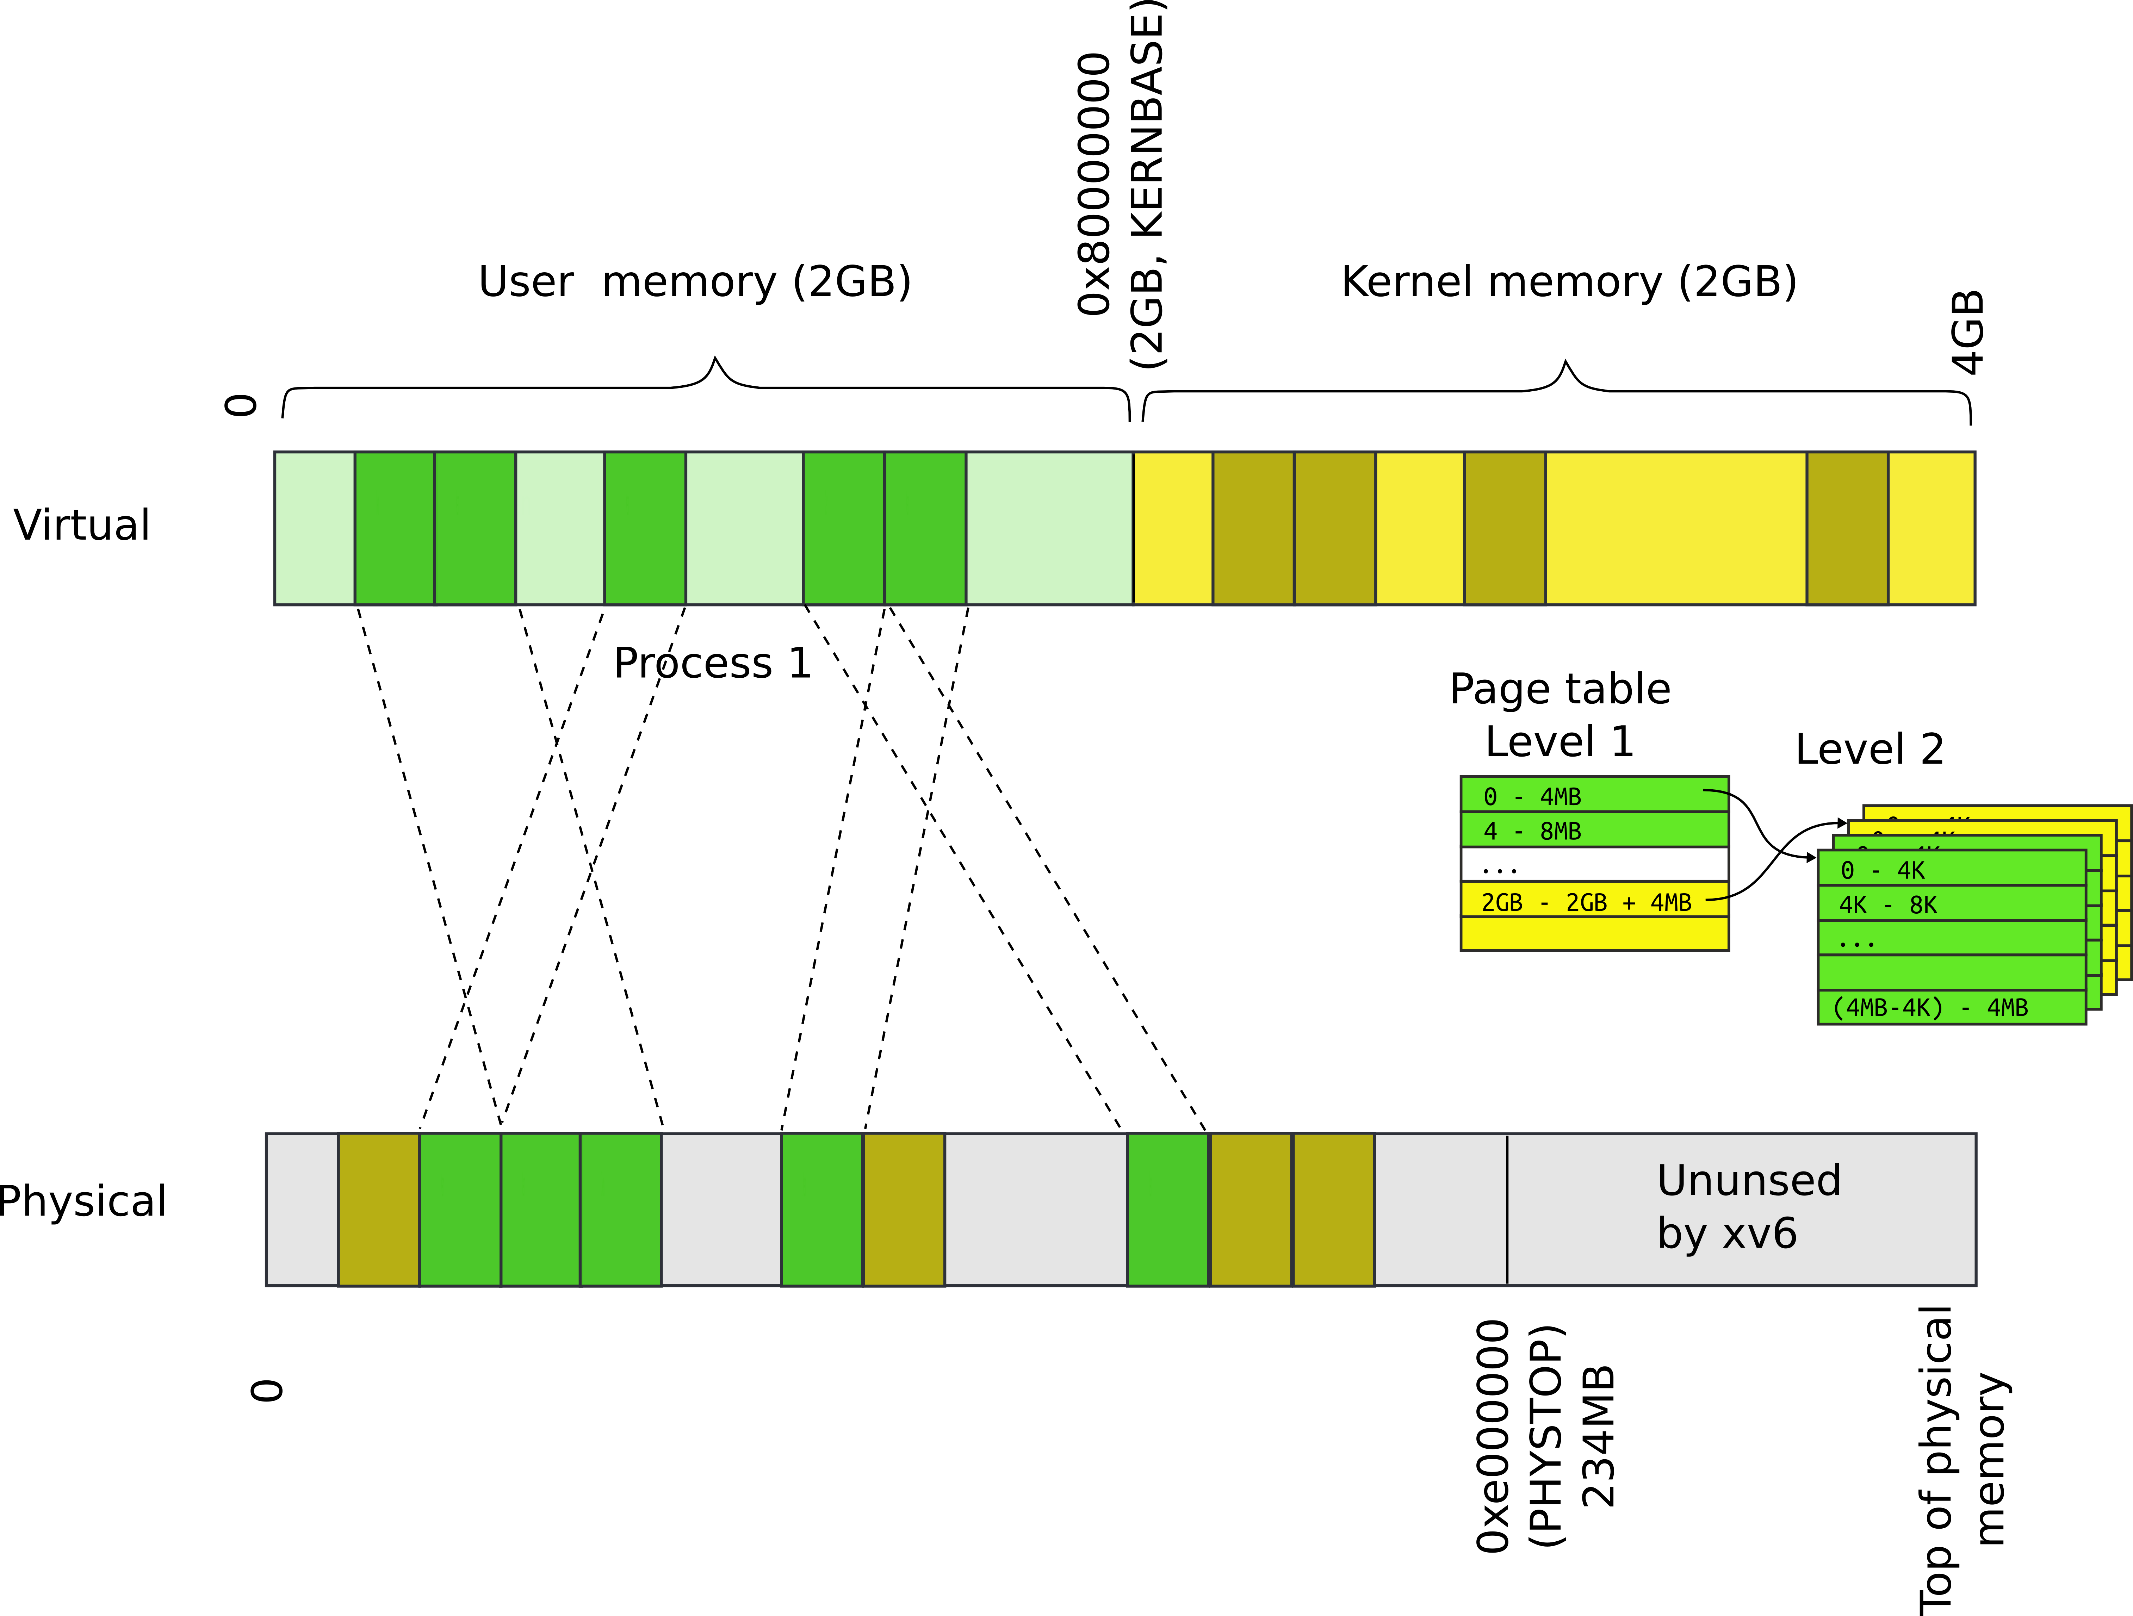
Process and kernel memory

Slide 4

Multiple processes

Slide 5
Recap: our goal

Slide 6
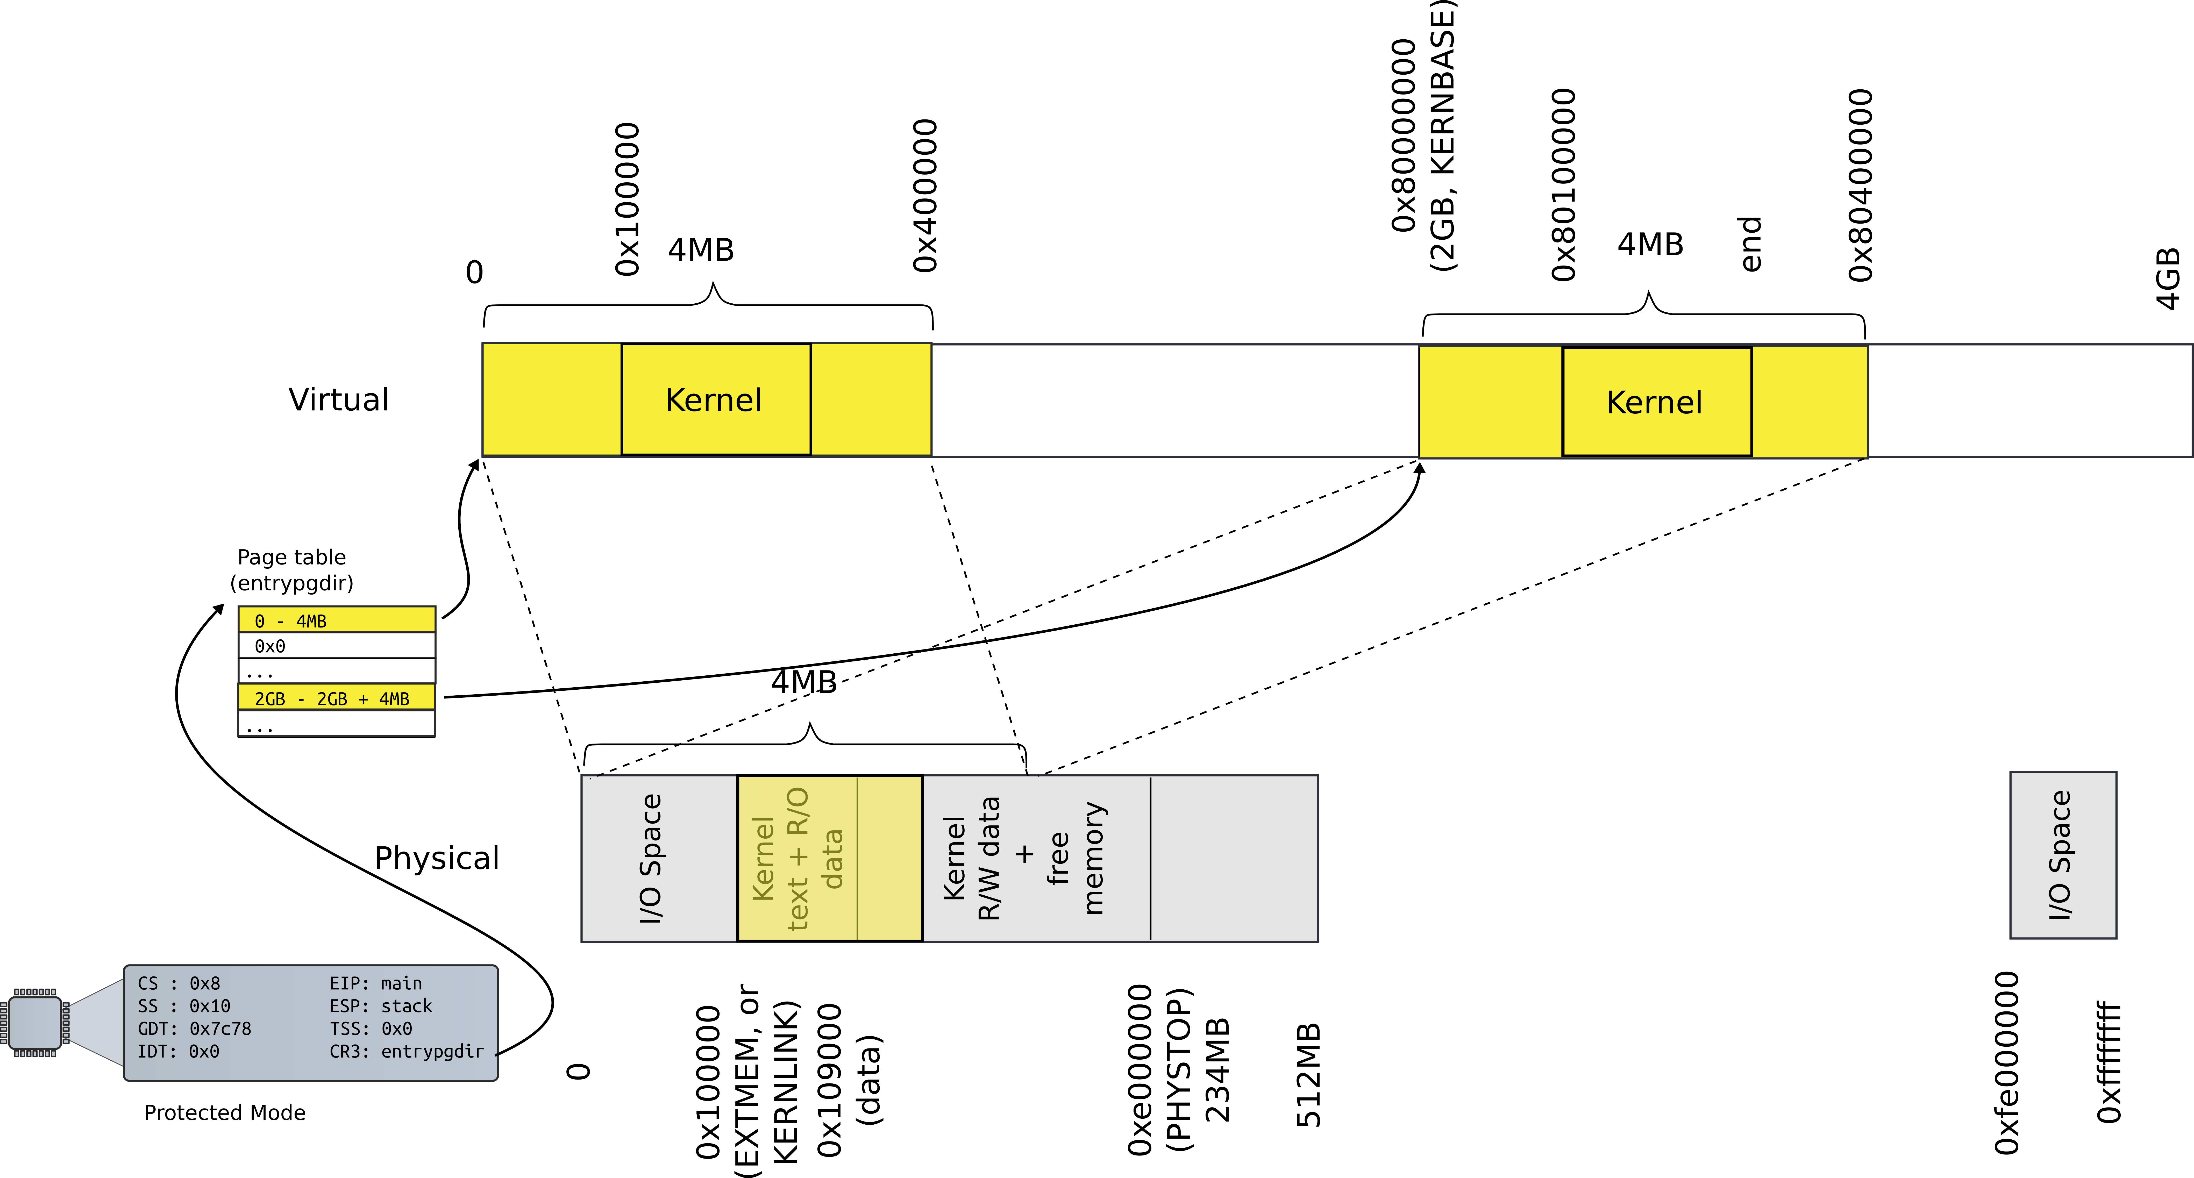
Memory after boot

Slide 7
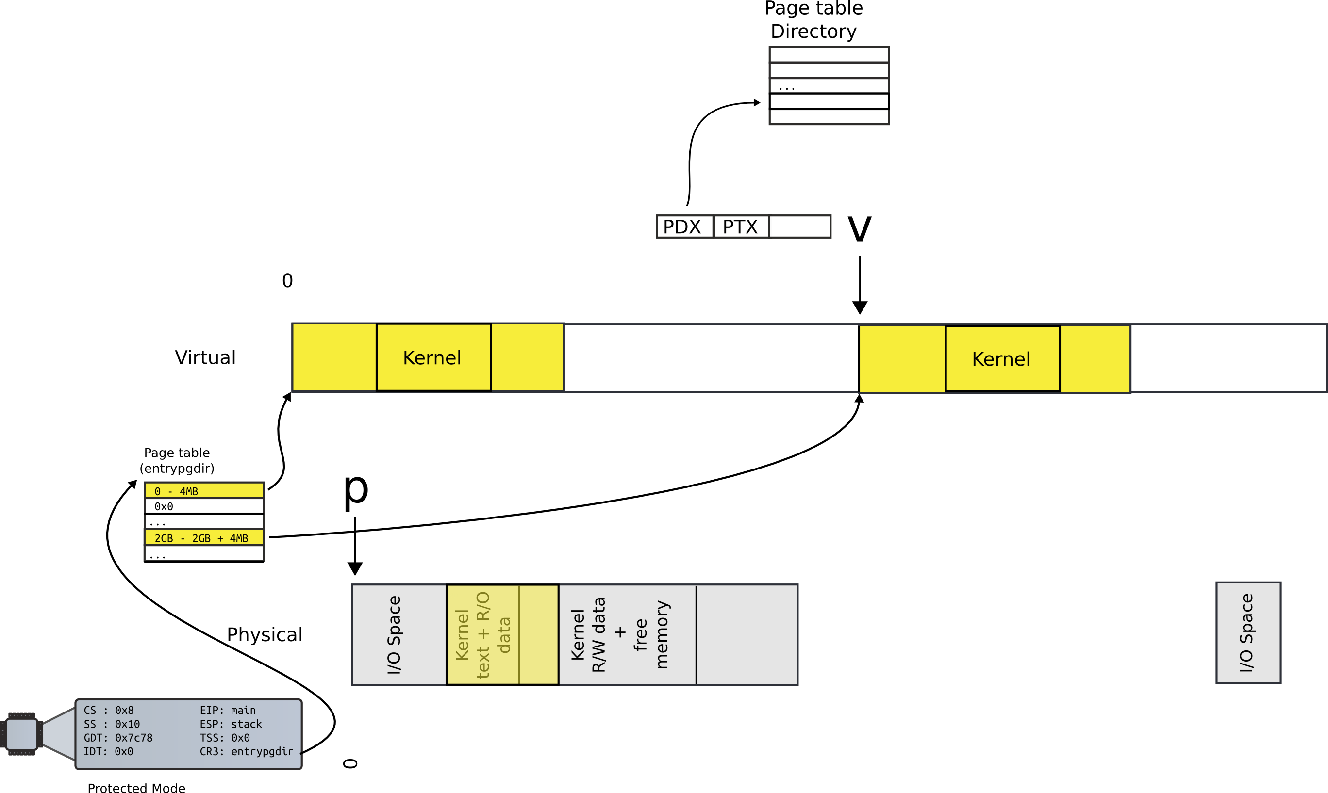
Locate page table directory entry

Slide 8
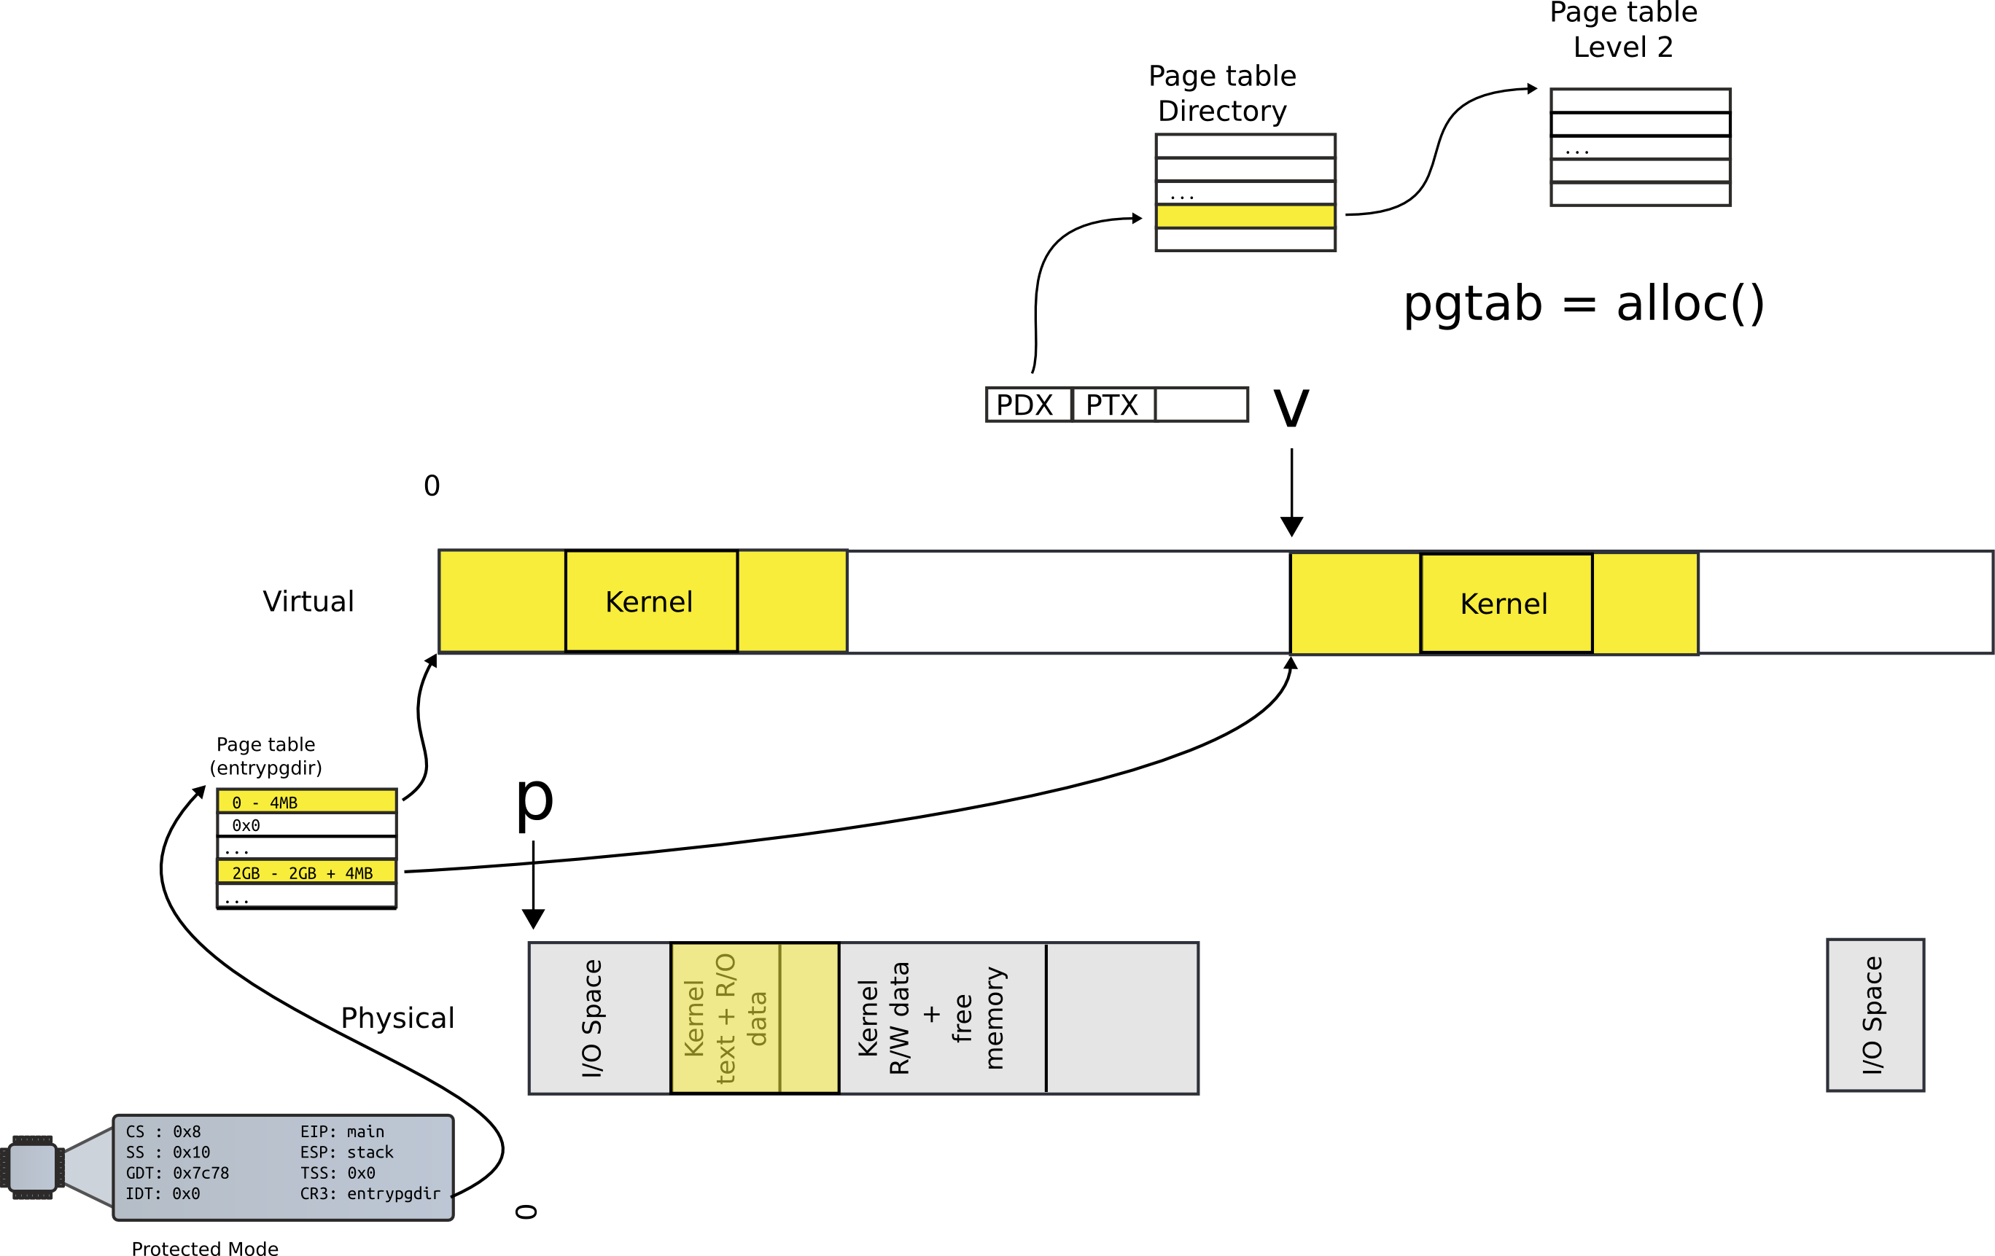
Allocate next level page table

Slide 9
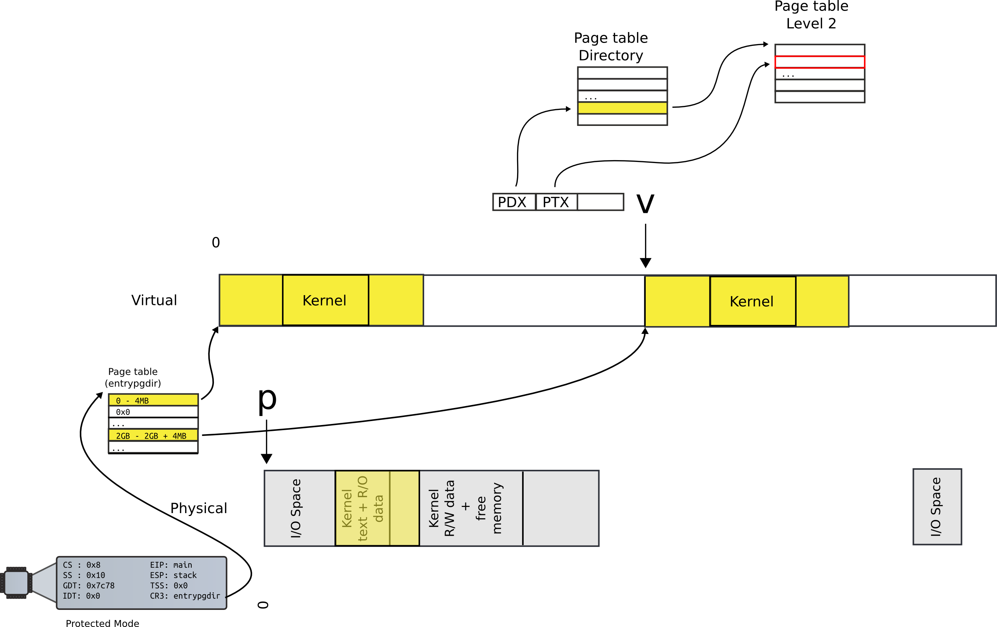
Locate PTE entry

Slide 10
Locate PTE entry

Slide 11
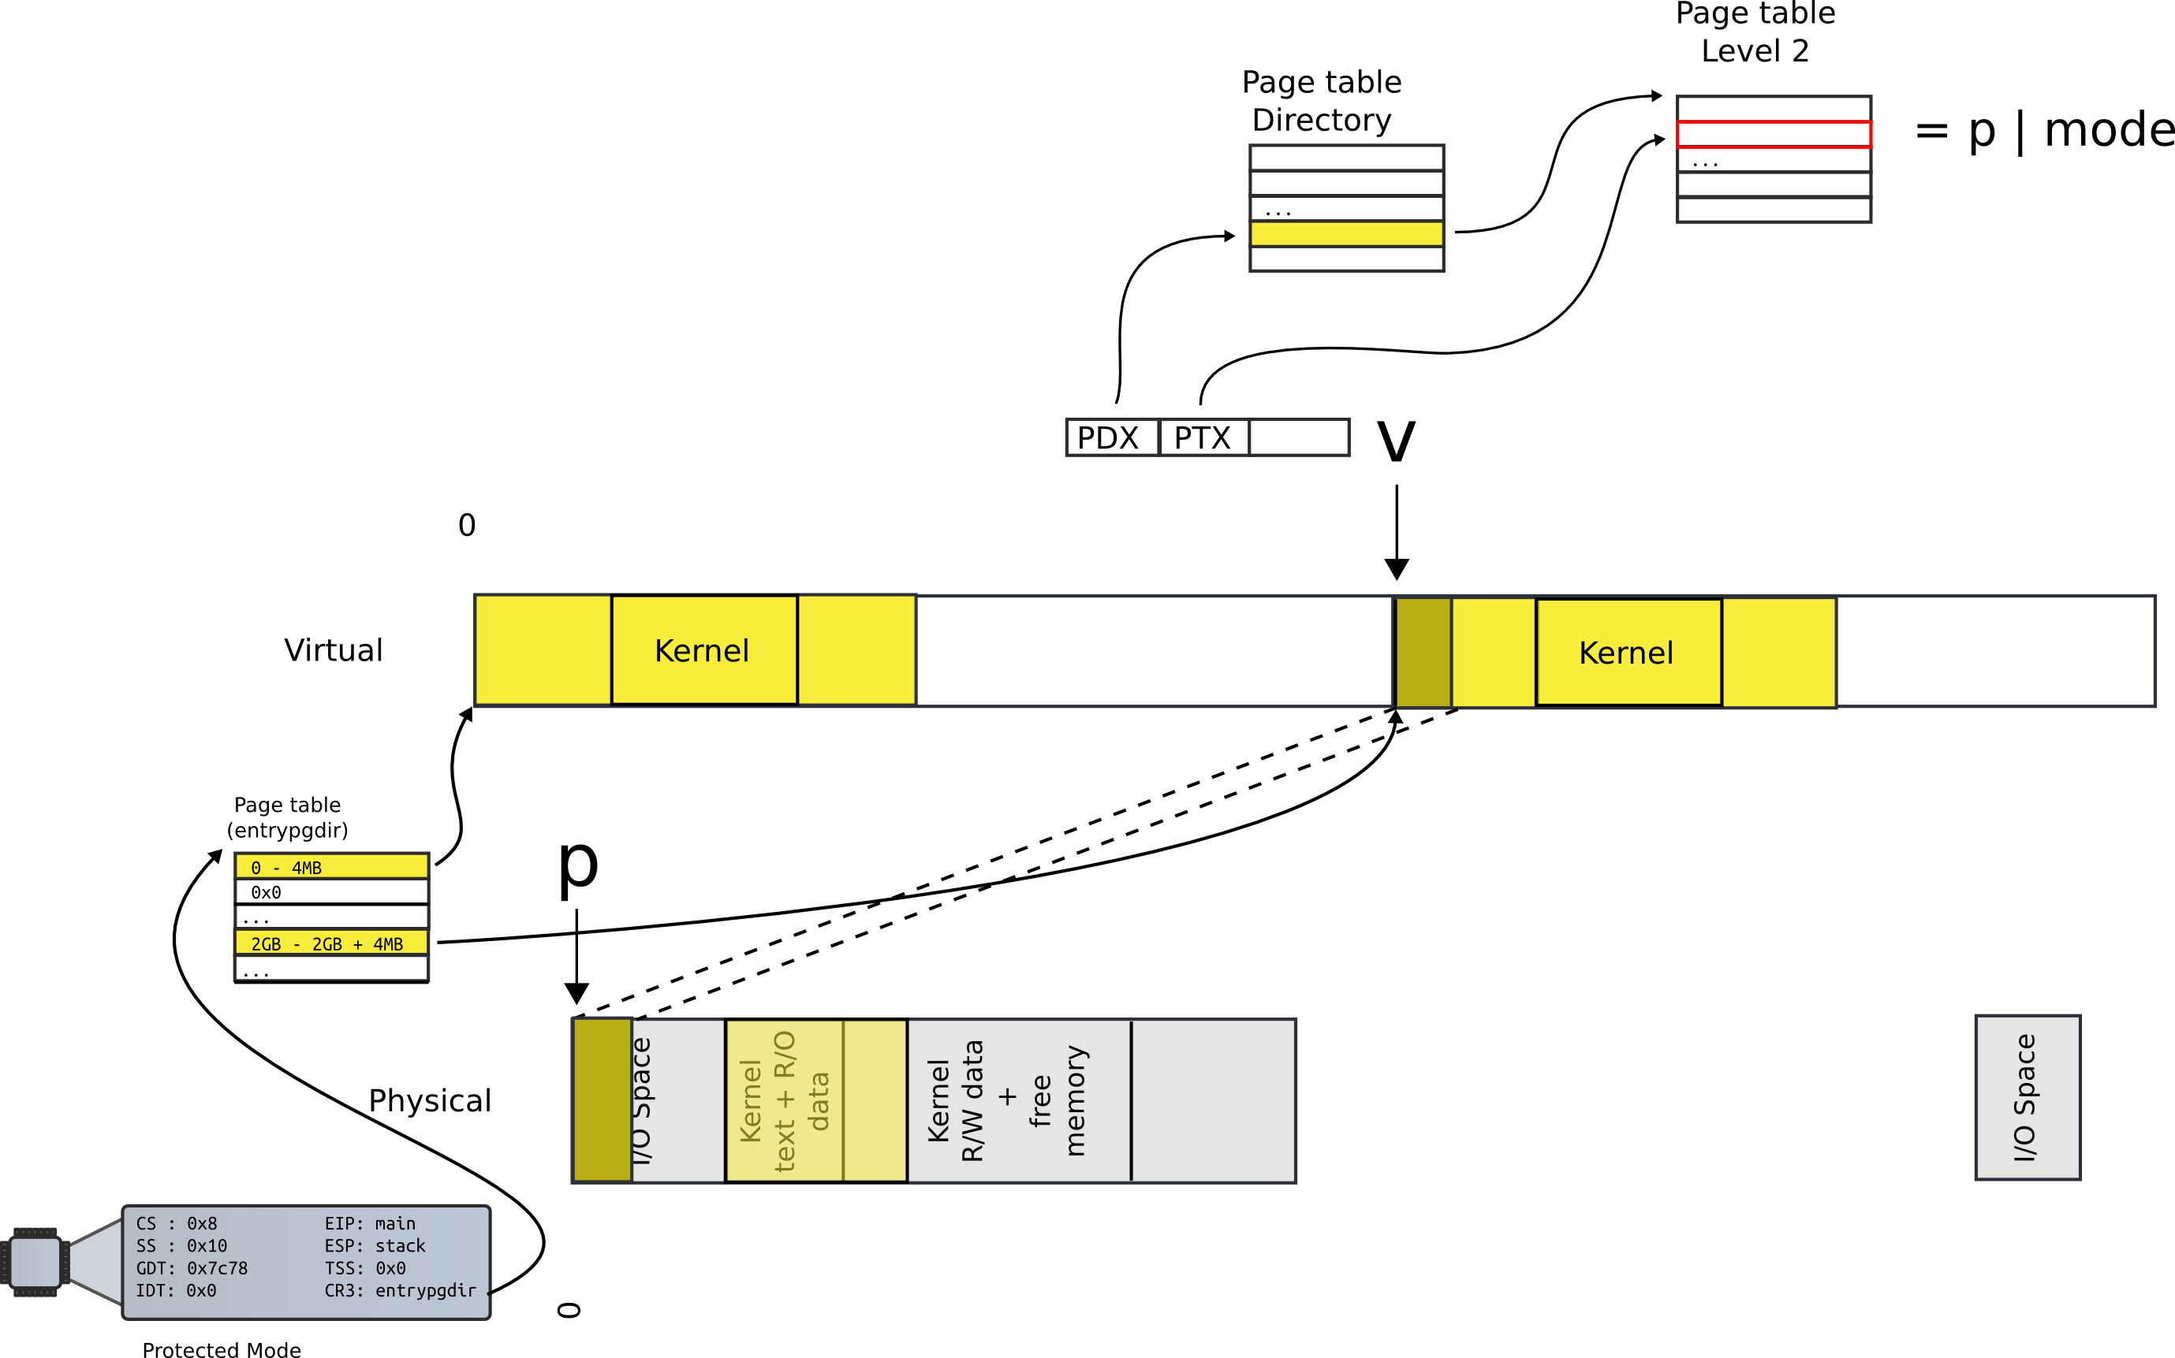
Update mapping with physical addr

Slide 12
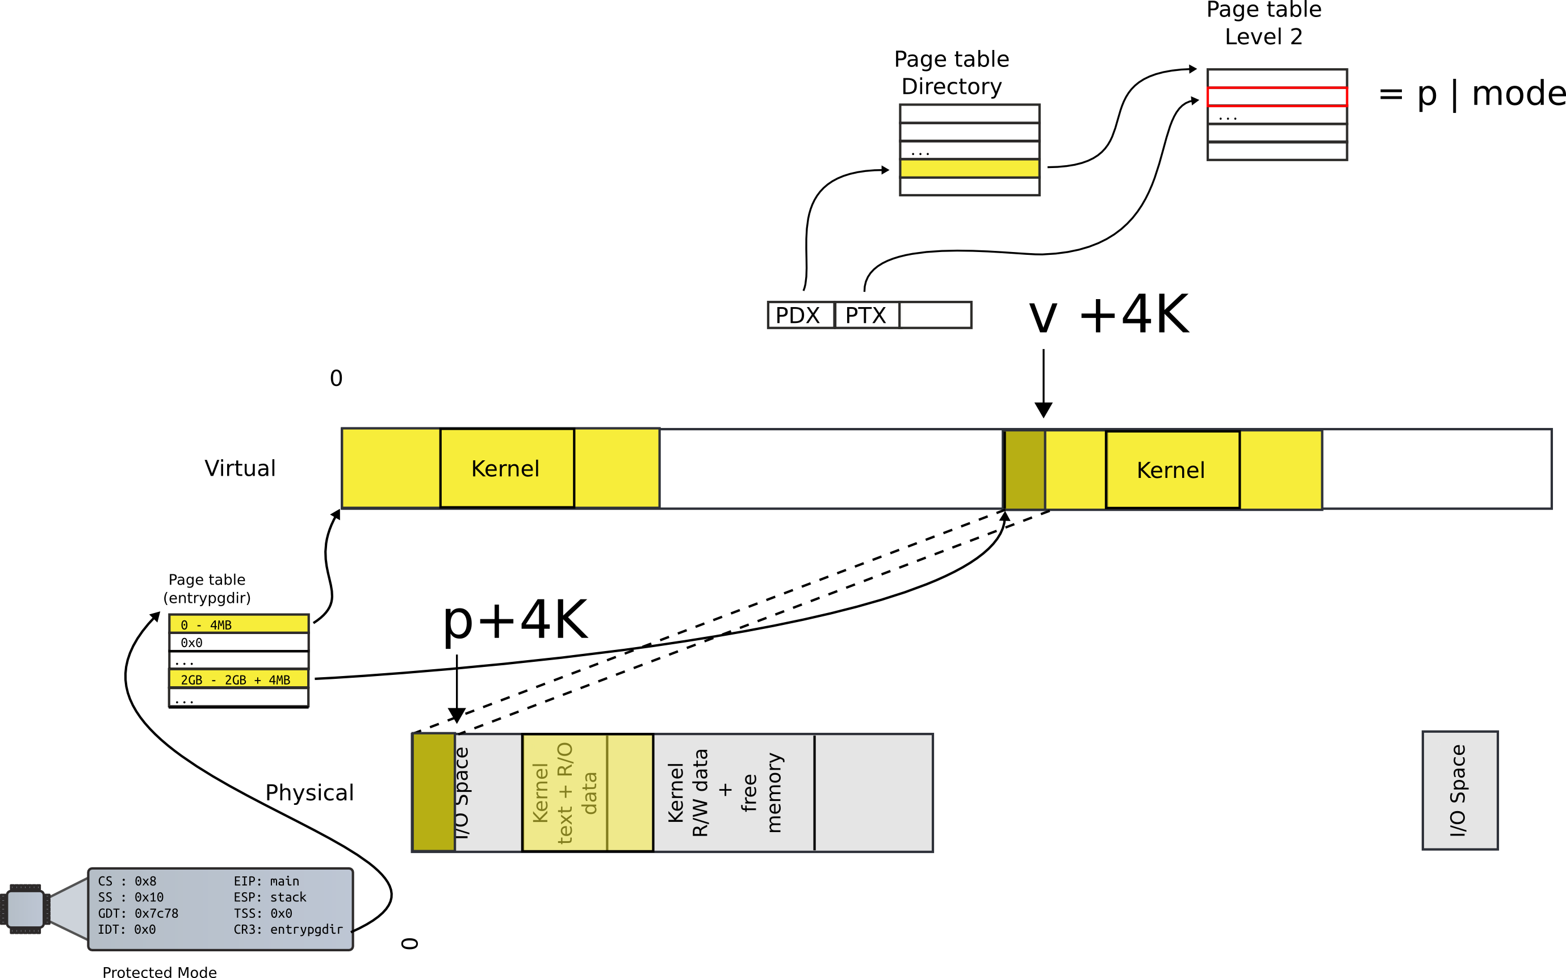
Move to next page

Slide 13
Walk page table
1754 walkpgdir(pde_t *pgdir, const void *va, int alloc)
1755 {
1756 pde_t *pde;
1757 pte_t *pgtab;
1758
1759 pde = &pgdir[PDX(va)];
1760 if(*pde & PTE_P){
1761 pgtab = (pte_t*)P2V(PTE_ADDR(*pde));
1762 } else {
1763 if(!alloc || (pgtab = (pte_t*)kalloc()) == 0)
1764 return 0;
1765 // Make sure all those PTE_P bits are zero.
1766 memset(pgtab, 0, PGSIZE);
...
1770 *pde = V2P(pgtab) | PTE_P | PTE_W | PTE_U;
1771 }
1772 return &pgtab[PTX(va)];
1773 }

Slide 14
Create page table entries
1779 mappages(pde_t *pgdir, void *va, uint size, uint pa, int perm)
1780 {
1781 char *a, *last;
1782 pte_t *pte;
1783
1784 a = (char*)PGROUNDDOWN((uint)va);
1785 last = (char*)PGROUNDDOWN(((uint)va) + size − 1);
1786 for(;;){
1787 if((pte = walkpgdir(pgdir, a, 1)) == 0)
1788 return −1;
1789 if(*pte & PTE_P)
1790 panic("remap");
1791 *pte = pa | perm | PTE_P;
1792 if(a == last)
1793 break;
1794 a += PGSIZE;
1795 pa += PGSIZE;
1796 }
1797 return 0;
1798 }

Slide 15
Can a process overwrite kernel memory?

Slide 16
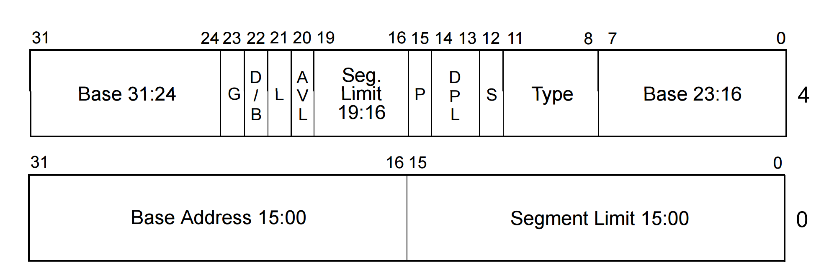
Privilege levels
Each segment has a privilege level
  DPL (descriptor privilege level)
  4 privilege levels ranging 0-3

Slide 17
Privilege levels
Currently running code also has privilege level
  “Current privilege level” (CPL): 0-3
  Can access only less privileged segments
    E.g., 0 can access 1, 2, 3
Some instructions are “privileged”
  Can only be invoked at CPL = 0
  Examples:
    Load GDT
    MOV <control register>
      E.g. reload a page table by changing CR3

Slide 18
Real world
Only two privilege levels are used in modern OSes:
  OS kernel runs at 0
  User code runs at 3
This is called “flat” segment model
  Segments for both 0 and 3 cover entire address space
But then... how the kernel is protected?
  Page tables

Slide 19
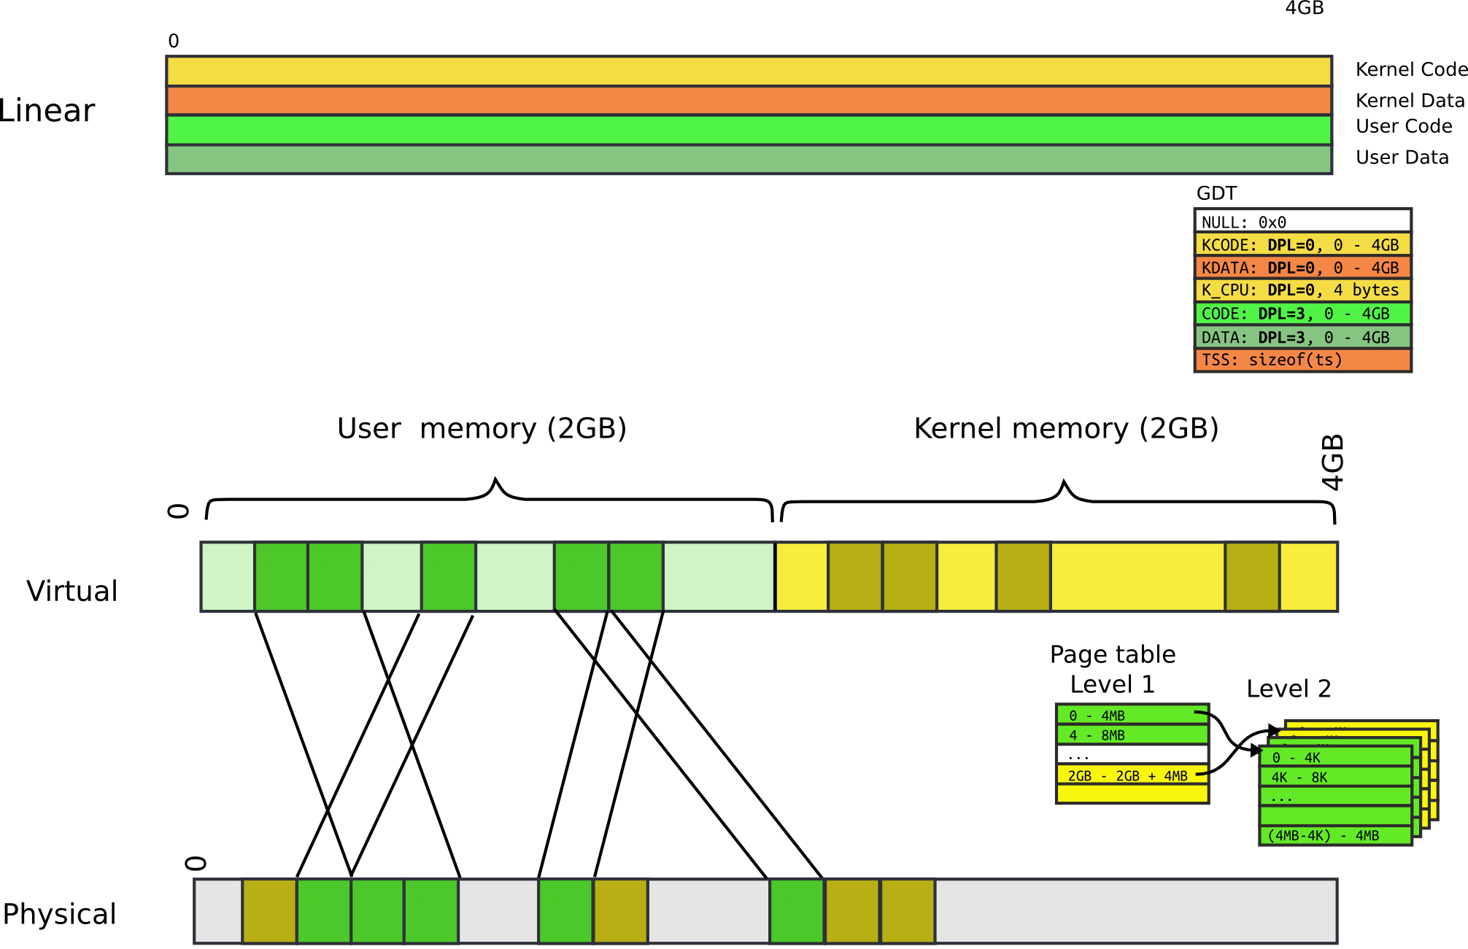

Slide 20
Page table: user bit
Each entry (both Level 1 and Level 2) has a bit
  If set, code at privilege level 3 can access
  If not, only levels 0-2 can access
Note, only 2 levels, not 4 like with segments
All kernel code is mapped with the user bit clear
  This protects user-level code from accessing the kernel

Slide 21
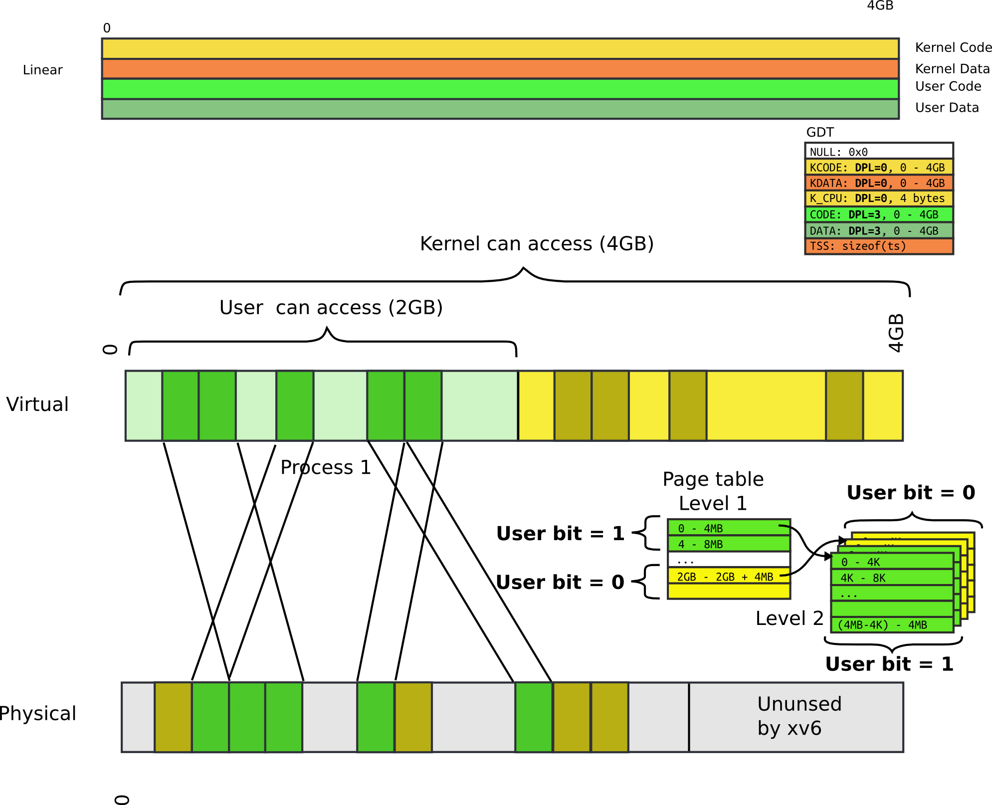

Slide 22
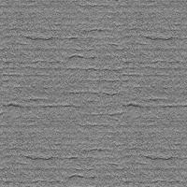
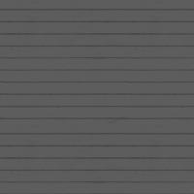
TLB
CPU caches results of page table walks
  In translation lookaside buffer (TLB)
Walking page table is slow
  Each memory access is 200-300 cycles on modern hardware
  L3 cache access is 70 cycles
Virt | Phys
0xf0231000 | 0x1000
0x00b31000 | 0x1f000
0xb0002000 | 0xc1000
- | -
cr3

Slide 23
TLB
TLB is a cache (in CPU)
  It is not coherent with memory
  If page table entry is changes, TLB remains the same and is out of sync
cr3
Virt | Phys
0xf0231000 | 0x1000
0x00b31000 | 0x1f000
0xb0002000 | 0xc1000
- | -
Same
Virt Addr.
No Change!!!

Slide 24
Invalidating TLB
After every page table update, OS needs to manually invalidate cached values
Modern CPUs have “tagged TLBs”,
  Each TLB entry has a “tag” – identifier of a process
  No need to flush TLBs on context switch
On Intel this mechanism is called
  Process-Context Identifiers (PCIDs)

Slide 25
Questions?

