Slide 1
143A: Principles of Operating Systems
Lecture 09: First process
Anton Burtsev
January, 2017

Slide 2

Recap: Can a process overwrite kernel memory?

Slide 3
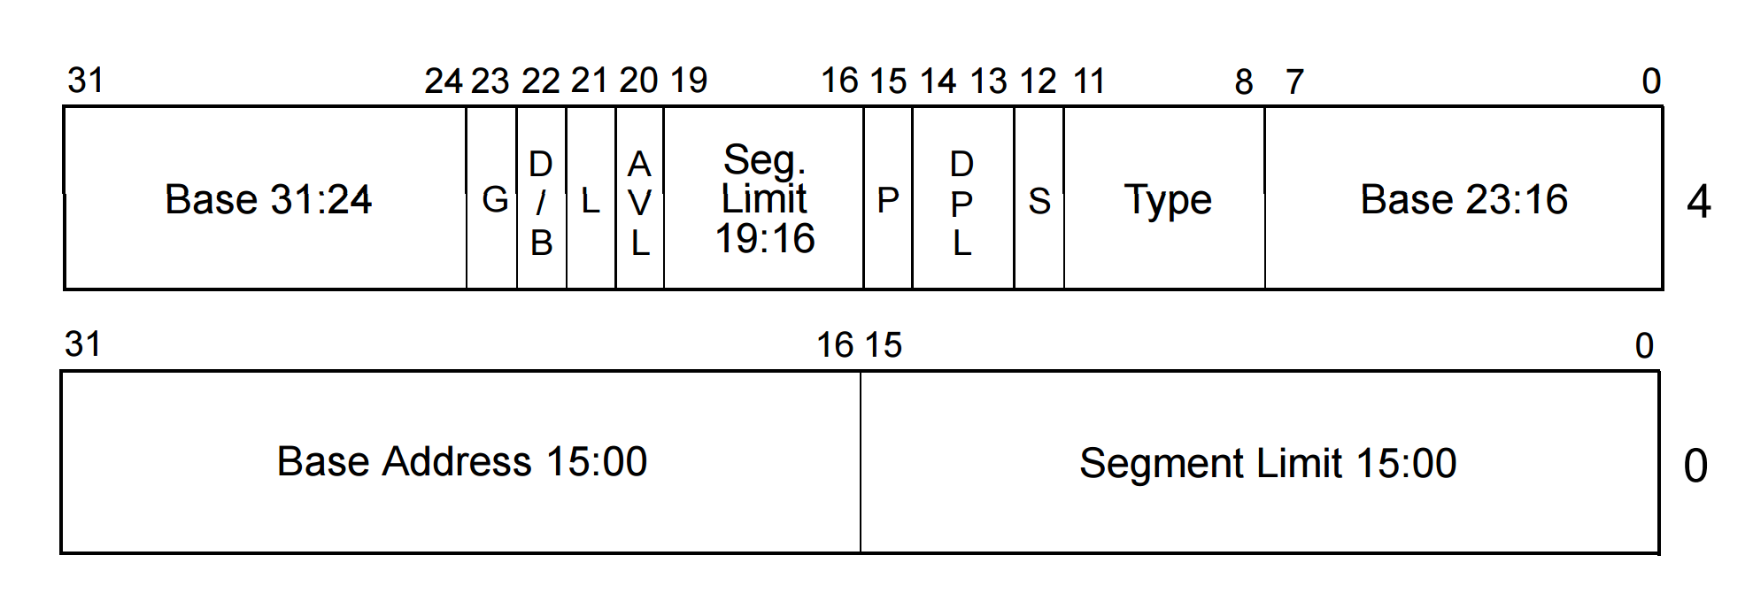
Privilege levels
Each segment has a privilege level
  DPL (descriptor privilege level)
  4 privilege levels ranging 0-3

Slide 4
Privilege levels
Currently running code also has privilege level
  “Current privilege level” (CPL): 0-3
  Can access only less privileged segments
    E.g., 0 can access 1, 2, 3
Some instructions are “privileged”
  Can only be invoked at CPL = 0
  Examples:
    Load GDT
    MOV <control register>
      E.g. reload a page table by changing CR3

Slide 5
Real world
Only two privilege levels are used in modern OSes:
  OS kernel runs at 0
  User code runs at 3
This is called “flat” segment model
  Segments for both 0 and 3 cover entire address space
But then... how the kernel is protected?
  Page tables

Slide 6
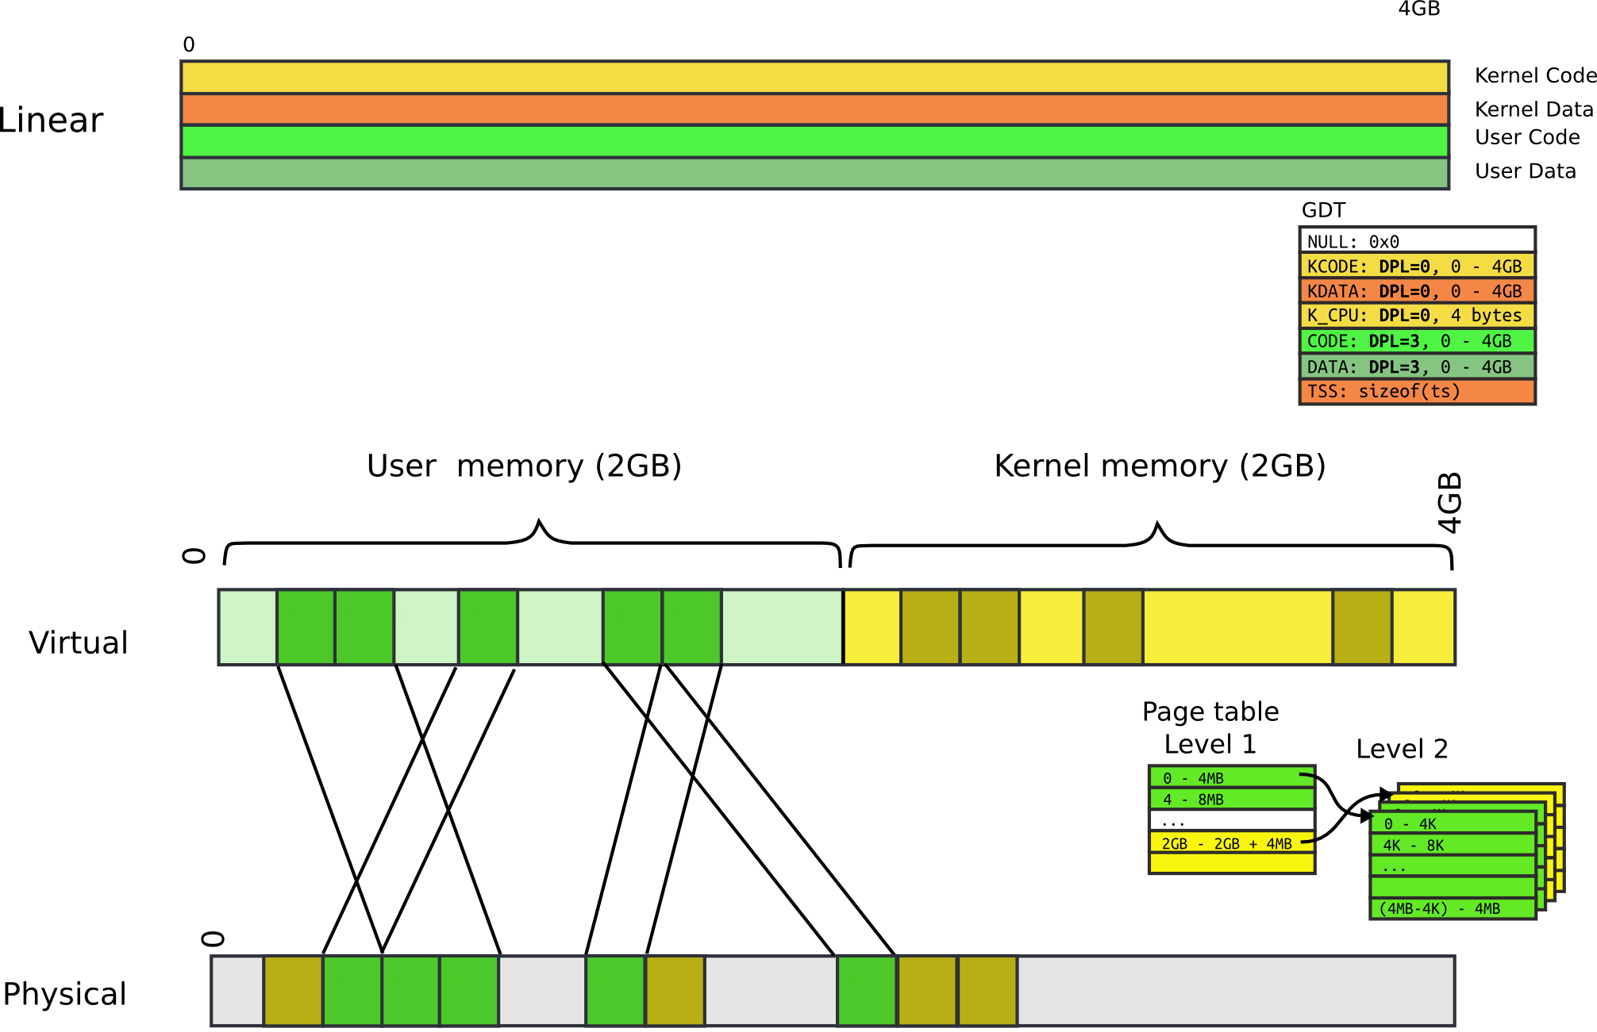

Slide 7
Page table: user bit
Each entry (both Level 1 and Level 2) has a bit
  If set, code at privilege level 3 can access
  If not, only levels 0-2 can access
Note, only 2 levels, not 4 like with segments
All kernel code is mapped with the user bit clear
  This protects user-level code from accessing the kernel

Slide 8
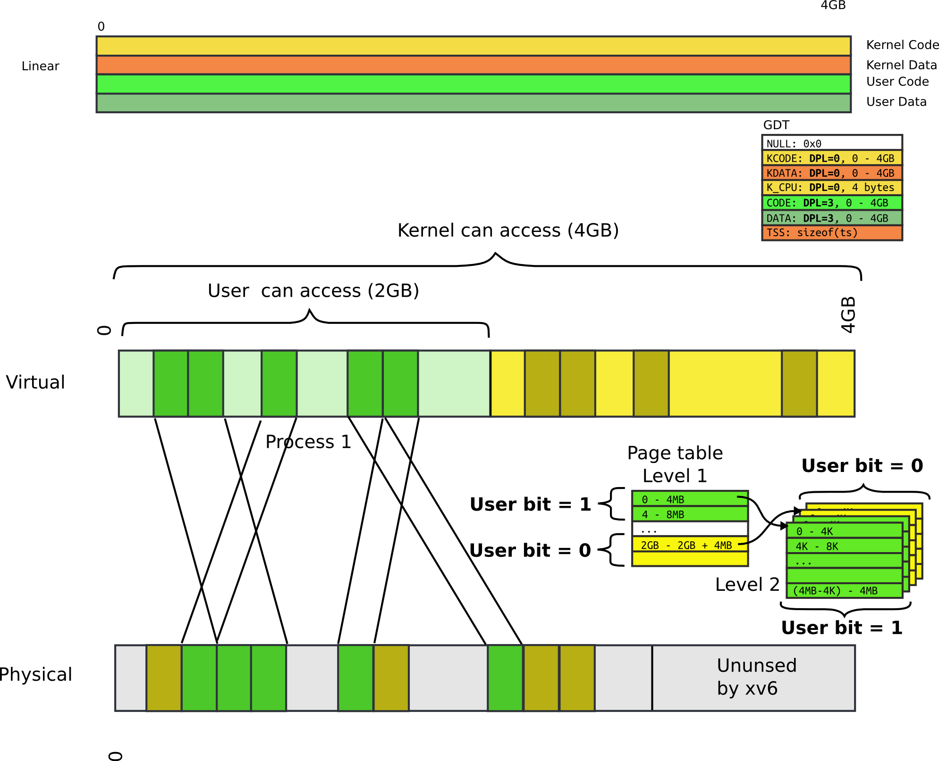

Slide 9
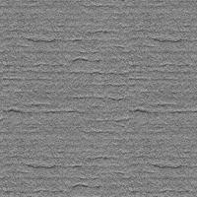

TLB
CPU caches results of page table walks
  In translation lookaside buffer (TLB)
Walking page table is slow
  Each memory access is 200-300 cycles on modern hardware
  L3 cache access is 70 cycles
Virt | Phys
0xf0231000 | 0x1000
0x00b31000 | 0x1f000
0xb0002000 | 0xc1000
- | -
cr3

Slide 10
TLB
TLB is a cache (in CPU)
  It is not coherent with memory
  If page table entry is changes, TLB remains the same and is out of sync
cr3
Virt | Phys
0xf0231000 | 0x1000
0x00b31000 | 0x1f000
0xb0002000 | 0xc1000
- | -
Same
Virt Addr.
No Change!!!

Slide 11
Invalidating TLB
After every page table update, OS needs to manually invalidate cached values
Modern CPUs have “tagged TLBs”,
  Each TLB entry has a “tag” – identifier of a process
  No need to flush TLBs on context switch
On Intel this mechanism is called
  Process-Context Identifiers (PCIDs)

Slide 12
Creating Processes

Slide 13

Recap: kernel memory layout

Slide 14

Process memory layout

Slide 15
How does kernel creates new processes?

Slide 16
How does kernel creates new processes?
Exec
  exec(“/bin/ls”, argv);

Slide 17
exec(): high-level outline
We want to create the following layout
What shall we do?

Slide 18
exec(): high-level outline
Load program from disk
Create user-stack
Run!

Slide 19
exec(): locate inode
6309 int
6310 exec(char *path, char **argv)
6311 {
...
6321 if((ip = namei(path)) == 0){
6322 end_op();
6323 return −1;
6324 }
6328 // Check ELF header
6329 if(readi(ip, (char*)&elf, 0, sizeof(elf)) <
sizeof(elf))
6330 goto bad;
6331 if(elf.magic != ELF_MAGIC)
6332 goto bad;

Slide 20
exec(): check ELF header
6309 int
6310 exec(char *path, char **argv)
6311 {
...
6321 if((ip = namei(path)) == 0){
6322 end_op();
6323 return −1;
6324 }
6328 // Check ELF header
6329 if(readi(ip, (char*)&elf, 0, sizeof(elf)) <
sizeof(elf))
6330 goto bad;
6331 if(elf.magic != ELF_MAGIC)
6332 goto bad;

Slide 21
Setup kernel address space()
6333
6334 if((pgdir = setupkvm()) == 0)
6335 goto bad;
6336

Slide 22

Remember: each process maps kernel in its page table

Slide 23

allocuvm(): allocate user pages

Slide 24

loaduvm(): read program from disk

Slide 25
exec(): allocate process' stack
Allocate two pages
  One will be stack
  Mark another one as inaccessible
6361 sz = PGROUNDUP(sz);
6362 if((sz = allocuvm(pgdir, sz, sz + 2*PGSIZE)) == 0)
6363 goto bad;
6364 clearpteu(pgdir, (char*)(sz − 2*PGSIZE));
6365 sp = sz;

Slide 26

Allocate stack

Slide 27
Switch page tables
Switch page tables
Deallocate old page table
6398 switchuvm(proc);
6399 freevm(oldpgdir);
6400 return 0;

Slide 28
Wait... which page table we are deallocating?

Slide 29
Wait... which page table we are deallocating?
Remember exec() replaces content of an already existing process
  That process had a page table
  We have to deallocate it

Slide 30
Deallocate address space

Slide 31
Outline: deallocate process address space
Walk the page table
  Deallocate all pages mapped by the page table
Deallocate pages that contain Level 2 of the page-table
Deallocate page directory

Slide 32
Deallocate user address space
2015 freevm(pde_t *pgdir)
2016 {
2017 uint i;
2018
2019 if(pgdir == 0)
2020 panic("freevm: no pgdir");
2021 deallocuvm(pgdir, KERNBASE, 0);
2022 for(i = 0; i < NPDENTRIES; i++){
2023 if(pgdir[i] & PTE_P){
2024 char * v = P2V(PTE_ADDR(pgdir[i]));
2025 kfree(v);
2026 }
2027 }
2028 kfree((char*)pgdir);
2029 }

Slide 33
Walk page table and get pte
1987 deallocuvm(pde_t *pgdir, uint oldsz, uint newsz)
1988 {
...
1995 a = PGROUNDUP(newsz);
1996 for(; a < oldsz; a += PGSIZE){
1997 pte = walkpgdir(pgdir, (char*)a, 0);
1998 if(!pte)
1999 a += (NPTENTRIES − 1) * PGSIZE;
2000 else if((*pte & PTE_P) != 0){
2001 pa = PTE_ADDR(*pte);
2002 if(pa == 0)
2003 panic("kfree");
2004 char *v = P2V(pa);
2005 kfree(v);
2006 *pte = 0;
2007 }
2008 }
2009 return newsz;
2010 }

Slide 34
Deallocate a page
1987 deallocuvm(pde_t *pgdir, uint oldsz, uint newsz)
1988 {
...
1995 a = PGROUNDUP(newsz);
1996 for(; a < oldsz; a += PGSIZE){
1997 pte = walkpgdir(pgdir, (char*)a, 0);
1998 if(!pte)
1999 a += (NPTENTRIES − 1) * PGSIZE;
2000 else if((*pte & PTE_P) != 0){
2001 pa = PTE_ADDR(*pte);
2002 if(pa == 0)
2003 panic("kfree");
2004 char *v = P2V(pa);
2005 kfree(v);
2006 *pte = 0;
2007 }
2008 }
2009 return newsz;
2010 }

Slide 35
Deallocate Level 2
2015 freevm(pde_t *pgdir)
2016 {
2017 uint i;
2018
2019 if(pgdir == 0)
2020 panic("freevm: no pgdir");
2021 deallocuvm(pgdir, KERNBASE, 0);
2022 for(i = 0; i < NPDENTRIES; i++){
2023 if(pgdir[i] & PTE_P){
2024 char * v = P2V(PTE_ADDR(pgdir[i]));
2025 kfree(v);
2026 }
2027 }
2028 kfree((char*)pgdir);
2029 }

Slide 36
Recap
We know how exec works!
We can create new processes

Slide 37
Questions?

