Slide 1
ICS143A: Principles of Operating Systems
Lecture 11: Interrupts and Exceptions
Anton Burtsev
February, 2017

Slide 2
12 balls
You have 12 identical-looking balls. One of these balls has a different weight from all the others. You also have a two-pan balance for comparing weights. Using the balance in the smallest number of times possible, determine which ball has the unique weight, and also determine whether it is heavier or lighter than the others. (Hint: 3 measurements)

Slide 3
Why do we need interrupts?
Remember:
hardware interface is designed to help OS

Slide 4
Why do we need interrupts?
Fix an abnormal condition
  Page not mapped in memory
Notifications from external devices
  Network packet received
Preemptive scheduling
  Timer interrupt
Secure interface between OS and applications
  System calls

Slide 5
Two types
Synchronous
Exceptions – react to an abnormal condition
  Map the swapped out page back to memory
  Invoke a system call
  Intel distinguishes 3 types: faults, traps, aborts
Asynchronous
Interrupts – preempt normal execution
  Notify that something has happened (new packet, disk I/O completed, timer tick, notification from another CPU)

Slide 6
Handling interrupts and exceptions
Same procedure
  Stop execution of the current program
  Start execution of a handler
  Processor accesses the handler through an entry in the Interrupt Descriptor Table (IDT)
Each interrupt is defined by a number
  E.g., 14 is pagefault, 3 debug
  This number is an index into the interrupt table (IDT)

Slide 7
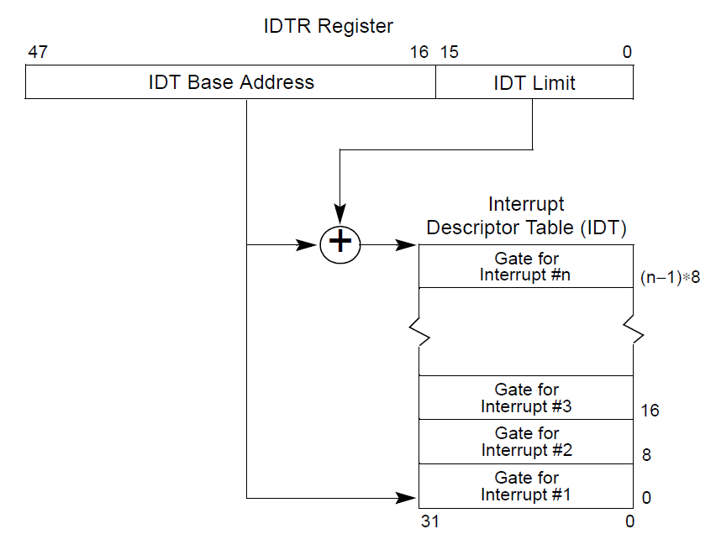

Slide 8
CPU
CPU
Memory

Slide 9
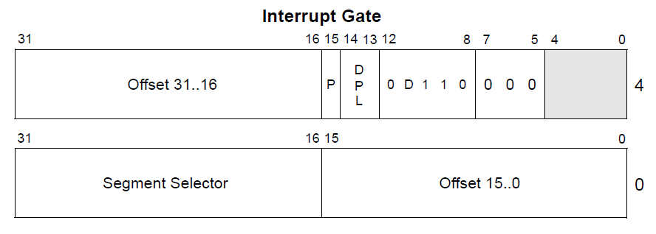
Interrupt descriptor

Slide 10
Interrupt descriptor

Slide 11
Interrupt handlers
Just plain old code in the kernel
The IDT stores a pointer to the right handler routine

Slide 12
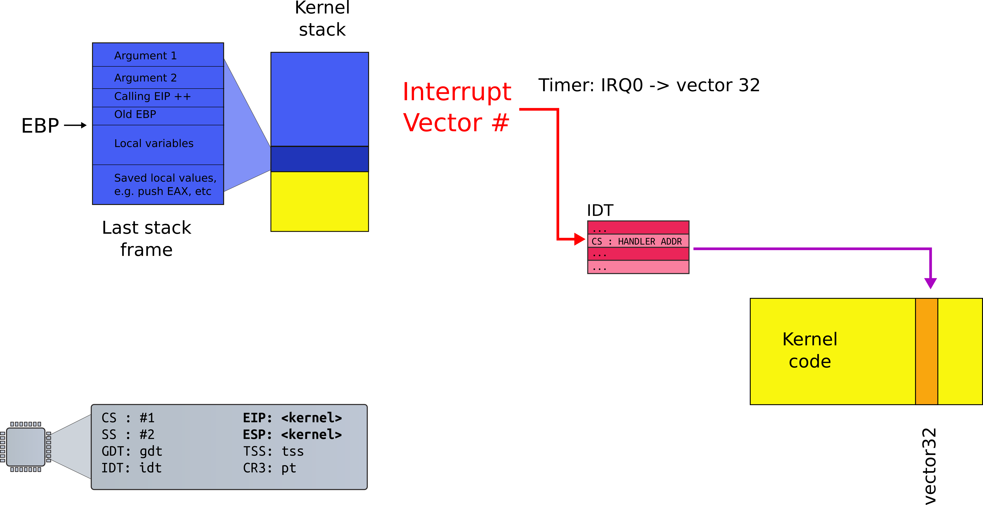
Interrupt path

Slide 13
Processing of interrupt (same PL)
Push the current contents of the EFLAGS, CS, and EIP registers (in that order) on the stack
Push an error code (if appropriate) on the stack
Load the segment selector for the new code segment and the new instruction pointer (from the interrupt gate or trap gate) into the CS and EIP registers
If the call is through an interrupt gate, clear the IF flag in the EFLAGS register
Begin execution of the handler

Slide 14
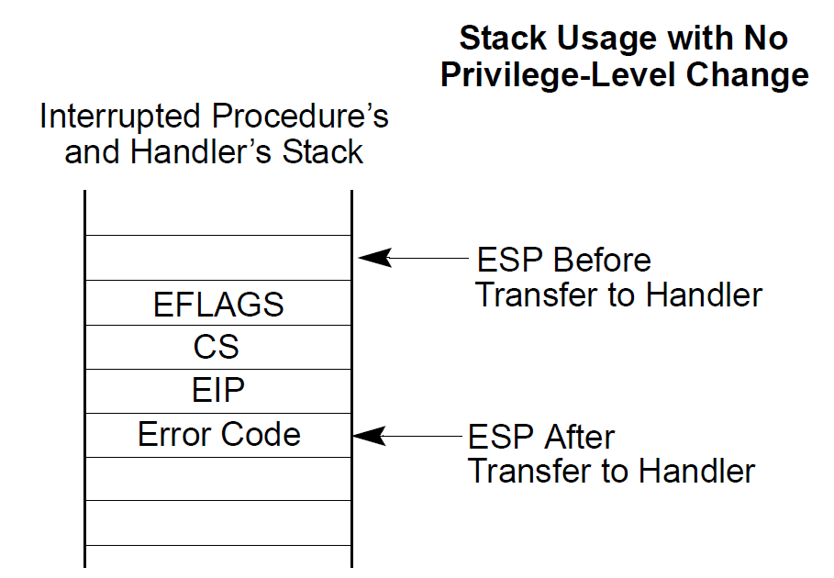

Slide 15
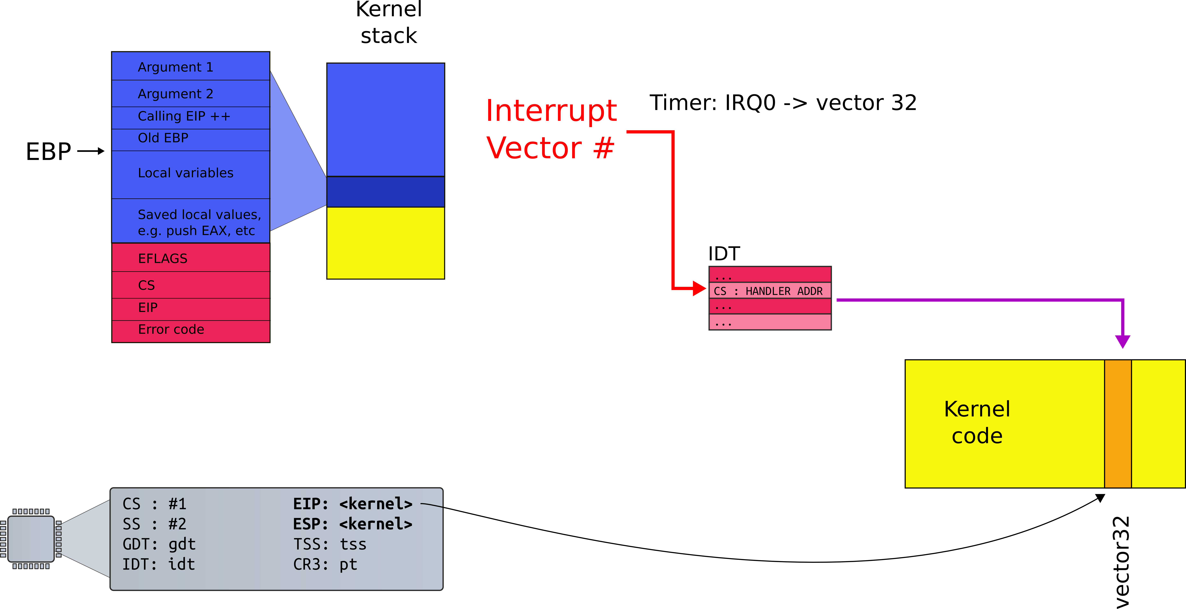
Interrupt path

Slide 16
Processing of interrupt (cross PL)
Need to change privilege level...

Slide 17
Interrupt path

Slide 18
Interrupt descriptor

Slide 19
Stack
Can we continue on the same stack?

Slide 20
Stack
But how hardware knows where it is?

Slide 21
TSS

Slide 22
Task State Segment
Another magic control block
  Pointed to by special task register (TR)
    Selector
    Actually stored in the GDT
  Hardware-specified layout
Lots of fields for rarely-used features
Two features we care about in a modern OS:
  Location of kernel stack (fields SS/ESP)
  I/O Port privileges (more in a later lecture)

Slide 23
Processing of interrupt (cross PL)
Save ESP and SS in a CPU-internal register
Load SS and ESP from TSS
Push user SS, user ESP, user EFLAGS, user CS, user EIP onto new stack (kernel stack)
Set CS and EIP from IDT descriptor's segment selector and offset
If the call is through an interrupt gate clear some EFLAGS bits
Begin execution of a handler

Slide 24
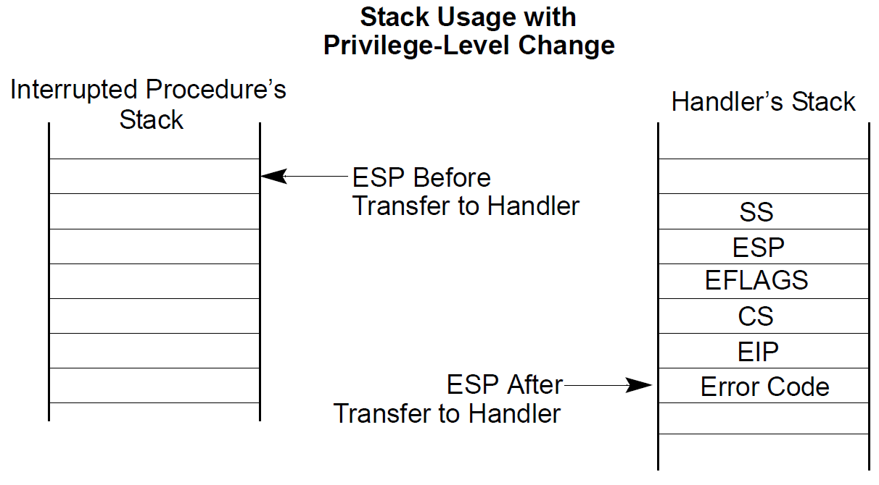

Slide 25
Complete interrupt path

Slide 26
Return from an interrupt
Starts with IRET
  Restore the CS and EIP registers to their values prior to the interrupt or exception
  Restore EFLAGS
  Restore SS and ESP to their values prior to interrupt
    This results in a stack switch
  Resume execution of interrupted procedure

Slide 27
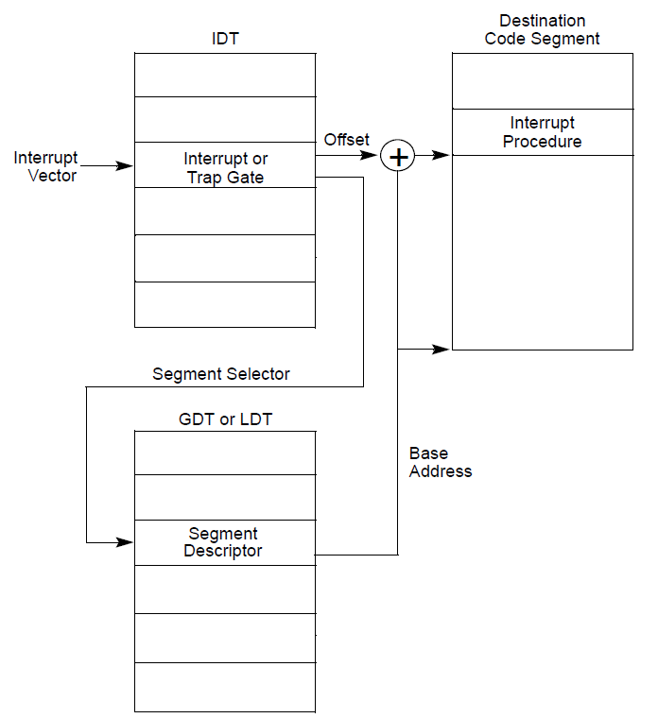
Interrupt gate disables interrupts
  Clears the IF flag in EFLAGS register
Trap gate doesn't
  IF flag is unchanged

Slide 30
x86 interrupt table
Device IRQs
…
…
…
0
31
47
255
Reserved for
the CPU
Software Configurable

Slide 31
Interrupts
Each type of interrupt is assigned an index from 0—255.
  0—31 are for processor interrupts fixed by Intel
  E.g., 14 is always for page faults
32—255 are software configured
  32—47 are often for device interrupts (IRQs)
  Most device’s IRQ line can be configured
  Look up APICs for more info (Ch 4 of Bovet and Cesati)
  0x80 issues system call in Linux (more on this later)

Slide 32
Sources
Interrupts
  External
    Through CPU pins connected to APIC
  Software generated with INT n instruction
Exceptions
  Processor generated, when CPU detects an error in the program
    Fault, trap, abort
  Software generated with INTO, INT 3, BOUND

Slide 33
Software interrupts
The INT n instruction allows software to raise an interrupt
  0x80 is just a Linux convention
  You could change it to use 0x81!
There are a lot of spare indexes
OS sets ring level required to raise an interrupt
  Generally, user programs can’t issue an int 14 (page fault manually)
  An unauthorized int instruction causes a general protection fault
  Interrupt 13

Slide 34
Disabling interrupts
Delivery of maskable interrupts can be disabled with IF (interrupt flag) in EFLAGS register
Exceptions
  Non-maskable interrupts (see next slide)
  INT n – cannot be masked as it is synchronous

Slide 35
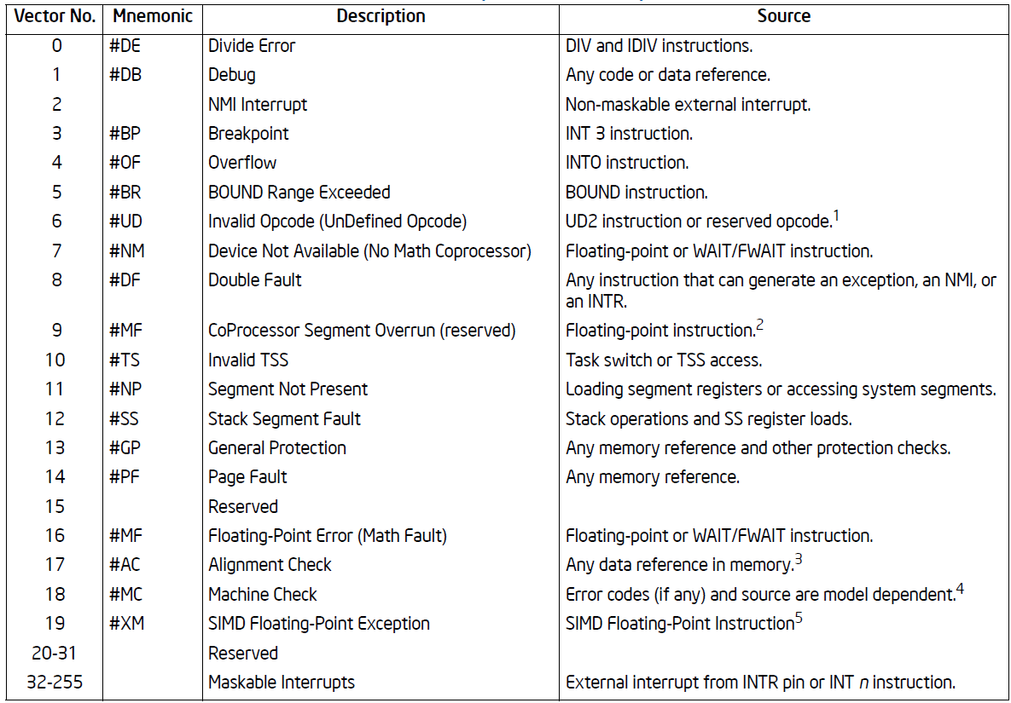

Slide 37
Nonmaskable interrupts (NMI)
Delivered even if IF is clear, e.g. interrupts disabled
  CPU blocks subsequent NMI interrupts until IRET
Sources
  External hardware asserts the NMI pin
  Processor receives a message on the system bus, or the APIC serial bus with NMI delivery mode
Delivered via vector #2

Slide 39
Thank you.

