Slide 1
ICS143A: Principles of Operating Systems
Lecture 13: Context switching
Anton Burtsev
February, 2017

Slide 2
  User mode
  Two stacks
    Kernel and user
    Kernel stack is empty

Slide 3
Page table
GDT

Slide 4
Page table
GDT

Slide 5
Timer interrupt

Slide 6
Interrupt path

Slide 7
Where does IDT
(entry 32) point to?
vector32:
pushl $0 // error code
pushl $32 // vector #
jmp alltraps
Automatically generated
From vectors.pl
  vector.S

Slide 8

Kernel stack after interrupt

Slide 9
alltraps()
3254 alltraps:
3255 # Build trap frame.
3256 pushl %ds
3257 pushl %es
3258 pushl %fs
3259 pushl %gs
3260 pushal
3261
3262 # Set up data and per−cpu segments.
3263 movw $(SEG_KDATA<<3), %ax
3264 movw %ax, %ds
3265 movw %ax, %es
3266 movw $(SEG_KCPU<<3), %ax
3267 movw %ax, %fs
3268 movw %ax, %gs
3269
3270 # Call trap(tf), where tf=%esp
3271 pushl %esp
3272 call trap

Slide 10

Kernel stack after interrupt

Slide 11
alltraps()
3254 alltraps:
3255 # Build trap frame.
3256 pushl %ds
3257 pushl %es
3258 pushl %fs
3259 pushl %gs
3260 pushal
3261
3262 # Set up data and per−cpu segments.
3263 movw $(SEG_KDATA<<3), %ax
3264 movw %ax, %ds
3265 movw %ax, %es
3266 movw $(SEG_KCPU<<3), %ax
3267 movw %ax, %fs
3268 movw %ax, %gs
3269
3270 # Call trap(tf), where tf=%esp
3271 pushl %esp
3272 call trap

Slide 12
trap()
3351 trap(struct trapframe *tf)
3352 {
...
3363 switch(tf−>trapno){
3364 case T_IRQ0 + IRQ_TIMER:
3365 if(cpu−>id == 0){
3366 acquire(&tickslock);
3367 ticks++;
3368 wakeup(&ticks);
3369 release(&tickslock);
3370 }
3372 break;
...
3423 if(proc && proc−>state == RUNNING
&& tf−>trapno == T_IRQ0+IRQ_TIMER)
3424 yield();

Slide 13
Invoke the scheduler
2777 yield(void)
2778 {
2779 acquire(&ptable.lock);
2780 proc−>state = RUNNABLE;
2781 sched();
2782 release(&ptable.lock);
2783 }

Slide 14
Start the context switch
2758 sched(void)
2759 {
...
2771 swtch(&proc−>context,
cpu−>scheduler);
...
2773 }

Slide 15
swtch()
2958 swtch:
2959 movl 4(%esp), %eax
2960 movl 8(%esp), %edx
2961
2962 # Save old callee−save registers
2963 pushl %ebp
2964 pushl %ebx
2965 pushl %esi
2966 pushl %edi
2967
2968 # Switch stacksh
2969 movl %esp, (%eax)
2970 movl %edx, %esp
2971
2972 # Load new callee−save registers
2973 popl %edi
2974 popl %esi
2975 popl %ebx
2976 popl %ebp
2977 ret
void swtch(struct context **old,
struct context *new);
First argument:
  A pointer to a pointer to a context
  That we're going to save
Second argument:
  A pointer to a context
  We're going to restore

Slide 16
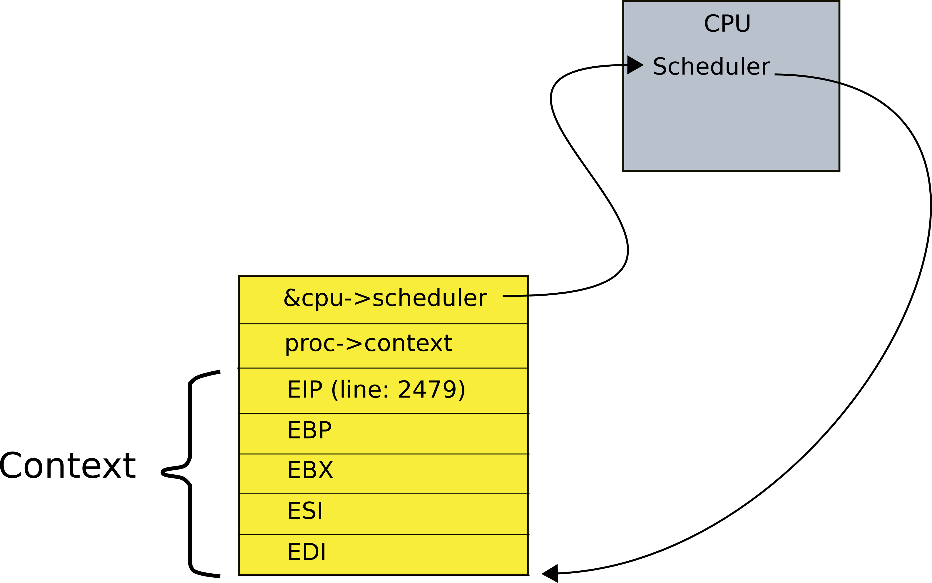
Context data structure
2093 struct context {
2094 uint edi;
2095 uint esi;
2096 uint ebx;
2097 uint ebp;
2098 uint eip;
2099 };

Slide 17
swtch()
2958 swtch:
2959 movl 4(%esp), %eax
2960 movl 8(%esp), %edx
2961
2962 # Save old callee−save registers
2963 pushl %ebp
2964 pushl %ebx
2965 pushl %esi
2966 pushl %edi
2967
2968 # Switch stacksh
2969 movl %esp, (%eax)
2970 movl %edx, %esp
2971
2972 # Load new callee−save registers
2973 popl %edi
2974 popl %esi
2975 popl %ebx
2976 popl %ebp
2977 ret
2093 struct context {
2094 uint edi;
2095 uint esi;
2096 uint ebx;
2097 uint ebp;
2098 uint eip;
2099 };

Slide 18
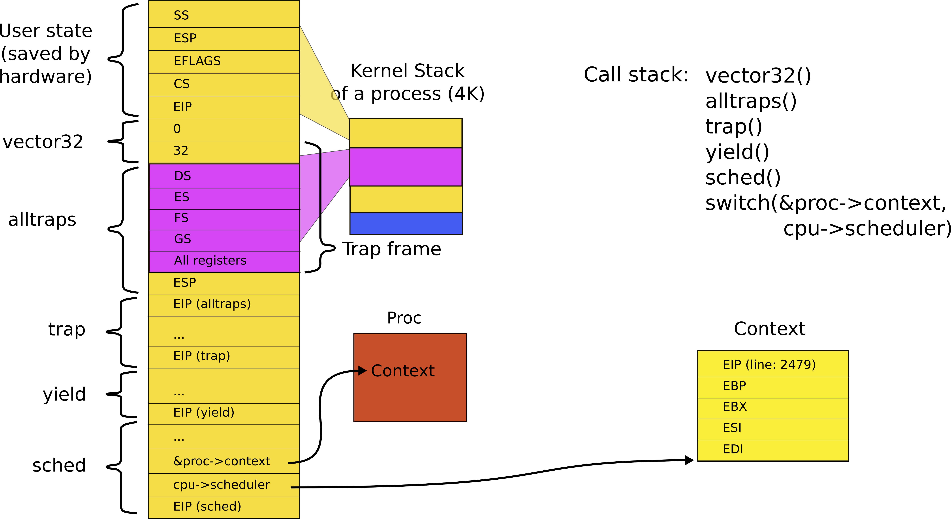
Stack inside swtch() and its two arguments (passed on the stack)

Slide 19
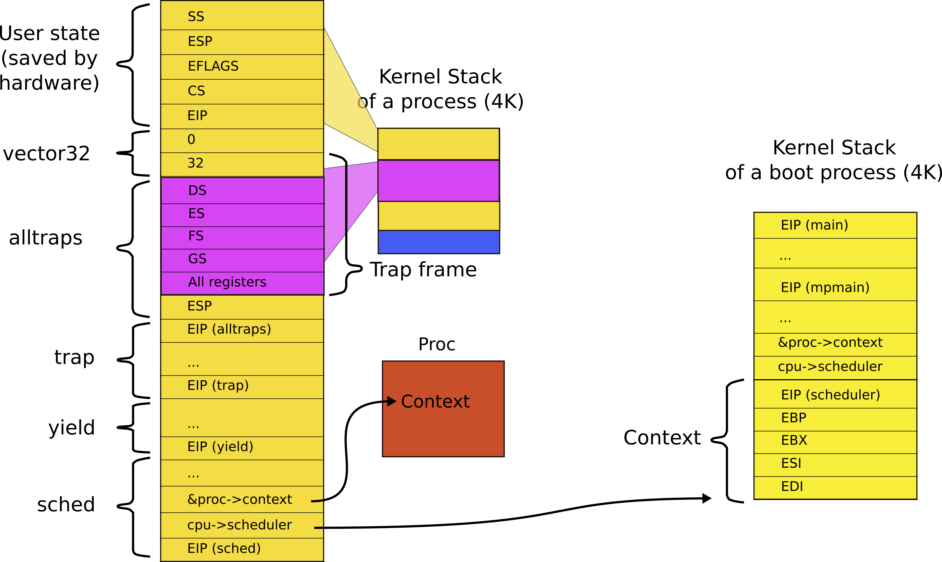
Context is always top of some stack

Slide 20
Context is always top of some stack, why?
Remember how we initialized each CPU last time?

Slide 21
1251 static void
1252 mpenter(void)
1253 {
1254 switchkvm();
1255 seginit();
1256 lapicinit();
1257 mpmain();
1258 }

Slide 22
1260 // Common CPU setup code.
1261 static void
1262 mpmain(void)
1263 {
1264 cprintf("cpu%d: starting\n", cpu−>id);
1265 idtinit(); // load idt register
1266 xchg(&cpu−>started, 1);
1267 scheduler(); // start running processes
1268 }

Slide 23
We ended boot by starting a scheduler

Slide 24
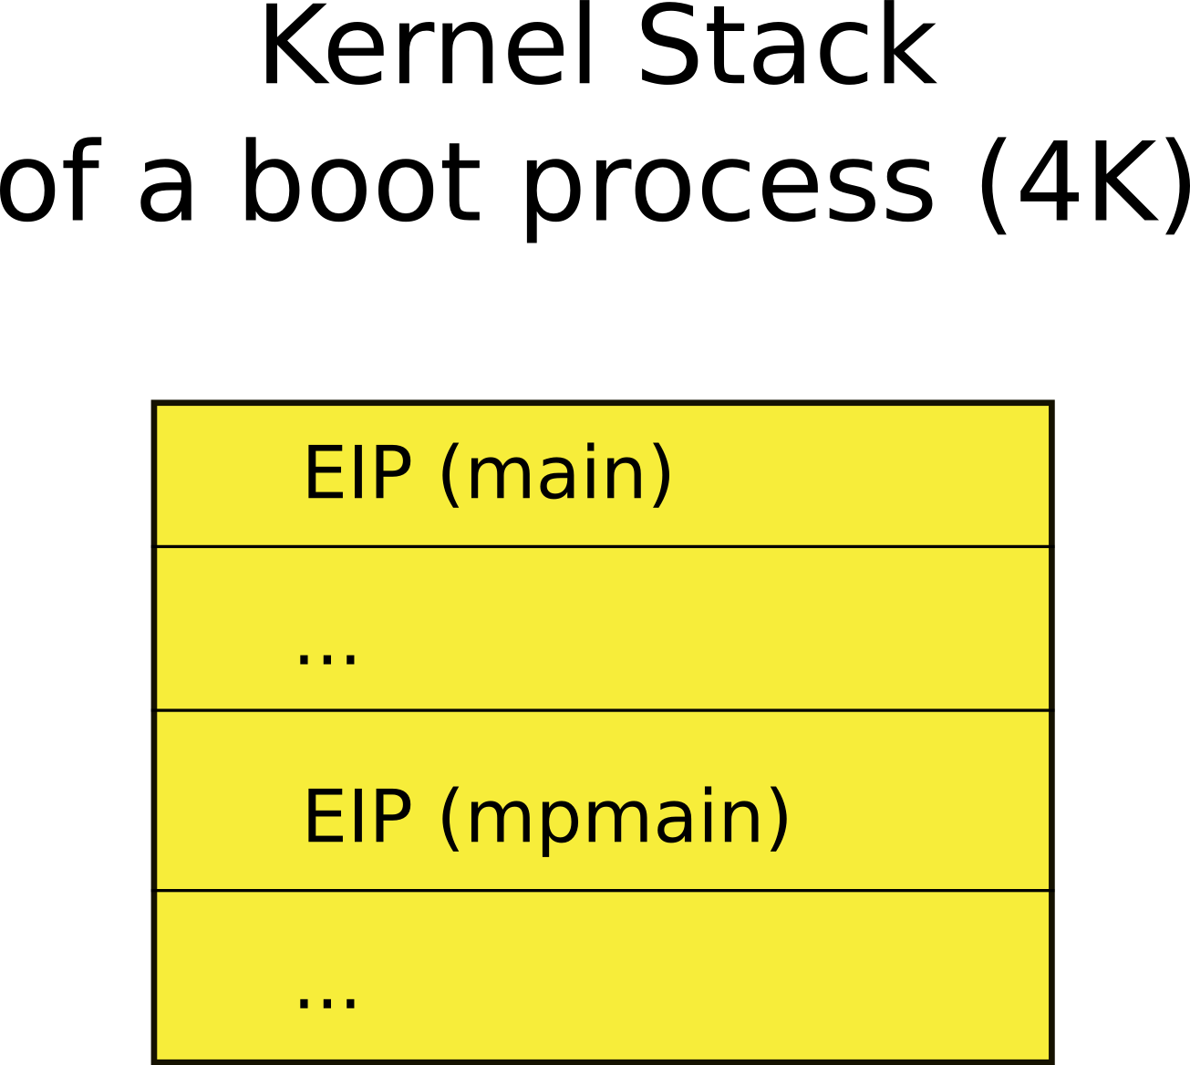
Remember the stack of the boot process?

Slide 25
How does scheduler start?
2458 scheduler(void)
2459 {
2462 for(;;){
2468 for(p = ptable.proc; p < &ptable.proc[NPROC]; p++){
2469 if(p−>state != RUNNABLE)
2470 continue;
2475 proc = p;
2476 switchuvm(p);
2477 p−>state = RUNNING;
2478 swtch(&cpu−>scheduler, proc−>context);
2479 switchkvm();
2483 proc = 0;
2484 }
2487 }
2488 }
Chooses next process to run
Switches to it
  From the current context

Slide 26
So when the scheduler context switched the first time
2478 swtch(&cpu−>scheduler,
proc−>context);
It saved its own context
&cpu−>scheduler
And restored a context of the first process
proc−>context

Slide 27
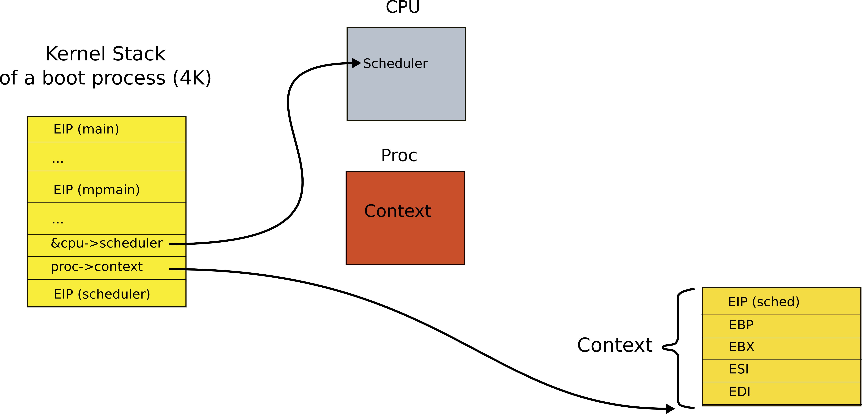
This is how stack looked like when scheduler() invoked swtch() for the first time
What is this context?

Slide 28
This is how stack looked like when scheduler() invoked swtch() for the first time
What is this context?
It's the context of the first process scheduler decides to run

Slide 29

Save context of the scheduler

Slide 30
swtch()
2958 swtch:
2959 movl 4(%esp), %eax // struct context **old
2960 movl 8(%esp), %edx // struct context *new
2961
2962 # Save old callee−save registers
2963 pushl %ebp
2964 pushl %ebx
2965 pushl %esi
2966 pushl %edi
2967
2968 # Switch stacksh
2969 movl %esp, (%eax) // load current context (top of current stack) into
// the memory location pointed by *old
2970 movl %edx, %esp // set stack to be equal to *new (the top of the new context)
2971
2972 # Load new callee−save registers
2973 popl %edi
2974 popl %esi
2975 popl %ebx
2976 popl %ebp
2977 ret

Slide 31
This is why the context is the top of some stack
Initially it was the stack of mpenter()
  On which scheduler started
Then first process...
  Then scheduler again
  And the next process...

Slide 32
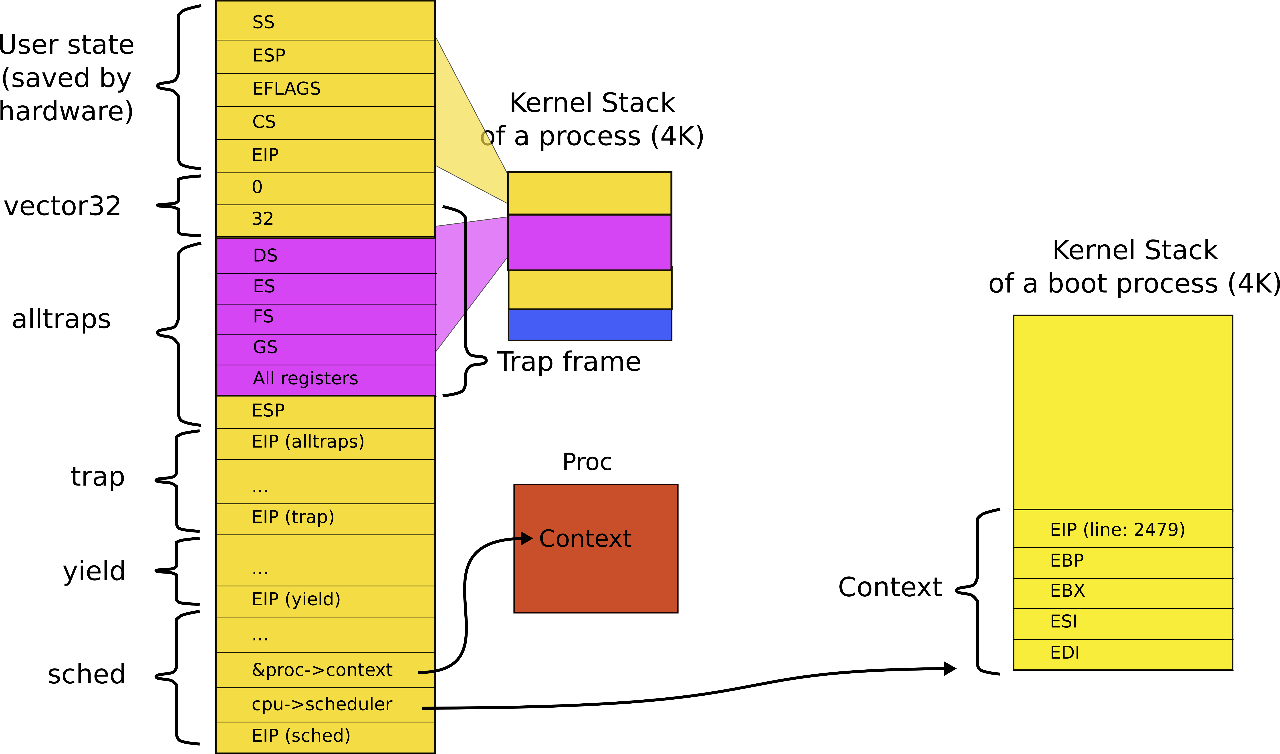
Back to main context switch: so context is always top of some stack

Slide 33
Currently the *new context is the stack of the scheduler
We switch to the scheduler,
It runs on the stack of the boot process

Slide 34
swtch()
2958 swtch:
2959 movl 4(%esp), %eax // struct context **old
2960 movl 8(%esp), %edx // struct context *new
2961
2962 # Save old callee−save registers
2963 pushl %ebp
2964 pushl %ebx
2965 pushl %esi
2966 pushl %edi
2967
2968 # Switch stacks
2969 movl %esp, (%eax) // load current context (top of current stack) into
// the memory location pointed by *old
2970 movl %edx, %esp // set stack to be equal to *new (the top of the new context)
2971
2972 # Load new callee−save registers
2973 popl %edi
2974 popl %esi
2975 popl %ebx
2976 popl %ebp
2977 ret

Slide 35
And now: exit from swtch()
2958 swtch:
2959 movl 4(%esp), %eax
2960 movl 8(%esp), %edx
2961
2962 # Save old callee−save registers
2963 pushl %ebp
2964 pushl %ebx
2965 pushl %esi
2966 pushl %edi
2967
2968 # Switch stacks
2969 movl %esp, (%eax)
2970 movl %edx, %esp
2971
2972 # Load new callee−save registers
2973 popl %edi
2974 popl %esi
2975 popl %ebx
2976 popl %ebp
2977 ret

Slide 36
Where does this swtch() return?

Slide 37
Where does this swtch() return?
Scheduler
After all remember
  We started with timer interrupt
  Entered the kernel
  Entered schedule()
  Entered switch
And are currently on our way from the process into the scheduler

Slide 38
What does scheduler do?
2458 scheduler(void)
2459 {
2462 for(;;){
2468 for(p = ptable.proc; p < &ptable.proc[NPROC]; p++){
2469 if(p−>state != RUNNABLE)
2470 continue;
2475 proc = p;
2476 switchuvm(p);
2477 p−>state = RUNNING;
2478 swtch(&cpu−>scheduler, proc−>context);
2479 switchkvm();
2483 proc = 0;
2484 }
2487 }
2488 }
Chooses next process to run
Switches to it

Slide 39
What does stack look like when scheduler() invokes swtch()?
What is this context?

Slide 40
What does stack look like when scheduler() invokes swtch()?
What is this context?
  Right the context of the next process to run

Slide 41
We save the context of the scheduler again
Restore the context of the next proces

Slide 42
Remember, from inside the scheduler we invoked swtch() as
2478 swtch(&cpu−>scheduler,
proc−>context);
Hence, we save context of the scheduler into
&cpu−>scheduler
And restore
proc−>context

Slide 43
Stacks and context inside swtch()

Slide 44
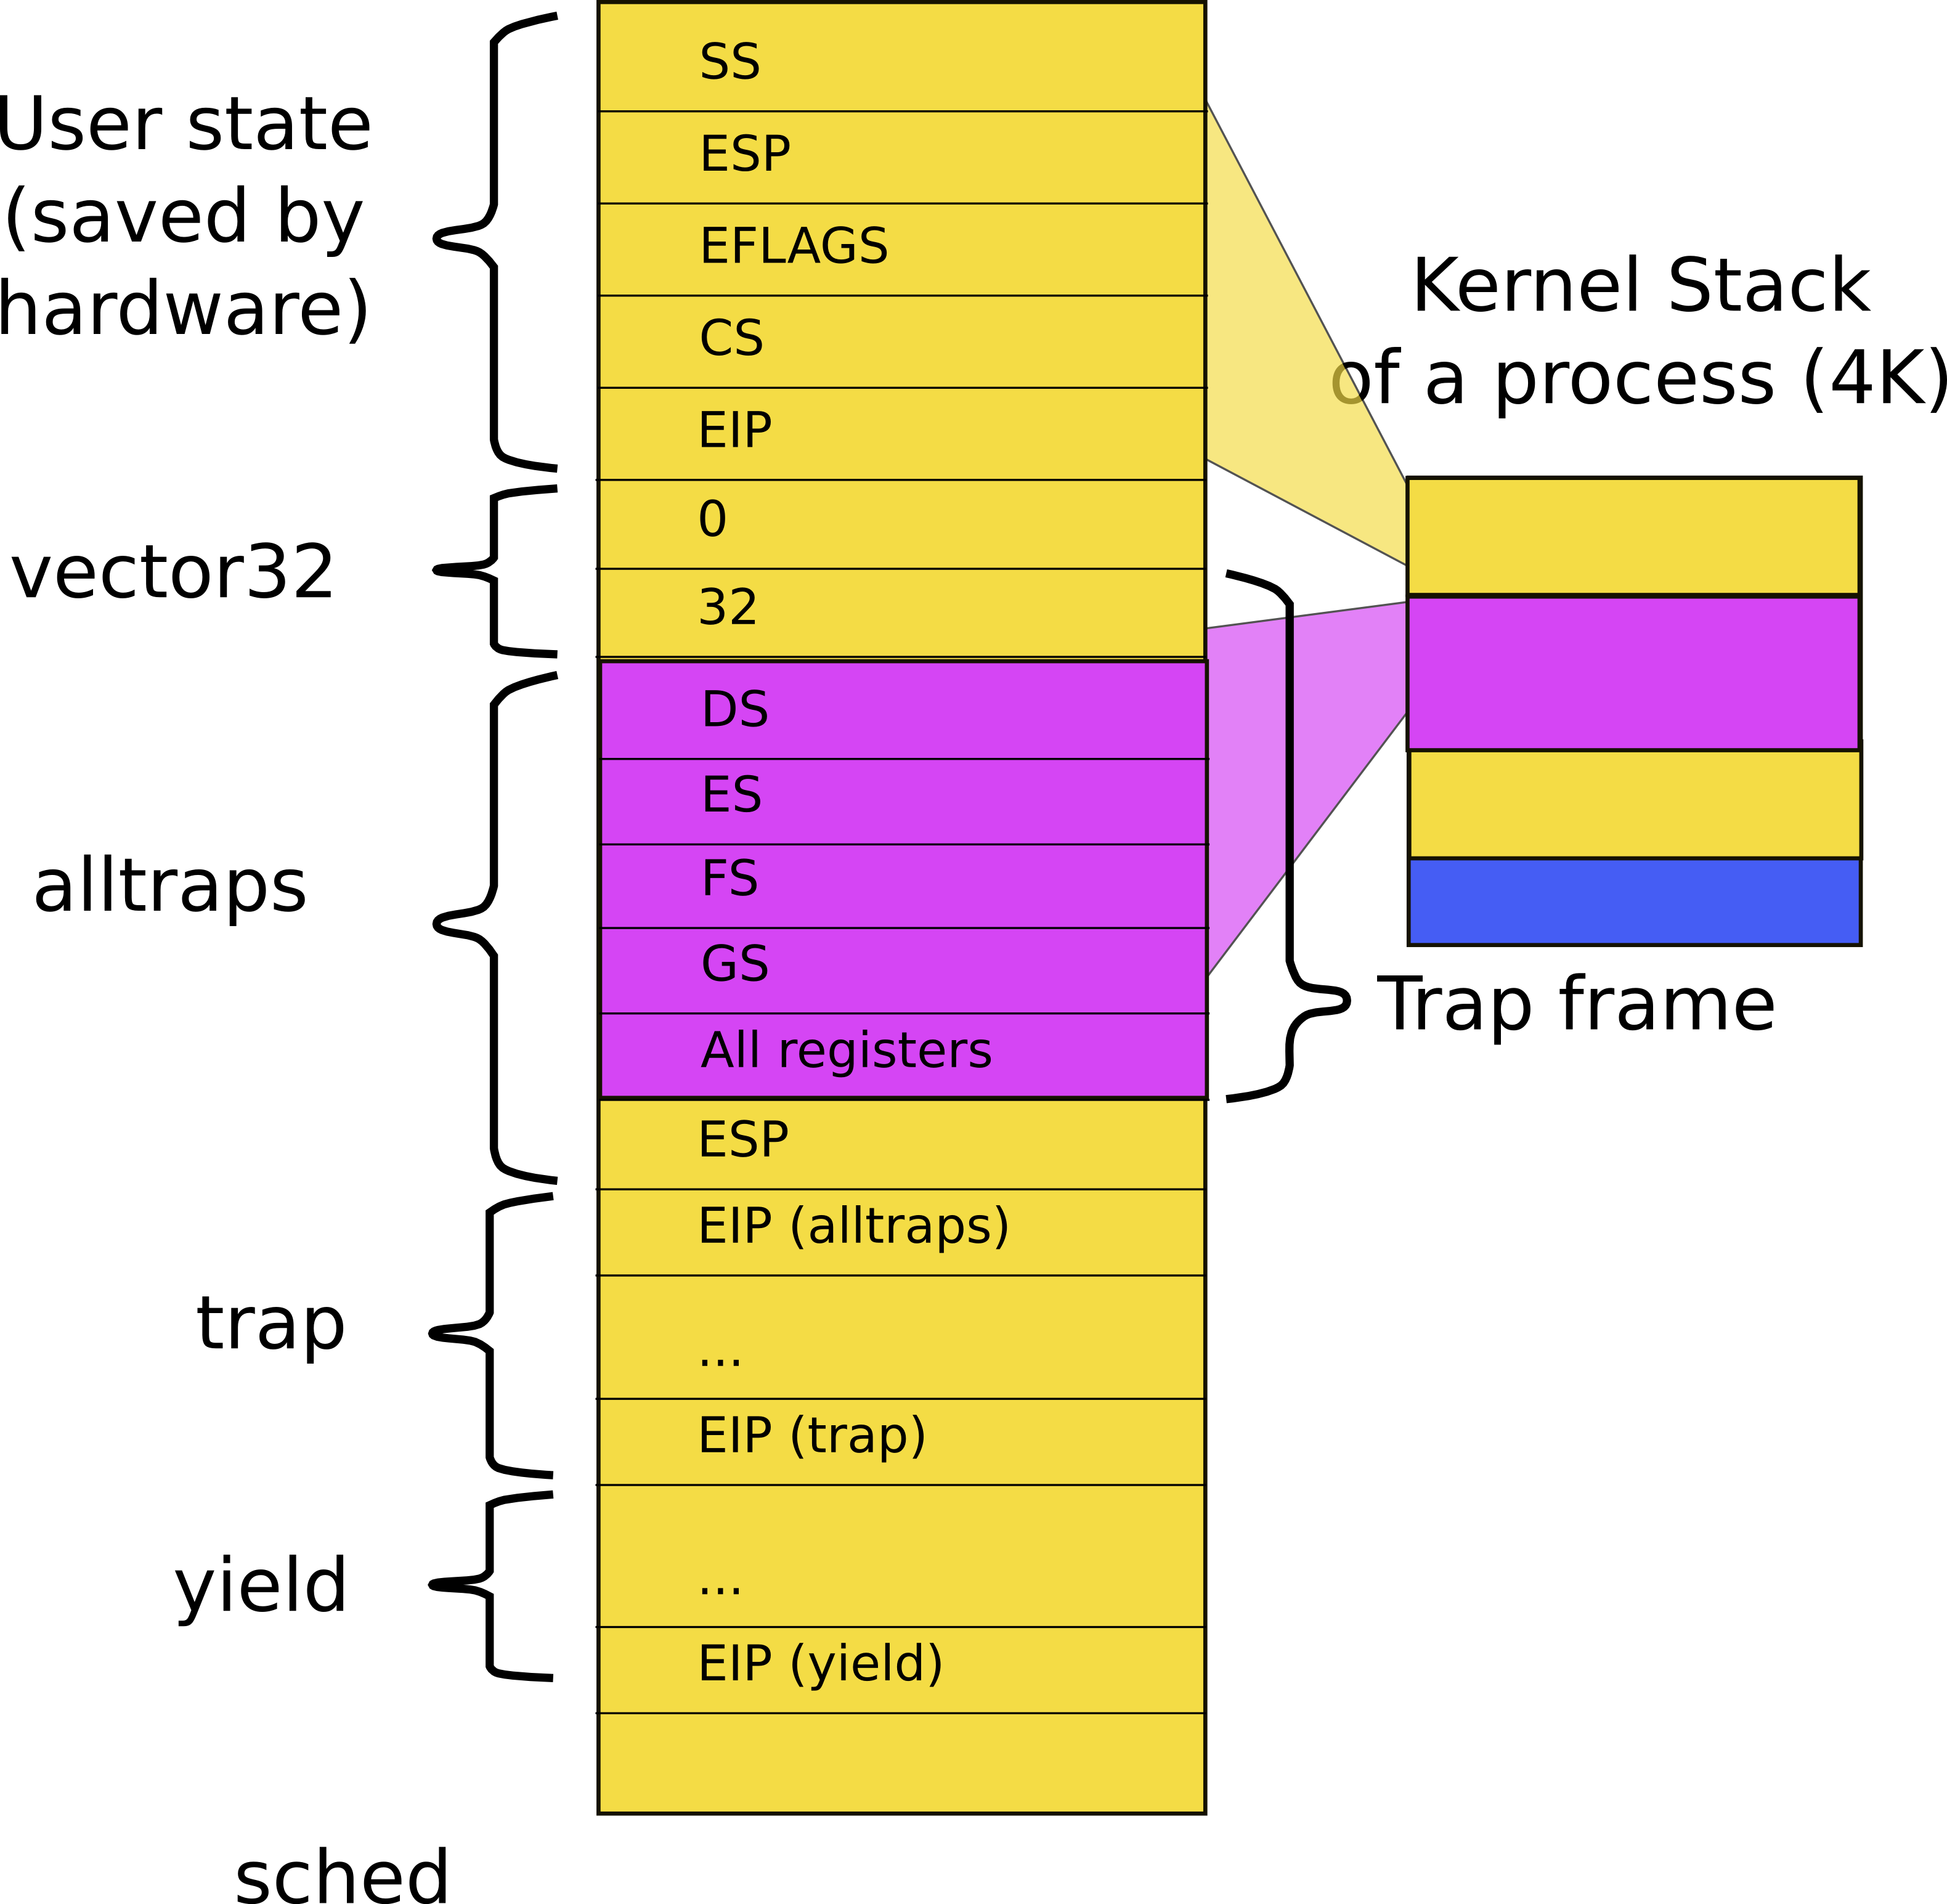
Exiting back to user-level
Stack inside sched()
  Normal returns until back to alltrap()

Slide 45
alltraps(): Exiting back into user level process
3004 alltraps:
...
3020 # Call trap(tf), where tf=%esp
3021 pushl %esp
3022 call trap
3023 addl $4, %esp
3024
3025 # Return falls through to trapret...
3026 .globl trapret
3027 trapret:
3028 popal
3029 popl %gs
3030 popl %fs
3031 popl %es
3032 popl %ds
3033 addl $0x8, %esp # trapno and errcode
3034 iret

Slide 46
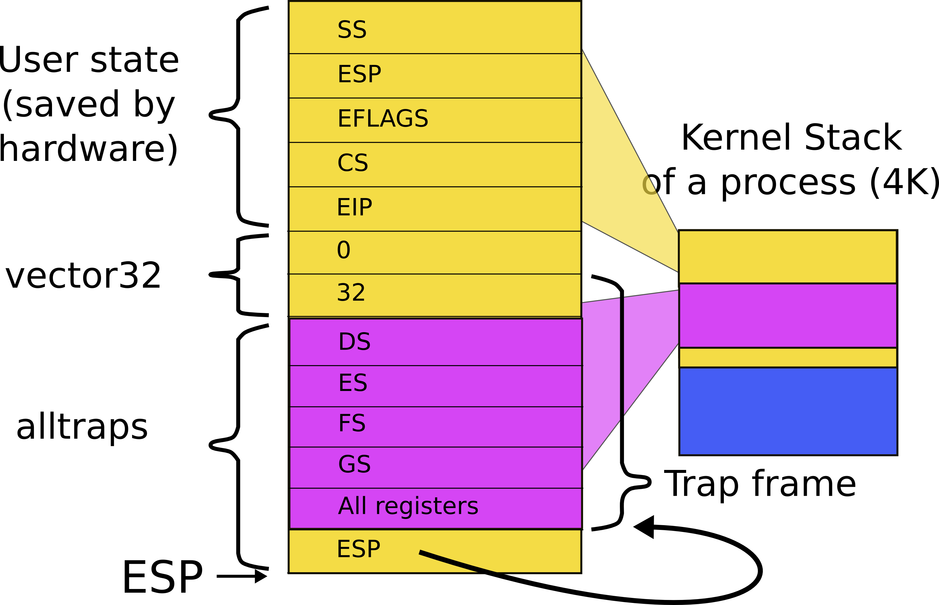
Stack after trap() returns

Slide 47
alltraps(): exiting
3004 alltraps:
...
3020 # Call trap(tf), where tf=%esp
3021 pushl %esp
3022 call trap
3023 addl $4, %esp
3024
3025 # Return falls through to trapret...
3026 .globl trapret
3027 trapret:
3028 popal
3029 popl %gs
3030 popl %fs
3031 popl %es
3032 popl %ds
3033 addl $0x8, %esp # trapno and errcode
3034 iret
Restore all registers
Exit into user
  iret

Slide 48
We're back to where we started, but in a new process

Slide 49
Summary
We switch between processes now

Slide 50
Thank you

