Slide 1
ICS143A: Principles of Operating Systems
Lecture 14: System calls & the first process (again!)
Anton Burtsev
February, 2017

Slide 2
12 balls
You have 12 identical-looking balls. One of these balls has a different weight from all the others. You also have a two-pan balance for comparing weights. Using the balance in the smallest number of times possible, determine which ball has the unique weight, and also determine whether it is heavier or lighter than the others. (Hint: 3 measurements)

Slide 3


Slide 4
12 balls
...One of the most beautiful riddles...

Slide 5


Slide 6
But ok... how to solve it?

Slide 7
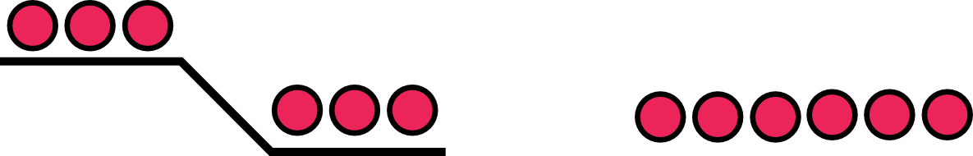
Measurement #1
We know symmetry is good
  Middle of array... fast search

Slide 8
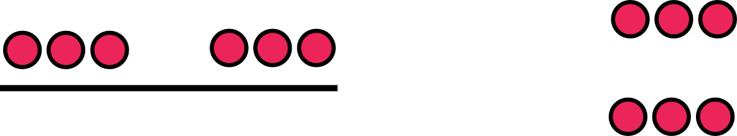
Measurement #2

Slide 9
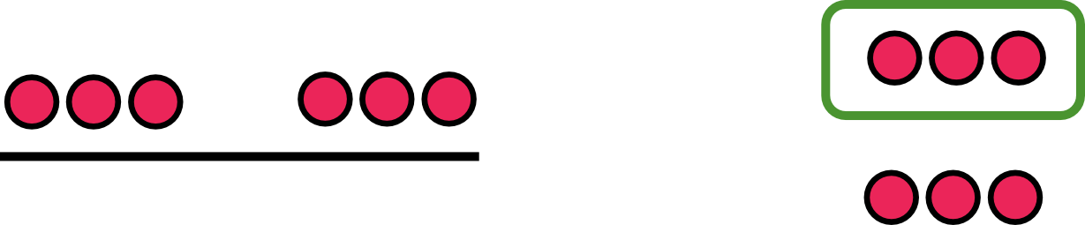
Measurement #2
It's one of these three

Slide 10
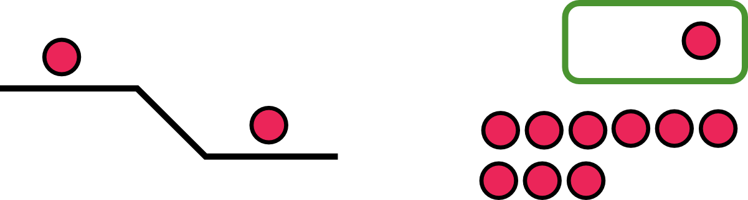
Measurement #3
It's one of these two... but which?

Slide 11


Slide 12
System calls

Slide 13
  User mode
  Two stacks
    Kernel and user
    Kernel stack is empty

Slide 14
Page table
GDT

Slide 15
Page table
GDT

Slide 16
Timer interrupt

Slide 17
Interrupt path

Slide 18
Initialize IDT
3316 void
3317 tvinit(void)
3318 {
3319 int i;
3320
3321 for(i = 0; i < 256; i++)
3322 SETGATE(idt[i], 0, SEG_KCODE<<3, vectors[i], 0);
3323 SETGATE(idt[T_SYSCALL], 1, SEG_KCODE<<3,
vectors[T_SYSCALL], DPL_USER);
3324
3325 initlock(&tickslock, "time");
3326 }
tvinit() is called from main()

Slide 19
Initialize IDT
3316 void
3317 tvinit(void)
3318 {
3319 int i;
3320
3321 for(i = 0; i < 256; i++)
3322 SETGATE(idt[i], 0, SEG_KCODE<<3, vectors[i], 0);
3323 SETGATE(idt[T_SYSCALL], 1, SEG_KCODE<<3,
vectors[T_SYSCALL], DPL_USER);
3324
3325 initlock(&tickslock, "time");
3326 }
A couple of important details

Slide 20
Initialize IDT
3316 void
3317 tvinit(void)
3318 {
3319 int i;
3320
3321 for(i = 0; i < 256; i++)
3322 SETGATE(idt[i], 0, SEG_KCODE<<3, vectors[i], 0);
3323 SETGATE(idt[T_SYSCALL], 1, SEG_KCODE<<3,
vectors[T_SYSCALL], DPL_USER);
3324
3325 initlock(&tickslock, "time");
3326 }
Only int T_SYSCALL can be called from user-level

Slide 21
Initialize IDT
3316 void
3317 tvinit(void)
3318 {
3319 int i;
3320
3321 for(i = 0; i < 256; i++)
3322 SETGATE(idt[i], 0, SEG_KCODE<<3, vectors[i], 0);
3323 SETGATE(idt[T_SYSCALL], 1, SEG_KCODE<<3,
vectors[T_SYSCALL], DPL_USER);
3324
3325 initlock(&tickslock, "time");
3326 }
Syscall is a “trap”
i.e., doesn't disable interrupts

Slide 22
Where does IDT
(entry 64) point to?
vector64:
pushl $0 // error code
pushl $64 // vector #
jmp alltraps
Automatically generated
From vectors.pl
  vector.S

Slide 23

Kernel stack after interrupt

Slide 24

Kernel stack after interrupt

Slide 25
Syscall number
System call number is passed in the %eax register
  To distinguish which syscall to process, e.g., sys_read, sys_exec, etc.
alltrap() saves it as rest of the registers

Slide 26
alltraps()
3254 alltraps:
3255 # Build trap frame.
3256 pushl %ds
3257 pushl %es
3258 pushl %fs
3259 pushl %gs
3260 pushal
3261
3262 # Set up data and per−cpu segments.
3263 movw $(SEG_KDATA<<3), %ax
3264 movw %ax, %ds
3265 movw %ax, %es
3266 movw $(SEG_KCPU<<3), %ax
3267 movw %ax, %fs
3268 movw %ax, %gs
3269
3270 # Call trap(tf), where tf=%esp
3271 pushl %esp
3272 call trap

Slide 27
Remember we went to trap() to handle timer interrup
3351 trap(struct trapframe *tf)
3352 {
...
3363 switch(tf−>trapno){
3364 case T_IRQ0 + IRQ_TIMER:
3365 if(cpu−>id == 0){
3366 acquire(&tickslock);
3367 ticks++;
3368 wakeup(&ticks);
3369 release(&tickslock);
3370 }
3372 break;
...
3423 if(proc && proc−>state == RUNNING
&& tf−>trapno == T_IRQ0+IRQ_TIMER)
3424 yield();

Slide 28
Same for syscalls
3351 trap(struct trapframe *tf)
3352 {
3353 if(tf−>trapno == T_SYSCALL){
3354 if(proc−>killed)
3355 exit();
3356 proc−>tf = tf;
3357 syscall();
3358 if(proc−>killed)
3359 exit();
3360 return;
3361 }
3362
3363 switch(tf−>trapno){
3364 case T_IRQ0 + IRQ_TIMER:

Slide 29
syscall(): get the number from trap frame
3625 syscall(void)
3626 {
3627 int num;
3628
3629 num = proc−>tf−>eax;
3630 if(num > 0 && num < NELEM(syscalls) && syscalls[num]) {
3631 proc−>tf−>eax = syscalls[num]();
3632 } else {
3633 cprintf("%d %s: unknown sys call %d\n",
3634 proc−>pid, proc−>name, num);
3635 proc−>tf−>eax = −1;
3636 }
3637 }

Slide 30
syscall(): process a syscall from the table
3625 syscall(void)
3626 {
3627 int num;
3628
3629 num = proc−>tf−>eax;
3630 if(num > 0 && num < NELEM(syscalls) && syscalls[num]) {
3631 proc−>tf−>eax = syscalls[num]();
3632 } else {
3633 cprintf("%d %s: unknown sys call %d\n",
3634 proc−>pid, proc−>name, num);
3635 proc−>tf−>eax = −1;
3636 }
3637 }

Slide 31
System call table
3600 static int (*syscalls[])(void) = {
3601 [SYS_fork] sys_fork,
3602 [SYS_exit] sys_exit,
3603 [SYS_wait] sys_wait,
3604 [SYS_pipe] sys_pipe,
3605 [SYS_read] sys_read,
3606 [SYS_kill] sys_kill,
3607 [SYS_exec] sys_exec,
3608 [SYS_fstat] sys_fstat,
3609 [SYS_chdir] sys_chdir,
3610 [SYS_dup] sys_dup,
3611 [SYS_getpid] sys_getpid,
3612 [SYS_sbrk] sys_sbrk,
3613 [SYS_sleep] sys_sleep,
3614 [SYS_uptime] sys_uptime,
3615 [SYS_open] sys_open,
3616 [SYS_write] sys_write,
3617 [SYS_mknod] sys_mknod,
3618 [SYS_unlink] sys_unlink,
3619 [SYS_link] sys_link,
3620 [SYS_mkdir] sys_mkdir,
3621 [SYS_close] sys_close,
3622 };

Slide 32
What do you think is the first system call xv6 executes?

Slide 33
1317 main(void)
1318 {
1319 kinit1(end, P2V(4*1024*1024)); // phys page allocator
1320 kvmalloc(); // kernel page table
1321 mpinit(); // detect other processors
...
1323 seginit(); // segment descriptors
...
1330 tvinit(); // trap vectors
...
1338 userinit(); // first user process
1339 mpmain(); // finish this processor’s setup
1340 }

Slide 34
Userinit() – create first process
Allocate process structure
  Information about the process

Slide 35
2502 userinit(void)
2503 {
2504 struct proc *p;
2505 extern char _binary_initcode_start[],
_binary_initcode_size[];
...
2509 p = allocproc();
2510 initproc = p;
2511 if((p−>pgdir = setupkvm()) == 0)
2512 panic("userinit: out of memory?");
2513 inituvm(p−>pgdir, _binary_initcode_start,
(int)_binary_initcode_size);
2514 p−>sz = PGSIZE;
2515 memset(p−>tf, 0, sizeof(*p−>tf));
...
2530 }

Slide 36
2103 struct proc {
2104 uint sz; // Size of process memory (bytes)
2105 pde_t* pgdir; // Page table
2106 char *kstack; // Bottom of kernel stack for this process
2107 enum procstate state; // Process state
2108 volatile int pid; // Process ID
2109 struct proc *parent; // Parent process
2110 struct trapframe *tf; // Trap frame for current syscall
2111 struct context *context; // swtch() here to run
2112 void *chan; // If non−zero, sleeping on chan
2113 int killed; // If non−zero, have been killed
2114 struct file *ofile[NOFILE]; // Open files
2115 struct inode *cwd; // Current directory
2116 char name[16]; // Process name (debugging)
2117 };

Slide 37
Userinit() – create first process
Allocate process structure
  Information about the process
Create a page table
  Map only kernel space

Slide 38
2502 userinit(void)
2503 {
2504 struct proc *p;
2505 extern char _binary_initcode_start[],
_binary_initcode_size[];
...
2509 p = allocproc();
2510 initproc = p;
2511 if((p−>pgdir = setupkvm()) == 0)
2512 panic("userinit: out of memory?");
2513 inituvm(p−>pgdir, _binary_initcode_start,
(int)_binary_initcode_size);
2514 p−>sz = PGSIZE;
2515 memset(p−>tf, 0, sizeof(*p−>tf));
...
2530 }

Slide 39

Remember: each process maps kernel in its page table

Slide 40
Userinit() – create first process
Allocate process structure
  Information about the process
Create a page table
  Map only kernel space
Allocate a page for the user init code
  Map this page

Slide 41
2502 userinit(void)
2503 {
2504 struct proc *p;
2505 extern char _binary_initcode_start[],
_binary_initcode_size[];
...
2509 p = allocproc();
2510 initproc = p;
2511 if((p−>pgdir = setupkvm()) == 0)
2512 panic("userinit: out of memory?");
2513 inituvm(p−>pgdir, _binary_initcode_start,
(int)_binary_initcode_size);
2514 p−>sz = PGSIZE;
2515 memset(p−>tf, 0, sizeof(*p−>tf));
...
2530 }

Slide 42
1903 inituvm(pde_t *pgdir, char *init, uint sz)
1904 {
1905 char *mem;
1906
1907 if(sz >= PGSIZE)
1908 panic("inituvm: more than a page");
1909 mem = kalloc();
1910 memset(mem, 0, PGSIZE);
1911 mappages(pgdir, 0, PGSIZE, V2P(mem),
PTE_W|PTE_U);
1912 memmove(mem, init, sz);
1913 }

Slide 43
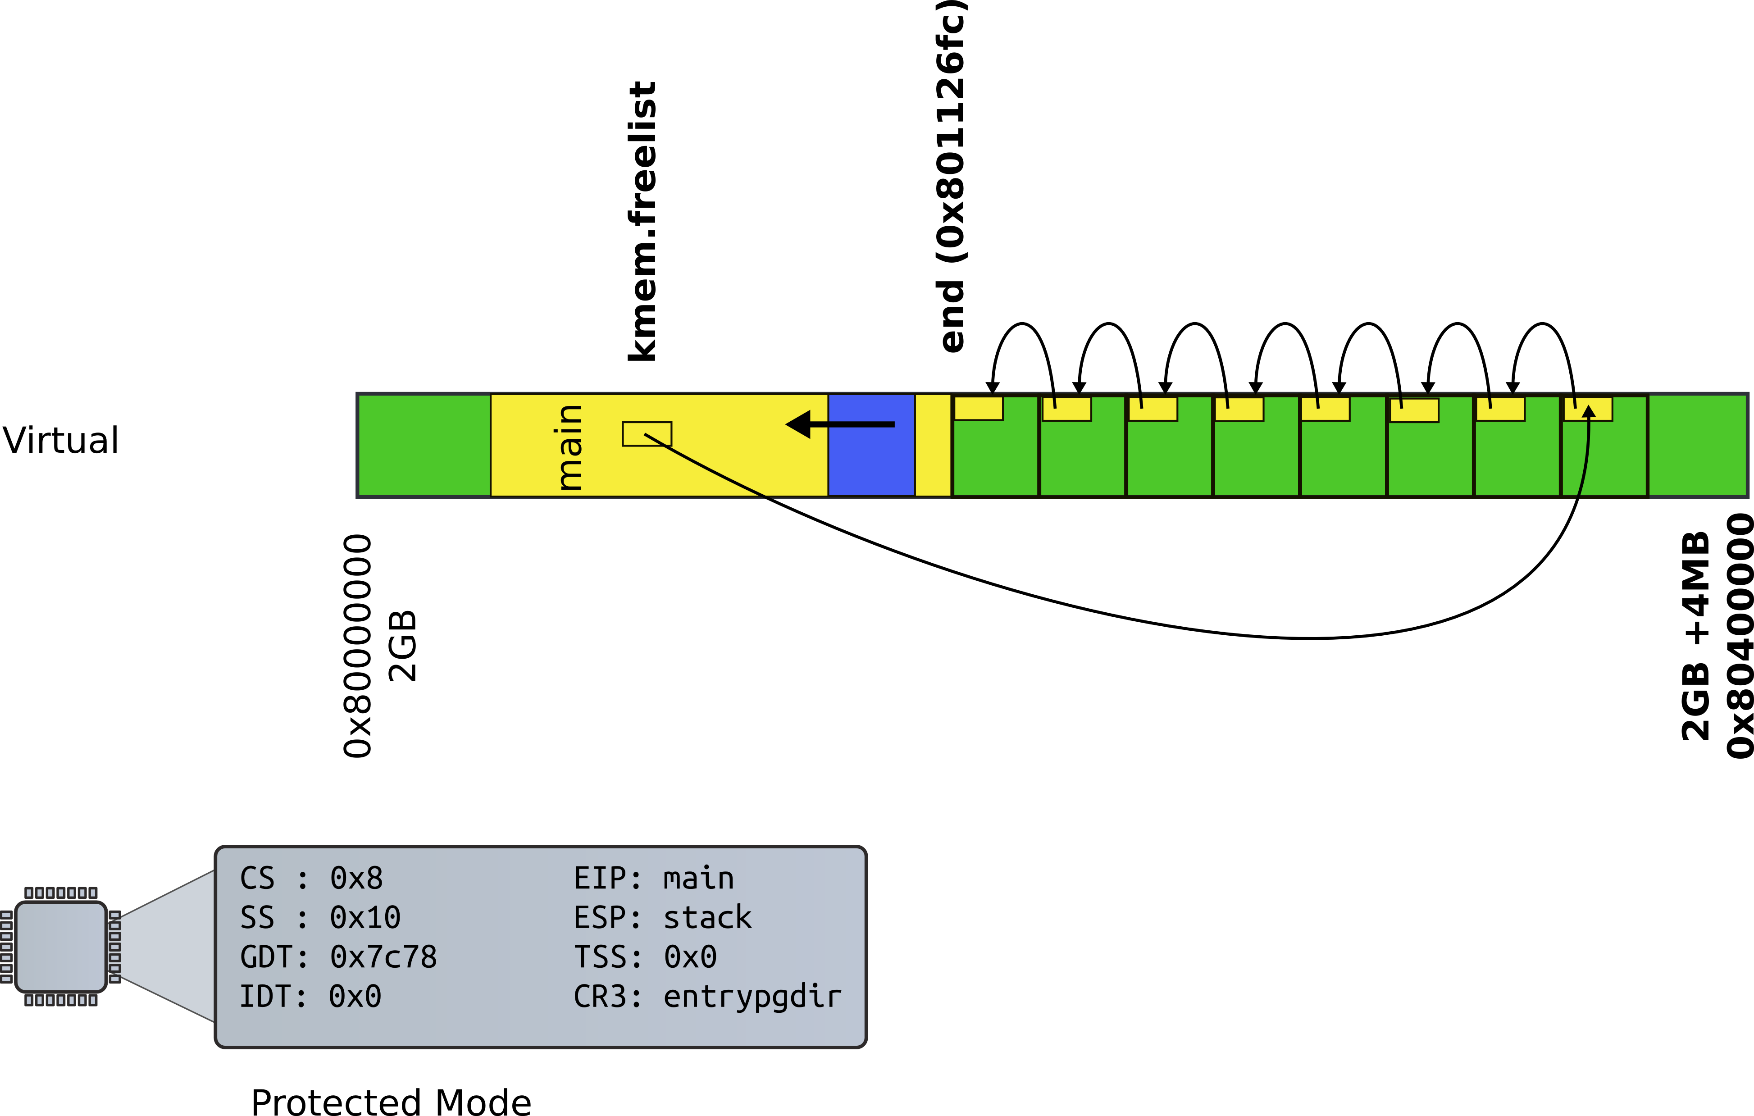
Recap: kalloc() – allocate page

Slide 44
1903 inituvm(pde_t *pgdir, char *init, uint sz)
1904 {
1905 char *mem;
1906
1907 if(sz >= PGSIZE)
1908 panic("inituvm: more than a page");
1909 mem = kalloc();
1910 memset(mem, 0, PGSIZE);
1911 mappages(pgdir, 0, PGSIZE, V2P(mem),
PTE_W|PTE_U);
1912 memmove(mem, init, sz);
1913 }

Slide 45
2502 userinit(void)
2503 {
2504 struct proc *p;
2505 extern char _binary_initcode_start[],
_binary_initcode_size[];
...
2509 p = allocproc();
2510 initproc = p;
2511 if((p−>pgdir = setupkvm()) == 0)
2512 panic("userinit: out of memory?");
2513 inituvm(p−>pgdir, _binary_initcode_start,
(int)_binary_initcode_size);
2514 p−>sz = PGSIZE;
2515 memset(p−>tf, 0, sizeof(*p−>tf));
...
2530 }

Slide 46
1903 inituvm(pde_t *pgdir, char *init, uint sz)
1904 {
1905 char *mem;
1906
1907 if(sz >= PGSIZE)
1908 panic("inituvm: more than a page");
1909 mem = kalloc();
1910 memset(mem, 0, PGSIZE);
1911 mappages(pgdir, 0, PGSIZE, V2P(mem),
PTE_W|PTE_U);
1912 memmove(mem, init, sz);
1913 }

Slide 47
8409 start:
8410 pushl $argv
8411 pushl $init
8412 pushl $0 // where caller pc would be
8413 movl $SYS_exec, %eax
8414 int $T_SYSCALL
8415
...
8422 # char init[] = "/init\0";
8423 init:
8424 .string "/init\0"
8425
8426 # char *argv[] = { init, 0 };
8427 .p2align 2
8428 argv:
8429 .long init
8430 .long 0
Userinit.S: call exec(“/init”, argv);

Slide 48
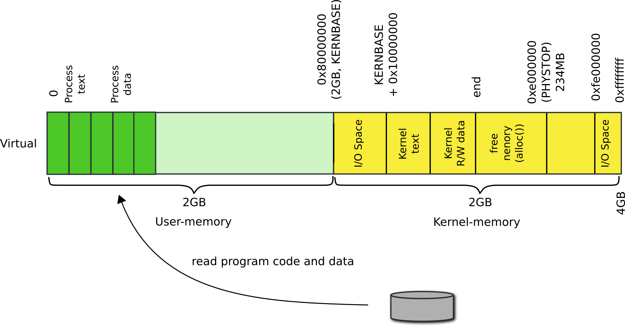
Where does userinit.S go?

Slide 49
Userinit() – create first process
Allocate process structure
  Information about the process
Create a page table
  Map only kernel space
Allocate a page for the user init code
  Map this page
Configure trap frame for “iret”

Slide 50
Kernel stack after interrupt/syscall

Slide 51
2103 struct proc {
2104 uint sz; // Size of process memory (bytes)
2105 pde_t* pgdir; // Page table
2106 char *kstack; // Bottom of kernel stack for this process
2107 enum procstate state; // Process state
2108 volatile int pid; // Process ID
2109 struct proc *parent; // Parent process
2110 struct trapframe *tf; // Trap frame
2111 struct context *context; // swtch() here to run
2112 void *chan; // If non−zero, sleeping on chan
2113 int killed; // If non−zero, have been killed
2114 struct file *ofile[NOFILE]; // Open files
2115 struct inode *cwd; // Current directory
2116 char name[16]; // Process name (debugging)
2117 };

Slide 52
2456 allocproc(void)
2457 {
...
2470 // Allocate kernel stack.
2471 if((p−>kstack = kalloc()) == 0){
2472 p−>state = UNUSED;
2473 return 0;
2474 }
2475 sp = p−>kstack + KSTACKSIZE;
2476
2477 // Leave room for trap frame.
2478 sp −= sizeof *p−>tf;
2479 p−>tf = (struct trapframe*)sp;
2480
...
2492 }
Trap frame is on the
kernel stack of the process

Slide 53
2502 userinit(void)
2503 {
...
2513 inituvm(p−>pgdir, _binary_initcode_start,
(int)_binary_initcode_size);
2514 p−>sz = PGSIZE;
2515 memset(p−>tf, 0, sizeof(*p−>tf));
2516 p−>tf−>cs = (SEG_UCODE << 3) | DPL_USER;
2517 p−>tf−>ds = (SEG_UDATA << 3) | DPL_USER;
2518 p−>tf−>es = p−>tf−>ds;
2519 p−>tf−>ss = p−>tf−>ds;
2520 p−>tf−>eflags = FL_IF;
2521 p−>tf−>esp = PGSIZE;
2522 p−>tf−>eip = 0; // beginning of initcode.S
...
2530 }

Slide 54
Kernel stack after interrupt/syscall

Slide 55
2502 userinit(void)
2503 {
...
2515 memset(p−>tf, 0, sizeof(*p−>tf));
2516 p−>tf−>cs = (SEG_UCODE << 3) | DPL_USER;
2517 p−>tf−>ds = (SEG_UDATA << 3) | DPL_USER;
2518 p−>tf−>es = p−>tf−>ds;
2519 p−>tf−>ss = p−>tf−>ds;
2520 p−>tf−>eflags = FL_IF;
2521 p−>tf−>esp = PGSIZE;
2522 p−>tf−>eip = 0; // beginning of initcode.S
2523
2524 safestrcpy(p−>name, "initcode", sizeof(p−>name));
2525 p−>cwd = namei("/");
2526
2527 p−>state = RUNNABLE;
...
2530 }

Slide 56
Wait, we mapped process memory, created trap frame, but it doesn't really run...

Slide 57

Remember what scheduler does?

Slide 58
2456 allocproc(void)
2457 {
...
2477 // Leave room for trap frame.
2478 sp −= sizeof *p−>tf;
2479 p−>tf = (struct trapframe*)sp;
2480
2481 // Set up new context to start executing at forkret,
2482 // which returns to trapret.
2483 sp −= 4;
2484 *(uint*)sp = (uint)trapret;
2485
2486 sp −= sizeof *p−>context;
2487 p−>context = (struct context*)sp;
2488 memset(p−>context, 0, sizeof *p−>context);
2489 p−>context−>eip = (uint)forkret;
...
2492 }
Trap frame is on the
kernel stack of the process

Slide 59
2788 forkret(void)
2789 {
...
2803 // Return to "caller",
actually trapret (see allocproc).
2804 }
forkret(): just returns

Slide 60
Kernel stack after interrupt/syscall

Slide 61
3276 .globl trapret
3277 trapret:
3278 popal
3279 popl %gs
3280 popl %fs
3281 popl %es
3282 popl %ds
3283 addl $0x8, %esp # trapno and
errcode
3284 iret
forkret(): just returns

Slide 62
Back to the first system call:
exec()

Slide 63
Summary
We've finally learned how the first process came to life
We're half way into system calls

Slide 64
Thank you

Slide 65
sys_exec()
6225 sys_exec(void)
6226 {
6227 char *path, *argv[MAXARG];
6228 int i;
6229 uint uargv, uarg;
6230
6231 if(argstr(0, &path) < 0 || argint(1, (int*)&uargv) < 0){
6232 return −1;
6233 }
6234 memset(argv, 0, sizeof(argv));
6235 for(i=0;; i++){
6236 if(i >= NELEM(argv))
6237 return −1;
6238 if(fetchint(uargv+4*i, (int*)&uarg) < 0)
6239 return −1;
6240 if(uarg == 0){
6241 argv[i] = 0;
6242 break;
6243 }
6244 if(fetchstr(uarg, &argv[i]) < 0)
6245 return −1;
6246 }
6247 return exec(path, argv);
6248 }

Slide 66
sys_exec()
6225 sys_exec(void)
6226 {
6227 char *path, *argv[MAXARG];
6228 int i;
6229 uint uargv, uarg;
6230
6231 if(argstr(0, &path) < 0
|| argint(1, (int*)&uargv) < 0){
6232 return −1;
6233 }
...
6247 return exec(path, argv);
6248 }

