Slide 1
ICS143A: Principles of Operating Systems
Lecture 20: Memory management
Anton Burtsev
March, 2017

Slide 2
Xv6 Book, Chapter 1. KERNBASE limits the amount of memory a single process can use, which might be irritating on a machine with a full 4 GB of RAM.
Would raising KERNBASE allow a
process to use more memory?

Slide 3

Xv6: physical page allocator

Slide 4
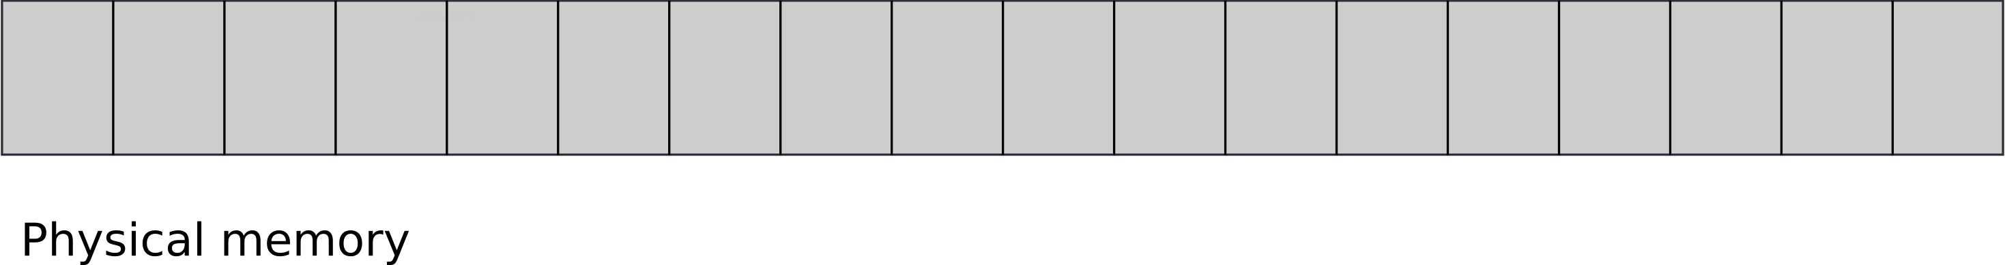
Physical memory

Slide 5
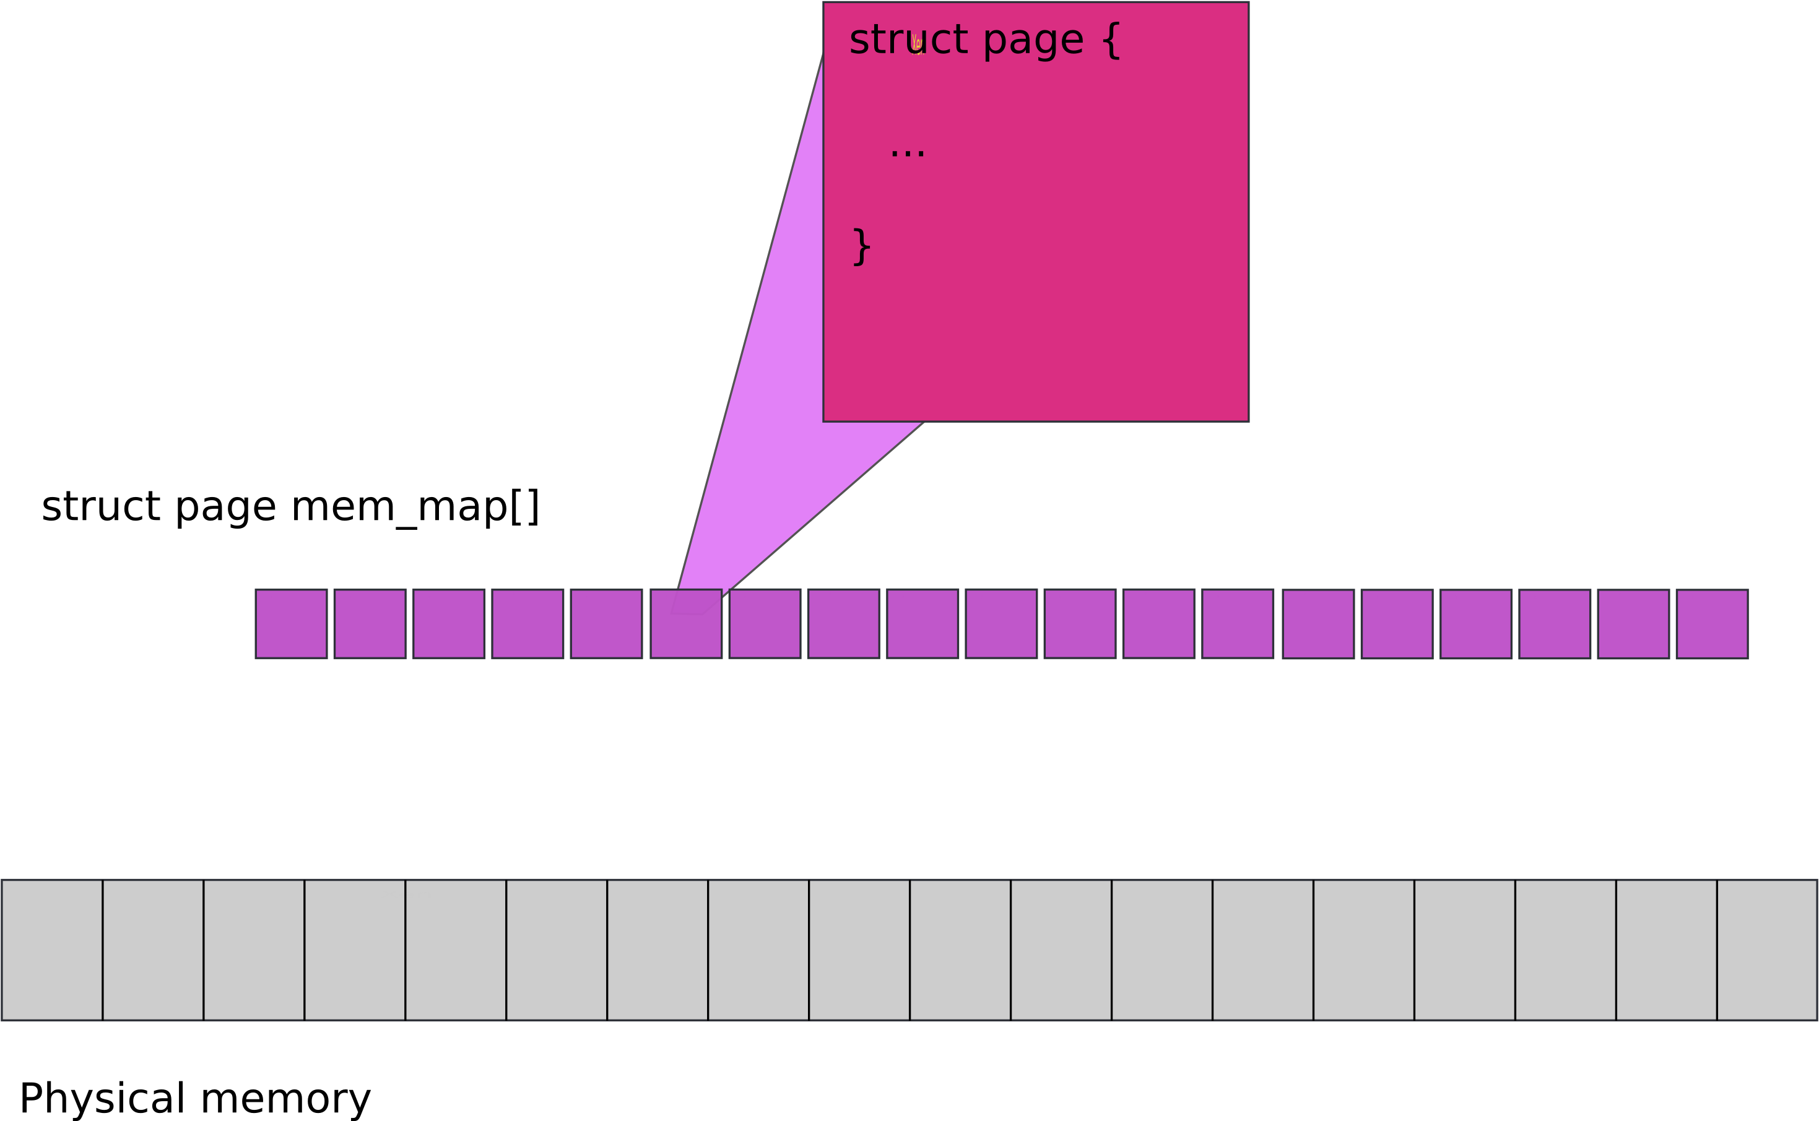
We need a smaller array to describe physical pages, e.g., mem_map[] in Linux

Slide 6
Memory allocation

Slide 7
Simplest memory allocator
Bitmap of all pages
  Bootmem allocator in Linux
Allocation searches for an unused page
  Multiple sub-page allocations can be served from the same page by advancing a pointer
Works ok, but what is the problem?

Slide 8
Boot memory allocator
Bitmap of all pages
Allocation searches for an unused page
  Multiple sub-page allocations can be served from the same page by advancing a pointer
Works ok, but what is the problem?
  Linear scan of the bitmap
    Too long

Slide 9
Buddy:
Physical Memory Allocator

Slide 10
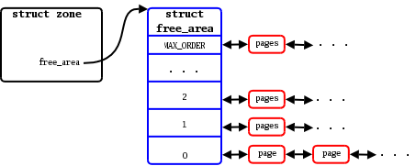
Buddy memory allocator

Slide 11
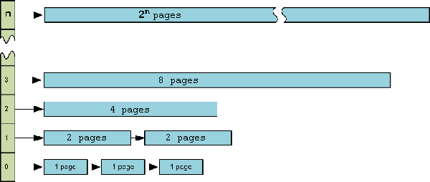
Buddy allocator

Slide 12
What's wrong with buddy?

Slide 13
What's wrong with buddy?
Buddy allocator is ok for large allocations
  E.g. 1 page or more
But what about small allocations?
  Buddy uses the whole page for a 4 bytes allocation
    Wasteful
  Buddy is still slow for short-lived objects

Slide 14
Slab:
Allocator for object of a fixed size

Slide 15
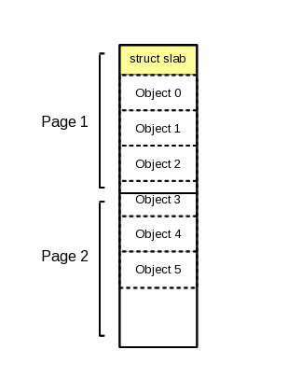
Slab
A 2 page slab with 6 objects

Slide 16
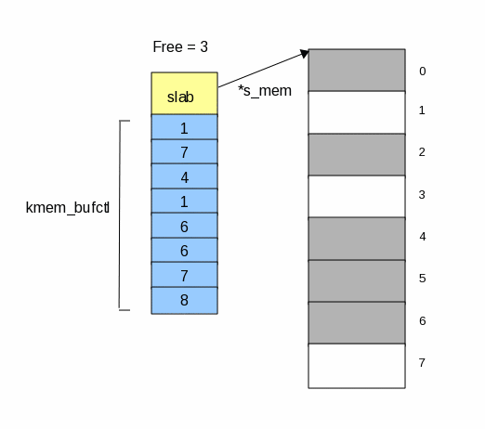
Keeping track of free objects
kmem_bufctl array is effectively a linked list
  First free object: 3
  Next free object: 1

Slide 17
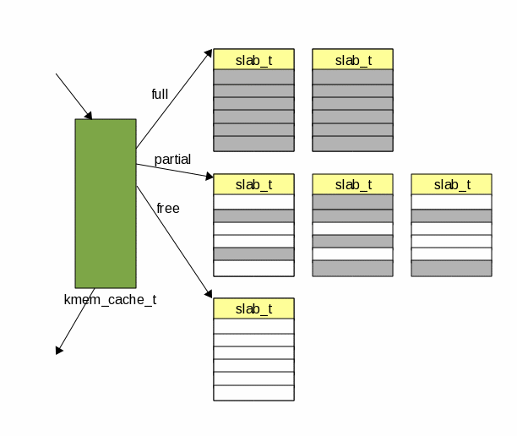
A cache is formed out of slabs

Slide 18
Slab is fine, but what's wrong?

Slide 19
Slab is fine, but what's wrong?
We can only allocate objects of one size

Slide 20
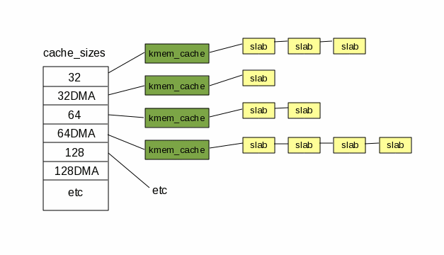
Kmalloc(): variable size objects
A table of caches
  Size: 32, 64, 128, etc.

Slide 21
NUMA
Non-uniform memory access

Slide 22
Uniform and non-uniform memory access
Parts of memory can be faster than others

Slide 23
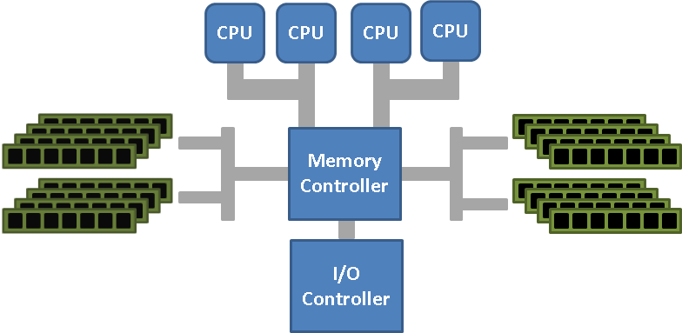
Uniform memory access (UMA)

Slide 24
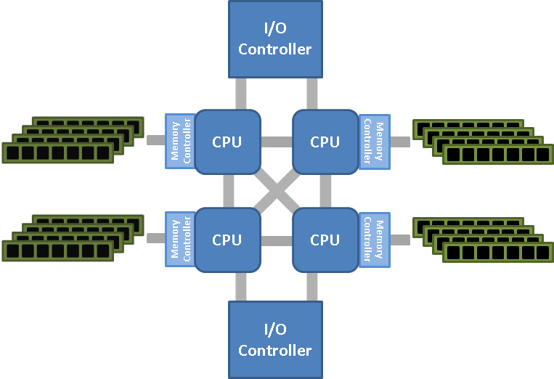
Nonuniform memory access (NUMA)

Slide 25
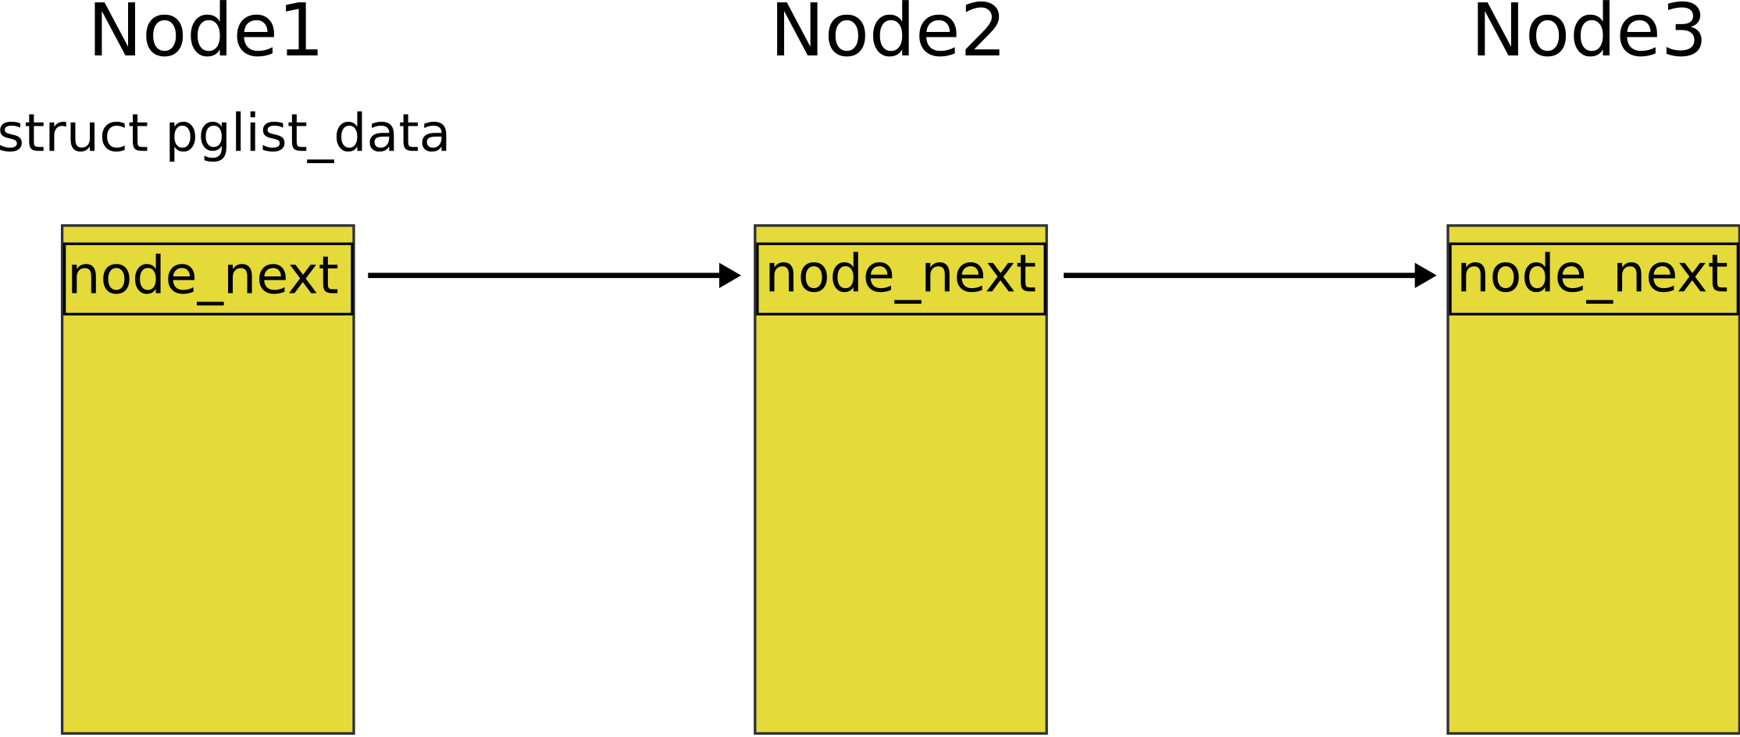
Nodes
Attempt to allocate memory from the current node
  Fall back to the next node in list
    If ran out of local memory

Slide 26
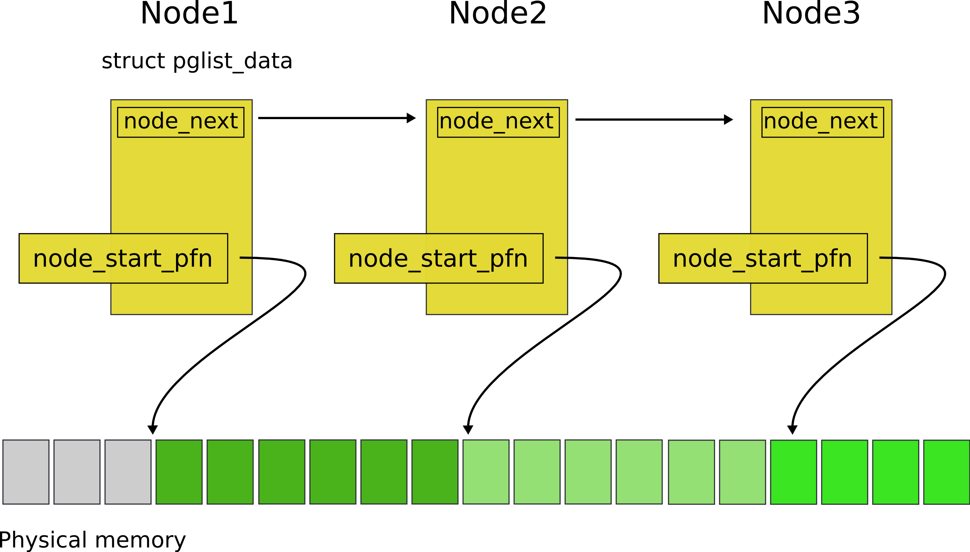
Nodes

Slide 27
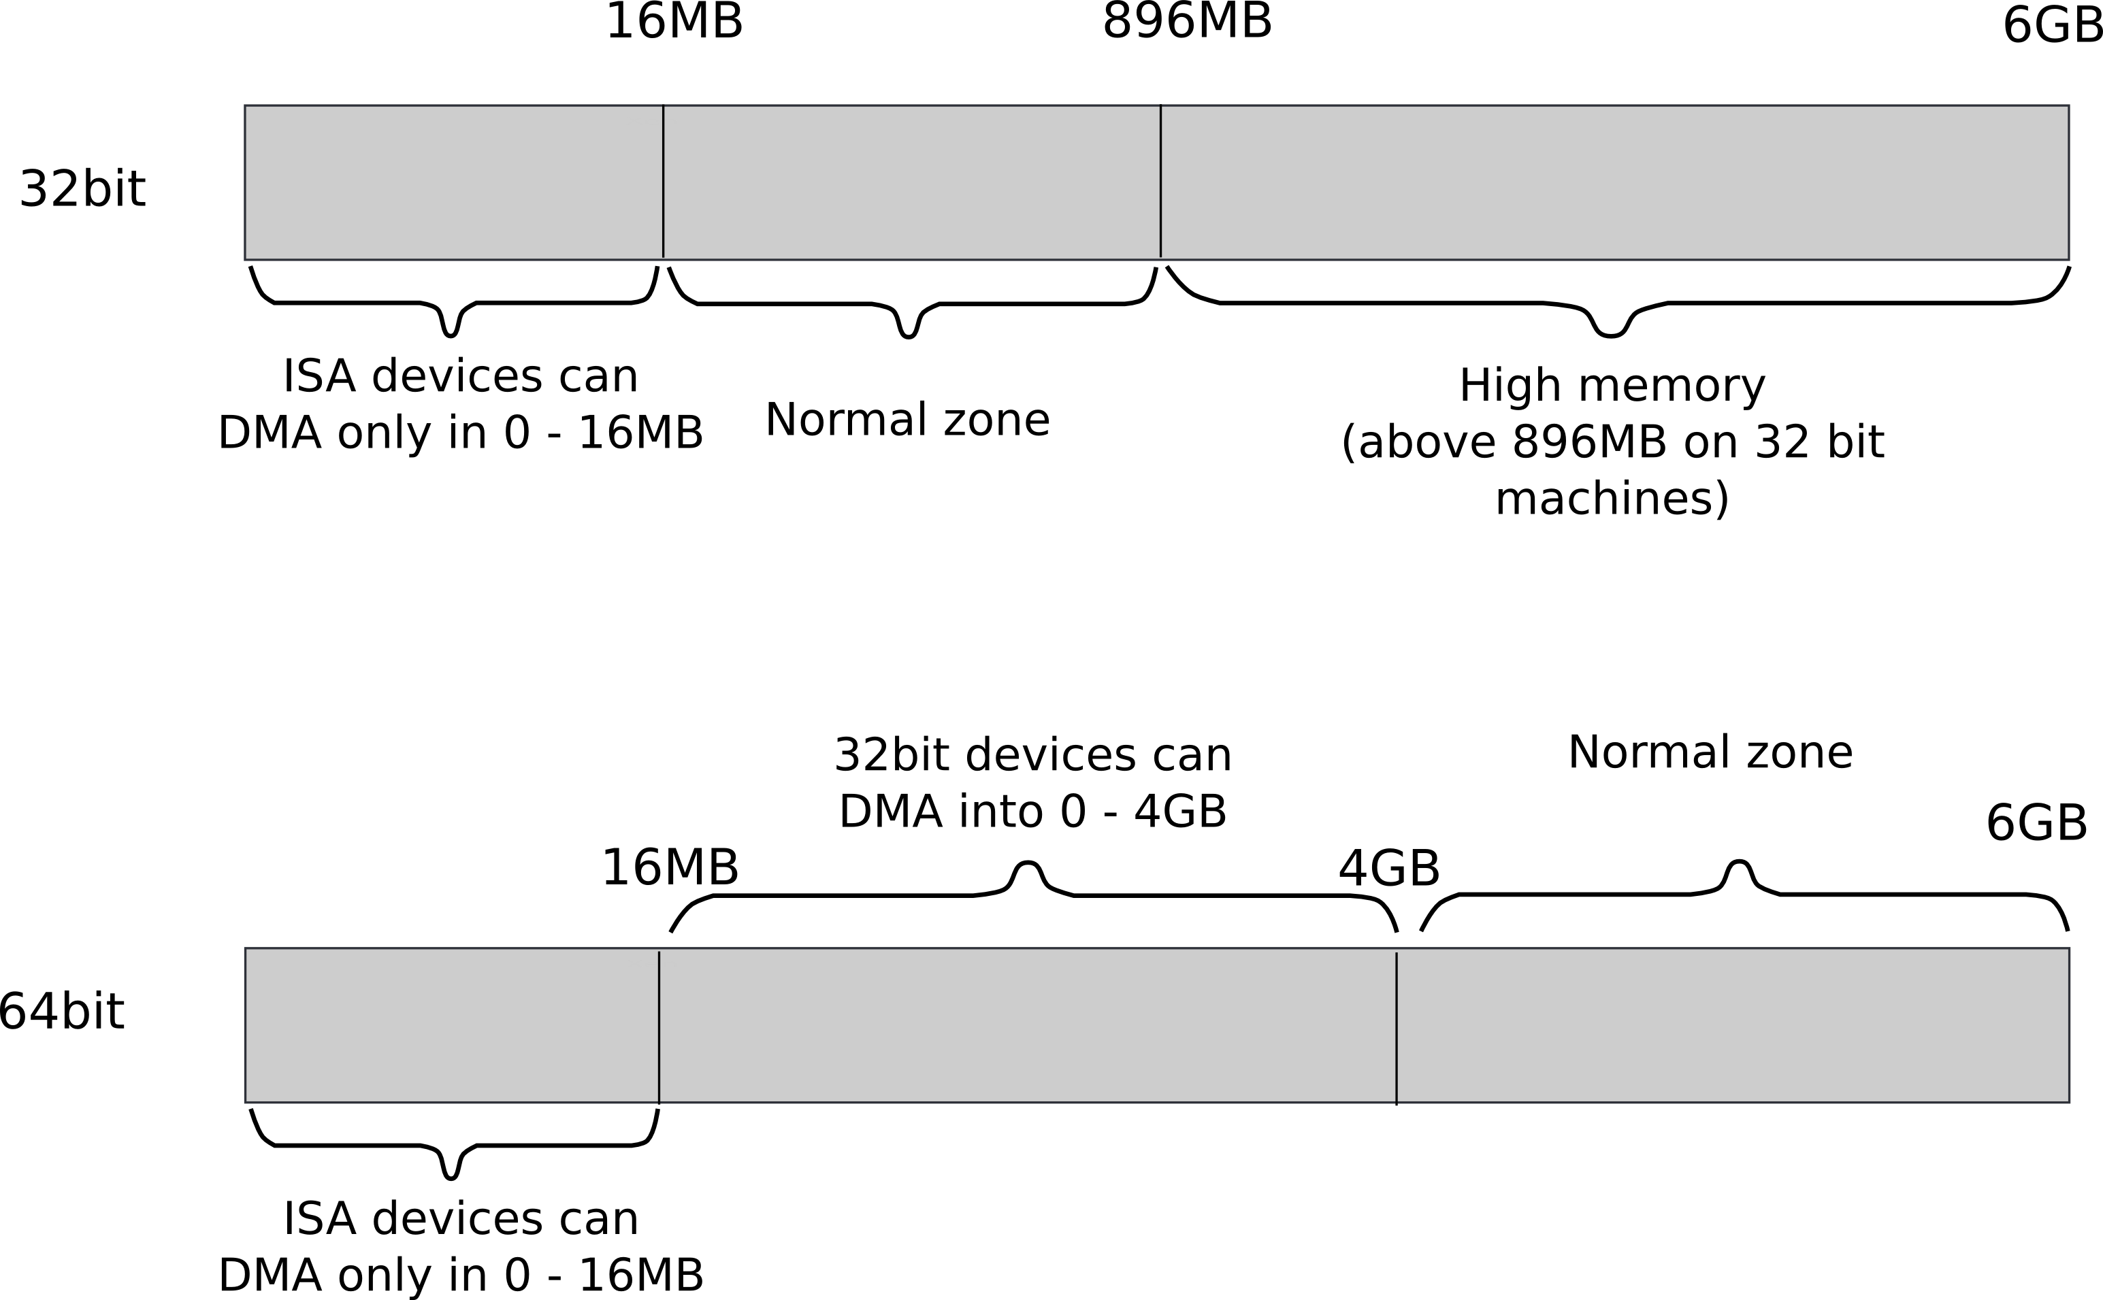
Zones

Slide 28
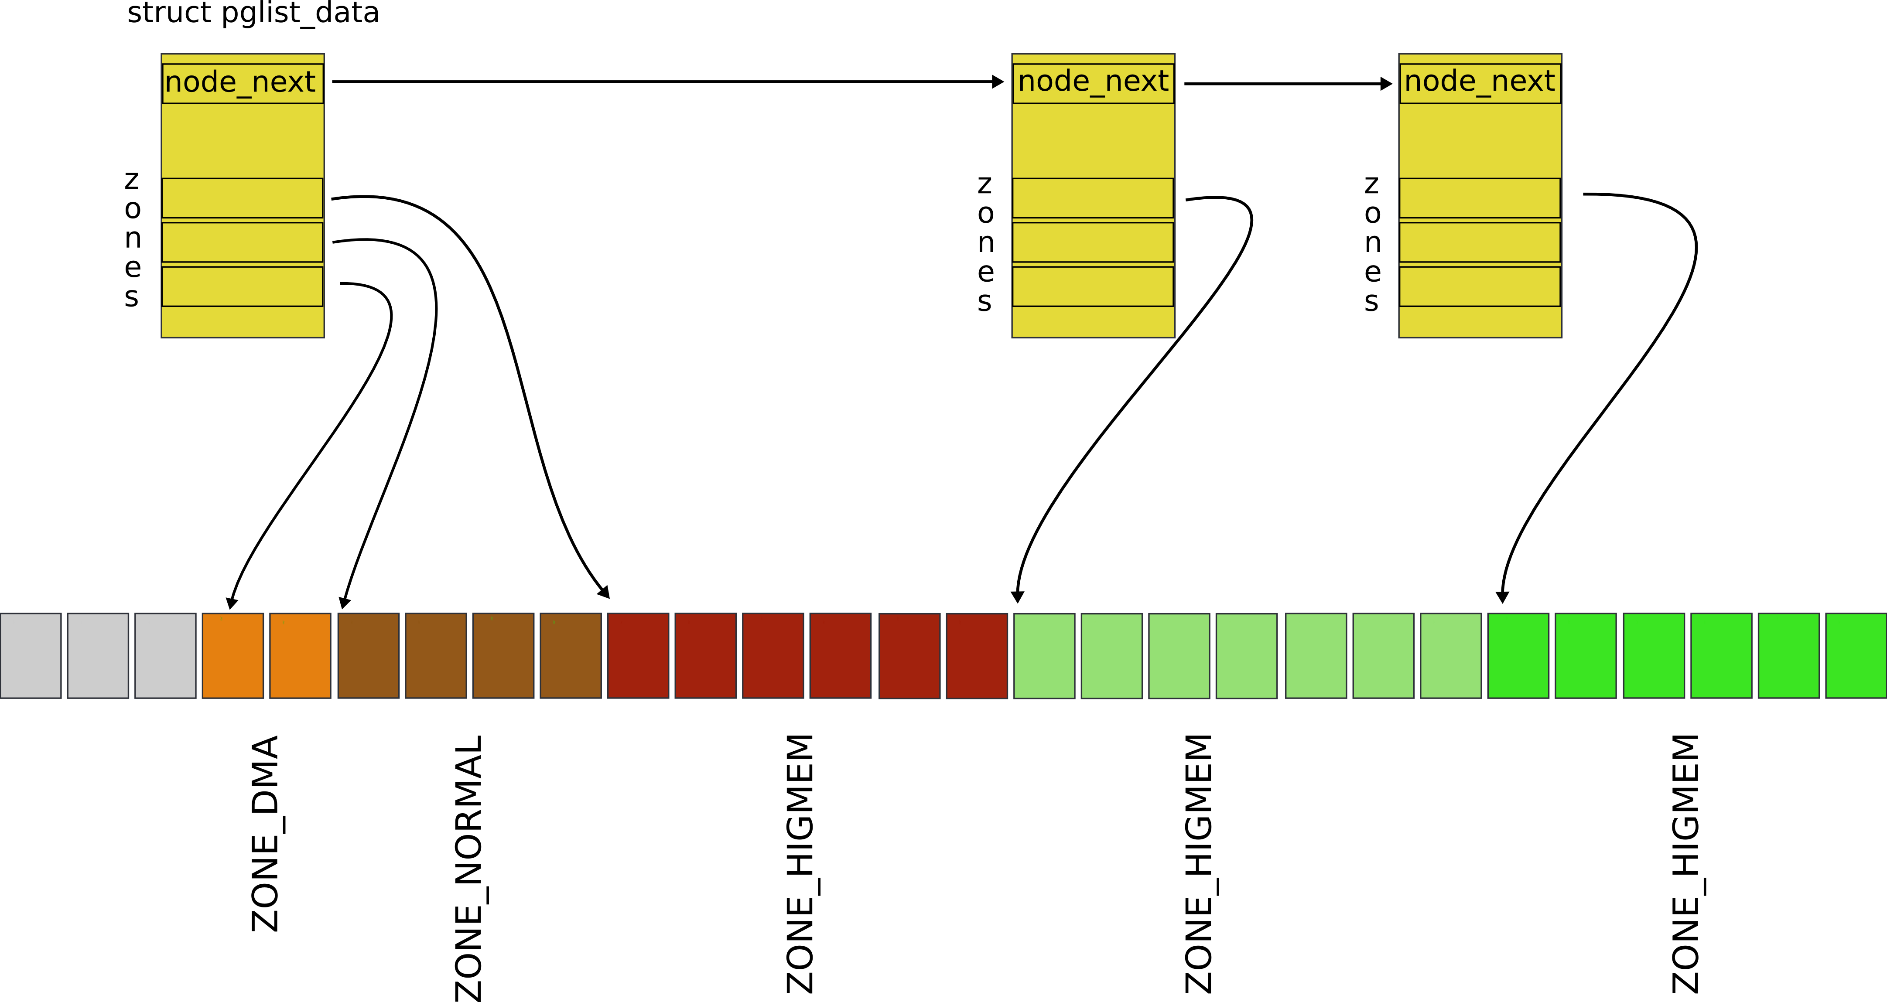
Zones

Slide 29
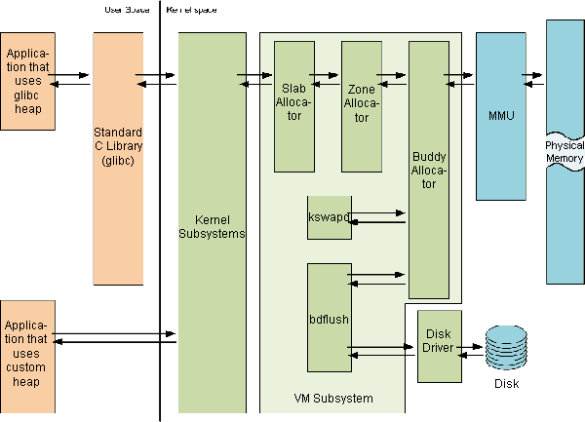
Linux memory management

Slide 30
Linux memory management

Slide 31
Thank you!

