Slide 1
ICS143A: Principles of Operating Systems
Lecture 18: Process scheduling
This lecture is heavily based on
the material developed by Don Porter
Anton Burtsev
March, 2017

Slide 2
Cooperative vs preemptive
What is cooperative multitasking?
What is preemptive multitasking?
Pros/cons?

Slide 3
Cooperative vs preemptive
What is cooperative multitasking?
  Processes voluntarily yield CPU when they are done
What is preemptive multitasking?
  OS only lets tasks run for a limited time, then forcibly context switches the CPU
Pros/cons?
  Cooperative gives more control; so much that one task can hog the CPU forever
  Preemptive gives OS more control, more overheads/complexity

Slide 4
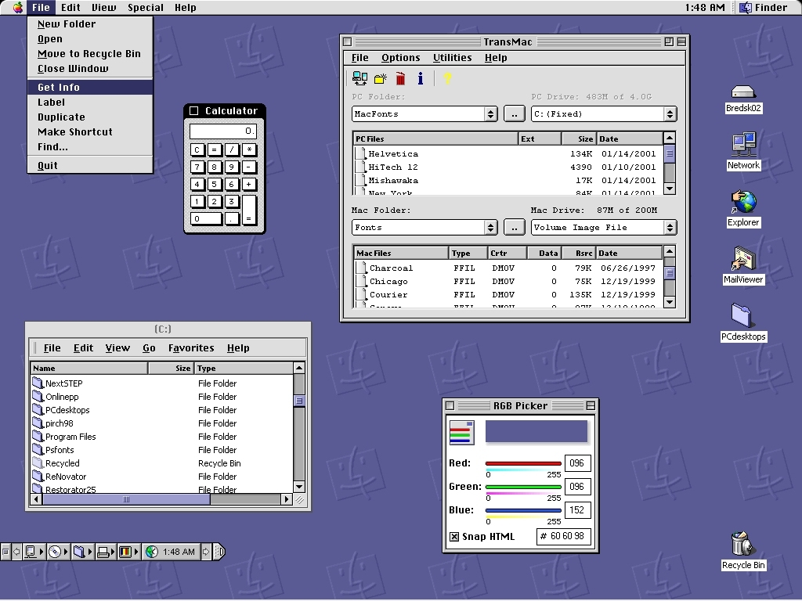
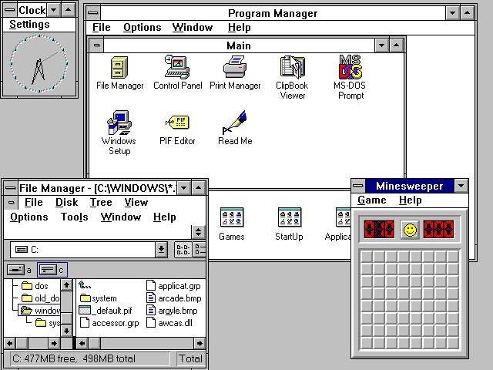
MacOS 9
Windows 3.1

Slide 5
At what point process can get preempted?

Slide 6
At what point process can get preempted?
When entered the kernel
  Inside one of the system calls
Timer interrupt
  Ensures maximum time slice

Slide 7
Policy vs mechanism
Remember we know the mechanism
  Context switching
    Switch stacks
This lecture is about policy
  Pick the next process to run

Slide 8
Policy goals
Fairness
  Everything gets a fair share of the CPU
Real-time deadlines
  CPU time before a deadline more valuable than time after
Latency vs. throughput: Timeslice length matters!
  GUI programs should feel responsive
  CPU-bound jobs want long timeslices, better throughput
User priorities
  Virus scanning is nice, but I don’t want it slowing things down

Slide 9
Strawman scheduler (xv6)
Organize all processes as a simple list
In schedule():
  Pick first one on list to run next
  Put suspended task at the end of the list
Problem?

Slide 10
Xv6 scheduler
2458 scheduler(void)
2459 {
2462 for(;;){
2468 for(p = ptable.proc; p < &ptable.proc[NPROC]; p++){
2469 if(p−>state != RUNNABLE)
2470 continue;
2475 proc = p;
2476 switchuvm(p);
2477 p−>state = RUNNING;
2478 swtch(&cpu−>scheduler, proc−>context);
2479 switchkvm();
2483 proc = 0;
2484 }
2487 }
2488 }

Slide 11
Strawman scheduler (xv6)
Organize all processes as a simple list
In schedule():
  Pick first one on list to run next
  Put suspended task at the end of the list
Problem?

Slide 12
Strawman scheduler
Organize all processes as a simple list
In schedule():
  Pick first one on list to run next
  Put suspended task at the end of the list
Problem?
  Only allows round-robin scheduling
  Can’t prioritize tasks

Slide 13
Priority based scheduling
Higher-priority processes run first
Processes within the same priority are round-robin

Slide 14
O(1) scheduler (Linux 2.6 – 2.6.22)
Priority based scheduling
Goal: decide who to run next, independent of number of processes in system
  Still maintain ability to prioritize tasks, handle partially unused quanta, etc

Slide 15
O(1) data structures
runqueue: a list of runnable processes
  Blocked processes are not on any runqueue
  A runqueue belongs to a specific CPU
  Each task is on exactly one runqueue
  Task only scheduled on runqueue’s CPU unless migrated
2 *40 * #CPUs runqueues
  40 dynamic priority levels (more later)
  2 sets of runqueues – one active and one expired

Slide 16
O(1) data structures (contd)
Active
Expired
139
139
138
138
137
137
.
.
.
.
.
.
101
101
100
100

Slide 17
O(1) intuition
Take the first task off the lowest-numbered runqueue on active set
  Confusingly: a lower priority value means higher priority
When done, put it on appropriate runqueue on expired set
Once active is completely empty, swap which set of runqueues is active and expired
Constant time, since fixed number of queues to check; only take first item from non-empty queue

Slide 18
O(1) example
Active
Expired
139
139
138
138
137
Pick first, highest
priority task to run
137
Pick first, highest
priority task to run
Move to the
expired queue
.
.
.
.
.
.
101
101
100
100

Slide 19
What now?
Active
Expired
Flip active and
expired queues
139
139
138
138
137
137
.
.
.
.
.
.
101
101
100
100

Slide 20
Blocked tasks
What if a program blocks on I/O, say for the disk?
  It still has part of its quantum left
  Not runnable, so don’t waste time putting it on the active or expired runqueues
We need a “wait queue” associated with each blockable event
  Disk, lock, pipe, network socket, etc.

Slide 21
Blocking example
Disk
Active
Expired
139
139
138
138
137
137
.
.
.
.
.
.
Process goes on
disk wait queue
101
101
100
100

Slide 22
Blocked tasks (contd)
A blocked task is moved to a wait queue until the expected event happens
  No longer on any active or expired queue!
Disk example:
  After I/O completes, interrupt handler moves task back to active runqueue

Slide 23
Time slice tracking
Each task tracks ticks left in ‘time_slice’ field
  On each clock tick: current->time_slice--
  If time slice goes to zero, move to expired queue
  Refill time slice
  Schedule someone else
  An unblocked task can use balance of time slice
  Forking halves time slice with child

Slide 24
More on priorities
100 = highest priority
  Priorities 0 – 99 are for real-time processes
139 = lowest priority
120 = base priority
  “nice” value: user-specified adjustment to base priority
  Selfish (not nice) = -20 (I want to go first)
  Really nice = +19 (I will go last)

Slide 25
Base time slice
Timeslice:
  If priority < 120
    Time = (140 – prio) * 20 ms
  else
    Time = (140 – prio) * 5 ms
“Higher” priority tasks get more time
  And run first

Slide 26
Responsive UI
Most GUI programs are I/O bound on the user
  Unlikely to use entire time slice
Users get annoyed when they type a key and it takes a long time to appear
Idea: give UI programs a priority boost
  Go to front of line, run briefly, block on I/O again
Which ones are the UI programs?

Slide 27
Idea: infer from sleep time
By definition, I/O bound applications spend most of their time waiting on I/O
We can monitor I/O wait time and infer which programs are GUI (and disk intensive)
Give these applications a priority boost
Note that this behavior can be dynamic
  Ex: GUI configures DVD ripping, then it is CPU-bound
  Scheduling should match program phases

Slide 28
Dynamic priority
dynamic priority =
  max (100, min ((static priority − bonus + 5), 139 ) )
Bonus is calculated based on sleep time
Dynamic priority determines a tasks’ runqueue
This is a heuristic to balance competing goals of CPU throughput and latency in dealing with infrequent I/O
  May not be optimal

Slide 29
Dynamic priority in O(1)
Important: The runqueue a process goes in is determined by the dynamic priority, not the static priority
  Dynamic priority is mostly determined by time spent waiting, to boost UI responsiveness
Nice values influence static priority
  No matter how “nice” you are (or aren’t), you can’t boost your dynamic priority without blocking on a wait queue!

Slide 30
Completely Fair Scheduler
Linux 2.6.23 - now

Slide 31
Fairness
Each task makes proportional progress on the CPU
  No starvation

Slide 32
Problems with O(1)
Heuristics became hard
  Hard to maintain and make sense of

Slide 33
CFS idea
Back to a simple list of tasks (conceptually)
  Ordered by how much time they ran
  Least time to most time
Always pick the “neediest” task to run
  Until it is no longer neediest
  Then re-insert old task in the timeline
  Schedule the new neediest

Slide 34
CFS example
5
10
15
22
26
Schedule the
neediest task
List sorted by how
many cycles the
task has had

Slide 35
CFS example
10
15
22
26
No longer neediest
Put back on the list
11

Slide 36
Lists are inefficient
That’s why we really use a tree
  Red-black tree: 9/10 Linux developers recommend it
log(n) time for:
  Picking next task (i.e., search for left-most task)
  Putting the task back when it is done (i.e., insertion)
  Remember: n is total number of tasks on system

Slide 37
CPU time accounting
Global virtual clock: ticks at a fraction of real time
  Fraction is number of total tasks
Each task counts how many clock ticks it has had
Example: 4 tasks
  Global vclock ticks once every 4 real ticks
  Each task scheduled for one real tick; advances local clock by one tick

Slide 38
More details
Task’s ticks make key in RB-tree
  Fewest tick count get serviced first
No more runqueues
  Just a single tree-structured timeline

Slide 39
CFS example
Tasks sorted by ticks executed
Global ticks = 12
One global tick per n ticks
  n == number of tasks (5)
4 ticks for first task
  Reinsert into the list
1 tick to new first task
  Increment global clock
10
5
12
4
5
1
8

Slide 40
New tasks
What about a new task?
  If task ticks start at zero, doesn’t it get to unfairly run for a long time?
Strategies:
  Could initialize to current time (start at right)
  Could get half of parent’s deficit

Slide 41
Priorities
In CFS, priorities weigh the length of a task’s “tick”
Example:
  For a high-priority task, a virtual, task-local tick may last for 10 actual clock ticks
  For a low-priority task, a virtual, task-local tick may only last for 1 actual clock tick
Result: Higher-priority tasks run longer, low-priority tasks make some progress

Slide 42
Interactivity
Recall: GUI programs are I/O bound
  We want them to be responsive to user input
  Need to be scheduled as soon as input is available
  Will only run for a short time

Slide 43
GUI programs
Just like O(1) scheduler, CFS takes blocked programs out of the RB-tree of runnable processes
Virtual clock continues ticking while tasks are blocked
  Increasingly large deficit between task and global vclock
When a GUI task is runnable, generally goes to the front
  Dramatically lower vclock value than CPU-bound jobs
  Reminder: “front” is left side of tree

Slide 44
Other refinements
User A has 1 job, user B has 99
  B will get 99% of CPU time
  We want A and B split CPU in half
Per group or user scheduling
  Real to virtual tick ratio becomes a function of number of both global and user’s/group’s tasks

Slide 45
Group scheduling
Per group or user scheduling
  Real to virtual tick ratio becomes a function of number of both global and user’s/group’s tasks

Slide 46
Real-time scheduling

Slide 47
Real-time scheduling
Different model: need to do a modest amount of work by a deadline
Example:
  Audio application needs to deliver a frame every nth of a second
  Too many or too few frames unpleasant to hear

Slide 48
Strawman
If I know it takes n ticks to process a frame of audio, just schedule my application n ticks before the deadline
Problems?
Hard to accurately estimate n
  Interrupts
  Cache misses
  Disk accesses
  Variable execution time depending on inputs

Slide 49
Hard problem
Gets even worse with multiple applications + deadlines
May not be able to meet all deadlines
Interactions through shared data structures worsen variability
  Block on locks held by other tasks
  Cached CPU, TLB, and file system data gets evicted

Slide 50
Real-time scheduling in Linux
Linux has soft-real time scheduling
  No hard real-time guarantees
All real-time tasks are higher priority than any conventional process
  Priorities 0 – 99
Assumption: like GUI programs, RR tasks will spend most of their time blocked on I/O
  Latency is key concern

Slide 51
Real-time policies
First-in, first-out: SCHED_FIFO
  Static priority
  Process is only preempted for a higher priority process
  No time quanta; it runs until its done, blocked or yields voluntarily
Round robin: SCHED_RR
  Same as above but with a time quanta (800ms)

Slide 52
Accounting kernel time
Should time spent in the OS count against an application’s time slice?
  Yes: Time in a system call is work on behalf of that task
  No: Time in an interrupt handler may be completing I/O for another task

Slide 53
Latency of system calls
System call times vary
Context switches are generally at system call boundary
  Can also context switch on blocking I/O operations
If a time slice expires inside of a system call:
  Task gets rest of system call “for free”
  Steals from next task
  Potentially delays interactive/real time task until finished

Slide 54
Idea: kernel preemption
Why not preempt system calls just like user code?
Well, because it is harder!
Why?
  May hold a lock that other tasks need to make progress
  May be in a sequence of HW config options that assumes it won’t be interrupted
General strategy: allow fragile code to disable preemption
  Interrupt handlers can disable interrupts if needed

Slide 55
Kernel preemption
Implementation: actually not too bad
  Essentially, it is transparently disabled with any locks held
  A few other places disabled by hand
Result: UI programs a bit more responsive

Slide 56
Conclusion
O(1)
  Two sets of runques
  Each process has priority
CFS
  Queue of runnable tasks
  Red/black tree for fast lookup and insertion
Real-time
  Run in front of O(1) or CFS scheduler
  No good solution so far

Slide 57
Thank you!

